Slide 1
ECMAScript 6 — New Features
Overview & Comparison –s ES5

Slide 2
What is ECMAScript ?
ECMAScript (or ES) is a scripting-language specification standardized by Ecma International in ECMA-262 and ISO/IEC-16262. It was created to standardize JavaScript, so as to foster multiple independent implementations. JavaScript has remained the best-known implementation of ECMAScript since the standard was first published, with other well-known implementations including JScript and ActionScript. ECMAScript is commonly used for client-side scripting on the World Wide Web, and it is increasingly being used for writing server applications and services using Node.js.
ECMAScript là một chuẩn hóa của các ngôn ngữ client side – server side cho Jscript, Javascript, Actionscript. Và nó đã được cấp bản quyển bởi tổ chức ECMA International.
Source : https://en.wikipedia.org/wiki/ECMAScript

Slide 3
What is ECMAScript ?
ECMAScript 3 (December 1999). This is the version of ECMAScript that most browsers support today. It introduced many features that have become an inherent part of the language:
ECMAScript 4 (abandoned July 2008). ECMAScript 4 was developed as the next version of JavaScript, with a prototype written in ML. However, TC39 could not agree on its feature set. To prevent an impasse, the committee met at the end of July 2008 and came to an accord, summarized in four points
ECMAScript 5 (December 2009). This version brings several enhancements to the standard library and even updated language semantics via a strict mode.

Slide 4


Slide 5
Constants
Constants
Support for constants (also known as "immutable variables"), i.e., variables which cannot be re-assigned new content. Notice: this only makes the variable itself immutable, not its assigned content (for instance, in case the content is an object, this means the object itself can still be altered).
Hỗ trợ các hằng số (còn được gọi là "các biến không thay đổi"), tức là các biến không thể được gán lại nội dung mới. Lưu ý: điều này chỉ làm cho chính biến đó không thay đổi, không phải nội dung được gán của nó (ví dụ, trong trường hợp nội dung là một object, điều này có nghĩa là chính object vẫn có thể bị thay đổi).
Ex:
const PI = 3.141593;
PI > 3.0;
const a = {one: 1};
a.three = 3; // this is ok.
a = {two: 2}; // this doesn't work.

Slide 6
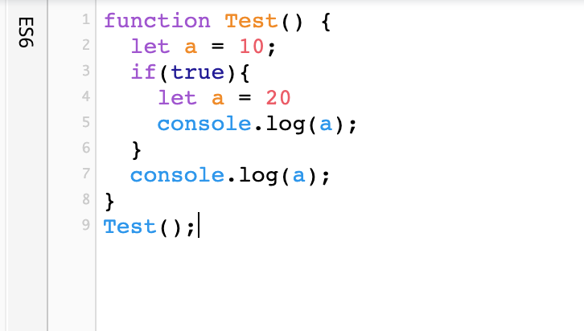
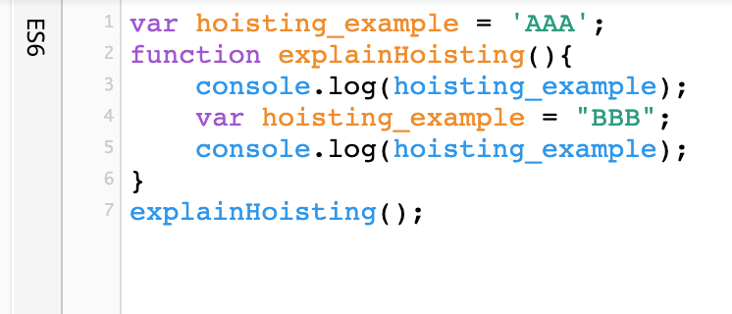
Scoping
Block-Scoped Variables
Block-scoped variables (and constants) without hoisting.
for (let i = 0; i < a.length; i++) { let x = a[i]; … }

Slide 7
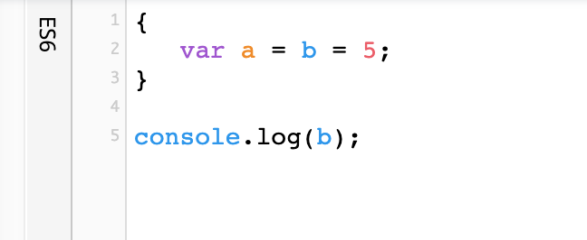
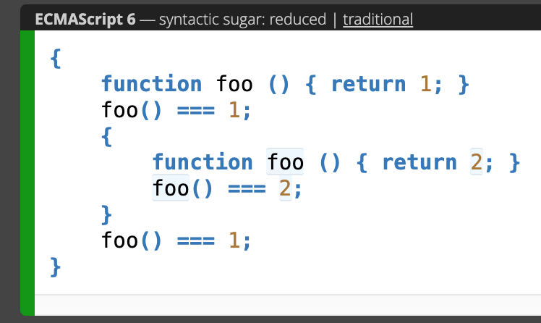
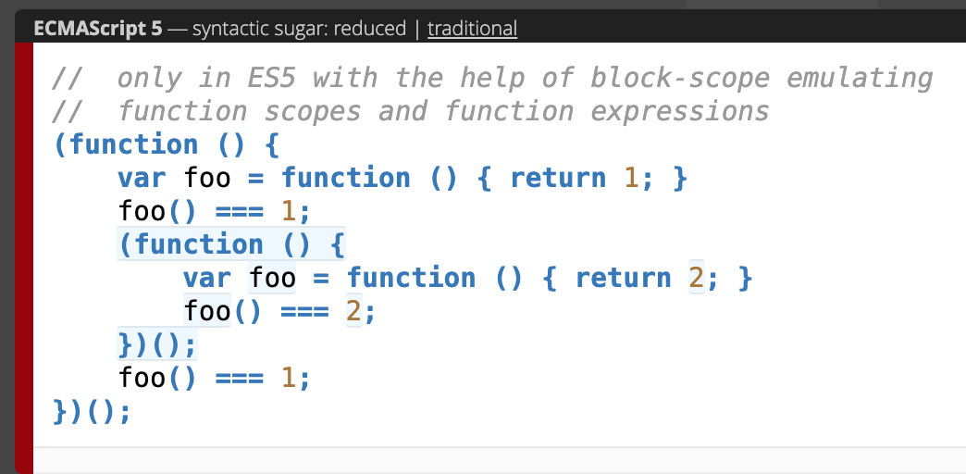
Scoping
Block-Scoped Functions
Block-scoped function definitions.

Slide 8
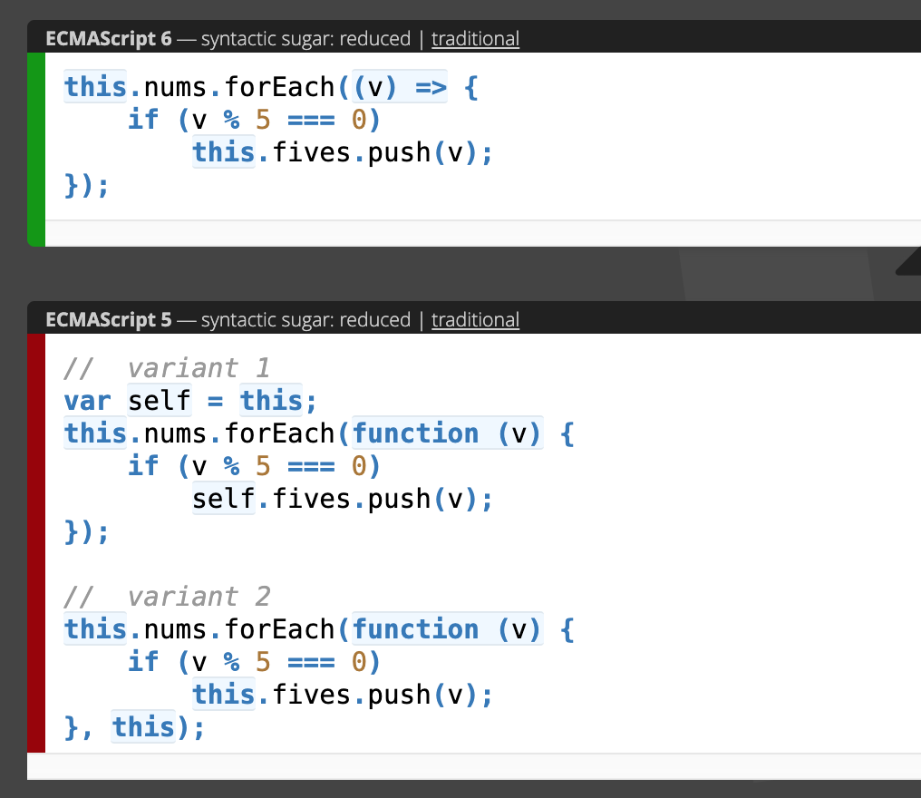
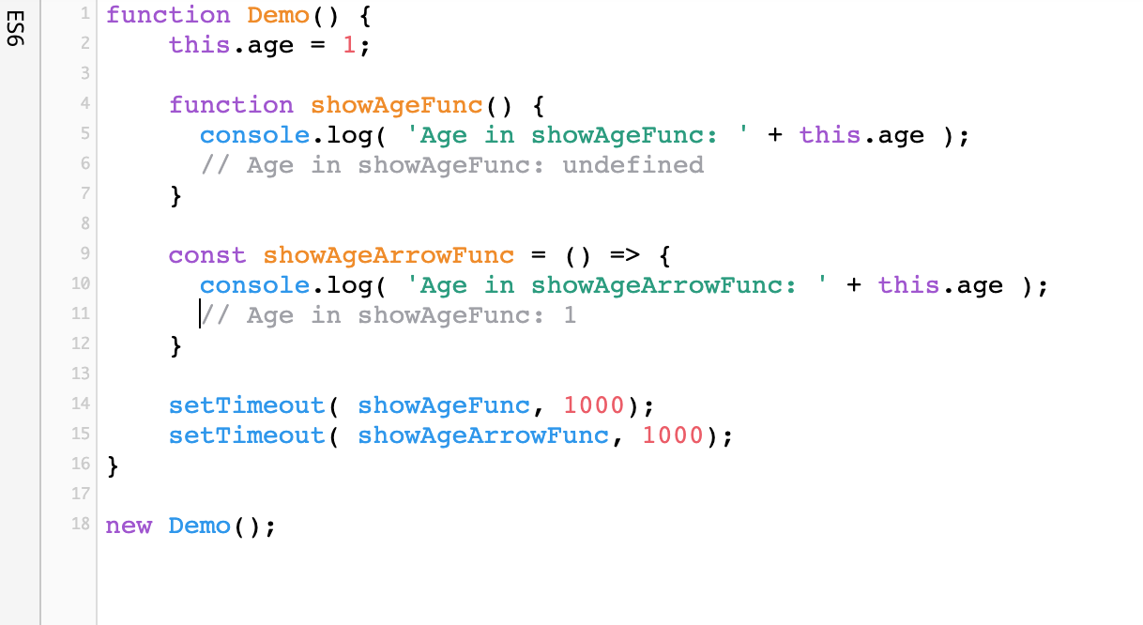
Arrow Functions
Lexical this
More intuitive handling of current object context.

Slide 9
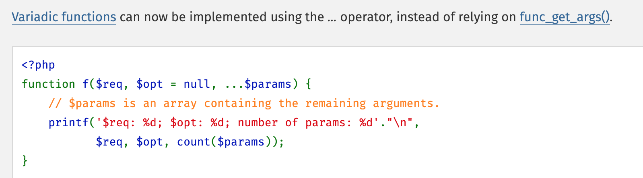
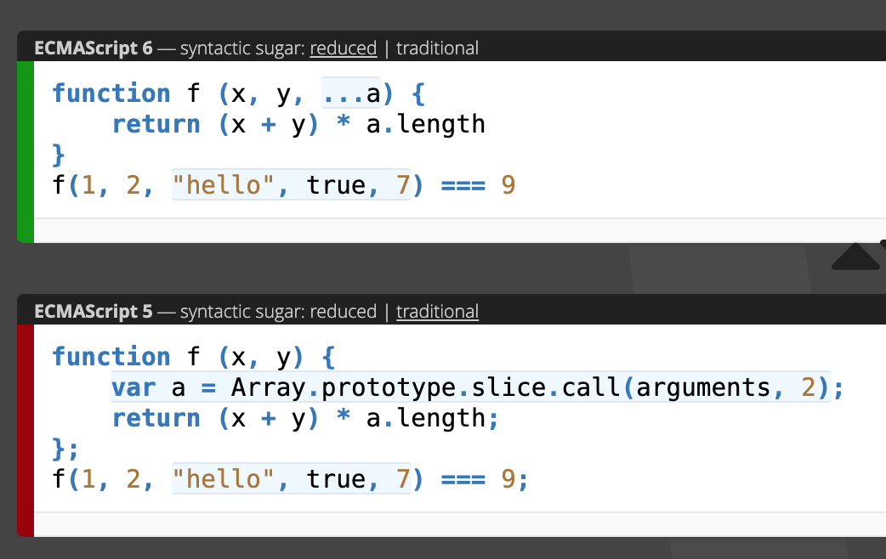
Rest Parameter

Slide 10
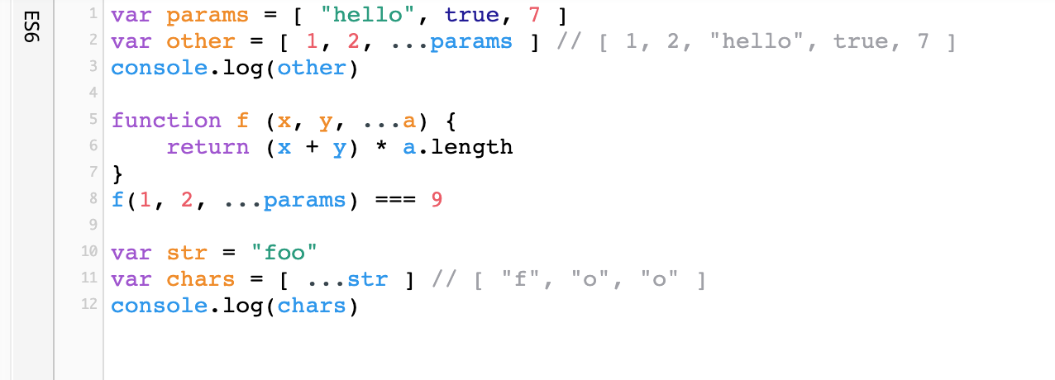
Spread Operator
Spreading of elements of an iterable collection (like an array or even a string) into both literal elements and individual function parameters.

Slide 11
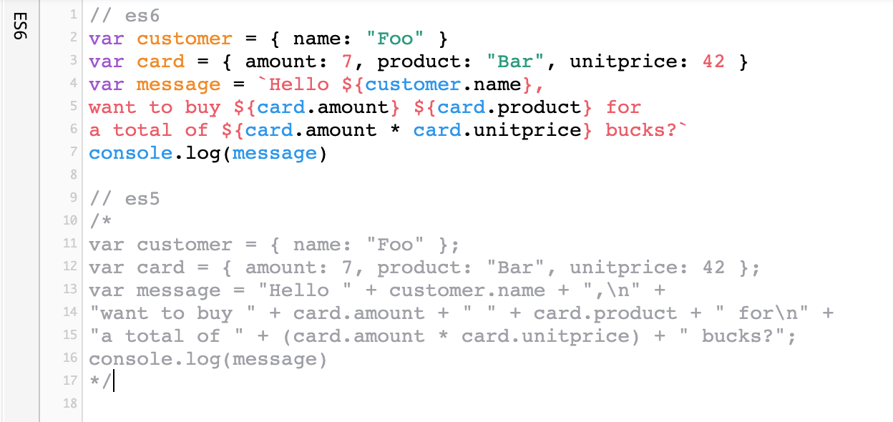
Template Literals (Template strings)
Intuitive expression interpolation for single-line and multi-line strings.

Slide 12
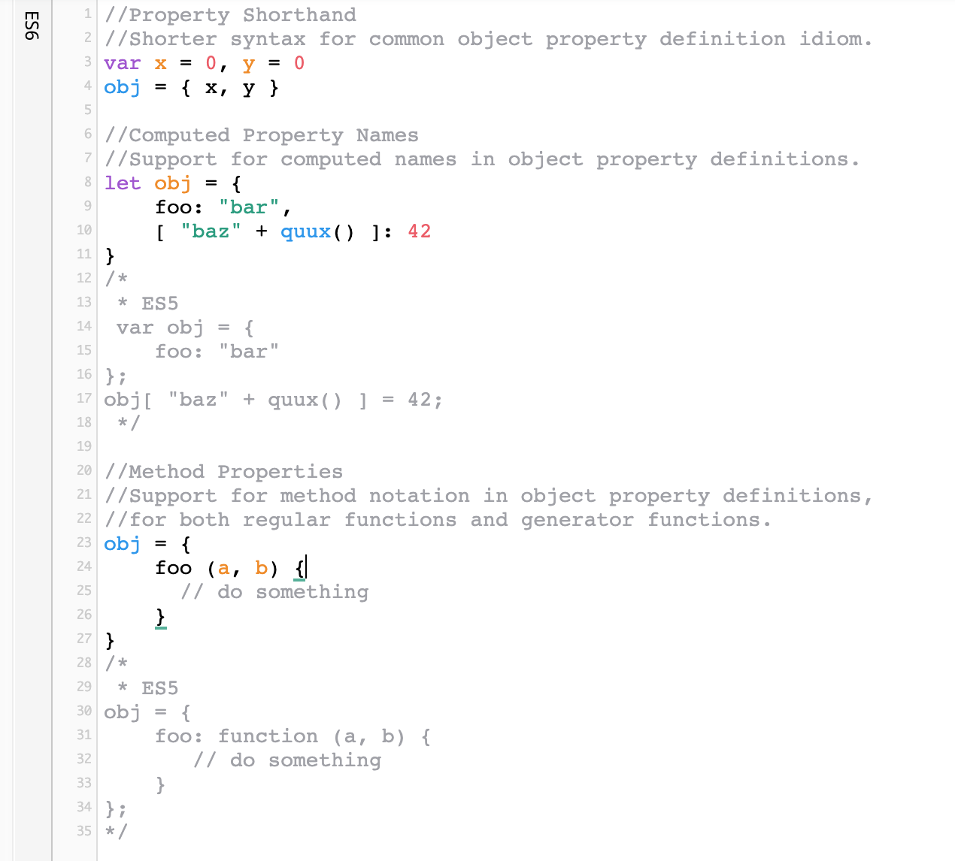
Enhanced Object Properties

Slide 13
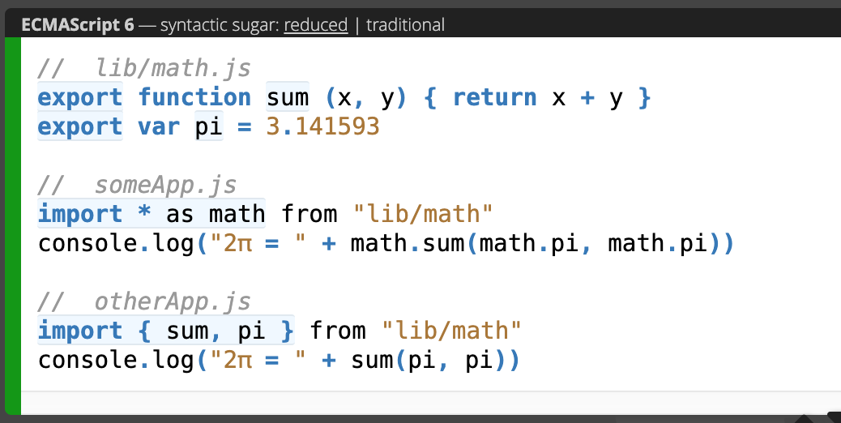
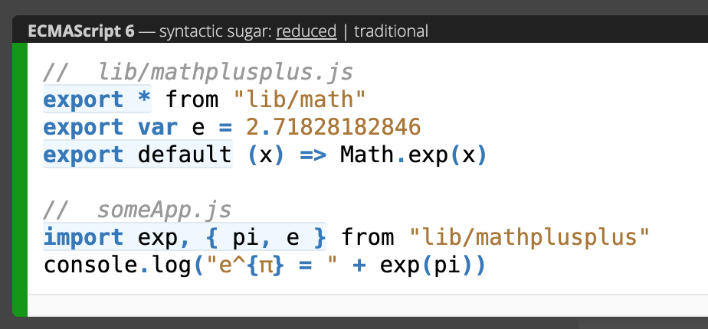
Export/Import

Slide 14
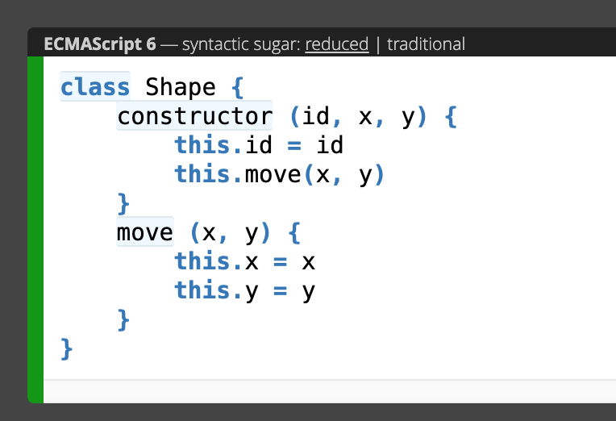
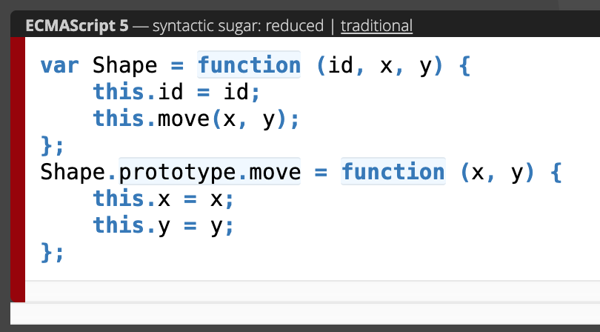
Classes
Class
Constructor Function
https://developer.mozilla.org/en-US/docs/Web/JavaScript/Reference/Global_Objects/Object/constructor

Slide 15
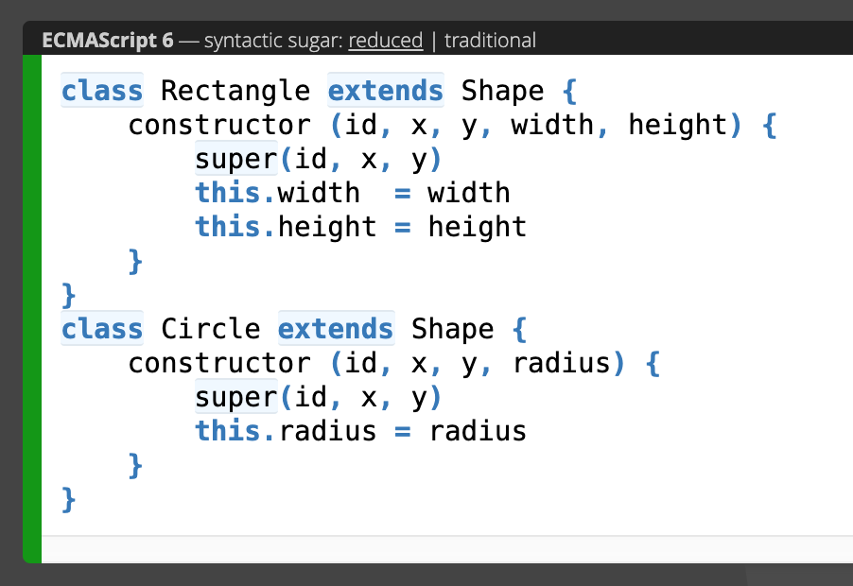
Class
Class Inheritance
More intuitive, OOP-style and boilerplate-free inheritance.
https://gist.github.com/Loilo/4d385d64e2b8552dcc12a0f5126b6df8

Slide 16
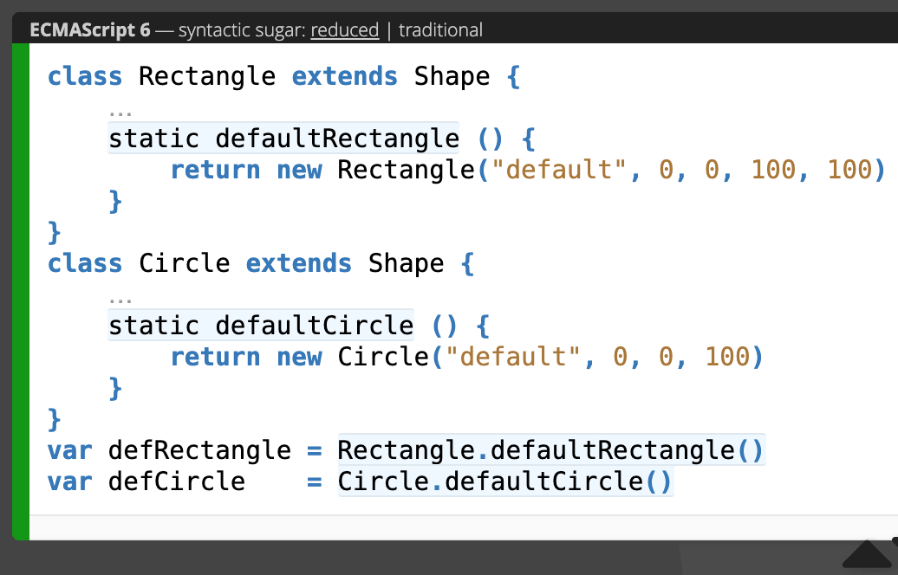
Class
Static Members
Simple support for static class members.

Slide 17
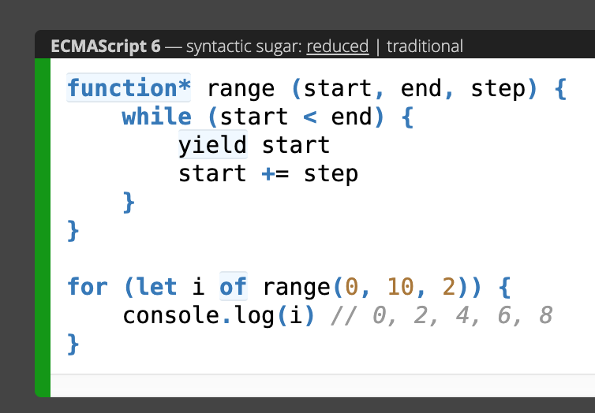
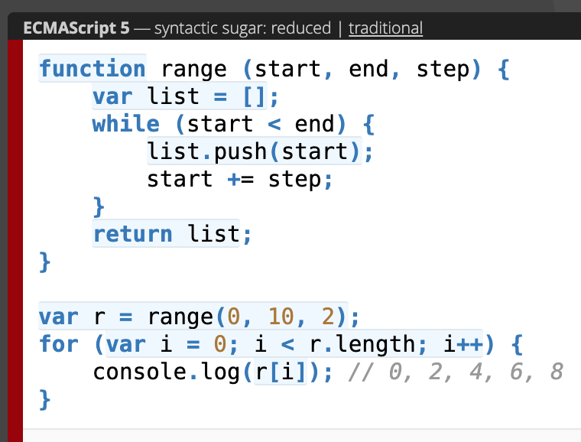
Generators
Generator Function, Direct Use
Support for generator functions, a special variant of functions where the control flow can be paused and resumed, in order to produce sequence of values (either finite or infinite).

Slide 18
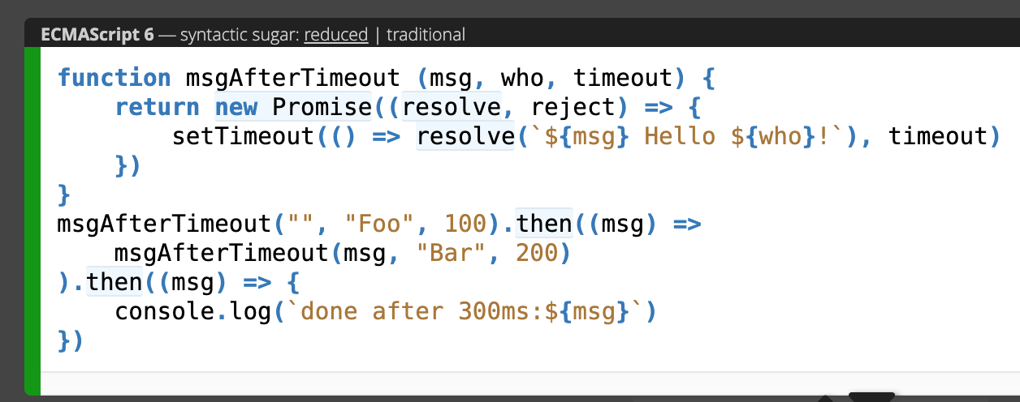
Promises
Promise Usage
First class representation of a value that may be made asynchronously and be available in the future.

Slide 19
Tìm hiểu thêm về các kiến thức liên quan và bổ trợ cho phần ES6
(Không phải từ ES6 mới có)

Slide 20
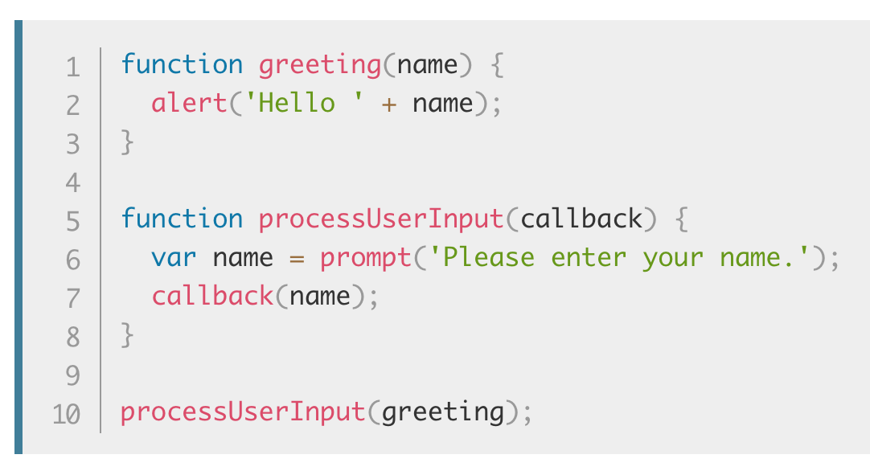
Callback function
A callback function is a function passed into another function as an argument, which is then invoked inside the outer function to complete some kind of routine or action.

Slide 21
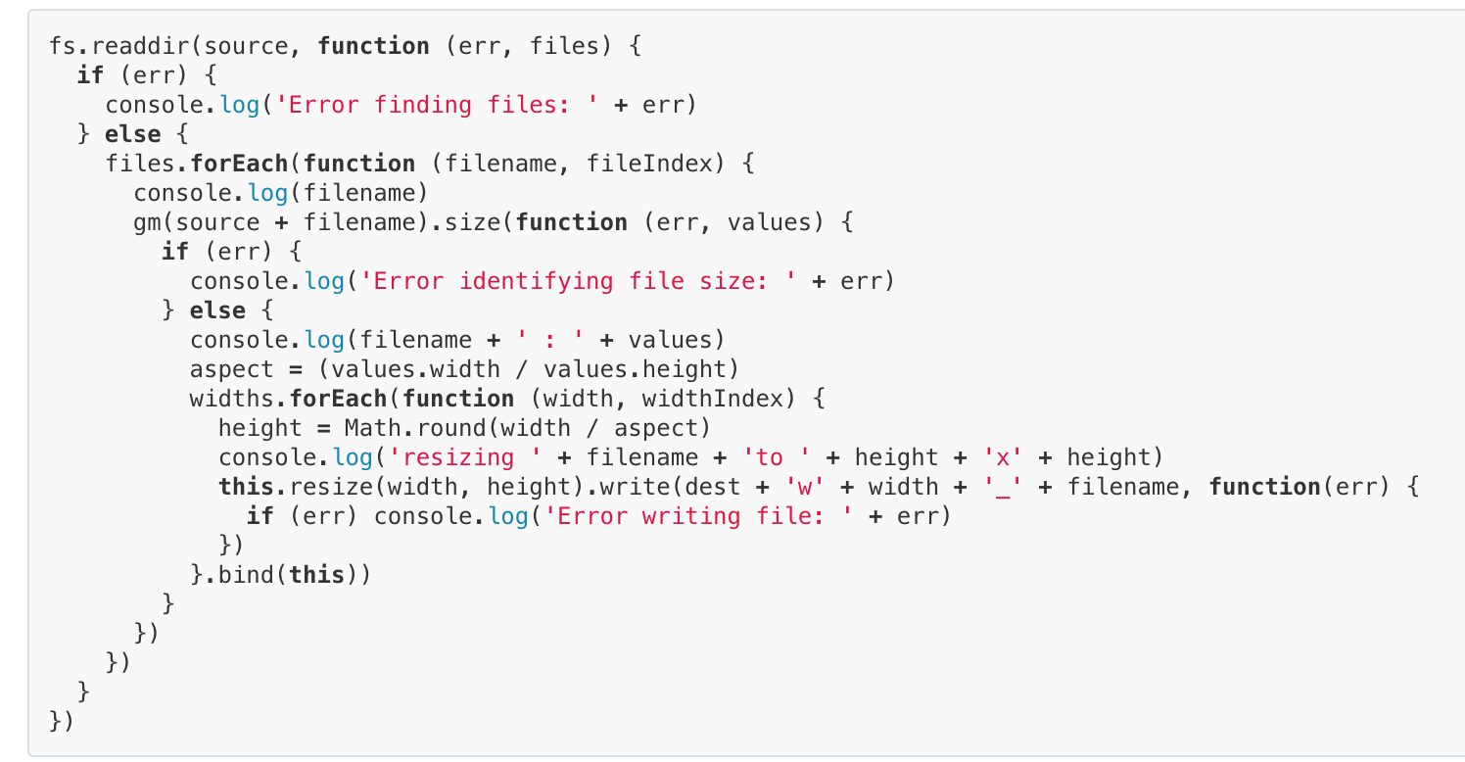
Callback Hell -pyramid of doom - hadouken

Slide 22
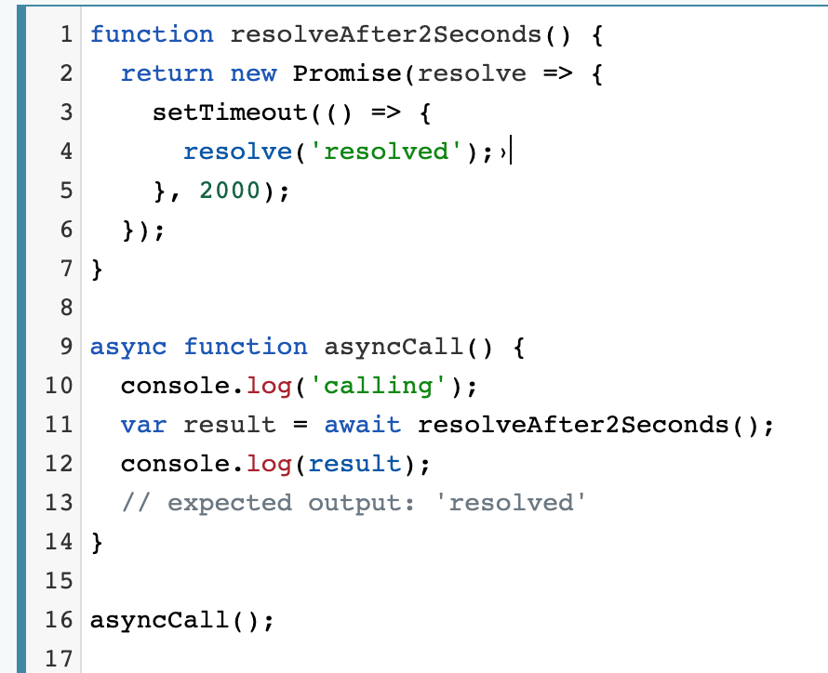
async function
The async function declaration defines an asynchronous function, which returns an AsyncFunction object. An asynchronous function is a function which operates asynchronously via the event loop, using an implicit Promise to return its result. But the syntax and structure of your code using async functions is much more like using standard synchronous functions.

Slide 23
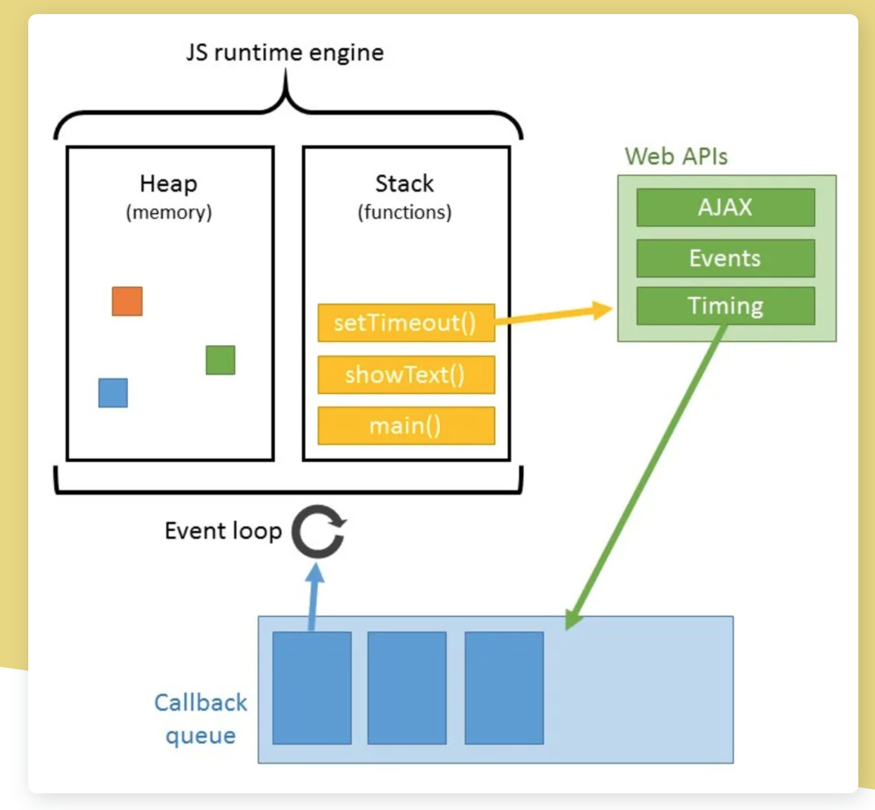
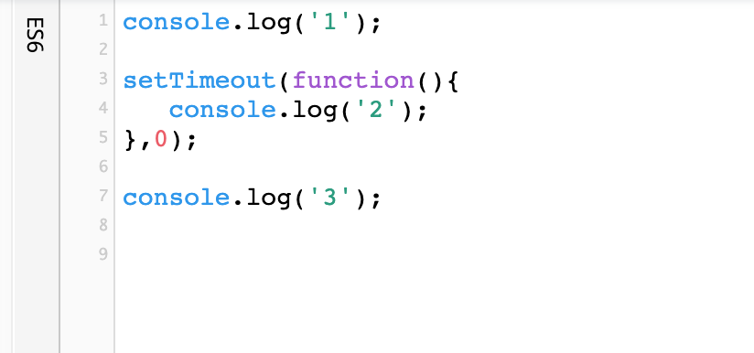
Example Funny

Slide 24
Thanks you !

