Slide 1
How to Build a SINGLE PROJECT For BOTH iOS and TVOS

Slide 2
Agenda
Introduce about tvOS
Build tvOS app on current iOS project
Demo

Slide 3
Introduce about Apple tv & tvos

Slide 4
What is tvos?
iOS | tvOS
iPhone, iPad, iPod, (iTV) | Apple TV
2007: iPhone OS 1.0 (iPhone & iPod) 2009: iPhone OS 3.2 (+iPad) 2010: iOS 4.1 (+Apple TV 2nd Gen) 2015: iOS 9 (- Apple TV) 2018: iOS 12 | 2015: tvOS 9 (Apple TV 4th Gen) 2018: tvOS 12
2017: 1.2b iPhone + 0.3b iPad + 0.5b iPod | 2017: 75m
2018: 2.1m Apps | 2016: 10k Apps
Notes:
- tvOS 9 is 95% base on iOS 9

Slide 5
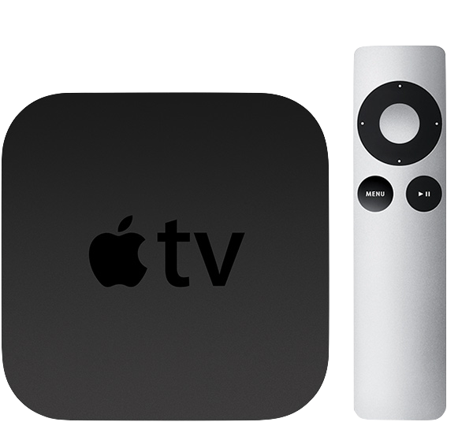
Apple TV 2nd Gen (2010)

Slide 6
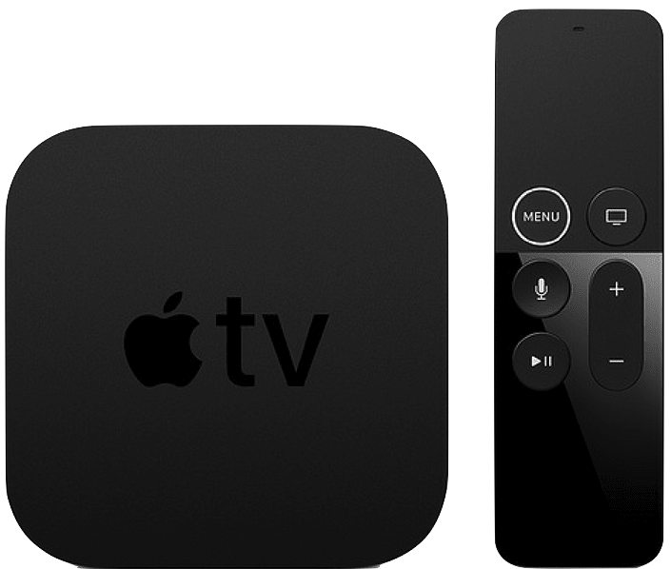
Apple TV 5th Gen (2017)

Slide 7

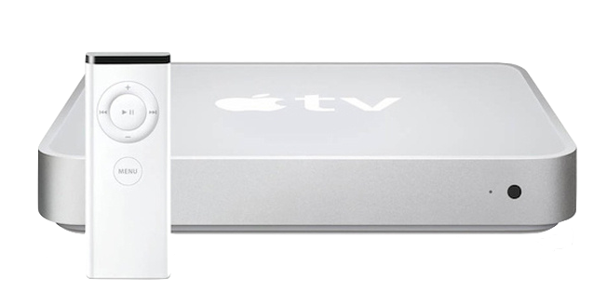
iPhone and apple TV, which one is older?
2007: iPhone 1st Gen
2006: iTV 1st Gen
Notes:
iPhone 1st Gen runs iPhone OS 1, CPU: Samsung 32-but ARM
Apple TV 1st Gen runs on MacOS X 10.3.9, CPU: Intel Pentium

Slide 8
HOW TO BUILD an app for Apple tv?
Traditional app:
Same techniques and frameworks used by iOS
Client-Server app:
TVML
Notes:
The process for creating apps for Apple TV is similar to the process for creating iOS apps. You can create games, utility apps, media apps, and more using the same techniques and frameworks used by iOS. New and existing apps can target both iOS and the new Apple TV, allowing for unprecedented multiplayer options.
Apple TV makes it easier to create client-server apps, whose primary purpose is to stream media, using web technologies such as HTTPS, XMLHTTPRequest, DOM, and JavaScript. You use Apple’s custom markup language, TVML, to create interfaces, and you specify app behaviors using JavaScript. The TVMLKit framework provides the bridge between your native code and the JavaScript code in your user interface

Slide 9
Build tvos app on ios project

Slide 10
What can reuse from iOs?
UI
Business Logic
3rd Party Libs
Core Framework
Notes:
3rd Libs: from Pod, Carthage, or framework directly
Core framework from Cocoa Touch framework, such as Foundation, UIKit, …

Slide 11
Why not UI code?

Slide 12
Fastlane
Fastlane is not supporting tvOS officially
But it’s still working well though
Notes:
@default = [:ios, :mac, :android]
https://github.com/fastlane/fastlane/blob/master/fastlane/lib/fastlane/supported_platforms.rb

