Slide 1
Thanh
Software Engineer
Rakuten Viki
thanh.ta@rakuten.com
linkedin.com/in/thanhturin/
Notes:
Welcome
Introduce about myself

Slide 2
How to Build a tvos app on ios PROJECT
Notes:
Today I’m gonna talk about tvOS and how to implement it on scratch or in an iOS application which is already built and already working

Slide 3
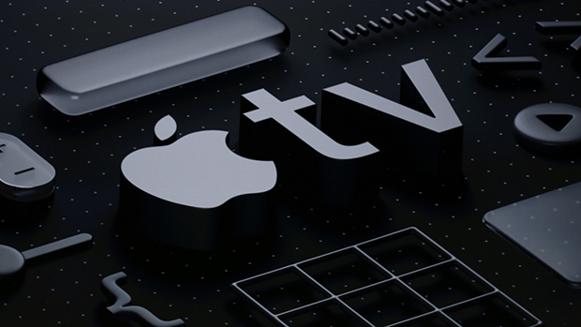
How to Build a tvos app on ios PROJECT
Notes:
Today I’m gonna talk about tvOS and how to implement it on scratch or in an iOS application which is already built and already working

Slide 4
Agenda
Introduce about tvOS
How to build a tvOS app on iOS project?
Demo

Slide 5
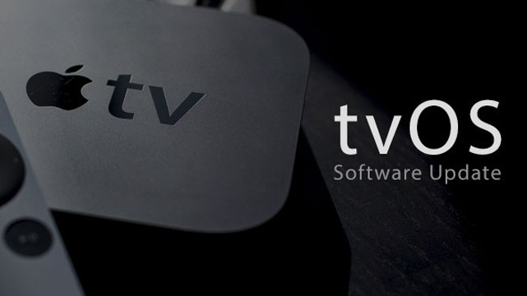
tvOS & Apple TV

Slide 6
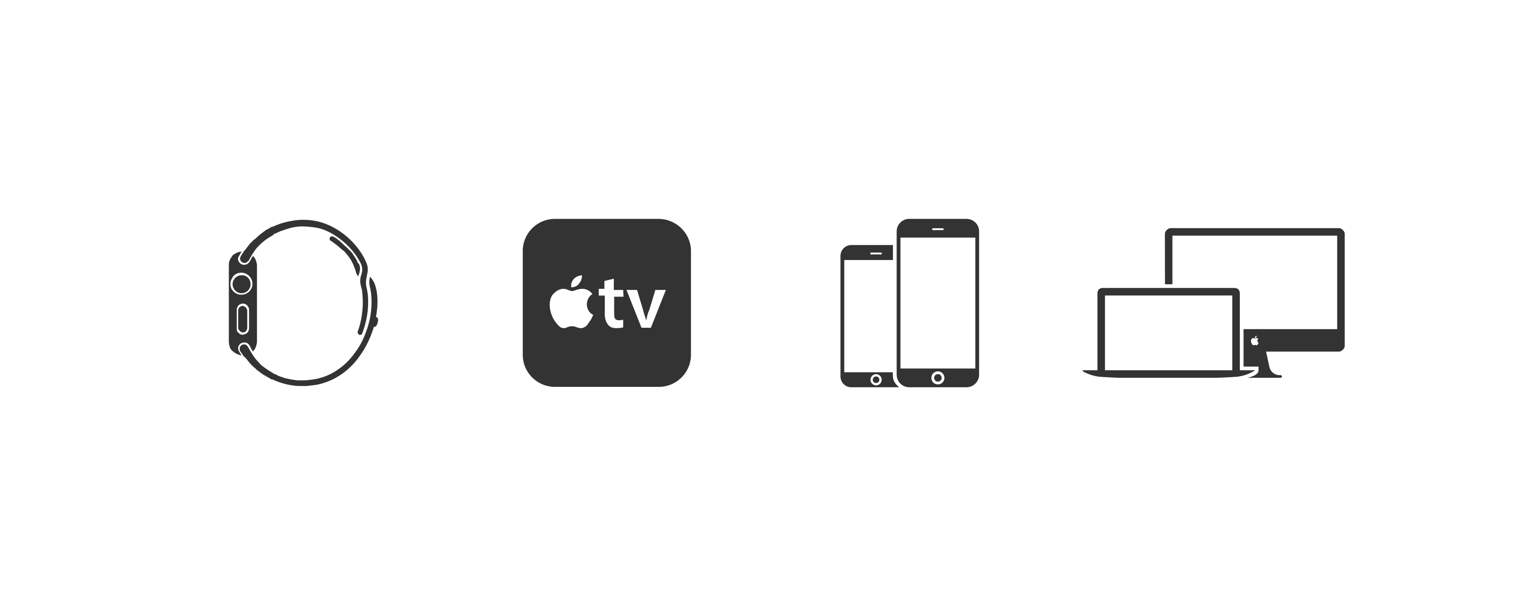

Slide 7
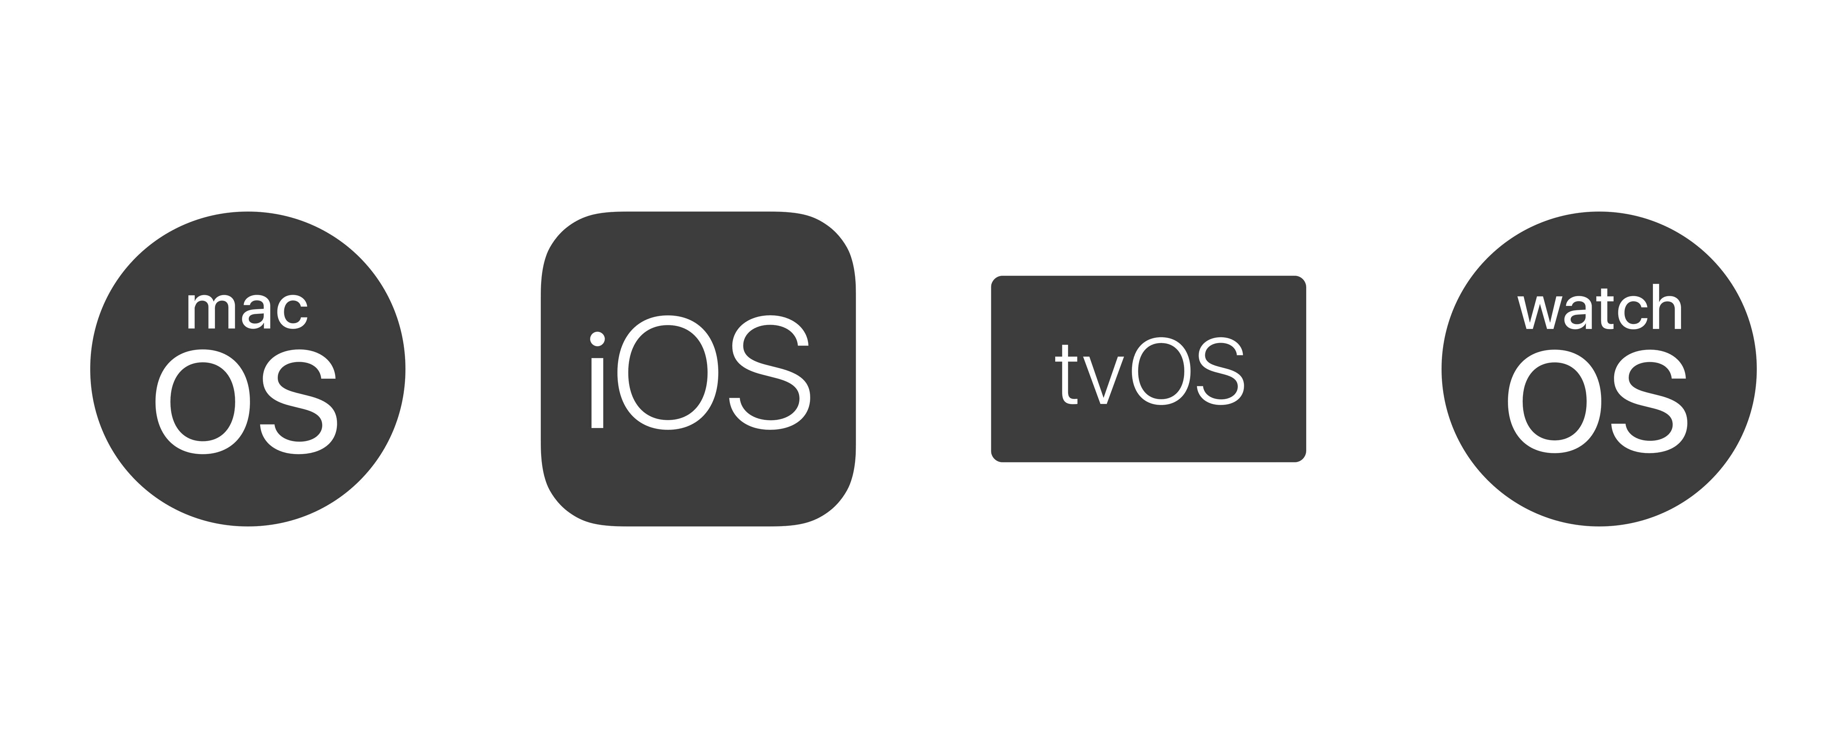

Slide 8
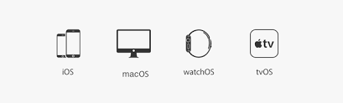
tvOS
Specifically for Apple TV
2017: 75m Apple TV have been sold
(1.2b iPhone + 0.3b iPad + 0.5b iPod)
2016: 8k apps
(2.1m on iOS)
Notes:
- To make it easier to imagine, there are 1.2b iPhone + … meanwhile only have 75m Apple TV in end of 2017. (quite humble?)

Slide 9
tvOS History
iOS | tvOS
2007: iPhone OS 1.0 (iPhone & iPod)
2009: iPhone OS 3.2 (+iPad)
2010: iOS 4.1 (+Apple TV 2nd Gen)
2015: iOS 9 (- Apple TV) | 2015: tvOS 9 (Apple TV 4th Gen)
2018: iOS 12 | 2018: tvOS 12
Notes:
- tvOS 9 is 95% base on iOS 9

Slide 10
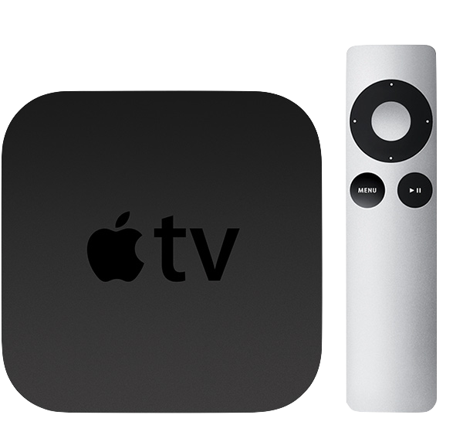
Apple TV 2nd Gen (2010)

Slide 11
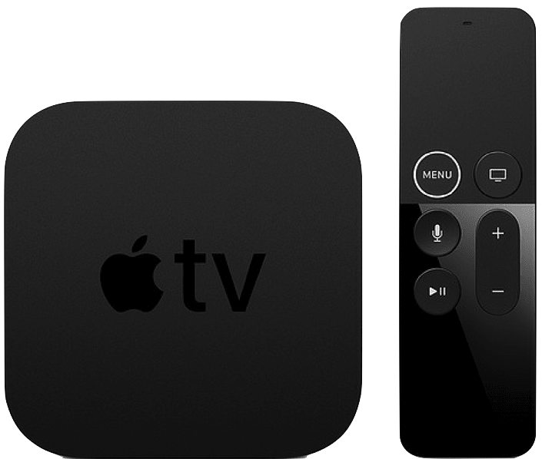
Apple TV 5th Gen (2017)

Slide 12

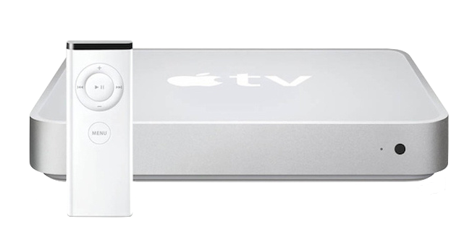
iTV Is Older Than iPhone
2007: iPhone 1st Gen
2006: iTV 1st Gen
Notes:
iPhone 1st Gen runs iPhone OS 1, CPU: Samsung 32-but ARM
Apple TV 1st Gen runs on MacOS X 10.3.9, CPU: Intel Pentium

Slide 13
Kinds Of Apple TV App
Traditional app:
Same techniques and frameworks used by iOS
Client-Server app:
TVML
Notes:
The process for creating apps for Apple TV is similar to the process for creating iOS apps. You can create games, utility apps, media apps, and more using the same techniques and frameworks used by iOS. New and existing apps can target both iOS and the new Apple TV, allowing for unprecedented multiplayer options.
Apple TV makes it easier to create client-server apps, whose primary purpose is to stream media, using web technologies such as HTTPS, XMLHTTPRequest, DOM, and JavaScript. You use Apple’s custom markup language, TVML, to create interfaces, and you specify app behaviors using JavaScript. The TVMLKit framework provides the bridge between your native code and the JavaScript code in your user interface

Slide 14
Build tvos app on ios project

Slide 15
What can reuse from iOs?
UI
Business Logic
3rd Party Libs
Core Framework
Notes:
3rd Libs: from Pod, Carthage, or adding framework directly
Core framework from Cocoa Touch framework, such as Foundation, UIKit, …

Slide 16
Why not sharing UI code?
Different devices
→ Different User Behavior
→ Different UI
iOS has Orientation meanwhile tvOS has Dark/Light mode
iOS has WebKit meanwhile tvOS has TVUIKit
Notes:
Different devices, one use touch on the screen, and one use the remote
Layout is different, size and color. iOS scroll vertical mostly meanwhile on Apple TV prefer to scroll horizontally
iOS need to care with orientation as well as multitasking on iPad (compact and regular) meanwhile on tvOS need to care about light and dark

Slide 17
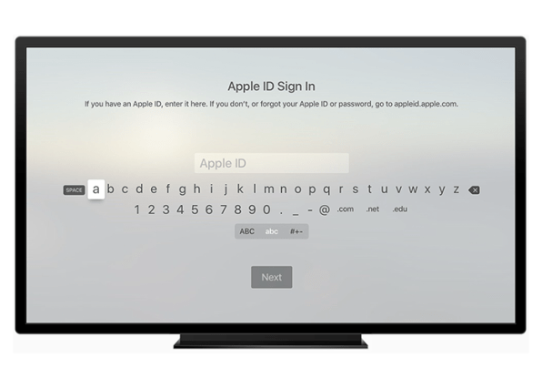

Slide 18
Fastlane
Fastlane is not supporting tvOS officially
Using platform tvos to define lane
Notes:
@default = [:ios, :mac, :android]
https://github.com/fastlane/fastlane/blob/master/fastlane/lib/fastlane/supported_platforms.rb

Slide 19
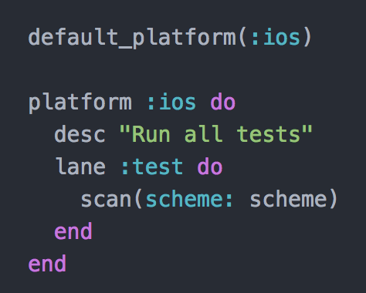

Slide 20
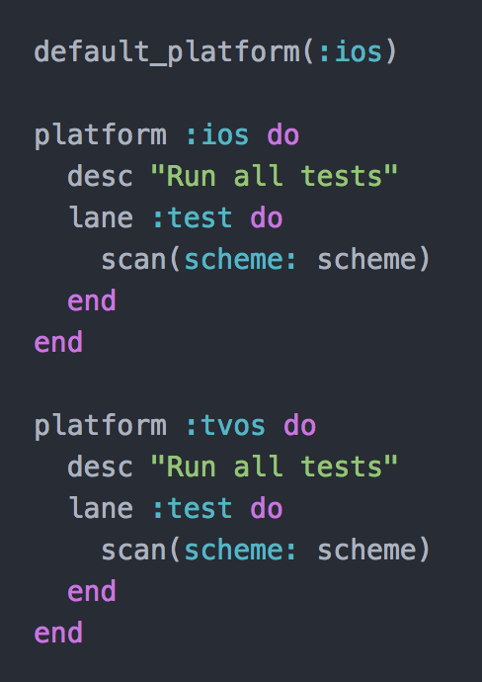

Slide 21
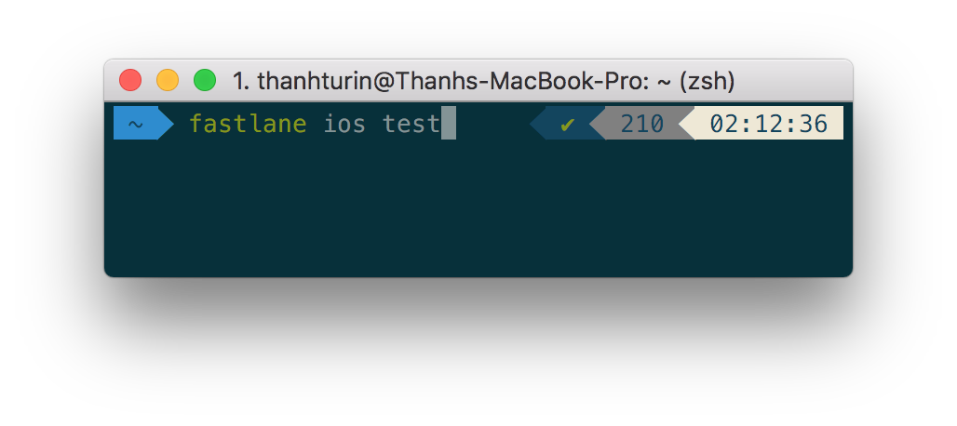


Run fastlane

Slide 22
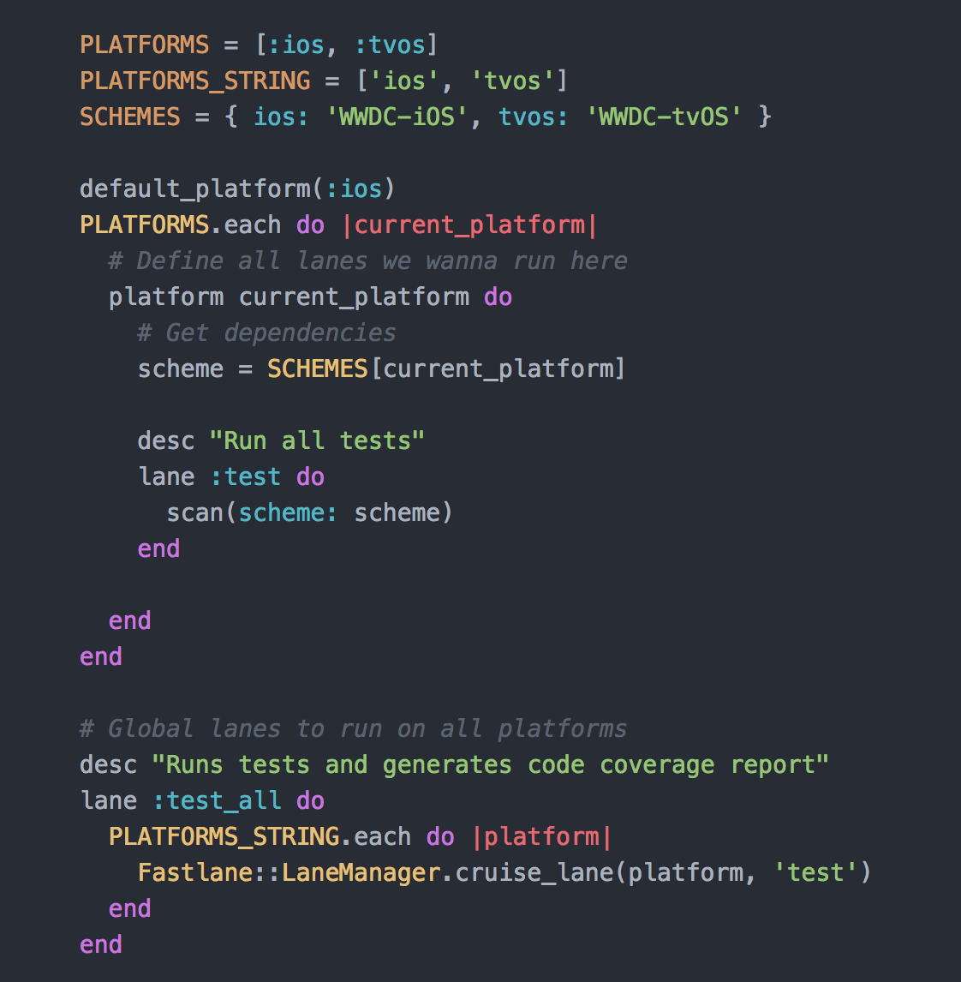

Slide 23
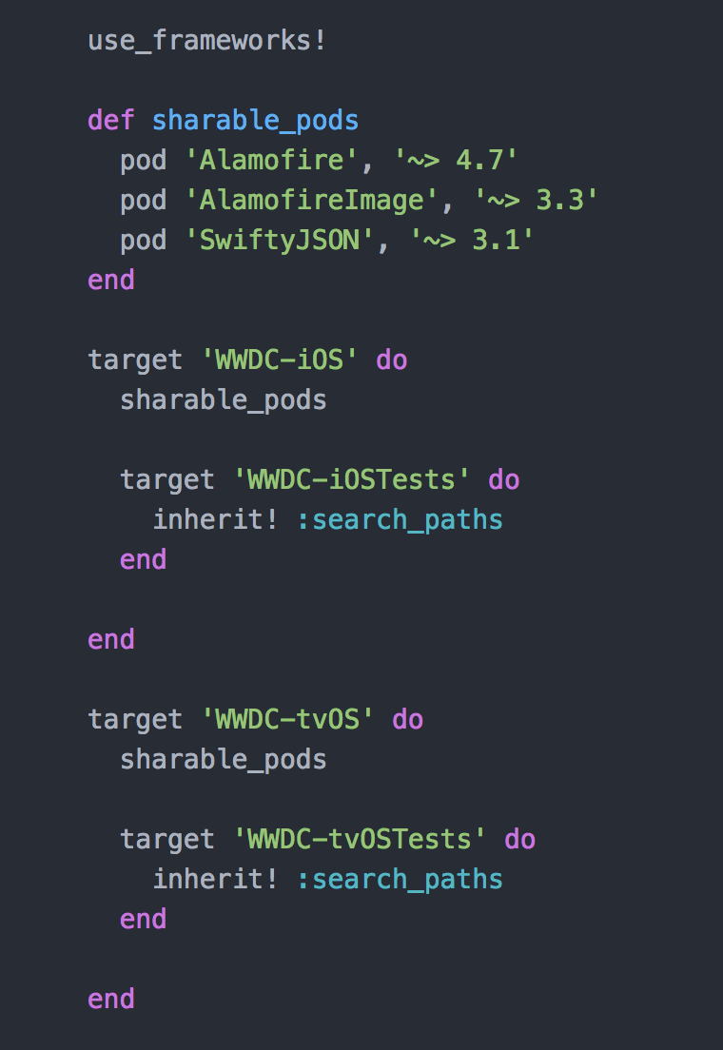
Cocoa pod

