Slide 1
Singapore ios meetup
Add logo here
Notes:
Hello everyone. Welcome to iOS meetup October 2018.
Today in my talk, I would like to introduce to you one way that can potentially raise up your revenue. Sound attractive right? Let get starting!

Slide 2
Thanh
Software Engineer
Rakuten Viki
linkedin.com/in/thanhturin/
thanhturin@gmail.com
Notes:
So I wanna briefly introduce about myself
My name is Thanh
I’m currently an iOS developer at Rakuten Viki
Viki a video streaming platform.
Thanks Lizzie for her recent introduction.
More information you can find me on my linkedin.
So feel free to give me a message if you have a question.

Slide 3
Put logo Apple here
Notes:
I think most of us here are iOS developers
And that’s why you may be very familiar with Apple eco system (if don’t wanna say you are all experts)
Everyday we use products from Apple
We use Macbook for working
iPhone not only for work but also for communication
I don’t know your feeling about Apple products but I really love it. This is one of the reason make me become iOS developer.
The truth is I have not seen any iOS developers use Android phone but I saw many Android developers use iPhone
So what does it mean. It means Apple has built a successful eco system
They build devices and the operation system for it, such as Macbook and MacOS, iPhone and iOS, etc. And they are just compatible perfectly.
And today I wanna talk about one of the young child in Apple family, which is a pair of a device and operation system
That device looks like a mac mini, but runs on an operation system very close to iOS
This is Apple TV and tvOS
And the talk I will give today is “Developing for Apple TV”

Slide 4
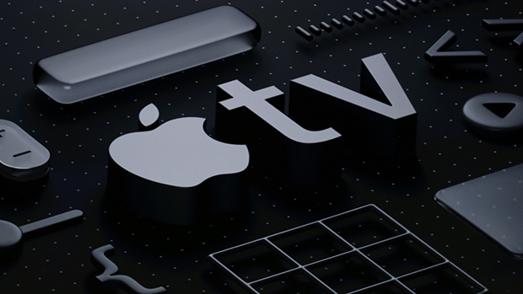
Developing for apple tv
Notes:
Today I’m gonna talk about tvOS and how to implement it on scratch or in an iOS application which is already built and already working
Why do we should implement Apple TV app:
First, Apple users always spend more than other platforms users.
It makes sense because usually Apple devices are more expensive
And people who adapt to buy it for entertainment are very potential to pay for our service...
Show how grows it is on number of Apple TV sold…
From 5m in 2012 to 25m in 2015 and 75m in 2017
More and more support, better device, better user experiences…
User feedback about experience while using tv app compare with phone app
Last but not least, It does not cost much to keep building and maintaining tvOS app. You wanna see how easy is it. I will show you right now.

Slide 5
Agenda
Introduce about Apple TV and tvOS
Developing Apple TV App
Demo
Notes:
First, I will briefly introduce about Apple TV and tvOS
Then I will simutanously talk about how to build tvOS app on an existing iOS project with the demo to show you how easy to build it
And finally I will try to implement with you a small feature to enhance how easy it is to maintain the app

Slide 6
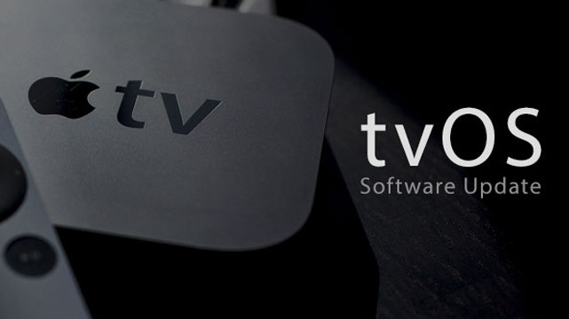
tvOS & Apple TV
Notes:
SO okay. let’s quick start with Apple TV and tvOS introduction

Slide 7

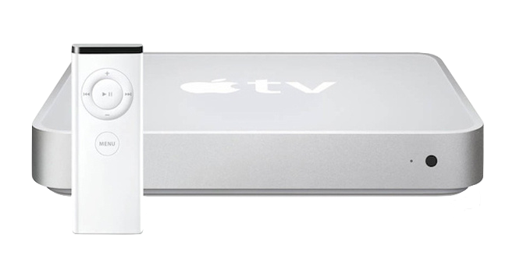
iTV Is Older Than iPhone
2007: iPhone 1st Gen
2006: iTV 1st Gen
Notes:
If you have not watched the historical iPhone introduction by Steve Jobs
Let’s find it on Youtube, it’s very impressive
That event was held in 2007
But do you know before it one year Apple also introduced another new device.
This is the Apple TV 1st Gen (or as they call it iTV)
That Apple TV is very similar with a mac mini
Which also runs on MacOS X 10.3.9, CPU: Intel Pentium

Slide 8
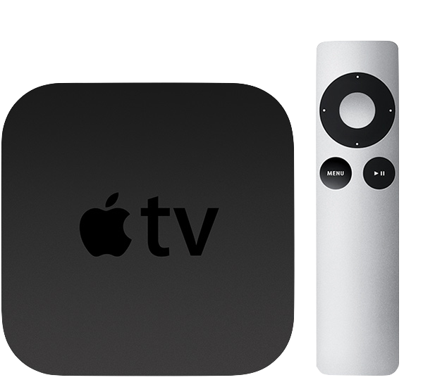
Apple TV 2nd Gen (2010)
Notes:
After the success of the first iPhone, Apple focused 100% on enhancing iPhone
And 4 years later, after they have a stable version of iPhone and iOS
In 2010 Apple redesign iTV and introduce the secondary generation.
From this version, Apple decided to use the name Apple TV instead of iTV as previously
This is also the first Apple TV not run on Mac OS
Actually when it was just launched it still run on iOS 8
Until end of 2010 Apple introduced tvOS 9 which is 95% bases on iOS 9
And since there Apple TV will only run on tvOS
Which split into 2 items
First is the TV box which has the processor, memory. It also has a HDMI hub to connect with TV, similarly with a Mac Mini
Another one is the controller and we will use it to control the app on the screen
You also can use your phone to control Apple TV by download app which name Remote on Apple Store

Slide 9
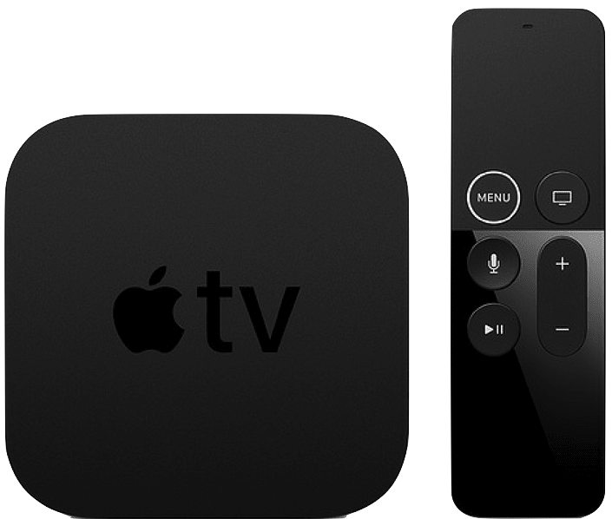
Apple TV 5th Gen (2017)
Notes:
On the screen is Apple TV 5th gen, which is also the latest Apple TV
The latest tvOS version is tvOS 12

Slide 10
Apple tv sold
Notes:
Which is also around 18% of the whole market (beside Apple TV is Android TV, Xiaomi TV, Roku TV,…)
To make it easier to imagine, there are 1.2b iPhone + … meanwhile only have 75m Apple TV in end of 2017. (quite humble?)
(1.2b iPhone + 0.3b iPad + 0.5b iPod)
Look at the chart we can see the increasement is significant
And we can hope about the wider market will come in the soon future
In 2016 there are 8k apps for tvOS (2k is game)

Slide 11
tvOS app
Traditional app:
Same techniques and frameworks used by iOS
Client-Server app:
TVML
Notes:
The process for creating apps for Apple TV is similar to the process for creating iOS apps. You can create games, utility apps, media apps, and more using the same techniques and frameworks used by iOS. New and existing apps can target both iOS and the new Apple TV, allowing for unprecedented multiplayer options.
Apple TV makes it easier to create client-server apps, whose primary purpose is to stream media, using web technologies such as HTTPS, XMLHTTPRequest, DOM, and JavaScript. You use Apple’s custom markup language, TVML, to create interfaces, and you specify app behaviors using JavaScript. The TVMLKit framework provides the bridge between your native code and the JavaScript code in your user interface
Update:
- Can make it side by side to easier to compare
Pros and cons here for Traditional way and TVML way
For every business we need to care able scability and beside that you need to rewrite lots of tests for both.

Slide 12
Developing apple tv app

Slide 13
Project structure
UI
Business Logic
3rd Party Libs
Core Framework
Notes:
3rd Libs: from Pod, Carthage, or adding framework directly
At the bottom is Core framework from Cocoa Touch framework, such as Foundation, UIKit, CoreData, StoreKit, … which is very fundamental
Then we import some 3rd party libraries which is built on top of Core Framework for more specific purpose. Such as Alamofire, RxSwift, Pop Animation
We cover another level by writing business logic code. There will have model serialization, API calling, viewModel creation, services, …
UI Code for rendering and interaction with user

Slide 14
Why not sharing UI code?
Different devices
→ Different User Behavior
→ Different UI
iOS has Orientation meanwhile tvOS has Dark/Light mode
iOS has WebKit meanwhile tvOS has TVUIKit
Notes:
Different devices, one use touch on the screen, and one use the remote
Layout is different, size and color. iOS scroll vertical mostly meanwhile on Apple TV prefer to scroll horizontally
iOS need to care with orientation as well as multitasking on iPad (compact and regular) meanwhile on tvOS need to care about light and dark

Slide 15
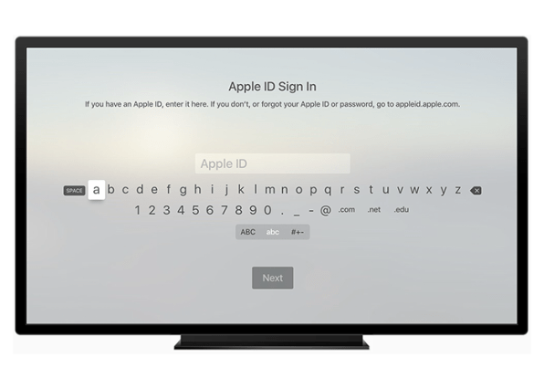

Slide 16
Project structure
Show the structure here

Slide 17
Notes:
Showing demo project
First will show the iOS initial project
Then moving code around to make it fit for tvOS
Then open the final project which already has right configuration (if there is any unexpected issue happen)

Slide 18
Fastlane
Fastlane is not supporting tvOS officially
Using platform tvos to define lane
Notes:
@default = [:ios, :mac, :android]
https://github.com/fastlane/fastlane/blob/master/fastlane/lib/fastlane/supported_platforms.rb

Slide 19
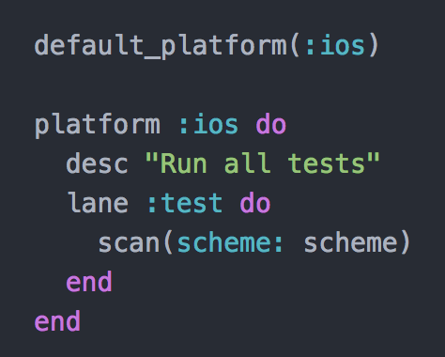

Slide 20
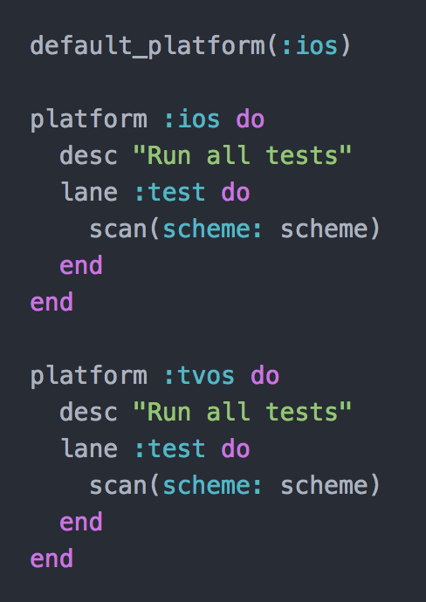

Slide 21
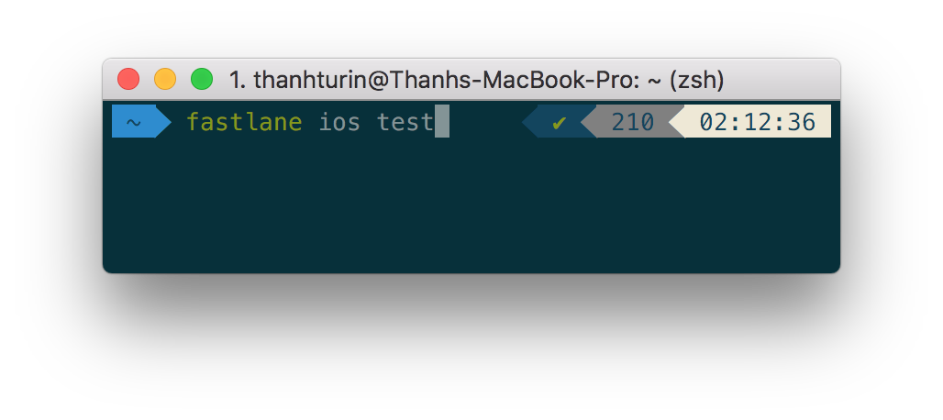


Run fastlane

Slide 22
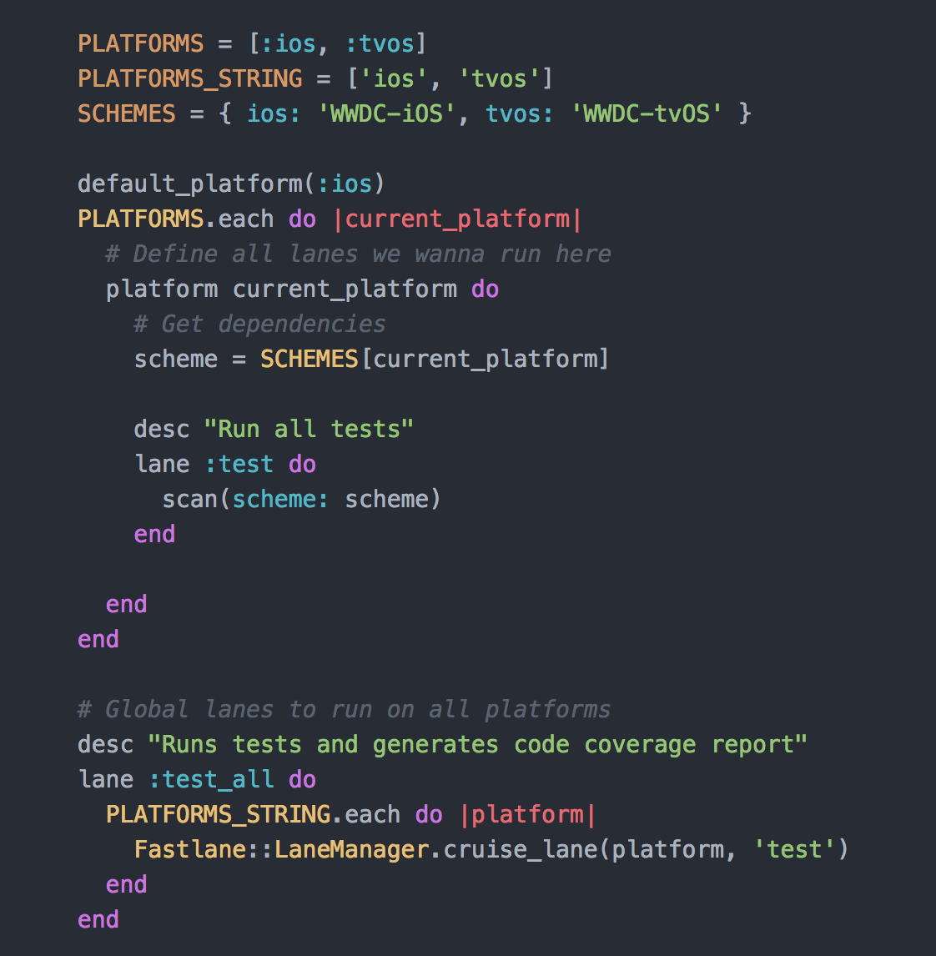

Slide 23
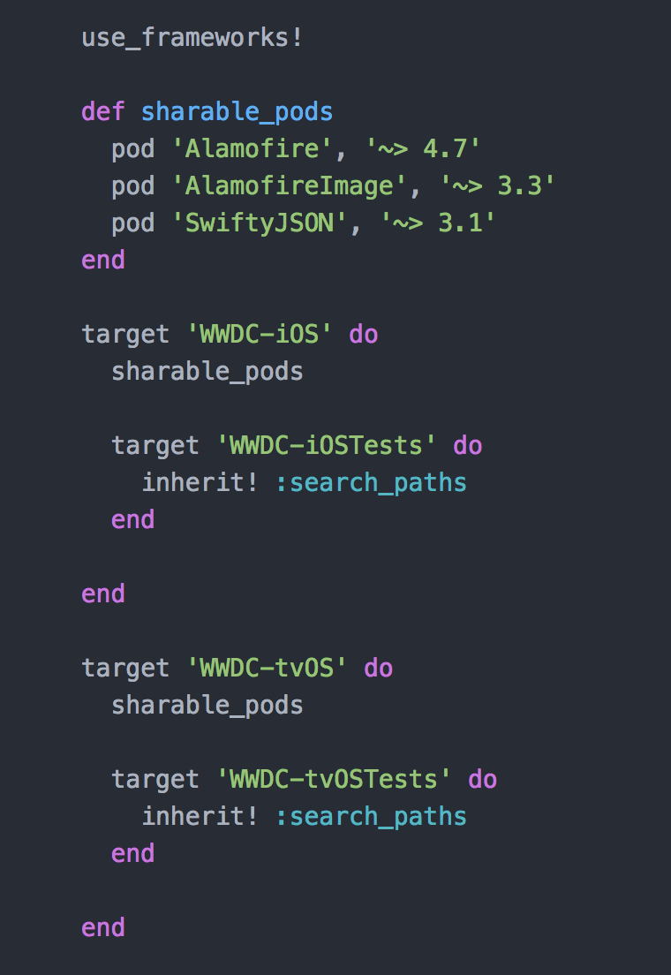
Cocoa pod

