Slide 1

iOS Dev Scout Singapore, October 2018
Notes:
Hello everyone. Welcome to iOS dev scout October 2018.
Today in my talk, I would like to introduce to you one way that can potentially raise up your revenue.
Before we start, I wanna briefly introduce about myself.

Slide 2

Thanh
Software Engineer
Rakuten Viki
linkedin.com/in/thanhturin/
thanhturin@gmail.com
Notes:
My name is Thanh
I’m currently an iOS developer at Rakuten Viki
Viki a video streaming platform.
Thanks Lizzie for her recent introduction.
You can fine more information about me by visit my home page on linkedin.
And if you have any question or anything unclear about my talk, please feel free to give me a message to my email at thanhturin@gmail.com

Slide 3



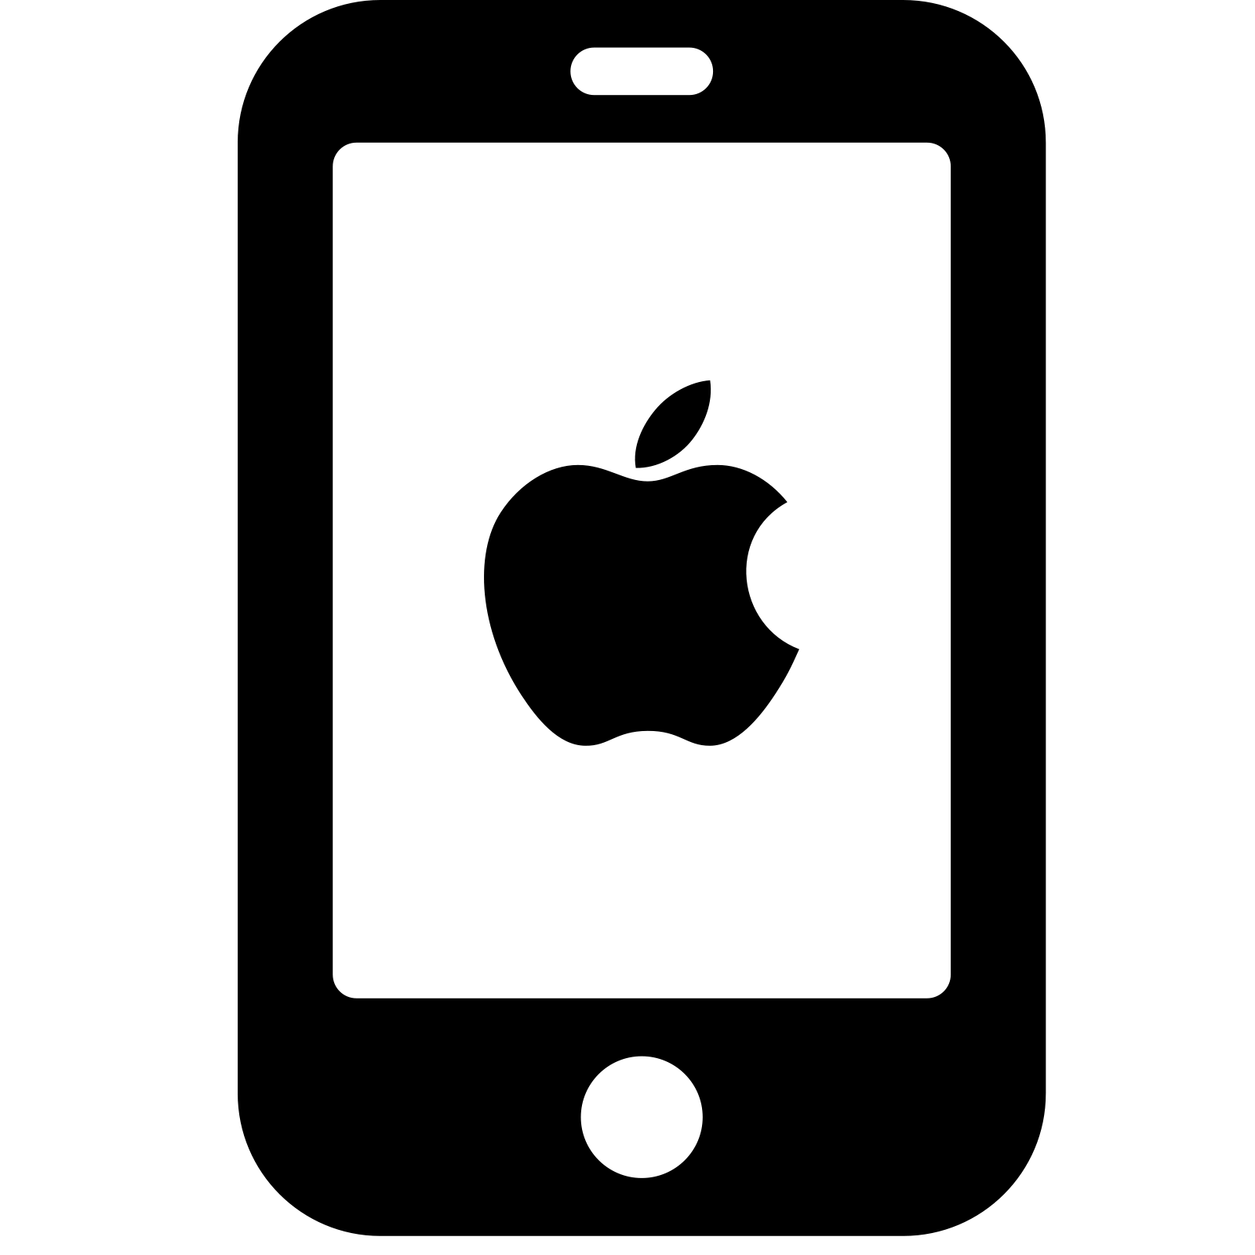





Notes:
I know most of us here are iOS developers
And that’s why I think you may be very familiar with Apple eco system (if don’t wanna say you are all experts)
Everyday we use products from Apple
We use Macbook for working
iPhone not only for work but also for communication
I don’t know your feeling about Apple products but I really love it. This is one of the reason make me become iOS developer.
The truth is I have not seen any iOS developers use Android phone but I saw many Android developers use iPhone
So what does it mean. It means Apple has built a successful eco system
They build devices and the operation system for it, such as Macbook and MacOS, iPhone and iOS, etc. And they are just compatible perfectly.
And today I wanna talk about one of the young child in Apple family, which is a pair of a device and operation system
That device looks like a mac mini, but runs on an operation system very close to iOS
This is Apple TV and tvOS
And the talk I will give today is “Developing for Apple TV”

Slide 4
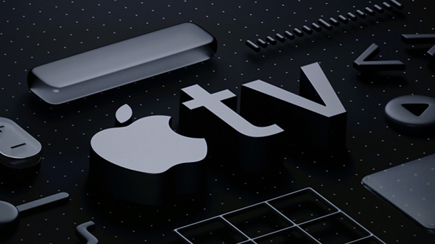
Developing For Apple TV
Notes:
Today I’m gonna talk about tvOS and how to implement it on scratch or in an iOS application which is already built and already working
We thought there would be only tv app on Apple TV but actually there are more than that. There are some other ideas like comic, weather, plane finder
There are not many apps so far on Apple TV so if you implement it you can be a featured partner with Apple
Also it is a way to make the commitment with user.
Why do we should implement Apple TV app:
First, Apple users always spend more than other platforms users.
It makes sense because usually Apple devices are more expensive
And people who adapt to buy it for entertainment are very potential to pay for our service...
Show how grows it is on number of Apple TV sold…
From 5m in 2012 to 25m in 2015 and 75m in 2017
More and more support, better device, better user experiences…
User feedback about experience while using tv app compare with phone app
Last but not least, It does not cost much to keep building and maintaining tvOS app. You wanna see how easy is it. I will show you right now.

Slide 5

Agenda
Introduce about Apple TV and tvOS
Building Apple TV App
Demo
Notes:
First, I will briefly introduce about Apple TV and tvOS
Then I will simutanously talk about how to build tvOS app on an existing iOS project with the demo to show you how easy to build it
And finally I will try to implement with you a small feature to enhance how easy it is to maintain the app

Slide 6
Apple TV & tvOS
Notes:
SO okay. let’s quick start with Apple TV and tvOS introduction

Slide 7
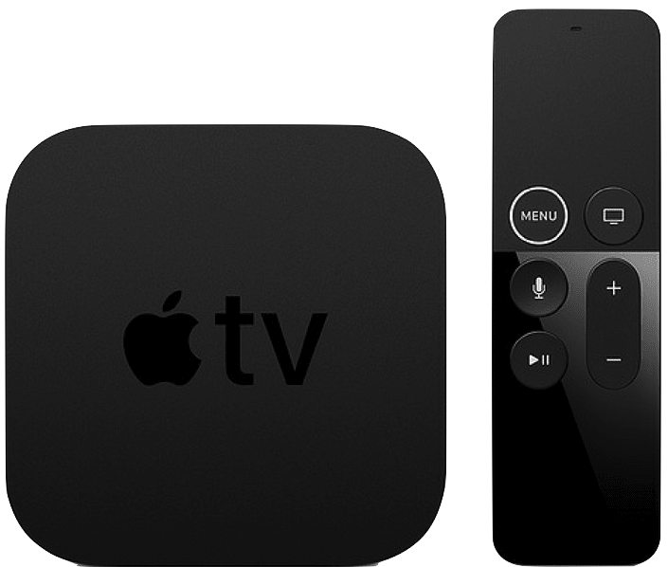
Apple TV
5th Gen (2017)
Notes:
On the screen is Apple TV 5th gen, which is also the latest Apple TV
The latest tvOS version is tvOS 12

Slide 8

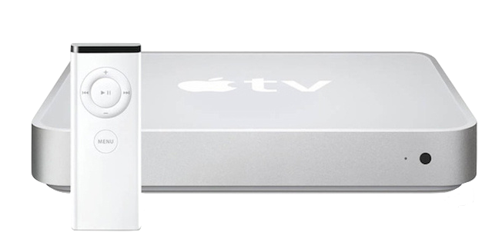
2007: iPhone 1st Gen
2006: iTV 1st Gen
Notes:
If you have not watched the historical iPhone introduction by Steve Jobs
Let’s find it on Youtube, it’s very impressive
That event was held in 2007
But do you know before it one year Apple also introduced another new device.
This is the Apple TV 1st Gen (or as they call it iTV)
That Apple TV is very similar with a mac mini
Which also runs on MacOS X 10.3.9, CPU: Intel Pentium

Slide 9
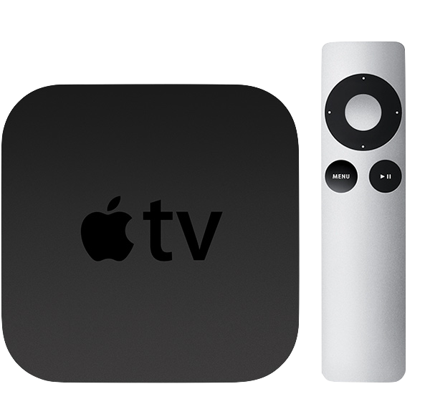
Apple TV 2nd Gen (2010)
Notes:
After the success of the first iPhone, Apple focused 100% on enhancing iPhone
And 4 years later, after they have a stable version of iPhone and iOS
In 2010 Apple redesign iTV and introduce the secondary generation.
From this version, Apple decided to use the name Apple TV instead of iTV as previously
This is also the first Apple TV not run on Mac OS
Actually when it was just launched it still run on iOS 8
Until end of 2010 Apple introduced tvOS 9 which is 95% bases on iOS 9
And since there Apple TV will only run on tvOS
Which split into 2 items
First is the TV box which has the processor, memory. It also has a HDMI hub to connect with TV, similarly with a Mac Mini
Another one is the controller and we will use it to control the app on the screen
You also can use your phone to control Apple TV by download app which name Remote on Apple Store

Slide 10
Apple TV sold
Notes:
Which is also around 18% of the whole market (beside Apple TV is Android TV, Xiaomi TV, Roku TV,…)
To make it easier to imagine, there are 1.2b iPhone + … meanwhile only have 75m Apple TV in end of 2017. (quite humble?)
(1.2b iPhone + 0.3b iPad + 0.5b iPod)
Look at the chart we can see the increasement is significant
And we can hope about the wider market will come in the soon future
In 2016 there are 8k apps for tvOS (2k is game)

Slide 11
tvOS app
Custom app
Using same frameworks with native iOS
Client-Server app
Using TVML, TVJS, TVMLKit
Notes:
The process for creating apps for Apple TV is similar to the process for creating iOS apps. You can create games, utility apps, media apps, and more using the same techniques and frameworks used by iOS. New and existing apps can target both iOS and the new Apple TV, allowing for unprecedented multiplayer options.
Apple TV makes it easier to create client-server apps, whose primary purpose is to stream media, using web technologies such as HTTPS, XMLHTTPRequest, DOM, and JavaScript. You use Apple’s custom markup language, TVML, to create interfaces, and you specify app behaviors using JavaScript. The TVMLKit framework provides the bridge between your native code and the JavaScript code in your user interface
TVML is a form of XML and stands for “Television Markup Language”.
TVJS is set of JavaScript APIs which provide you with the means to display apps created with TVML.
TVMLKit is the glue between TVML, JavaScript, and your native tvOS application.
Update:
- Can make it side by side to easier to compare
Pros and cons here for Traditional way and TVML way

Slide 12
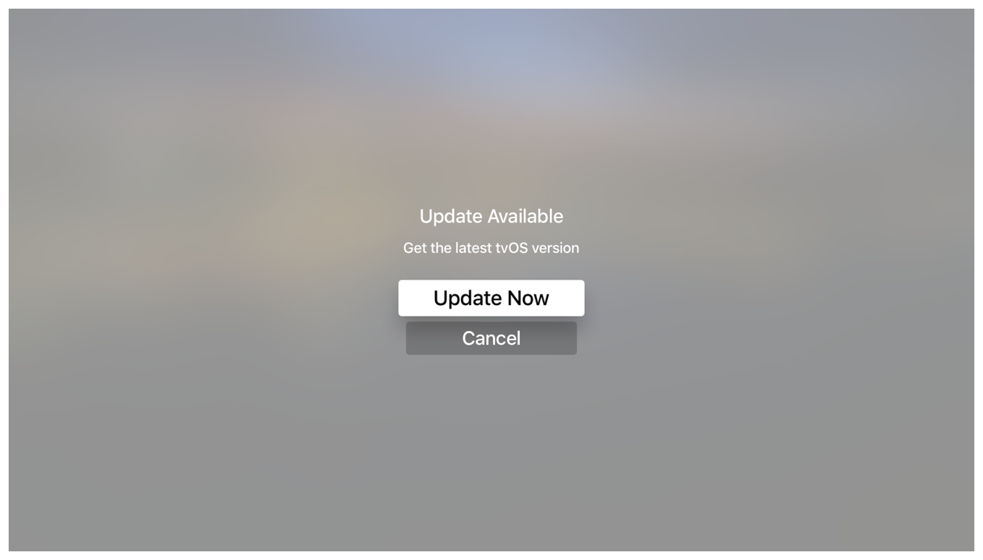
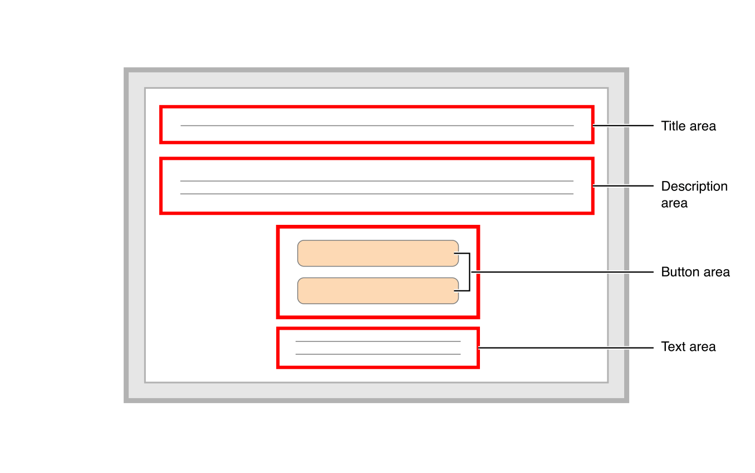
TVMLKit Template Example

Slide 13
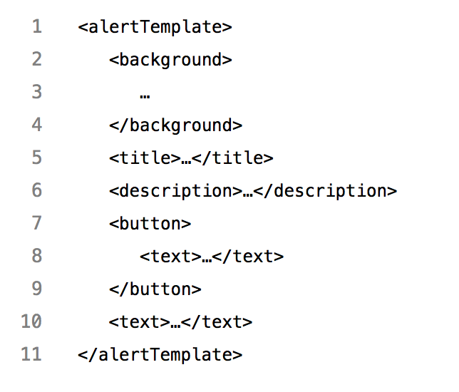
TVMLKit Template Example

Slide 14
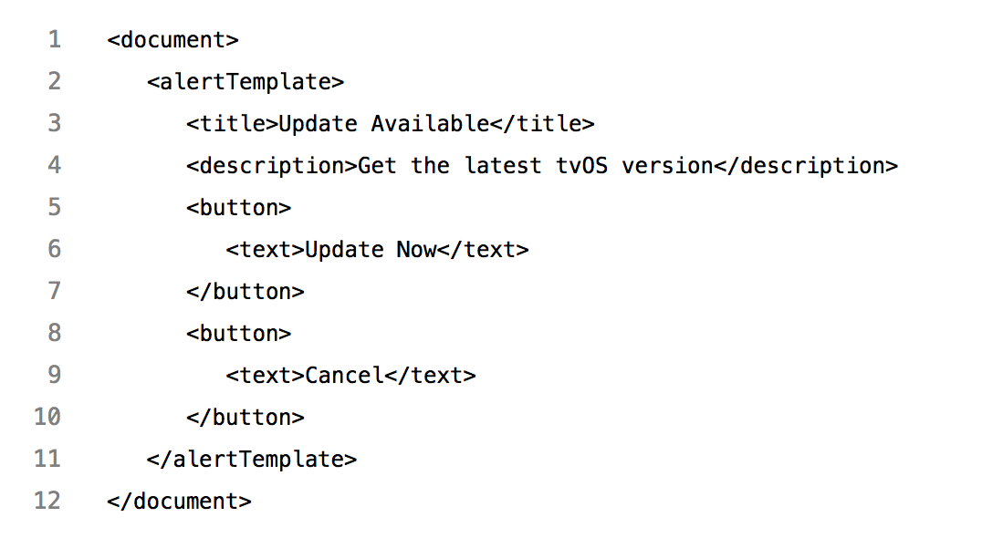
TVMLKit Template Example

Slide 15
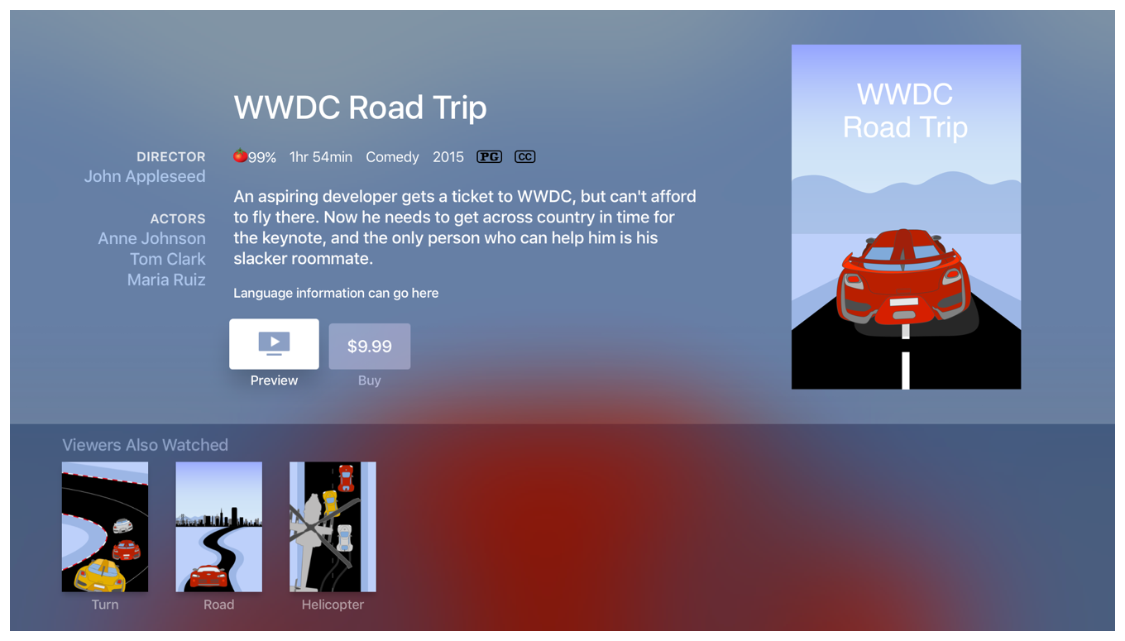
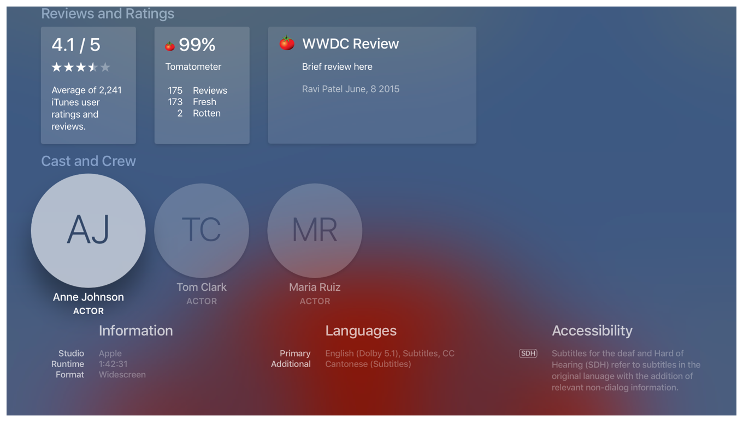
Complicated Template
Notes:
This is a long page.
I slip it into 2 images to make it easier to follow
On the left hand is the front, and the one on the right is the back

Slide 16
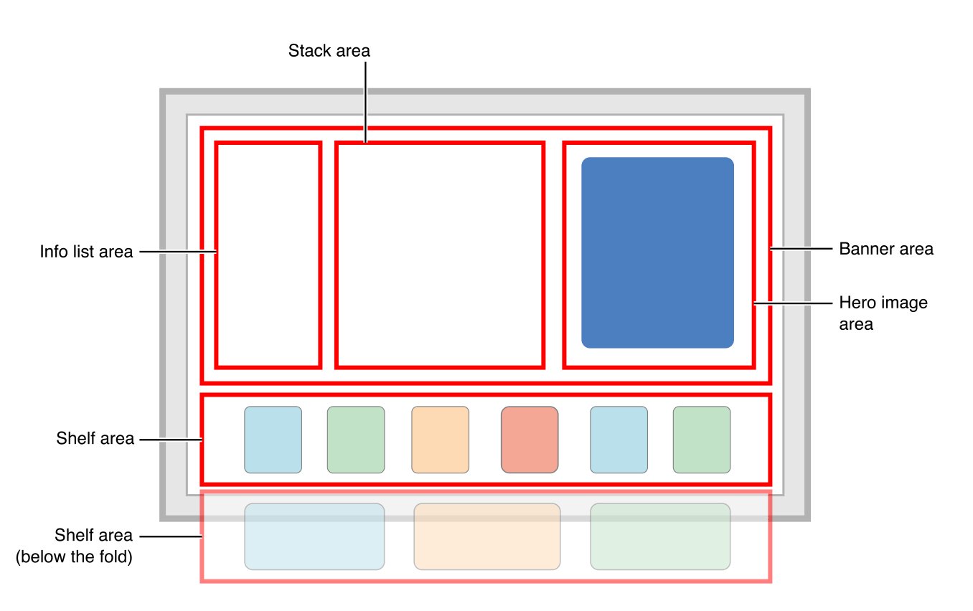

Slide 17
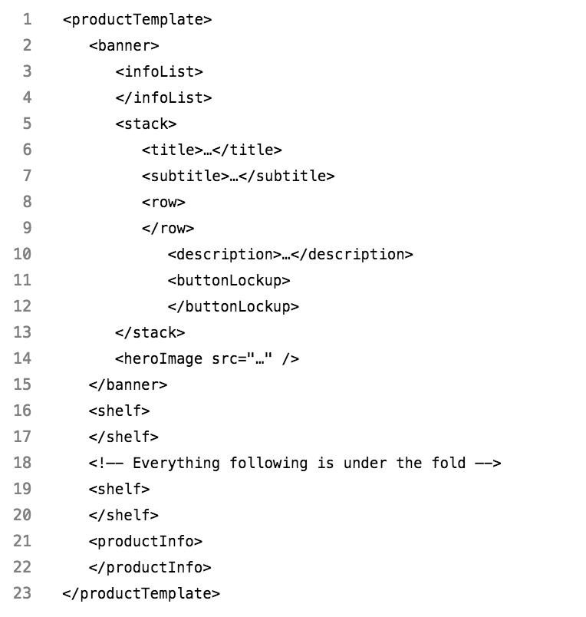
Complicated Template

Slide 18
COMPARISION
Custom App | TVML App
Cocoa framework | TVML, TVJS, TVMLKit
Similar to native iOS | Similar to React Native
Swift, Objective-C | Javascript
Hard to make, easy to maintain | Easy to make, hard to maintain
Suitable with customizing app | Suitable with simple template app
Notes:
In short:
Make a TVML App if you primarily provide menus of content, especially if you already have a server set up.
Make a Custom App if you’re aiming to provide a fully immersive experience in your app, where your users will be spending more time interacting with your interface than passively watching or listening to content.
Debug:
Custom App: Can use break point
TVML App: Don’t need recompile
So depends on your purpose you can find a good way to implement your tvOS app.
Put the line below to my suggestions
But if you already have an iOS app, I really recommend you to build up a custom app.
For every business we need to care able scability and beside that you need to rewrite lots of tests for both.
On Viki we also write both and we learn from the reality.

Slide 19
Developing Custom Apple TV App

Slide 20
Project structure
UI
View, User Action Handler
Business Logic
API Service, Deeplink Handler, etc
Third Party Libraries
Install from CocoaPods, Carthage or import Framework directly
Core Framework
Foundation, UIKit, CoreData, etc
Notes:
At the bottom is Core framework from Cocoa Touch framework, such as Foundation, UIKit, CoreData, CoreLocation, … which is very fundamental
Then we import some 3rd party libraries which is built on top of Core Framework for more specific purpose.
It can be from Cocoa Pod, Carthage, or adding framework directly
The good news is, RxSwift is available on both platforms
Beside that, A lot of other awesome framework, such as Alamofire or AFNetworking, SwiftyJSON, … support for tvOS as well
One upper level is business logic code. There will have model serialization, API calling, viewModel creation, services, …
UI Code for rendering and interaction with user. It receives user action and use business logic to make the change then reflect it to user.
So basically, look at the chart, our app is base on UI and Business Logic code.
But they are all bases on Core Framework which is 90% similar on iOS and tvOS. So most of the part in project is shareable
As well as the hardware on both platforms support a feature, this feature implementation will be shareable no doubt

Slide 21
Reusability
UI
Very little, unless it is very basic
Business Logic
Most of them, as well as the feature is adaptable on the device
Third Party Libraries
Most of them, except libraries from unsupported framework
Including RxSwift, Alamofire, SwiftyJSON, Crashlytics, etc
Core Framework
Most of them unless the device does not have the function
WebKit, BiometricKit on iOS <> TVUIKit, TVServices on tvOS
Notes:
Core Framework
But because of the difference on device, there are some framework only support for particular platform, like Local Authentication is only available on iOS
Or because of standard user behavior, there are some framework only available on one platform, such as TVUIKit on tvOS or Webkit on iOS
Third Party Libraries
The good news is, RxSwift is also available on tvOS
Beside that, a lot of other framework, such as Alamofire or AFNetworking, SwiftyJSON, … support for tvOS as well
Business Logic
Most of them, as well as the feature is adaptable on the device
UI
Most of the UI on iOS and tvOS are different
Different devices, one use touch on the screen, and one use the remote
Layout is different, size and color. iOS scroll vertical mostly meanwhile on Apple TV prefer to scroll horizontally
iOS need to care with orientation as well as multitasking on iPad (compact and regular) meanwhile on tvOS need to care about light and dark
But some base class is useful for both, for example you wanna make a custom UILabel with default content spacing
So basically, look at the chart, our app is base on UI and Business Logic code.
But they are all bases on Core Framework which is 90% similar on iOS and tvOS. So most of the part in project is shareable
As well as the hardware on both platforms support a feature, this feature implementation will be shareable no doubt

Slide 22
Demo

Slide 23
conclusion

Slide 24
Fastlane
Fastlane is not supporting tvOS officially
Using platform tvos to define lane
Notes:
@default = [:ios, :mac, :android]
https://github.com/fastlane/fastlane/blob/master/fastlane/lib/fastlane/supported_platforms.rb

Slide 25
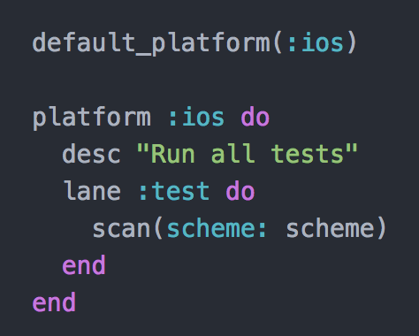

Slide 26
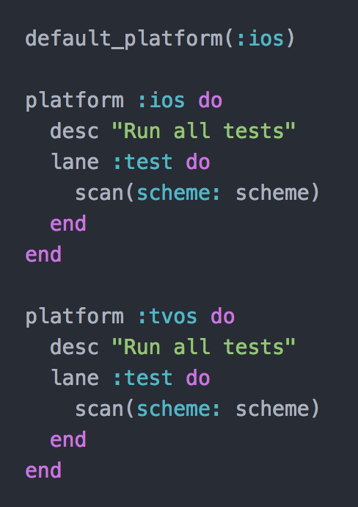

Slide 27
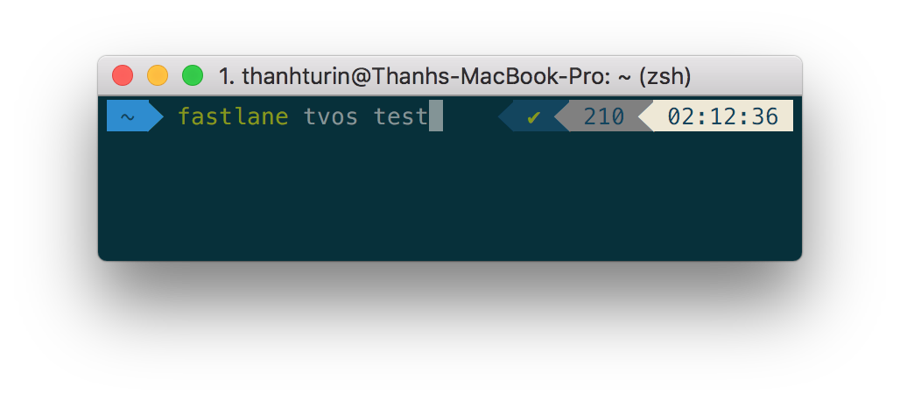


Run fastlane

Slide 28
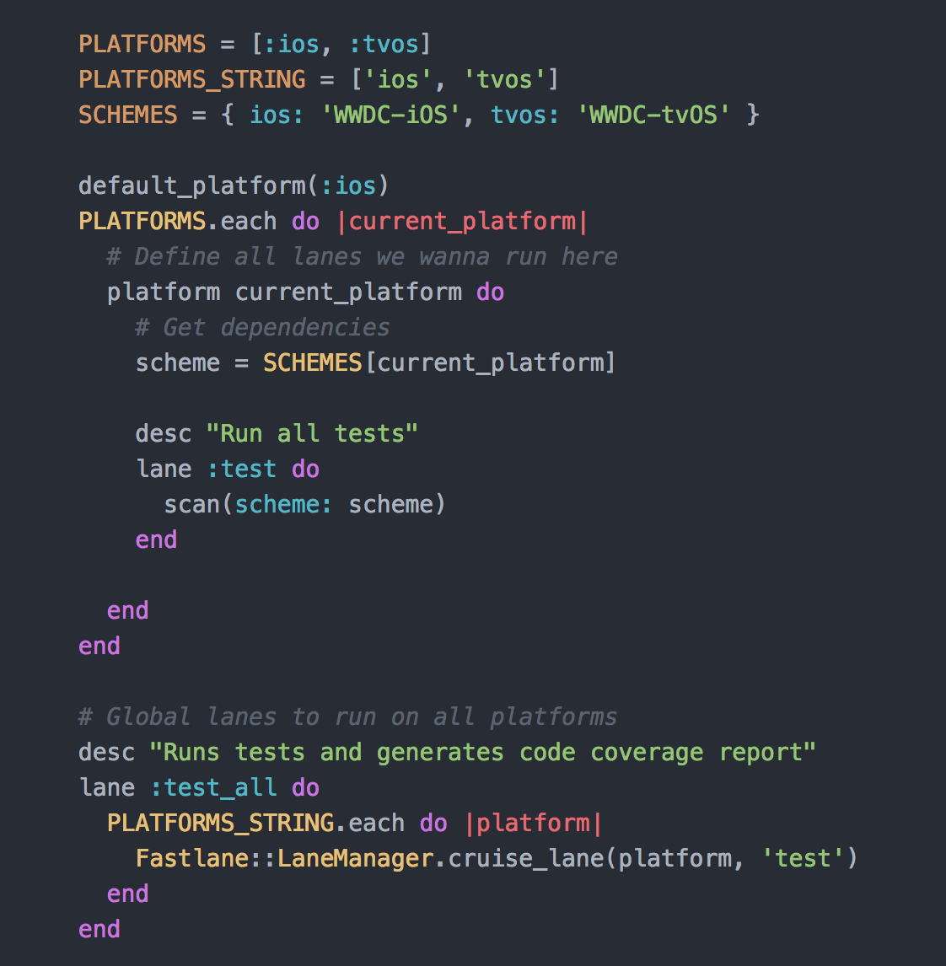

Slide 29
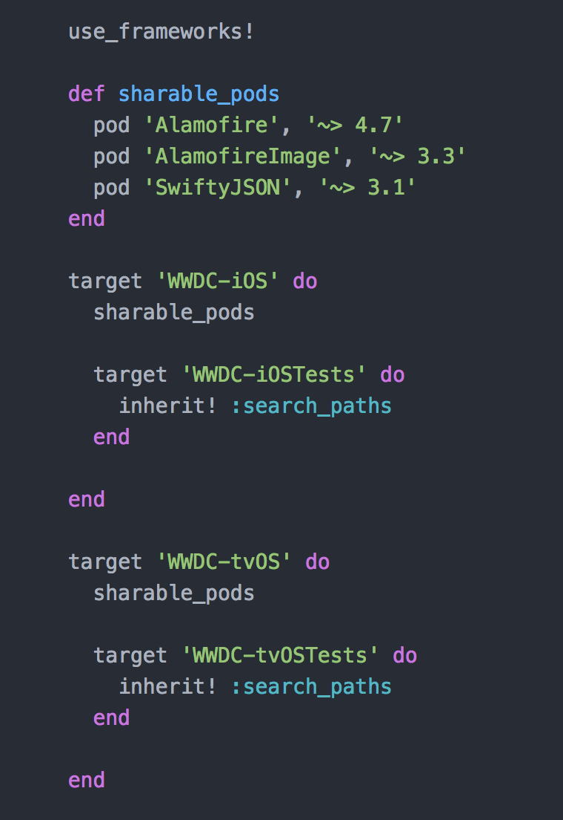
Cocoa pod

Slide 30
Q&A

Slide 31
Thanks for your attention

