Slide 1

Project name: Predicting Housing Prices
Group 14 Student names:
Tống Thành Vinh – 20194884
Phan Nguyên Anh – 20194727
Phạm Vũ Huy – 20194779
Phạm Đức Minh – 20194803
Supervisor Assoc. Prof. Phạm Văn Hải

Slide 2
Table of content
1. Introduction / Overview of System / Background
2. Related works
2.1 House Price Affecting Factors
2.2 Hedonic Pricing
3. The proposed model / Algorithm / Steps of the Algorithm / System
4. Experiments and results / Evaluation
4.1 Datasets
4.2 Testing methods
4.3 Experimental results
5. Conclusion

Slide 3
1. Introduction / Overview of System / Background

Slide 4

In this first section of this project, we will separate the dataset into 2 variables:
Features variable
'RM’
'LSTAT’
'PTRATIO'
Target variable
'MEDV'

Slide 5

In the second section of this project, we need to define a performance metric so that the AI knows how well it performs, regression analysis will be used here.

Slide 6
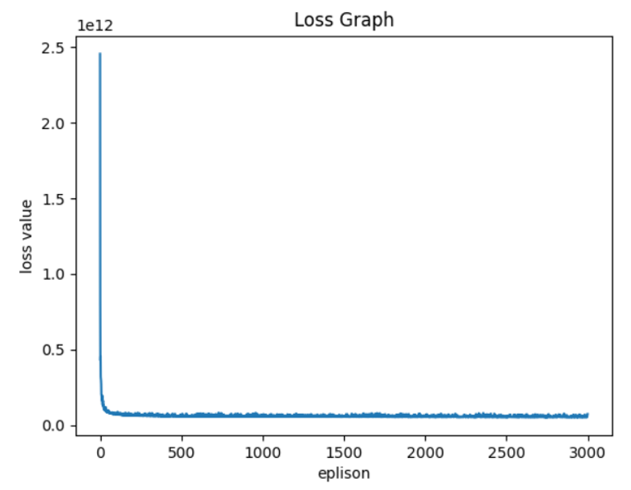
In the third section of this project, we'll take a look at several learning models' and testing performances on various subsets of training data.

Slide 7

In the final section of the project, we will construct a model and make a prediction.

Slide 8
2. Related Works

Slide 9
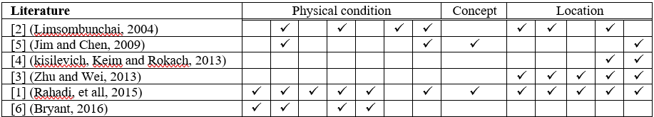
House Price Affecting Factors
There are several factors that affect house prices. In his research Rahadi, et al. [1] divide these factors into three main groups:
physical condition, concept and location. Physical conditions are properties possessed by a house that can be observed [2].
The concept is an idea offered by developers who can attract potential buyers.
Location is an important factor because the location determines the ease of access to public facilities [4], [5].
TABLE I. HOUSE PRICE AFFECTING FACTORS

Slide 10

Hedonic pricing is a price prediction model that assumes that the value of a property is the sum of all its attributes value [7]. In the implementation, hedonic pricing can be implemented using regression model.

Slide 11
3. The proposed model / Algorithm / Steps of the Algorithm / System

Slide 12
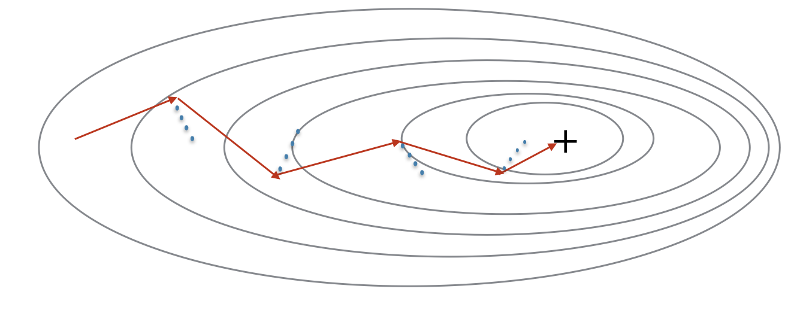
The proposed model called House Price Prediction mainly uses Batch Gradient Descent on Regression to predict price of house based on given data sets.

Slide 13
Step 1. Collect data sets from UCI website
The Boston housing data was collected in 1978 and each of the 506 entries represent aggregated data about 14 features for homes from various suburbs in Boston, Massachusetts
The features 'RM', 'LSTAT', 'PTRATIO', and 'MEDV' are essential. The remaining non-relevant features have been ex-cluded.
The feature 'MEDV' has been multiplicatively scaled to account for 35 years of market inflation.

Slide 14
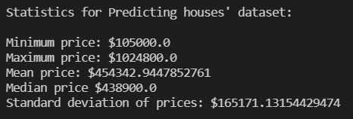
Step 2: Exploring the datasets

Slide 15
Step 3: Feature Observation
We are using three features from the Boston housing dataset: 'RM', 'LSTAT', and 'PTRATIO'. For each data point (neighborhood):
'RM' is the average number of rooms among homes in the neighborhood.
'LSTAT' is the percentage of homeowners in the neighbor-hood considered "lower class" (working poor).
'PTRATIO' is the ratio of students to teachers in primary and secondary schools in the neighborhood.

Slide 16
Step 4 & 5: Polynomial Features Transform & Normalize the Polynomial Features
Linear regression is linear in the model parameters and adding polynomial terms to the model can be an effective way of allowing the model to identify nonlinear patterns.
After that, the features become too large! Thus, we would want to reducing the amount of the data while retaining its essential qualities

Slide 17
Step 6: Implementation: Shuffle and Split Data
For the next implementation it is required to take the Boston housing dataset and split the data into training and testing subsets. Typically, the data is also shuffled into a random order when creating the training and testing subsets to remove any bias in the ordering of the dataset.
For a learning algorithm, splitting a dataset into some ratio of training and testing subsets is important for evaluating our model after it has been learned.

Slide 18
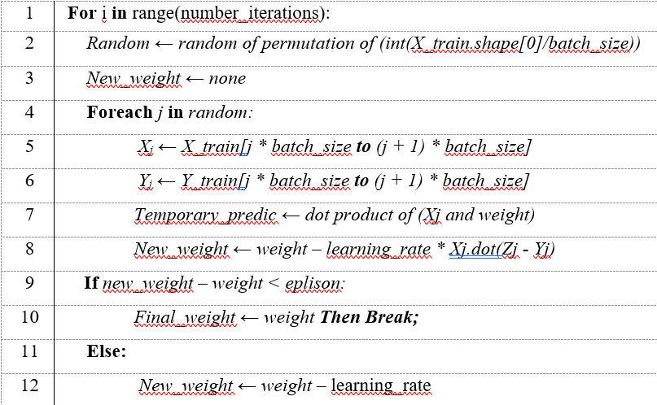
Step 7. Calculate weights from the datasets
ALGORITHM: Mini-Batch Gradient Descent
Goals: We want to discover the weights so that the forecast price data produced (from given data and weights) is as near to the true price data as feasible.
Input: Features produced from datasets (matrix X_train).
Output: Matrix final_weight

Slide 19
Step 8. Calculate predict price from given data and final weight
After getting the final_weight, we can extract the predict_price by calculating matrix production of processed_data and final_weight.

Slide 20
4. Experiments and results / Evaluation

Slide 21

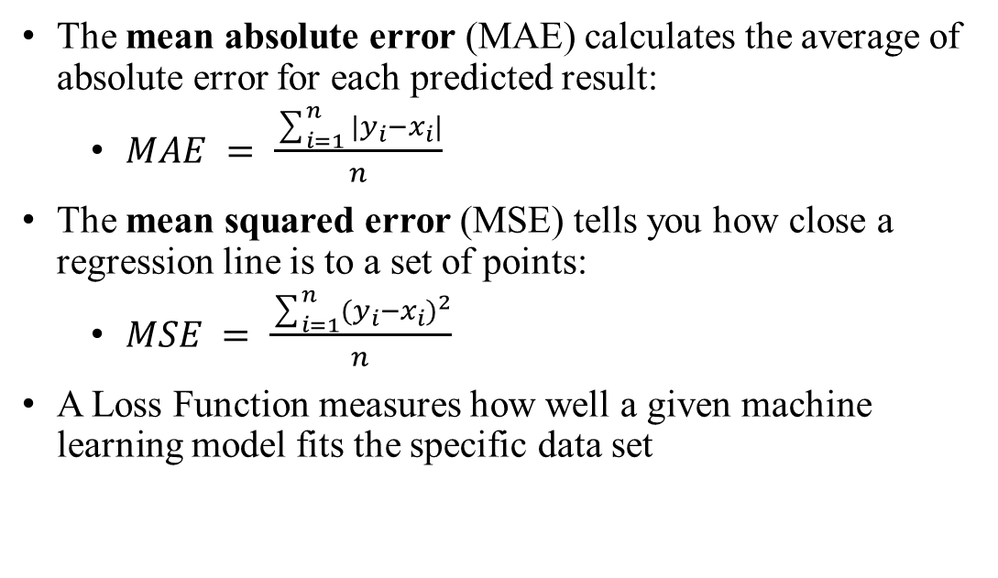
Testing method
The mean absolute error (MAE) calculates the average of absolute error for each predicted result:
$MAE = \frac{\sum_{i=1}^{n}{|y_{i}−x_{i}|}}{n}$
The mean squared error (MSE) tells you how close a regression line is to a set of points:
$MSE = \frac{\sum_{i=1}^{n}{(y_{i}−x_{i})^{2}}}{n}$
A Loss Function measures how well a given machine learning model fits the specific data set

Slide 22
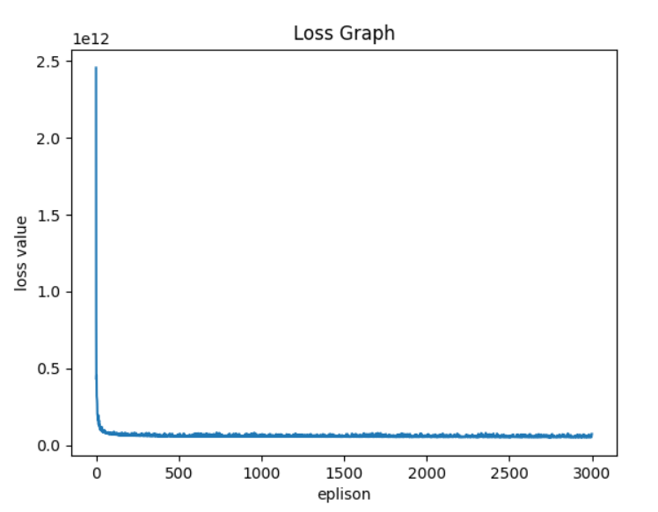
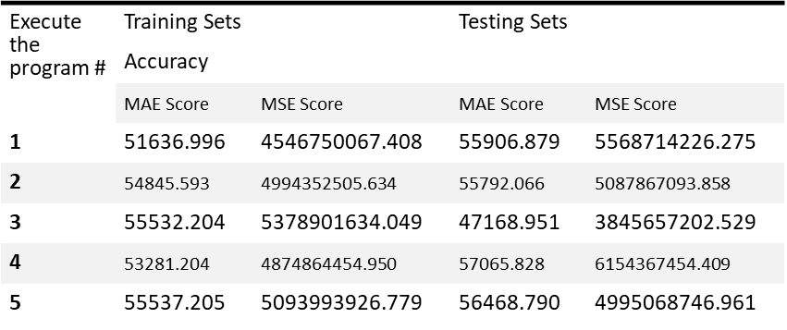
Experimental results
Loss function graph for the 5th time the program executed:
MAE and MSE table:

Slide 23
5.Conclusion

Slide 24

In this paper, several tests have been performed using Mini-Batch Gradient Descent for polynomial regression. Due to the properties of this algorithm, the program forecasts the price of the property very close to the actual price. As can be seen above from the experimental results, each time the program executes a different score is obtained. The mean absolute error (MAE) score ranges from 47000 to 56000 for each execution due to the different sets of data being used. The score between training sets and testing sets are close approximate after training 3000 times due to the loss value asymptotes to 0 meaning the program stopped learning after around 50-100 trials.

Slide 25

Thank you for listening! Do you have any questions?

