Slide 1
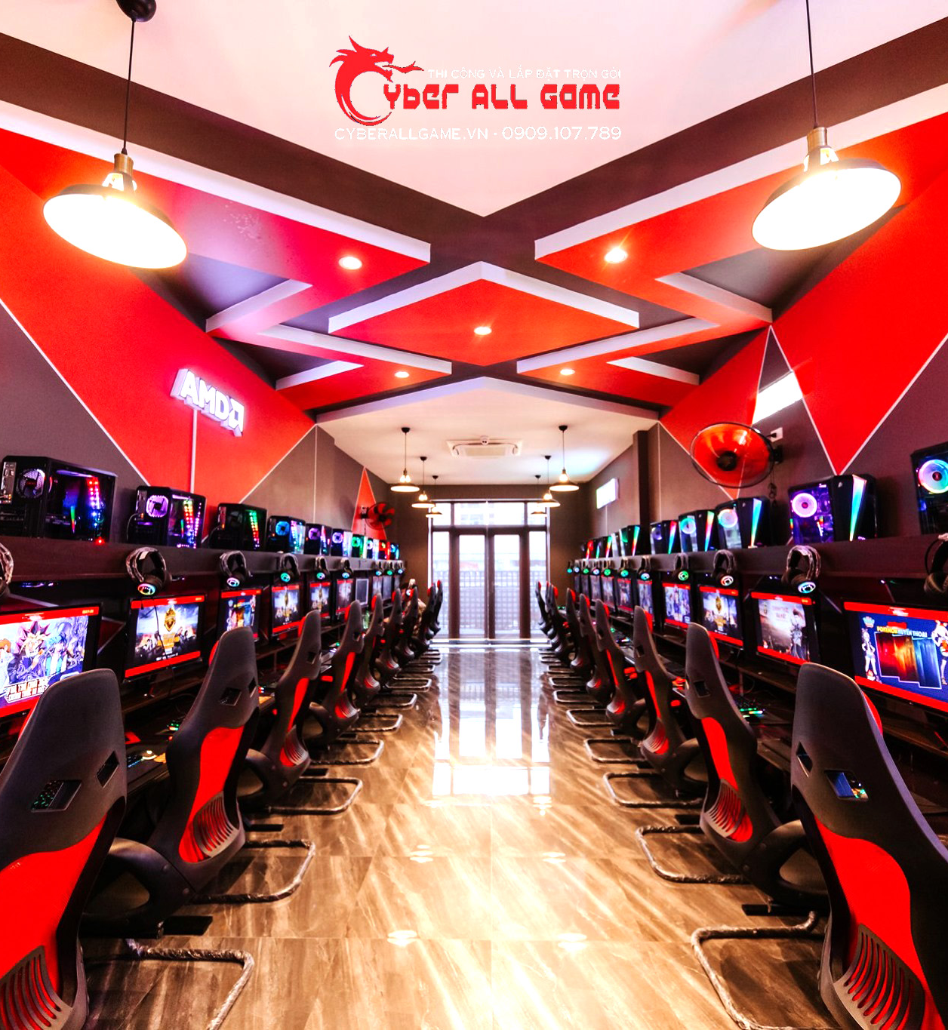
NET CAFÉ DATA MANAGEMENT
Phùng hải nguyên – 20194812
Tống thành vinh – 20194884
Phạm vũ huy - 20194779

Slide 2
Why do we need netcafe database
To manage a lot of informations while running this business (in reality, a netcafe cyber can serve up to hundred of users per day – means up to thousands of information
To optimize the system to earn more profits (main purpose) .

Slide 3
Some usecase
User:
Create account
Order service, use service
Add money to the account
Admin
Manage the computers, and other items in the store
Offer sales
Edit user profile, restore user’s password

Slide 4
Description about the system
When customers come to the store, they order a computer for a seat. The admin will check whether there are any computer left. If there aren’t any computer left or the type of the computer isn’t what the user want, the admin ask them to wait or leave and comeback next time
If order success, user’s money in the user’s account will start decreasing once start using, depend on the type of computers that the decreasing rate is fast or slow.
If user forget their password, user can ask admin to restore their password if user’s tell exactly the correct user_id, DOB and identity card serial.
When using, user can search for food and drinks to order, check the quantity, and order. They can choose either to pay by the money in their account or by cash immediately.
When user’s money run out, computer status change from occupy to free to use, at this moment, user and add money to continue using or leave.

Slide 5
Attribute in the system
User
Admin
Computer
Food & drink
User_id
Password
User_name
DOB
Money
Identity_card_ serial
Admin_id
Password
Wage
Name
DOB
Type
Status
User_id (currently using the computer)
Computer_id
Name
Price
Quantity

