Slide 1

NET CAFÉ DATA MANAGEMENT
Phùng hải nguyên – 20194812
Tống thành vinh – 20194884
Phạm vũ huy - 20194779

Slide 2
Why do we need netcafe database
To manage a lot of informations while running this business (in reality, a netcafe cyber can serve up to hundred of users per day – means up to thousands of information
To optimize the system to earn more profits (main purpose) .

Slide 3
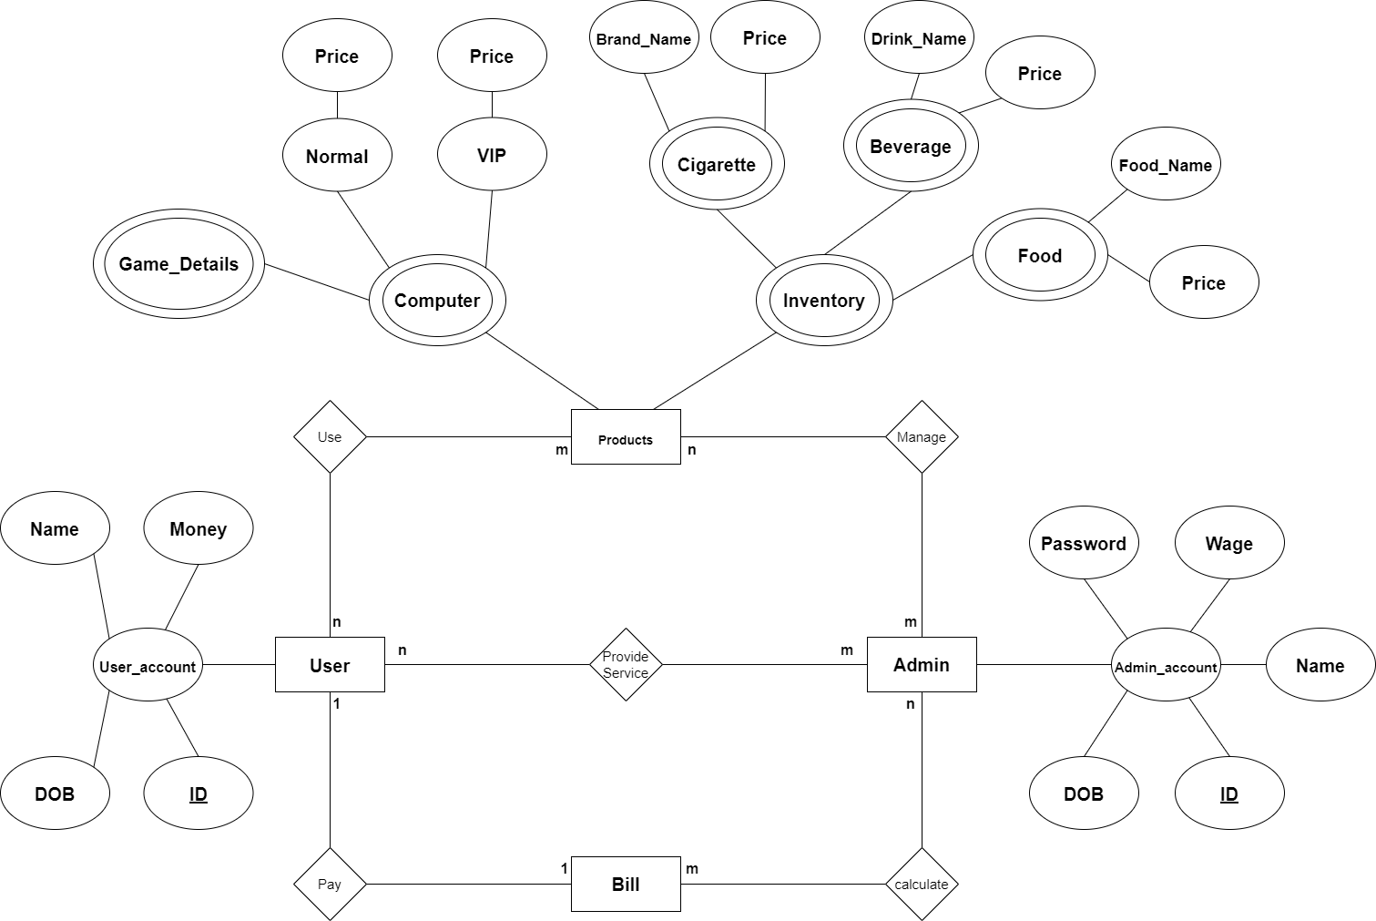

Slide 4
