Slide 1
Employee Attrition
Prediction Using HR Analytics
Predictive Analytics | Digital University Kerala | 2026
Anusree S · Thanha Noorudheen TT · Nihala Thajudeen
Instructor: Prof. Aswin V S

Slide 2






Agenda
01
04
Problem Statement & Motivation
Models & Key Results
02
05
Dataset Overview
Deployment (Streamlit App)
03
06
Methodology & Pipeline
Conclusions & Future Work

Slide 3
Problem Statement
Employee attrition leads to increased recruitment costs and loss of experienced talent. This project predicts whether an employee is likely to leave based on HR features like job satisfaction, overtime, salary, and tenure.

Slide 4

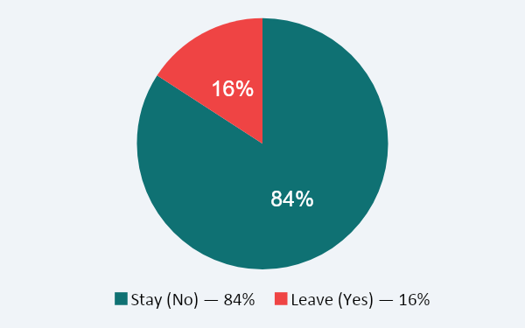



Dataset Overview
1,470
30
2
IBM
Records
Features
Classes
Source
Key Features
Target: Attrition
JobSatisfaction
Employee satisfaction score (1–4)
OverTime
Whether employee works overtime
MonthlyIncome
Monthly salary in USD
YearsAtCompany
Tenure at the organization
Department
HR, Sales, R&D divisions

Slide 5
Methodology & Pipeline
1
Data Collection
5
Model Building
IBM HR Dataset (1,470 records, 35+ features)
Logistic Regression • Decision Tree • XGBoost
2
Preprocessing
6
Evaluation
Missing values • Label encoding • Feature scaling
Accuracy • Confusion Matrix • Classification Report
3
EDA
7
Explainability
Count plots • Salary vs Attrition • Correlations
SHAP values for feature importance
4
Feature Selection
8
Deployment
Chi-Square Test + ANOVA (F-test)
Streamlit app with prediction + probability

Slide 6
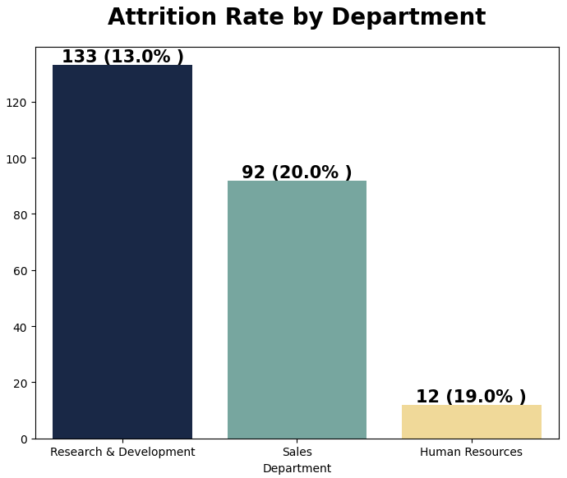
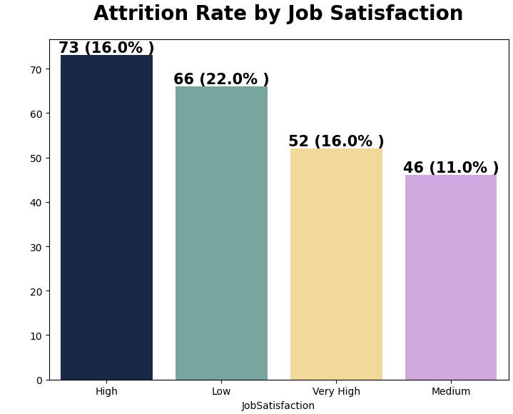

Exploratory Data Analysis
Highest Attrition is in the Sales Department
Employees who rated their job satisfaction low are mostly leaving the organization.

Slide 7
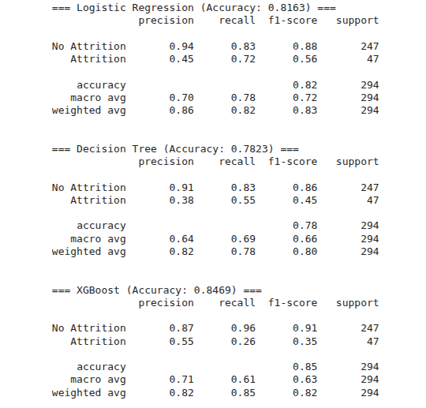
Model Comparison & Results
Best Model
XGBoost
84.7% Accuracy

Slide 8
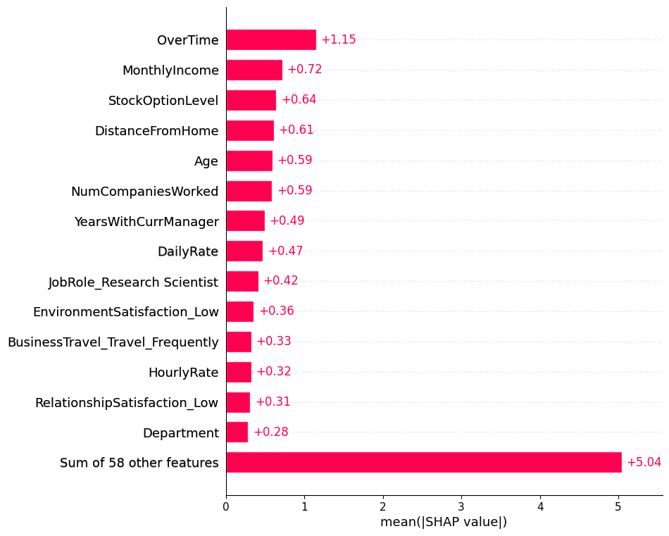
SHAP – Model Explainability
Key Findings
Overtime is the strongest predictor of attrition
Lower income employees are significantly more likely to leave
Low job satisfaction doubles the attrition risk
Newer employees (<2 years) show higher turnover

Slide 9
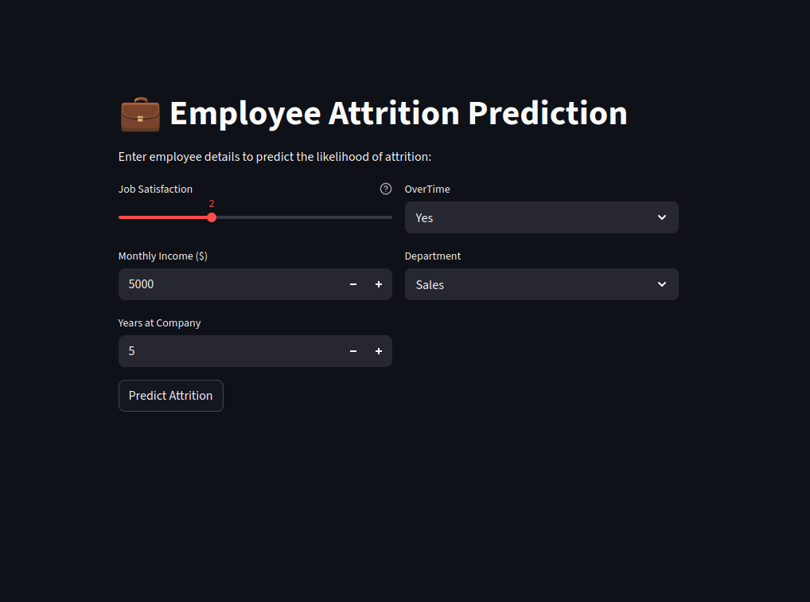
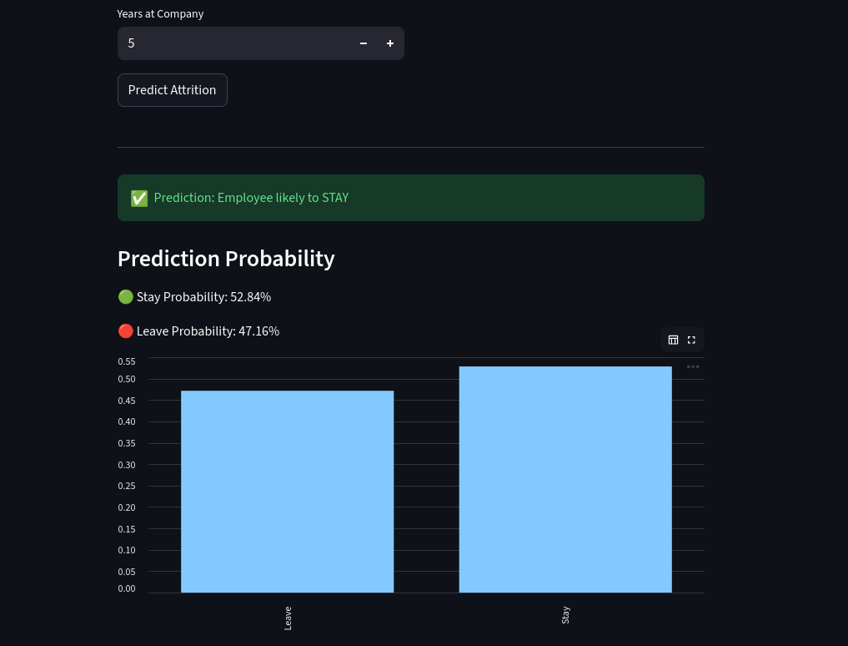
Streamlit Deployment
User Input
Form
XGBoost
Model
Prediction
+ Probability
Visual
Output
Department, Salary
Satisfaction, Overtime…
▶
Pre-trained model
loaded via pickle
▶
Stay / Leave +
confidence score
▶
Probability bar
& risk level

Slide 10

Conclusions & Limitations
Conclusions
Limitations
XGBoost achieved the best accuracy (84.7%)
Class imbalance — minority class underrepresented
Overtime and low salary are the top drivers of attrition
Dataset limited to IBM; may not generalize universally
SHAP provides actionable, interpretable insights for HR teams
Static model, does not adapt to real-time changes
Streamlit app enables real-time, user-friendly predictions
No temporal features (e.g., performance trends)

Slide 11
Future Work
SMOTE / Class Balancing
Personalized Intervention
Apply oversampling to handle class imbalance and improve recall on the minority class.
Generate employee-specific retention strategies based on SHAP explanations.
Deep Learning Models
Multi-company Dataset
Explore LSTM / Transformer-based models for time-series attrition prediction.
Validate the model on diverse datasets across industries for broader generalization.
Real-time Data Integration
Interactive Dashboard
Connect to live HR systems for dynamic, up-to-date predictions and monitoring.
Build a full BI dashboard with trend analysis, alerts, and department-level insights.

Slide 12
Thank You!
Anusree S · Thanha Noorudheen TT · Nihala Thajudeen
Predictive Analytics | Prof. Aswin V S | Digital University Kerala

