Slide 1
D7043E · GROUP 17
Edge-Ready ECG Classification
Finding abnormal heartbeats on a microcontroller
CRISP-DM, end to end — 44 patients, 100,622 beats, four AAMI classes, one 35 KB CNN synthesised for the MAX78002.
100,622
beats prepared
35,588
parameters (1.5 % of memory)
11 / 11
toolchain checks passed
Shravani Kuchi · Agata Marchi · Thanigaiarasu Shanmugam · Monika Shrivastava · Abhay Soni

Slide 2
Raw recordings to a model-ready dataset
MIT-BIH
Causal filter
Downsample
Normalise
Segment
48 records
2 leads, 360 Hz
›
0.5–40 Hz, 60 Hz notch
no future samples
›
360 → 180 Hz
halves data memory
›
per patient, robust
99.5th percentile
›
256-sample windows
1.42 s per beat
What came out — and why one class is hard
N 90,034 V 7,007 S 2,779 F 802 — the two rare classes are 3.6 % of the data
Split by patient, never by beat.
22 patients to train on, 22 held back for test — no one appears on both sides. A random beat split puts the same patient on both, and accuracy jumps to ~99 % for the wrong reason.
100,622
0
beats prepared
unexplained
Notes:
My part of Submission 1 was turning raw recordings into a dataset. Five stages. The filter is causal - it only looks backwards, because a device reading a live signal cannot see the future. The bar shows what came out: normal beats are ninety percent, and the two classes we care about are three and a half percent between them. And we split by patient, not by beat - nobody appears in both training and test.

Slide 3
Logistic Regression - Baseline
ECG Input
DS1 Split
Training
Model selection
One lead at 180 Hz
256 samples per beat
40,223 training beats
10,743 validation beats
Training-set scaling
20:1 class weight cap
C = 0.01, 0.1, 1 and 10
Validation macro-F1 for N/S/V
C = 10 Selected setting 0.4781 validation macro-F1 for N/S/V 82.19 % Validation accuracy
Notes:
We chose logistic regression as a simple comparison for the CNN. It predicts N, S, V or F from the same 256-sample ECG window. We fitted the scalar and calculated the inverse-frequency class weights on DS1 training data. We capped the largest weight at 20 times the smallest.
A smaller C puts a stronger penalty on large weights. We tested four values and selected C = 10 using validation macro-F1 for N, S and V. The validation set had only 21 F beats. We kept F in the four-class test results.

Slide 4
Noise Lowered Baseline accuracy on DS2
Metric | Clean DS2 | 0 dB SNR
Accuracy | 74.28% | 64.50%
Macro-F1 (N/S/V) | 0.4433 | 0.3921
Macro-F1 (all four classes) | 0.3429 | 0.3031
Same model, same beats
49,656 test beats
22 DS2 records
9.78
Percentage point drop in accuracy at 0 dB
Electrode-motion Noise was added to the raw ECG before pre-processing
Notes:
The saved logistic regression model was evaluated on 49,656 beats from 22 DS2 records. Then we added electrode-motion noise to the raw recordings at 0 dB signal-to-noise ratio and evaluated the same fitted model on the same beats. Accuracy fell from 74.28 to 64.50 percent, a drop of 9.78 percentage points. Macro-F1 also fell.

Slide 5
A CNN shaped by the chip, not by taste
Input
Conv 16
Pool 2
Conv 32
Pool 2
Conv 64
Pool 2
Conv 64
Pool 4
FC 512→4
1 × 256
›
16 × 256
›
32 × 128
›
64 × 64
›
64 × 32
›
4 classes
96 params
2,592 params
10,304 params
20,544 params
2,052 params
bar width = how much of the 1.42 s window is left after pooling
Stride fixed at 1
Pooling before convolution
ReLU only, no batch-norm
Classifier input ≤ 1024
so pooling does every downsample
the order the toolchain requires
nothing else is supported
the limit that decided our model
35,588 parameters 35 KiB of the 2,340 KiB weight budget 1.5 % used
Notes:
This is the network. Four convolution blocks and one small classifier. Every choice is forced by the chip, not chosen for accuracy. Stride is locked at one, so pooling does all the shrinking - you can see the window getting shorter in the bars underneath. ReLU only, no batch-norm. And the classifier input is capped at one thousand twenty-four. Remember that number. Thirty-five thousand parameters - one and a half percent of the chip's memory.

Slide 6
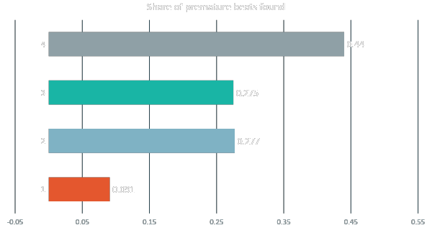
One heartbeat cannot show a premature beat
Why
An early beat is early. Timing lives between beats — one beat alone cannot carry it.
The catch
The longest bar false-alarms on 539 normal beats a run. We did not pick it.
Notes:
Same network, four different inputs, five seeds each. Give it a single heartbeat and it finds nine percent of premature beats - and it stops improving after ten epochs, so it is not undertrained. Give it a longer slice and it triples. That is the finding. The longest bar - the top one - we did not pick: it false-alarms on five hundred normal beats a run.

Slide 7
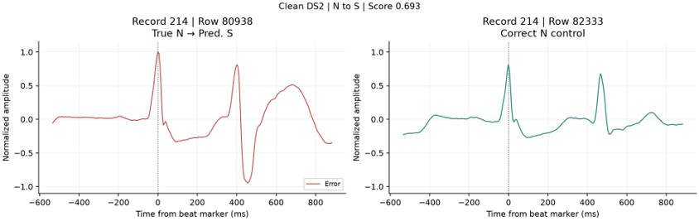
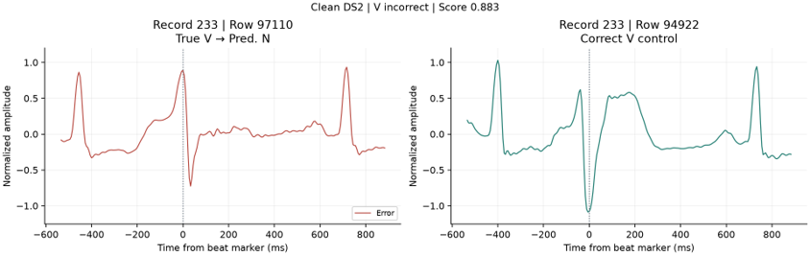
What the Baseline got wrong
N classified as S
Record 214, row 80938
The following beat has a deeper dip than in the correctly classified N example
V classified as N
Record 233, row 97110
The correctly classified V beat has a deeper dip near the beat marker
Each plot shows the error on the left and correctly classified beat of same class on the right
Notes:
The two plots show clean DS2 errors. Each plot puts the misclassified beat on the left and a correctly classified beat from the same class and record on the right. In the top plot, the next peak in record 214, row 80938, is followed by a deeper dip. The baseline sees the whole window, so the following beat may have influenced its prediction. In the bottom plot, the correctly classified V comparison dips lower near the beat marker than the missed V beat in record 233, row 97110.

Slide 8
Test results on new patients (DS2)
Overall result
Recall per class
0.47
0.16
macro-F1 (baseline: 0.34)
S recall (target: 0.60)
Accuracy is 0.87. The FP32 and INT8 models give almost the same results.
N 0.90, V 0.88, F 0.10. N and V beats are found well, S and F are not.
Record 232 has 75 % of all S beats in DS2. The model finds only 2.9 % of them. Without this patient, S recall is 0.54.

Slide 9
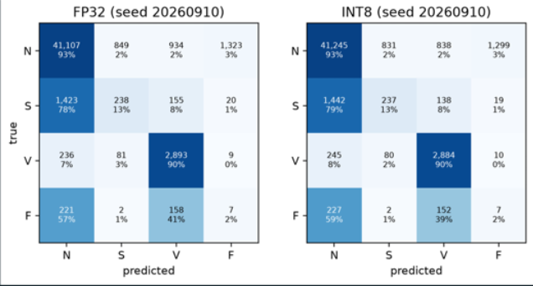
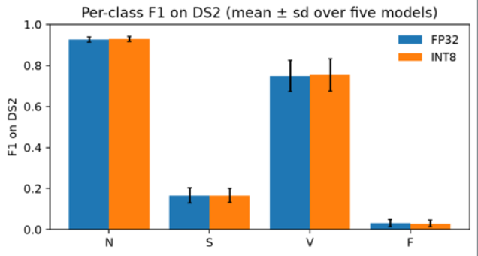
Where the model makes mistakes
Model S beats are predicted as N, and F beats are split between N and V. FP32 and INT8 make the same mistakes.

Slide 10
Did we reach our goals?
Achieved
Partially achieved
Noise: keeps 99 % at 12 dB and 97 % at 6 dB
Macro-F1: 0.47 is better than the baseline (0.34), but below our target of 0.55
Quantization: the INT8 model is as good as FP32
Recall: V reaches 0.88 (target 0.80), but S is only 0.16 (target 0.60)
Size: 35,588 parameters, only 35 KB
MAX78002: all 11 checks passed (software only)
4 achieved, 2 partially achieved. The main reason is that very few patients have S beats, not the size of the model.

Slide 11
From a trained model to C code for the chip
Re-express
Train (QAT)
Quantize
Simulate
Synthesize
ai8x layer classes
same 35,588 params
›
8-bit from epoch 60
best epoch 83
›
int8 weights, biases
quantize.py
›
8-bit arithmetic
validation data only
›
C project generated
ai8xize.py
Why the model fits the accelerator
Supported ops only
6 of 128 layers
Final pool is its own layer
Input 1 × 256, 8-bit
conv, max pool, ReLU, one FC layer
pooling is fused into the convolutions
the chip cannot pool and flatten at once
output: 4 logits, the largest is the class
35,588 parameters 6 / 128 hardware layers 1.5 % of weight memory

Slide 12
The toolchain accepts it, and all 11 checks pass
Verification checks
Resources on the chip
11 / 11
1.5 %
independent checks passed
of weight memory — 35,408 of 2,396,160 bytes
Weights are int8, and the synthesiser’s simulation matches PyTorch’s 8-bit logits bit for bit on 40 beats.
Biases 2.2 %, activations about 8 KiB of 1,280 KiB, 1,660,928 MACs per beat.
Quantised model on validation: accuracy 0.944, macro-F1 (N/S/V) 0.681. S recall 0.24, F recall 0.00. The rare classes are still the weak spot.

Slide 13
Verified in software, not measured on a board
Verified in software
Needs a MAX78002 board
Toolchain accepts, quantises and synthesises
Memory use and 1.66 M MACs per beat
8-bit accuracy in simulation
Simulation bit-exact with PyTorch
Inference latency
Power and energy per inference
Accuracy on the real chip
Real-time streaming behaviour
No board, no hardware claim. Nothing here was measured on a MAX78002. Next: run the built-in known-answer test, compare logits beat by beat, then time and power.

Slide 14
The best model was not the best edge model
Highest score
What we selected
1024 / 1024
512 / 1024
classifier inputs used — no headroom
same score, half the width
Quantisation and synthesis still ahead, with no room to give.
Difference smaller than seed noise (p = 0.46). The metric could not choose — the hardware limit did.
We also miss our own target: 0.60 promised, 0.16 measured. Only four patients in our training data have premature beats. Reported, not revised.
Notes:
Was the best-scoring model the best edge model? For us, no. The top scorer used all one thousand twenty-four classifier inputs - exactly the chip limit, no margin, with quantisation still ahead. The one we picked scores the same at half that width; the difference is smaller than seed noise. The metric could not choose - the hardware limit did. And to be straight: we promised zero point six on premature beats, we get zero point two seven. Only four patients in our training data have them. We report that rather than move the target.
Looking at accuracy alone would have selected the model which performed best but sat exactly at the MAX78002’s fully-connected input limit and used twice the convolutional operations. Therefore we selected a model that matched the best model’s performance while using half the classifier width. Because quantisation and synthesis still had to be carried out, a model with no headroom was a poor choice. So we chose the model based on the hardware constraint which fixed in advance.

Slide 15
Testing the model’s robustness to noise
Three types of noise
Three levels of noise
BASELINE WANDER
Low-frequency baseline shifts caused primarily by respiration or slow body movements.
12 dB
ELECTRODE MOTION
Disturbances caused by the shifting or pulling of electrodes against the skin.
6dB
MUSCLE ARTIFACT
Higher-frequency electrical activity generated by skeletal muscle contractions.
0dB
MIT-BIH Noise Stress Test Database
Notes:
Noise was taken from the MIT-BIH Noise Stress Test Database (NSTDB), which provides three 30-minute recordings of real ECG noise:
baseline wander (BW) = Low-frequency baseline shifts caused primarily by respiration or slow body movements.
electrode motion artifact (EM) = Disturbances caused by the shifting or pulling of electrodes against the skin.
muscle artifact (MA) = Higher-frequency electrical activity generated by skeletal muscle contractions.
Each noise type was added to the raw records at three signal-to-noise ratios: 12, 6 and 0 dB. The noisy signal were then passed through exactly the same preprocessing as the clean data.

Slide 16
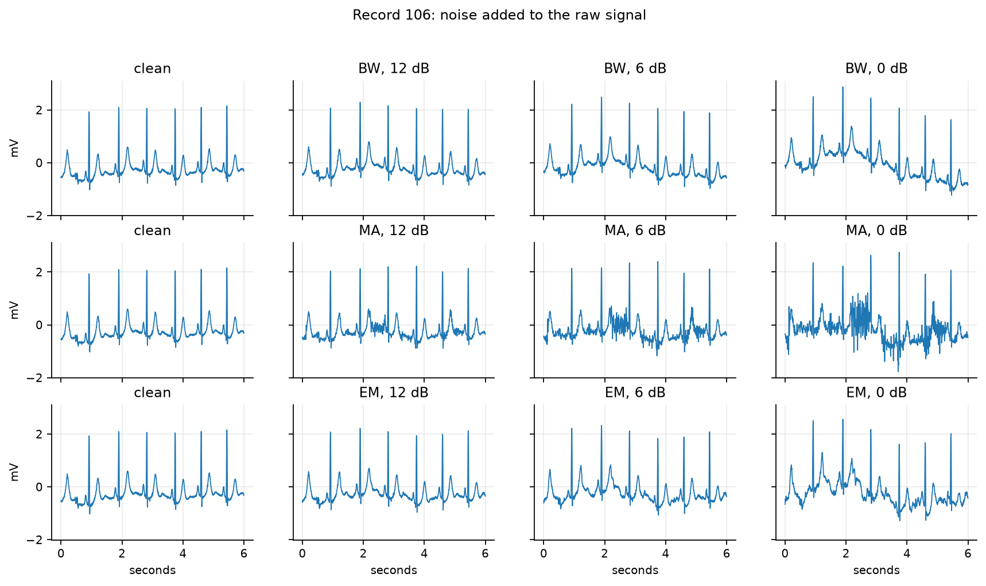
Levels of noise
Type of noise
Notes:
Here we can see an example of 6 seconds from Record 106 with each noise type added at 12, 6 and 0 dB → We can observe how different types of noise change the ECG shape differently, especially the second row showing the noise coming from the muscle artifacts class.

Slide 17
GROUP 17 · D7043E · EDGE-READY ECG CLASSIFICATION
Thank you
Code, results and the generated MAX78002 C files:
github.com/ThaniJames/Group17_ECG_Project
Shravani Kuchi · Agata Marchi · Thanigaiarasu Shanmugam · Monika Shrivastava · Abhay Soni

