Slide 1
R7020E · OBJECT DETECTION AND LOCALIZATION · GROUP 7
Fire extinguisher detection,
decoy rejection and 3D localization
RGB-D camera · YOLO detector · depth-based real/decoy filter · 3D position in metres
TASK 1 · DETECTION
TASK 2 · REAL VS DECOY
TASK 3 · 3D + EVALUATION
Kelechi Athanesious Ezekwe
Shravani Kuchi
Thanigaiarasu Shanmugam
YOLO11n detector, trained on Roboflow photos
Depth-based filter that rejects printed decoys
3D centre, tracking, evaluation pipeline
October 2026

Slide 2
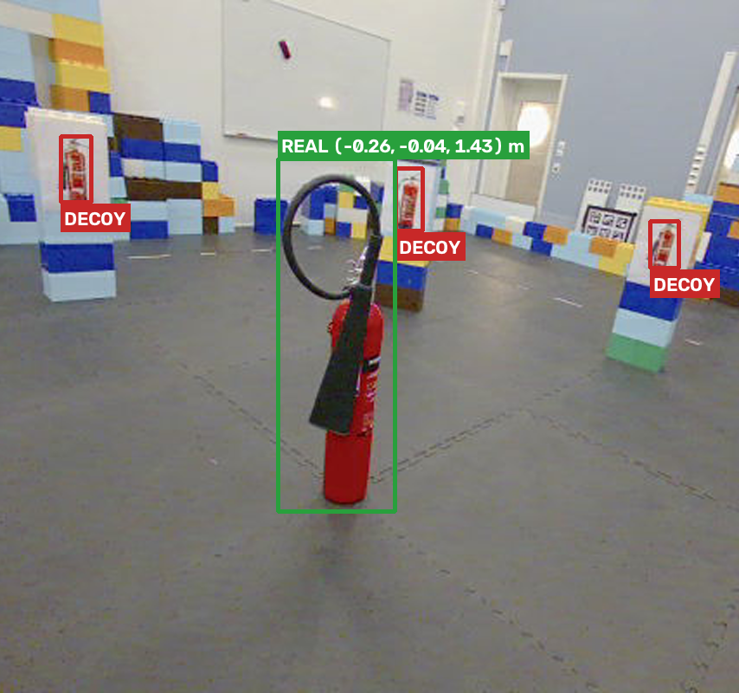
MOTIVATION
Real or printed? A robot must know the difference
Real-world problem: robots must tell real fire extinguishers from printed decoys.
Core challenge: in a colour image a printed extinguisher looks just like a real one.
Our idea: use depth (RGB-D) — a print is flat on a wall or block, a real one stands free in 3D.
Why it matters
Safety compliance inspection
Emergency response
Indoor robot navigation
Same scene: one real extinguisher, several printed decoys

Slide 3
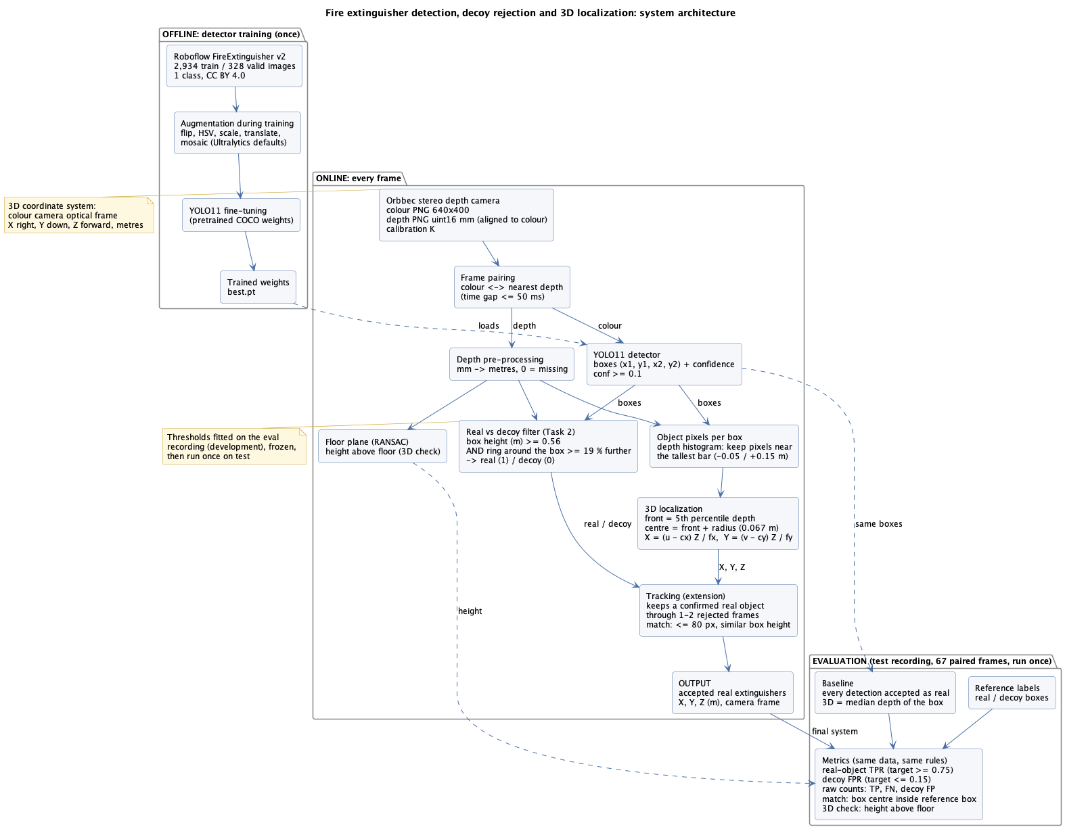
SYSTEM ARCHITECTURE
One pipeline, three stages
1 Detection
Kelechi
YOLO11n finds every candidate box (conf ≥ 0.10)
2 Real vs decoy
Shravani
box height ≥ 0.56 m AND background ≥ 19 % further
3 3D + tracking
Thanigaiarasu
X, Y, Z of the object centre in metres
whole pipeline ≈ 66 FPS

Slide 4
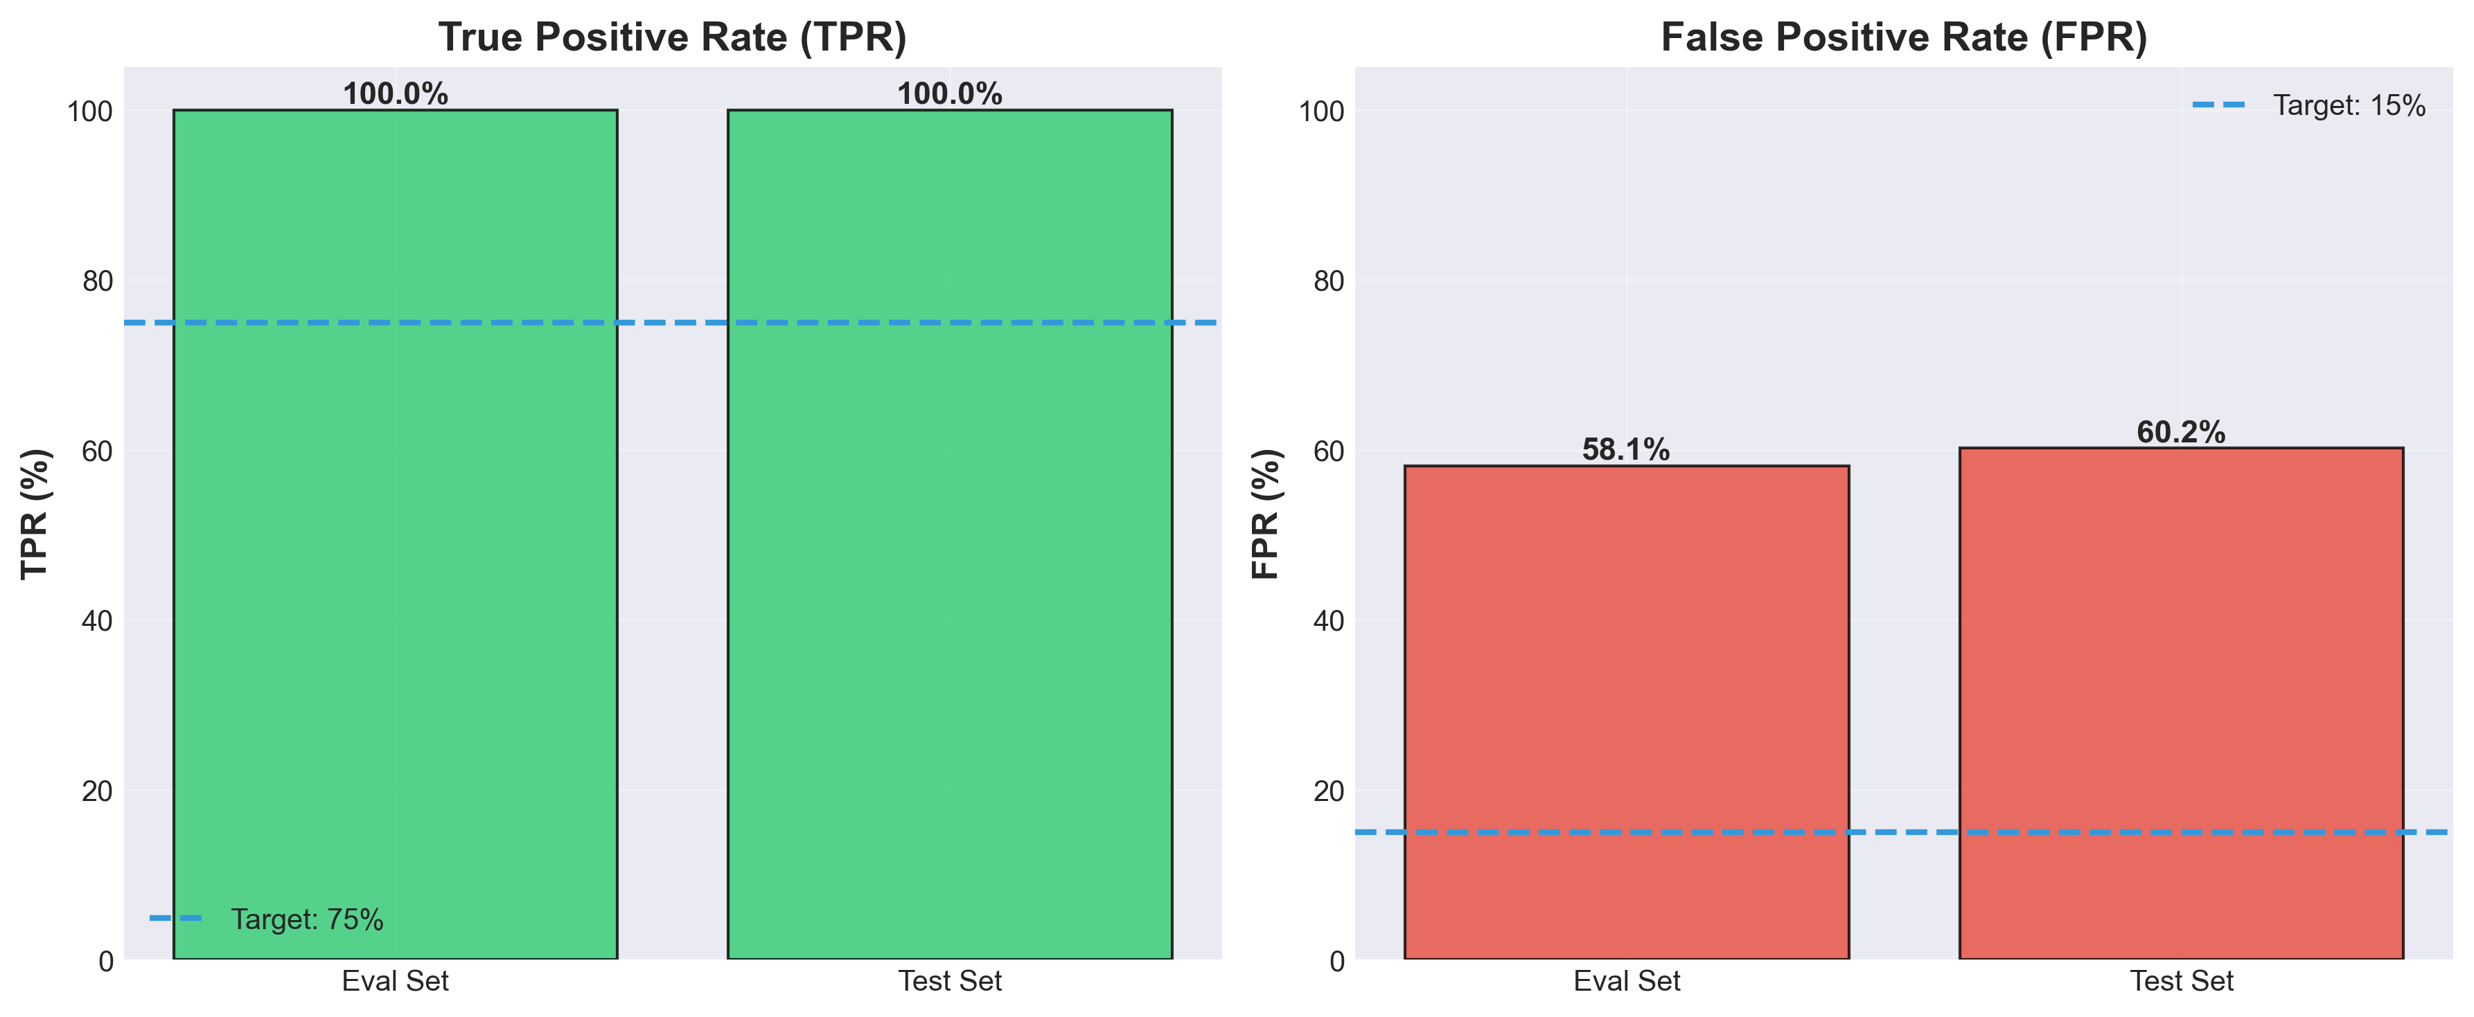
TASK 1 · DETECTION · 1 / 3
Kelechi Athanesious Ezekwe
YOLO11n detector, trained on Roboflow photos only
1 Roboflow photos
2 Fine-tune YOLO11n
3 Default augmentation
4 Low threshold
2,934 train / 328 val
1 class, web photos
pretrained on COCO
100 epochs, patience 20
flip, HSV, scale,
translate, mosaic
keep boxes with
confidence ≥ 0.10
0.93
mAP50 on Roboflow validation
1.00
TPR: every real found (eval and test)
0.58 / 0.60
decoys also detected (eval / test)
14.6 ms
per frame for detection

Slide 5
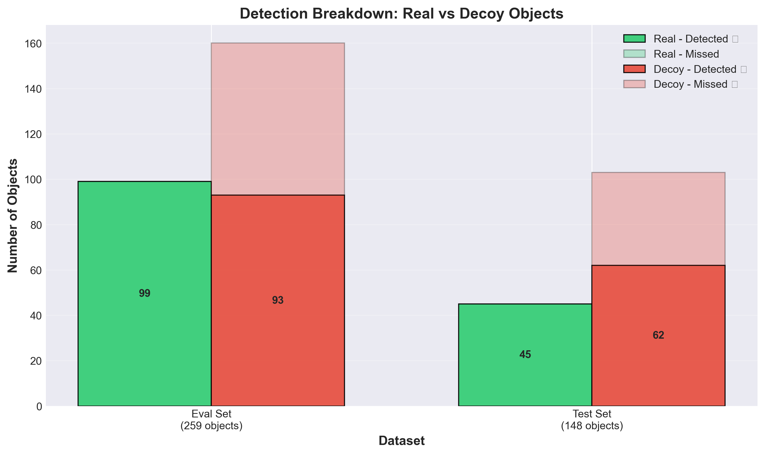
TASK 1 · DETECTION · 2 / 3
Kelechi Athanesious Ezekwe
Detector alone: every real found, but most decoys too
eval
test
Real detected
99 / 99
45 / 45
Decoys detected
93 / 160
62 / 103
Decoy rate
0.58
0.60
Printed decoys look real in colour
→ Stage 2 must remove them
This detector-only result is the baseline

Slide 6
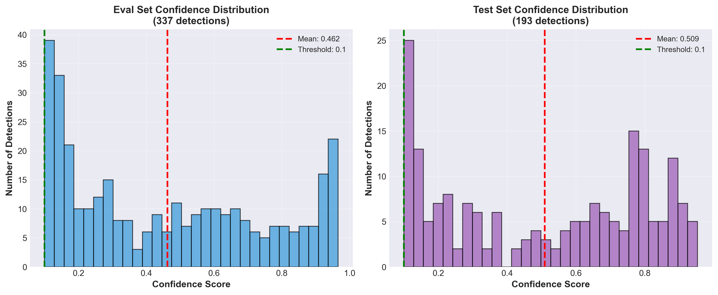
TASK 1 · DETECTION · 3 / 3
Kelechi Athanesious Ezekwe
Low threshold (0.10) on purpose
All detector boxes at conf ≥ 0.10 (real, decoy, background)
A real missed here is lost for good
Decoys are removed later by Stage 2

Slide 7
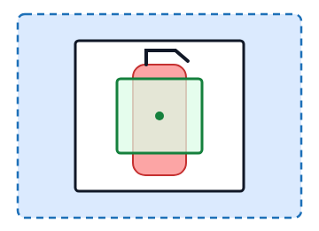
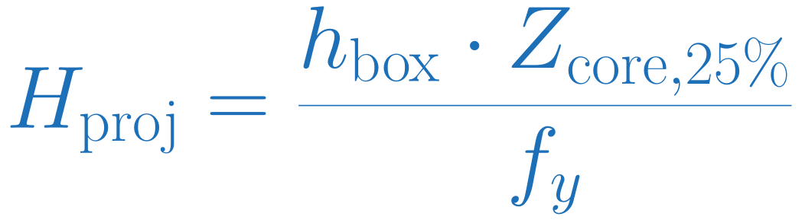
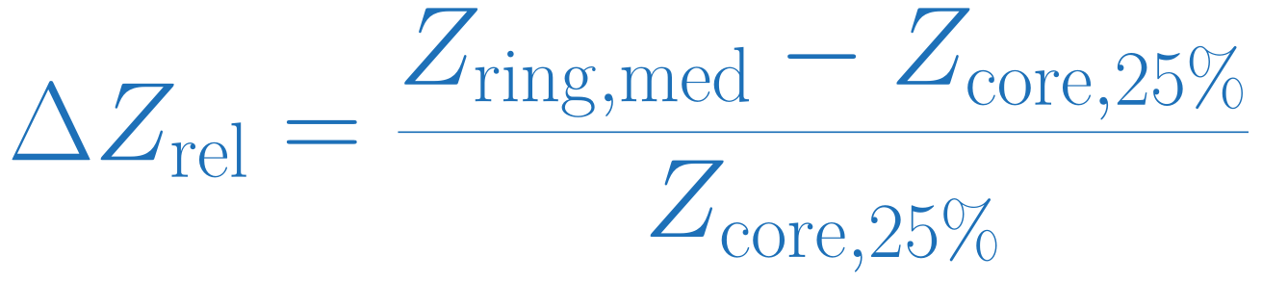
TASK 2 · REAL VS DECOY · 1 / 3
Shravani Kuchi
Two depth cues from the detector box
1 Projected box height (m)
Metric height represented by the detection box
2 Relative depth contrast
▢ Outer ring (+50 % box pad): median valid depth
▢ Detector box: depth frame within 50 ms
◎ Central half: 25th percentile of valid depth
Compares the ring depth with the central estimate
SAVED RULE (FINAL FIT ON EVAL DATA)
REAL if both pass
height ≥ 0.5554 m AND contrast ≥ 0.1922
Both cues must be valid
A printed decoy is small in metres and sits flat on its background

Slide 8
TASK 2 · REAL VS DECOY · 2 / 3
Shravani Kuchi
Threshold selection on eval, checked on held-out blocks
01 Reference match
02 Three time blocks
03 Threshold search
04 Final eval fit
box centre inside a reference box
fit on two, check the held-out one
real TPR ≥ 0.75, then fewest decoys
fit on all eval, save for test
Held-out check (eval)
Cutoffs fitted on two blocks, applied to the third
Block
Real accepted
Decoys accepted
1
31 / 33
0 / 53
2
33 / 33
1 / 55
3
33 / 33
1 / 52
Total
97 / 99
2 / 160
Accept-all baseline
Held-out filter
93 / 160
2 / 160
decoys · TPR 1.00 · FPR 0.58
decoys · TPR 0.98 · FPR 0.013
Why did two decoys pass? Each held-out block uses cutoffs fitted on the other two. The final fit on all eval data rejects both.

Slide 9
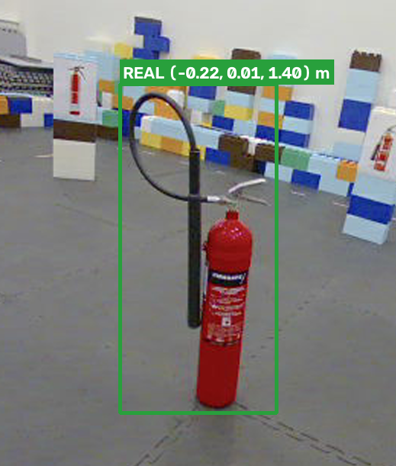
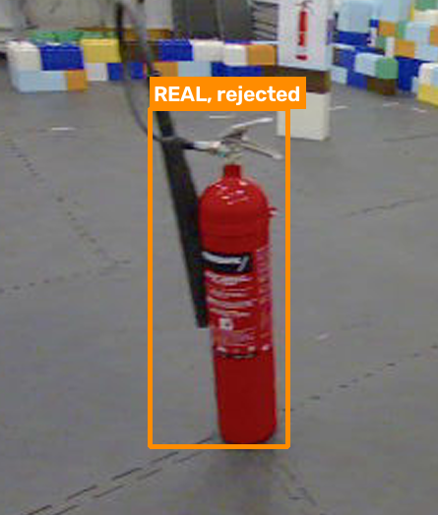
TASK 2 · REAL VS DECOY · 3 / 3
Shravani Kuchi
Test examples and boundary cases
✔ Accepted real object
✔ Rejected printed decoys
✘ Real object rejected
both cues pass
small and flat against the blocks
height 0.955 m, contrast 0.098 < 0.192
Test: 2 real missed, 0 / 103 decoys accepted
Mixed or missing depth near a box can change either cue

Slide 10
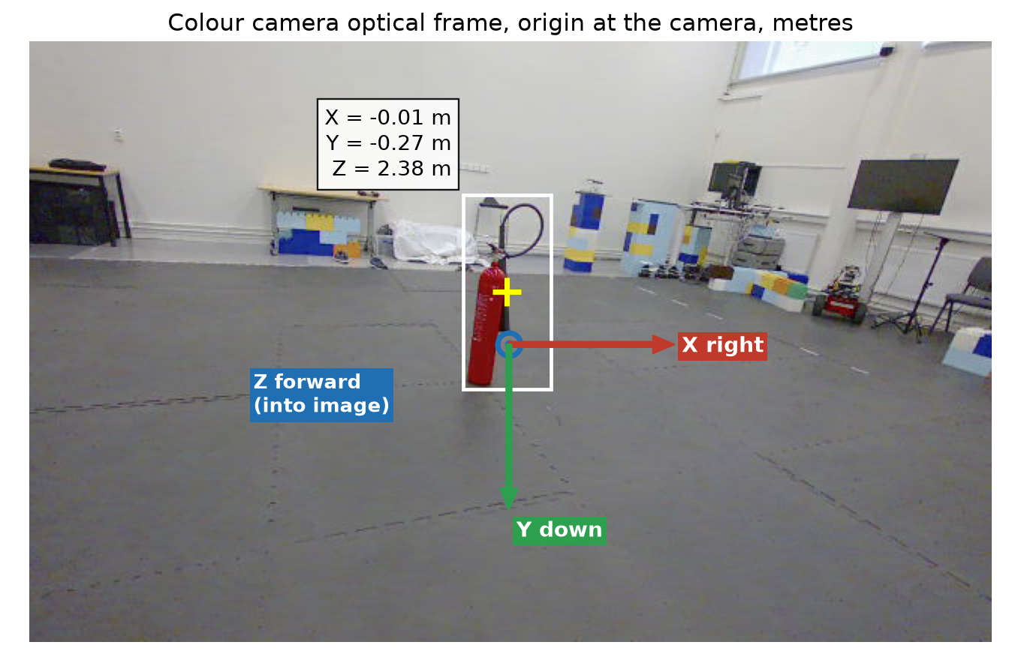
TASK 3 · 3D LOCALISATION · 1 / 3
Thanigaiarasu Shanmugam
Depth from stereo, position in the camera frame
point
Z = f · B / d
Z
IR left
IR right
B = 0.10 m
dense disparity d per pixel (Lab 4)
depth aligned to colour
colour ↔ depth pairs ≤ 50 ms
f ≈ 306 px (camera_info)
frame: X right, Y down, Z forward, metres

Slide 11
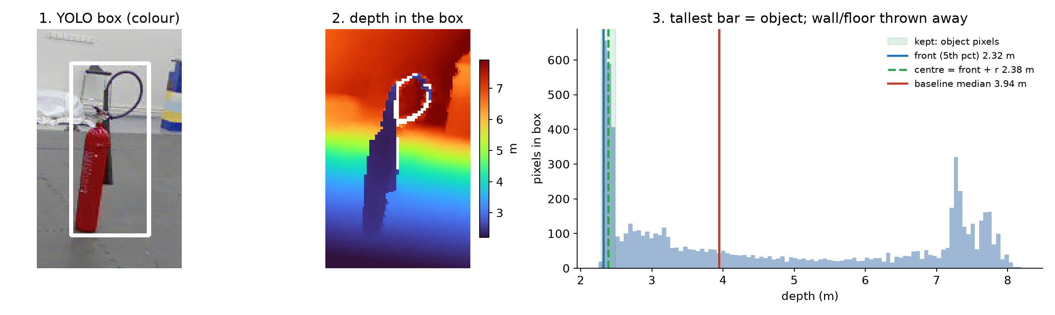
TASK 3 · 3D LOCALISATION · 2 / 3
Thanigaiarasu Shanmugam
From box to 3D centre
1 Tallest histogram bar = object
2 Front = 5th percentile
3 Centre = front + r
4 Back-project box centre
keep −5 / +15 cm
robust to noisy pixels
r = 6.7 cm (cylinder)
X=(u−cx)Z/f · Y=(v−cy)Z/f
tracking extension: keeps a confirmed real through ≤ 2 rejected frames (≤ 80 px, chosen on eval)

Slide 12
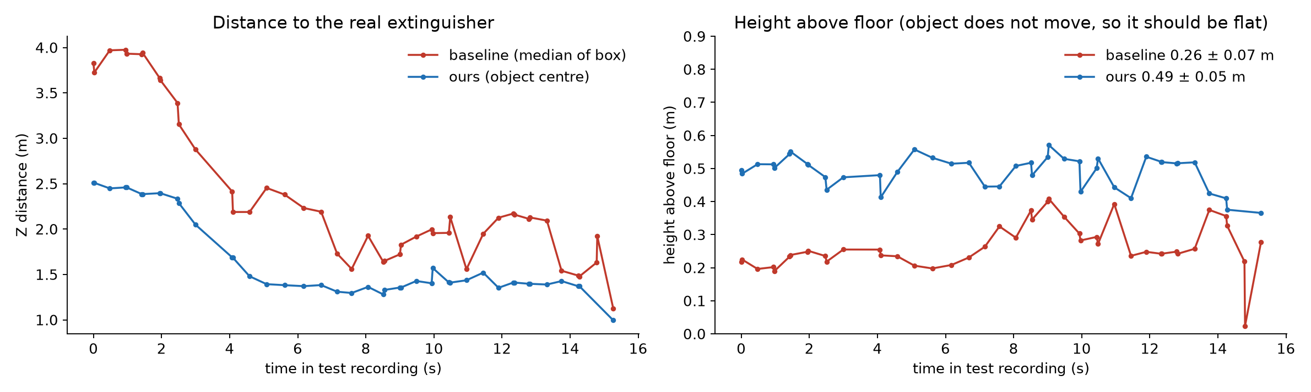
TASK 3 · 3D LOCALISATION · 3 / 3
Thanigaiarasu Shanmugam
3D estimates over the test recording (final evaluation)
0.49 ± 0.05 m
0.26 ± 0.07 m
t (s)
ours X, Y, Z (m)
baseline Z (m)
0.0
−0.08, −0.29, 2.51
3.83
ours: height above floor (≈ half object height)
baseline: median includes the wall
8.1
−0.18, 0.03, 1.36
1.93
11.4
−0.17, 0.07, 1.52
1.95
No 3D ground truth: a stable height above the floor is the consistency check

Slide 13
EVALUATION · 1 / 3
Evaluation setup
Roboflow
eval recording
test recording
2,934 train / 328 val photos
99 frames · 99 real / 160 decoy
67 frames · 45 real / 103 decoy
train YOLO
development: all choices
evaluation: locked, run once
Match rule
Metrics (per object, per frame)
Thresholds
TPR = real accepted / all real (target ≥ 0.75)
FPR = decoys accepted / all decoys (target ≤ 0.15)
detector conf ≥ 0.10
real if box height ≥ 0.56 m
AND background ≥ 19 % further than object
fitted on eval (3 time blocks, cross-validated)
detection
centre inside
→ match
reference box
Reference labels: YOLO proposals reviewed frame by frame (AI-assisted) + team spot-check
Same data and same rules for baseline and final

Slide 14
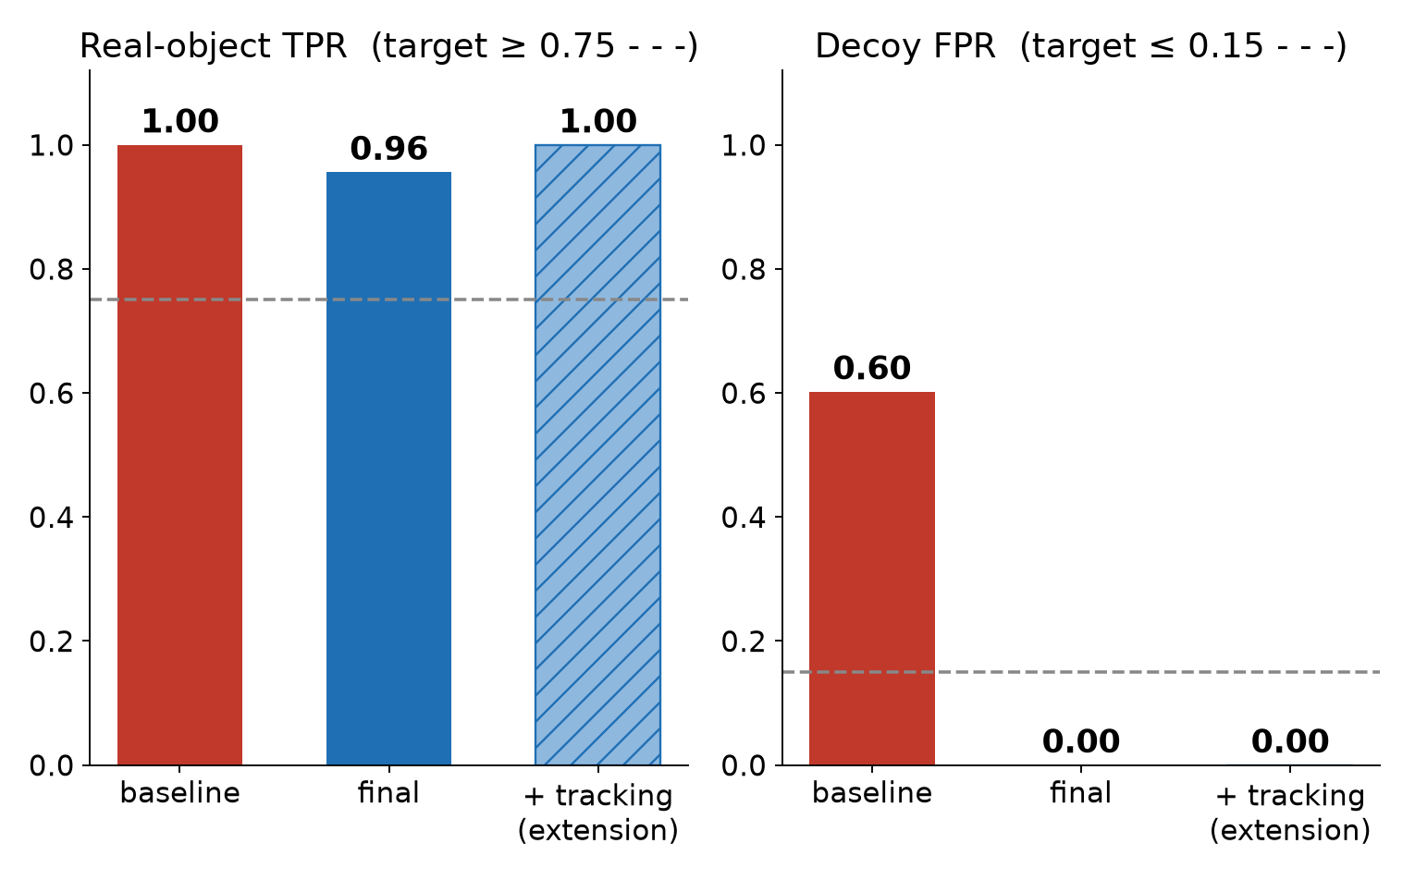
EVALUATION · 2 / 3
Baseline vs final (test, same data)
baseline
final
+ tracking*
Real: accepted / missed
45 / 0
43 / 2
45 / 0
Decoys accepted
62 / 103
0 / 103
0 / 103
TPR
1.00
0.96
1.00
Decoy FPR
0.60
0.00
0.00
Background accepted
22
2
2
Height above floor (m)
0.26 ± 0.07
0.49 ± 0.05
0.48 ± 0.06
Speed
—
≈ 66 FPS
≈ 66 FPS
Baseline = same YOLO, accept all, median depth
Trade-off: −2 real for −62 decoys
Both targets met
* extension: settings chosen on eval (80 px, 2 frames)

Slide 15
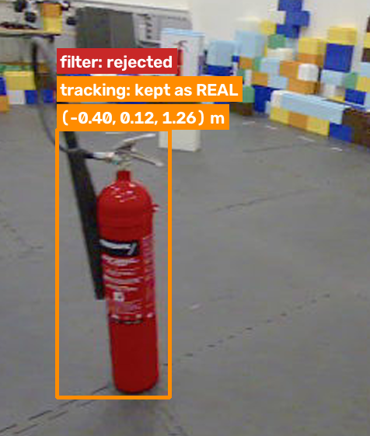
EVALUATION · 3 / 3
Visual evidence (test)
✔ Real accepted + 3D
✔ Decoys rejected
✘ Real missed by filter
✔ Same frame + tracking*
with its position in metres
prints on blocks: no free space around
camera turning: depth 28 ms older → box sees floor
seen as real in earlier frames → kept
Decoy accepted as real: none (0 / 103)
Filter misses: 2 (same turning moment, one old depth frame) → both kept by tracking*
Tracking adds no decoys or background boxes

Slide 16
SUMMARY
Final result and limitations
0.96
0.00
1.00
≈ 66 FPS
TPR, final system (target ≥ 0.75)
decoy FPR: 0 of 103 accepted (target ≤ 0.15)
TPR with the tracking extension
15.2 ms per frame, all stages
What worked
Limitations
Simple depth cues remove every printed decoy
3D centre from the object pixels, not the box median
Every choice made on eval; test run once at the end
Tracking recovers the 2 misses without adding decoys
Small test set: 67 frames, one real extinguisher
Fast camera turns: colour/depth time gap → 2 misses
No 3D ground truth: checked by stable height only
Thresholds fitted in one room; new scenes may need a refit
Questions?

