Slide 1
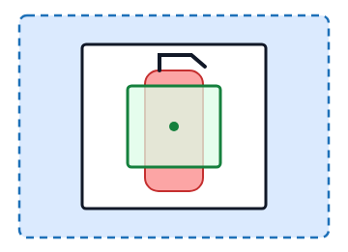
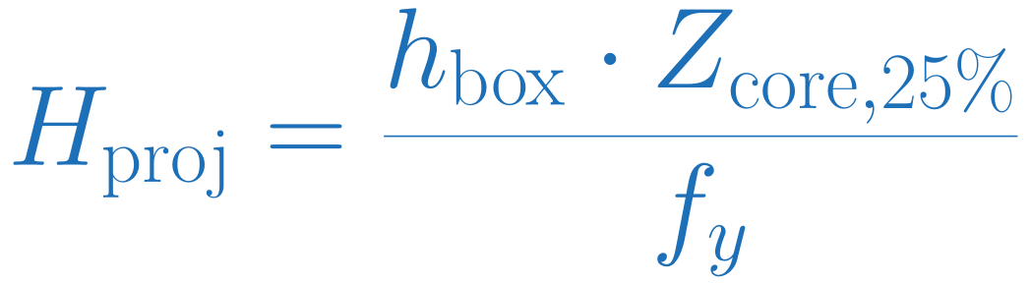
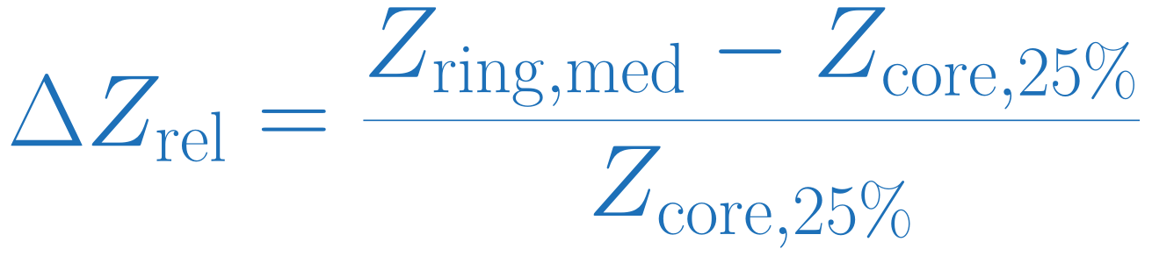
REAL VS DECOY FILTER 1/4
Two Depth Cues from Detector Boxes
1. Projected box height (m)
Estimates the metric height represented by the detection box.
2. Relative depth contrast
Outer ring (+50% box pad): median valid depth
Detector box: depth frame within 50 ms
Compares the ring depth with the central estimate.
Central half: 25th percentile of valid depth

Slide 2
REAL VS DECOY FILTER 2/4
Threshold Selection and Decision Rule
STEP 01
STEP 02
STEP 03
STEP 04
Reference Match
Three Time Blocks
Threshold Search
Final Eval Fit
Fit on two blocks, then check the held-out block.
Require real TPR ≥ 0.75, then minimize accepted decoys.
Match a detector box by its centre inside a reference box.
Fit on all eval labels and save the thresholds for test.
SAVED RULE (FINAL FIT ON EVAL DATA)
REAL if both pass
height ≥ 0.5554 m AND contrast ≥ 0.1922
Both cues must be valid

Slide 3
REAL VS DECOY FILTER 3/4
Eval Depth Cues and Held-Out Results
Matched candidates with both depth cues
Held-out check
Relative contrast
Fit on two blocks, check the third.
5.5
4.5
Block
Real accepted
Decoys accepted
3.5
1
31 / 33
0 / 53
2
33 / 33
1 / 55
2.5
3
33 / 33
1 / 52
1.5
Total
97 / 99
2 / 160
0.5
Counts are labeled occurrences per frame.
-0.5
0
0.4
0.8
1.2
1.6
Why did two decoys pass?
Projected box height (m)
Each held-out block uses cutoffs fitted on the other two. The final fit on all eval data rejects both.
Real (n=140)
Decoy (n=106)
Accept-all baseline
Held-out filter
99 / 99 real, 93 / 160 decoys
97 / 99 real, 2 / 160 decoys
TPR 1.000, FPR 0.581
TPR 0.980, FPR 0.013

Slide 4
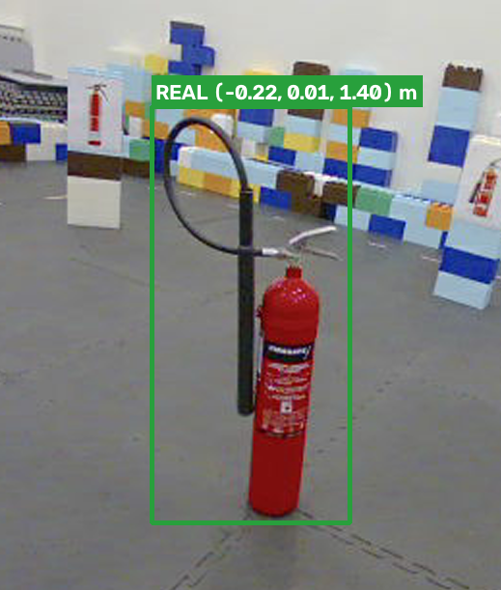
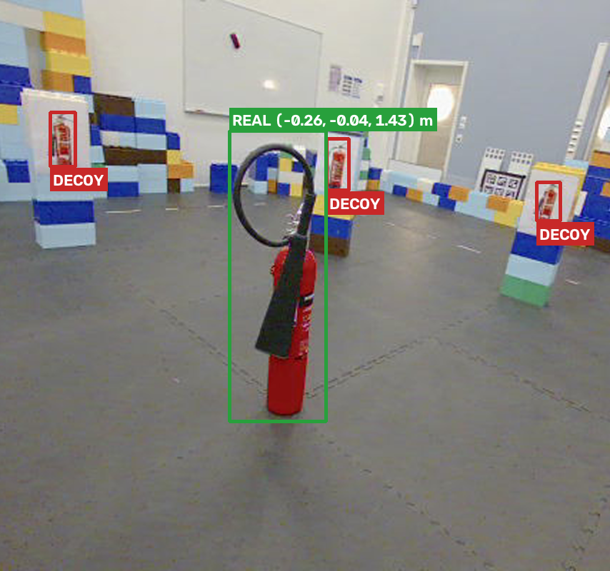
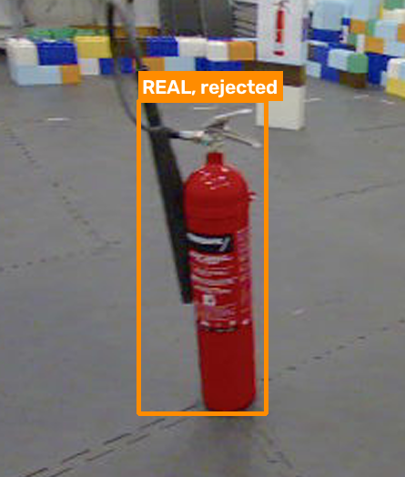
REAL VS DECOY FILTER 4/4
Test Examples and Boundary Cases
Accepted real object
Rejected printed decoys
Real object rejected
Height 0.955 m, contrast 0.098 < 0.192
Mixed or missing depth near a box can change either cue.
Test: 2 real missed, 0 / 103 decoys accepted

