Slide 1
ONLINE JOB PORTAL MANAGEMENT SYSTEM
Guided by : Dr. Sangram Ray
Submitted by :Thani Karthik
B220036CS

Slide 2
CONTENTS-
INTRODUCTION
OBJECTIVE
TOOLS AND LANGUAGES USED
KEY FEATURES
E-R DIAGRAM
SCREENSHOTS
CONCLUSION

Slide 3
INTRODUCTION-
Online Job Portal Management System is an excellent solution for the Jobseekers and recruiters to give or get job easily. It helps Jobseekers to search the jobs easily and also help recruiters to get students with the required skills easily. Recruiter can add or delete the jobs posted. Jobseekers can apply or reject the jobs offer. Jobseekers and Recruiters can post, delete or update their profile.
Hence, the system helps to get information of posts in company, contact details and admin and managers can easily manage the large data of online job information.

Slide 4
OBJECTIVE-
The main objective of the project is to create an online portal system, that allows to find jobs and recruit people.
From the website, admin can control the number of users, number of jobs.
Recruiters can login and post job and select candidates.
Users can login and apply to the jobs.

Slide 5
TOOLS & LANGUAGE USED-
HTML
CSS
JavaScript
Mongodb
Nodejs

Slide 6
KEY FEATURES-
Employers Page:
A signup page shows the signup of Jobseekers, recruiters, admin.
After Recruiters login it will show profiles of Jobseekers who wants Jobs and Employer can Recruit them
Recruiter can advertise any Job by providing the required details.
Recruiter can update and delete the job that he advertises

Slide 7
Jobseekers Page:
After Jobseekers login it will show of Jobs advertises by recruiters
Jobseekers can apply to those Jobs and send notification to recruiters
Jobseekers can send their profile details to recruiters to get Job.
Jobseekers can update and delete the profile details

Slide 8
Admin Page:
After Admin login it will show of Jobs advertises by recruiters and profiles of Jobseekers who want job.
Admin can update and delete the profile details of Jobseekers and Jobs published by recruiters

Slide 9
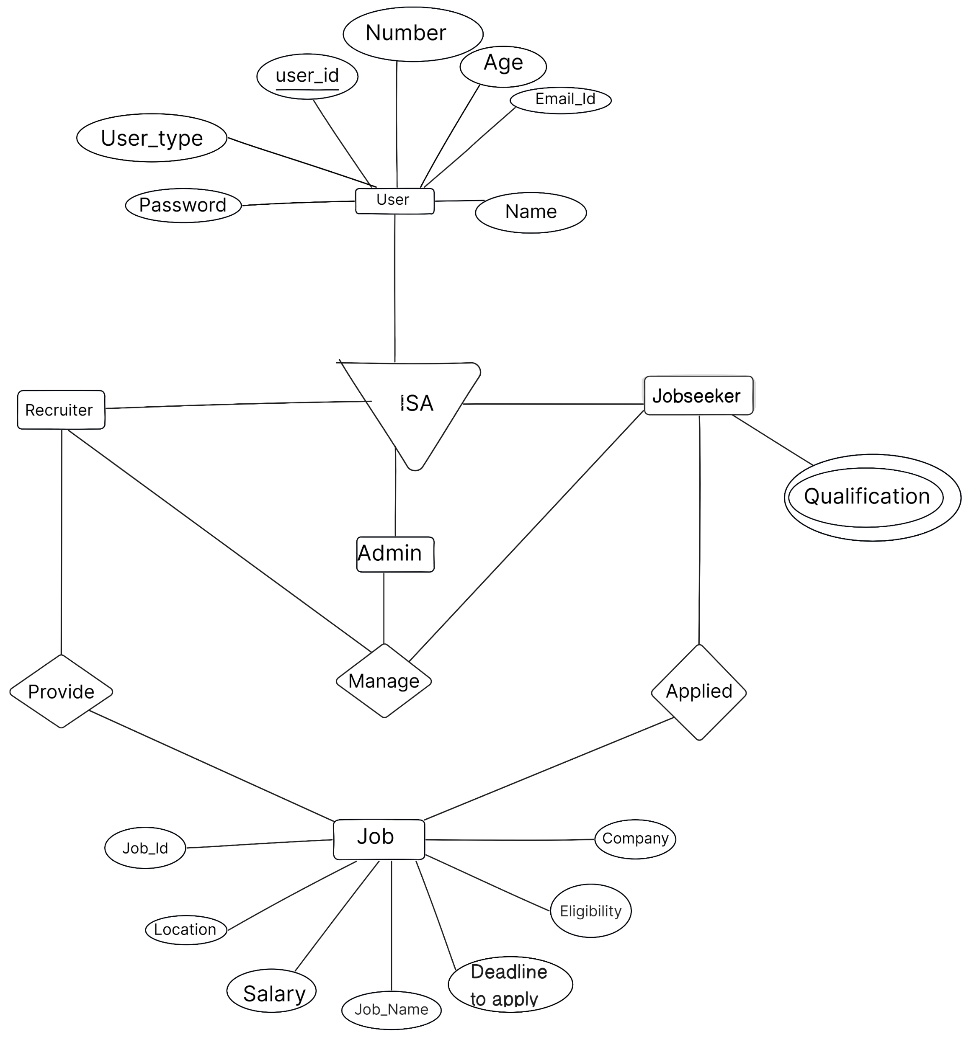
ER –Diagram :

Slide 10
DATABASE DESIGN:
User (user_id,Number, email, Name,Age,password,user_type)
Jobseeker (User_Id,Qualification)
Job (Job Id,Job_Name,Salary, Company, Eligibility, Deadline, Location)

Slide 11
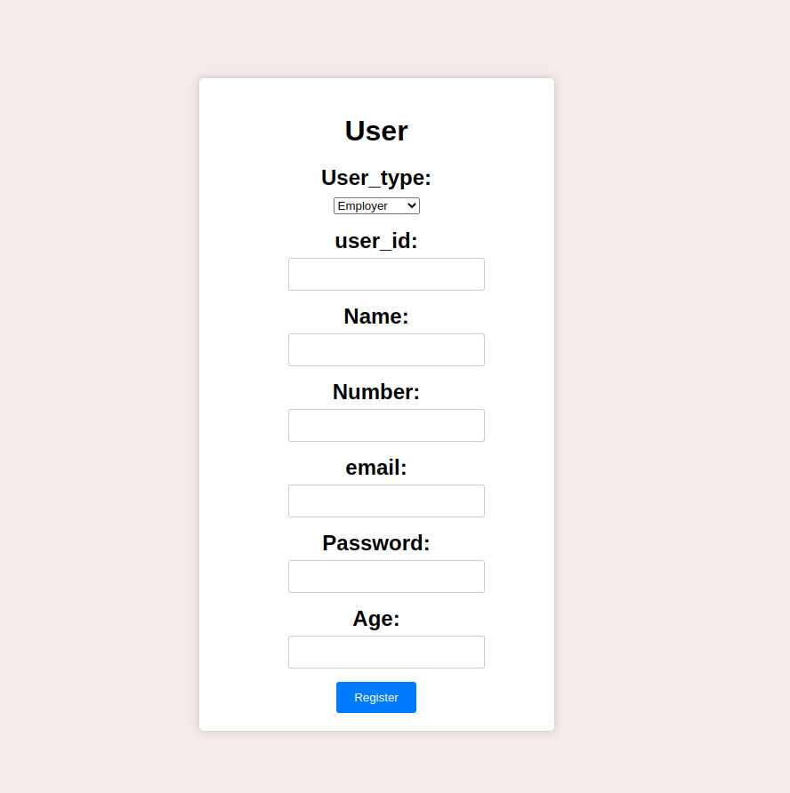
User signup Page :

Slide 12
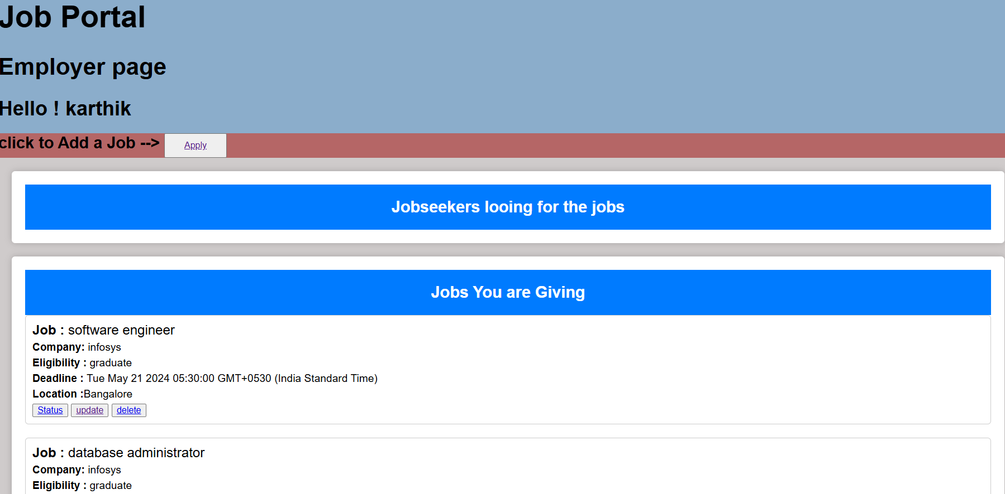
SNAPSHOTS-Employers Page

Slide 13
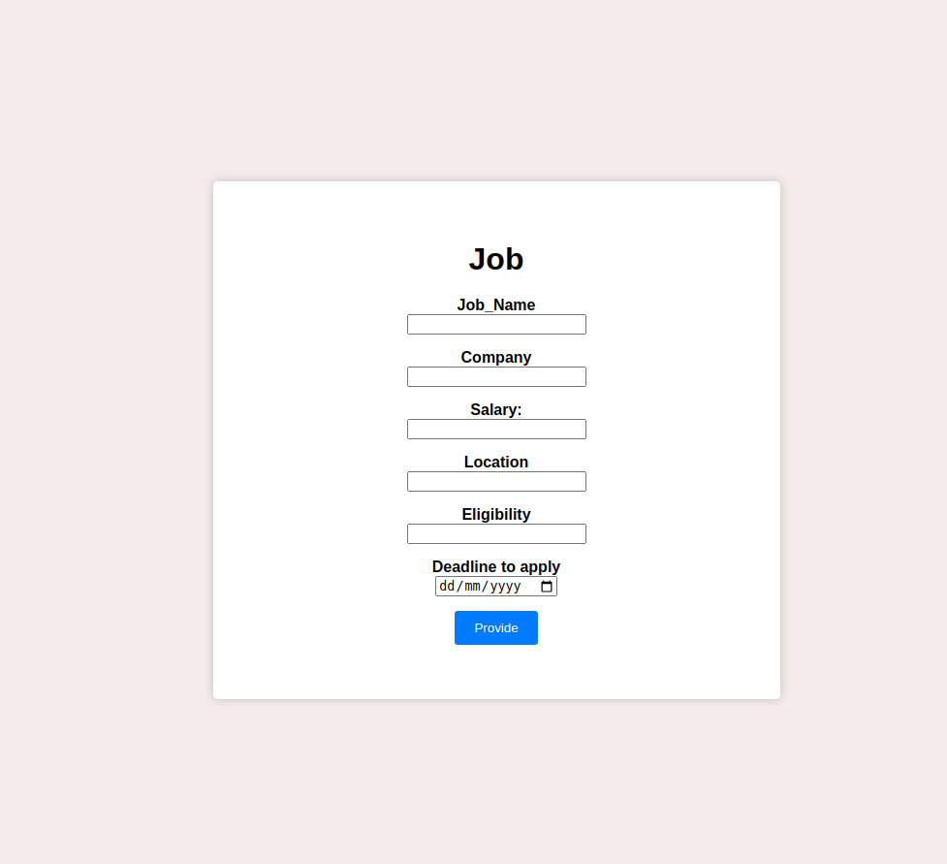
Job Profile Page :

Slide 14
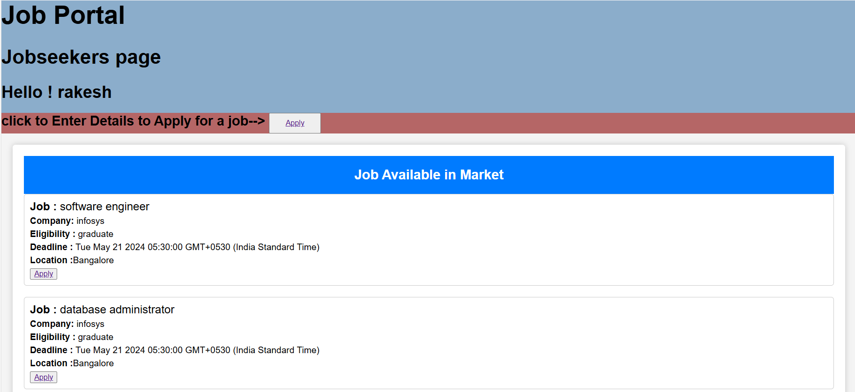
Jobseekers Profile Page:

Slide 15
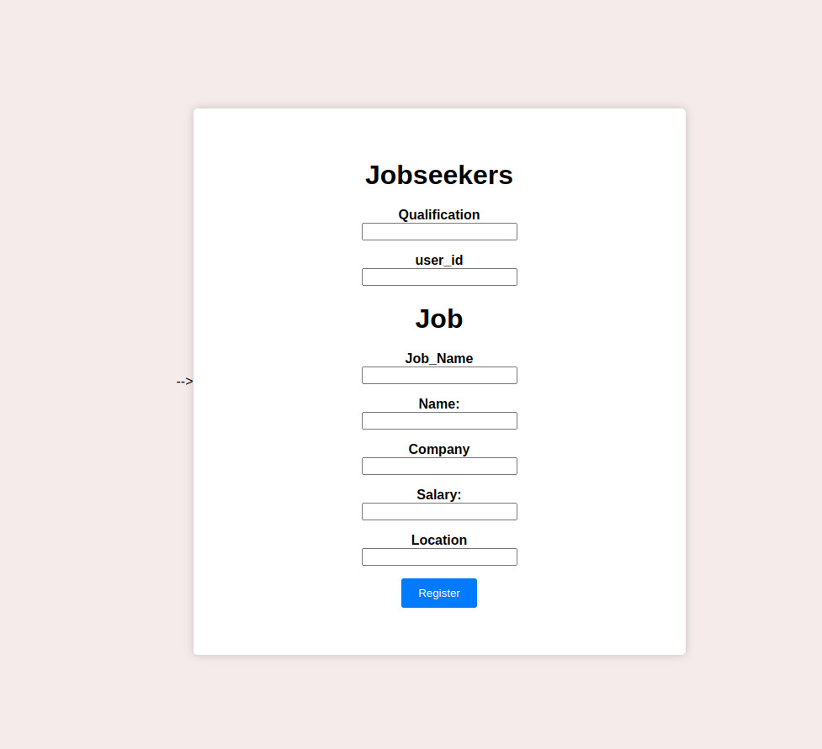
Jobseekers job Applying Page:

Slide 16
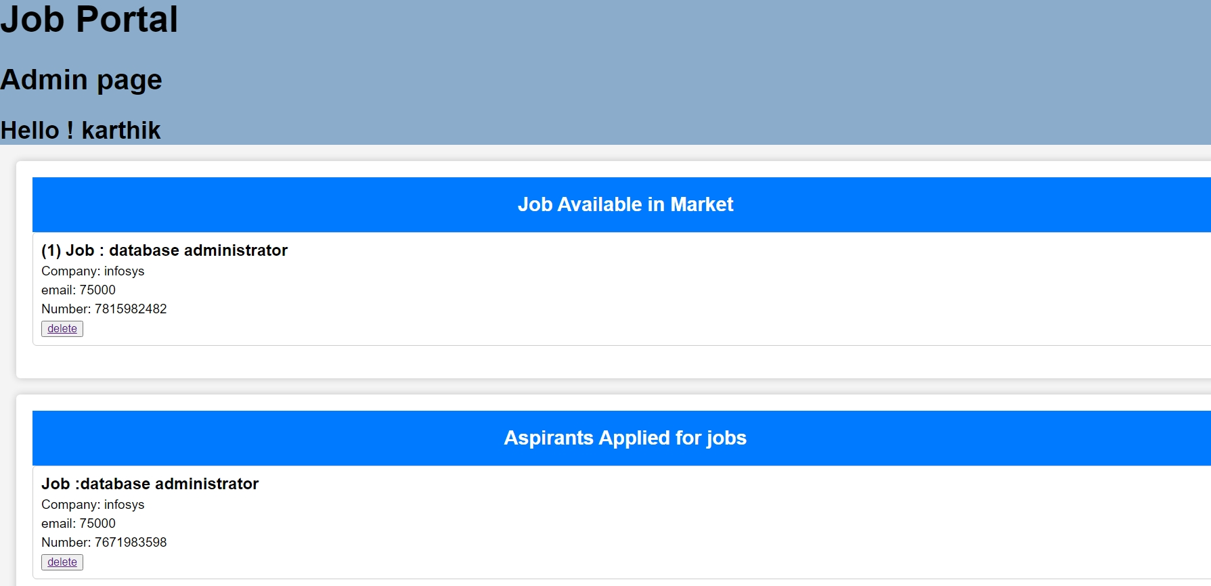
Admins Profile Page :

Slide 17
Conclusion:
The main objectives of Online Job portal management system is to develop a bridge between job seeker and job providing company.
Since this is a web-based project therefore candidates can access it over internet which saves their time and money to travel.
The mini project was designed in such a way that future modifications can be done easily.

Slide 18
-
THANK YOU
Any Questions ?

