Slide 1
AI-Driven Exploration and Prediction of Company Registration Trends with Registrar of Companies (RoC)
IBM NAAN MUDHALVAN

Slide 2


Slide 3
DATA SOURCE:
Variable identification: define each variable and its role in the dataset
Univariate analysis: for continuous variables, build box plots or histograms for each variable independently; for categorical variables, build bar charts to show the frequencies
Bi-variable analysis - determine the interaction between variables by building visualization tools
~Continuous and Continuous: scatter plots
~Categorical and Categorical: stacked column chart
~Categorical and Continuous: boxplots combined with swarmplots
Detect and treat missing values
Detect and treat outliers

Slide 4
What is ROC?
ROC full form is Registrar of Companies. It is an office established under the Ministry of Corporate Affairs. The ROC, under Section 609 of the Companies Act, vested with the primary duty of registering companies and LLPs (limited liability partnerships). The office of the ROC maintains a registry of records relating to the companies registered with it. These records are available for inspection by the public, on payment of the prescribed fee. After the introduction of the Companies Act, 2013, some of the powers under Section 609 are now conferred to the ROCs under Section 396 of the Companies Act, 2013.

Slide 5
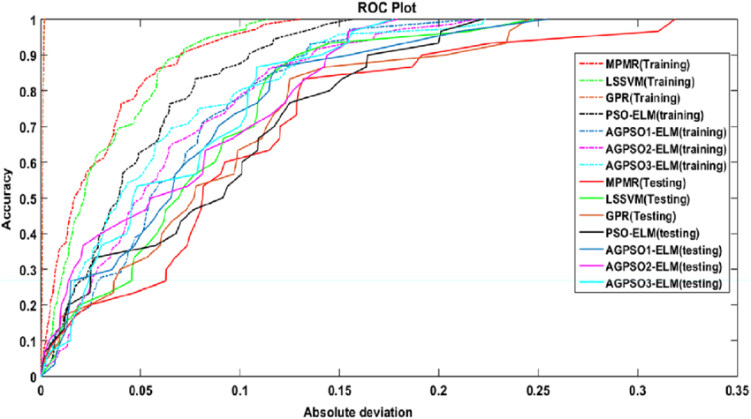

Slide 6
Data Preprocessing:
One way AI is used in automating data cleaning and preprocessing is through machine learning algorithms that learn from patterns in large datasets. These algorithms can identify inconsistencies in the data and suggest ways to correct them automatically
Validity
Accuracy
Completeness
Consistency
Uniformity

Slide 7
Exploratory Data Analysis (EDA):
Exploratory Data Analysis (EDA) refers to the method of studying and exploring record sets to apprehend their predominant traits, discover patterns, locate outliers, and identify relationships between variables. EDA is normally carried out as a preliminary step before undertaking extra formal statistical analyses or modeling.
Data Cleaning
Descriptive Statistics
Data Visualization
Feature Engineering
Correlation and Relationships
Data Segmentation
Hypothesis Generation
Data Quality Assessment

Slide 8
Feature Engineering:
Feature engineering is a machine learning technique that leverages data to create new variables that aren’t in the training set. It can produce new features for both supervised and unsupervised learning, with the goal of simplifying and speeding up data transformations while also enhancing model
accuracy.
Feature Creation
Transformations
Feature Extraction
Exploratory Data Analysis
Benchmark

Slide 9
Predictive Modelling:
Random Forest. This algorithm combines unrelated decision trees and uses classification and regression to organize and label vast amounts of data.
Gradient boosted model. Similar to Random Forest, this algorithm uses several decision trees, but in this method, each tree corrects the flaws of the previous one and builds a more accurate picture.
K-Means. This algorithm groups data points in a similar fashion as clustering models and is popular in devising personalized retail offers. It create personalized offers by seeking out similarities among large groups of customers.
Prophet. A forecasting procedure, this algorithm is especially effective when dealing with capacity planning. This algorithm deals with time series data and is relatively flexible.

Slide 10
Model Evaluation:
Metrics that can be used for evaluation a classification model: Percent correction classification (PCC): measures overall accuracy. Every error has the same weight. Confusion matrix: also measures accuracy but distinguished between errors, i.e false positives, false negatives and correct predictions.
Accuracy
Precision

Slide 11
1. Accuracy
Overall, how often is the classifier correct?
Accuracy = (TP+TN)/total
When our classes are roughly equal in size, we can use accuracy, which will give us correctly classified values.
Accuracy is a common evaluation metric for classification problems. It’s the number of correct predictions made as a ratio of all predictions made.
Misclassification Rate(Error Rate): Overall, how often is it wrong. Since accuracy is the percent we correctly classified (success rate), it follows that our error rate (the percentage we got wrong) can be calculated as follows:
Misclassification Rate = (FP+FN)/total

Slide 12
2.Precision
When it predicts yes, how often is it correct?
Precision=TP/predicted yes
When we have a class imbalance, accuracy can become an unreliable metric for measuring our performance. For instance, if we had a 99/1 split between two classes, A and B, where the rare event, B, is our positive class, we could build a model that was 99% accurate by just saying everything belonged to class A. Clearly, we shouldn’t bother building a model if it doesn’t do anything to identify class B; thus, we need different metrics that will discourage this behavior. For this, we use precision and recall instead of accuracy.

