Slide 1
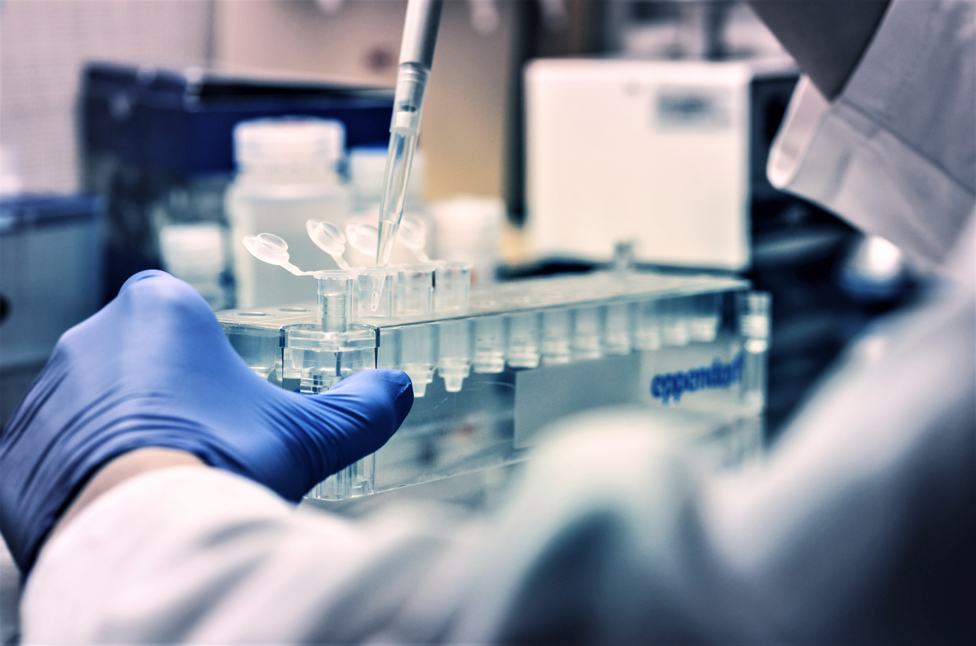
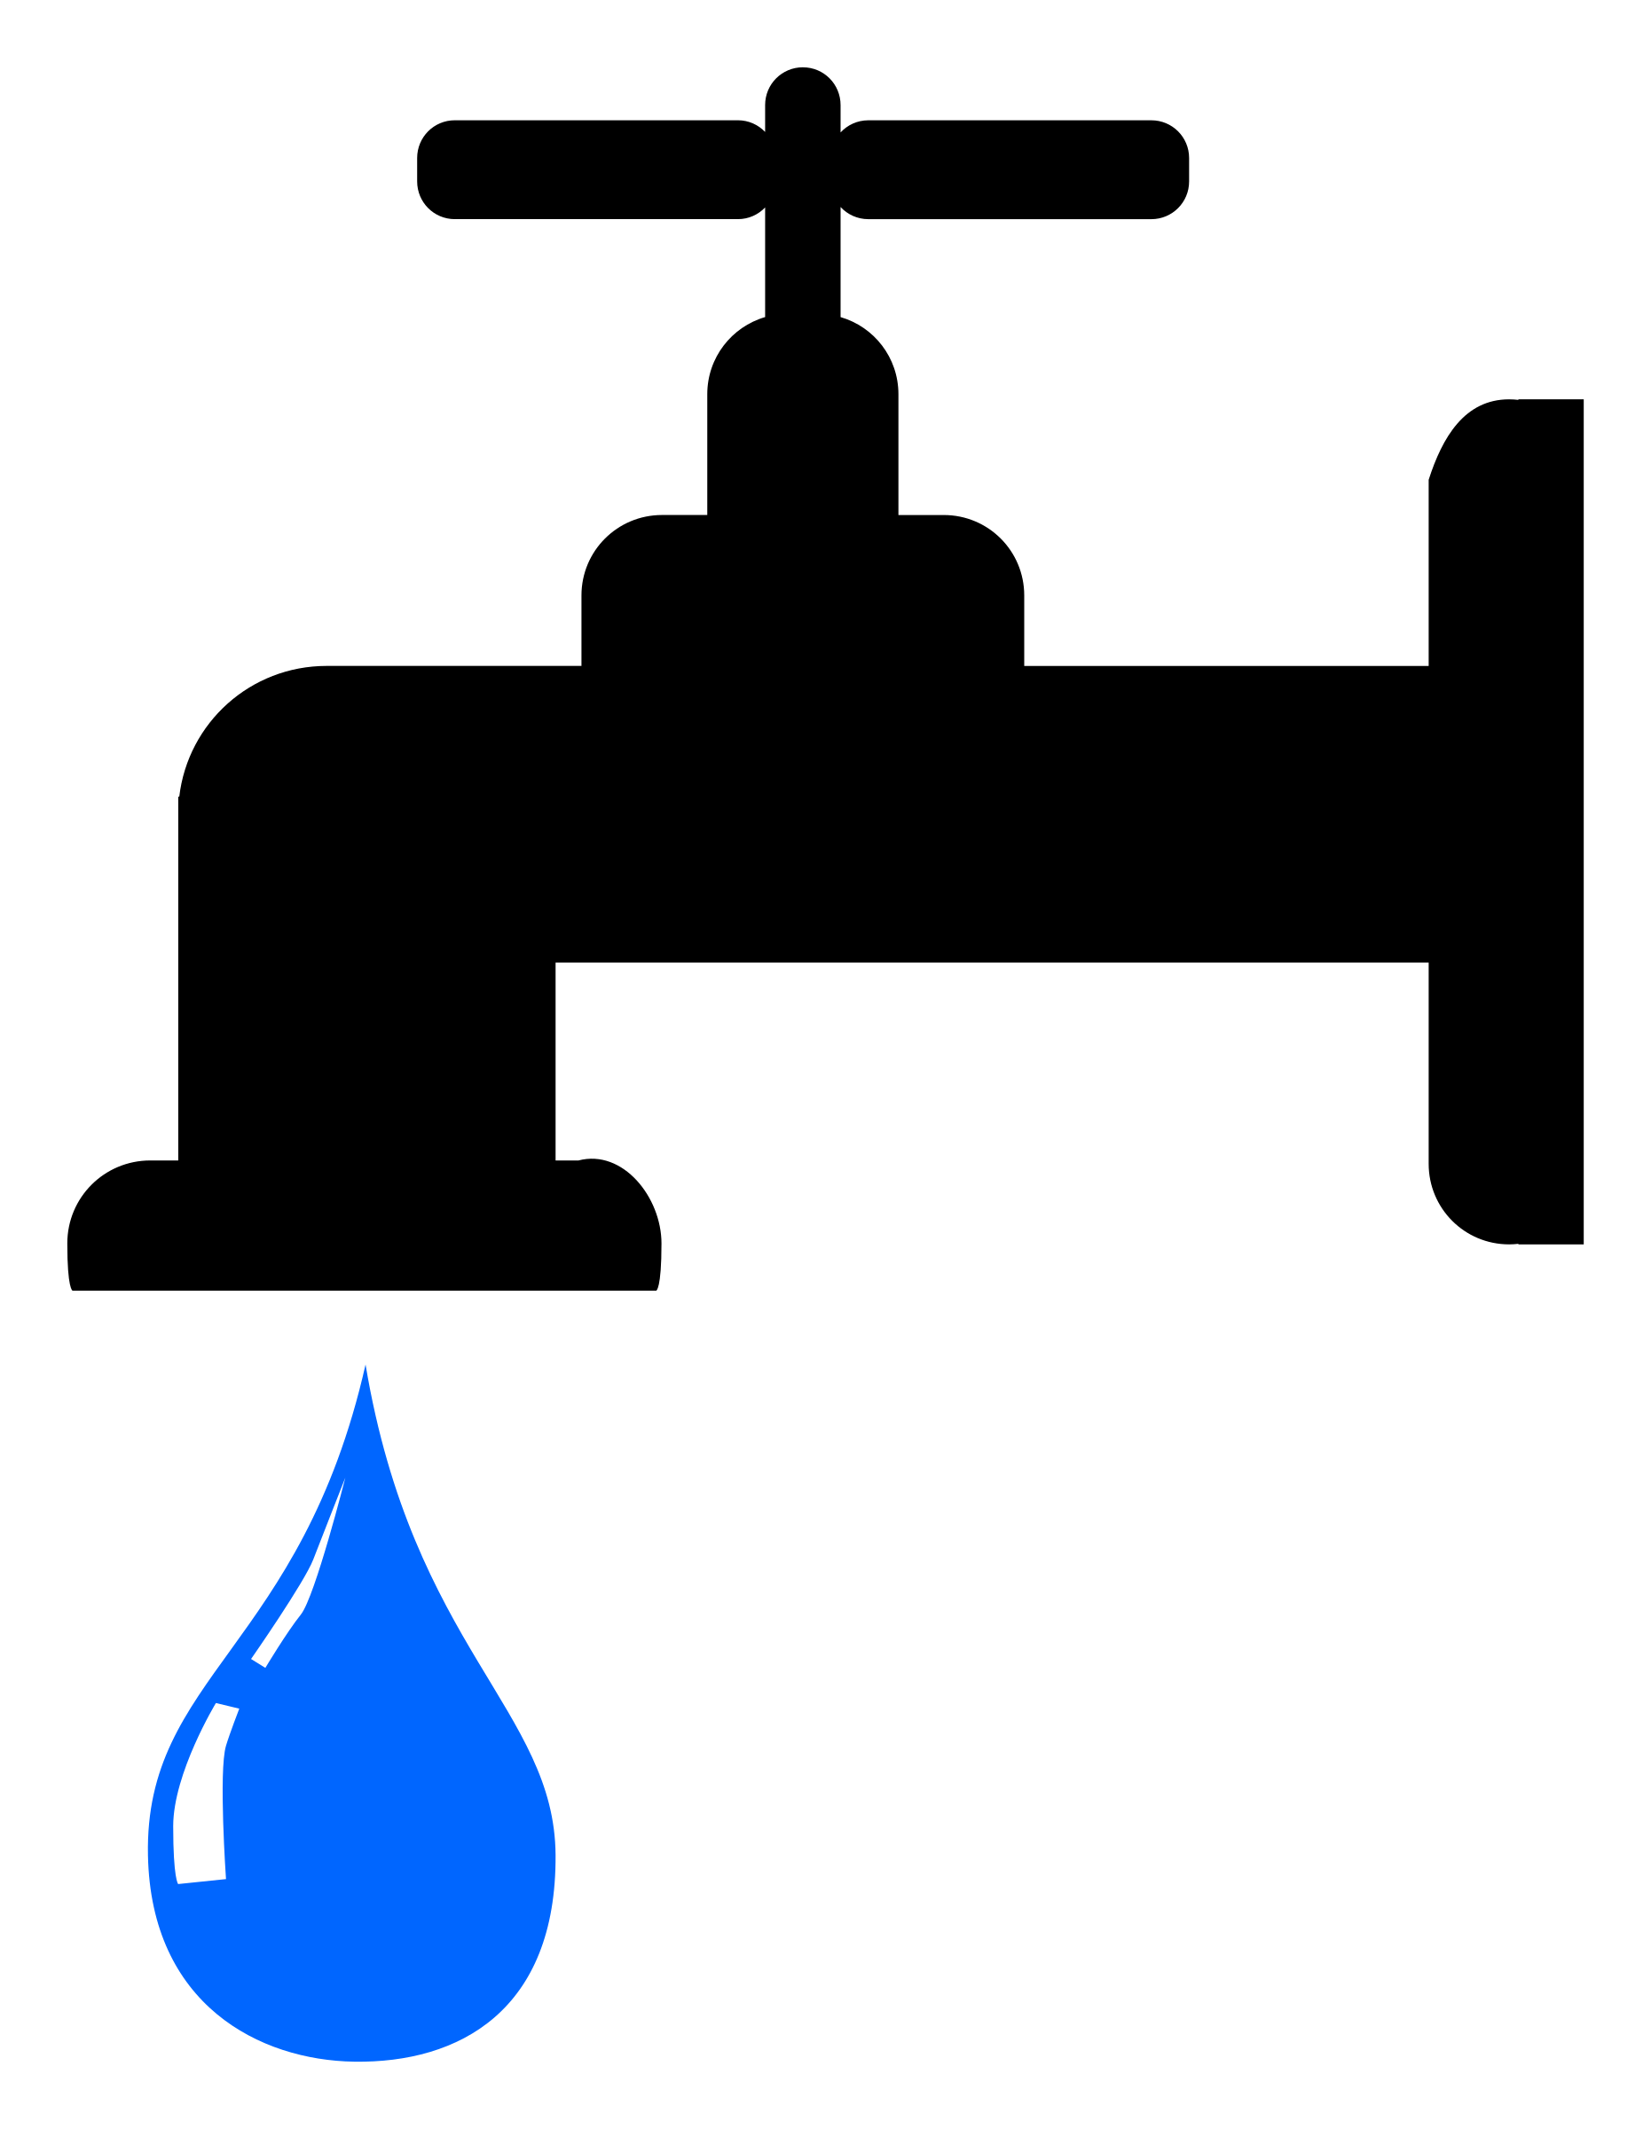
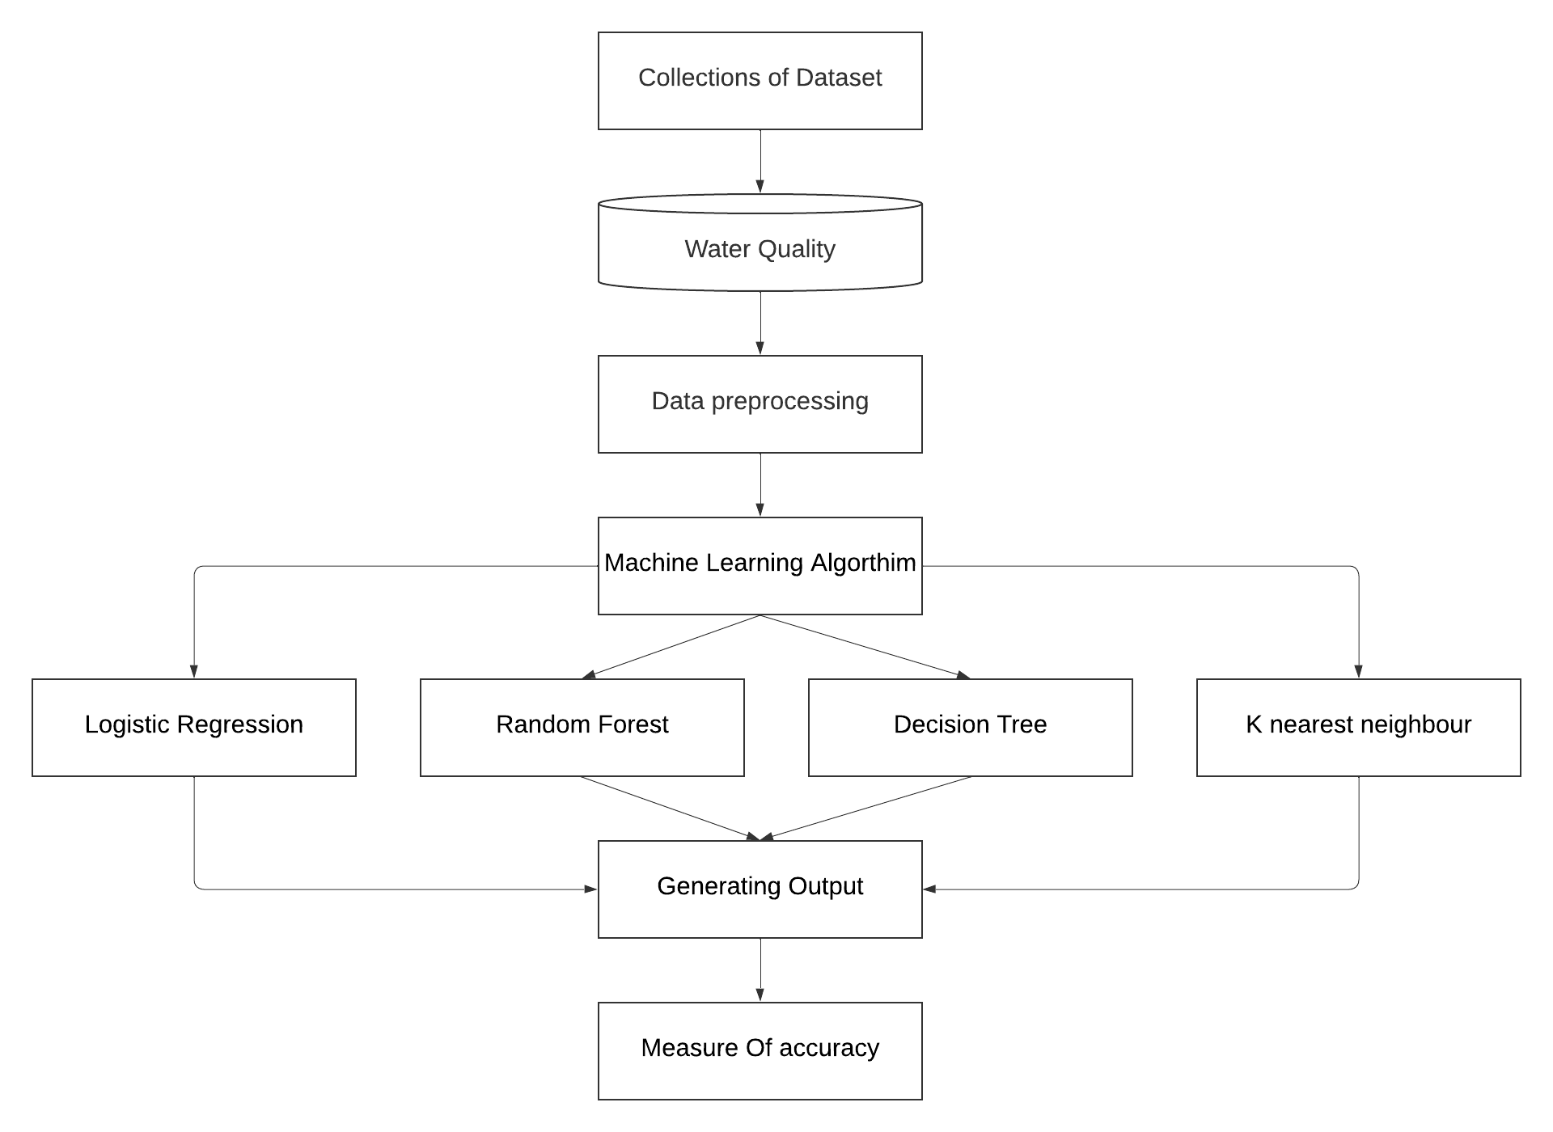
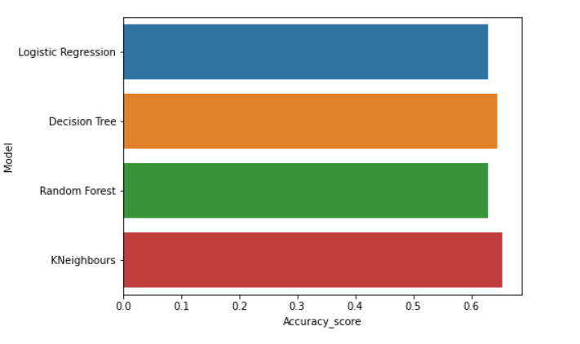

WATER QUALITY ANALYSIS SYSTEM USING MACHINE LEARNING
THANKAKUMAR K V – 312419104152 VEERA ASWIN S - 312419104155
OBJECTIVE
SYSTEM ARCHITECTURE
MODULES
Surveillance of water quality is mandatory. Water quality can be tested using traditional techniques such as collecting the water specimens manually and analyzed it in a laboratory. But it is time-consuming and expensive. Water quality is predicted modelling using machine learning approaches. Compared to other conventional methods, it has several advantages: lower costs, efficient in terms of time required.
1. IMPORTING LIBRARIES & LOADING DATASET The project was started by importing some python libraries like numpy, pandas, etc. Water Quality Datasets are collected from Kaggle to analyze Machine learning regression algorithms. This dataset helps to predict the medical insurance in different ages and conditions. Then the datasets was loaded into our project. 2. VISUALISING THE DATA Visualizing the dataset means plotting the values in the dataset in x-axis and y-axis to see how the values are distributed in the dataset. Histograms and box plots are common visualizations used to understand the distribution and characteristics of a dataset. 3. SPLITTING THE DATA The simplest and probably the most common strategy to split such a dataset is to randomly sample a fraction of the dataset.2/3 of the rows of the dataset can be randomly chosen for training and the remaining 1/3 can be used for testing. | 4. MODEL BUILDING Classification algorithms like Logistic regression, K nearest neighbor, Decision Tree (DT), Random Forest (RF) are applied in the data set for better analysis of Water Quality. 5. CALCULATING THE ACCURACY The accuracy of a regression model can be measured using various metrics depending on the nature of the problem and the desired performance. Some of the commonly used metrics for evaluating the accuracy of regression models are Mean squared error and R-squared (R2). 6. RESULT EVALUATION The graph with the algorithms in x-axis and the accuracy in the y-axis. The most basic metric for evaluating a regression algorithm is its accuracy in predicting the target variable. The Best algorithm will have the highest accuracy. In this project KNN achieved highest accuracy.
KEY ASPECTS
Water quality analysis involves classifying data into portable and non portable using ML algorithms. To successfully analyse the quality of water, here are some key aspects to consider:
Ph, Hardness, Solids, Sulphate, Conductivity, Turbidity and so on.
REQUIREMENTS
PROPOSED SYSTEM OUTPUT
PERFORMANCE ANALYSIS
CONCLUSION
The proposed method is to build a machine learning model for Water quality. The process carries from data collection where the past data related to Water qualities are collected. Then proper machine learning algorithms are applied to the dataset where the pattern of data is learned, trained and tested. Fitting the classification algorithm like logistic regression, K-Nearest neighbor, Decision tree and Random forest to get better accuracy rate.
To get maximum analysis we used four machine learning algorithms like Logistic Regression, Random Forest, Decision Tree and K-Nearest Neighbor. The accuracy obtained by each model are Logistic Regression as 62.846%, Random Forest as 62.846%, K-Nearest Neighbor as 65.342% and Decision Tree as 64.510%.
The goal of this project was to predict the water quality of various bodies of water around the world. Using a combination of machine learning algorithms we were able to accurately predict water quality in different areas with more accuracy. Our model was able to detect changes in the water quality over time, and even estimate the overall health of the water quality in different areas.
HARDWARE | SOFTWARE
Processor : 4 GHz Intel i3 Hard Disk : 500 GB RAM : 4GB | Windows 7/10 Python Jupyter Notebook VS Code
Guided By,
Dr. M. Tamil Thendral, M.E., Ph.D.,
Assistant Professor,
Computer Science and Engineering

