Slide 1
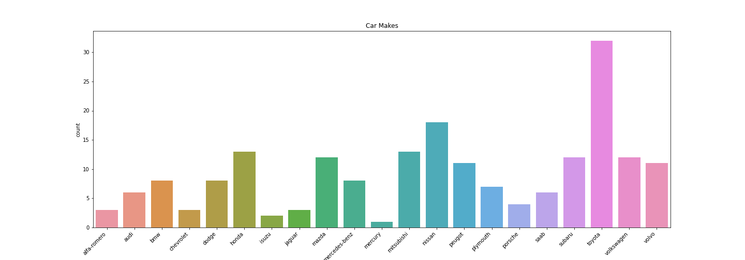
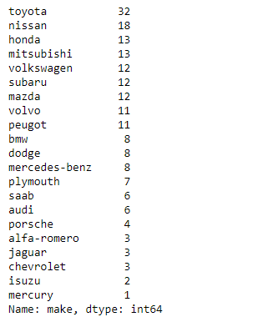
Car Make Counts

Slide 2
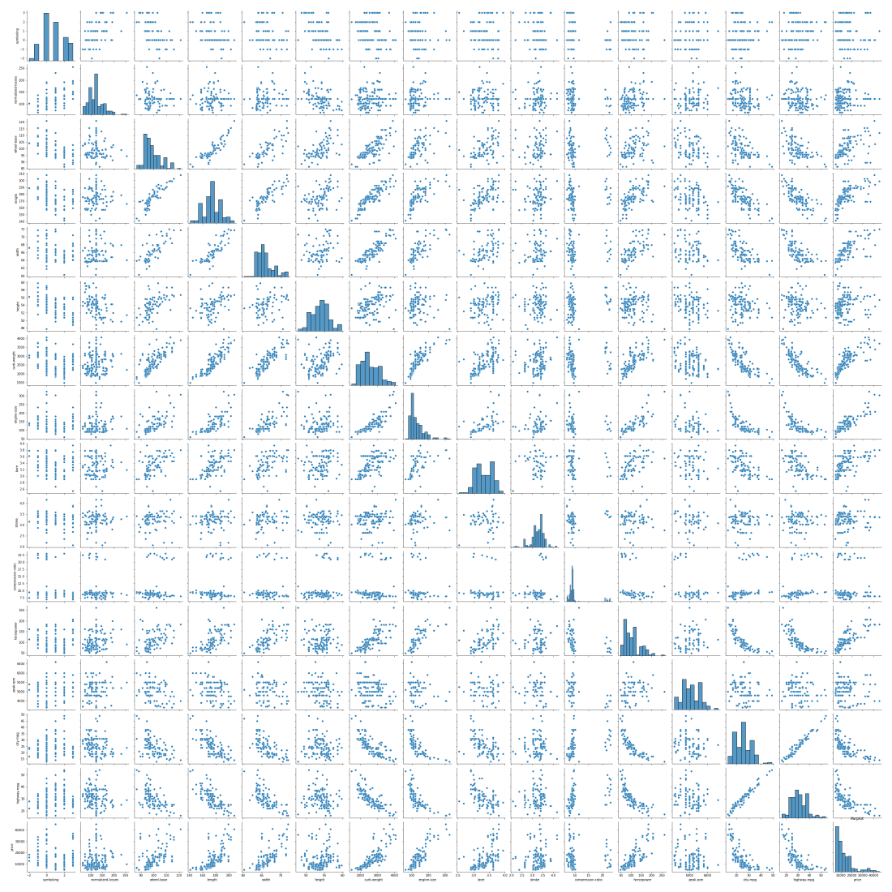
Pair plot relationship between all the columns

Slide 3
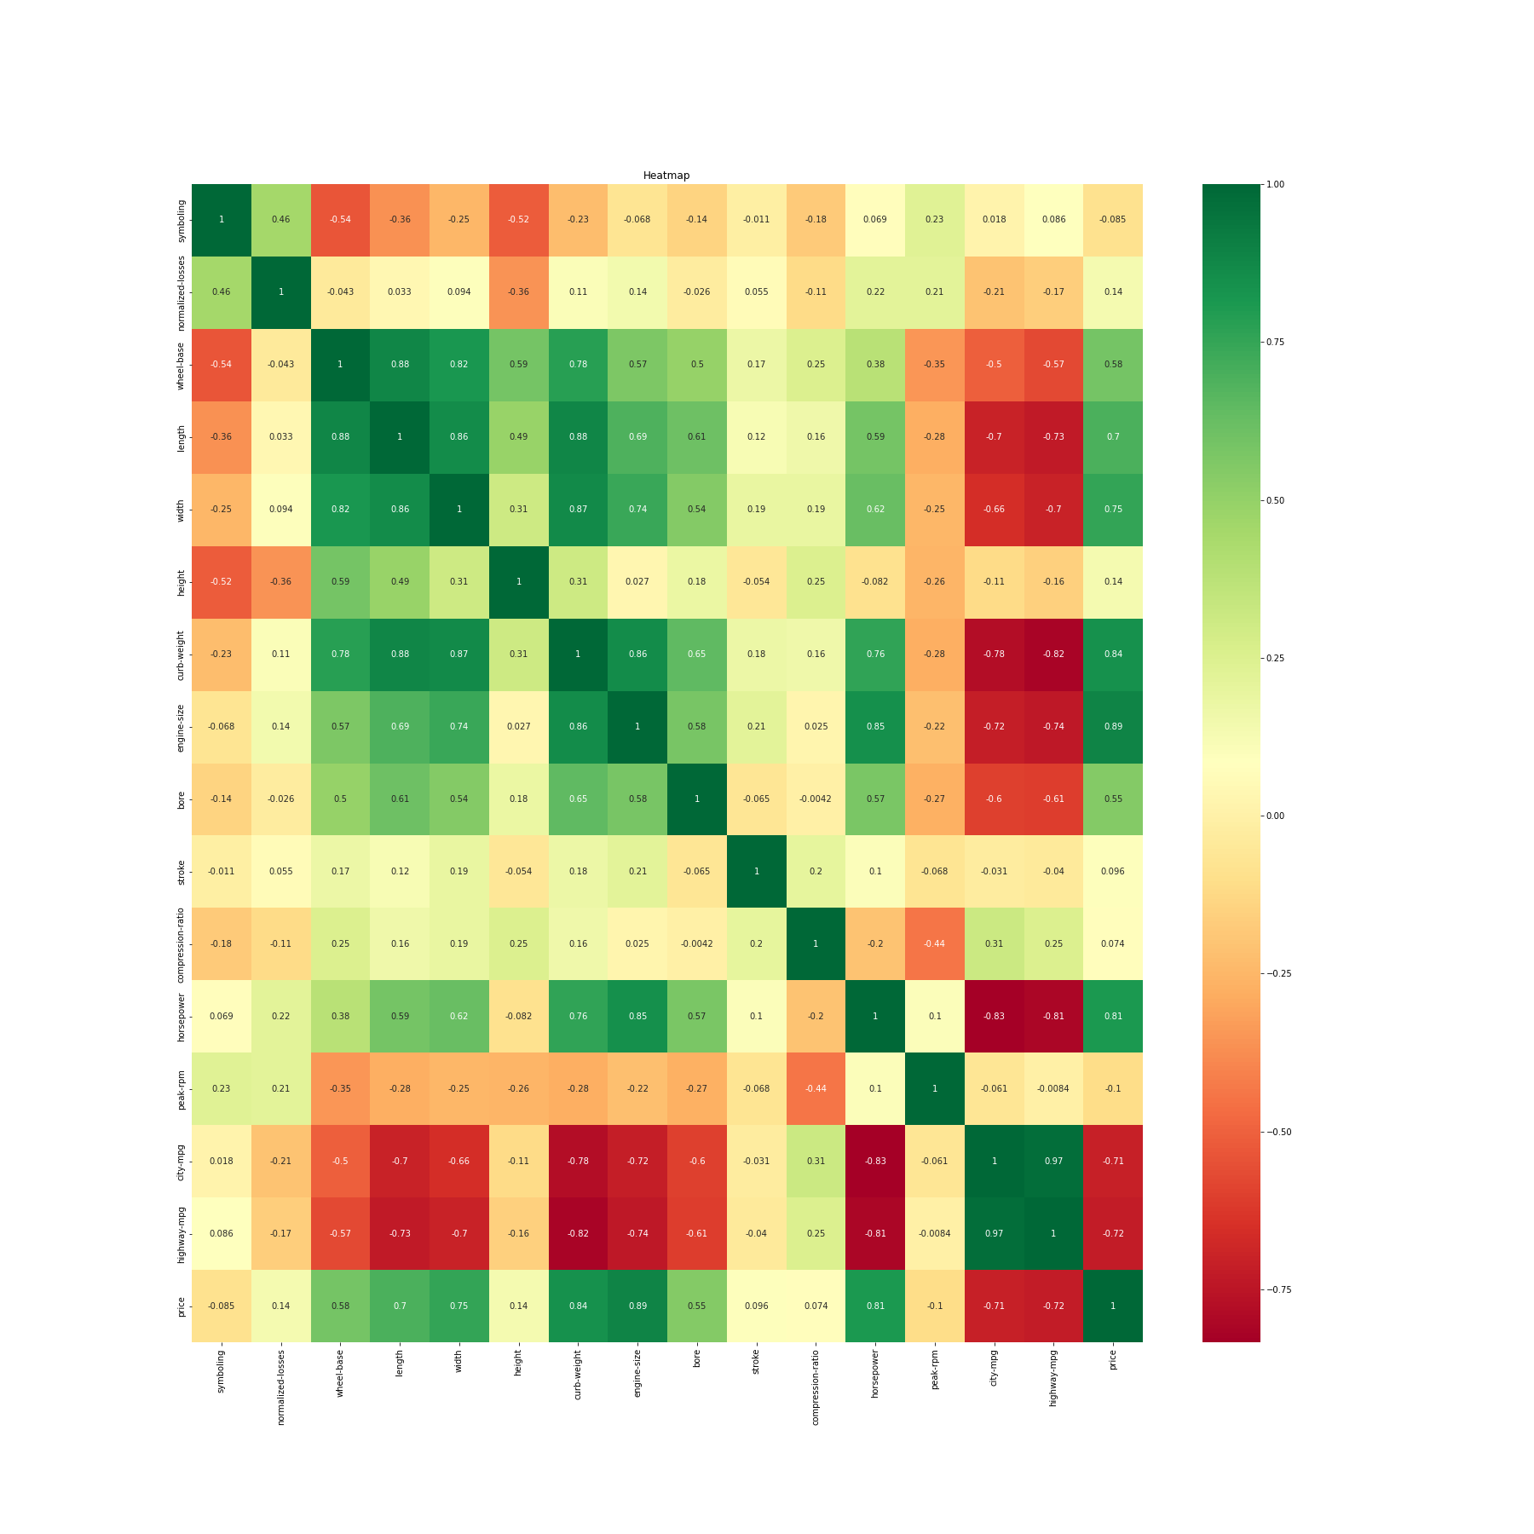
Correlation between the whole columns in heat map view

Slide 4
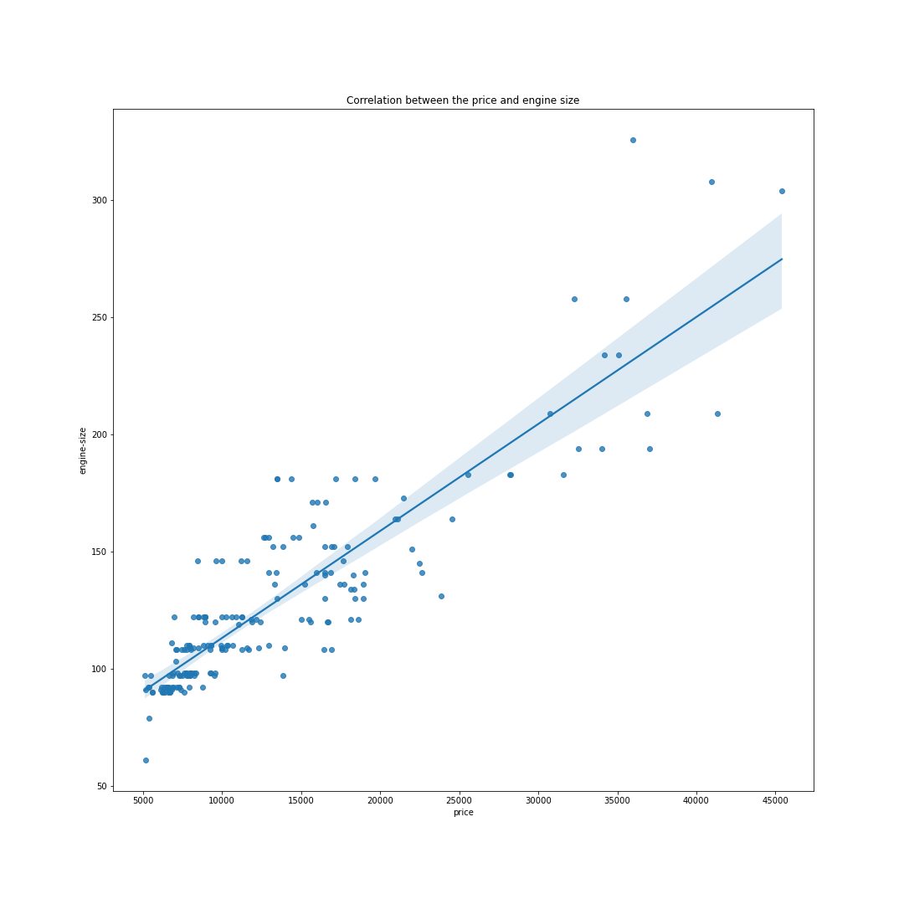
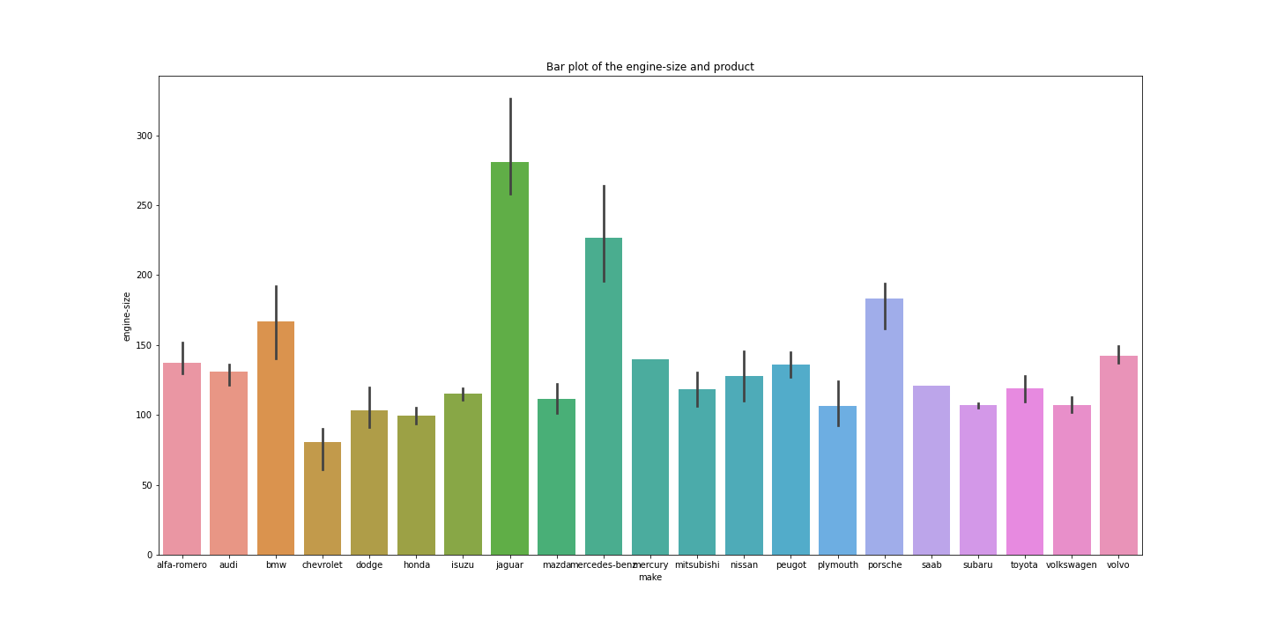
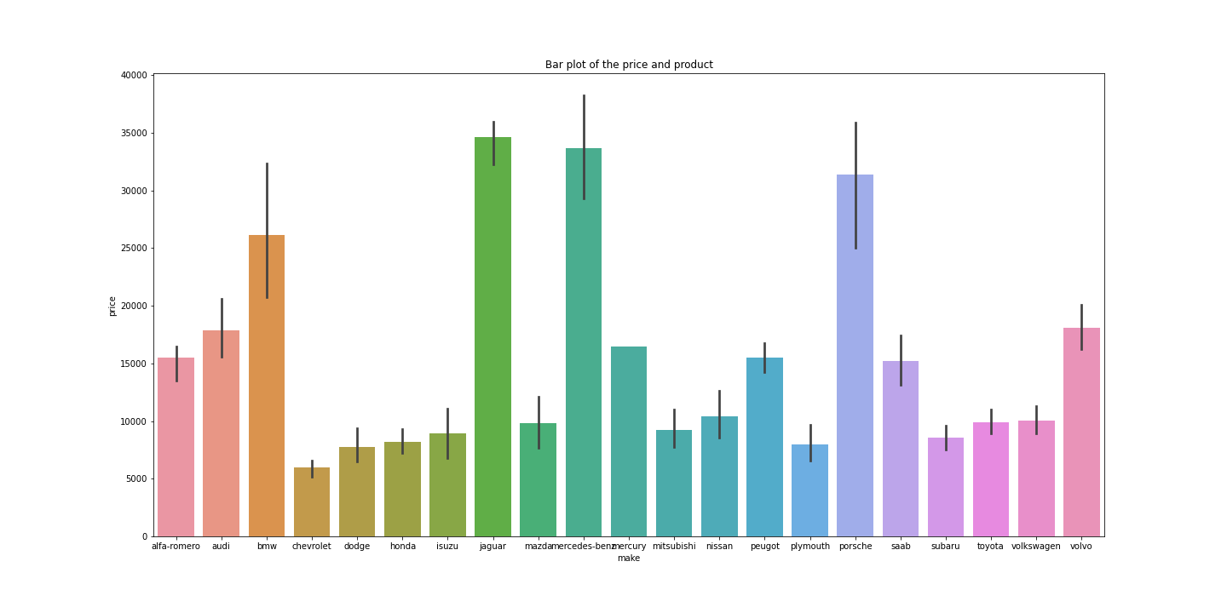
Plots showing the relationship and dependency as shown in heat map view of the correlation

Slide 5
In the third slide, we observe a heat map visualization that illustrates the relationships between all the columns and their interdependencies. If we focus on the car price, it becomes evident that the car price is influenced primarily by the engine size, followed by the curb weight, and thirdly by the horsepower.
Starting from the 4th slide, we observe a clear positive correlation between car prices and engine size. The subsequent visualization on the right-hand side juxtaposes engine sizes with the cars, while the final image at the bottom further illustrates the comparison between car prices and models. It's evident that the car with the highest price is a Jaguar, which also boasts the largest engine size.

