Slide 1
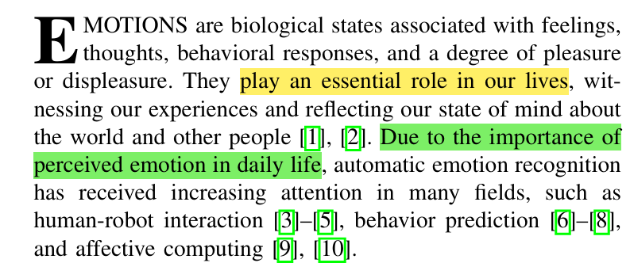
Hook
Emotions
Automatic emotion recognition
Due to the importance of… ,
… has received increasing attention.
Affective 情感的——同义词Emotional Affective更常用语学术研究

Slide 2
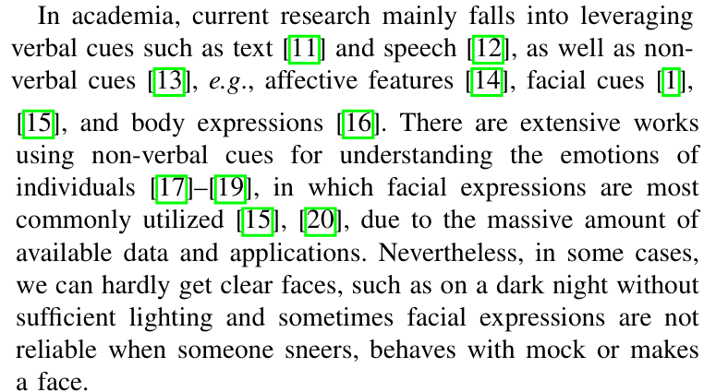





Hook
verbal cues
介绍目前研究重点
non-verbal cues
大量可用数据和应用程序
某些情况下存在问题
verbal 言语的
sneer 嘲笑 mock 模仿 make a face 做鬼脸

Slide 3
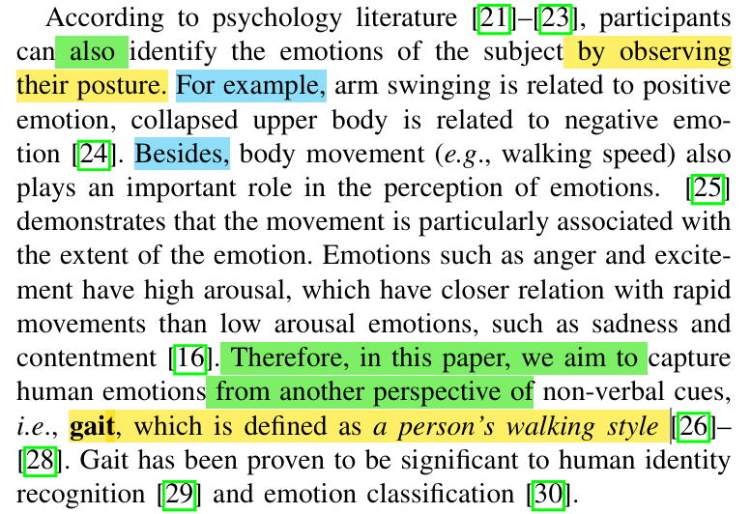


Background information
Automatic emotion recognition
Posture
Gait
Collapsed adj.收缩的
arousal n.唤醒
High arousal（高唤起）指的是一种生理和心理状态，表示个体的身体和心理激活程度较高

Slide 4
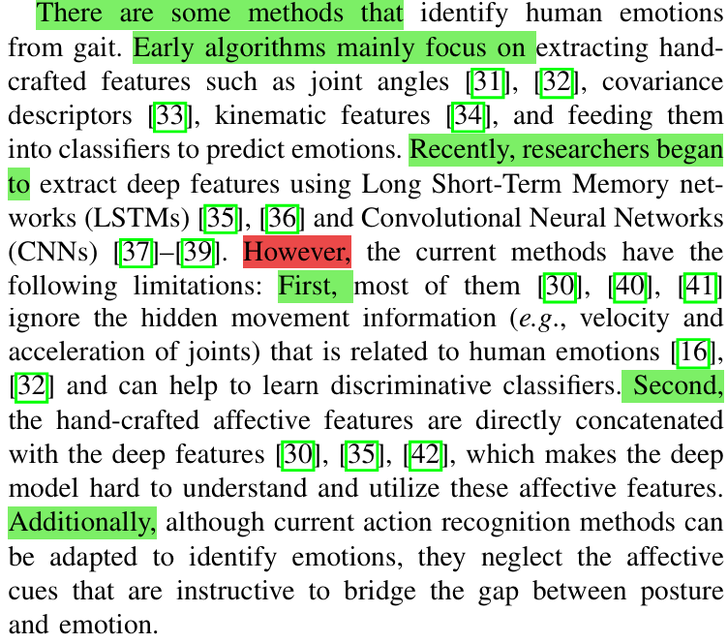








Thesis statement
介绍领域的方法
Early
Hand-crafted features
Recently
Deep features
Gap
Explain why it needs to be filled
extract v. 提取
Hand-crafted 手工制作的
Concatenate v. 连接

Slide 5
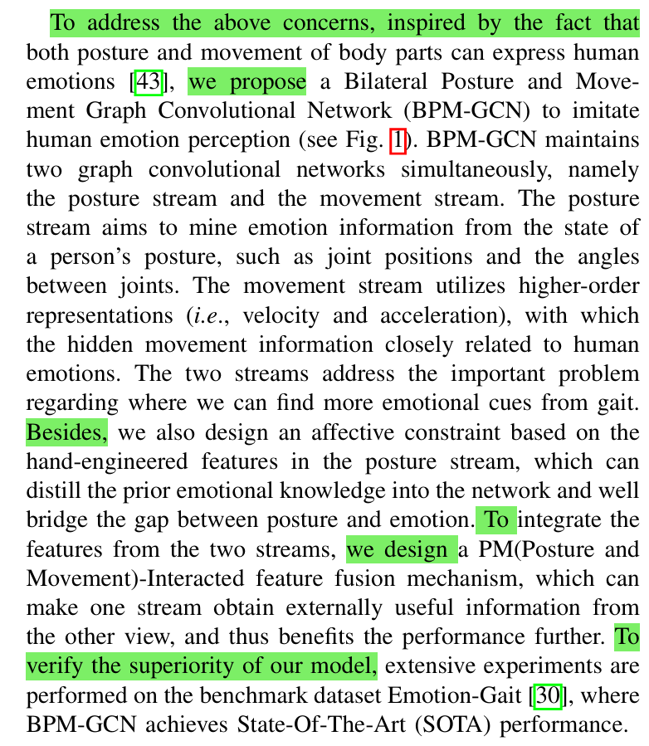
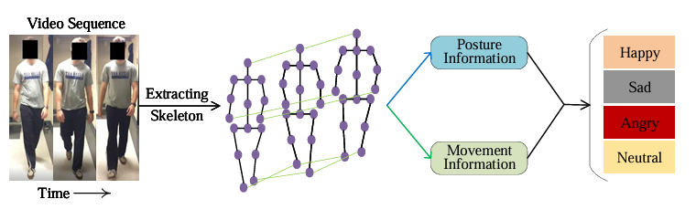







介绍自己的方法
BPM-GCN
Affective constraint
contribution
PM-Interacted feature fusion mechanism
Summarize how this study attempts to fill that gap
State-Of-The-Art (SOTA) performance
novel 新颖的
fourfold 四部分的
mine … from … 从…挖掘
superiority 优越性
imitate 模仿 simultaneously同时地 constraint约束 distill提取
骨架

