Slide 1
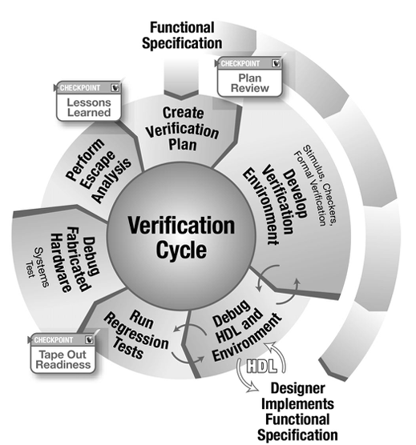


ECE 593 Fundamentals of Pre-Silicon Validation
Venkatesh Patil Electrical and Computer Engineering Department Maseeh College of Engineering and Computer Science

Slide 2
Design and Verification of Asynchronous FIFO
Winter 2025 – Group 11
Uma Mahesh Bestha bestha@pdx.edu
Sathwik Bandi sathwikb@pdx.edu
Bhanu Sai Sidhardha Tummala bhanusai@pdx.edu
Thanmai Neelampalli thanmain@pdx.edu
Date: 03/04/2025

Slide 3
Agenda
Introduction of Team Members
Project Introduction
Task Division
Design Implementation
Class based Verification
UVM based Verification
Overall Challenges and Learnings
Demo
Q & A

Slide 4
Project Introduction
Our project focuses on testing and verifying an Asynchronous FIFO designed to handle data transfer between two modules operating at different clock frequencies. The key specifications include:
Write Frequency (fA): 240 MHz
Read Frequency (fB): 400 MHz
Burst Length: 512 data items
Idle Cycles between Writes: 0
Idle Cycles between Reads: 2

Slide 5
Task Division
Task Category | Uma Mahesh | Thanmai
Design | Write pointer module Design Top | FIFO Memory
Class based Verification | Scoreboard Transaction class Verification of Burst passing from all Components | Generator class Test module Coverage class Verification of Burst passing from all Components
UVM based Verification | Write Sequence Agent UVM Test Bench Hierarchy | Monitor Read Sequence Verification of Burst passing from all Components
Documentation | HLDS Document PPT | HLDS Document PPT

Slide 6
Task Division
Task Category | Sathwik | Sidhardha
Design | FIFO Depth Calculation Write Synchronizer | Read pointer module
Class based Verification | Environment class Class based Test Bench Hierarchy Verification of Burst passing from all Components | Driver Monitor Verification of Burst passing from all Components
UVM based Verification | Driver Coverage Verification of Burst passing from all Components | Sequence Item Sequencer Test Testbench Top Scoreboard
Documentation | HLDS Document PPT | HLDS Document PPT

Slide 7
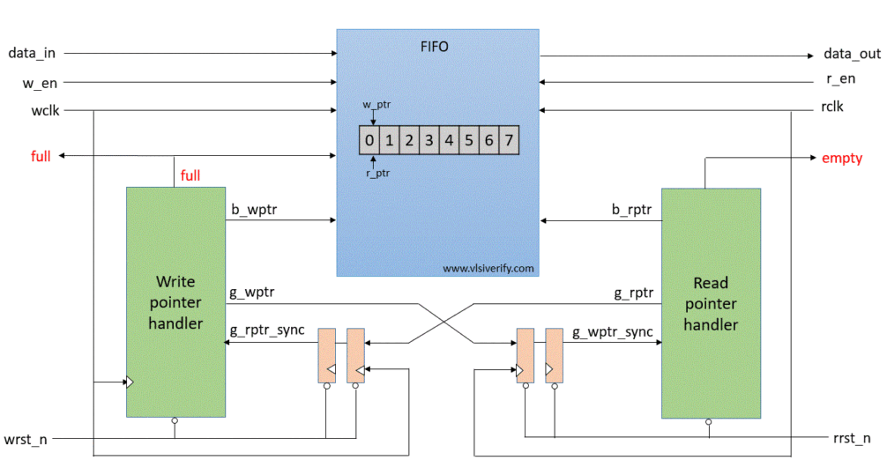
Design Implementation
Source: CummingsSNUG2002SJ_FIFO1.pdf (sunburst-design.com)

Slide 8
Design Implementation
For the given specifications, a FIFO depth of 228 data items is required to handle the write and read rates effectively. However, we are designing a FIFO with a depth of 256(approx to 2 power 8) data items.
Condition | Depth = 228 | Depth = 256
Empty State | FIFO starts empty. Fills up as data is written faster than read. | FIFO starts empty. Provides more buffer before filling up.
Steady-State Operation | FIFO oscillates between partially full and full. | FIFO provides more buffer, delaying full state.
Full Condition | Reached at 228 data items, risks overflow sooner. | Reached at 256 data items, more resilient to bursts.
Empty Condition | Less likely but possible if writing pauses. | Takes longer to empty if writing stops.(Writing freq > Effective reading freq)
Transient Condition | Handles intermediate states but fills up quicker. | Handles intermediate states more smoothly.

Slide 9
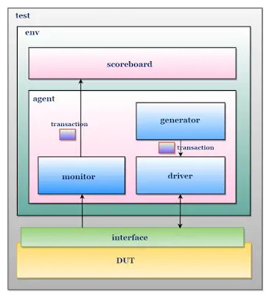
Class based Verification
Define verification Plan
Developed Testbench Environment
Wrote Test Cases
Ran Simulations
Analyzed results
Identified and addressed gaps

Slide 10
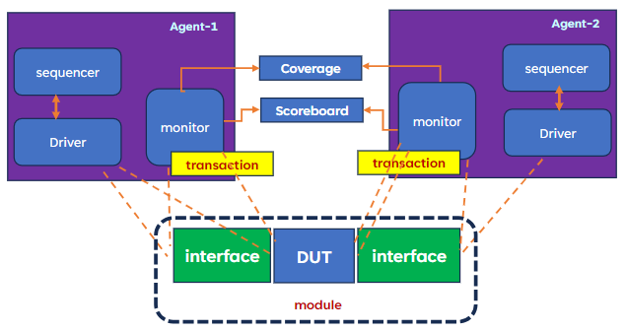
UVM based Verification
Agent 1 generates writing sequence
Agent 2 generates reading sequence

Slide 11
Test Scenarios and Coverage – Basic Tests
Test Scenario | Description | Functional Coverage Metrics
Write Operation | Writes a set of data into FIFO and checks if it is correctly stored. | Coverage of all write operations, including full FIFO condition.
Read Operation | Reads data from FIFO and verifies correctness. | Coverage of all read operations, including empty FIFO condition.
Write & Read Sequentially | Performs write followed by read and checks data integrity. | Coverage of write-read transitions, ensuring correct data flow.
Reset Functionality | Checks if FIFO clears all data and resets pointers properly. | Coverage of reset assertion and deassertion in different scenarios.

Slide 12
Test Scenarios and Coverage – Complex Tests
Test Scenario | Description | Functional Coverage Metrics
Concurrent Read & Write | Performs simultaneous read and write operations to check synchronization. | Coverage of all concurrent read/write scenarios, including edge cases where read and write occur in the same cycle
FIFO Full Condition Handling | Writes continuously until FIFO reaches full state and verifies correct full flag behavior. | Coverage of FIFO full condition, ensuring the full flag is asserted at the correct threshold and no further writes occur.

Slide 13
Test Scenarios and Coverage – Complex Tests
Test Scenario | Description | Functional Coverage Metrics
FIFO Empty Condition Handling | Reads continuously until FIFO is empty and ensures correct empty flag behavior. | Coverage of FIFO empty condition, verifying the empty flag is asserted correctly and no further reads occur.
Clock Domain Crossing | Tests FIFO behavior across different read and write clock frequencies. | Coverage of multiple clock ratios, ensuring data integrity across asynchronous clock domains.

Slide 14
Test Scenarios and Coverage – Regression Tests
Test Scenario | Description | Functional Coverage Metrics
Basic Regression Test | Runs a combination of read/write operations and checks for any failures. | Coverage of diverse read/write sequences, ensuring correct operation under normal conditions.
Randomized Read/Write Sequences | Uses constrained random stimulus to generate various FIFO usage scenarios. | Coverage of random read/write patterns, verifying behavior across different FIFO depths and corner cases.
Back-to-Back Read/Write Operations | Continuously writes and reads without pause, ensuring no glitches. | Coverage of continuous operation, ensuring no data loss or corruption under sustained traffic.

Slide 15
Test Scenarios and Coverage – Corner Cases
Test Scenario | Description | Functional Coverage Metrics
Almost Full & Almost Empty Handling | Ensures FIFO correctly handles near-full and near-empty conditions. | Coverage of near-full and near-empty thresholds, ensuring proper flag assertion and deassertion.
Simultaneous Reset & Operation | Checks if a reset during a read/write operation properly resets FIFO without data corruption. | Coverage of reset assertion during active transactions, verifying pointer resets and data integrity.
Bug Injection Test | Intentionally introduces errors (e.g., incorrect pointer updates) to verify error detection mechanisms. | Coverage of error scenarios, ensuring detection and recovery mechanisms function correctly.

Slide 16
Test Scenarios and Coverage
Test Scenario | Description | Functional Coverage Metrics
1. Reset Functionality | Verify that FIFO correctly resets and initializes all pointers and flags. | Reset signal assertion and de-assertion coverage
2. Write | Validate that data can be written to the FIFO correctly. | Write operation for all address locations.
3. Read | Validate that data can be read from the FIFO correctly. | Read operation for all address locations.
4. Full Condition | Verify the FIFO asserts the full flag when it is completely full. | Full condition detection and full flag assertion coverage.
5. Empty Condition | Verify the FIFO asserts the empty flag when it is completely empty. | Empty condition detection and empty flag assertion coverage.
6. Simultaneous Read and Write | Validate the FIFO behavior when read and write operations are performed simultaneously. | Simultaneous read/write operation coverage.

Slide 17
Challenges faced
Initial Setup Issues: Incorrect connections and read address increments caused initial setup failures.
Data Transfer Issues: Full and empty flags were not properly received due to connectivity and timing issues.
Monitoring Problems: Extraction of latest data post-read transfers failed, requiring synchronization fixes.
Error Detection Failures: Implementation of error detection and repair systems was insufficient due to race conditions.
Reset Functionality: The system faced difficulties in returning to the previous state due to an erroneous reset value, which was subsequently corrected.

Slide 18
Challenges resolved
Fixed incorrect connections and read address increment problems.
Corrected interface connections and timing to achieve accurate full and empty status.
Synchronized delays in the monitor and driver to ensure proper data updates.
Resolved race conditions affecting error detection and repair systems.
Corrected the erroneous reset value in the UVM testbench verification hierarchy to restore proper functioning state.

Slide 19
Demo and Conclusion
The design uses FIFO memory for sequential data management and 2-level synchronizers to reduce metastability risk.
Testing includes functional, boundary condition, random data transactions, and asynchronous operation testing.
The Asynchronous FIFO identifies FULL and EMPTY states with pointer-based techniques, ensuring efficient sequential data management and metastability reduction via 2-level synchronizers.
Testing methods cover functional, boundary condition, random data transactions, and asynchronous operation testing.

Slide 20
References
Venkatesh Patil-“ECE-593-Lecture Slides”.
https://verificationguide.com/uvm/uvm-testbench-architecture/
https://www.chipverify.com/
https://vlsiverify.com/verilog/verilog-codes/asynchronous-fifo/
https://www.verilogpro.com/asynchronous-fifo-design
Clifford E. Cummings, Sunburst Design, “Simulation and Synthesis Techniques for Asynchronous FIFO Design” http://www.sunburst-design.com/papers/CummingsSNUG2002SJ_FIFO1.pdf
https://hardwaregeeksblog.files.wordpress.com/2016/12/fifodepthcalculationmadeeasy2.pdf

