Slide 1
Software Engineering (Code: CSE3122)
B. Tech CSE 5th Sem.
(School of Computer Engineering)
Dr. Kranthi Kumar Lella
Associate Professor,
School of Computer Engineering,
Manipal Institute of Technology,
MAHE, Manipal – 576104.

Slide 2
SOFTWARE ENGINEERING
Module – 7
(CODING AND TESTING)
Coding, Code review, Software Documentation, Testing, Unit Testing, Black-Box testing, White-Box Testing, Debugging, Program Analysis tools, Regression testing, Security testing, Robustness testing, Fuzzy testing, Integration testing, Testing OOP, System testing, Some general issues associated with testing.

Slide 3
🔷 Coding and Testing: Overview
This Module focuses on the implementation and verification stages of software development, specifically:
Coding Phase
Testing Phase
✅ Coding Phase
📌 What Happens:
Each module designed during the design phase is coded (implemented).
Once coded, each module undergoes unit testing — tested in isolation to verify its correctness.
🔧 Key Activities:
Writing code based on the design document.
Unit testing modules as soon as they're coded.
Ensuring each module functions independently before integration.

Slide 4
🔗 Integration and Testing
📌 Integration Plan:
Modules are integrated step by step following a predefined integration plan.
In each step, new modules are added to the partially integrated system, and the combined system is tested.
Gradually, the complete system is built and tested.
System Testing
📌 What It Involves:
Done on the fully integrated product.
Software is tested against the Software Requirements Specification (SRS) to ensure it behaves as expected.

Slide 5
🔎 Importance of Testing
⚠️ Reality Check:
Testing is the most effort-intensive phase in software development.
A large number of test cases are required to validate functionality, performance, and robustness.
Parallel execution of test cases is common to save time.
👨‍💻 Manpower:
Testing teams are often larger than design/coding teams.
There's a high demand for software test engineers in the industry.
❌ Misconception:
Some beginners think testing is less intellectual than design or coding.
However, modern testing requires strong understanding of:
Testing techniques
Tools
Creative thinking to uncover bugs

Slide 6
7.1 CODING
🎯 Main Objective of the Coding Phase
To transform the design document into working code in a high-level programming language, followed by unit testing of each module.
🧾 Input to the Coding Phase
The Design Document, which contains:
High-level design (structure charts showing module call relationships)
Detailed design (module specifications including algorithms and data structures)
Example: Suppose your design includes calculateBill() and applyDiscount(). Each must now be coded separately and tested individually.
💼 What Happens in the Coding Phase?
Every module identified in design is coded as per its specifications.
Unit testing is done immediately after coding each module.
Code reviews are conducted to:
Check for errors
Ensure coding standard compliance

Slide 7
🔒 Coding Standards vs Coding Guidelines
Feature | Coding Standards | Coding Guidelines
Meaning | Rigid, formal rules that must be followed | Suggestions or good practices
Enforceability | Mandatory – checked during code review | Optional – developer discretion
Purpose | Ensure uniformity and consistency | Encourage clarity, maintainability, and efficiency
Example | Variable naming conventions, error codes | avoid cleavage coding, Don't re-use variables
📌 Benefits of Coding Standards
Uniform appearance across the codebase
Easier understanding, debugging, and maintenance
Promotes good programming practices
Supports code reuse

Slide 8
Example Coding Standards
Variable Naming
Global variables: Start with uppercase (e.g., GlobalCount)
Local variables: Start with lowercase (e.g., tempValue)
Constants: All uppercase (e.g., MAX_SIZE)
📄 Module Header Format
Should include:
Module Name
Creation Date
Author Name
Modification History
Synopsis (short description)
Functions list with I/O
Global variables used
🚨 Error and Exception Handling
Consistent return values for errors (e.g., 0 for success, 1 for failure)

Slide 9
📘 Example Coding Guidelines (Best Practices)
Guideline | Reason
❌ Don’t write clever or cryptic code (undesirable splitting or breaking up of code logic) | Makes code hard to understand and maintain
❌ Avoid uncertain side effects | E.g., hidden global variable changes or I/O
❌ Don’t use one variable for multiple purposes | Leads to confusion and bugs during enhancement
✅ Use meaningful variable names | Enhances code readability
✅ Add adequate comments | Rule of thumb: 1 comment per 3 lines of code
❌ Avoid GO TO statements | Makes code unstructured and hard to debug
❌ Limit function size to 10 lines max | Keeps functions simple, modular, and testable
📌 Code Review
Ensures compliance with coding standards
Identifies errors early (before testing)
Mandatory in good software development practices
Code that violates standards is rejected and reworked

Slide 10
✅ 7.2 CODE REVIEW
🎯 Objective
To detect logical, algorithmic, and programming errors in the code before testing begins.
It is more cost-effective than testing because:
Reviews directly detect errors, skipping the lengthy debugging process.
Debugging after testing is labor-intensive and time-consuming.
📌 When is Code Review Performed?
After successful compilation of a module (i.e., all syntax errors are fixed).
Targets semantic and logical errors, not syntax issues.
Benefits of Code Review
Reduces cost of error detection.
Produces high-quality, maintainable code.
Helps teams identify recurring coding issues and refine practices.
Improves coding style, algorithm selection, and design feedback.

Slide 11
🔍 Types of Code Review
1. Code Walkthrough
An informal review technique.
️ How it works:
Small group of developers (ideally 3 to 7 members).
Members review code a few days before the walkthrough meeting.
Each simulates execution of the code by hand using selected test cases.
Meeting is held to discuss findings.
✅ Guidelines for Effective Walkthroughs:
Focus on error discovery, not error fixing.
Managers should not attend, to encourage open, non-judgmental discussion.
Avoid large teams; keep it small and focused.
🎯 Objective:
To uncover algorithmic and logical flaws through mental simulation.

Slide 12
2. Code Inspection
A formal review technique aimed at detecting:
Common coding errors
Violations of coding standards
Programming oversights
🧰 Inspection Checklist (Sample Errors):
Use of uninitialized variables
Infinite loops or incorrect loop conditions
Array out-of-bounds access
Incorrect parameter passing
Improper memory allocation/deallocation
Use of wrong logical operators or precedence
Dangling references (use of unallocated memory)
Floating-point comparison issues
📈 Benefits Beyond Bug Detection:
Educates developers through exposure to others’ mistakes
Improves design thinking and coding practices
Enhances code maintainability

Slide 13
3. Cleanroom Technique
Developed by IBM; prevents defects instead of finding them later. Inspired by semiconductor "clean rooms."
🚫 Key Feature:
No code execution-based testing allowed by the programmer.
Only formal verification, walkthroughs, and inspections are used to remove bugs.
✅ Benefits:
Highly reliable and maintainable code
Strong emphasis on defect prevention
⚠️ Drawbacks:
Time-consuming
May miss runtime or environment-specific bugs that only show during real execution

Slide 14
7.3 SOFTWARE DOCUMENTATION
🎯 Purpose
Software documentation refers to all supporting documents created during the development lifecycle, alongside source code and executables.
Documentation = all supporting texts accompanying software.
📌 Importance of Documentation
Helps understand and maintain code.
Assists users in operating the software effectively.
Mitigates the manpower turnover issue by ensuring knowledge transfer.
Provides project tracking evidence to managers.

Slide 15
Types of Documentation
1. internal Documentation
Located within the source code. Aimed at making the code more understandable to developers.
🛠️ Common Forms:
Comments in code
Meaningful variable names ✅ Most useful for understanding
Function/module headers
Code indentation
Modular structure
Use of:
Enumerated types
Constant identifiers
User-defined data types
⚠️ Commenting Tip:
Avoid trivial comments like:
a = 10; /* a made 10 */ // ❌ Not helpful
Prefer comments that explain non-obvious logic or design decisions.

Slide 16
2. External Documentation
Created outside of code and shared with stakeholders.
📄 Examples:
SRS (Software Requirements Specification)
Design document
Test document
User manual
Installation guide
🧭 Key Qualities:
Must be up-to-date with code changes (to ensure consistency).
Should be understandable by its target audience.

Slide 17

📏 Gunning’s Fog Index
🧠 What is it?
A readability metric that tells how many years of education someone needs to understand a document.
For example, a fog index of 12 means a person with 12th-grade education can understand it comfortably.
🧮 Formula:
Complex words: Words with 3 or more syllables
Syllables are individual sounds, e.g., “understand” = un-der-stand (3 syllables)

Slide 18
✅ Example:
Sentence: “The Gunning’s fog index is based on the premise that use of short sentences and simple words makes a document easy to understand.”
Total words: 23
Complex words (≥3 syllables): 4
Count Complex Words
A complex word means a word with three or more syllables. In this sentence, the complex words (≥3 syllables) are:
Gunning’s – (Gun-ning’s → 2 syllables) ❌ Not complex
premise – (pre-mise → 2 syllables) ❌
sentences – (sen-ten-ces → 3 syllables) ✅
simple – (sim-ple → 2 syllables) ❌
document – (doc-u-ment → 3 syllables) ✅
understand – (un-der-stand → 3 syllables) ✅
index – (in-dex → 2 syllables) ❌
based – (1 syllable) ❌
So, there are 4 complex words total.
🎯 Application:
If you’re writing a manual for users with class 8 education, ensure fog index ≤ 8.

Slide 19
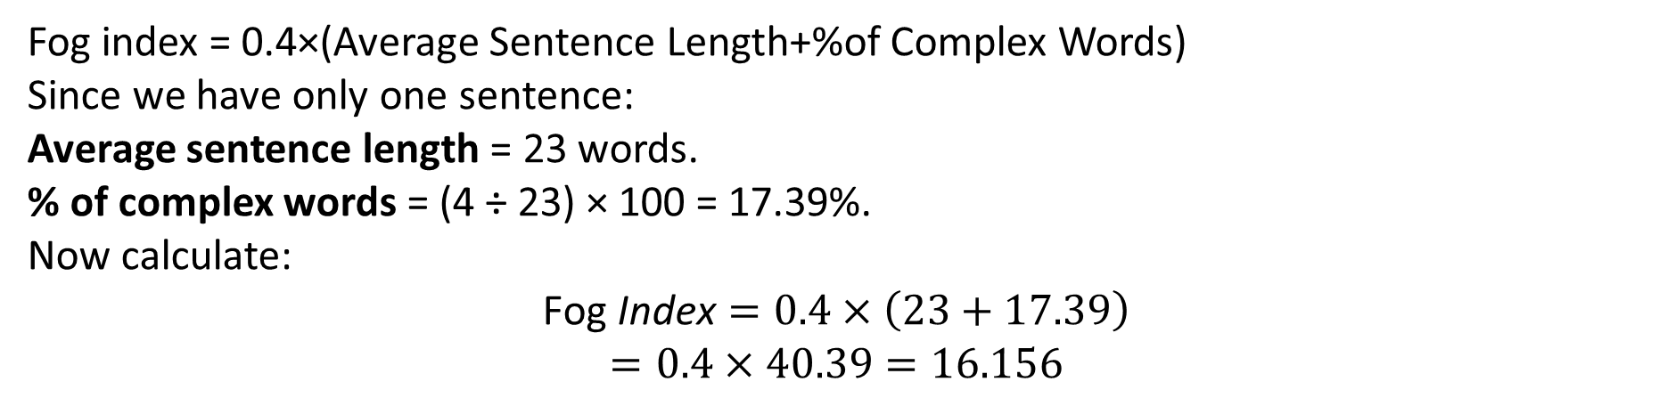
Fog index = 0.4×(Average Sentence Length+%of Complex Words)
Since we have only one sentence:
Average sentence length = 23 words.
% of complex words = (4 ÷ 23) × 100 = 17.39%.
Now calculate:
$$\text{Fog} \text{Index}=0.4×\left(23+17.39\right)$$
$$=0.4×40.39=16.156$$
A fog index of 16 means the document would be easily understood by someone with 16 years of formal education (roughly a college graduate).
Simpler writing (shorter sentences, fewer complex words) would lower the index and make it easier for a wider audience.

Slide 20
7.4 TESTING
🎯 Goal of Testing
To identify and eliminate defects in software.
However, exhaustive testing is impossible due to large input domains (e.g., floating-point numbers), but careful testing can still expose most bugs.
🔑 7.4.1 Basic Concepts & Terminologies
🧪 Testing Process
Involves:
Executing the program with test inputs.
Comparing actual vs expected output.
Noting down failures and conditions for debugging.

Slide 21
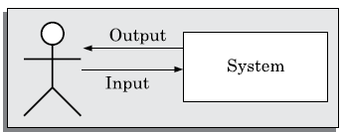
A highly simplified view of program testing is schematically shown in Figure 7.1.
FIGURE 7.1 A simplified view of program testing.

Slide 22
📘 Important Terms
Term | Definition
Mistake | Human error during development (e.g., not initializing a variable).
Error / Fault / Bug / Defect | The result of a mistake. All considered synonymous.
Failure | Incorrect behavior during execution due to bugs. Example: Program crash or incorrect result.
Test Case | A triplet [Input (I), State (S), Expected Result (R)].
Test Scenario | High-level idea of what to test; doesn’t include specific input/output.
Test Script | Programmatic version of a test case for automation.
Positive Test Case | Tests correct functionality (e.g., correct login).
Negative Test Case | Tests undesired functionality (e.g., invalid login).
Test Suite | Collection of test cases.
Testability | How easily a system can be tested.
Failure Mode | Observable form of failure (e.g., crash, incorrect output).
Equivalent Faults | Different bugs that lead to the same failure (e.g., division by zero and illegal memory access → crash).

Slide 23
🔄 Verification vs Validation
Aspect | Verification | Validation
Purpose | Are we building the product right? | Are we building the right product?
Focus | Checks if one phase output conforms to the previous. | Checks if final software meets requirements.
Methods | Review, simulation, formal verification, unit/integration testing. | Primarily system testing.
Execution | Doesn’t require running code. | Requires software execution.
Example | Design vs SRS match. | Code vs user requirement match.
Goal | Early bug detection (phase containment). | Ensure software meets user needs.
📝 Both together form the “V & V” (Verification and Validation) activities.

Slide 24
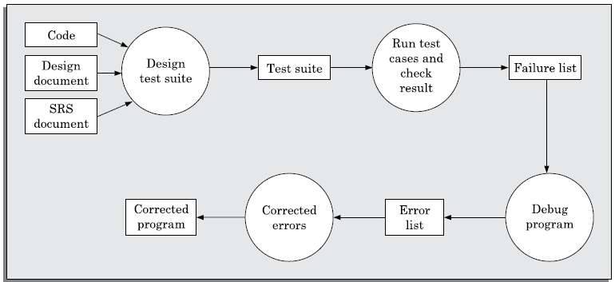
A typical testing process in terms of the activities that are carried out has been shown
schematically in Figure 7.2.
FIGURE 7.2 Testing process.

Slide 25
🔁 7.4.2 Testing Activities
Test Suite Design – Create test cases using strategies.
Run Test Cases – Execute them and compare results.
Locate Error (Debugging) – Trace failures back to bugs.
Correct Error – Modify code and re-test.
🔍 Debugging is often the most time-consuming activity.
❓ 7.4.3 Why Design Test Cases?
Random inputs ≠ effective testing.
Carefully designed test cases find unique errors.
Example: A wrong else block (max = x instead of max = y) may go undetected if only tested with inputs where x > y.
🧠 Goal: A minimal, well-designed test suite that finds as many errors as possible.

Slide 26
🎯 7.4.4 Testing in the Large vs Small
Type | Definition
Unit Testing | Testing individual modules (functions/classes).
Integration Testing | Testing combined modules and their interactions.
System Testing | Testing the complete integrated system.
🔹 Unit testing = Testing in the Small 🔹 Integration + System testing = Testing in the Large
📌 Why not test the system as a whole?
Other modules may not be ready.
Easier debugging at unit level.
Helps localize errors faster.

Slide 27
7.4.5 Tests as Bug Filters
📉 Diminishing Returns
Once a test suite covers most defects, adding similar test cases won’t help much. Each new test strategy filters more bugs, but returns diminish.
🐛 Bug Filter Analogy (Beizer, 1990):
Like using pesticides — first spray kills many bugs, survivors become resistant. You need different sprays (test strategies) to catch remaining bugs.
📐 Example Calculation – Bug Reduction
Suppose: 10 test strategies, each removes 30% of current bugs. Initial bugs = 1000 Remaining after each step = 70% of previous bugs
Bugs after 10 rounds = 1000 × (0.7) 10 = 1000×0.028 = 28 bugs left​

Slide 28
Test Levels
Unit testing
Test each module (unit, or component) independently
Mostly done by developers of the modules
Integration testing
Modules are integrated in steps according to an integration plan
The partially integrated system is tested at each integration step
system testing
Test the system as a whole
Often done by separate testing or QA team

Slide 29
Overview of Activities During System and Integration Testing
Test Suite Design
Run test cases
Check results to detect failures.
Prepare failure list
Debug to locate errors
Correct errors.
Tester
Developer

Slide 30
7.5 UNIT TESTING
Definition
Unit testing is the process of testing individual modules or units of software (functions, procedures, classes) in isolation to verify that they work correctly.
Done after coding is complete and syntax errors are removed.
Usually performed by the developer (coder) of that module.
Conducted during the coding phase.
Why Unit Testing Needs a Test Environment
To test a single module, it must be placed in a suitable environment that simulates its interactions with:
Other modules it calls
Global data it uses
A function that calls it
Since the complete system may not yet exist (other modules may not be ready), we use two artificial components:

Slide 31
🧩 Stubs and Drivers
🧰 Driver
Acts as the caller of the module under test.
Simulates the higher-level module.
Provides:
Input values
Any global or shared data
Code to invoke the unit’s functions
🔧 Stub
Simulates the lower-level modules called by the unit under test.
Is a dummy procedure with:
The same interface (same function signature)
Simplified logic, often returns fixed or table-based values

Slide 32
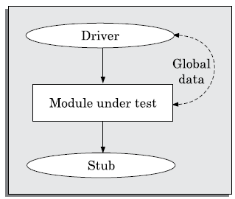
FIGURE 7.3 Unit testing with the help of driver and stub modules.
Think of:
Driver = Test Harness → Calls the module
Stub = Fake Callees → Simulate dependencies

Slide 33
✅ Benefits of Unit Testing
Helps detect early-stage bugs in individual functions.
Makes debugging easier, as problems are localized.
Encourages modular design.
Limitation
Even well-designed unit test suites cannot guarantee that a module is completely error-free — only that it behaves as expected for the tested inputs.
📝 Example Scenario
If you're testing a calculateBill() function:
The Driver might pass sample user and product data.
The Stub for fetchDiscount() might return 10% always instead of computing from a database.

Slide 34
7.6 BLACK-BOX TESTING
🔍 What is Black-Box Testing?
Test cases are designed based only on input/output specifications — no knowledge of internal code or logic is required.
Also known as functional testing.
🔧 Two Main Techniques:
1. Equivalence Class Partitioning (ECP)
Idea: Divide the input domain into equivalence classes such that:
All values within a class are treated the same by the program.
Testing one representative value from each class is enough.
🧠 How to Identify Equivalence Classes:
If input is from a range, define:
1 valid class (within range)
2 invalid classes (below and above range)
📌 Example: For input range [1,10] ➤ Valid: [1–10] ➤ Invalid: (−∞ to 0), (11 to ∞)

Slide 35
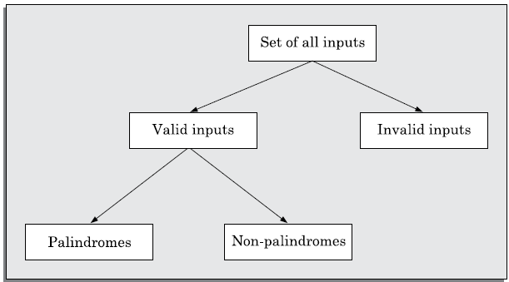
FIGURE 7.4 Equivalence classes for Problem 7.3.

Slide 36
If input must come from a specific set of valid values, say {A, B, C}, then:
Valid class: {A, B, C}
Invalid class: All other inputs (anything not in {A, B, C})
This means we pick one test value from each class — one valid, one invalid — to represent the whole set.
✔️ Examples:
🧮 Problem 7.1: Square root function for integers 0–5000
Specification: Function accepts integers between 0 and 5000 (inclusive).
Equivalence classes:
Invalid: (-∞, -1] → negative numbers (can’t take sqrt of negatives)
Valid: [0, 5000] → acceptable range
Invalid: [5001, ∞) → too large (beyond allowed range)
Representative test cases: { -5, 500, 6000 }
-5 → invalid (below range)
500 → valid
6000 → invalid (above range)

Slide 37
📏 Problem 7.2: Lines intersection
We are testing a program that finds the intersection of two lines.
When we input two lines, the program should tell us what kind of intersection they have.
There are three possible outcomes:
The lines are parallel → they never meet.
The lines are intersecting → they meet at exactly one point.
The lines are coincident → they are the same line, so they meet at infinite points.
🧠 Step 1: Identify the Classes
Each type of intersection represents a different equivalence class — because the program’s behavior (output) changes depending on which case it is.
So the equivalence classes are:
Class Name | Meaning | Example Behavior
Parallel | Lines never meet | Output: “No intersection”
Intersecting | Lines cross at one point | Output: “Lines meet at (x, y)”
Coincident | Lines overlap completely | Output: “Infinite intersections”
Notes:
✅ 1. Rule: Set of Values Example
If input must come from a specific set of valid values, say {A, B, C}, then:
Valid class: {A, B, C}
Invalid class: All other inputs (anything not in {A, B, C})
This means we pick one test value from each class — one valid, one invalid — to represent the whole set.
💡 Example Problem Explanations
🧮 Problem 7.1: Square root function for integers 0–5000
Specification: Function accepts integers between 0 and 5000 (inclusive).
Equivalence classes:
Invalid: (-∞, -1] → negative numbers (can’t take sqrt of negatives)
Valid: [0, 5000] → acceptable range
Invalid: [5001, ∞) → too large (beyond allowed range)
Representative test cases: { -5, 500, 6000 }
-5 → invalid (below range)
500 → valid
6000 → invalid (above range)
📏 Problem 7.2: Lines intersection
Specification: Two lines may be:
Parallel (no intersection point)
Intersecting (one intersection point)
Coincident (infinite intersections)
Equivalence classes:
Class 1: Parallel lines
Class 2: Intersecting lines
Class 3: Coincident lines
Test cases (representative of each class):
{(2,2)(2,5)} → Parallel
{(5,5)(7,7)} → Intersecting
{(10,10)(10,10)} → Coincident
Each represents one class of behavior.
🔁 Problem 7.3: Palindrome checker
Specification: Input string must have fewer than 5 characters.
Equivalence classes:
Valid Palindrome (e.g., "aba")
Valid Non-palindrome (e.g., "abc")
Invalid Input (≥5 chars, e.g., "abcdef")
Test cases: { "aba", "abc", "abcdef" }
"aba" → palindrome → valid
"abc" → non-palindrome → valid
"abcdef" → invalid input (too long)

Slide 38
Step 2: Choose Representative Test Cases
We don’t need to test every possible pair of lines — just one example per class, because all lines in the same class behave similarly.
Class | Test Case Example | Explanation
Parallel | {(2,2)(2,5)} | Two vertical lines that never meet.
Intersecting | {(5,5)(7,7)} | Two lines crossing each other.
Coincident | {(10,10)(10,10)} | Both lines are exactly the same.
🧾 Case 1: Parallel lines — {(2,2)(2,5)}
These are two vertical lines at x = 2 and x = 5 (for example). They go up and down but never meet.
🧱 Class: Parallel (no intersection) 🧪 Expected Output: "No intersection point."

Slide 39
🧾 Case 2: Intersecting lines — {(5,5)(7,7)}
These are two lines with different slopes, so they cross each other at exactly one point. Think of one line going diagonally up-right and another going diagonally down-right — they cross once.
🧱 Class: Intersecting (one intersection point) 🧪 Expected Output: "Intersection at (x, y)."
🧾 Case 3: Coincident lines — {(10,10)(10,10)}
Here, the two lines are exactly the same — all their points overlap. That means they meet at infinite points.
🧱 Class: Coincident (infinite intersections) 🧪 Expected Output: "Lines are the same."
You are dividing the behavior of “lines intersection” into three logical categories (equivalence classes) and picking one test case from each. That’s how Equivalence Class Partitioning works — each test represents a group of similar possible inputs.

Slide 40
🔁 Problem 7.3: Palindrome checker
Specification: Input string must have fewer than 5 characters.
Equivalence classes:
Valid Palindrome (e.g., "aba")
Valid Non-palindrome (e.g., "abc")
Invalid Input (≥5 chars, e.g., "abcdef")
Test cases: { "aba", "abc", "abcdef" }
"aba" → palindrome → valid
"abc" → non-palindrome → valid
"abcdef" → invalid input (too long)
🎯 Key Idea
Each equivalence class represents a distinct type of input behavior. By testing one value from each class, we efficiently ensure broad coverage of all functional possibilities — this is the essence of Equivalence Class Partitioning in black-box testing.
Notes:
✅ 1. Rule: Set of Values Example
If input must come from a specific set of valid values, say {A, B, C}, then:
Valid class: {A, B, C}
Invalid class: All other inputs (anything not in {A, B, C})
This means we pick one test value from each class — one valid, one invalid — to represent the whole set.
💡 Example Problem Explanations
🧮 Problem 7.1: Square root function for integers 0–5000
Specification: Function accepts integers between 0 and 5000 (inclusive).
Equivalence classes:
Invalid: (-∞, -1] → negative numbers (can’t take sqrt of negatives)
Valid: [0, 5000] → acceptable range
Invalid: [5001, ∞) → too large (beyond allowed range)
Representative test cases: { -5, 500, 6000 }
-5 → invalid (below range)
500 → valid
6000 → invalid (above range)
📏 Problem 7.2: Lines intersection
Specification: Two lines may be:
Parallel (no intersection point)
Intersecting (one intersection point)
Coincident (infinite intersections)
Equivalence classes:
Class 1: Parallel lines
Class 2: Intersecting lines
Class 3: Coincident lines
Test cases (representative of each class):
{(2,2)(2,5)} → Parallel
{(5,5)(7,7)} → Intersecting
{(10,10)(10,10)} → Coincident
Each represents one class of behavior.
🔁 Problem 7.3: Palindrome checker
Specification: Input string must have fewer than 5 characters.
Equivalence classes:
Valid Palindrome (e.g., "aba")
Valid Non-palindrome (e.g., "abc")
Invalid Input (≥5 chars, e.g., "abcdef")
Test cases: { "aba", "abc", "abcdef" }
"aba" → palindrome → valid
"abc" → non-palindrome → valid
"abcdef" → invalid input (too long)

Slide 41
2. Boundary Value Analysis (BVA)
Idea: Programmers often make mistakes at the boundaries of input ranges (e.g., using < instead of <=).
So, test cases should include:
Lower bound, upper bound, and values just outside these bounds.
✔️ Examples:
Problem 10.11: Square root for range [0–5000] ➤ Test cases: {−1, 0, 5000, 5001}
Problem 10.12: String palindrome (< 5 characters) ➤ Boundary between valid and invalid input length ➤ Test cases: {abcdef (6 chars), abcde (5 chars)}

Slide 42
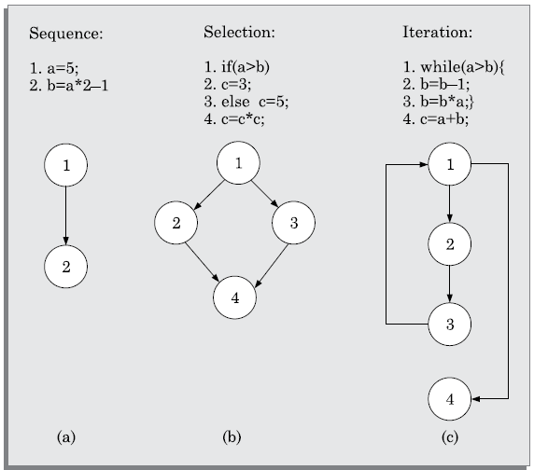
FIGURE 7.5 CFG for (a) sequence, (b) selection, and (c) iteration type of constructs.

Slide 43
📝 Summary of Black-Box Testing Process:
Examine input and output values of the software.
Identify equivalence classes (valid & invalid).
Select one representative test input from each equivalence class.
Design boundary value test cases by:
Including edge values
Including just-beyond-the-edge values
Equivalence Class Testing → Maximizes coverage with minimal test cases.
Boundary Testing → Targets common edge-case errors.
Black-box testing is simple, intuitive, but requires practice to identify all equivalence classes accurately.
Use both ECP and BVA together for effective black-box testing.

Slide 44
7.7 WHITE-BOX TESTING
White-box testing is a unit testing method based on internal code structure. It uses the source code to design test cases. There are two types of strategies:
📌 7.7.1 Basic Concepts
Coverage-Based Testing: Ensures specific parts of code (e.g., statements, branches) are executed.
Fault-Based Testing: Designed to uncover specific faults (e.g., using mutation testing).
A test suite is adequate if it satisfies the chosen testing criterion.
Comparison:
One strategy is stronger if it covers all that another does and more.
Two strategies are complementary if they cover different program elements.

Slide 45
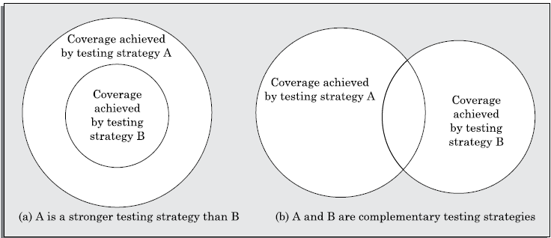
When none of two testing strategies fully covers the program elements exercised by the other, then the two are called complementary testing strategies. The concepts of stronger, weaker, and complementary testing are schematically illustrated in Figure 7.6. Observe in Figure 7.6(a) that testing strategy A is stronger than B since B covers only a proper subset of elements covered by B. On the other hand, Figure 7.6(b) shows A and B are complementary testing strategies since some elements of A are not covered by B and vice versa.
FIGURE 7.6 Illustration of stronger, weaker, and complementary testing strategies.

Slide 46
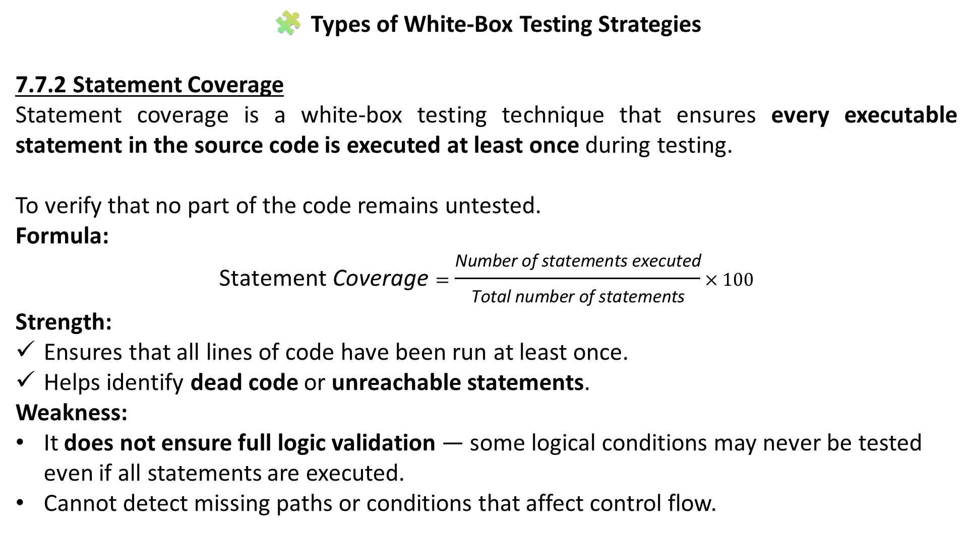
🧩 Types of White-Box Testing Strategies
7.7.2 Statement Coverage
Statement coverage is a white-box testing technique that ensures every executable statement in the source code is executed at least once during testing.
To verify that no part of the code remains untested.
Formula:
$$\text{Statement} \text{Coverage}=\frac{\text{Number} \text{of} \text{statements} \text{executed}}{\text{Total} \text{number} \text{of} \text{statements}}×100$$
Strength:
Ensures that all lines of code have been run at least once.
Helps identify dead code or unreachable statements.
Weakness:
It does not ensure full logic validation — some logical conditions may never be tested even if all statements are executed.
Cannot detect missing paths or conditions that affect control flow.

Slide 47
Example GCD
int gcd(int a, int b) {
while (a != b) {
if (a > b)
a = a - b;
else
b = b - a;
}
return a;
}
Test Cases for Statement Coverage:
(3, 3) → Executes the return statement directly (loop skipped).
(4, 3) → Executes if (a > b) branch.
(3, 4) → Executes the else branch.
✅ All statements are executed at least once.
Limitation: These test cases cover all statements but do not guarantee all logical conditions (a > b and a < b) are tested in all possible orders or scenarios.

Slide 48
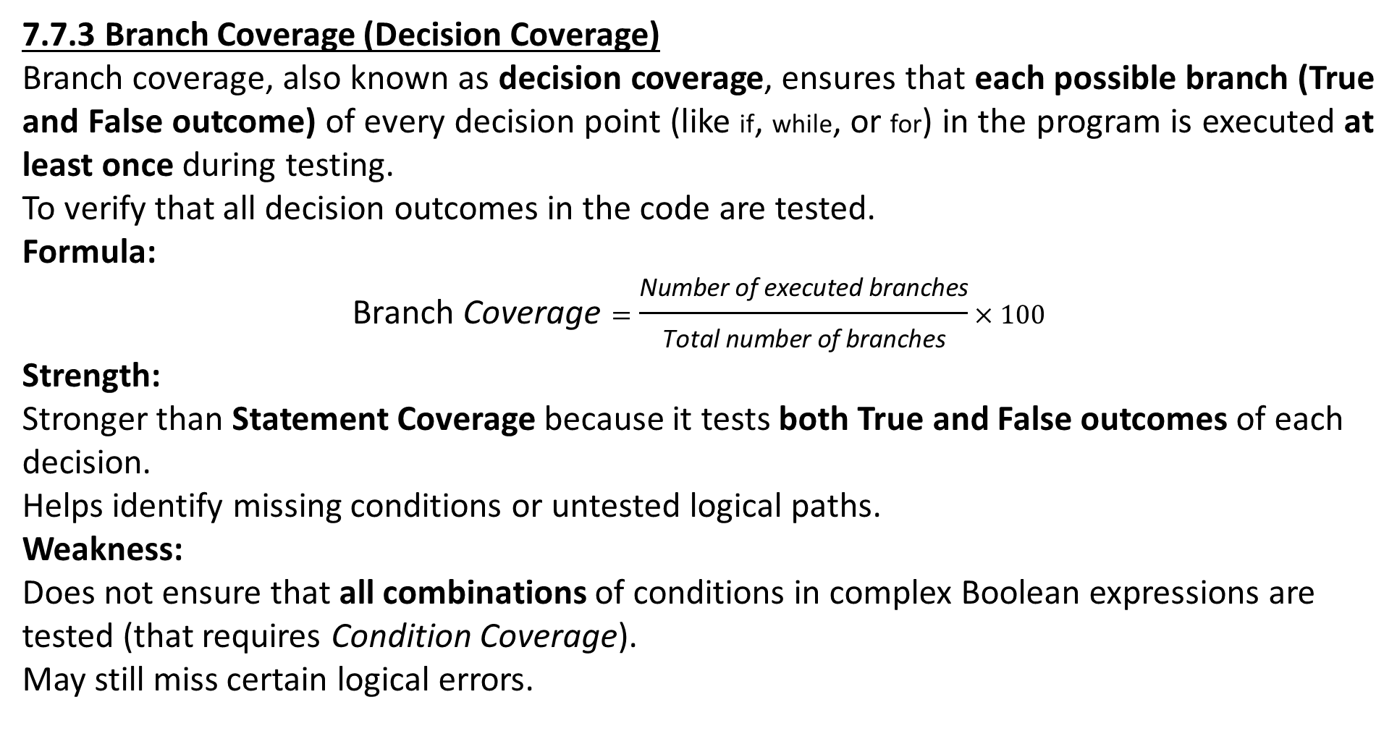
7.7.3 Branch Coverage (Decision Coverage)
Branch coverage, also known as decision coverage, ensures that each possible branch (True and False outcome) of every decision point (like if, while, or for) in the program is executed at least once during testing.
To verify that all decision outcomes in the code are tested.
Formula:
$$\text{Branch} \text{Coverage}=\frac{\text{Number} \text{of} \text{executed} \text{branches}}{\text{Total} \text{number} \text{of} \text{branches}}×100$$
Strength:
Stronger than Statement Coverage because it tests both True and False outcomes of each decision.
Helps identify missing conditions or untested logical paths.
Weakness:
Does not ensure that all combinations of conditions in complex Boolean expressions are tested (that requires Condition Coverage).
May still miss certain logical errors.

Slide 49
Example: Euclid’s GCD Algorithm
int gcd(int a, int b) {
while (a != b) {
if (a > b)
a = a - b;
else
b = b - a;
}
return a;
}
Decision Points:
while (a != b) → True / False
if (a > b) → True / False
Test Case | Description | while (a!=b) | if (a>b)
(3,3) | Loop condition false immediately | False | —
(3,2) | Loop true, if true branch executes | True | True
(4,3) | Loop true, if true branch executes | True | True
(3,4) | Loop true, else branch executes | True | False
✅ All True and False branches of both decisions are executed at least once. Thus, Branch Coverage = 100%

Slide 50
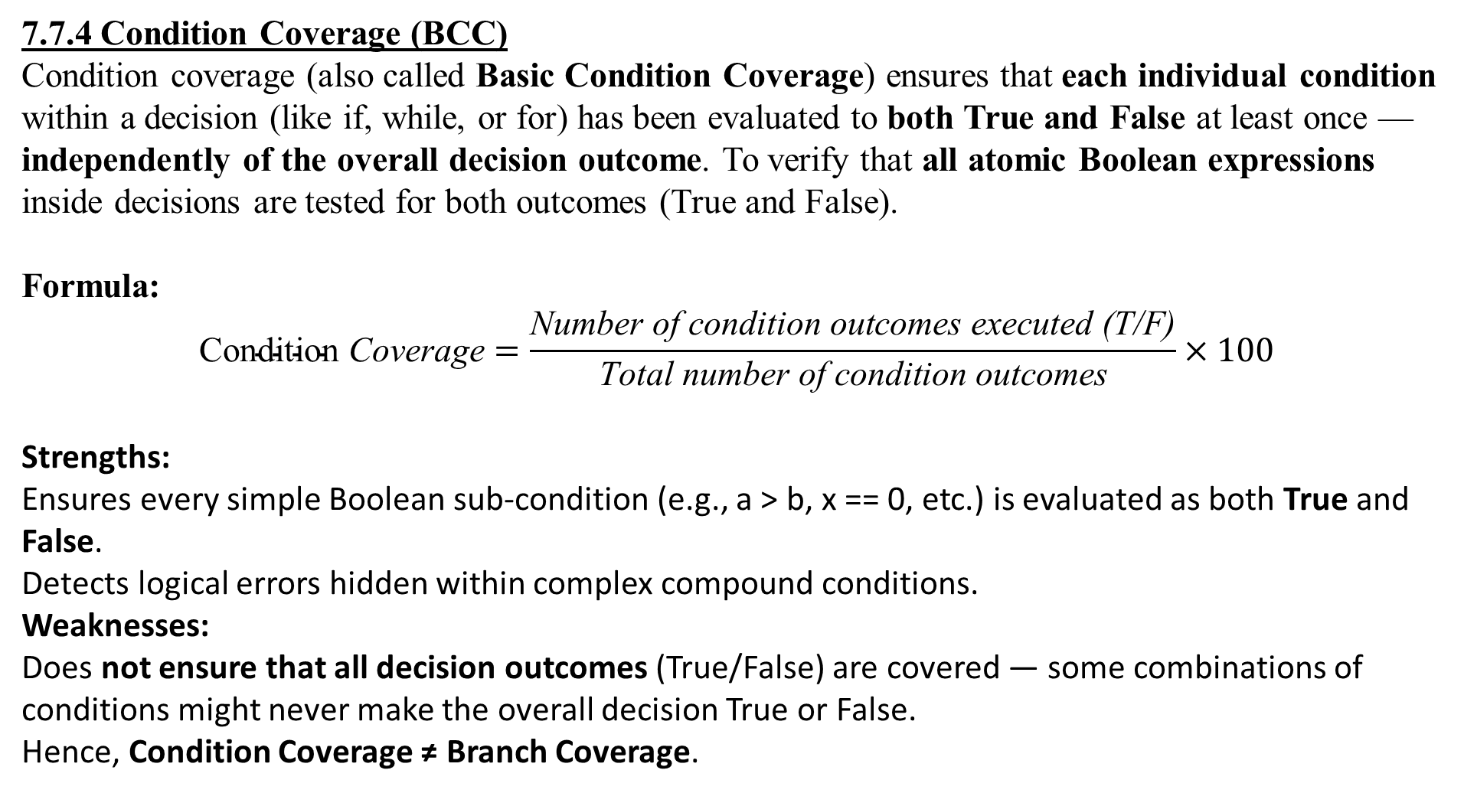
7.7.4 Condition Coverage (BCC)
Condition coverage (also called Basic Condition Coverage) ensures that each individual condition within a decision (like if, while, or for) has been evaluated to both True and False at least once — independently of the overall decision outcome. To verify that all atomic Boolean expressions inside decisions are tested for both outcomes (True and False).
Formula:
$$\text{Condition} \text{Coverage}=\frac{\text{Number} \text{of} \text{condition} \text{outcomes} \text{executed}\text{ (}\text{T}\text{/}\text{F}\text{)}}{\text{Total} \text{number} \text{of} \text{condition} \text{outcomes}}×100$$
Strengths:
Ensures every simple Boolean sub-condition (e.g., a > b, x == 0, etc.) is evaluated as both True and False.
Detects logical errors hidden within complex compound conditions.
Weaknesses:
Does not ensure that all decision outcomes (True/False) are covered — some combinations of conditions might never make the overall decision True or False.
Hence, Condition Coverage ≠ Branch Coverage.

Slide 51
Example:
if ((a > b) && (b > 0))
printf("Valid\n");
else
printf("Invalid\n");
Basic Conditions:
a > b
b > 0
Each of these two conditions must be True and False at least once, regardless of the overall decision result.
Test Case | a | b | (a>b) | (b>0) | Overall Decision
3, 2 | T | T | True
3, -1 | T | F | False
1, 2 | F | T | False
1, -1 | F | F | False
✅ Each basic condition (a>b and b>0) has been True and False at least once. ❌ However, not all combinations necessarily make the overall decision True or False, so full branch coverage is not guaranteed.

Slide 52
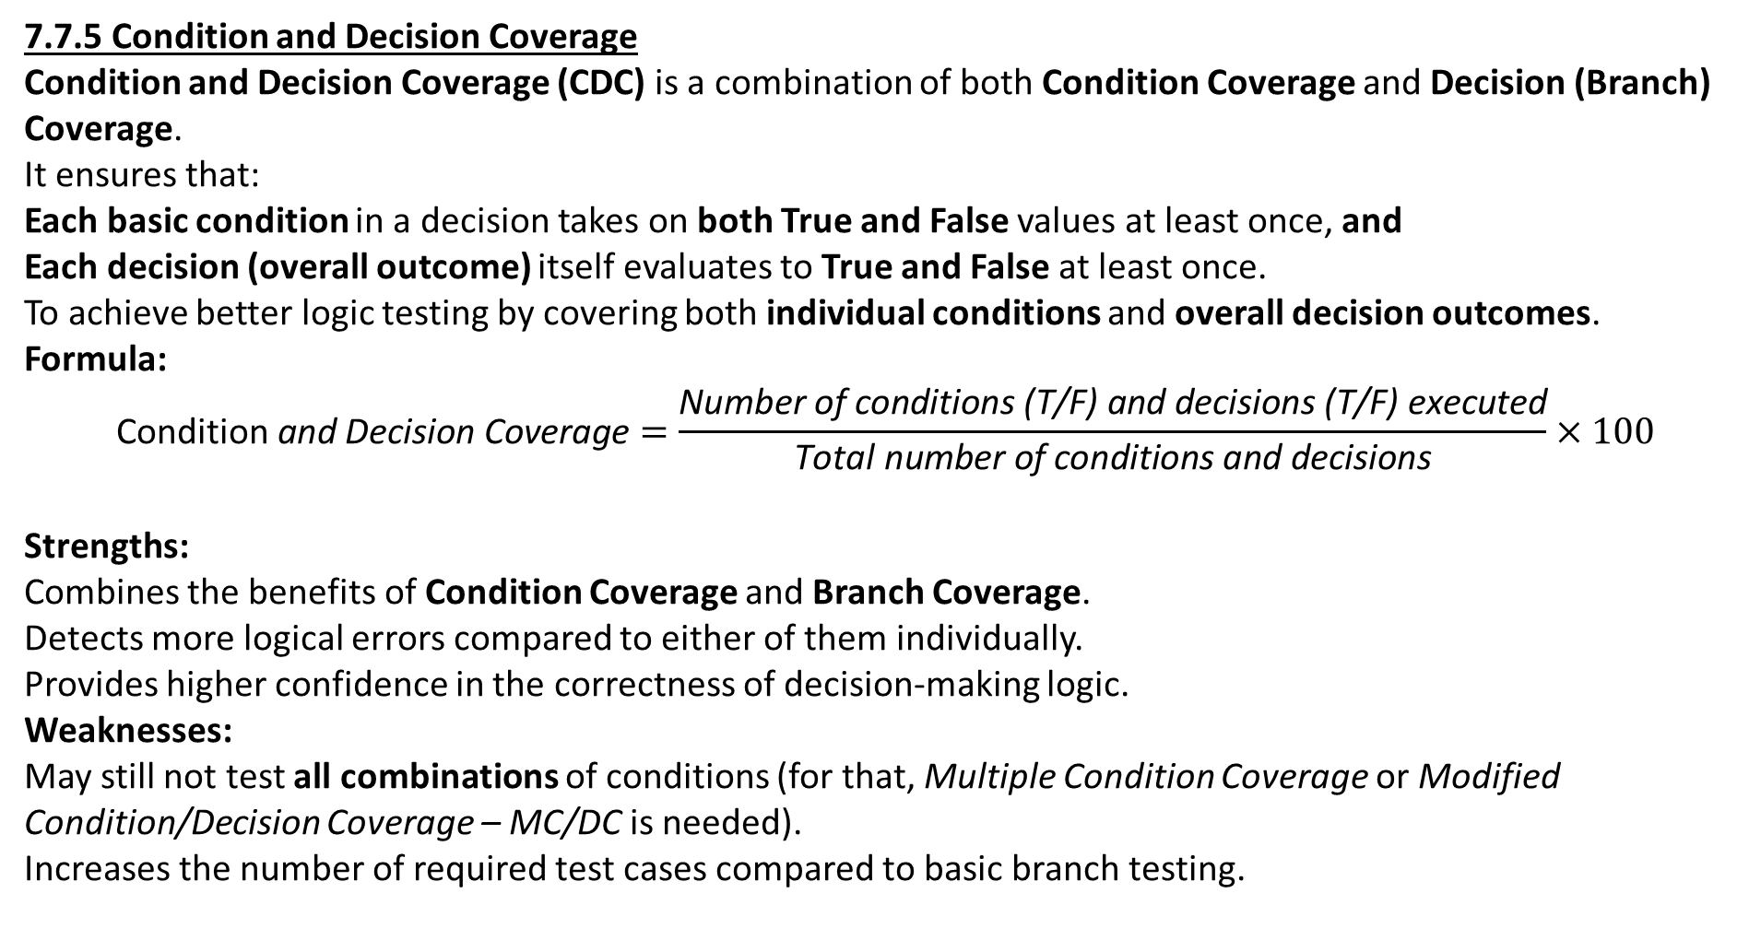
7.7.5 Condition and Decision Coverage
Condition and Decision Coverage (CDC) is a combination of both Condition Coverage and Decision (Branch) Coverage. It ensures that:
Each basic condition in a decision takes on both True and False values at least once, and
Each decision (overall outcome) itself evaluates to True and False at least once.
To achieve better logic testing by covering both individual conditions and overall decision outcomes.
Formula:
$$\text{Condition} \text{and} \text{Decision} \text{Coverage}=\frac{\text{Number} \text{of} \text{conditions}\text{ (}\text{T}\text{/}\text{F}\text{) }\text{and} \text{decisions}\text{ (}\text{T}\text{/}\text{F}\text{) }\text{executed}}{\text{Total} \text{number} \text{of} \text{conditions} \text{and} \text{decisions}}×100$$
Strengths:
Combines the benefits of Condition Coverage and Branch Coverage.
Detects more logical errors compared to either of them individually.
Provides higher confidence in the correctness of decision-making logic.
Weaknesses:
May still not test all combinations of conditions (for that, Multiple Condition Coverage or Modified Condition/Decision Coverage – MC/DC is needed).
Increases the number of required test cases compared to basic branch testing.

Slide 53
Example:
if ((a > b) && (b > 0))
printf("Valid\n");
else
printf("Invalid\n");
Basic Conditions:
a > b
b > 0 Decision: (a > b) && (b > 0)
Test Case | a | b | (a > b) | (b > 0) | Decision Result
3, 2 | T | T | True
3, -1 | T | F | False
1, 2 | F | T | False
1, -1 | F | F | False
✅ Each basic condition has been True and False at least once. ✅ The overall decision has evaluated to True and False. Thus, Condition and Decision Coverage = 100%.

Slide 54
Coverage Type | Ensures | Notes
Statement Coverage | Every statement executed | Weakest
Branch Coverage | Every decision True/False | Stronger
Condition Coverage | Each condition True/False | Does not ensure decision outcomes
Condition & Decision Coverage | Both individual conditions and overall decisions True/False | Stronger, more thorough

Slide 55
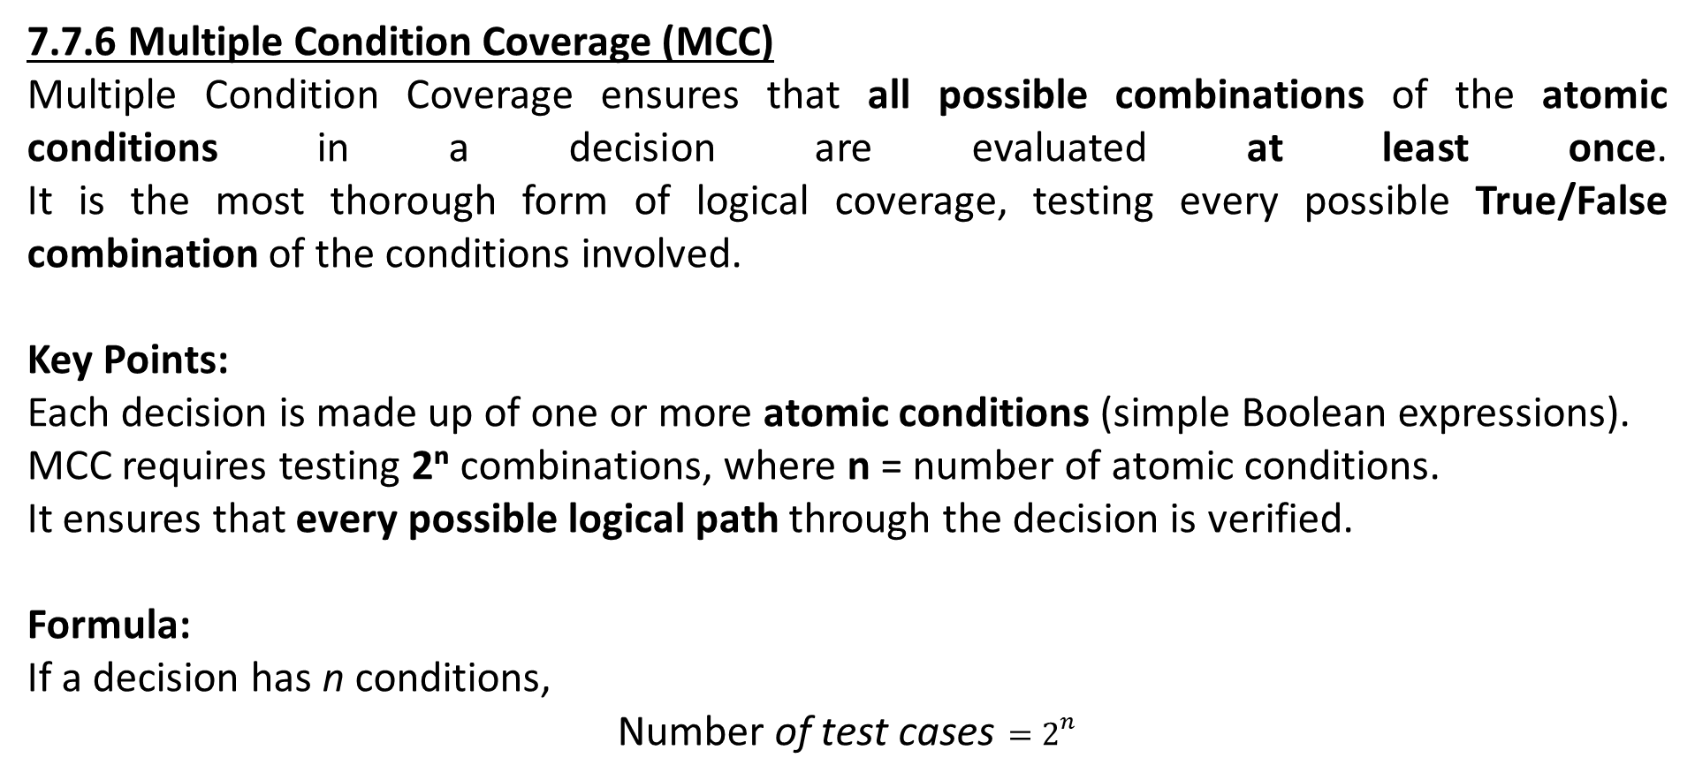
7.7.6 Multiple Condition Coverage (MCC)
Multiple Condition Coverage ensures that all possible combinations of the atomic conditions in a decision are evaluated at least once. It is the most thorough form of logical coverage, testing every possible True/False combination of the conditions involved.
Key Points:
Each decision is made up of one or more atomic conditions (simple Boolean expressions).
MCC requires testing 2ⁿ combinations, where n = number of atomic conditions.
It ensures that every possible logical path through the decision is verified.
Formula: If a decision has n conditions,
$$\text{Number} \text{of} \text{test} \text{cases}=2^{n}$$

Slide 56
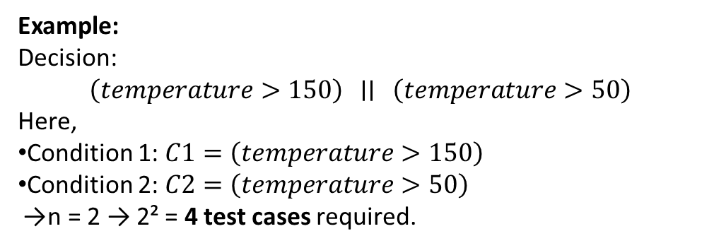
Example: Decision:
$$\left(temperature>150\right) ∣∣ \left(temperature>50\right)$$
Here,
Condition 1: $C1=\left(temperature>150\right)$
Condition 2: $C2=\left(temperature>50\right)$ → n = 2 → 2² = 4 test cases required.
Test Case | C1 (temp >150) | C2 (temp >50) | Decision Output
1 | F | F | F
2 | F | T | T
3 | T | F | T
4 | T | T | T

Slide 57
7.7.7 Modified Condition/Decision Coverage (MC/DC)
Modified Condition/Decision Coverage (MC/DC) ensures that each atomic condition within a decision is shown to independently affect the outcome of that decision. It provides almost the same fault-detection power as Multiple Condition Coverage (MCC) but requires significantly fewer test cases (linear in n instead of exponential).
Key Points:
Each decision must evaluate to both True and False.
Each atomic condition must take on both True and False values.
Each condition must be shown to independently influence the decision’s result (i.e., changing only that condition flips the decision outcome).
Why It’s Important:
Strikes a balance between thoroughness and practicality.
Widely used in safety-critical systems such as:
Avionics (FAA DO-178C)
Automotive (ISO 26262)
Medical devices and aerospace systems

Slide 58
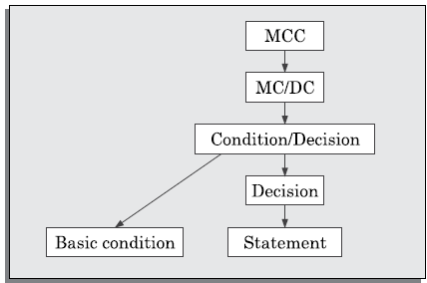
Subsumption hierarchy
We have already pointed out that MCC subsumed the other condition-based test coverage metrics. In fact, it can be proved that we shall have the subsumption hierarchy shown in Figure 7.7 for the various coverage criteria discussed. We leave the proof to be worked out by the reader. Observe that MCC is the strongest, and statement and condition coverage are the weakest. However, statement and condition coverage are not strictly comparable and are complementary.
FIGURE 7.7 Subsumption hierarchy of various coverage criteria.

Slide 59
The figure illustrates how various condition-based test coverage criteria relate to one another in terms of strength (or thoroughness).
Multiple Condition Coverage (MCC) is the strongest criterion — it subsumes all the others because it requires testing all combinations of conditions.
Modified Condition/Decision Coverage (MC/DC) is slightly weaker than MCC but still powerful, ensuring each atomic condition independently affects the decision outcome.
Condition/Decision Coverage combines both decision and condition testing requirements.
Decision Coverage ensures every decision’s outcome (True/False) is executed at least once.
Basic Condition Coverage verifies that each individual condition is evaluated both True and False, but not necessarily in combination.
Statement Coverage is the weakest, ensuring that every line or statement of code is executed at least once.

Slide 60
📈 7.7.8 Path Coverage
Covers all linearly independent paths in the control flow graph (CFG).
Relies on McCabe’s Cyclomatic Complexity (V(G)):
V(G) = E − N + 2
E: Edges, N: Nodes in CFG.
Also: V(G) = Number of decision points + 1
Steps for Path Testing:
Draw CFG.
Compute V(G).
Random test cases + dynamic analysis until ~90% path coverage is achieved.

Slide 61
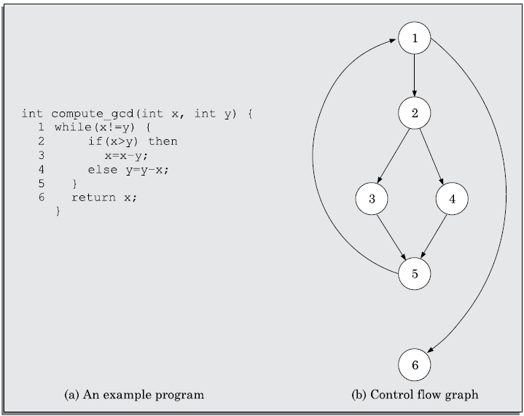
Using these basic ideas, the CFG of the program given in Figure 10.8(a) can be drawn as shown in Figure 10.8(b).
FIGURE 7.8 Control flow diagram of an example program.

Slide 62
7.7.9 McCabe’s Cyclomatic Complexity Metric
McCabe’s Cyclomatic Complexity is a graph-based software metric that provides:
An upper bound on the number of linearly independent paths through a program.
A quantitative measure of code complexity, helping estimate testing effort, code maintainability, and reliability.
Three Methods to Compute Cyclomatic Complexity
Let V(G) be the cyclomatic complexity of the control flow graph (CFG) G.
Method 1: Using Nodes and Edges
V(G) = E − N + 2
E: Number of edges in the CFG
N: Number of nodes in the CFG
📌 Example: If E = 7, N = 6 → V(G) = 7 - 6 + 2 = 3

Slide 63
Method 2: Using Bounded Areas
V(G) = Number of bounded areas + 1
Count the distinct non-overlapping bounded regions (closed loops) in a planar CFG.
📌 Example: 2 bounded areas → V(G) = 2 + 1 = 3
🔴 Note: This method does not work for non-planar graphs (e.g., those with goto statements).
Method 3: Using Decision/Loop Statements
V(G)=Number of decision/loop statements+1
Count all if, while, for, switch, etc.
📌 Example: 2 decisions → V(G) = 2 + 1 = 3

Slide 64
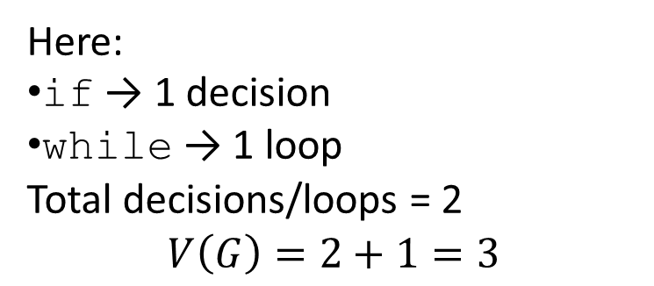
Count the following statements:
✅ if ✅ else if ✅ while ✅ for ✅ do-while ✅ switch ✅ Conditional operator ?: (in some cases)
if (x > 0)
y++;
else
y--;
while (y < 10)
y++;
Here:
if → 1 decision
while → 1 loop
Total decisions/loops = 2
$$V\left(G\right)=2+1=3$$

Slide 65
✅ Interpretation
A higher V(G) indicates more complex code, requiring more test cases.
Typically, V(G) ≤ 10 is acceptable. Beyond that, functions are considered too complex.
🧪 Using McCabe’s Metric for Path Testing
🚶 Steps to Perform Path Coverage Testing
Draw the control flow graph (CFG) of the program.
Compute cyclomatic complexity V(G) using one of the above methods.
Determine the minimum number of test cases needed = V(G).
Generate test cases (often random inputs).
Execute and monitor path coverage with tools (like dynamic program analyzers).
Repeat until ≥90% path coverage is achieved.
🟡 Note: Full 100% path coverage is not practical due to:
Infeasible paths (e.g., contradictory conditions)
Exponential increase in path count with code complexity

Slide 66
📌 Uses of McCabe’s Cyclomatic Complexity
Use | Purpose
Structural Complexity Estimation | Indicates code difficulty and maintainability
Testing Effort Estimation | Cyclomatic complexity ≈ Minimum test cases required
Reliability Estimation | Higher complexity ⇒ Higher chance of undetected errors
✅ Best Practice:
Keep function complexity under 10 for maintainability
Limit complexity to ≤7 to reduce testing effort
Cyclomatic Complexity measures the logical complexity of code.
It helps in estimating testing efforts, understanding code structure, and ensuring software reliability.
It is widely used in path-based testing to determine minimum required test cases.

Slide 67
7.7.10 Data Flow-Based Testing
💡 Purpose: To ensure that data (variables) in a program are defined, used, and killed (redefined) properly — and that no variable is used before initialization or after its value becomes invalid. Focuses on how variables are defined and used in the code, aiming to test data usage across paths in a program.
✅ Key Concepts:
DEF(S): Variables defined at statement S → e.g., for a = b + c;, DEF(S) = {a}
USES(S): Variables used at statement S → e.g., for a = b + c;, USES(S) = {b, c}
A definition is live at a statement S1 if there's a path from S to S1 with no redefinition of that variable.

Slide 68
🔍 Test Coverage Criteria in Data Flow Testing:
Criterion | Meaning
All-Definitions Criterion | At least one use of each variable definition must be tested.
All-Uses Criterion | All uses of each variable definition must be tested.
All DU-Paths Criterion | Test every path between a variable's definition and its use, excluding complex cycles.
DU Chain Coverage | Each Definition-Use (DU) chain must be tested at least once.
🔗 DU Pair and DU Chain (Definition-Use Chain (DU Chain)):
DU Pair: [X, S, S1] → Variable X is defined at S, used at S1, and is live in between.
DU Chain: A sequence of DU pairs.
🟡 Used to ensure the data is handled correctly from assignment to use across the program’s execution.

Slide 69
Example:
1. a = 10; // Definition of a
2. b = a + 5; // Use of a (DU chain: a₁ → a₂)
3. a = 20; // Redefinition (kills previous definition)
Live Definition Example:
S1: a = 5; → defines a
S2: if (a > 0) → uses a (a is live here)
S3: a = 7; → redefines a (previous definition no longer live)
⚙️ Purpose of Data Flow Testing
Detects data anomalies such as:
Undefined variable use
Unreferenced definitions
Multiple redundant definitions
Ensures that each defined variable is used meaningfully.

Slide 70
7.7.11 Mutation Testing
💡 Purpose:
A fault-based testing method to evaluate the effectiveness of a test suite by introducing small code errors (mutants).
✅ Key Concepts:
A mutant is a version of the program with a small change, like:
+ → -
&& → ||
Deleting a statement
Changing variable type or value
If a test case detects a difference (i.e., fails on the mutant), the mutant is killed.

Slide 71
🧪 Process of Mutation Testing:
Initial Testing: Test the original program with existing test cases.
Mutant Generation: Apply mutation operators to create mutants.
Testing Mutants: Run original test suite on each mutant.
Evaluate:
Killed mutant: Detected by test suite (good).
Alive mutant: Not detected (test suite is weak → improve tests).
Equivalent mutant: Functionally same as original (cannot be killed).
⚙️ Mutation Operators Examples:
Replace + with -
Replace > with <
Change constant 5 to 0
Delete a line or variable

Slide 72
📈 Advantages:
Reveals weaknesses in test suites.
Automatable using mutation tools (e.g., PIT, MutPy).
⚠️ Challenges:
High computational cost
Many mutants generated
Difficult to detect equivalent mutants

Slide 73
7.8 DEBUGGING
💡 Definition:
Debugging is the process of identifying, locating, and fixing errors (bugs) in a program after a failure has been detected.
7.8.1 Debugging Approaches
Different strategies can be used to trace the cause of an error. Each has its pros and cons depending on the complexity and nature of the program.
1. Brute Force Method
What it is: Adding print statements to check values at various points.
Advanced tool: Use a symbolic debugger to check variable values, set breakpoints, and step through code.
Form: Single-stepping with expected vs actual results.
Drawback: Inefficient and time-consuming, especially for large programs.

Slide 74
2. Backtracking
What it is: Trace code backward from where failure occurred to find the bug.
Drawback: Becomes complex and impractical with loops, branches, and long control paths.
3. Cause Elimination Method
What it is: List possible causes for the error and eliminate them one by one through testing.
Technique: Similar to fault tree analysis.
Strength: Good for systematic narrowing of fault source.
4. Program Slicing
What it is: Identify only the relevant code lines affecting the value of a variable.
Definition: A slice is the set of statements that influence the value of a variable at a particular point.
Advantage: Reduces search space compared to full backtracking.

Slide 75
7.8.2 Debugging Guidelines
Here are some key best practices for effective debugging:
Guideline | Why it matters
✅ Understand the program design completely | Partial understanding can mislead debugging efforts.
⚠️ Avoid fixing only the symptoms | Might hide the real bug and cause deeper issues later.
🔁 Be prepared to redesign if necessary | Sometimes, poor design is the root cause, not just faulty logic.
🔄 Always do regression testing after fixing bugs | To ensure that new bugs aren't introduced while fixing old ones.

Slide 76
7.9 PROGRAM ANALYSIS TOOLS
✅ Definition:
Program analysis tools are automated software tools that analyze a program’s source or executable code to assess various attributes such as:
Size
Complexity
Comment quality
Coding standard adherence
Testing adequacy
These tools help improve code quality and ensure reliable software development.
🔸 TYPES OF PROGRAM ANALYSIS TOOLS
Program analysis tools are broadly classified into:
Type | Description
Static Analysis Tools | Analyze code without executing it
Dynamic Analysis Tools | Analyze program during execution using real inputs

Slide 77
7.9.1 Static Analysis Tools
📌 What They Do:
Static analysis tools check the source code to:
Calculate metrics: Cyclomatic complexity, Halstead’s metrics, size
Check coding standard compliance
Detect common programming errors, e.g.:
Uninitialized variables
Unused variables
Mismatched function parameters
✅ Examples of Static Analysis Activities:
Code walkthroughs
Code inspections
(These are manual static methods, not automated tools)

Slide 78
⚠️ Limitations:
Cannot evaluate run-time behaviour
Cannot handle dynamic memory issues caused by:
Pointer arithmetic
Dynamic memory allocation (e.g., using malloc in C)
📈 Kiviat Chart (a.k.a. Radar Chart):
A graphical tool used to summarize analysis of each function
Axes show:
Cyclomatic complexity
Lines of code
% of comment lines
Halstead metrics, etc.

Slide 79
7.9.2 Dynamic Analysis Tools
📌 What They Do:
Dynamic analysis tools monitor the program’s behaviour during execution to:
Evaluate test coverage
Record execution trace (values of variables, paths taken, etc.)
⚙️ How It Works:
Uses instrumentation: Adds extra code to log behaviour during execution
Collected data includes:
Path coverage
Statement coverage
Branch coverage
✅ Use Cases:
Analyze and improve test suite effectiveness
Identify redundant or missing test cases
Ensure sufficient coverage has been achieved
Provide evidence of proper testing (e.g., printed reports, graphs)

Slide 80
📊 Output Format:
Coverage results are often shown using:
Histograms
Pie charts
Reports per module
Feature | Static Analysis Tools | Dynamic Analysis Tools
Execution Required? | ❌ No | ✅ Yes
Detects Run-time Issues? | ❌ No | ✅ Yes
Useful for Early Detection | ✅ Yes | ❌ No (Requires executable/test cases)
Typical Output | Kiviat charts, metrics, error lists | Histograms, pie charts, coverage reports
Examples of Use | Coding standard checks, complexity stats | Path coverage, identifying weak test cases

Slide 81
Regression Testing
🔸 Definition:
Regression Testing is the process of re-running previously executed test cases after a change is made to the code (e.g., bug fix or enhancement) to ensure that:
Existing functionalities still work correctly
No new bugs are introduced as a side-effect
📍 Key Characteristics:
Spans multiple levels: Regression testing is not limited to unit, integration, or system testing—it's an orthogonal (separate) activity that applies across all these levels.
Must be repeated after:
Bug fixes
Code changes
Feature additions
Helps ensure software stability after changes.

Slide 82
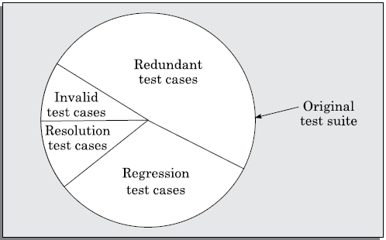
🧪 Types of Testing Involved:
Type | Checks For
Resolution Testing | Verifies that a specific bug has been fixed
Regression Testing | Ensures other unaffected code still works
1. Redundant Test Cases
These are duplicate or overlapping tests that check the same functionality multiple times.
2. Regression Test Cases
These are designed to ensure that previously working functionality still works correctly after code changes, bug fixes, or enhancements.
3. Resolution Test Cases
These are the newly added tests to verify that a specific bug fix (defect resolution) has indeed corrected the problem.
4. Invalid Test Cases
These tests are obsolete, poorly designed, or no longer applicable due to code or requirement changes.
FIGURE 7.9 Types of test cases in the original test suite after a change.

Slide 83
After a code change, the original test suite contains:
Type of Test Case | Description
✅ Valid Tests | Still applicable to the modified program
🔁 Redundant Tests | Test unaffected parts of code (still correct but not essential to rerun)
❌ Invalid Tests | No longer valid due to structural change in code or logic
🎯 Affected Tests | Directly test the changed or impacted code (must be rerun)
Regression Testing Strategy:
Discard invalid ones.
Retain unaffected ones as needed (for full assurance or periodic testing).
Automate: Automating test cases makes regression testing quick and cost-effective.

Slide 84
🚀 Benefits of Regression Testing:
Maintains software reliability
Prevents reintroduction of old bugs
Reduces risk of side effects from changes
Ensures long-term code stability

Slide 85
Security Testing
Security Testing is a type of software testing that ensures that the system protects data and maintains functionality as intended. It is done to identify vulnerabilities and weaknesses in the software system that may be exploited by attackers or unauthorized users.
🔐 Objective of Security Testing:
To protect software systems and data from unauthorized access, misuse, or damage.
To ensure confidentiality, integrity, authentication, authorization, availability, and non-repudiation.

Slide 86
🧩 Key Aspects of Security Testing:
Aspect | Description
🔑 Authentication | Ensures that the system correctly verifies user identity (e.g., login security).
🔒 Authorization | Ensures users can only access resources or perform actions they are permitted to.
📦 Confidentiality | Ensures that sensitive data is accessible only to authorized users.
🛠 Integrity | Ensures data is not modified or tampered with without authorization.
📡 Availability | Ensures that services remain available and accessible even under attack (e.g., DDoS).
🧾 Non-repudiation | Ensures that a user cannot deny the authenticity of their actions.
🛡️ Common Types of Security Testing:
Type | Purpose
Vulnerability Scanning | Automated scanning to find known vulnerabilities.
Penetration Testing (Pen Testing) | Simulated attack to find security weaknesses.
Security Auditing | Reviewing code and configurations for security compliance.
Ethical Hacking | Legally hacking the system to find vulnerabilities before attackers do.
Risk Assessment | Identifying potential security risks and impact.
Security Posture Assessment | Evaluating overall security and identifying gaps in protection.

Slide 87
🧪 Steps in Security Testing:
Understand security requirements of the application.
Identify potential threats and vulnerabilities (e.g., SQL injection, XSS).
Create threat models or risk-based test cases.
Execute security tests (manual and automated).
Analyze results, log security defects.
Fix vulnerabilities and retest for resolution.
Verify against security standards (e.g., OWASP Top 10, ISO 27001).
🛠️ Security Testing Tools (Examples):
Tool Name | Purpose
OWASP ZAP | Web application vulnerability scanning
Burp Suite | Penetration testing
Nessus | Vulnerability assessment
Metasploit | Exploitation framework
Fortify | Static code analysis

Slide 88
🚨 Common Security Vulnerabilities:
SQL Injection
Cross-Site Scripting (XSS)
Cross-Site Request Forgery (CSRF)
Buffer Overflow
Insecure Authentication
Data Exposure
Insecure APIs
🎯 Why Security Testing is Critical?
Prevents data breaches and financial losses
Protects reputation of the organization
Ensures legal and regulatory compliance
Builds user trust in the system

Slide 89
💪 Robustness Testing
Robustness Testing is a type of software testing that checks whether a software system behaves correctly and gracefully handles unexpected or invalid inputs, stressful conditions, and system failures.
🎯 Objective of Robustness Testing:
To ensure that the software:
Does not crash or behave unpredictably when faced with invalid, unexpected, or extreme input conditions.
Handles stressful system states (like memory shortages or hardware failures) gracefully.
Provides meaningful error messages and recovers properly without loss of functionality.

Slide 90
🧪 What Robustness Testing Covers:
Aspect | Example/Test Case
Invalid inputs | Entering special characters, extremely large numbers, etc.
Boundary conditions | Inputs near min/max limits of data types
Error handling | System behavior when a file is missing or connection fails
Hardware/software failures | Test behavior when disk is full, network is down, etc.
Incorrect API usage | Calling functions with wrong parameter types
🔍 Difference Between Robustness and Reliability Testing:
Aspect | Robustness Testing | Reliability Testing
Focus | Behavior under invalid/unexpected conditions | Behavior under normal, expected conditions
Objective | Ensure system doesn't break with bad input or failures | Ensure consistent and correct output over time
Input Type | Invalid, unexpected, or extreme inputs | Valid inputs only

Slide 91
🛠️ Approaches in Robustness Testing:
Fault Injection Simulate hardware faults, memory corruption, or network failure.
Fuzz Testing (Fuzzing) Random data is input to the system to check for crashes or errors.
Boundary Value Testing Inputs at the edge of allowable ranges are tested.
Negative Testing Supplying invalid or wrong inputs to ensure the system can handle them.
🧰 Tools for Robustness Testing:
Tool | Description
FuzzTester | Random input generation for fuzz testing
Jtest | Java-based robustness and exception testing
Ballista | Robustness testing of OS and libraries
Defensics | Protocol fuzzing and robustness testing

Slide 92
🔄 Benefits of Robustness Testing:
Prevents system crashes and data corruption
Ensures high availability even in adverse conditions
Enhances user trust by making the system resilient
Prepares software for real-world unpredictable scenarios
✅ Example:
int divide(int a, int b) {
return a / b;
}
Robustness Testing Case: Test with b = 0 (division by zero) → Should gracefully handle this with an error message, not crash.

Slide 93
🧪 Fuzz Testing (Fuzzing)
Fuzz Testing, also known as fuzzing, is an automated software testing technique that involves feeding random, unexpected, or malformed data into a program to uncover vulnerabilities, crashes, and unexpected behavior.
🎯 Objective of Fuzz Testing:
To detect security loopholes, buffer overflows, input validation issues, and system crashes.
To test how well the software handles invalid or unpredictable inputs.
⚙️ How Fuzzing Works:
Fuzz Input Generator creates random, invalid, or semi-valid inputs.
These inputs are fed into the System Under Test (SUT).
A monitoring system observes the program’s behavior:
Crashes
Hangs
Memory leaks
Unexpected outputs
If abnormal behavior is detected, the test logs the input that caused it.

Slide 94
🔍 Types of Fuzz Testing:
Type | Description
Mutation-based Fuzzing | Modifies existing valid inputs slightly to create new test cases.
Generation-based Fuzzing | Generates inputs from scratch based on input format rules.
Protocol-aware Fuzzing | Tests structured inputs for protocols (e.g., HTTP, FTP).
File format fuzzing | Sends corrupted images, audio, or files to test apps or systems.
📌 Common Vulnerabilities Found via Fuzzing:
Buffer overflows
Memory leaks
Stack overflows
Input validation flaws
SQL/Command injection
Denial of Service (DoS)

Slide 95
🛠️ Popular Fuzzing Tools:
Tool | Description
AFL (American Fuzzy Lop) | Powerful, open-source, coverage-guided fuzzer
LibFuzzer | In-process, coverage-based fuzzer for LLVM
Peach Fuzzer | Commercial tool supporting file and network fuzzing
OSS-Fuzz | Google’s platform for fuzzing open-source software
Burp Suite | Web app fuzzing, especially for input validation
✅ Example Scenario:
A login form expects:
Username: alphanumeric, max 10 chars
Password: alphanumeric, max 12 chars
Fuzz Input Example:
Username: @@@@@@@#####$$$$$%%%%%...
Password: '; DROP TABLE users;--
If the software doesn’t validate inputs properly, it might crash or even execute harmful code (like SQL injection).

Slide 96
⚖️ Advantages of Fuzz Testing:
Detects hidden bugs not found in functional testing.
Effective in uncovering security vulnerabilities.
Low cost, can be largely automated.
Good for stress and robustness testing.
⚠️ Limitations of Fuzz Testing:
Doesn’t guarantee full test coverage.
May miss logical errors.
Hard to interpret if many false positives occur.
May require significant manual analysis of crash logs.
🧠 Best Practices:
Combine fuzzing with static and dynamic analysis.
Use instrumentation to track code coverage.
Always log and replay crashes to reproduce and fix bugs.

Slide 97
🧵 Fuzz Testing vs Robustness Testing:
Aspect | Fuzz Testing | Robustness Testing
Input Strategy | Random or malformed inputs | Invalid or stressful inputs
Focus | Find vulnerabilities and crashes | Graceful handling of errors
Automation | Highly automated | Can be semi-automated or manual
Common Use | Security testing, bug hunting | Reliability and system stability

Slide 98
🔗 Integration Testing
Integration Testing is a level of software testing where individual modules are combined and tested as a group to expose interface defects between them. It focuses on data flow between units and how well they collaborate.
🎯 Goal of Integration Testing:
To verify that modules or components interact correctly.
To identify errors in interfaces, data sharing, or inter-module logic.
To ensure the integrated system behaves as expected before system testing.
Why Integration Testing is Needed:
Even if each module works perfectly in isolation (after unit testing), errors may arise when modules:
Exchange data.
Use shared memory or global variables.
Call one another with wrong parameters.
Rely on timing or sequence.

Slide 99
🔍 Types of Integration Testing Approaches:
Approach | Description
Big Bang | All modules are integrated and tested together.
Top-down | Starts with top-level modules and integrates downward using stubs.
Bottom-up | Begins with low-level modules and integrates upward using drivers.
Sandwich / Hybrid | Mix of top-down and bottom-up strategies.
Incremental | Modules are integrated and tested one by one in sequence.
🔄 Terminology:
Stub: Dummy module used to simulate lower-level modules (used in top-down testing).
Driver: Dummy module used to simulate higher-level modules (used in bottom-up testing).

Slide 100
🧪 Integration Testing Example:
Consider 3 modules in an e-commerce system:
Login Module
Product Catalog
Payment Gateway
Unit testing ensures each works individually. In integration testing:
Ensure after login, product catalog loads properly.
Ensure selecting a product passes correct info. to the payment gateway.
✅ Advantages of Integration Testing:
Catches interface issues early.
Helps uncover design flaws.
Ensures data communication is correct.
Prevents bugs during system assembly.

Slide 101
⚠️ Challenges:
Requires careful planning of module dependencies.
Stub/driver creation may take effort.
Interface errors can be harder to debug than isolated ones.
Complex in large systems with many modules.
🧠 Best Practices:
Plan integration order logically (least dependent modules first).
Automate test scripts if possible.
Test both valid and invalid data flows.
Use continuous integration (CI) tools to catch issues early.
Maintain proper logs to track issues between components.
🔁 Integration Testing vs Unit & System Testing:
Type | Scope | Responsibility
Unit Testing | Individual functions/modules | Developers
Integration Testing | Combined modules & their interfaces | Developers/Testers
System Testing | Entire system against requirements | QA/Testers

Slide 102
Testing Object-Oriented Programs (OOP)
Testing object-oriented software differs from traditional procedural software due to encapsulation, inheritance, polymorphism, and interaction between objects. Let’s explore how testing is approached in the context of object-oriented programming (OOP).
🔍 Key Challenges in OOP Testing:
OOP Concept | Testing Challenge
Encapsulation | Data is hidden; internal state is hard to access directly for testing.
Inheritance | Behavior is inherited; base class changes can affect derived class behavior.
Polymorphism | A method call may refer to many actual implementations, making test prediction hard.
Dynamic Binding | Methods are resolved at runtime; exact behavior is known only during execution.
Object Interaction | Objects collaborate via messages; fault may lie in interactions rather than logic.

Slide 103
🧰 Types of Tests in OOP:
1. Unit Testing
Focuses on individual classes and methods.
Verifies method logic, constructors, and getter/setter behaviors.
Tools: JUnit (Java), pytest (Python), NUnit (.NET).
2. Integration Testing
Tests collaboration among objects.
Verifies message passing, shared data, and interface contracts.
Mocks/stubs often simulate object dependencies.
3. System Testing
Entire system is tested as a whole to ensure it meets requirements.
Object interactions, flows, and business logic are verified in a full environment.

Slide 104
🧪 OOP-Specific Testing Strategies:
✅ Method Testing
Test all public methods.
Include tests for overloaded methods and methods with default arguments.
🔁 State-Based Testing
Focuses on class behavior based on its internal state.
Ensures correct transitions between states.
📥 Interaction Testing
Ensures that messages passed between objects follow the expected sequence and correctness.
Often tested using mocking frameworks.
🧬 Inheritance & Polymorphism Testing
Test both base and derived class behavior.
Ensure that overridden methods maintain behavioral contracts.
Use Liskov Substitution Principle (LSP) to ensure objects of derived types can replace base types without altering functionality.

Slide 105
🧠 Best Practices for Testing OOP:
Design for testability – make classes loosely coupled and use interfaces.
Keep classes small – single responsibility principle helps in easier testing.
Avoid tight coupling – prefer dependency injection.
Use mocks and stubs – simulate collaborators in tests.
Ensure 100% code coverage for polymorphic and inherited methods.
🧪 Tools for Testing OOP:
Language | Framework
Java | JUnit, TestNG
Python | unittest, pytest, mock
C++ | Google Test (gtest)
C#/.NET | NUnit, xUnit
JavaScript | Jest, Mocha

Slide 106
SYSTEM TESTING
✅ Definition:
System testing validates a fully integrated software system to ensure it meets all functional and non-functional requirements outlined in the SRS document.
🧪 Types of System Testing:
These differ based on who performs the test:
Type | Description
Alpha Testing | Conducted by developers’ internal team before release.
Beta Testing | Performed by select external customers in a real-world setting.
Acceptance Testing | Done by the customer/client to decide whether to accept the software.
Smoke Testing:
Purpose: To verify that the main functionalities of the system work before full system testing begins.
Example: For a library system, smoke tests may check book loan/return and user registration.
Also known as build verification testing.

Slide 107
⚙️ Performance Testing:
Tests whether the system meets its non-functional requirements.
🔹 Types of Performance Testing:
Test Type | Purpose & Example
Stress Testing | Push the system beyond its design limits (e.g., more users or transactions).
Volume Testing | Examine performance with large data volumes (e.g., compiler with 100,000 lines).
Configuration Testing | Check system across different hardware/software configurations.
Compatibility Testing | Ensure correct interfacing with external systems like databases or networks.
Recovery Testing | Simulate failures (e.g., power off, device disconnect) and check recovery.
Maintenance Testing | Test diagnostic tools or update mechanisms for system maintainability.
Documentation Testing | Validate manuals and instructions for users and maintainers.
Usability Testing | Test the user interface (UI) for compliance with user-friendliness.
Security Testing | Verify robustness against threats (e.g., penetration testing, password attacks).

Slide 108


Error Seeding:
Purpose: Estimate the number of residual (undetected) errors and evaluate the effectiveness of the test suite.
Process:
Seed known artificial errors (S).
Count how many of them are found during testing (s).
Count actual (non-seeded) errors found (n).
Estimating Total Errors (N):
Estimating Remaining Errors:
Note: Accuracy depends on how closely seeded errors reflect real ones.

Slide 109
GENERAL ISSUES IN TESTING
📝 1. Test Documentation
The Test Summary Report is prepared at the end of testing and includes:
✅ Total number of tests conducted
✅ Number of successful tests
❌ Number of unsuccessful tests
Degree of failure (partial or complete)
🔁 2. Regression Testing
Definition: Running old test cases after any code change or bug fix to ensure no new bugs are introduced.
It spans across unit, integration, and system testing.
✅ Run only those test cases that could be affected by the change.
📌 Difference from Resolution Testing:
Resolution Testing: Checks if a defect has been fixed.
Regression Testing: Checks that previously working features still work.
🔁 Automated regression testing can save significant effort, especially as some tests may become:
🔸 Invalid (due to change),
🔹 Redundant (not affected by the change),
⚠️ Or may need to be added for new functionality.

Slide 110
🤖 3. Test Automation
Used to reduce human effort, cost, and time, while increasing accuracy and test coverage.
🔹 Benefits:
Eliminates monotony and human error in repeated testing
Supports thorough testing with large test suites
Essential for regression testing, especially after frequent changes
🔸 Types of Test Automation Tools:
Tool Type | Description
Capture & Playback | Records input-output during manual testing, then replays them automatically
Test Script-Based | Uses scripts (in various languages) to automate test execution and validation
Random Input Test | Randomly generates inputs to crash the system; doesn’t check output correctness
Model-Based Test | Uses models (e.g., state diagrams, activity diagrams) to generate test cases

Slide 111
Capture & Playback tools are great for regression testing, but maintaining tests after changes can be expensive.
Test Script tools require effort for debugging and updating after any code change.
Random Testing is limited—it finds crash-causing defects only.
Model-Based Testing can be powerful for validating system behavior.

