Slide 1
Online Resume Builder
TEAM 4 V.Thanmayee-2210030072 I.Kavya Priya-2210030071 V.Thanmai Naga Siri-2210030163 T.Taniswi-2210030402

Slide 2
Introduction & Objective
A web-based tool for resume creation
Provide an easy-to-use UI for customization
Many users struggle with resume formatting our tool simplifies the process.

Slide 3
Problem Statement & Solution Approach
Problem Statement:
Creating a well-structured resume is often a time-consuming and complex task for users, especially those without design experience. Many existing tools either lack customization options or require advanced skills. A user-friendly, interactive, and efficient solution is needed to simplify resume creation while maintaining professional standards.
Solution Approach:
To address this issue, we developed a web-based Resume Builder with the following key features:
Intuitive UI/UX: A simple and guided process for resume creation.
Live Preview: Users can see real-time updates while editing.
Pre-designed Templates: Professionally crafted layouts for easy customization.
Multiple Export Options: Resumes can be downloaded in PDF, Word, or JSON formats.
Responsive Design: Ensures accessibility on different devices.
Optimized Performance: Uses React.js with Context API for smooth and fast interactions.

Slide 4
Features
Interactive resume editor: Users can enter and edit resume details dynamically
Live preview: Updates resume formatting in real time.
Pre-designed templates: Multiple layouts to choose from.
Export options: Users can download resumes as PDF, Word, or JSON files.

Slide 5
Technology Stack
Framework: React.js
Styling: Tailwind CSS
State Management: Context API
Deployment: Vercel/Netlify

Slide 6
Architecture Plan
Navbar:- Home, FAQ, Build
Resume Editor:- Input sections (Name, Experience, Skills, etc.)
Template Selector:- Switch between different styles
Live Preview:- Live Preview: See resume changes in real-time
Export Button:- Download in multiple formats

Slide 7
Wireframes
Wireframes represent the structural layout of the Resume Builder to ensure an intuitive user experience. Key screens include:
Landing Page:
Bold heading ("Build Your Resume, Build Your Career")
"Create Resume" button for easy access
Sample resume preview on the right
Template Selection:
Grid view of available resume designs
Click-to-select functionality
Resume Editor:
Input sections (Name, Experience, Skills, etc.)
Live preview to reflect changes instantly
Export Options:
Buttons to Download as PDF, Word, or JSON

Slide 8
UI/UX Design
Minimalist & Clean Layout for ease of use
Interactive Real-time Preview to reduce guesswork
Mobile-friendly & Responsive Design using Tailwind CSS
Seamless Navigation from editing to exporting resumes

Slide 9
Development Approach
Phase 1: UI/UX Design
Create wireframes and user flow.
Develop UI components using React + Tailwind CSS.
Phase 2: Resume Editing Functionality
Implement React State/Context API for managing user inputs.
Enable real-time updates in the Live Preview component.
Phase 3: Template Selection & Export Options
Integrate multiple resume templates for users to choose from.
Add html2pdf.js for PDF export and other format options.
Phase 4: Optimization & Deployment
Ensure responsiveness across devices.
Optimize performance and deploy on Vercel/Netlify.

Slide 10
Challenges & Solutions
1. Responsive Design
Challenge: Ensuring the UI adapts to various screen sizes, including desktops, tablets, and mobile devices.
Solution: We used Tailwind CSS, which provides utility-first styling and responsive classes to ensure a seamless layout across all devices.
2. Real-time Resume Updates
Challenge: Handling dynamic changes to resume content without causing performance issues.
Solution: The Context API was implemented to efficiently manage state, ensuring smooth updates without unnecessary re-renders.
3. Dynamic Template Selection
Challenge: Allowing users to switch between different resume designs dynamically.
Solution: We created React components that render selected templates instantly, making customization easy and user-friendly.
4. Exporting Resumes in Multiple Formats
Challenge: Maintaining proper formatting when exporting resumes as PDF, Word, or JSON.
Solution: We integrated html2pdf.js and other export libraries to ensure that the resume structure remains intact when downloaded in different formats.

Slide 11
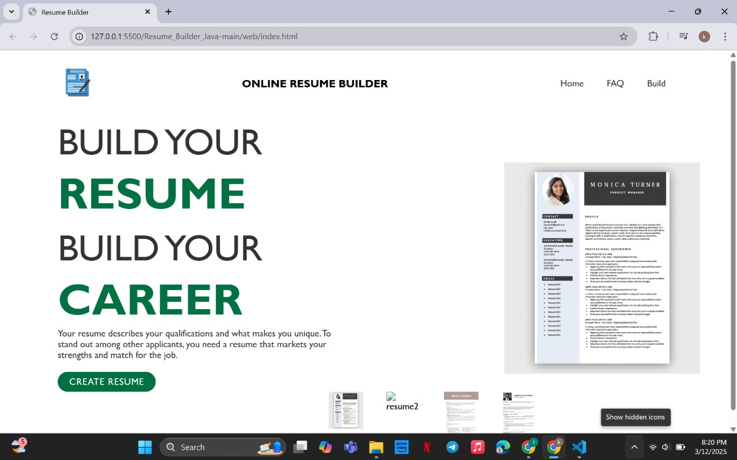
Demo

Slide 12
Conclusion & Next Steps
Conclusion:
The Resume Builder successfully provides a user-friendly, interactive, and efficient solution for creating professional resumes. With features like real-time preview, template selection, and multiple export options, users can generate high-quality resumes effortlessly.
Next Steps:
UI Improvements: Enhance animations, transitions, and overall design aesthetics.
More Resume Templates: Expand template collection for diverse styles.
Drag-and-Drop Editing: Improve user experience with more intuitive interactions.
Advanced Customization: Allow users to adjust fonts, colors, and section orders.
Cloud Save Option: Enable users to save and load resumes for future edits.

