Slide 1
Présentation projet fil rouge

Slide 2



Présentation fonctionnement

Slide 3
But
Gestion ludothèque

Slide 4


Supports

Slide 5






les langages de programmation
framework

Slide 6


Versioning

Slide 7
Les Principales librairies utilisées
OkHttpUtils
Picasso
Room
JbCrypt
Gson
kotlinx-coroutines
kotlin-reflect
Django
django-colorfield
djangorestframework
psycopg2
requests

Slide 8


Base de données

Slide 9



IDE

Slide 10
Cible

Slide 11
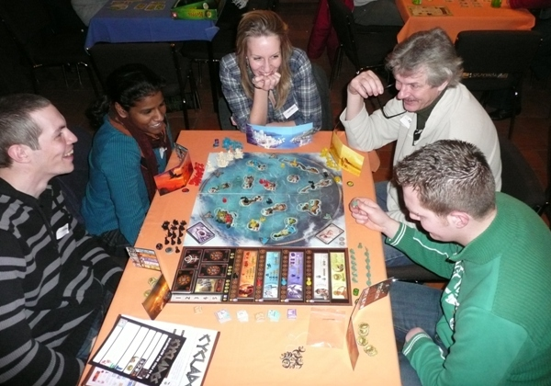
GAME’LUD
4 ans , Association de jeux de société, Pamiers
Aisance numérique
Venez prendre un tour de bon temps
Expertise domaine
Fréquence d’utilisation
2 fois par semaine
Fondée en 2016 GAME’LUD est une association promouvant le jeux de société moderne. Son objectif et de permettre de faire découvrir aux gens cet objet culturel et de créer par son intermédiaire du lien social. L’association aime organiser des soirées à thèmes. Elle cherche pour cela un logiciel qui lui permettrait d’inventorier ses jeux plus facilement, pour pouvoir les rechercher par des thèmes précis.
Buts clés
Personnalité
Pouvoir organiser ces jeux pour des soirées à thèmes
Facilité l’inventaire des jeux
Pouvoir avoir un site personnalisable pour les soirées
Se retrouver pour une partie de jeux
Découvrir le monde ludique

Slide 12

Mathilda Vosgiers
30 ans , mère au foyer, Artigat
J’ai toujours plaisir à recevoir
Un nouveau jeu, malgré ma pile de la honte...
Aisance numérique
Expertise domaine
Fréquence d’utilisation
2 fois par jour
Quand Mathilda ne s’occupe pas de son enfant, un de ses plaisirs est d’organiser des soirées jeux avec ses amis. Collectionneuse autant que joueuse, elle aime accumuler les bonnes affaires. Dont elle revend une partie. Elle aime gérer les choses depuis son portable car elle peut l’emporter de partout avec elle et son enfant.
Buts clés
Personnalité
Savoir les jeux dont elle dispose
Accéder à ses jeux n’importe ou et leur valeur
Personnaliser ses fiches jeux
Aime les choses ordonnées
Accorde de l’importance à l’interface
À des exigences esthétiques

Slide 13

Victor POUDELIN
35 ans , ingénieur aéronautique à AIRBUS, Foix
Aisance numérique
Un de mes plaisirs dans la vie, c'est de partager un jeu
Expertise domaine
Fréquence d’utilisation
2 fois par semaine
Vick est un adulte qui travaille en tant qu’ingénieur à Airbus. Sa passion pour le jeux et les avions lui remonte à l’enfance. Vick est quelqu’un de ‘connecté’, il utilise fréquemment son portable, internet et possède de nombreuses applications. Un de ses plaisirs est d’acheter de nouveaux jeux pour varier sa ludothèque déjà impressionante. Depuis l’arrivée de son enfant Vick à beaucoup moins de temps à consacrer à ses jeux du coup il voudrait un programme lui permettant de rechercher rapidement dans sa ludothèque le jeu dont il a envie quand un créneau se libère
Buts clés
Personnalité
Trouver ses jeux rapidement et précisément
Accéder à ses jeux n’importe ou
Personnaliser ses fiches jeux
Curieux, passionné
Accorde de l’importance à l’esthétique
Préfère personnaliser don interface

Slide 14


Concurrence

Slide 15



Schéma technologique
Board Game Atlas
Smartphone
Serveur
ORM Room
ORM (SQL généré)
+
Base de données
Base de données

Slide 16
Schema UML
Schema d’utilisation

Slide 17
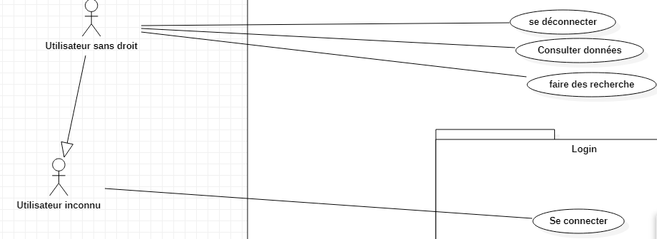
Schema UML

Slide 18
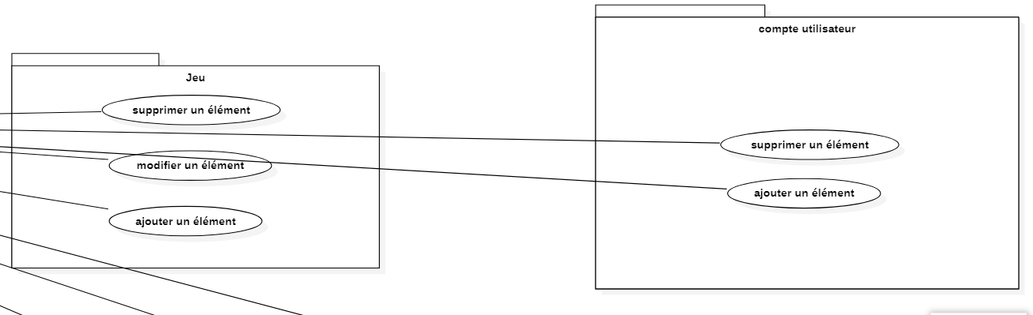
Schema UML

Slide 19
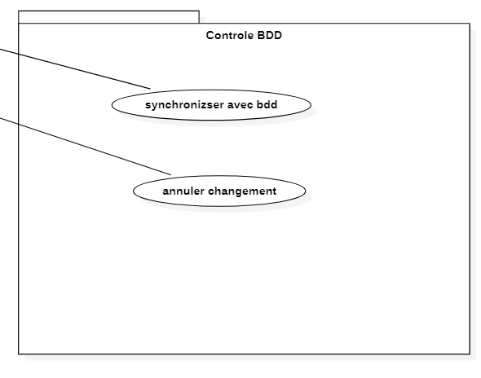
Schema UML

Slide 20
Schema UML
Diagramme d’activité

Slide 21
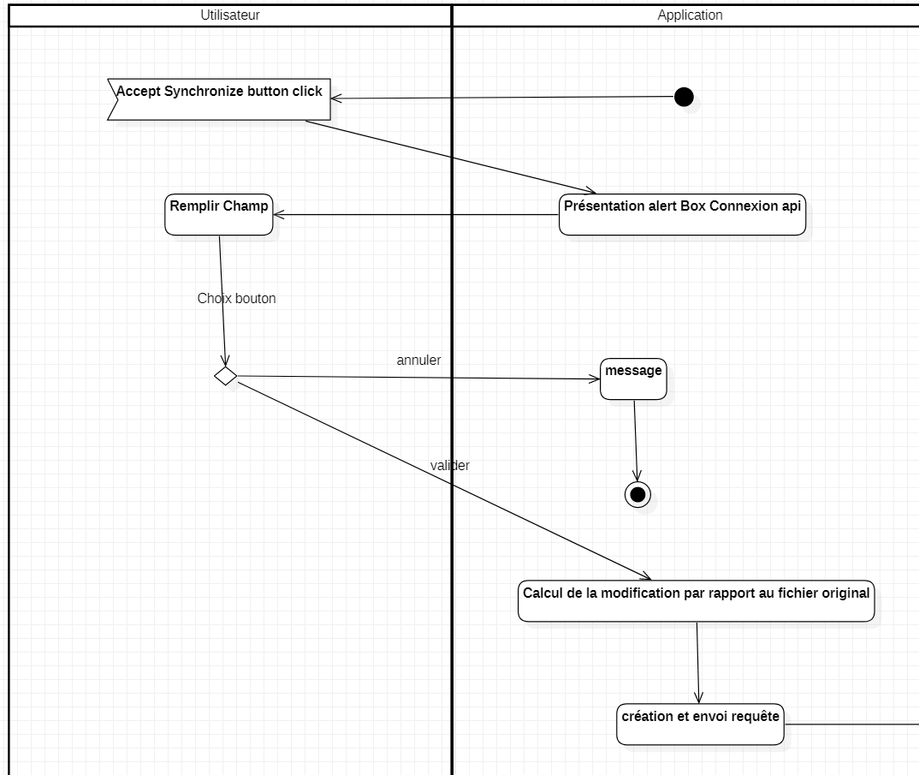
Schema UML

Slide 22
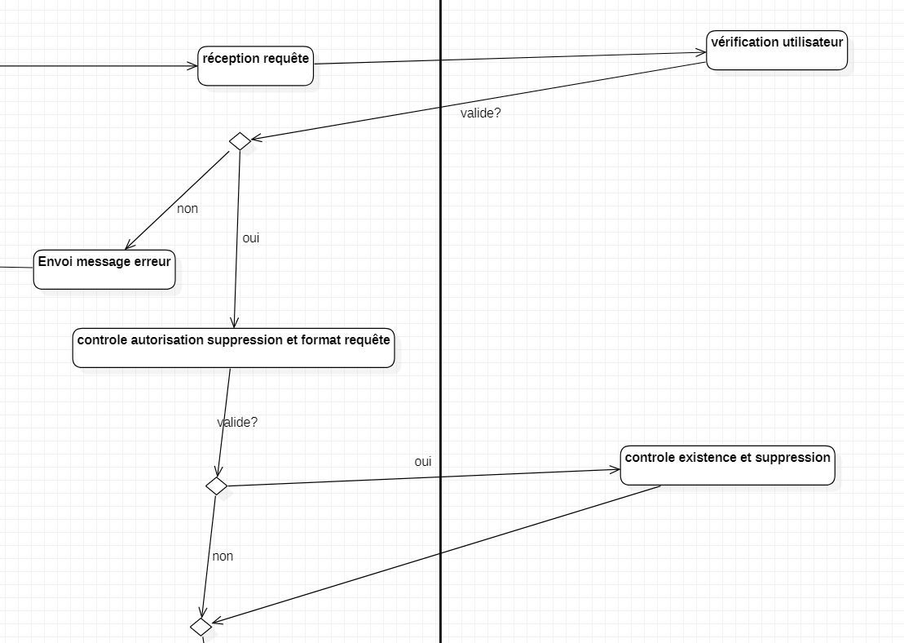
Schema UML

Slide 23
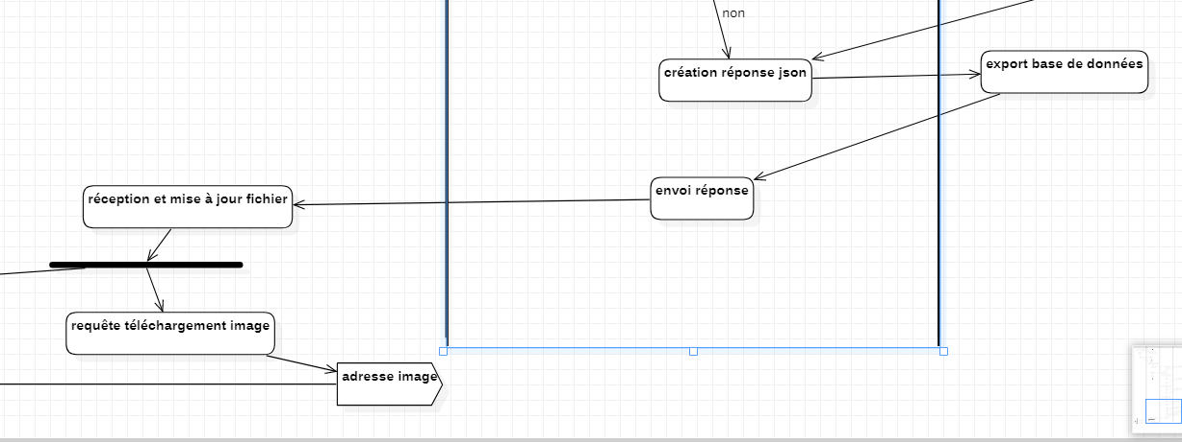
Schema UML

Slide 24
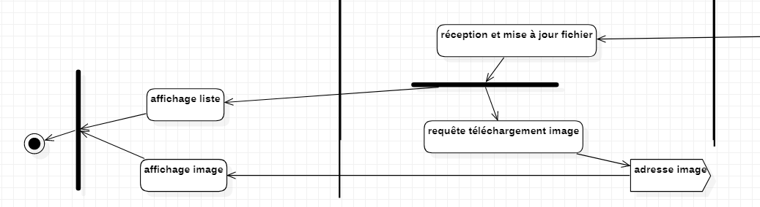
Schema UML

Slide 25
Schema UML
Diagramme de séquence

Slide 26
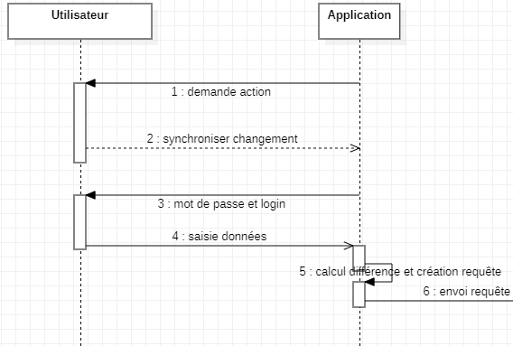
Schema UML

Slide 27
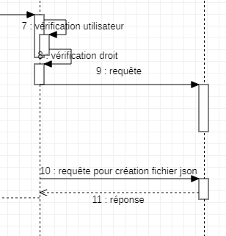
Schema UML

Slide 28
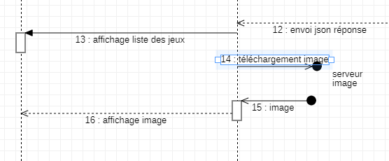

Slide 29
Schema UML
Diagramme de classe

Slide 30
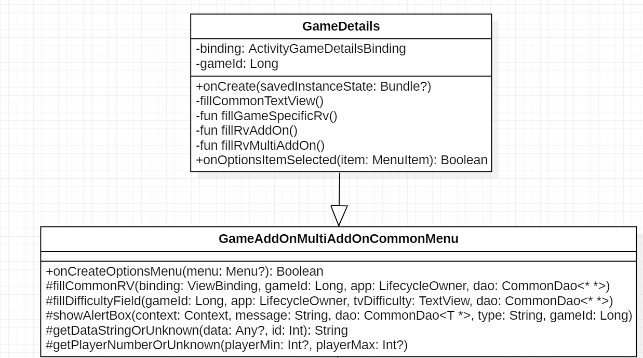

Slide 31
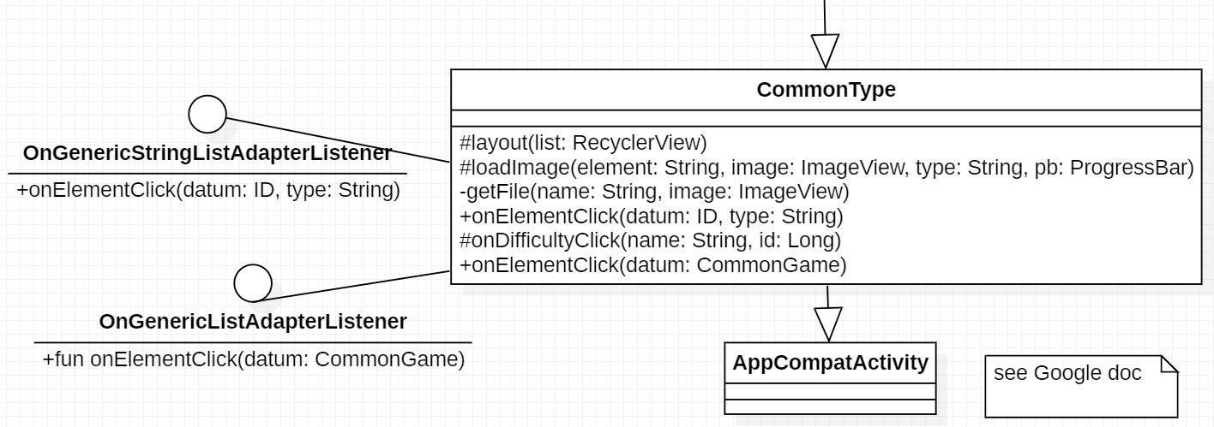

Slide 32
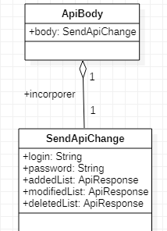

Slide 33
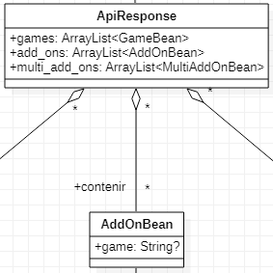

Slide 34
MCD-MLD

Slide 35
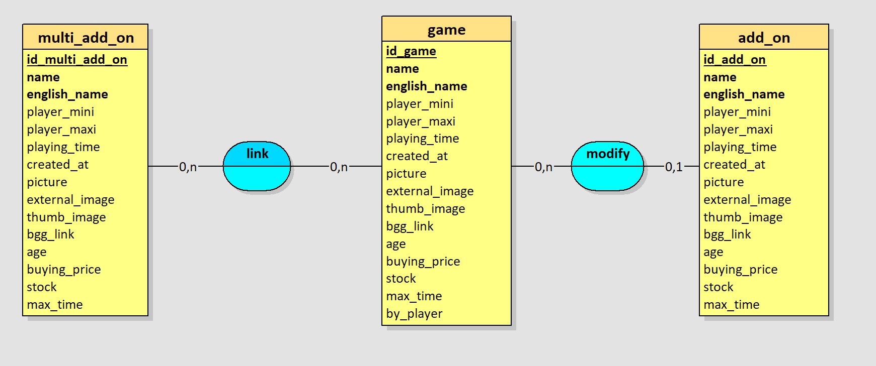
Schema MCD/MLD

Slide 36
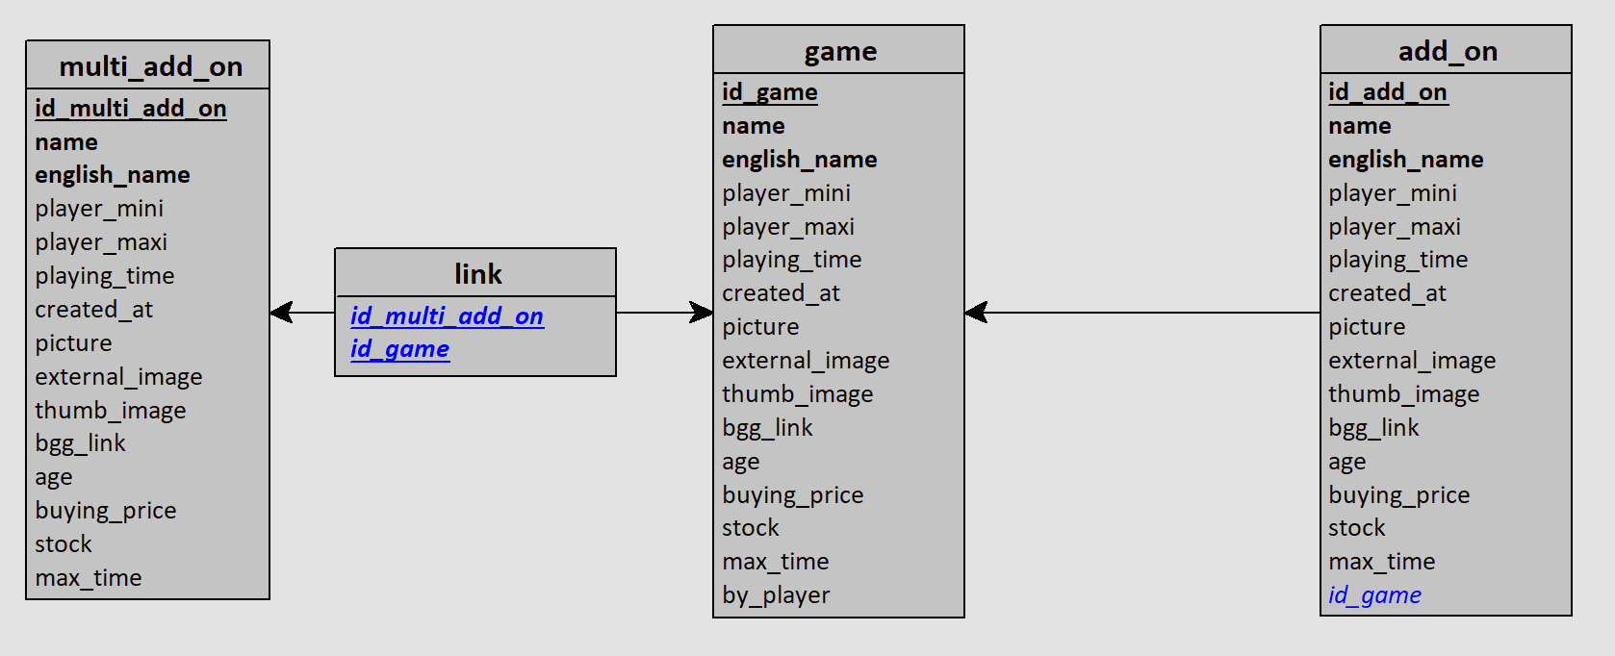
Schema MCD/MLD

Slide 37
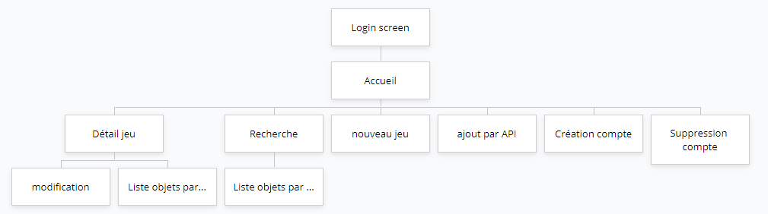
Arborescence

Slide 38
Zoning
Fil rouge
MENU
CONTENU

Slide 39

Wire Frame
Nom appli
Nom appli
Titre
Auteur
Login
Titre
Auteur
Titre
Auteur
Mot de passe
Titre
Auteur
Se connecter
Titre
Auteur
Se souvenir de moi
Titre
Auteur

Slide 40
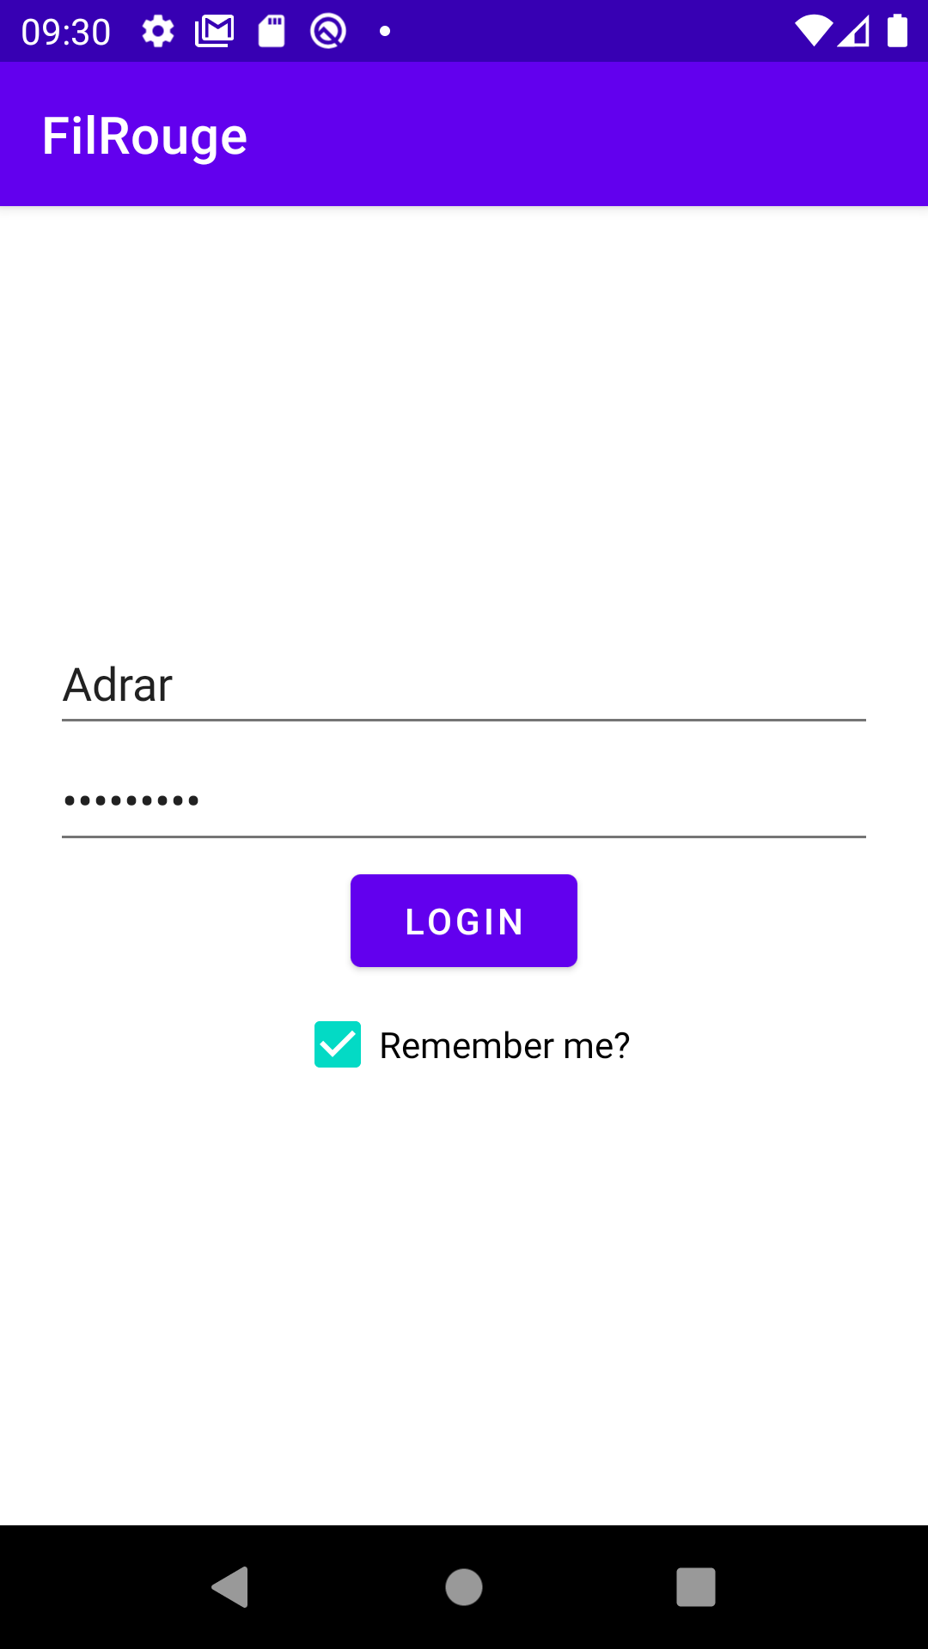
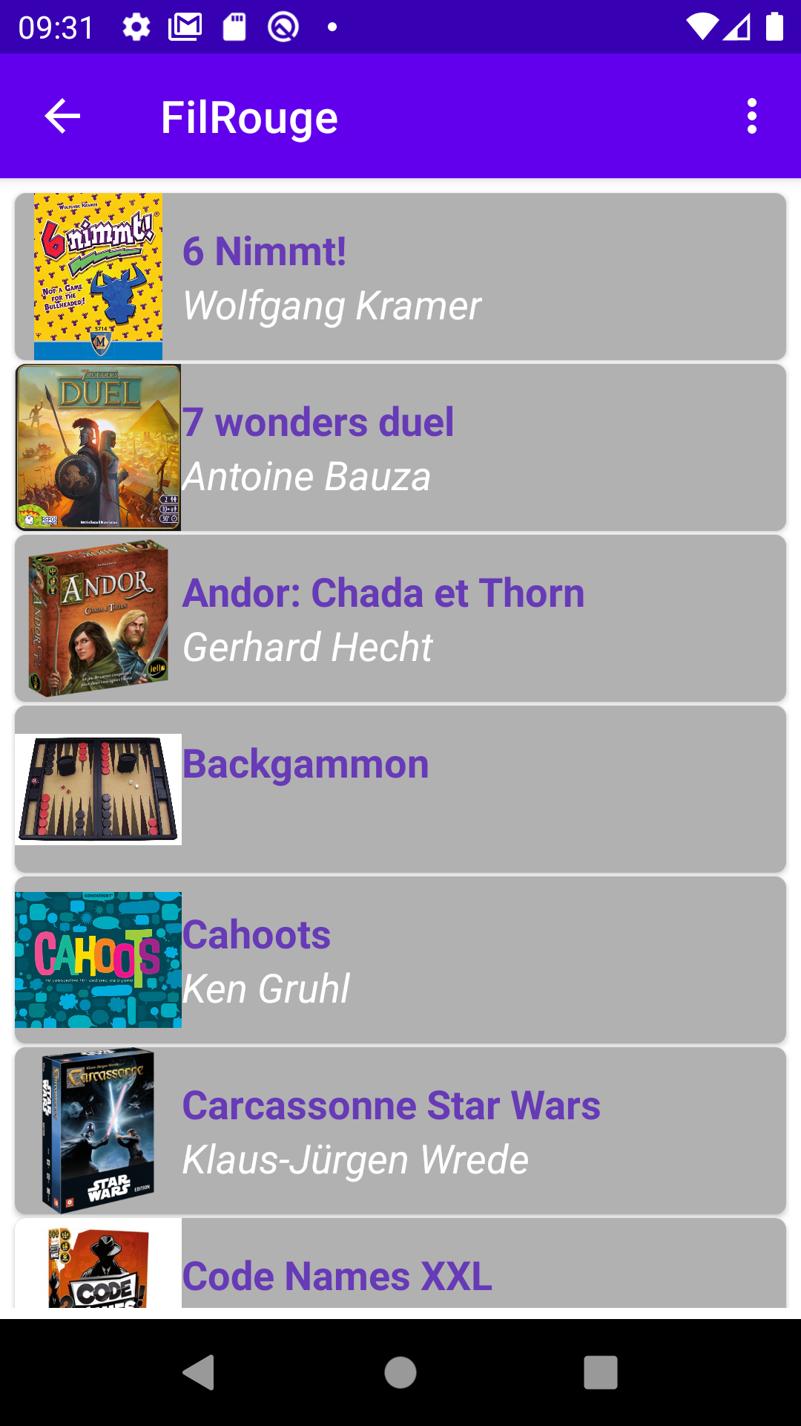
Mock up

Slide 41
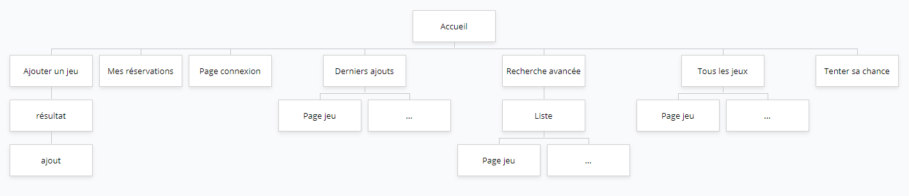
Arborescence

Slide 42
Zoning
Menu
Contenu
Footer
NavBar

Slide 43
Wire Frame
sub1
TITRE
sub2
sub3
sub4
recherche
Search bar
titre
titre
titre
titre
titre
auteur
auteur
auteur
auteur
auteur
titre
titre
titre
titre
titre
auteur
auteur
auteur
auteur
auteur
sub3
Projet xxx
sub2
sub1
Btn
Btn
Btn
Btn

Slide 44
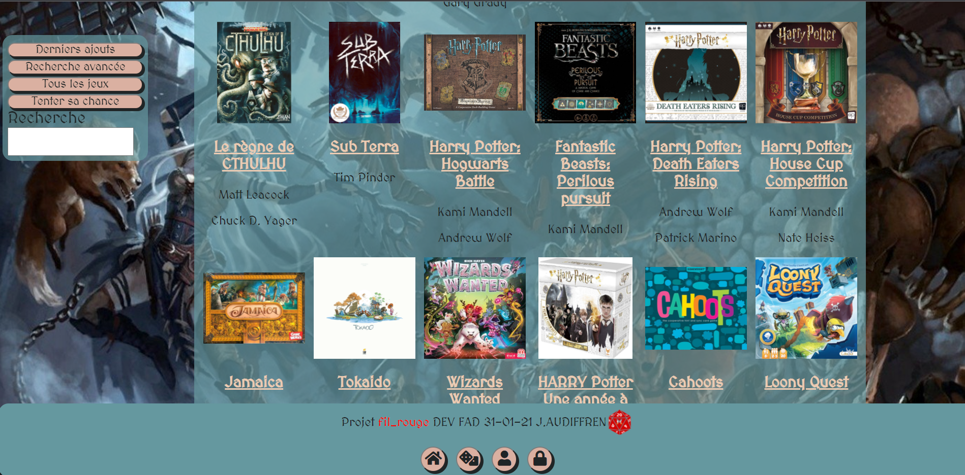
Mock up

Slide 45
Un peu de SQL

Slide 46
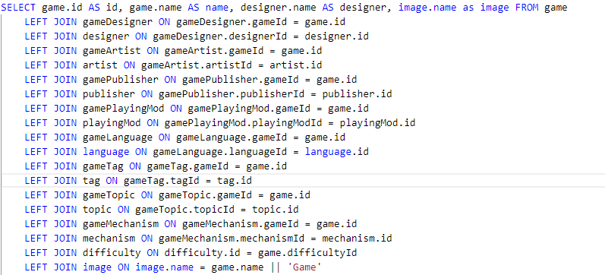

Slide 47
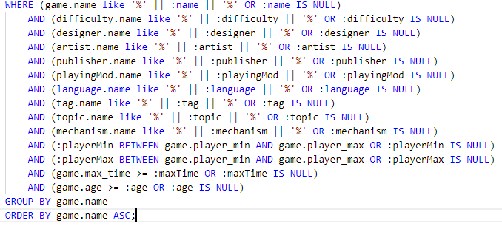

Slide 48
Exemple ajout de jeu et synchronisation

Slide 49

if (!isLocal) {
menu?.add(
0,
MenuId.Synchronize.ordinal,
0,
getString(R.string.save_and_synchronize)
)
menu?.add(0, MenuId.ResetDB.ordinal, 0, getString(R.string.reset_content))
}
/**
* Determine if the application use server or not
*/
var isLocal:Boolean = true
MenuId.Synchronize.ordinal -> synchronizeBox(
getString(R.string.save_synchronize_message),
false
)

Slide 50
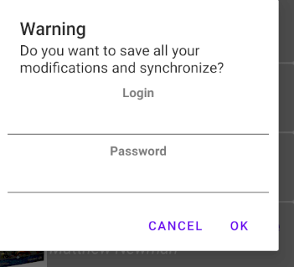
/**
* Create A synchronize AlertDialog box
*/
private fun synchronizeBox(message: String, cancel: Boolean) {
val login = EditText(this)
val pwd = addEditTextPassword()
val view = arrayListOf<View>(
addTextView(getString(R.string.login)),
login,
addTextView(getString(R.string.password)),
pwd
)
val ll = addLinearLayout(view)
AlertDialog.Builder(this)
.setMessage(message)
.setTitle(getString(R.string.warning))
.setPositiveButton(getString(R.string.ok)) { _, _ ->
run {
synchronize(login.text.toString(), pwd.text.toString(), cancel)
}
}.setNegativeButton(getString(R.string.cancel)) { _, _ ->
Toast.makeText(this, getString(R.string.canceled), Toast.LENGTH_SHORT).show()
}.setView(ll)
.show()
}

Slide 51
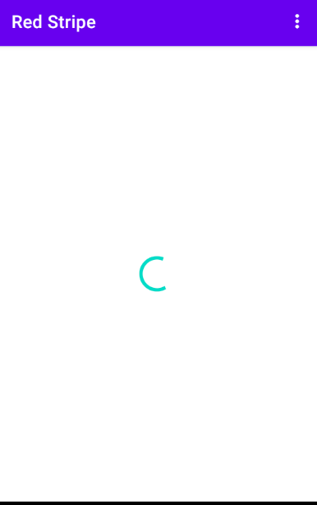
/**
* A method to synchronize loacal database with server
* available only in server mode
*/
private fun synchronize(login: String, password: String, cancel: Boolean) {
hideRV()
binding.tvGameError.visibility = View.GONE
CoroutineScope(SupervisorJob()).launch {
val timestamp = appInstance.sharedPreference.getFloat(SerialKey.Timestamp.name)
var modification = SendApiChange(
login, password, ApiResponse(
ArrayList(), ArrayList(), ArrayList()
), ApiResponse(ArrayList(), ArrayList(), ArrayList()),
ApiDelete(ArrayList(), ArrayList(), ArrayList()), timestamp
)
if (!cancel) {
modification = getDbModification(login, password, timestamp)
}
sendApiChangeToServer(modification)
}
}

Slide 52
SendApiChange(
login,
password,
ApiResponse(
appInstance.database.gameDao().getWithoutServerId().map {
dbMethod.convertToBean(it)
}.toCollection(ArrayList()),
appInstance.database.addOnDao().getWithoutServerId().map {
dbMethod.convertToBean(it)
}.toCollection(ArrayList()),
appInstance.database.multiAddOnDao().getWithoutServerId().map {
dbMethod.convertToBean(it)
}.toCollection(ArrayList())
),
@Query("SELECT * FROM game WHERE serverId IS NULL")
override fun getWithoutServerId():List<GameTableBean>
@Query("SELECT * FROM addOn WHERE serverId IS NULL")
override fun getWithoutServerId():List<AddOnTableBean>
@Query("SELECT * FROM multiAddOn WHERE serverId IS NULL")
override fun getWithoutServerId(): List<MultiAddOnTableBean>

Slide 53
/**
* convert [AddOnTableBean] from local database to [AddOnBean] for server exchange
*/
fun convertToBean(game:AddOnTableBean): AddOnBean {
val dao = appInstance.database.addOnDao()
var difficulty:String? = null
game.difficultyId?.run{
val difficultyL = appInstance.database.difficultyDao().getById(this)
if (difficultyL.isNotEmpty()) difficulty = difficultyL[0].name
}
var linkGame:String? = null
game.gameId?.run{
val gameL = appInstance.database.gameDao().getObjectById(this)
if (gameL.isNotEmpty()) linkGame = gameL[0].name
}
return AddOnBean(
game.serverId,
game.name,
game.player_min,
game.player_max,
game.playing_time,
difficulty,
dao.getDesignerObject(game.id).map{it.name}.toCollection(ArrayList()),
dao.getArtistObject(game.id).map{it.name}.toCollection(ArrayList()),
dao.getPublisherObject(game.id).map{it.name}.toCollection(ArrayList()),
game.bgg_link,
dao.getPlayingModObject(game.id).map{it.name}.toCollection(ArrayList()),
dao.getLanguageObject(game.id).map{it.name}.toCollection(ArrayList()),
game.age,
game.buying_price,
game.stock,
game.max_time,
linkGame,
game.external_img,
game.picture)
}

Slide 54
ApiResponse(
appInstance.database.gameDao().getChanged().map {
dbMethod.convertToBean(it)
}.toCollection(ArrayList()),
appInstance.database.addOnDao().getChanged().map {
dbMethod.convertToBean(it)
}.toCollection(ArrayList()),
appInstance.database.multiAddOnDao().getChanged().map {
dbMethod.convertToBean(it)
}.toCollection(ArrayList()),
),
@Query("SELECT * FROM game WHERE hasChanged=1")
fun getChanged():List<GameTableBean>
@Query("SELECT * FROM addOn WHERE hasChanged=1")
fun getChanged():List<AddOnTableBean>
@Query("SELECT * FROM multiAddOn WHERE hasChanged=1")
fun getChanged(): List<MultiAddOnTableBean>

Slide 55
ApiDelete(
appInstance.database.deletedContentDao().getByType(Type.Game.name).map {
DeletedObject(it.idContent.toInt())
}.toCollection(ArrayList()),
appInstance.database.deletedContentDao().getByType(Type.AddOn.name).map {
DeletedObject(it.idContent.toInt())
}.toCollection(ArrayList()),
appInstance.database.deletedContentDao().getByType(Type.MultiAddOn.name).map {
DeletedObject(it.idContent.toInt())
}.toCollection(ArrayList()),
),
timestamp
)

Slide 56
/**
* A method to handle JSON post request to server
*/
private fun sendApiChangeToServer(modification: SendApiChange) {
val content = gson.toJson(ApiBody(modification))
try {
API_URL?.run {
val body = sendPostOkHttpRequest(this, content)
apiReception(body)
}
} catch (e: Exception) {
apiErrorHandling(e)
}
}
/**
* method for POST httpRequest with String Body Return
* use for communication with API of the server
* @author Anthony Monteiro
*/
fun sendPostOkHttpRequest(url: String, paramJson:String): String {
//Build request
val body = paramJson.toRequestBody(MEDIA_TYPE_JSON)
val request = Request.Builder().post(body).url(url).build() //Execute request
val response = client.newCall(request).execute() //Analyse response code
return if (response.code !in 200..299) {
throw Exception("Incorrect server answer : ${response.code}")
} else {
//Request result
response.body?.string() ?: ""
}
}

Slide 57
/**
* handle api json answer and check content
*/
private fun apiReception(body: String) {
if (body.isNotBlank()) {
val result = gson.fromJson(body, ApiReceive::class.java)
if (result.timestamp > 0.0) {
actualizeTimeStamp(result.timestamp)
}
if (!result.isNullOrEmpty()) {
CoroutineScope(SupervisorJob()).launch {
eraseDeletedItemAndWithoutServerIdItem()
handleResult(result)
refreshAll()
}
}
}
runOnUiThread {
displayRV()
}
}

Slide 58
/**
* update save time stamp if local timestamp is zero reset the database
*/
private fun actualizeTimeStamp(timeStamp: Float) {
val timestamp = appInstance.sharedPreference.getFloat(SerialKey.Timestamp.name)
if (timestamp < 1.0) {
//a 0.0 timestamp means database reset
dbReset()
}
appInstance.sharedPreference.saveFloat(SerialKey.Timestamp.name, timeStamp)
}

Slide 59
/**
* Delete serverless Id items(temporary item) after server reception
*/
private fun eraseDeletedItemAndWithoutServerIdItem() {
db.runInTransaction {
db.deletedContentDao().deleteAll()
dbMethod.getGameType().forEach {
val lowCamelCase = it.highToLowCamelCase()
val dao = db.getMember("${lowCamelCase}Dao") as CommonDao<ID, *>
dao.getWithoutServerId().forEach { id ->
dbMethod.deleteLink(id, it)
dao.deleteOne(id.id)
}
}
}
}
@Query("DELETE FROM game")
fun deleteAll()
@Query("DELETE FROM game WHERE id=:id")
override fun deleteOne(id:Long)
/**
* transform High camel case [String] to Low camel case [String]
*/
fun String.highToLowCamelCase() = this.replaceFirstChar { it.lowercase() }
/**
* @return member of any class get by [String] name as [Any]
* @throws NullPointerException if member does not exist
*/
fun Any.getMember(name:String) = this::class.members.find{it.name == name}!!.call(this)

Slide 60
/**
* use to delete game object from junction Tables
*/
fun deleteLink(game: ID, type: String){
getCommonField().forEach {
val dao = db.getMember("${type.highToLowCamelCase()}${it}Dao") as CommonJunctionDAo<*>
dao.deleteWithMember1Id(game.id)
}
if (type == Type.Game.name){
getGameSpecificField().forEach {
val dao = db.getMember("${type.highToLowCamelCase()}${it}Dao") as CommonJunctionDAo<*>
dao.deleteWithMember1Id(game.id)
}
}
}
@Query("DELETE FROM gameMultiAddOn WHERE gameId=:objectId")
override fun deleteWithMember1Id(objectId:Long)
/**
* list of common field use for semantic linking
*/
fun getCommonField() = arrayListOf(
Type.Designer.name,
Type.Publisher.name,
Type.Artist.name,
Type.PlayingMod.name,
Type.Language.name
)

Slide 61
/**
* global dispatch function to handle server api result
*/
private fun handleResult(result: ApiReceive) {
createDataOfApiResult(result)
deleteDataOfApiResult(result)
linkDataOfApiResult(result)
}

Slide 62
/**
* convert JSON Api Result into database insert
*/
private fun createDataOfApiResult(result: ApiReceive) {
val db = appInstance.database
val gameTypeList = dbMethod.getGameType()
gameTypeList.forEach {
val lowCamelCase = it.highToLowCamelCase()
val data = result.getMember(lowCamelCase) as ArrayList<*>?
data?.run {
db.runInTransaction {
this.forEach { g ->
when (g) {
is GameBean -> insertNewGameData(g)
is AddOnBean -> db.addOnDao().insert(dbMethod.convertToTableBean(g))
is MultiAddOnBean -> db.multiAddOnDao()
.insert(dbMethod.convertToTableBean(g))
}
insertNewCommonData(g)
}
}
}
}
}

Slide 63
/**
* insert element if not already present
*/
private fun insertNewCommonData(g: Any) {
dbMethod.getCommonField().forEach {
val loweCamelCase = it.highToLowCamelCase()
val list = g.getMember(loweCamelCase) as ArrayList<String>
val dao = db.getMember("${loweCamelCase}Dao") as CommonCustomInsert<*>
list.forEach { m ->
val isAny = dao.getByName(m)
if (isAny.isEmpty()) dao.insert(m)
}
}
}

Slide 64
/**
* Handle junction table fill
*/
private fun linkDataOfApiResult(result: ApiReceive) {
linkGame(result)
linkAddOn(result)
linkMultiAddOn(result)
}
/**
* handle all junction table for [AddOnTableBean] from JSON [AddOnBean]
*/
private fun linkAddOn(result: ApiReceive) {
result.addOn?.run {
this.forEach {
try {
val dbGame = db.addOnDao().getByName(it.name).first()
dbMethod.insertLink(
dbGame,
Type.AddOn.name,
it
)
} catch (e: Exception) {
e.printStackTrace()
println(it.name)
}
}
}
}

Slide 65
/**
* use to create link for game in junction Tables
*/
fun<T: CommonDataArrayList> insertLink(game: ID, type:String, data:T, map:HashMap<String, ArrayList<String>>?=null){
findMembers(game, getCommonField(), type, data)
if (game is GameTableBean)findMembers(game, getGameSpecificField(), type, data, map)
}
/**
* internal method get semantically linked element using Kotlin reflection and make junction tables link
*/
private fun<T: CommonDataArrayList> findMembers(game:ID, list: ArrayList<String>, type:String, data:T, map:HashMap<String, ArrayList<String>>?=null){
list.forEach {
val lowercase = it.highToLowCamelCase()
val lowerType = type.highToLowCamelCase()
val targetList = map?.get(it)?:data.getMember(lowercase)
targetList?.run{
val toList = this as ArrayList<String>
val targetDao =
appInstance.database.getMember("${lowercase}Dao") as CommonComponentDao<ID>
val junctionDao =
appInstance.database.getMember("$lowerType${it}Dao") as CommonJunctionDAo<*>
linkList(toList, targetDao, junctionDao, game.id)
}
}
}

Slide 66
private fun refreshAll() {
loadImages(appInstance.database.gameDao(), Type.Game.name)
loadImages(appInstance.database.addOnDao(), Type.AddOn.name)
loadImages(appInstance.database.multiAddOnDao(), Type.MultiAddOn.name)
cleanImageList()
}
@Query("SELECT * FROM game")
override fun getList(): List<GameTableBean>
/**
* Check source for image download
*/
private fun <T : CommonComponent, U> loadImages(dao: CommonDao<T, U>, type: String) {
CoroutineScope(SupervisorJob()).launch {
for (game in dao.getList()) {
if (dao.getImage(game.name).isEmpty()) {
if (!game.external_img.isNullOrBlank()) {
launch {
getImage(game.external_img!!, game.name, type)
}
} else if (!game.picture.isNullOrBlank() && API_STATIC != null) {
launch {
getImage("$API_STATIC${game.picture}", game.name, type)
}
}
}
}
}
}
@Query("SELECT * FROM image WHERE image.name = :name || 'Game'")
override fun getImage(name: String): List<ImageTableBean>

Slide 67
/**
* Download image from an url and save it as a [ByteArray] file
*/
private fun getImage(url: String, gameName: String, type: String) {
try {
val img = sendGetOkHttpRequestImage(url)
img?.run {
appInstance.database.imageDao().insert(
ImageTableBean(
0,
"$gameName$type",
gameName,
type
)
)
val file = File(
this@ViewGamesActivity.filesDir,
"$gameName$type"
)
file.writeBytes(this)
}
} catch (e: Exception) {
e.printStackTrace()
}
}
@Insert
fun insert(user: ImageTableBean) : Long
/**
* method for GET httpRequest with ByteArray Body Return
* used for downloading picture from external link
*/
fun sendGetOkHttpRequestImage(url: String): ByteArray? {
//Build request
val request = Request.Builder().url(url).build() //Execute request
val response = client.newCall(request).execute() //Analyse response code
return if (response.code !in 200..299) {
throw Exception("Incorrect server answer : ${response.code}")
} else {
//Request result
response.body?.bytes()
}
}

Slide 68
private fun cleanImageList() {
CoroutineScope(SupervisorJob()).launch {
appInstance.database.runInTransaction {
appInstance.database.imageDao().getList().forEach {
when (it.gameType) {
Type.Game.name -> if (appInstance.database.gameDao()
.getByName(it.gameName).isEmpty()
) deleteImage(it.name)
Type.AddOn.name -> if (appInstance.database.addOnDao()
.getByName(it.gameName).isEmpty()
) deleteImage(it.name)
Type.MultiAddOn.name -> if (appInstance.database.multiAddOnDao()
.getByName(it.gameName).isEmpty()
) deleteImage(it.name)
}
}
}
}
}
@Query("SELECT * FROM game WHERE name=:searchedName")
override fun getByName(searchedName:String): List<GameTableBean>
/**
* Delete Image URI from database and Image file from application
*/
private fun deleteImage(fileName: String) {
appInstance.database.imageDao().deleteByName(fileName)
File(this@ViewGamesActivity.filesDir, fileName).delete()
}

Slide 69
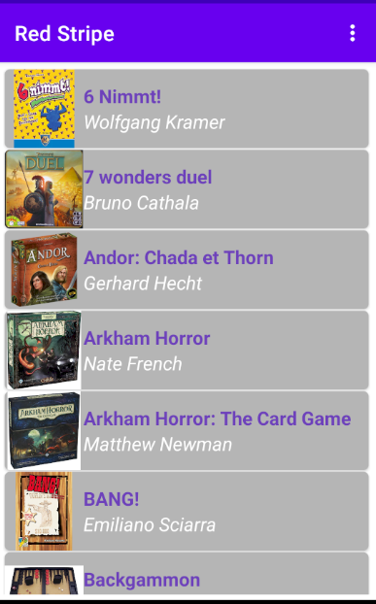

Slide 70
@api_view(['POST'])
@transaction.atomic
def synchronize_change(request):
if request.method == "POST":
body_response = json.loads(request.body)
if type(body_response) == dict:
body = body_response.get('body')
user = django_authentify(request, body)
if user is not None:
if user.has_perm('ludorecherche.add_Game') and \
user.has_perm('ludorecherche.change_Game') and \
user.has_perm('ludorecherche.delete_Game'):
modify_db(body)
new_timestamp = time.time()
if body.get('timestamp') is None:
return Response(get_all(0.0, new_timestamp))
else:
return Response(get_last_change(body.get('timestamp'), new_timestamp))
else:
return Response({'error': 'wrong credential'})

Slide 71
def django_authentify(request, body):
username = body.get('login')
password = body.get('password')
return authenticate(request, username=username, password=password)
def modify_db(body):
deleted_content = body.get('deletedList')
if type(deleted_content) == dict:
delete_dispatch(deleted_content)
modified_content = body.get('modifiedList')
if type(modified_content) == dict:
modify_dispatch(modified_content)
added_content = body.get('addedList')
if type(added_content) == dict:
add_dispatch(added_content)
late_common_object_fill(added_content)
if type(modified_content) == dict:
late_common_object_fill(modified_content)

Slide 72
def delete_dispatch(deleted_content: dict):
delete_from_db(deleted_content.get('games'), Game)
delete_from_db(deleted_content.get('add_ons'), AddOn)
delete_from_db(deleted_content.get('multi_add_ons'), MultiAddOn)
def delete_from_db(list_object, db_class):
if type(list_object) == list:
for data in list_object:
if type(data) == dict:
try:
db_data = db_class.objects.get(pk=data.get('id'))
db_data.delete()
except ObjectDoesNotExist:
continue

Slide 73
def modify_dispatch(modified_content: dict):
list_object_from_dict(modified_content.get('games'), Game, game_type())
list_object_from_dict(modified_content.get('add_ons'), AddOn, add_on_type())
list_object_from_dict(modified_content.get('multi_add_ons'), MultiAddOn, multi_add_on_type())
def list_object_from_dict(list_object, db_class, type_object):
if type(list_object) == list:
for data_object in list_object:
if type(data_object) == dict:
try:
db_data = db_class.objects.get(pk=data_object.get('id'))
try:
db_destination = db_class.objects.get(name=data_object.get('name', "").strip())
if db_destination.pk == db_data.pk:
common_field_change(db_data, data_object, type_object)
except ObjectDoesNotExist:
common_field_change(db_data, data_object, type_object)
except ObjectDoesNotExist:
continue

Slide 74
def add_dispatch(added_content):
common_field_fill(Game, added_content, 'games', game_type())
common_field_fill(AddOn, added_content, 'add_ons', add_on_type())
common_field_fill(MultiAddOn, added_content, 'multi_add_ons', multi_add_on_type())
def common_field_fill(db_class, added_content, field, type_object):
if added_content:
games = added_content.get(field)
if type(games) == list:
for game in games:
try:
db_class.objects.get(name=game.get('name', "").strip())
continue
except ObjectDoesNotExist:
new_game = db_class.objects.create(
name=game.get("name", "").strip(),
english_name=game.get("english_name", "").strip(),
player_min=get_int(game.get('player_min')),
player_max=get_int(game.get('player_max')),
playing_time=game.get('playing_time', "").strip(),
bgg_link=game.get('bgg_link', "").strip(),
age=get_int(game.get('age')),
max_time=get_int(game.get('max_playtime')),
stock=get_int(game.get('stock', 1)),
external_image=game.get('external_img', "").strip(),
buying_price=get_int(game.get('buying_price')),
)
common_object_fill(game, new_game, type_object)
new_game.save()

Slide 75
def late_common_object_fill(content):
add_ons = content.get('add_ons')
if type(add_ons) == list:
for add_on in add_ons:
db_add_on = AddOn.objects.get(name=add_on.get('name', "").strip())
try:
db_add_on.game = Game.objects.get(name=add_on.get('game', "").strip())
db_add_on.save()
except ObjectDoesNotExist:
pass
multi_add_ons = content.get('multi_add_ons')
if type(multi_add_ons) == list:
for multi_add_on in multi_add_ons:
db_multi_add_on = MultiAddOn.objects.get(name=multi_add_on.get('name', "").strip())
fill_complex_element(multi_add_on.get('games'), Game, db_multi_add_on)

Slide 76
def get_last_change(timestamp, new_timestamp):
games = [game for game in Game.objects.filter(modified_at__gte=timestamp).order_by('name')]
multi_add_ons = [add_on for add_on in MultiAddOn.objects.filter(modified_at__gt=timestamp).order_by('name')]
add_ons = [add_on for add_on in AddOn.objects.filter(modified_at__gt=timestamp).order_by('name')]
deleted_games = [game for game in DeletedGames.objects.filter(created_at__gt=timestamp,
product_type=game_type())]
deleted_add_ons = [add_on for add_on in DeletedGames.objects.filter(created_at__gt=timestamp,
product_type=add_on_type())]
deleted_multi_add_ons = [multi_add_on for multi_add_on in DeletedGames.objects.filter(
created_at__gt=timestamp, product_type=multi_add_on_type())]
dic_all = {'games': [
make_sub_dic(game, {
'by_player': game.by_player,
'tag': [tag.name for tag in game.tag.order_by('name')],
'topic': [topic.name for topic in game.topic.order_by('name')],
'mechanism': [mechanism.name for mechanism in game.mechanism.order_by('name')],
'add_on': [add_on.name for add_on in AddOn.objects.filter(game_id=game.pk)],
'multi_add_on': [multi_add_on.name for multi_add_on in MultiAddOn.objects.filter(games=game.pk)]
}) for game in games],
'multi_add_ons': [make_sub_dic(add_on, {
'games': [game.name for game in add_on.games.order_by('name')]
}) for add_on in multi_add_ons],
'add_ons': [make_sub_dic(add_on, {'game': add_on.game.name}) for add_on in add_ons if add_on.game is not None],
'deleted_games': [game.deleted_id for game in deleted_games],
'deleted_add_ons': [game.deleted_id for game in deleted_add_ons],
'deleted_multi_add_ons': [game.deleted_id for game in deleted_multi_add_ons],
'timestamp': new_timestamp
}
return dic_all

Slide 77
def make_sub_dic(game, sub_dic):
this_dic = {
'id': game.pk,
'name': game.name,
'english_name': game.english_name,
'player_min': game.player_min,
'player_max': game.player_max,
'playing_time': game.playing_time,
'difficulty': game.difficulty.name if game.difficulty else None,
'designer': [designer.name for designer in game.designers.order_by('name')],
'artist': [artist.name for artist in game.artists.order_by('name')],
'publisher': [publisher.name for publisher in game.publishers.order_by('name')],
'bgg_link': game.bgg_link,
'playingMod': [playing_mode.name for playing_mode in game.playing_mode.order_by('name')],
'language': [language.name for language in game.language.order_by('name')],
'age': game.age,
'buying_price': game.buying_price,
'stock': game.stock,
'max_time': game.max_time,
'external_img': game.external_image,
'picture': game.picture
}
this_dic.update(sub_dic)
return this_dic

Slide 78
Le passé…...
Les difficultés
Comment les surmonter
Ce que j’ai appris

Slide 79
Le futur…...
Les améliorations
Le futur de l’application

Slide 80
Merci à tous

