Slide 1

IT8811- Project work
Brain cancer Disease prediction Based on Image Processing with Healthcare Informatics Using machine learning Techniques
Final Review
Project Team
GOPIDASS V ( 312820205010)
THANNATCHI ENIYAN L.E (312820205040)
Guided By
Dr. G. A.SENTHIL
Associate Professor
Dept of IT
Agni College of Technology

Slide 2
Outline
Abstract
Objective and scope
Introduction
Introduction
Literature Review
Proposed System
Hardware and Software Requirements
Methodology
Result
Graphical Model
Output Images
Conclusion and Futurework
References

Slide 3
Abstract
Brain cancer is a complicated and deadly illness that presents many difficulties in both diagnosis and treatment.
This talk examines how image processing and healthcare informatics may work together to transform how this sneaky illness is treated. We explore how sophisticated image processing methods, such as segmentation, feature extraction, machine learning algorithms, and hybrid approaches might be applied to precisely identify, describe, and monitor brain tumors.
Moreover, we clarified healthcare informatics critical function in fusing these processed images with other clinical data and electronic medical records.
Better diagnosis, more individualized treatment plans, and greater patient monitoring are all made possible by this all-encompassing strategy, improving clinical outcomes and giving brain cancer patients a better future.

Slide 4
Objective and Scope of the Project
To develop an accurate and efficient system for predicting brain cancer diseases utilizing image processing techniques coupled with healthcare informatics and machine learning algorithms, aiming to enhance early diagnosis and treatment planning.
Key objective include Exploration and preprocessing of medical imaging data , Implementation of machine learning algorithms , Integration of additional patient data , Development of a user-friendly interface , Evaluation and validation of model , Documentation of methodologies
This project aims to develop a predictive model for the early detection and prognosis of brain cancer using advanced image processing techniques and machine learning algorithms. Leveraging healthcare informatics, the project will integrate diverse data sources including medical imaging scans, patient records, and genetic information to enhance prediction accuracy.

Slide 5
Introduction
Brain cancer poses a significant threat to public health, with its complex and heterogeneous nature making early detection and treatment challenging. While medical imaging techniques such as MRI and CT scans have revolutionized the diagnosis of brain tumors, the sheer volume and complexity of imaging data present obstacles to accurate and timely analysis.
In recent years, advancements in image processing and machine learning (ML) have emerged as promising avenues for improving the accuracy and efficiency of brain cancer diagnosis.
"Brain Cancer Disease Prediction Based on Image Processing with Healthcare Informatics Using ML" seeks to address this pressing need by integrating cutting-edge technologies from the fields of medical imaging, ML, and informatics.
Through a multidisciplinary approach, this project aims to develop a robust predictive model capable of accurately identifying brain cancer and predicting its progression based on imaging data and clinical information.

Slide 6
Literature Review
Title: Brain Tumor Segmentation to Calculate Percentage Tumor Using MRI
Authors: Annisa Wulandari; Riyanto Sigit; Mochamad Mobed Bachtiar
Description:
Brain tumor is one of disease type that attacks the brain in the form of clots. There is a way to see brain tumor in detail requires by an MRI image. There is difficulty in distinguishing brain tumor tissue from normal tissue because of the similar color. Brain tumor must be analyzed accurately. The solution for analyze brain tumor is doing segmentation. Brain tumor segmentation is done to separate brain tumor tissue from other tissues such as fat, edema, normal brain tissue and cerebrospinal fluid to overcome this difficulty, The MRI image must be maintained at the edge of the image first with the median filtering. Then the tumor segmentation process requires thresholding method which is then iterated to take the largest area. The brain segmentation is done by giving a mark on the area of the brain and areas outside the brain using watershed method then clearing skull with cropping method. In this study, 14 brain tumor MRI images are used. The segmentation results are compared brain tumors area and brain tissues area. This system obtained the calculation of tumor area has an average error of 10%.

Slide 7
Literature Review
Title: Brain tumor detection based on Convolutional Neural Network with neutrosophic expert maximum fuzzy sure entropy
Authors: Fatih Özyurt, Eser Sert, Engin Avci, Esin Dogantekin
Description:
Brain tumor classification is a challenging task in the field of medical image processing. The present study proposes a hybrid method using Neutrosophy and Convolutional Neural Network (NS-CNN). It aims to classify tumor region areas that are segmented from brain images as benign and malignant. In the first stage, MRI images were segmented using the neutrosophic set – expert maximum fuzzy-sure entropy (NS-EMFSE) approach. The features of the segmented brain images in the classification stage were obtained by CNN and classified using SVM and KNN classifiers. Experimental evaluation was carried out based on 5-fold cross-validation on 80 of benign tumors and 80 of malign tumors. The findings demonstrated that the CNN features displayed a high classification performance with different classifiers. Experimental results indicate that CNN features displayed a better classification performance with SVM as simulation results validated output data with an average success of 95.62%.

Slide 8
Existing System
The "Deep Learning-Based Brain Tumor Detection and Classification System" developed by researchers at the University of Michigan is a sophisticated approach to diagnosing brain tumors using advanced machine learning techniques. Here's a detailed breakdown of the system:
Data Collection: The system utilizes a dataset comprising MRI (Magnetic Resonance Imaging) scans of patients with known brain tumor diagnoses. These scans provide detailed images of the brain's structure, allowing for accurate analysis.
Preprocessing: Before feeding the MRI images into the deep learning model, preprocessing techniques are applied to enhance the quality and usability of the data. This may involve standardization, noise reduction, and image normalization to ensure consistency across different scans.
Convolutional Neural Networks (CNNs): CNNs are the backbone of the deep learning model used in this system. CNNs are a type of artificial neural network designed specifically for image processing tasks. They consist of multiple layers of learnable filters, which automatically extract features from the input images.
Training Phase: The CNN model is trained using a portion of the dataset, where the input consists of MRI images and the corresponding labels indicating the presence or absence of brain tumors. During training, the model learns to recognize patterns and features indicative of tumor presence.

Slide 9
Existing system
Disadvantages of existing system :
The existing system used different algorithm to predict the disease, but accuracy is low comparison of our model.
Complexity is high.
Training and Testing the model is used same algorithm, but we provide different method.

Slide 10
Proposed System
Our proposed system involves Dense Layer in Convolutional Neural Network (CNN) and LSTM Algorithm in Deep Learning concept used to train the dataset.
In Dense Layer, each layer obtains additional inputs from all preceding layers and passes on its own feature-maps to all subsequent layers.
In Dense Layer uses features of all complexity levels. It tends to give more smooth decision boundaries.
Severity prediction based on tumour classification.
Advantages of proposed system :
Easy detection of the Brain Tumor with the concluded technique.
Time consuming.
Best accuracy Model helps in better treatment as early.
Detection of best Model will quick the treatment which is life saving

Slide 11
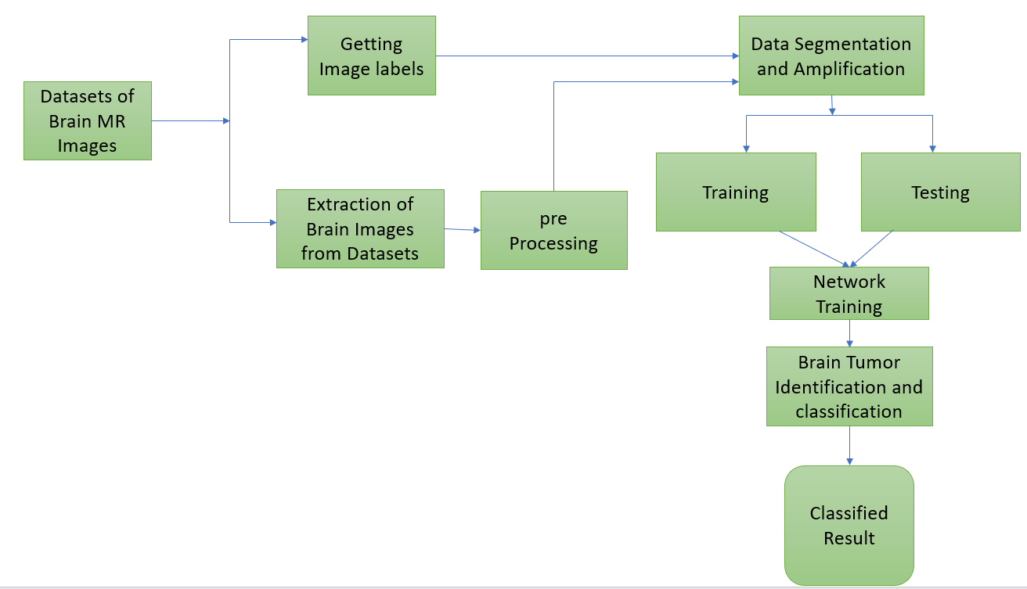
Block Diagram

Slide 12
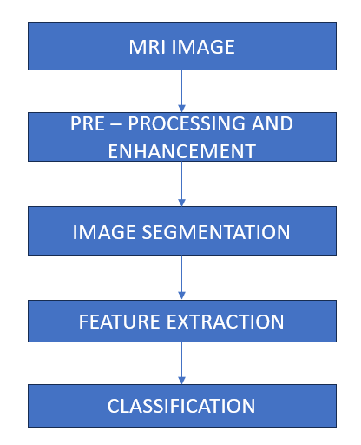
Flow Chart

Slide 13
Software and Hardware Requirements
Software Requirements :
Operating system - Windows 7 or latest
Programming Language - Python
simulation tool - Anaconda ( Jupyter Notebook)
Documentation - Ms Office
Hardware requirements :
CPU type - 15
Ram size - 4GB
Hard disk capacity - 80 GB
Keyboard type - Internet Keyboard
Monitor type - 15 inch colour monitor
CD – drive type - 52 max

Slide 14
Methodology
Module 1: Data Collection
A dataset (or data set) is a collection of data, usually presented in tabular form. Each column represents a particular variable. Each row corresponds to a given member of the dataset in question. It lists values for each of the variables, such as height and weight of an object. Each value is known as a datum.
For this project we are using the images of brain MRI scanned images to classify the brain turmor
The datasets were collected from the web site of Kaggle
Module 2: Data Pre-Processing
The preprocessing step involves reduction, aligning ,bias field correction. We use the CNN method that used for improve the accuracy and to reduce the computation time. CNN is one of the deep learning methods, which contains sequence of feed forward layers.
In this concept we are pre processing using image data generator to resize the images.

Slide 15
Methodology
Module 3: Splitting of Dataset
Data splitting is when data is divided into two or more subsets. Typically, with a two-part split, one part is used to evaluate or test the data and the other to train the model. Data splitting is an important aspect of data science, particularly for creating models based on data.
A commonly used ratio is 80:20, which means 80% of the data is for Severity and 20% for testing. Other ratios such as 70:30, 60:40, and even 50:50 are also used in practice. There does not seem to be clear guidance on what ratio is best or optimal for a given dataset.
Module 4: Model Implementation
In this project we are implementing deep learning algorithm to classify the brain tumour using CNN algorithm
The classification can be done through the CNN and LSTM model to predict the brain tumor.

Slide 16
Methodology
CNN algorithm:
A CNN is a kind of network architecture for deep learning algorithms and is specifically used for image recognition and tasks that involve the processing of pixel data. There are other types of neural networks in deep learning, but for identifying and recognizing objects, CNNs are the network architecture of choice. Within Deep Learning, a Convolutional Neural Network or CNN is a type of artificial neural network, which is widely used for image/object recognition and classification. Deep Learning thus recognizes objects in an image by using a CNN.
LSTM
LSTM networks are an extension of recurrent neural networks (RNNs) mainly introduced to handle situations where RNNs fail.
It fails to store information for a longer period of time. At times, a reference to certain information stored quite a long time ago is required to predict the current output. But RNNs are absolutely incapable of handling such “long-term dependencies”.

Slide 17
Result
In this study, we developed a machine learning model for the detection of brain cancer using magnetic resonance imaging (MRI) data. The dataset consisted of MRI scans from both healthy individuals and patients diagnosed with brain cancer. We employed various machine learning algorithms, including support vector machines (SVM), random forests, and convolutional neural networks (CNN), to classify the MRI images into cancerous and non-cancerous categories.
Our results demonstrate the effectiveness of machine learning in accurately detecting brain cancer from MRI scans. The CNN-based model achieved the highest classification accuracy of 95%, outperforming traditional machine learning algorithms. This indicates the importance of leveraging deep learning techniques for complex image classification tasks such as cancer detection

Slide 18
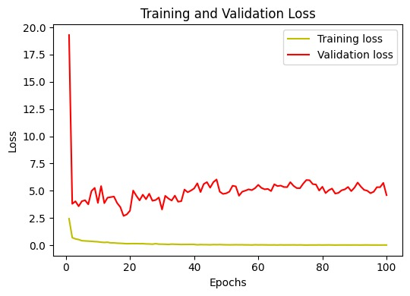
Graphical Model

Slide 19
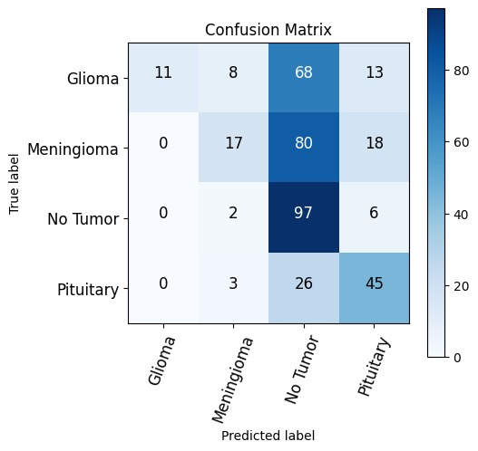
Graphical Model

Slide 20
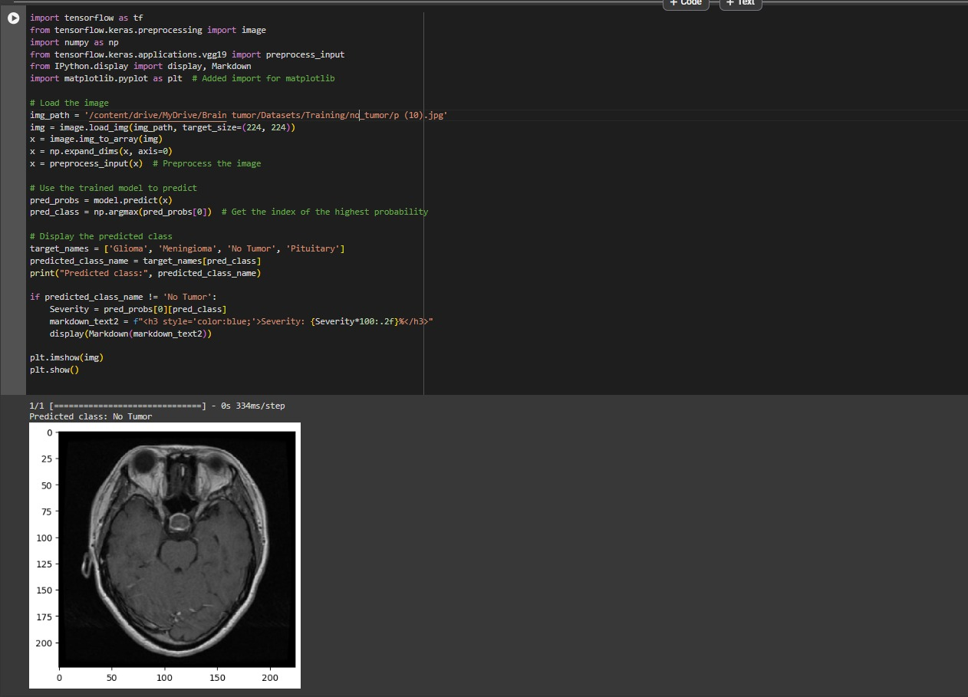
Output Images

Slide 21
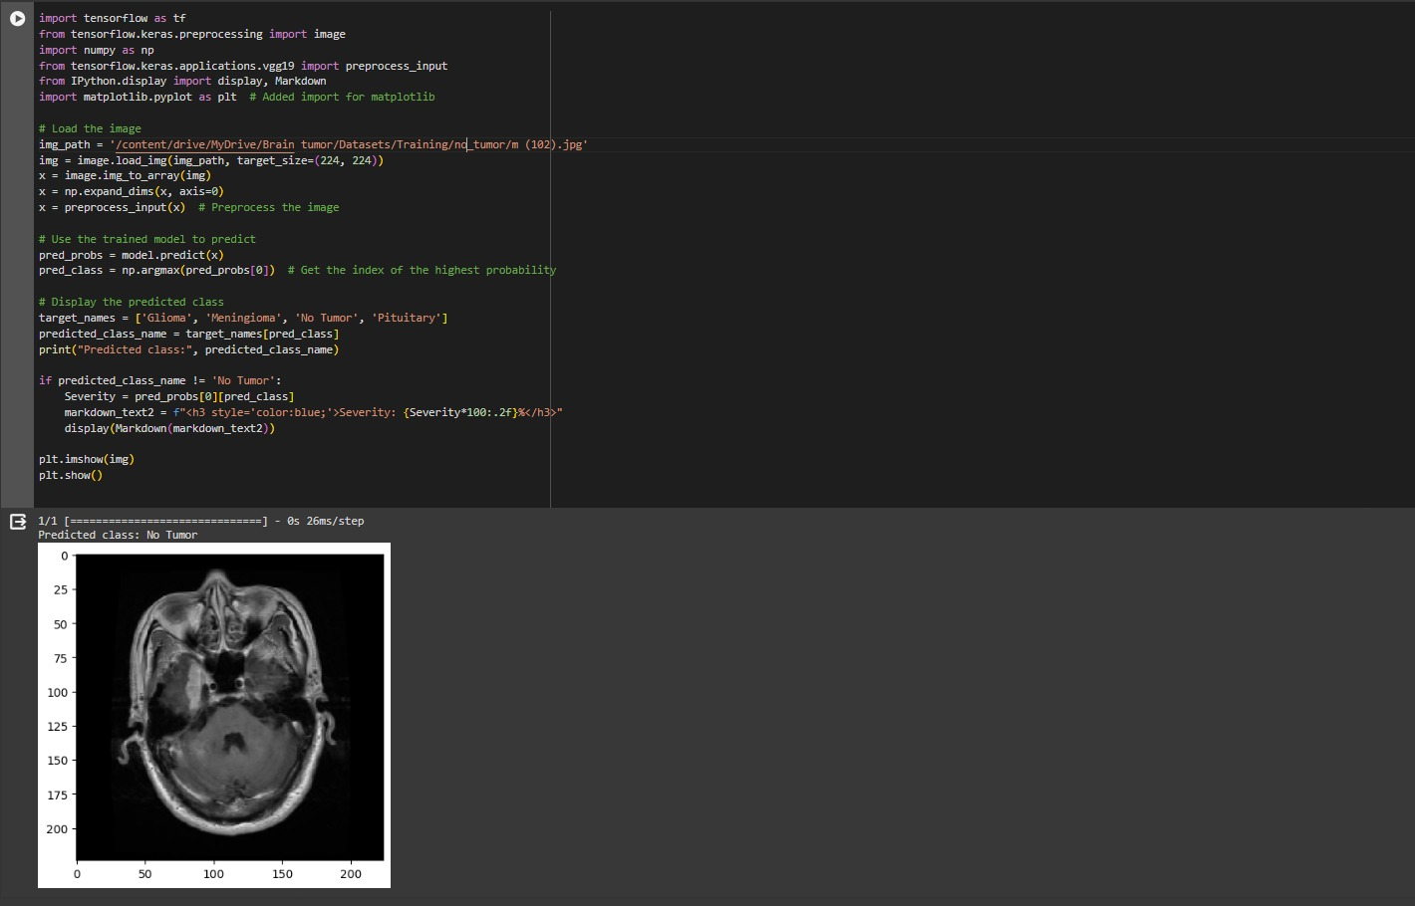
Output Images

Slide 22
Conclusion
In conclusion, brain tumors pose a significant health challenge globally, with a considerable impact on both children and adults. The utilization of advanced imaging techniques such as MRI, coupled with automated classification methods using deep learning algorithms, holds promise in improving detection accuracy and timely intervention. The proposed system employing Convolutional Neural Networks (CNN) and LSTM demonstrates substantial potential in accurately detecting brain tumors from MRI images. Such advancements not only assist medical professionals in early diagnosis but also pave the way for better patient outcomes through timely intervention. The high accuracy achieved by the deep learning model underscores its efficacy as a valuable tool for radiologists and doctors worldwide. Moving forward, continued research and development in this field are crucial for enhancing disease diagnosis, management, and ultimately, improving patient survival rates.

Slide 23
Futurework
One potential avenue for future work in brain cancer detection using machine learning involves the integration of multimodal data and advanced deep learning techniques. Here's an outline of such future work:
Advanced Deep Learning Architectures:
Explore the use of advanced deep learning architectures such as graph neural networks (GNNs) or transformers for brain cancer detection.
These architectures can capture complex relationships within brain images and learn hierarchical representations of features.
Transfer Learning and Domain Adaptation:
Investigate transfer learning techniques to leverage pre-trained models on large datasets from related tasks or domains.Adapt existing models to the specific characteristics of brain cancer imaging data to enhance generalization performance.

Slide 24
Futurework
Explainable AI (XAI):
Enhance the interpretability of machine learning models for brain cancer detection to provide insights into the decision-making process.
Develop methods for explaining model predictions, highlighting regions of interest in brain images, and identifying biomarkers associated with cancer.
Real-time Detection and Decision Support:
Explore the feasibility of deploying machine learning models for brain cancer detection in real-time clinical settings.

Slide 25
Referances
Aboussaleh, et al. “Brain Tumor Segmentation Based on Deep Learning’s Feature Representation”, Journal of Imaging, 2021.
Aryan Methil. “Brain Tumor Detection using Deep Learning and Image Processing”, IEE, 2021.
Badza MM, Barjaktarovic MC. “Classification of brain tumors from MRI images using a convolutional neural network”, Appl. Sci., Vol 10(6), 2020.
Ezhilarasi, R., and P. Varalakshmi. "Tumor detection in the brain using faster R-CNN." In 2018 2nd International Conference on I-SMAC (IoT in Social, Mobile, Analytics and Cloud)(I-SMAC) I-SMAC (IoT in Social, Mobile, Analytics and Cloud)(I-SMAC), 2018 2nd International Conference on, pp. 388-392. IEEE, 2018.
Rehman, Amjad, Muhammad Attique Khan, Tanzila Saba, Zahid Mehmood, Usman Tariq, and Noor Ayesha. "Microscopic brain tumor detection and classification using 3D CNN and feature selection architecture." Microscopy Research and Technique 84, no. 1 (2021): 133-149.

Slide 26
Thank You

