Slide 1
Parkinson’s Disease -
Hand Tremor Generation

Slide 2
CONTENTS
INTRODUCTION TO PD
TREMOR EFFECTS & DETECTION
PROBLEM STATEMENT AND SOLUTION
BLOCK DIAGRAM FOR VERIFICATION
TREMOR GENERATION SETUP

Slide 3
INTRODUCTION
Parkinson's disease is a progressive neurological disorder that affects millions of people worldwide. One of the primary symptoms of Parkinson's disease is tremors, which are involuntary, rhythmic movements that can occur at rest or during movement. These tremors can significantly impact the quality of life for individuals with Parkinson's disease, making even simple tasks challenging.
Our project aims to better understand Parkinson's disease tremors and contribute to the development of innovative technologies for diagnosis and treatment. We have developed a multifaceted approach that includes creating a 3D hand model, designing a hardware setup using servo motors and Arduino to simulate tremors, and implementing a patch antenna to detect the frequency of these tremors.
Through our work, we hope to shed light on the mechanisms underlying Parkinson's disease tremors and explore new avenues for more effective diagnosis and treatment strategies. Our ultimate goal is to improve the quality of life for individuals living with Parkinson's disease and contribute to the broader field of neurological research.

Slide 4
TREMOR OVERVIEW
Parkinson's disease tremors are one of the hallmark symptoms of the condition, affecting approximately 70-80% of individuals with Parkinson's disease. These tremors are involuntary, rhythmic, and typically occur at rest. They can also occur during movement, known as action tremors, but tend to diminish or disappear during sleep.
Frequency and Characteristics:
Parkinson's tremors typically have a frequency of 4-6 Hz (cycles per second), which is often described as a "pill-rolling" tremor due to its characteristic appearance.
The tremors usually start on one side of the body, commonly in the hand, and may later affect other limbs.
Tremors can vary in intensity, ranging from mild to severe, and can impact daily activities such as writing, eating, and dressing.

Slide 5
Effects on Quality of Life:
Parkinson's tremors can have a significant impact on the quality of life, causing embarrassment, social withdrawal, and difficulty performing daily tasks.
The presence of tremors can also lead to anxiety and depression in some individuals.
As the disease progresses, tremors may become more pronounced and difficult to control, further impacting mobility and independence.
Management and Treatment:
While there is no cure for Parkinson's disease, tremors and other symptoms can be managed effectively with medication, such as levodopa, dopamine agonists, and anticholinergics.
In some cases, deep brain stimulation (DBS) surgery may be recommended to help control tremors and other motor symptoms.
Research and Innovation:
Ongoing research is focused on understanding the underlying mechanisms of Parkinson's tremors and developing new treatments.
Innovations such as wearable devices and advanced imaging techniques are being explored to improve the monitoring and management of tremors in Parkinson's disease.

Slide 6
PROBLEM STATEMENT
Parkinson's disease tremors are a debilitating symptom affecting many patients, but their exact causes and effective treatments remain elusive. Our project aims to create a system using a 3D hand model, servo motors, and a patch antenna to simulate and study these tremors. This system will help uncover the underlying mechanisms of Parkinson's tremors and explore novel treatment approaches.

Slide 7
PROPOSED SOLUTION
Patch Antenna(RF sensor) integrated with arm
3D ARM
MICROCONTROLLER AND SERVO MOTOR BASED FRQUENCY GENERATION
Frequency measurement

Slide 8
BLOCK DIAGRAM
ARDUINO
FREQUENCY GENERATION(4-6HZ
3D PRINTED
FINGERS
SERVO MOTORS
MONITORING
VISUALIZING FREQUEMCY SHIFTS
ANTENNA
(RF SENSOR) FREQUENCY DETECTION

Slide 9
TREMOR GENERATION SETUP
Our Setup consist of 1)3D hand model
2)Hardware setup for frequency generation
3)Patch antenna for detection of generated frequency
3D HAND MODEL:
The 3D hand model was created using software such as Blender and Tinkercad, allowing for precise detailing and customization.
The model is designed to mimic the anatomy and movement of a human hand, with specific attention to details relevant to tremor simulation, such as joint movements and finger positions.
The 3D hand model is used to simulate tremors characteristic of Parkinson's disease, including the pill-rolling motion and the frequency of 4-6 Hz.
The 3D hand model is integrated with the hardware setup, allowing for real-time simulation of tremors.
Movements of the 3D hand model are synchronized with the hardware setup, providing a comprehensive simulation of tremors

Slide 10

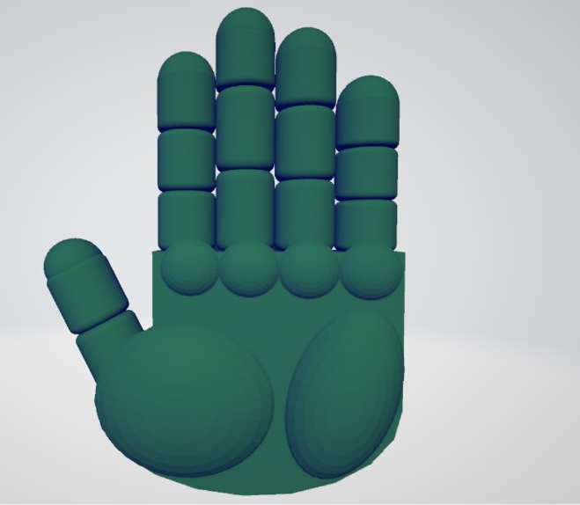

Slide 11
Hardware setup for Desired Frequency generation:
The hardware setup includes servo motors, Arduino microcontroller, and other electronic components such as jumper wires.
Servo motors are used to create controlled vibrations that simulate tremors, with the Arduino microcontroller providing the necessary control and coordination.
The servo motors are attached to specific points on the 3D hand model to induce tremor-like movements.
The Arduino microcontroller is programmed to generate signals that control the speed, amplitude, and frequency of the servo motors, allowing for precise control over the tremor simulation.
The hardware setup is integrated with the 3D hand model, enabling real-time simulation of tremors.
Movements generated by the servo motors are synchronized with the movements of the 3D hand model, providing a realistic simulation of Parkinson's disease tremors.

Slide 12
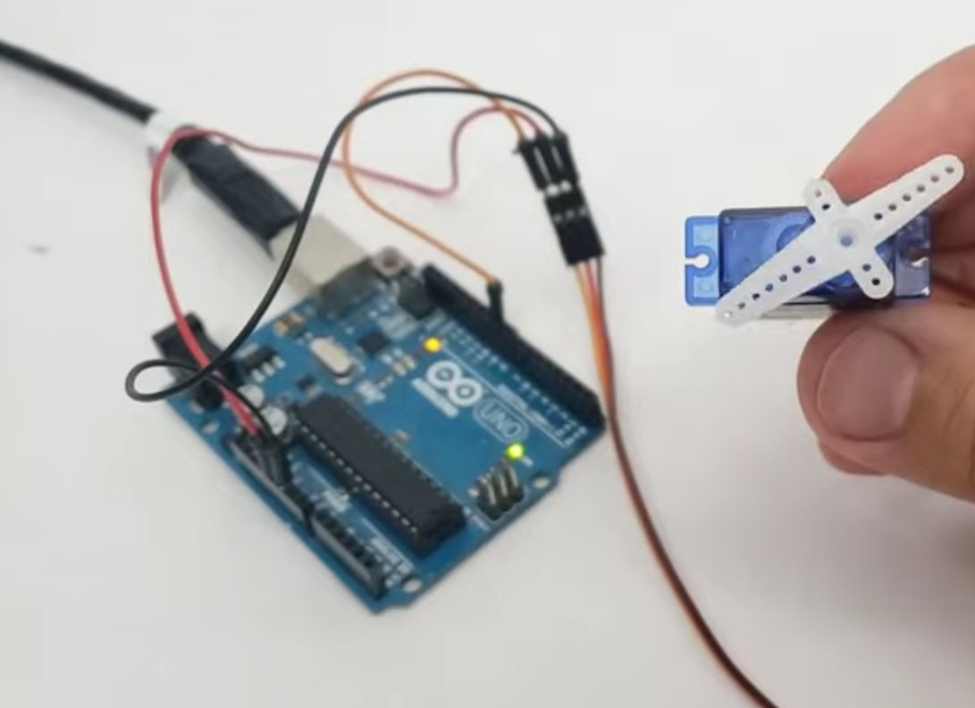

Slide 13
CODE FOR VERIFICATION
#include <Servo.h>
Servo myServo; // Create a servo object
void setup() {
myServo.attach(9); // Attach the servo to pin 9
}
void loop() {
int tremorAmplitude = 10; // Set the amplitude of the tremor (adjust as needed)
int tremorFrequency = 5; // Set the frequency of the tremor in Hz (adjust as needed)
}

Slide 14
// Generate a sinusoidal tremor pattern
int tremor = tremorAmplitude * sin(2 * PI * tremorFrequency * millis() / 1000.0);
// Map the tremor values to servo positions
int servoPosition = map(tremor, -tremorAmplitude, tremorAmplitude, 0, 180);
// Move the servo to the calculated position
myServo.write(servoPosition);
delay(2.5); // Adjust the delay for the desired frequency (50 Hz = 20 ms)

Slide 15
Patch antenna for detection of generated frequency
Using a patch antenna for the detection of frequencies associated with Parkinson's disease is an innovative approach. Parkinson's disease (PD) is a neurodegenerative disorder that affects movement, often characterized by tremors, stiffness, and impaired balance. While PD primarily involves the brain's dopamine-producing nerve cells, recent research has suggested potential connections between PD and changes in electromagnetic activity in the brain.
Here's how you might design a system using a patch antenna for detecting frequencies associated with PD:
Understanding Frequency Patterns: Research suggests that PD may involve aberrant oscillatory activity in specific frequency bands in the brain, such as beta (13-30 Hz) and gamma (30-100 Hz) bands. These frequency bands may exhibit abnormal synchronization or coherence in the brains of PD patients compared to healthy individuals.
In this we are designing a antenna to detect the 2.4GHz frequency
Patch Antenna Design: Design a patch antenna optimized for the frequency bands of interest (e.g., beta and gamma bands). Patch antennas are commonly used in wireless communication systems and can be tailored to specific frequency ranges. You would design the antenna to have a resonant frequency matching the frequencies you wish to detect.

Slide 16
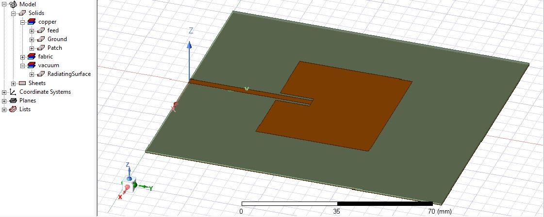
Designed Patch Antenna:

Slide 17
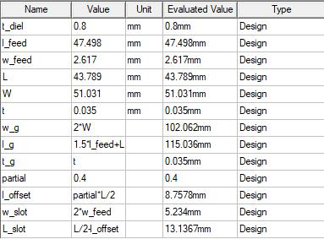
Parameters for the designed patch antenna are as given:
In the designed antenna the dielectric is chosen to be a fabric of the dielectric constant of 2 and materials for the ground and feed is used as the copper material. And the offset and slots for the patch and the micro-strips in the antenna is given as such so it can detect the 2.4GHz frequency which is approx the same as the tremors generated by the Parkinson disease.
Signal Processing and Detection: Once the antenna is designed and integrated into a system, you'll need signal processing algorithms to analyze the received signals. Techniques like Fourier analysis or wavelet transforms can help identify frequency components in the received signals. Machine learning algorithms can also be employed for pattern recognition if there are complex frequency patterns associated with PD.
Parameter values of the micro strip line, patch, ground and feed of the designed patch antenna

Slide 18
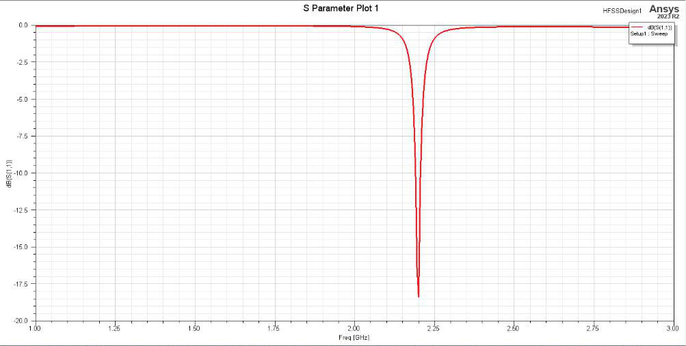
Obtained S-parameter plot for the designed Patch Antenna at 2.4 GHz:

Slide 19
Overall, utilizing a patch antenna for detecting frequencies associated with PD could offer a non-invasive, potentially cost-effective method for early detection and monitoring of the disease. However, it requires interdisciplinary collaboration between engineers, neuroscientists, and healthcare professionals to develop and validate such a system effectively.
To consolidate the final steps of the detection and generation of frequencies similar to the tremors created by the Parkinson disease are:
Data Collection and Analysis: Collect data from PD patients and healthy controls using the patch antenna system. Compare the frequency characteristics of the signals between the two groups. Look for differences in spectral power, coherence, or other features that might indicate PD-related abnormalities.
Clinical Validation and Optimization: Validate the system's performance in clinical settings, ensuring its accuracy and reliability in distinguishing PD patients from healthy individuals. Fine-tune the system parameters based on feedback from clinicians and researchers to optimize its sensitivity and specificity.
Integration into Diagnostic Tools: If successful, integrate the patch antenna system into diagnostic tools for PD. This could involve developing wearable devices or portable instruments that healthcare professionals can use for early detection, monitoring disease progression, or assessing the effectiveness of treatments.

Slide 20
Ethical Considerations: Consider ethical implications such as patient privacy, informed consent, and potential biases in data collection and analysis. Ensure that the technology is used responsibly and in accordance with ethical guidelines.
In conclusion, the utilization of a patch antenna for detecting frequencies associated with Parkinson's disease presents a promising avenue for non-invasive diagnosis and monitoring. By leveraging the electromagnetic activity in the brain, particularly in frequency bands such as beta and gamma, this approach offers the potential to identify aberrant oscillatory patterns indicative of PD.
Through careful design and optimization of patch antennas, coupled with advanced signal processing and machine learning techniques, it becomes feasible to extract relevant frequency information from collected signals. Clinical validation and integration into diagnostic tools can then facilitate early detection, disease monitoring, and assessment of treatment efficacy.However, successful implementation requires collaboration across multiple disciplines, including engineering, neuroscience, and healthcare. Moreover, ethical considerations regarding patient privacy, consent, and responsible use must be carefully addressed throughout the development and deployment of such technology.
In summary, while challenges remain, the use of patch antennas for PD detection holds considerable promise in advancing our understanding and management of this complex neurodegenerative disorder.

Slide 21
REFERNCE PAPER DETAILS
S. Abirami B, E. F. Sundarsingh and V. S. Ramalingam, "On-Body RF Sensor Toward Tremor Detection in Parkinson's Disease," in /EEE/ASME Transactions on Mechatronics, vol. 26, no. 5, pp. 2814-2817, Oct.
2021, Dol: 10.1109/TMECH.2020.3045139

