Slide 1


Ministry of Higher Education and Scientific Research
Northern Technical University
Technical Engineering College \ Mosul
Computer Technical Engineering
Router AQM QUEUE
PIE & FIFO
ALGORITHMS
Presented by
Arshad Luqman
Thanoon Younis
Maryam Majid
Supervisor
Dr. Ahmad Faleh

Slide 2
Network Queue Management Simulation Table of Contents
1. Project Overview
2. Algorithms - FIFO Algorithm - PIE Algorithm
3. Project Structure
4. Implementation Details 5.

Slide 3
1. Project Overview
Network queue management is crucial for maintaining efficient packet processing in modern networks. This simulation compares two fundamental approaches:
First-In-First-Out (FIFO): A basic queuing strategy where packets are processed strictly in arrival order
Proportional Integral controller Enhanced (PIE): An advanced algorithm using control theory to manage queue delays actively

Slide 4
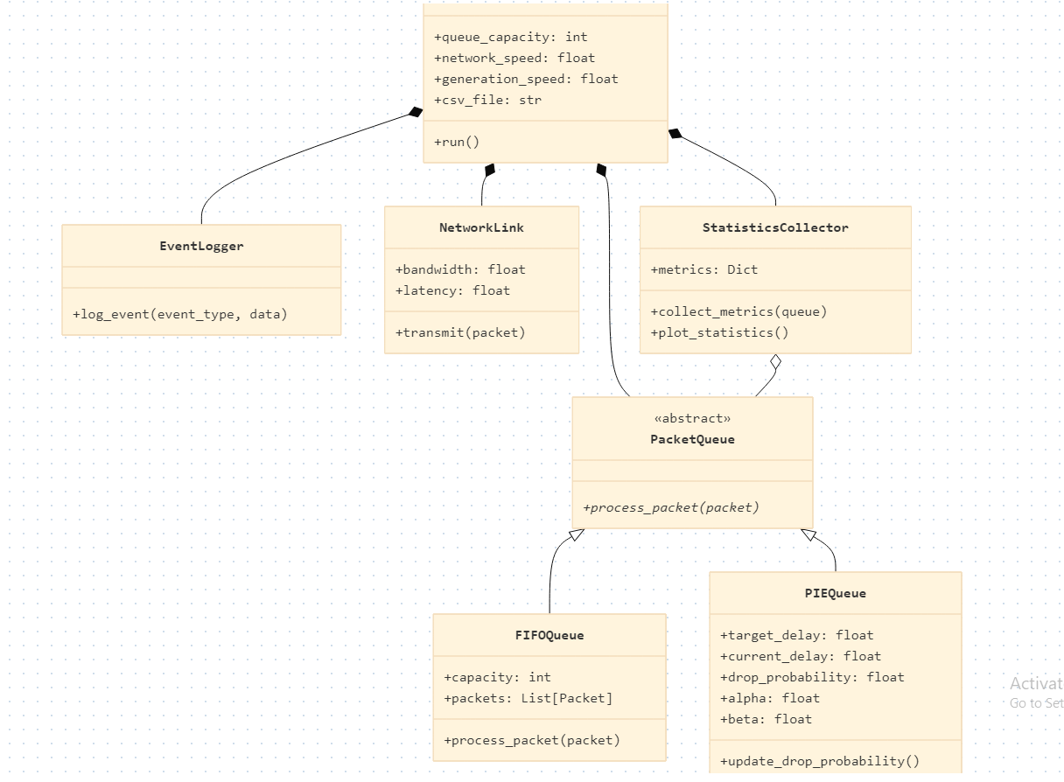
Project Overview

Slide 5
2. Algorithms
2.1 FIFO Algorithm
The First-In-First-Out algorithm implements a simple queue management strategy where packets are processed strictly in arrival order. Its mathematical model is defined as:
Q(t)=min(Q(t−1)+A(t)−D(t),C)
Where:
Q(t): Current queue size
A(t): Arriving packets
D(t): Departing packets
C: Queue capacity

Slide 6
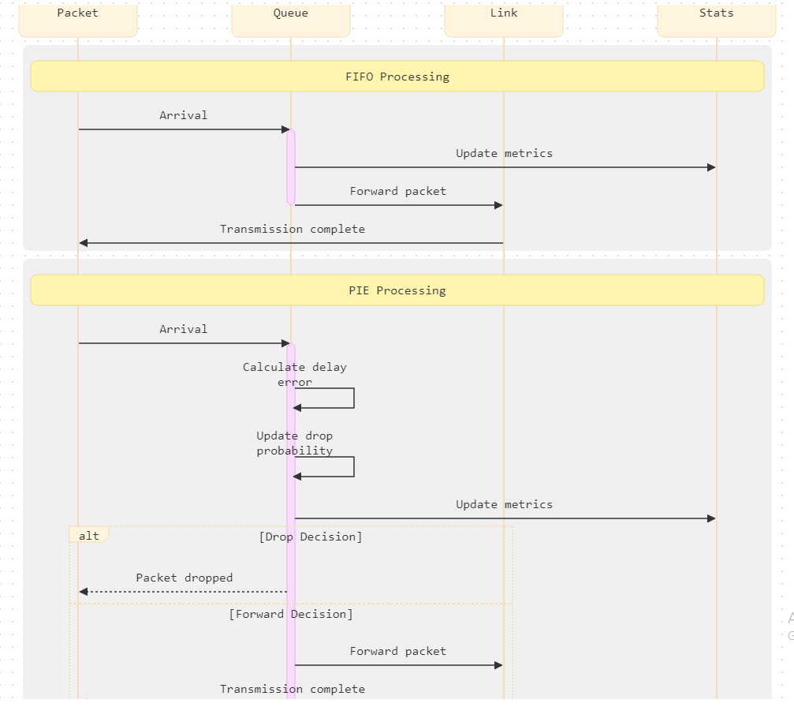

Slide 7

2.2 PIE Algorithm
PIE implements active queue management using control theory principles. Its core components include:
Delay Calculation:

Slide 8
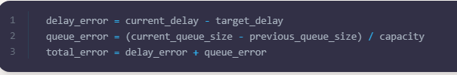

2.Error Signal Computation:
3.Drop Probability Update:

Slide 9
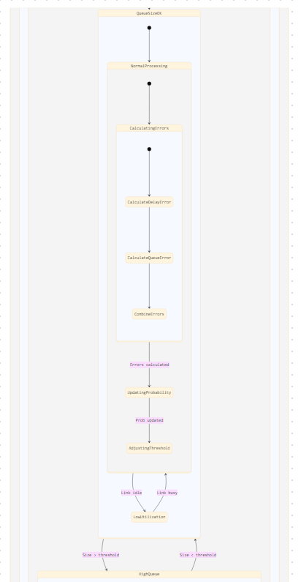
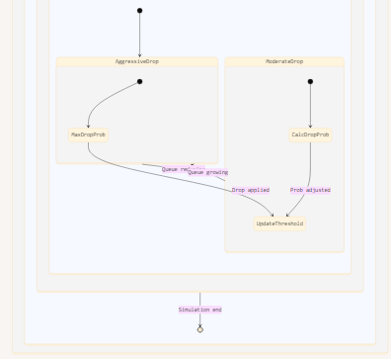

Slide 10
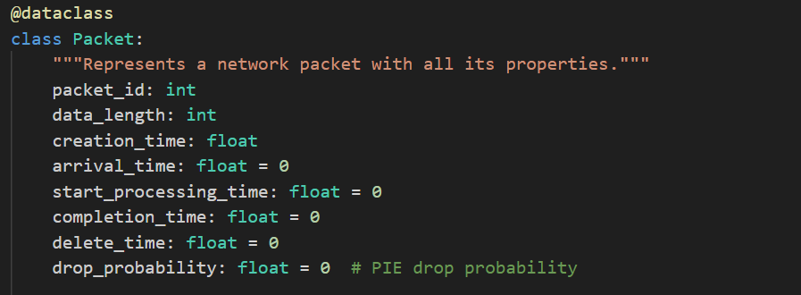
3.Implementation Details
1.Packet Class:
Responsible of loading and generation packets with it’s details:

Slide 11
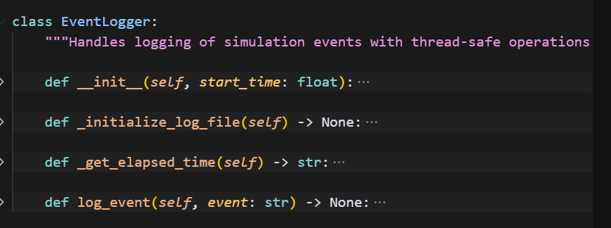
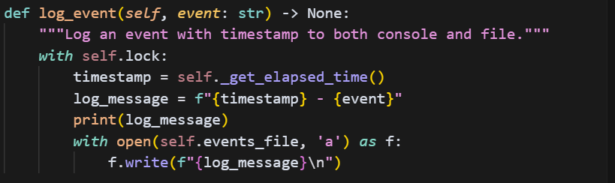
3.Implementation Details
2.Event Logger:
Handles logging of simulation events:

Slide 12
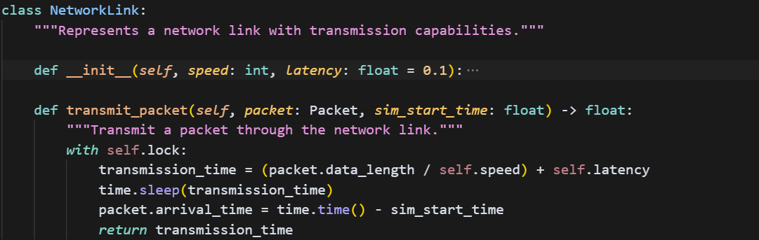
3.Implementation Details
1. NetworkLink Class:
Represents a network link with transmission capabilities.:

Slide 13
3.Implementation Details
1. NetworkLink Class:
Represents a network link with transmission capabilities.:

Slide 14
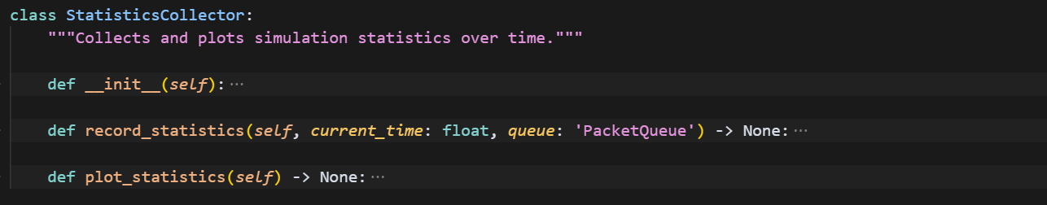
3.Implementation Details
1. StatisticsCollector Class:
Collects and plots simulation statistics over time:

Slide 15
3.Implementation Details
1. StatisticsCollector Class:
Collects and plots simulation statistics over time:

Slide 16
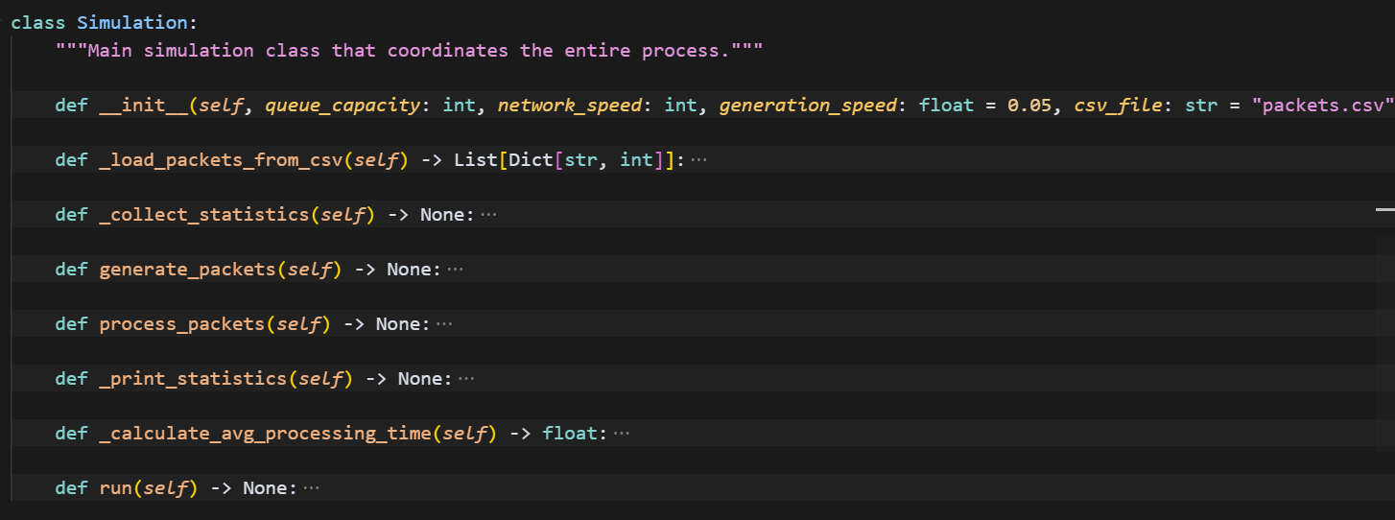
3.Implementation Details
1. Simulation Class:
Main simulation class that coordinates the entire process

Slide 17
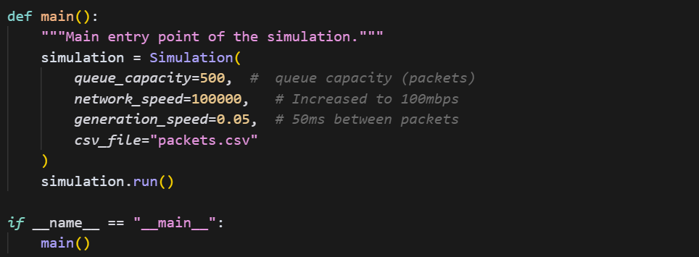
3.Implementation Details
1. Main Method:
Start point of the project

Slide 18
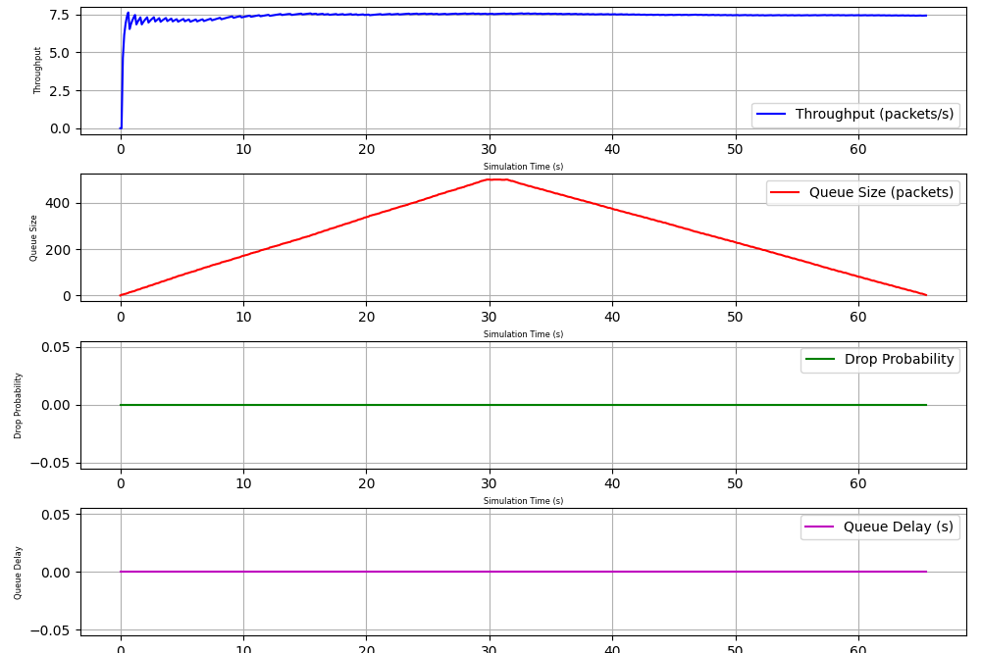
4. Results and Analysis

Slide 19
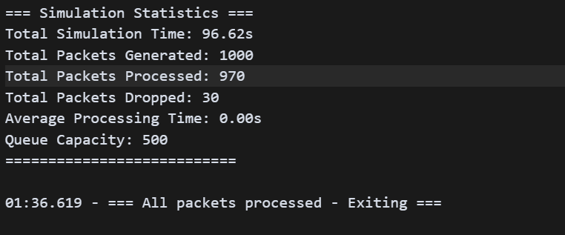
4. Results and Analysis
FIFO ALGORITHM
WEBSITE(HTTP) dataset
1000 packets

Slide 20

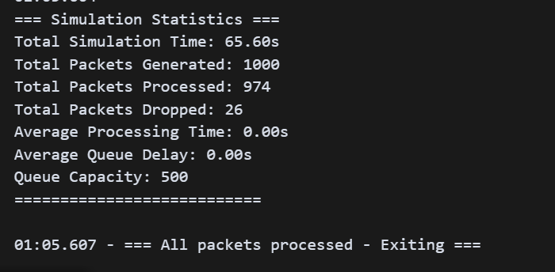
4. Results and Analysis
PIE ALGORITHM
WEBSITE(HTTP) dataset
1000 packets

Slide 21
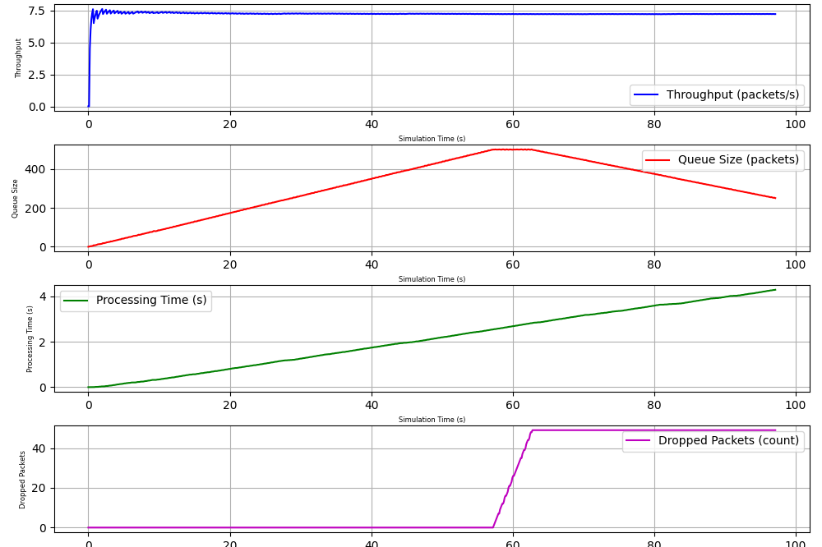
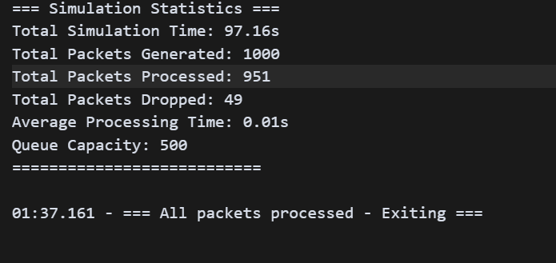
4. Results and Analysis
FIFO ALGORITHM
VIDEO dataset
1000 packets

Slide 22
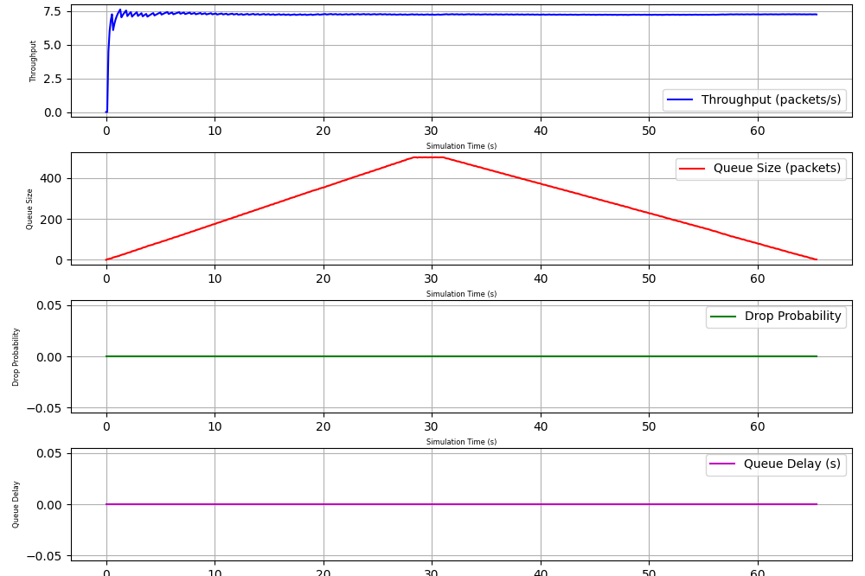
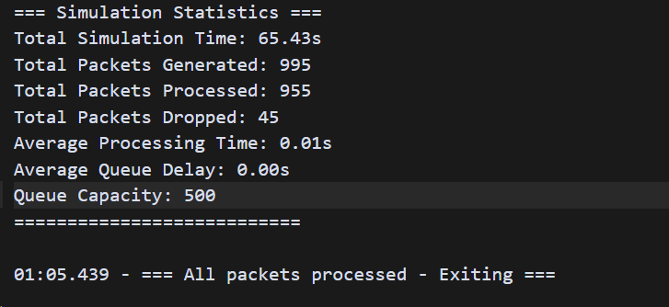
4. Results and Analysis
PIE ALGORITHM
VIDEO dataset
1000 packets

Slide 23
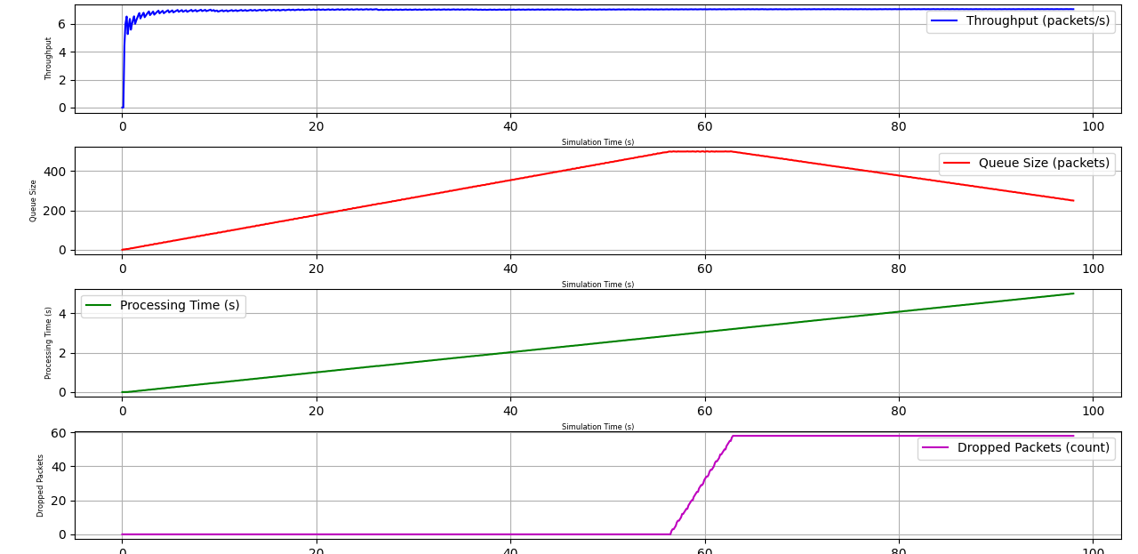
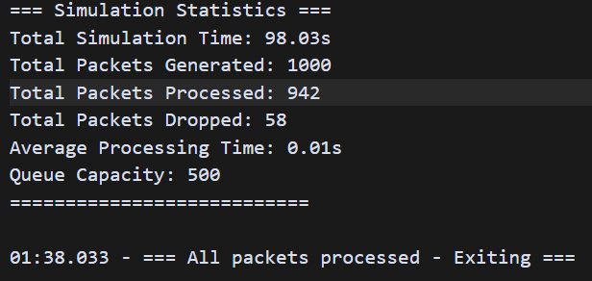
4. Results and Analysis
FIFO ALGORITHM
FTP dataset
1000 packets

Slide 24
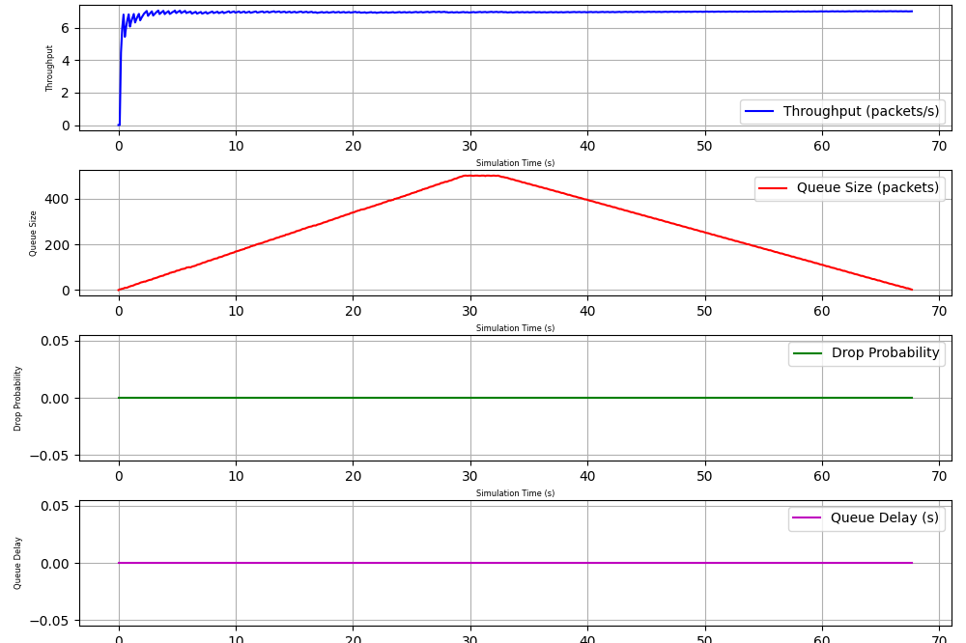
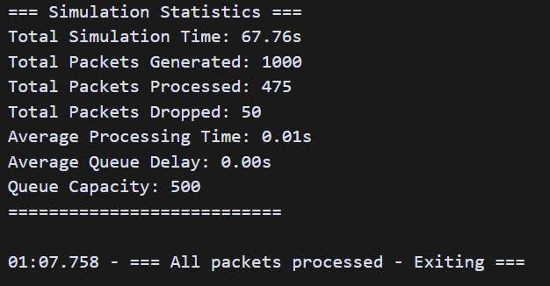
4. Results and Analysis
PIE ALGORITHM
FTP dataset
1000 packets

Slide 25
5. Future Improvements
Several enhancements can be made to the simulation framework:
1. Network Topology:
Multi-node network simulations
Complex routing scenarios
Network congestion modeling.
2.Visualization Enhancements:
Real-time monitoring dashboard
Interactive parameter tuning
Advanced statistical analysis tools

Slide 26
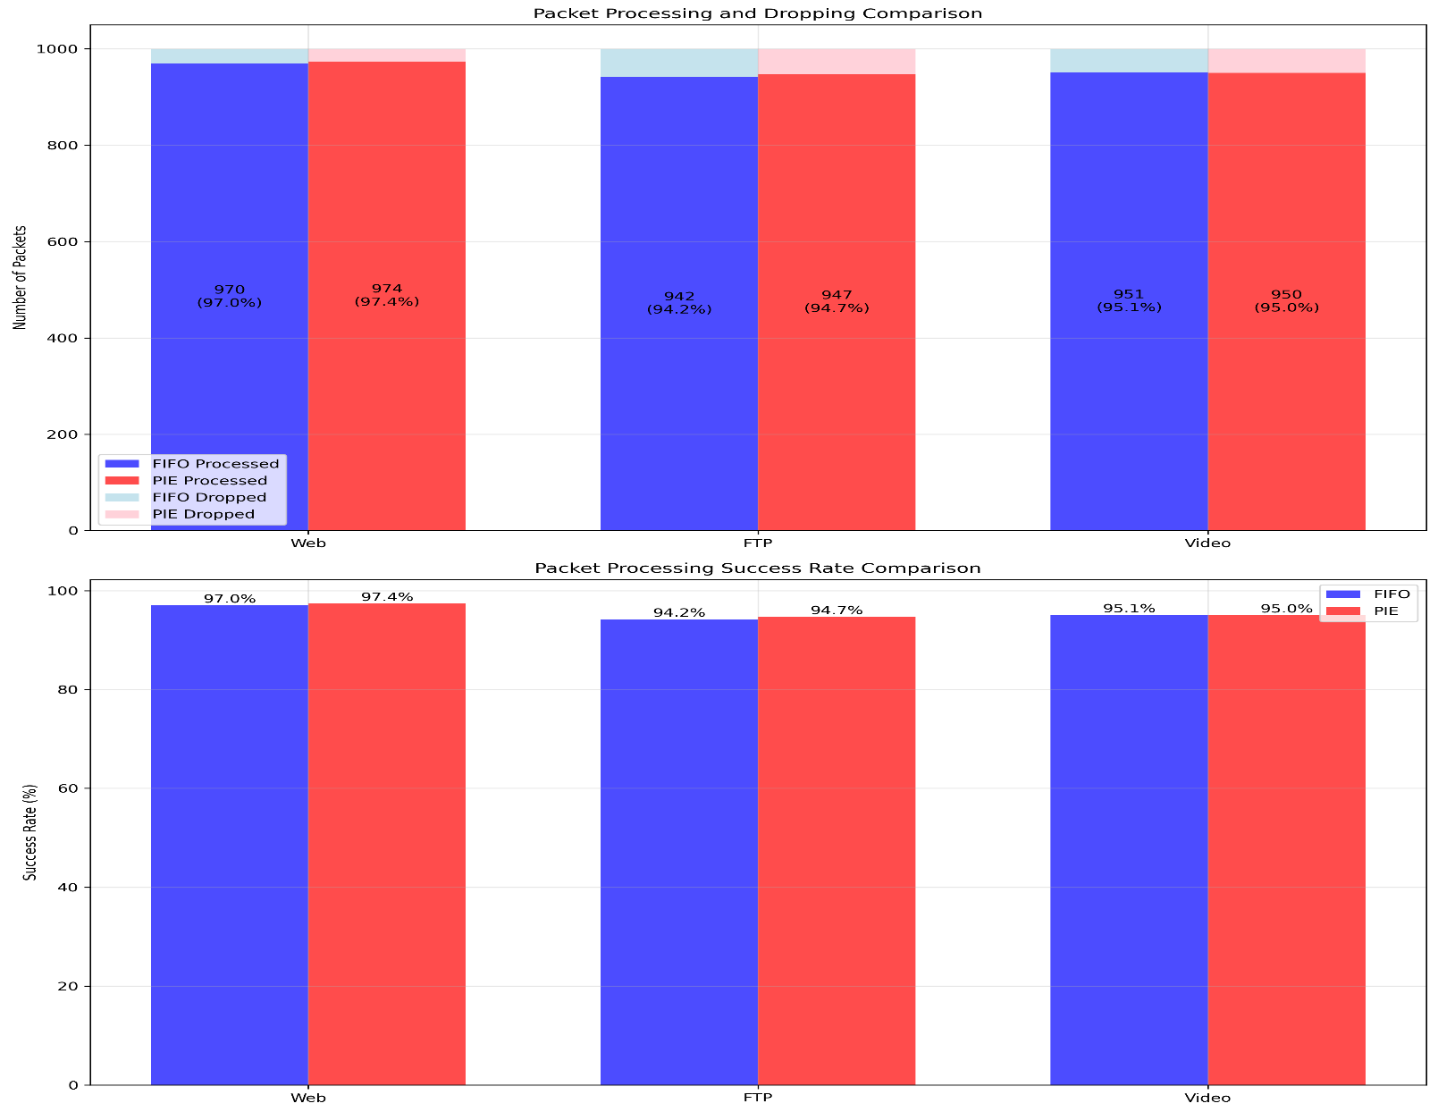
5. Results

Slide 27
5. Results Discussion
Key Advantages of PIE:
• Higher success rates for web and FTP
• 30% faster processing time
• Better overall performance
• More efficient queue management

Slide 28
Thank you

