Slide 1
More Dynamic Programming
Floyd-Warshall Algorithm

Slide 2
Floyd-Warshall Algorithm
A weighted, directed graph is a collection vertices connected by weighted edges (where the weight is some real number).
  One of the most common examples of a graph in the real world is a road map.
    Each location is a vertex and each road connecting locations is an edge.
    We can think of the distance traveled on a road from one location to another as the weight of that edge.
 | Tampa | Orlando | Jaxville
Tampa | 0 | 1.7 | 3.5
Orlando | 1.5 | 0 | ∞
Jax | 4 | 2.5 | 0
1.5
Tampa
Orlando
1.7
3.5
4
2.5
Jacksonville

Slide 3
Storing a Weighted, Directed Graph
Adjacency Matrix:
  Let D be an edge-weighted graph in adjacency-matrix form
  D(i,j) is the weight of edge (i, j), or ∞ if there is no such edge.
Update matrix D, with the shortest path through immediate vertices.
 | 0 | 1 | 2 | 3
0 | 0 | 6 | 5 | ∞
1 | ∞ | 0 | 4 | 3
2 | ∞ | ∞ | 0 | 2
3 | ∞ | ∞ | ∞ | 0
1
6
3
0
4
3
D =
5
2
2

Slide 4
Floyd-Warshall Algorithm
Given a weighted graph, we want to know the shortest path from one vertex in the graph to another.
  The Floyd-Warshall algorithm determines the shortest path between all pairs of vertices in a graph.
  What is the difference between Floyd-Warshall and Dijkstra’s??

Slide 5
Floyd-Warshall Algorithm
If V is the number of vertices, Dijkstra’s runs in Θ(V²)
  We could just call Dijkstra |V| times, passing a different source vertex each time.
  Θ(V × V²) = Θ(V³)
  (Which is the same runtime as the Floyd-Warshall Algorithm)
BUT, Dijkstra’s doesn’t work with negative-weight edges.

Slide 6
Floyd Warshall Algorithm
Let’s go over the premise of how Floyd-Warshall algorithm works…
  Let the vertices in a graph be numbered from 1 … n.
  Consider the subset {1,2,…, k} of these n vertices.
  Imagine finding the shortest path from vertex i to vertex j that uses vertices in the set {1,2,…,k} only.
  There are two situations:
    k is an intermediate vertex on the shortest path.
    k is not an intermediate vertex on the shortest path.
k
i
j

Slide 7
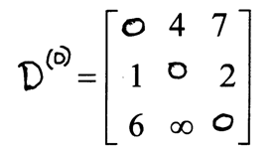
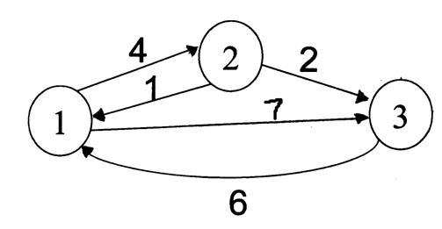
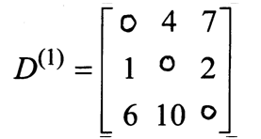
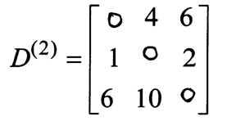
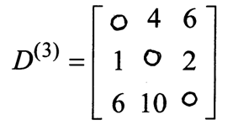
Floyd Warshall Algorithm - Example
Original weights.
Consider Vertex 1:
D(3,2) = D(3,1) + D(1,2)
Consider Vertex 2:
D(1,3) = D(1,2) + D(2,3)
Consider Vertex 3:
Nothing changes.

Slide 8
Floyd Warshall Algorithm
Looking at this example, we can come up with the following algorithm:
  Let D store the matrix with the initial graph edge information initially, and update D with the calculated shortest paths.
    For k=1 to n {
    For i=1 to n {
    For j=1 to n
    D[i,j] = min(D[i,j],D[i,k]+D[k,j])
    }
    }
  The final D matrix will store all the shortest paths.

Slide 9
Floyd Warshall Algorithm
Example on the board…

Slide 10
Floyd Warshall – Path Reconstruction
The path matrix will store the last vertex visited on the path from i to j.
  So path[i][j] = k means that in the shortest path from vertex i to vertex j, the LAST vertex on that path before you get to vertex j is k.
Based on this definition, we must initialize the path matrix as follows:
  path[i][j] = i if i!=j and there exists an edge from i to j
  = NIL otherwise
The reasoning is as follows:
  If you want to reconstruct the path at this point of the algorithm when you aren’t allowed to visit intermediate vertices, the previous vertex visited MUST be the source vertex i.
  NIL is used to indicate the absence of a path.

Slide 11
Floyd Warshall – Path Reconstruction
Before you run Floyd’s, you initialize your distance matrix D and path matrix P to indicate the use of no immediate vertices.
  (Thus, you are only allowed to traverse direct paths between vertices.)
Then, at each step of Floyd’s, you essentially find out whether or not using vertex k will improve an estimate between the distances between vertex i and vertex j.
If it does improve the estimate here’s what you need to record:
  record the new shortest path weight between i and j
  record the fact that the shortest path between i and j goes through k

Slide 12
Floyd Warshall – Path Reconstruction
If it does improve the estimate here’s what you need to record:
  record the new shortest path weight between i and j
    We don’t need to change our path and we do not update the path matrix
  record the fact that the shortest path between i and j goes through k
    We want to store the last vertex from the shortest path from vertex k to vertex j. This will NOT necessarily be k, but rather, it will be path[k][j].
This gives us the following update to our algorithm:
if (D[i][k]+D[k][j] < D[i][j]) { // Update is necessary to use k as intermediate vertex
D[i][j] = D[i][k]+D[k][j];
path[i][j] = path[k][j];
}

Slide 13
Path Reconstruction
Example on the board…

Slide 14
Path Reconstruction
Now, the once this path matrix is computed, we have all the information necessary to reconstruct the path.
  Consider the following path matrix (indexed from 1 to 5 instead of 0 to 4):
Reconstruct the path from vertex1 to vertex 2:
  First look at path[1][2] = 3. This signifies that on the path from 1 to 2, 3 is the last vertex visited before 2.
    Thus, the path is now, 1…3->2.
  Now, look at path[1][3], this stores a 4. Thus, we find the last vertex visited on the path from 1 to 3 is 4.
  So, our path now looks like 1…4->3->2. So, we must now look at path[1][4]. This stores a 5,
  thus, we know our path is 1…5->4->3->2. When we finally look at path[1][5], we find 1,
  which means our path really is 1->5->4->3->2.
NIL | 3 | 4 | 5 | 1
4 | NIL | 4 | 2 | 1
4 | 3 | NIL | 2 | 1
4 | 3 | 4 | NIL | 1
4 | 3 | 4 | 5 | NIL

Slide 15
Transitive Closure
Computing a transitive closure of a graph gives you complete information about which vertices are connected to which other vertices.
Input:
  Un-weighted graph G: W[i][j] = 1, if (i,j)∈E, W[i][j] = 0 otherwise.
Output:
  T[i][j] = 1, if there is a path from i to j in G, T[i][j] = 0 otherwise.
Algorithm:
  Just run Floyd-Warshall with weights 1, and make T[i][j] = 1, whenever D[i][j] < ∞.
  More efficient: use only Boolean operators

Slide 16
Transitive Closure
Transitive-Closure(W[1..n][1..n])
01 T ← W // T⁽⁰⁾
02 for k ← 1 to n do // compute T^{(k)}
03 for i ←1 to n do
04 for j ←1 to n do
05 T[i][j] ← T[i][j] ∨ (T[i][k] ∧ T[k][j])
06 return T
This is the SAME as the other Floyd-Warshall Algorithm, except for when we find a non-infinity estimate, we simply add an edge to the transitive closure graph.
Every round we build off the previous paths reached.
  After iterating through all vertices being intermediate vertices, we have tried to connect all pairs of vertices i and j through all intermediate vertices k.

Slide 17
Transitive Closure
Example on the board…

