Slide 1
Hierarchical core-periphery structure in networks
Austin Polanco, M. E. J. Newman
Ngoc Xuan Y Nguyen | s4372840@umail.leidenuniv.nl
Michail Athanasios Kalligeris Skentzos | s4398831@umail.leidenuniv.nl
Introduction
Background
Relevant Work
Method
Results
Questions
1 / 14
Notes:
‹#›

Slide 2
Introduction
Problem statement
Relevant work
Monte Carlo algorithm for Core Periphery model
Results
Our contribution
Introduction
Background
Relevant Work
Method
Results
Questions
2 / 14
‹#›

Slide 3
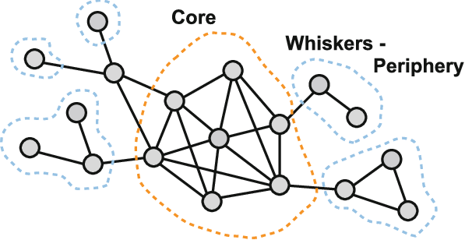
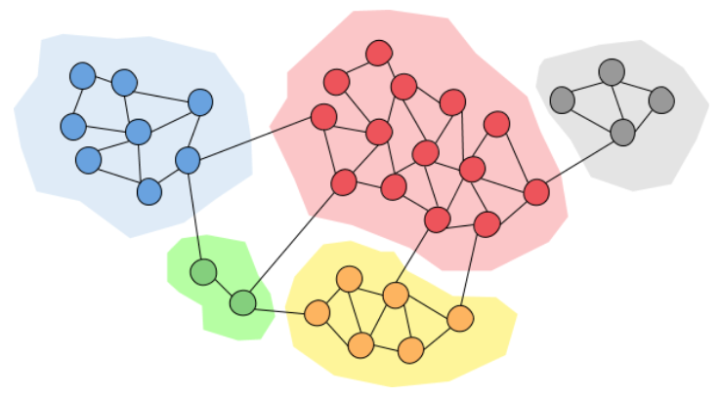
Problem statement
Community structure
Core - periphery structure
How to identify “Core” and “Periphery”?
Introduction
Background
Relevant Work
Method
Results
Questions
3 / 14
‹#›

Slide 4
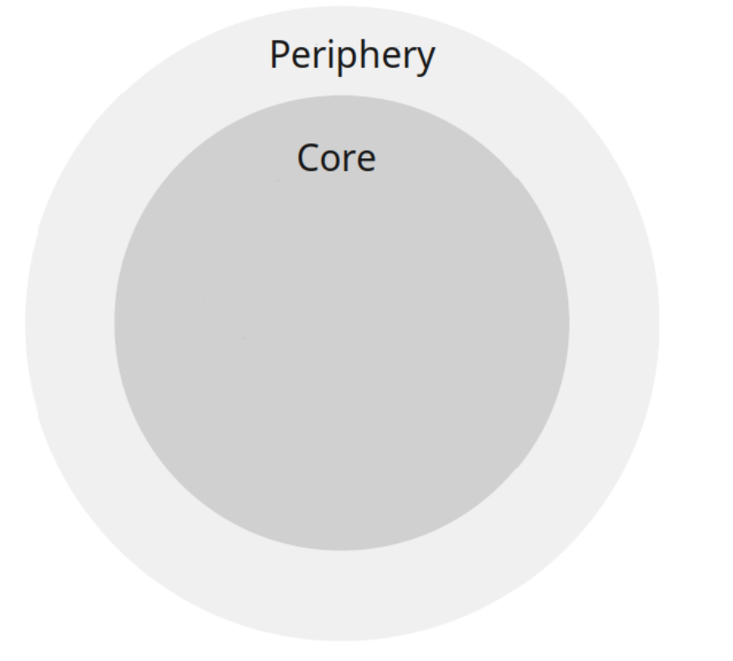
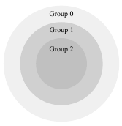
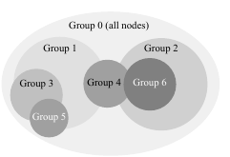
Relevant work
(a) Simple core periphery
k-core decomposition | Alvarez et al.[2]
Quality function | Borgatti and Everett [3]
(b) Multi-group nested core periphery
Quality function | Kojaku and Masuda et al.[7]
Stochastic block modelling | Gallagher et al.[5]
(d) Hierarchy and overlapping
Markov-chain Monte Carlo method | Austin Polanco, M.E.J. Newman [1]
Introduction
Background
Relevant Work
Method
Results
Questions
4 / 14
‹#›

Slide 5
Method - Fixed-k scenario
Define parameters:
k: number of groups (=2)
n: number of nodes
r: highest common group between nodes u and v
ω_{r}: edge probability between nodes u and v
t_{r}: total number of node pairs in r
m_{r}: total number of edges in r
Algorithm process:
Add or remove a random node from a group
Likelihood for current versus proposed state
Accept or reject the move
Output: group assignments for n nodes with maximum likelihood
Introduction
Background
Relevant Work
Method
Results
Questions
5 / 14
‹#›

Slide 6
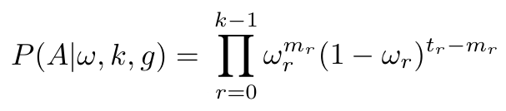
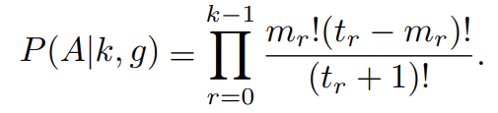
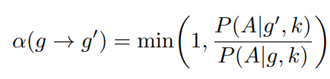
Method - Acceptance ratio
[1] page 3, Eq. 1
Total edge probabilities
Total non-edge probabilities
[1] page 4, Eq. 9
[1] page 3, Eq. 4
Example:
n = {1,2,3,4}
e = {(1,2),(1,3),(1,4),(2,3)} => non-edges: {(2,4),(3,4)}
r=0: P(A∣k,g) = (4! x (6 - 4)!) / (6 + 1)! = (4! x 2!) / 7! = 0.0095
r=1: P(A∣k,g) = (0! x (0 - 0)!) / (0 + 1)! = 1
Introduction
Background
Relevant Work
Method
Results
Questions
6 / 14
‹#›

Slide 7
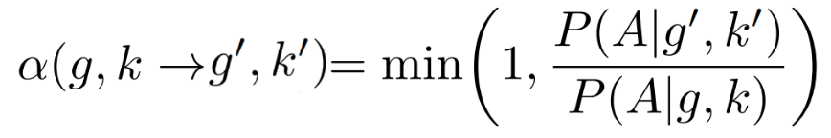
Method - Varying k
1
0
Example:
n=8, k=3
p=1/(2*8*(3+1)) = 1/64
Type 1 move: add or remove a node
Select group 0…k-1
add/rmv 50-50
If full, continue
If empty group delete
Type 2 move: add new group
random position s: 0…k-1
adjust all higher group labels
Process:
With probability 1/2k(n+1) choose Type 2 else Type1
Calculate Likelihood
Accept or reject the move with probability a
2
63/64 type 1
type
group
1/64 type 2
⅓ group 1
add/rmv
group
½ add
1/3
node
⅙ from nodes
0
2
1
0
1
3
2
[1] page 5, Eq. 21
Introduction
Background
Relevant Work
Method
Results
Questions
7 / 14
‹#›
Notes:
W_{h} is prob that edge u,v exists w_{h}ª makes the multiplication by that probability only if it exists (a=1) and in same manner (1-w)^{1-a} multiplies with prob that it doesn't exist
So 1st equation is for each edge multiply by w_{r} if it exists or by (1-w_{r}) if it does not
Next is for each group multiply by
Type1: 50-50 add or remove
if full → continue
if empty → delete

Slide 8
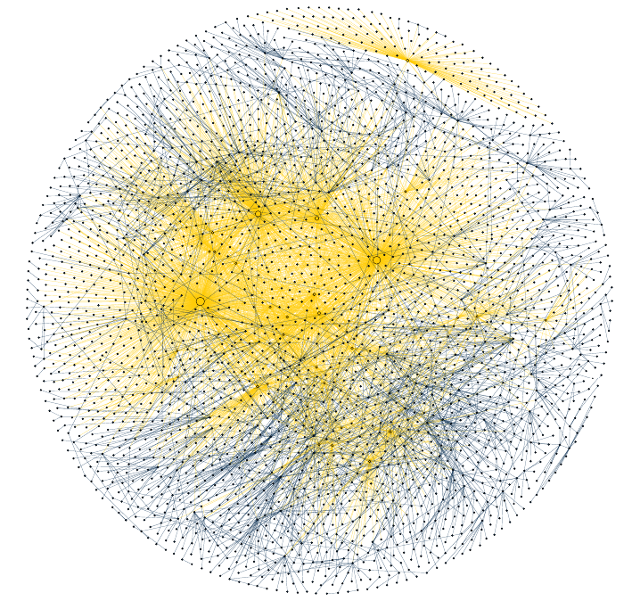
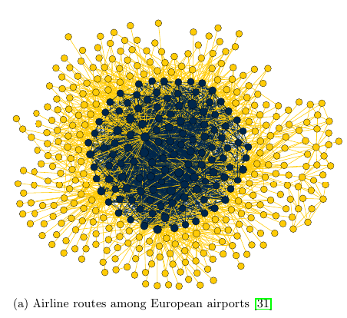
Results - 2 Group Core periphery
k=2 → traditional core periphery structure
10⁹ Monte Carlo steps → highest probability structure
Edge color: group 0 - yellow
group 1 - blue
[1] page 7, Fig. 2(a): Airline routes among European airports
Traditional case of core periphery
[1] page 7, Fig. 2(c): Internet - Nov 1997
“Inside out” structure
Introduction
Background
Relevant Work
Method
Results
Questions
8 / 14
‹#›
Notes:
Authors say there are 2 types of cores as seen in these images

Slide 9
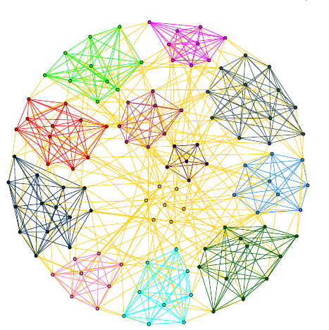
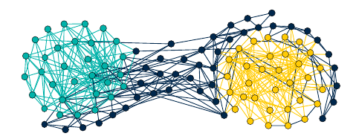
Results - Multi Group Core periphery
k>2 → hierarchical core periphery structure
10⁹ Monte Carlo steps → highest probability structure
[1] page 8, Fig. 3: Political books network
Nodes: books
Edges: co purchase in Amazon
2 cores (cyan & yellow) 1 periphery (blue)
[1] page 8, Fig. 4: American Football network
Nodes: teams
Edges: games between teams
colored cliques connected via periphery (yellow)
Introduction
Background
Relevant Work
Method
Results
Questions
9 / 14
‹#›
Notes:
Books: traditional community structure
Comedy algos capture left right
Hcp haptures left and right cores
Bonus periphery of books not so strongly alignes
Teams: also community structure as teams play mostly within “conferences” which are the communities
Algorithms correctly captures 11 + extra yellow teams that don’t belong to any and play between

Slide 10
Results - Conclusion
Proposed method - Hierarchical core periphery structure able to capture:
Traditional core periphery structure (k=2)
Varying number of cores
Hierarchical manner
Utilises monte carlo methods
number of groups
node membership
Introduction
Background
Relevant Work
Method
Results
Questions
10 / 14
‹#›

Slide 11
Results - ours
Setback compiling the code
Compare different algorithms
Core Periphery | Borgatti and Everett [3] (1999)
K core decomposition | Alvarez et al. (2006)
Stochastic Block Models| Gallagher et al.[5] (2021)
Hierarchical Core Periphery | Polanco et al.[1] (2023)
Use hierarchical core periphery probability for evaluation
Introduction
Background
Relevant Work
Method
Results
Questions
11 / 14
‹#›

Slide 12
Questions
Introduction
Background
Relevant Work
Method
Results
Questions
12 / 14

Slide 13
References
[1] A. Polanco and M. E. J. Newman, Hierarchical core-periphery structure in networks. Physical Review E 108, 024311 (2023).
[2] J. I. Alvarez-Hamelin, L. Dall’Asta, A. Barrat, and A. Vespignani, K-core decomposition: A tool for the visualization of large scale networks. Preprint arxiv:cs/0504107 (2006).
[3] S. P. Borgatti and M. G. Everett, Models of core/periphery structures. Social Networks 21, 375–395 (1999).
[4] X. Zhang, T. Martin, and M. E. J. Newman, Identification of core-periphery structure in networks. Phys. Rev. E 91, 032803 (2015).
[5] R. J. Gallagher, J.-G. Young, and B. F. Welles, A clarified typology of core-periphery structure in networks. Science Advances 7, eabc9800 (2021).
[6] A. Clauset, C. Moore, and M. E. J. Newman, Hierarchical structure and the prediction of missing links in networks. Nature 453, 98–101 (2008).
[7] S. Kojaku and N. Masuda, Finding multiple core periphery pairs in networks. Phys. Rev. E 96, 052313 (2017).
[8] M. Cucuringu, P. Rombach, S. H. Lee, and M. A. Porter, Detection of core-periphery structure in networks using spectral methods and geodesic paths. European Journal of Applied Mathematics 27, 846–887 (2016).
Introduction
Background
Relevant Work
Method
Results
Questions
References
‹#›

Slide 14
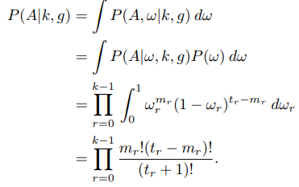
Appendix
Introduction
Background
Relevant Work
Method
Results
Questions
Secret Appendix
‹#›

