Slide 1


Deep Learning Project
Subject:
Chatbot
By
Alexandra Tsarouchi
Athanasios Vakouftsis

Slide 2
idea
Retrieval – based chatbot using predefined patterns and responses
Creation of dataset containing categories (intents), patterns and responses
Train on the dataset
Recurrent Neural Network (RNN) to classify which category the user's message belongs to
Give random response from the list of responses created
Process
Import and load
Import and load the data file
Preprocess
Preprocess data
Create
Create training and testing data
Build
Build the model
Predict
Predict the response ( Graphical User Interface)
Notes:
9

Slide 3
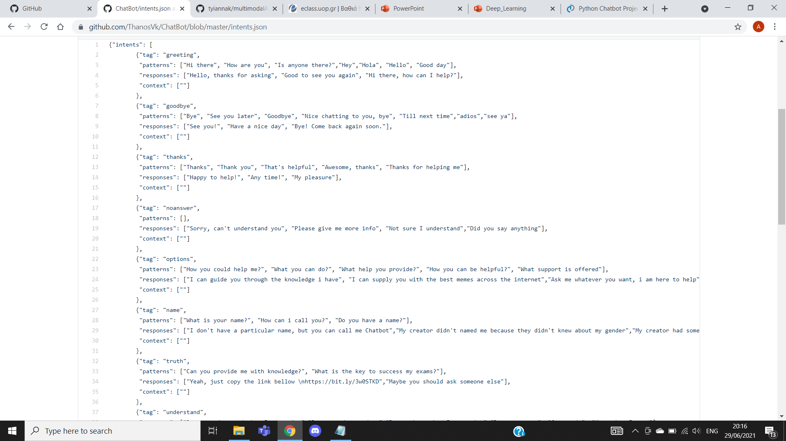
Create, import & load the data
Create intents.json
Import packages
Initialize variables
Notes:
9

Slide 4
preprocess
Tokenizing
Lemmatizing
Notes:
9

Slide 5
Train & test data
Training data in which we will provide the input and the output.
Input = The pattern
Output = The class our input pattern belongs to
Neural Networks don’t understand text so --> Tokenizing & Lemmatizing --> convert text into numbers.
Notes:
9

Slide 6
Rnn model
Epoch 194/200
11/11 [==============================] - 0s 2ms/step - loss: 0.0794 - accuracy: 0.9630 - val_loss: 2.3093 - val_accuracy: 0.4286
Epoch 195/200
11/11 [==============================] - 0s 2ms/step - loss: 0.1212 - accuracy: 0.9444 - val_loss: 2.3900 - val_accuracy: 0.5714
Epoch 196/200
11/11 [==============================] - 0s 2ms/step - loss: 0.0702 - accuracy: 0.9630 - val_loss: 2.4275 - val_accuracy: 0.5714
Epoch 197/200
11/11 [==============================] - 0s 2ms/step - loss: 0.1495 - accuracy: 0.9259 - val_loss: 2.3976 - val_accuracy: 0.4286
Epoch 198/200
11/11 [==============================] - 0s 2ms/step - loss: 0.1601 - accuracy: 0.9444 - val_loss: 2.3673 - val_accuracy: 0.4286
Epoch 199/200
11/11 [==============================] - 0s 2ms/step - loss: 0.1620 - accuracy: 0.9259 - val_loss: 2.2912 - val_accuracy: 0.4286
Epoch 200/200
11/11 [==============================] - 0s 2ms/step - loss: 0.1618 - accuracy: 0.9259 - val_loss: 2.2445 - val_accuracy: 0.4286
RNN with 3 layers First layer 80 neurons, second layer 40 neurons and 3rd output layer contains number of neurons equal to number of intents to predict output intent with softmax
Stochastic gradient descent with Nesterov accelerated gradient
After training the model for 200 epochs, we achieved ~100% accuracy on our model
Notes:
9

Slide 7
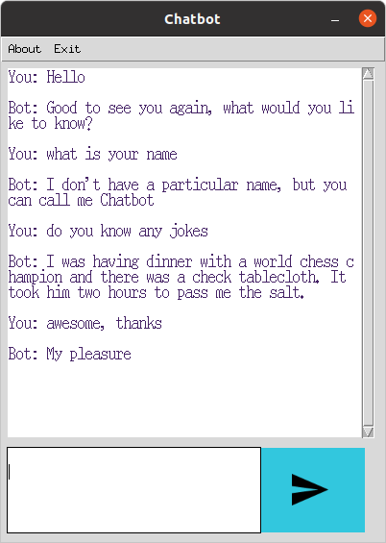
Response Graphical User Interface
Load the ‘words.pkl’ and ‘classes.pkl’ pickle files which we have created when we trained our model
Text preprocessing to predict the class
Get a random response from the list of intents
Develop a graphical user interface
Notes:
<αριθμός>

Slide 8
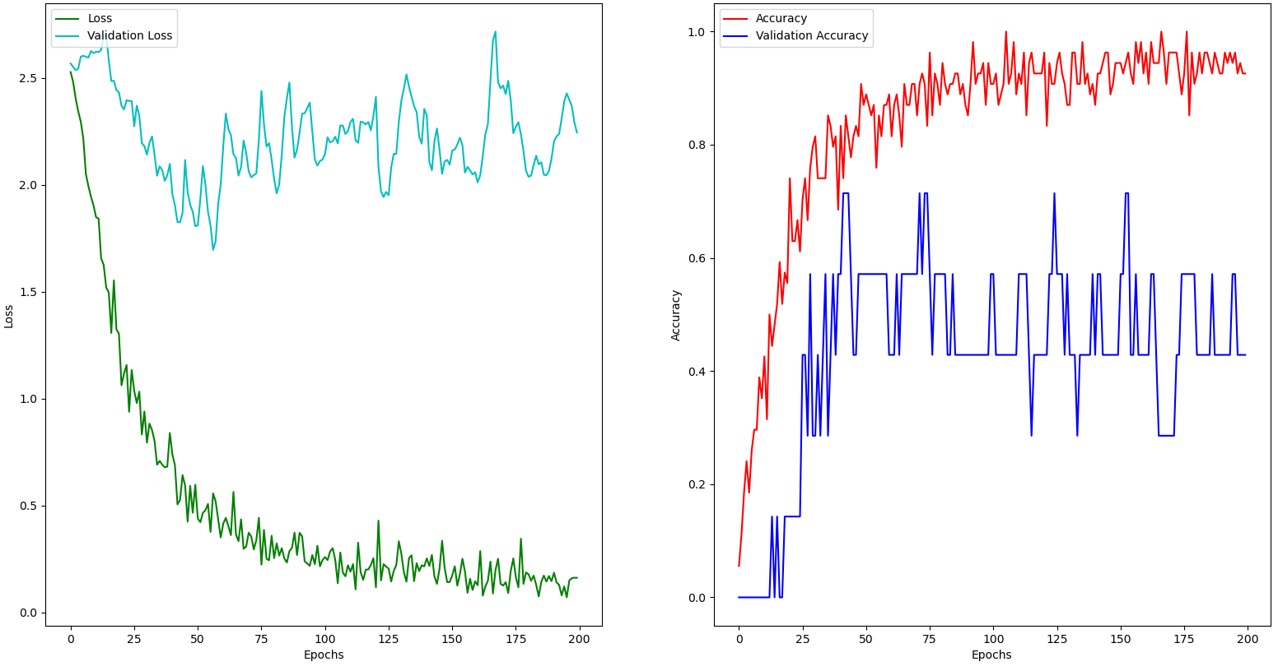
Results

Slide 9
Thank you !
Questions ?

