Slide 1
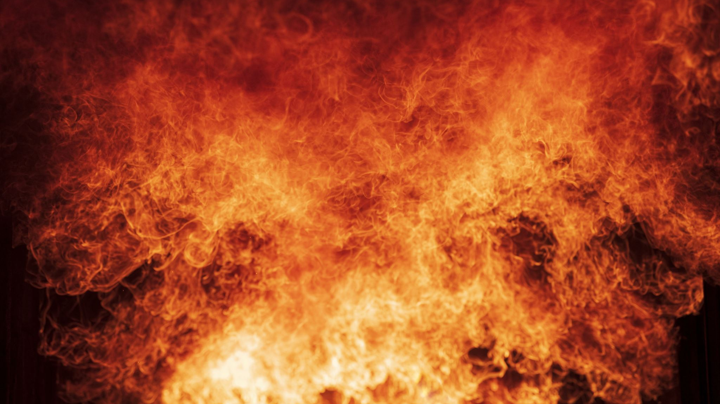
A Clustering and Spatiotemporal Network Analysis of California Wildfires
Thanshith Kannedari
Sai Bhavani Bandla

Slide 2
Our Subnetwork
Wildfire events occurring in:
Region: California
Time period: 2010–2024
Dataset consists of recorded wildfire incidents
Each wildfire event is treated as a node in the network

Slide 3
Network Features
How will our graph be constructed?
Nodes: Individual wildfire events
Edges: Spatiotemporal relationships between fires
Fires are connected if they occur:
Close in geographic space
Close in time

Slide 4
Our Nodes & Links
Nodes
Each node represents one wildfire event
Node size based on fire size or duration (when available)
Links
Weighted and undirected
Edge weight reflects strength of spatiotemporal association

Slide 5
Goal of the Network
Identify regions with recurring wildfire activity
Examine relationships between wildfire events across space and time
Detect influential or central wildfire events using network metrics
Provide insight beyond traditional spatial mapping

Slide 6
THANK YOU
ANY QUESTIONS ?

