Slide 1
IoT related Time Series Forecasting on Weather Data With LSTM
University of Technology ( Yatanarpon Cyber City )
Department of Information Science
(PreDefense)
Presented by:
Thant Htet Myet
(2ME_IST_9)
Supervised by:
Dr. Hnin Aye Thant
Date: .6.2019

Slide 2
Outline
Abstract
Objective
Introduction
Theoretical Background
System Architecture
System Design
Implementation
Test Results
Further Extensions
Limitations
Conclusion

Slide 3
Abstract
Weather information ( temperature, humidity, rainfall, etc) play an important role for human.
Internet of Things (IOT) based weather reporting system provides an efficient internet based weather reporting system for users.
Weather predictions using deep neural network could be applied to enhance energy efficiency in social environments.
The system presents a study of deep learning technique(Long Short-Term Memory) applied to time-series forecasting on indoor temperature and humidity.

Slide 4
Objective
To study Long Short-Term Memory(LSTM) neural network and use it as a prediction theory
To realize IoT and its usage in real application
To apply IoT with LSTM in the area of indoor temperature forecasting system
To make prediction for getting a positive impact on our lifestyle, energy conservation, transportation, and health

Slide 5
Introduction
Several weather stations have employed Internet of Things (IoT) to monitor the condition of weather systems.
The weather data from IoT based weather stations are useful for prediction and analyzing systems.
For effective prediction on weather data, it is necessary to understand various factors that causes the weather changes.
Accurate prediction is important because today’s world is largely depend on the varying weather situations.
Temperatures and energy consumption predictions using deep neural network could be applied to enhance energy efficiency in social environments.

Slide 6


Theoretical background
Recurrent Neural Network(RNN) are a type of Neural Network where the output from previous step are fed as input to the current step.
Recurrent neural networks are networks with loops in them, allowing information to persist.

Slide 7
Cont’d
RNN have a “memory” which remembers most information about what has been calculated.
The gap between the relevant information is small, RNNs can learn to use the past information.
For example, prediction on the next word based on the previous ones, “the clouds are in the sky”.
Recurrent Neural Networks suffer from short-term memory.
If the gap between the relevant information is very large and as that gap grows, RNNs become unable to learn to connect the information.
For example, predicting the last word in the text based on context of all words “I grew up in France… I speak fluent French.”

Slide 8

Cont’d
LSTMs are a special kind of RNN, capable of learning long-term dependencies.
LSTMs are designed to avoid the long-term dependency problem.
LSTMs have this chain like structure.

Slide 9
Cont’d
In the case of LSTM architecture, the usual hidden layers are replaced with LSTM cells.
The cells are composed of various gates that can control the input flow.
An LSTM cell consists of input gate, cell state, forget gate, and output gate.
It also consists of sigmoid layer, tanh layer and pointwise multiplication operation.

Slide 10
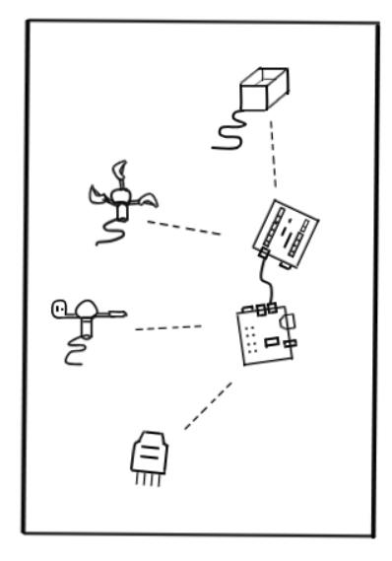
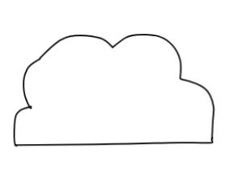
IoT related Time-Series Prediction System Architecture
ThingSpeak IoT Analytics Platform
Fully managed deep learning
Prediction requests
Trained model with LSTM
Training data
Predict Weather Data
Prediction results
Weather Prediction Results
Sensor Network

Slide 11
Time-Series Prediction System Architecture
Three Year Weather Data
Fully managed deep learning
Prediction requests
Trained model with LSTM
Training data
Test Weather
Data
Predict Weather Data
Prediction results
Weather Prediction Results

Slide 12
IoT related Time-Series Prediction System Design
Trained
LSTM model
Start
Temperature, Humidity, Rainfall, Wind Speed, Wind Direction
Predict Weather Data
Weather Prediction Results
Upload and Send Weather Data with Pi
End
IoT Platform
Received Weather Data

Slide 13
Time-Series Prediction System Design
Start
LSTM model
Train LSTM Prediction Model
Training Data
Temperature, Humidity, Rainfall, Wind Speed, Wind Direction
Testing Data
Predict Weather Data
Three Year Weather Data
Weather Prediction Results
End

Slide 14
Data Collection
The weather prediction system uses one sensor device and raspberry pi.
A raspberry pi are open hardware development boards that can be used to design and build devices that interact with the real world.
The time-series weather data are temperature and humidity.

Slide 15
Sensors for IoT related Time-Series Prediction System
DHT22 (Temperature and Humidity)
Anemometer (Wind Speed)
Wind Vane (Wind Direction)
Rain Gauge (Rainfall)

Slide 16
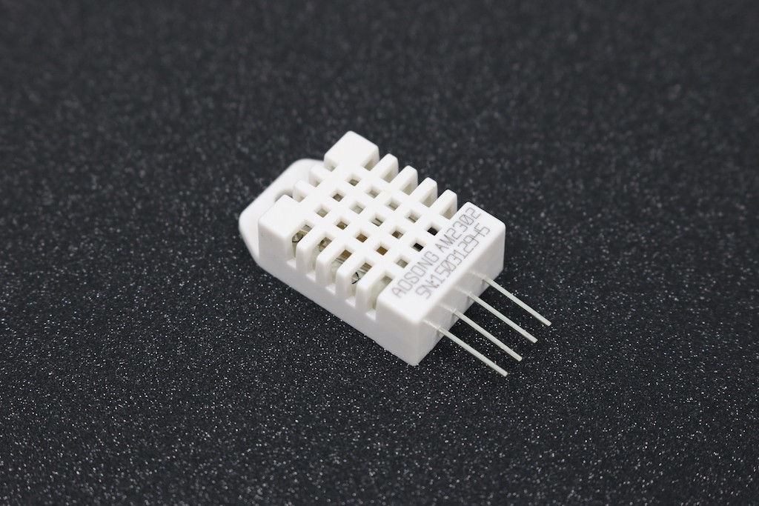
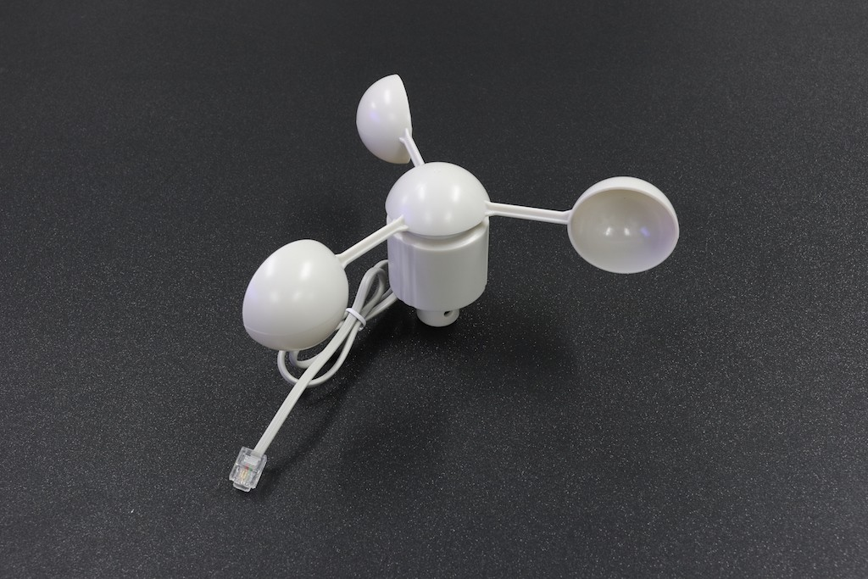
DHT22 and Anemometer
Fig. DHT22
Fig. Anemometer

Slide 17
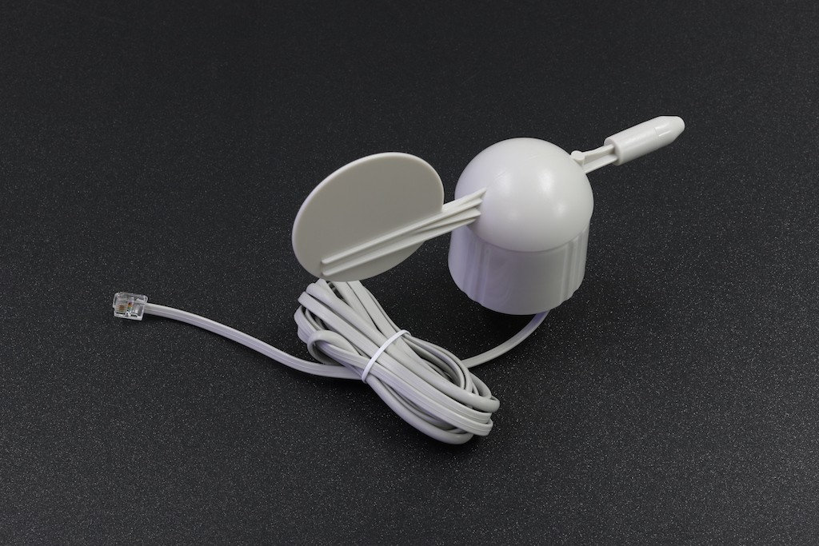
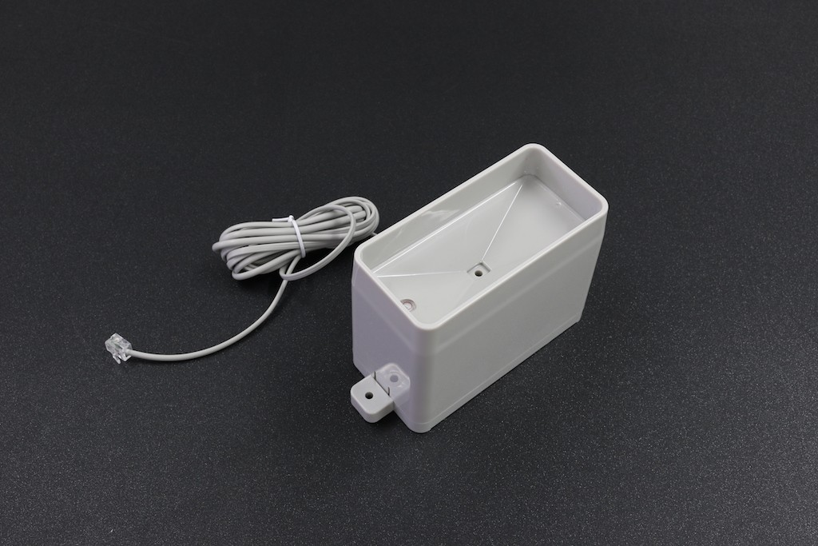
Wind Vane and Rain Gauge
Fig. Wind Vane
Fig. Rain Gauge

Slide 18
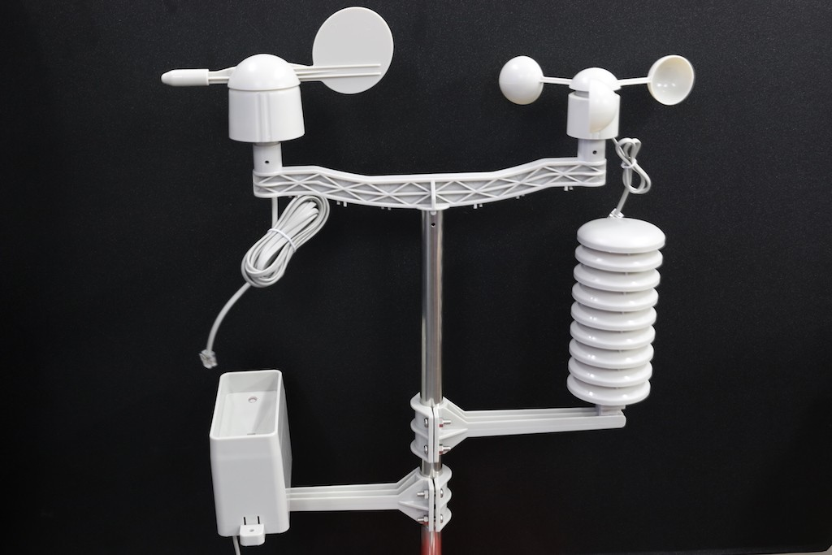
Weather Station Kits
Fig. Weather Station Kits

Slide 19
Data Nature
The time-series prediction system used three years weather data for Pyin Oo Lwin and Yangon.
The IoT-related time-series prediction system used one week weather data for real-time system.
The weather data for time-series prediction system are temperature, rainfall, humidity, wind speed and wind direction.
The weather data for IoT related system are temperature and humidity.

Slide 20
Cont’d
The weather data are collected and stored as in the following forms:
Date | Time | Temp | Rain_Fall | Humidity | Wind Speed | Wind Direction
2015-01-01 | 9:30 A.M | 32 | 0 | 58 | 3.6 | E
2015-01-01 | 12:30 P.M | 32 | 0 | 39 | 3.6 | N
2015-01-01 | 5:30 P.M | 32 | 0 | 68 | 1.2 | E
2015-01-02 | 9:0 A.M | 31.6 | 0 | 54 | 1.2 | S
Tabel: Sample Weather data

Slide 21
Cont’d
The IoT related time-series prediction system uses sensors and collected weather data are uploaded to ThingSpeak, IoT analytics platform service.
For IoT related prediction system, the collected data are downloaded to train the model.
All weather data( temperature, humidity, rainfall ,etc) are standardized with float type to all value for data cleaning stage.
For weather text data such as wind direction, it need to encode for training in LSTM.

Slide 22
Data Preprocessing
Rescale the data to the range of 0-to-1, also called normalizing.
Normalize the dataset using the MinMaxScaler preprocessing class from the scikit-learn library.
After normalizing, the dataset is transformed into series to supervised learning problem.
To define and fit model for LSTM, split the prepared three years weather dataset into train and test sets.
The train dataset contains thirty-three months weather data and test dataset contains three months weather data.

Slide 23
Implementation
The inputs weather data are reshaped into the 3D format expected by LSTMs, namely [samples, timesteps, features.
A multilayer model is composed of two LSTM layers with a 100 memory units to form the base architecture for the model.
The multilayer model is added with twenty percent of dropout layer.
Adding dropout layer prevent overfitting by ignoring randomly selected neurons during training.

Slide 24
Cont’d
20% is often used as a good compromise between retaining model accuracy and preventing overfitting.
A dense layer is added into the model.
LSTM model is compiled with mean squared error for loss function and used ‘rmsprop’ for optimization.
The model is trained with 125 epochs, and 58 batches size and training data is not shuffle.
The model used root mean squared error as a score function to evaluate the quality of the predictions.

Slide 25
Data Output Layer
The real-time prediction system results will send message to specific phone of users.
The twilio message library is used to send message in prediction system.

Slide 26
Analysis of Weather Prediction System
The result of prediction system depend on the epoch, batch size and training data.
The following tables show the result of prediction systems.
Figure. Analysis of IoT related Time-series Prediction System for Yatanarpon Cyber City Region
Epoch | Batch | TrainAccuracy | Loss | RMSE
140 | 64 | 0.9795 | 1.97E-03 | 0.023
132 | 32 | 0.974 | 9.32E-04 | 0.029
125 | 32 | 0.9767 | 7.55E-04 | 0.027
100 | 64 | 0.9779 | 1.10E-03 | 0.033
80 | 32 | 0.9732 | 9.47E-04 | 0.029
60 | 32 | 0.9743 | 9.59E-04 | 0.033

Slide 27
Cont’d
Epoch | Batch | TrainAccuracy | Loss | RMSE
140 | 64 | 68.46 | 0.0204 | 4.56
132 | 32 | 69.81 | 0.0194 | 4.37
125 | 56 | 70.1 | 0.0208 | 4.533
100 | 64 | 68.75 | 0.021 | 4.6
80 | 32 | 67.88 | 0.0207 | 4.567
60 | 32 | 69.81 | 0.0213 | 4.692
Figure. Analysis of Time-series Prediction System for Pyin Oo Lwin Region

Slide 28
Cont’d
Epoch | Batch | TrainAccuracy | Loss | Validation Accuracy | Validation Loss | RMSE
140 | 64 | 81.6 | 0.0159 | 80.66 | 0.0183 | 5.406
132 | 32 | 81.97 | 0.0154 | 80.66 | 0.019 | 5.76
125 | 64 | 81.37 | 0.0161 | 81.39 | 0.0185 | 5.504
100 | 64 | 81.43 | 0.0201 | 81.02 | 0.0187 | 5.605
80 | 32 | 81.73 | 0.0159 | 80.29 | 0.0195 | 5.607
60 | 32 | 81.6 | 0.0162 | 80.29 | 0.0194 | 5.827
Figure. Analysis of Time-series Prediction System for Yangon Region

Slide 29
Overview of System Model
The weather forecasting model using LSTM was implemented using Python.
The LSTM was programmed using Keras.
Keras is a high-level neural networks API, written in Python and capable of running on top of TensorFlow, CNTK, or Theano.
Besides, Keras, other Python libraries such as matplotlib, numpy, pandas, and sklearn were also used.

Slide 30
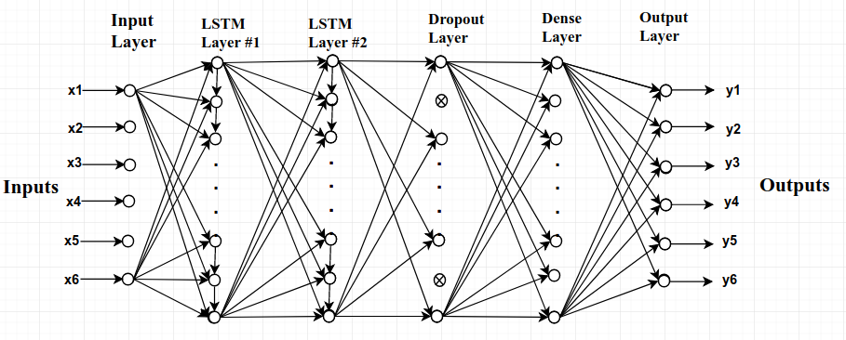
System Layer Design of LSTM
Fig: System Layer Design

Slide 31
Test Results
The total data is splitted into seventy percent for training and thirty percent for testing.
The LSTM model has two layers with 125 epochs and 56 batches.
Adjusting epochs and batches size and increasing training data can improve the LSTM model’s accuracy.

Slide 32
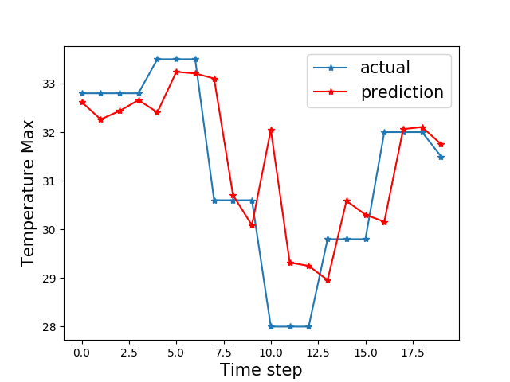
Test Results for Yangon
Fig: Comparison of prediction and actual for Temperature

Slide 33
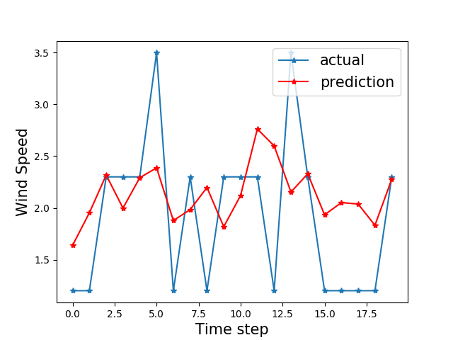
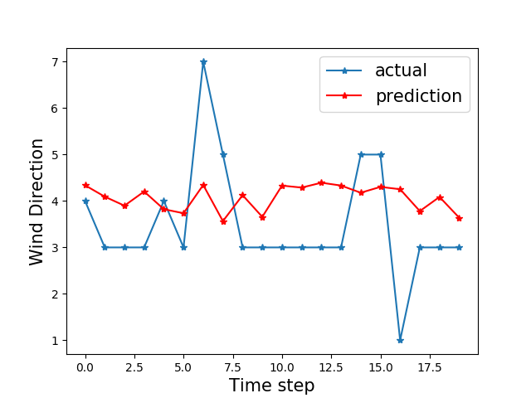
Cont’d
Fig: Comparison of prediction and actual for Wind Speed and Direction

Slide 34
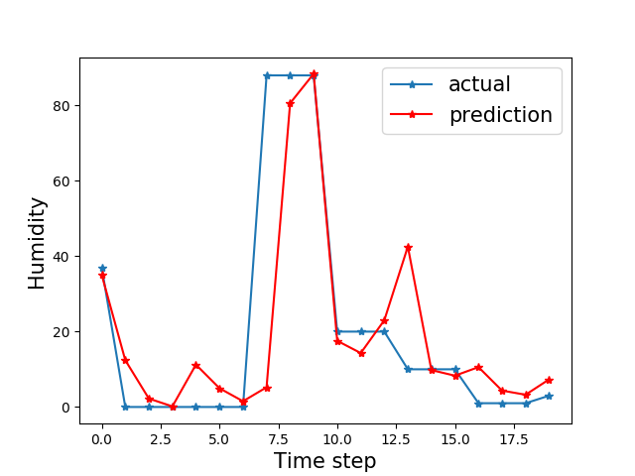
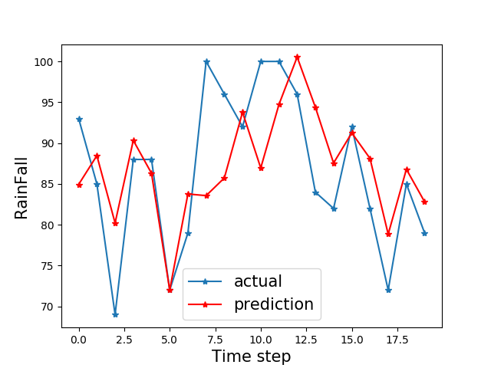
Cont’d
Fig: Comparison of prediction and actual for RainFall and Humidity

Slide 35
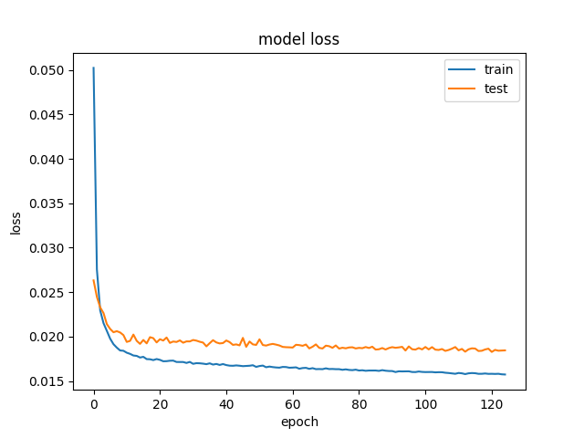
Cont’d
Fig:Comparison of Loss value and Epoch

Slide 36
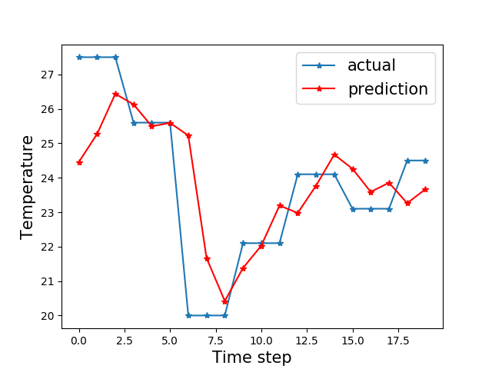
Test Results for Pyin Oo Lwin
Fig: Comparison of prediction and actual for Temperature

Slide 37
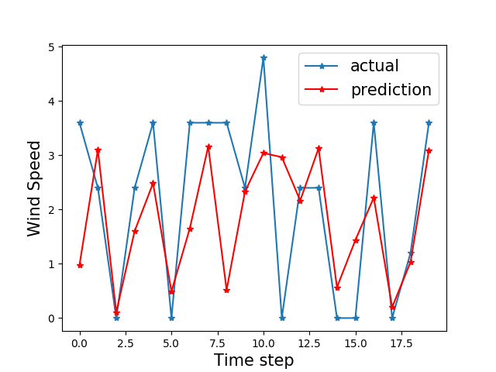
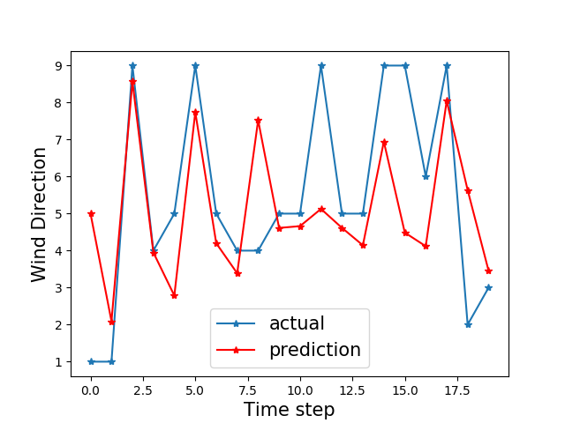
Cont’d
Fig: Comparison of prediction and actual for Wind Speed and Direction

Slide 38
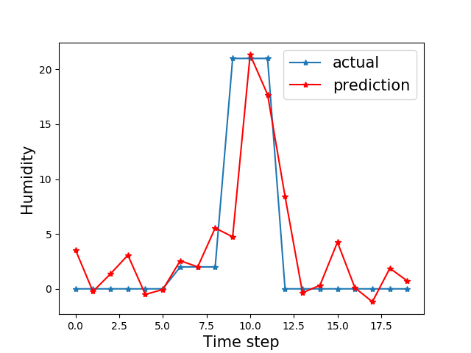
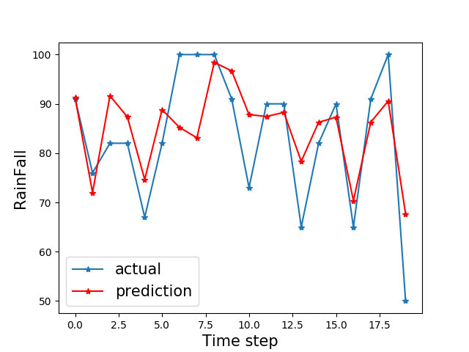
Cont’d
Fig: Comparison of prediction and actual for RainFall and Humidity

Slide 39
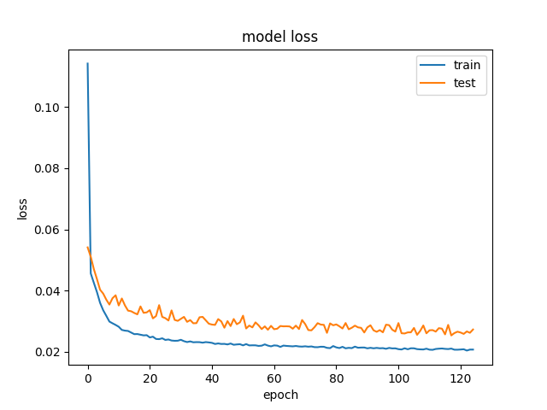
Cont’d
Fig:Comparison of Loss value and Epoch

Slide 40
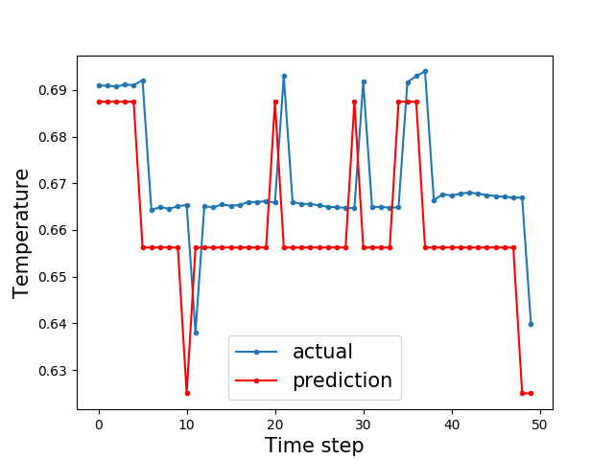
Test Results for Yatanarpon Cyber City
Fig: Comparison of prediction and actual for Temperature

Slide 41
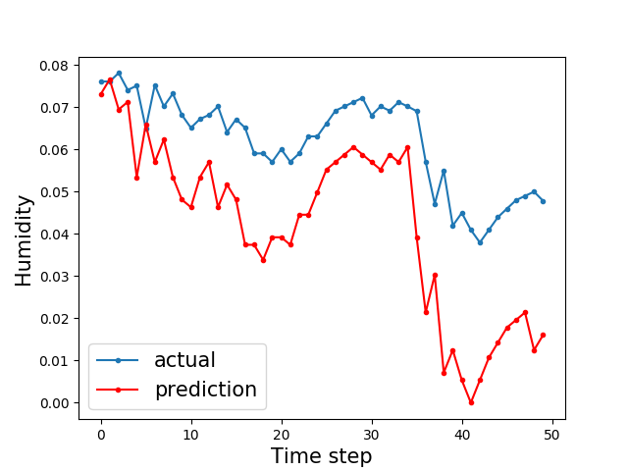
Cont’d
Fig: Comparison of prediction and actual for Humidity

Slide 42
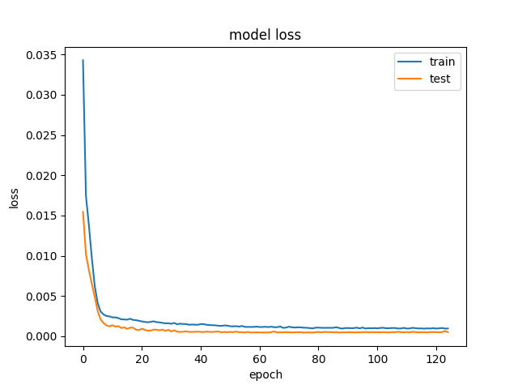
Cont’d
Fig:Comparison of Loss value and Epoch

Slide 43
Limitations
The system limits that the trained weather data is only for Yangon, Pyin Oo Lwin and Yatanarpon Cyber City University location in Myanmar.
The system performs prediction analysis on only five weather parameters.
Long Short Term Memory (LSTM) is only used to perform prediction.

Slide 44
Further Extension
Weather prediction using data from different locations on more parameters can be performed by the system.
The system can also analyze the accuracy of weather prediction results with other deep learning techniques.
The system can be applied as part of smart home IoT system.

Slide 45
Conclusion
Internet of Thing(IoT) and deep learning is very useful in many applications and environments in daily life.
The system help the people to know how much comfort level they have.
The system will tend to focus on smart home system.

Slide 46
….. Thank You .….

