Slide 1


DBSCAN:
DENSITY-BASED SPATIAL CLUSTERING OF APPLICATIONS WITH NOISE
Peter Lin Mang, Eh Si Si, Hnin Ei Wai Lwin, Yin Min Han, Thant Sin Tun, May Thiri Phyoe, May Thaw Tar

Slide 2
TABLE OF CONTENT
Clustering
DBSCAN Theory & Parameters
DBSCAN Algorithm Steps & Visualization
DBSCAN Implementation & Deployment
Algorithm Comparison & Key Findings

Slide 3
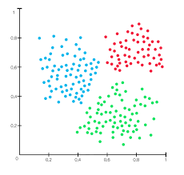
What is Clustering?
class identification by measuring distance
unsupervised learning
grouping objects into subclasses automatically without manual labeling
each cluster has a central point
discovers hidden patterns, structures
suitable for exploratory analysis
Requirements for clustering algorithm
the right parameters are needed
finding clusters of arbitrary shape, not only circles/shperes
efficiency on large databases, for example, thousands of points
01

Slide 4
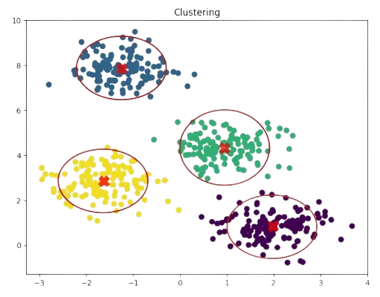
Why is Clustering Important?
Clustering is used when:
There are no labels
We want to explore data structure
We need to simplify or summarize datasets
Types of Clustering Methods
1. Partitioning Methods
These divide data into K predefined clusters.
K-Means Clustering
Chooses K centroids and assigns points based on distance
Pick K initial centroids
Assign points to nearest centroid
Pros: Simple and fast
Cons: Need to choose K, Sensitive to outliers
02

Slide 5
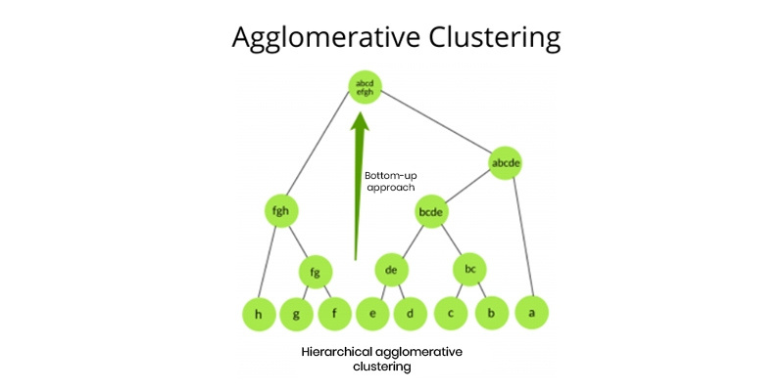
2. Hierarchical Clustering
Builds a tree-like structure (dendrogram)
Two types:
Agglomerative (bottom-up) → start with individual points
Divisive (top-down) → start with one cluster
Merge or split based on distance
03

Slide 6
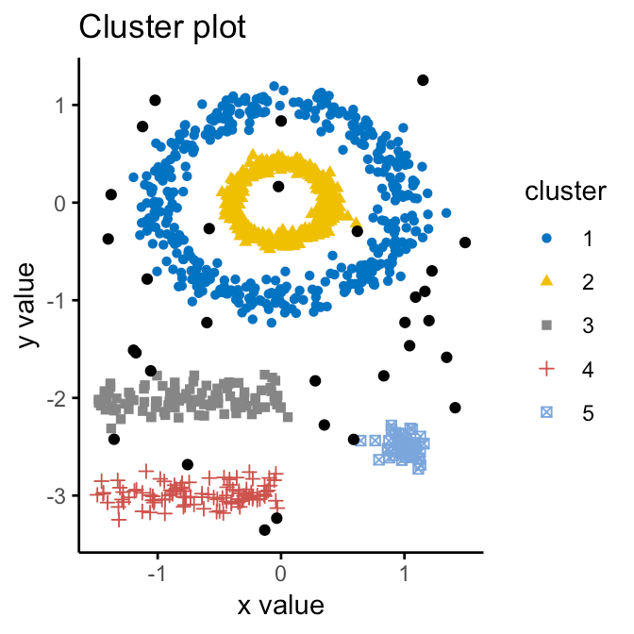
3. Density-Based Clustering
Groups points based on dense regions
DBSCAN
Finds clusters of arbitrary shapes
Identifies noise (outliers)
Pros: Handles noise well, No need to specify K
04

Slide 7
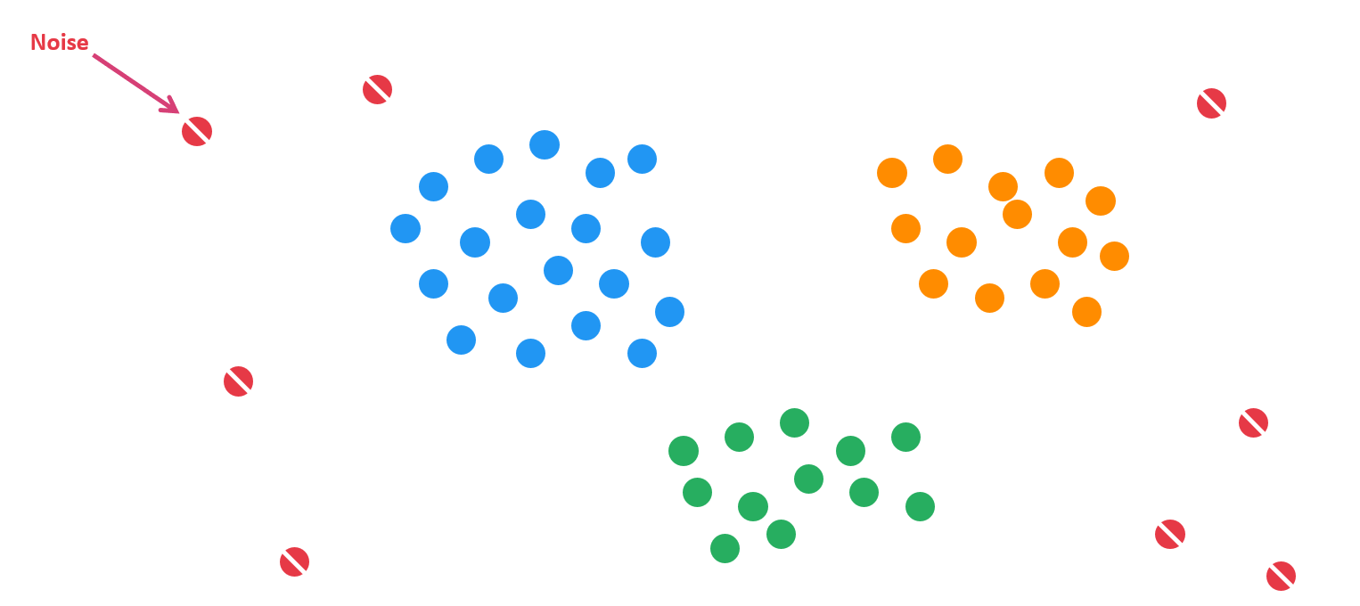
THEORY
DBSCAN is a density-based clustering algorithm that groups data points that are closely packed together and marks outliers as noise based on their density in the feature space. It identifies clusters as dense regions in the data space separated by areas of lower density.
The Problem with K-Means: Assumes spherical shapes; requires guessing "K"; sensitive to outliers.
The DBSCAN Solution: Clusters are high-density areas separated by low-density areas (noise).
low-density
high-density
05

Slide 8
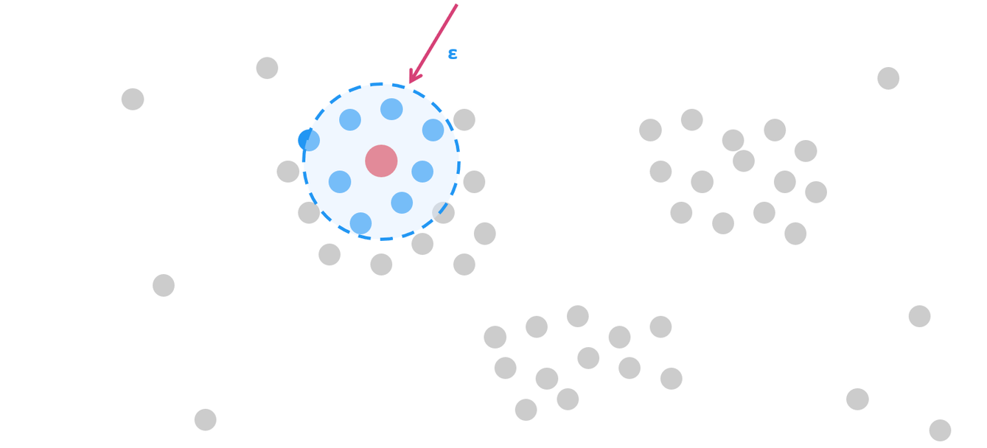
CORE PARAMETER
Epsilon (ε)
The radius of the neighborhood around a data point
If one point is within this distance from another, they are considered neighbors.
Too Small → Fragmentation (Noise everywhere).
Too Large → Collapse (Everything merges).
Look for the "elbow" in the k-distance graph.
06

Slide 9
CORE PARAMETER
MinPts
The minimum number of data points needed within the ε radius to define a cluster
Too Low → False clusters (Noise treated as clusters).
Too High → True clusters treated as noise.
MinPts = 4
07

Slide 10


TYPES OF POINTS
Core Point: Has at least MinPts inside radius
Border Point: Has fewer than MinPts, but is within radius of a Core.
( Belong to the cluster but don’t expand)
Noise Point (Outlier): Not enough neighbors; not reachable.
MinPts = 4
08

Slide 11
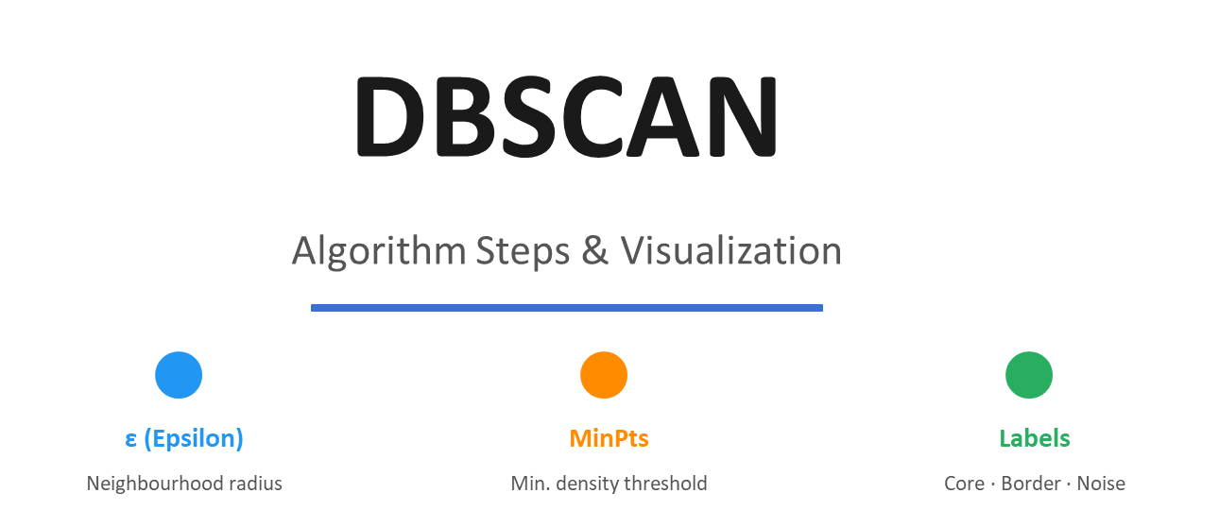
09

Slide 12
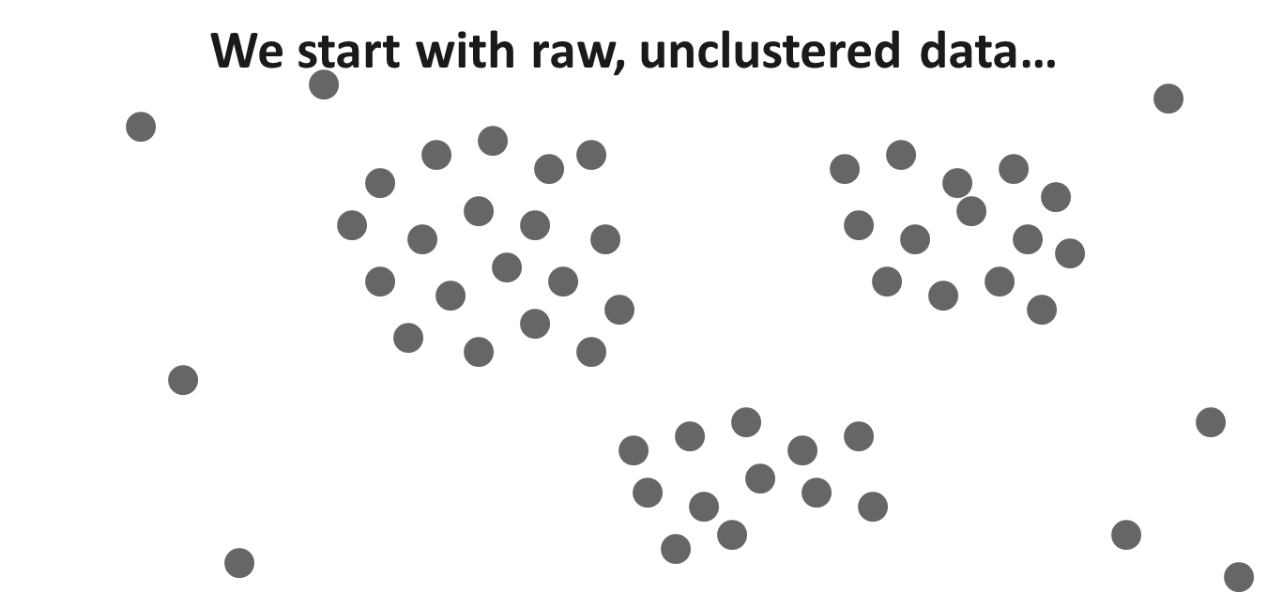
10

Slide 13
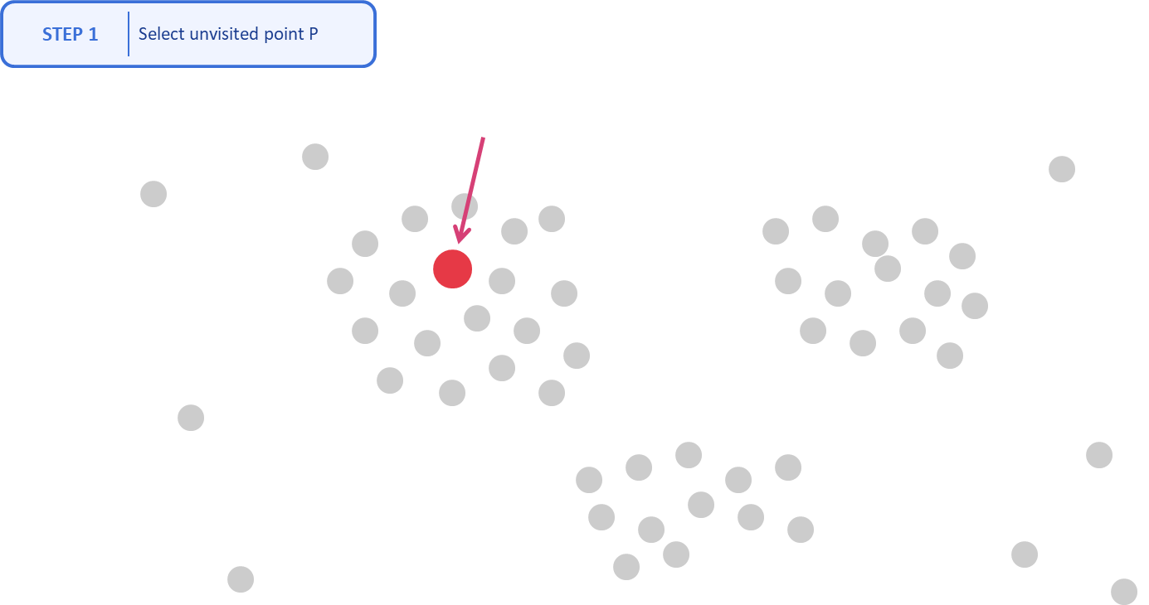
11

Slide 14
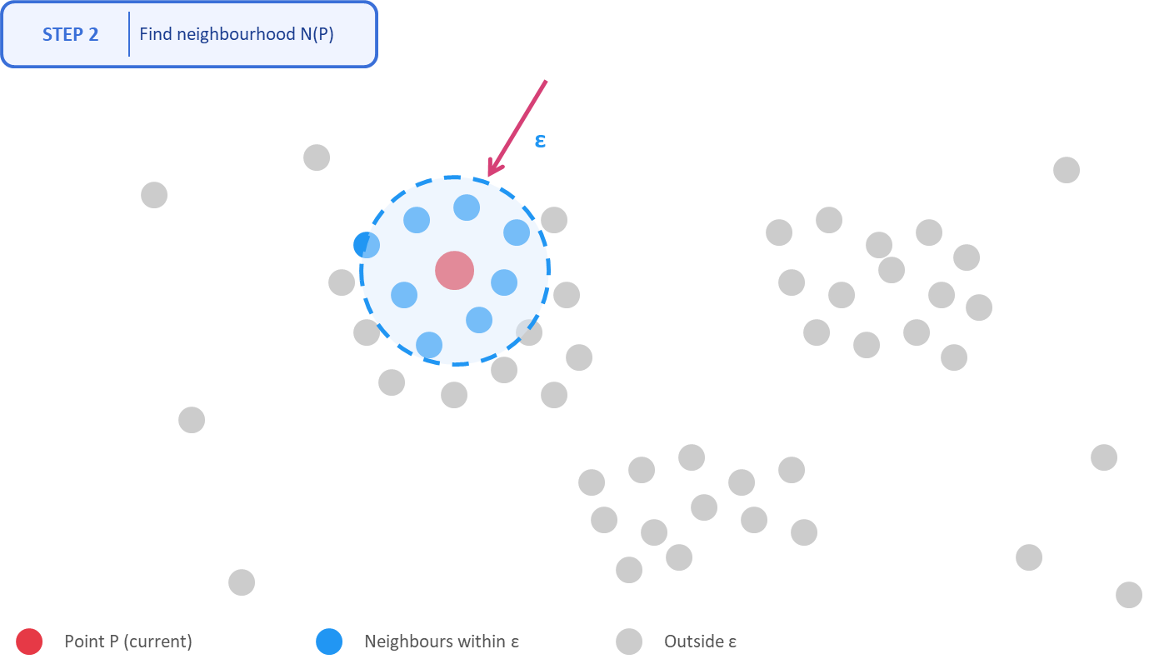
12

Slide 15
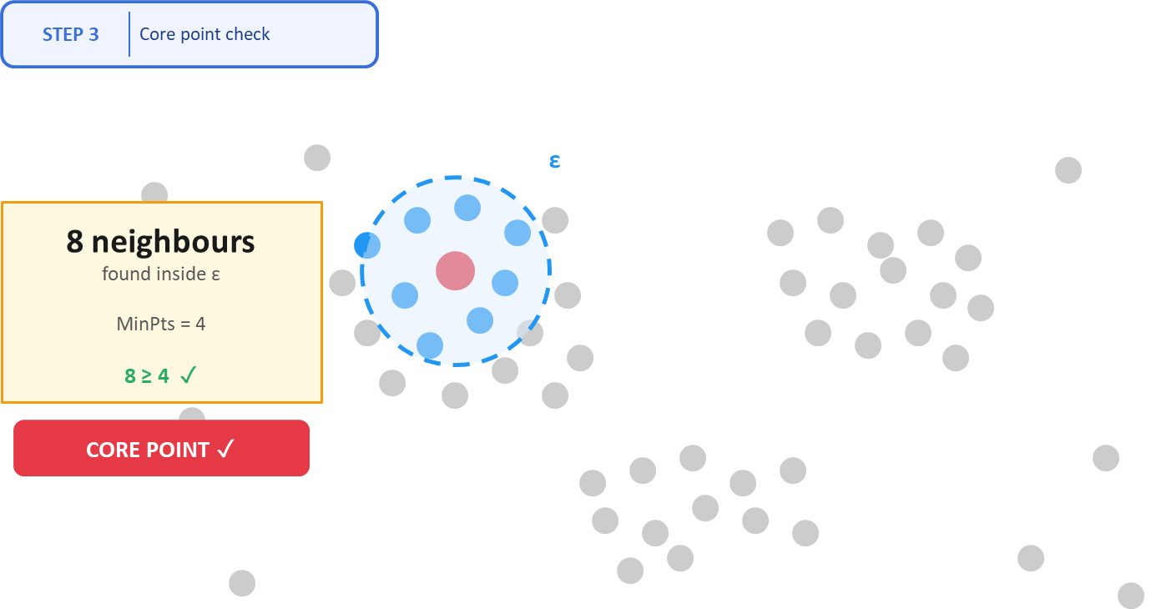
13

Slide 16
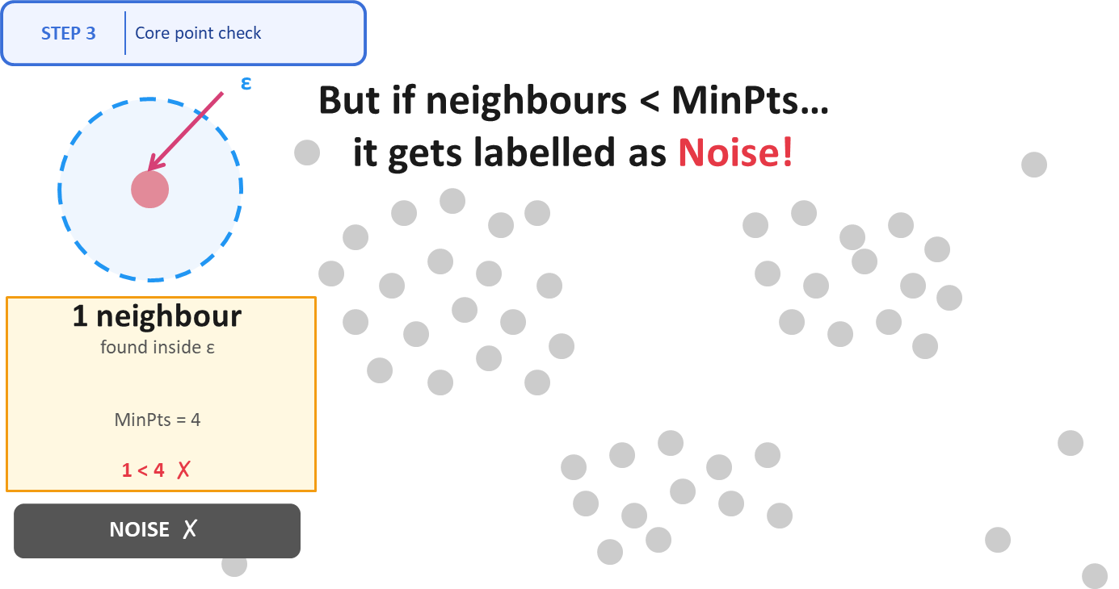
14

Slide 17
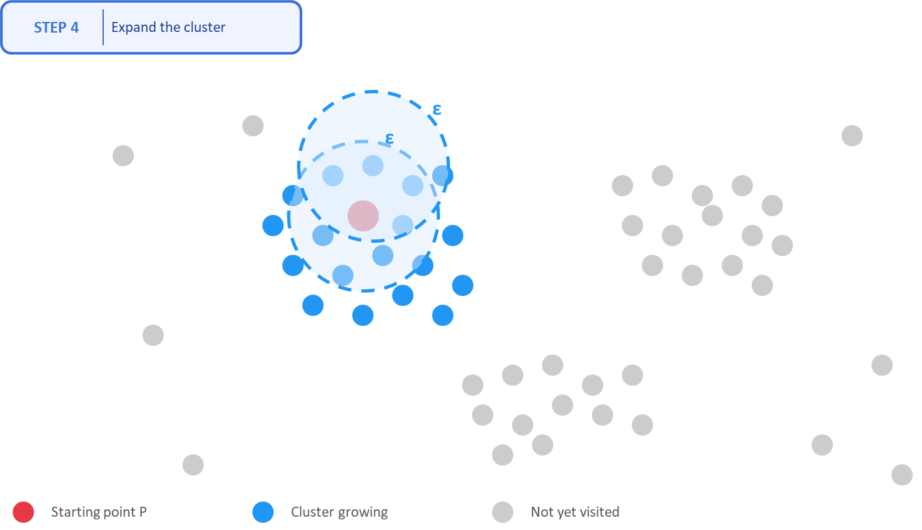
15

Slide 18
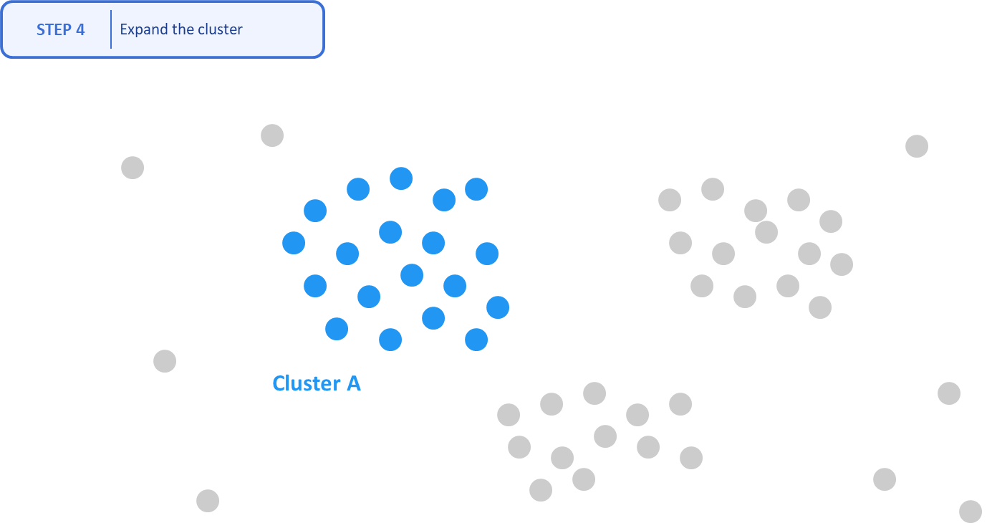
16

Slide 19
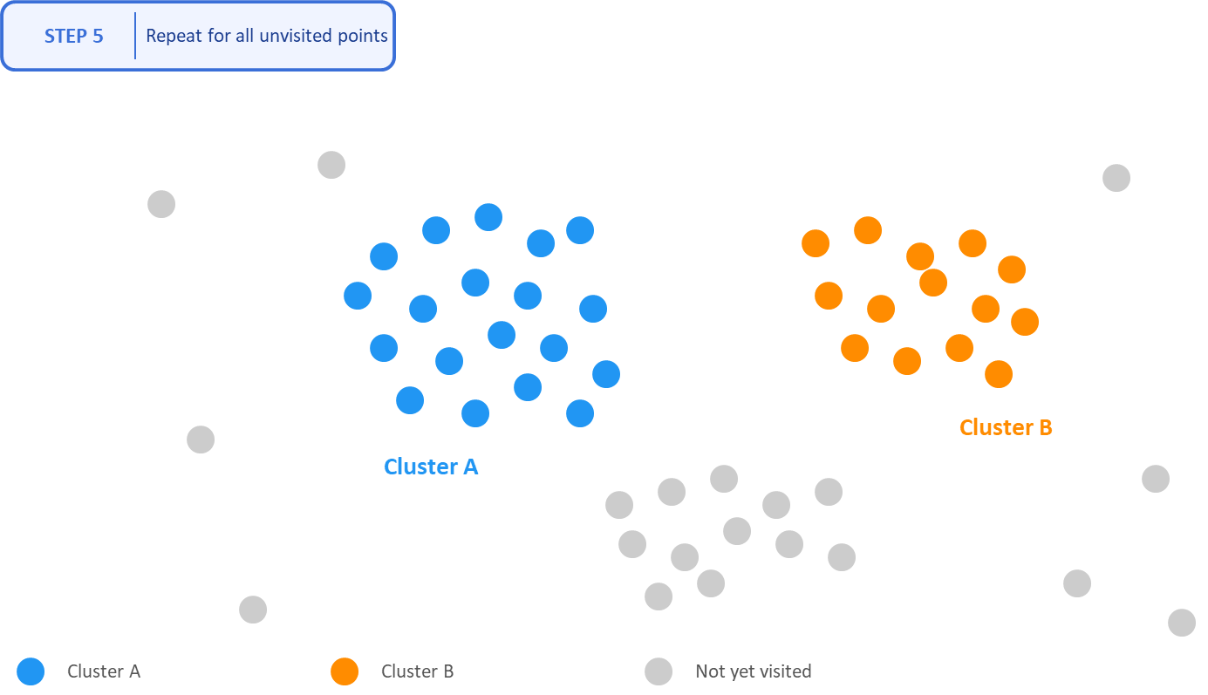
17

Slide 20
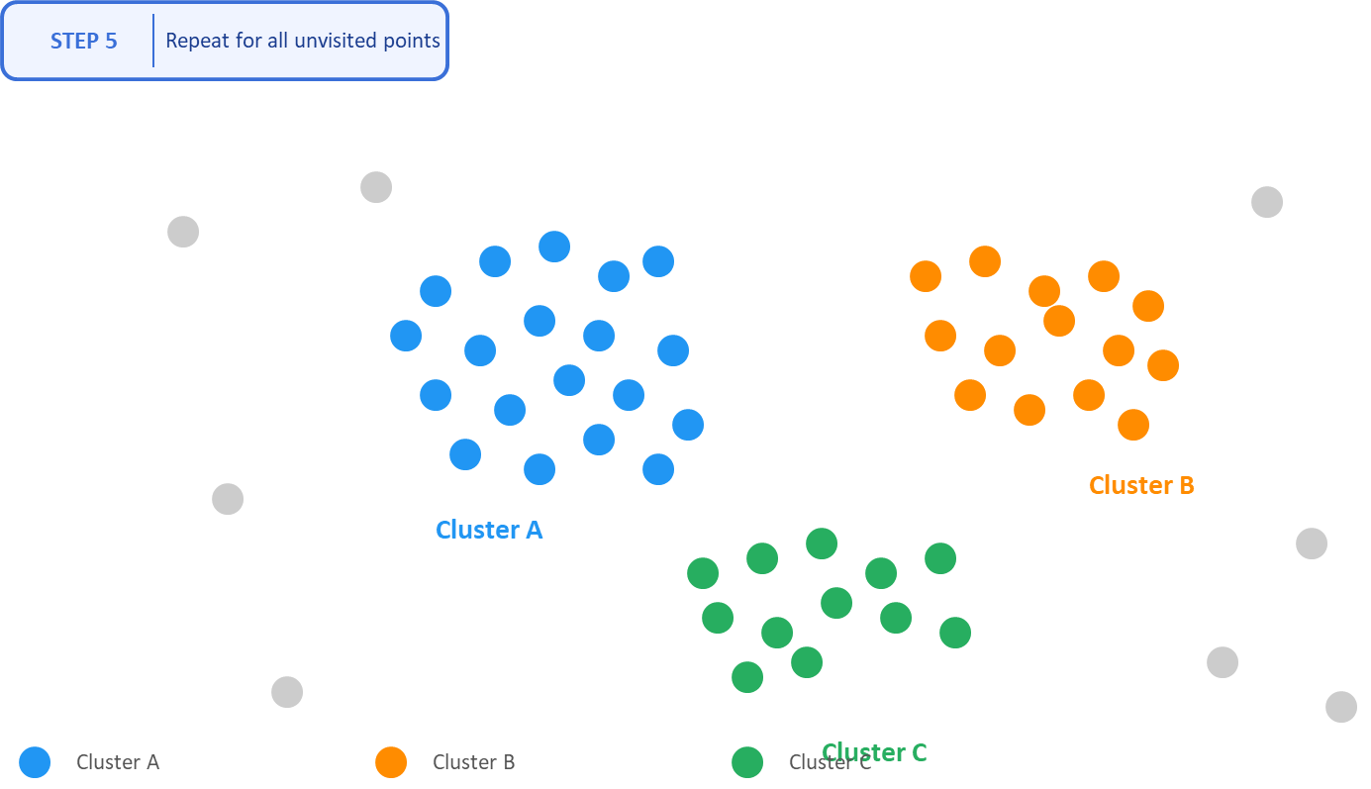
18

Slide 21
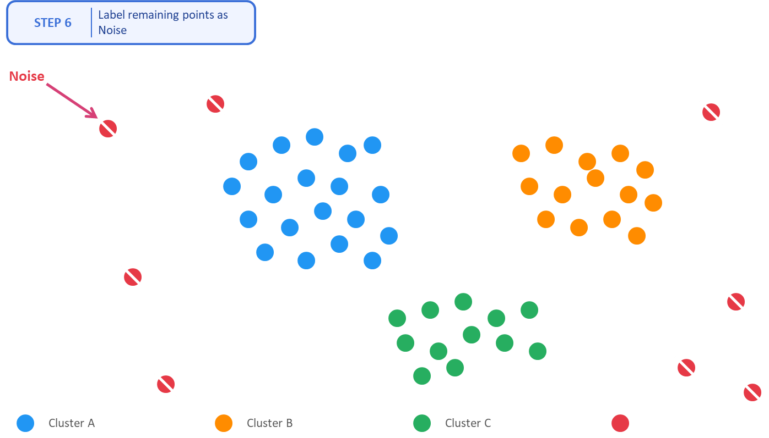
19

Slide 22
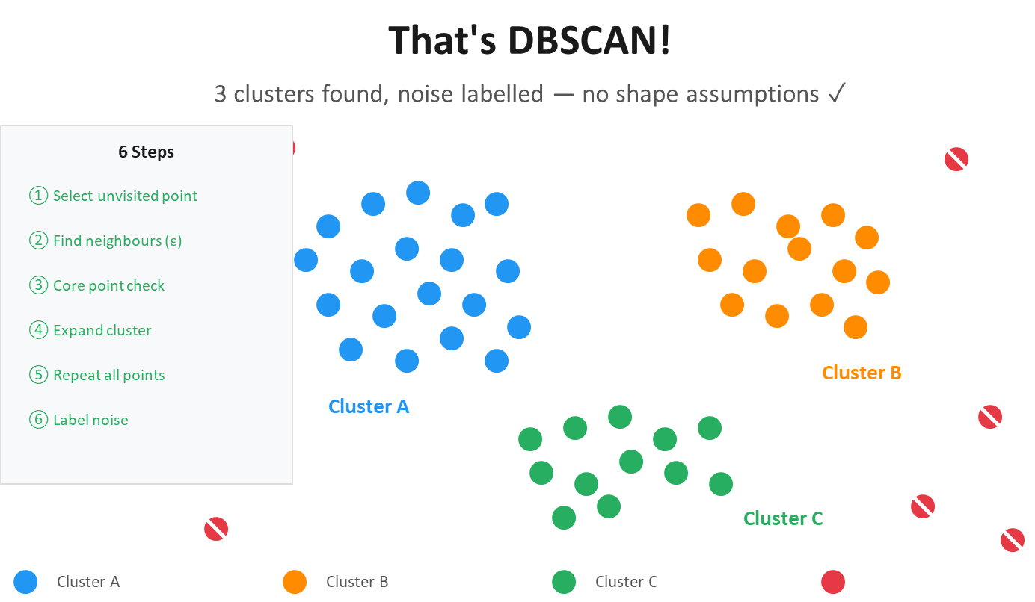
20

Slide 23
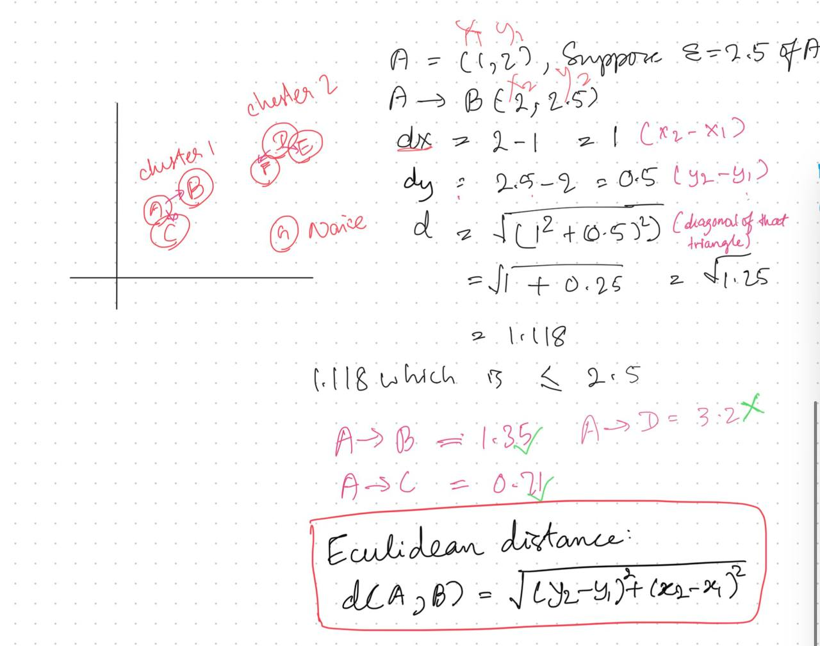

Calculation
21

Slide 24
DBSCAN Implementation & Deployment
22

Slide 25
ALGORITHM COMPARISON
Criteria
DBSCAN
K-Means
Cluster Shape
✓ Any shape
✗ Spherical only
Noise Handling
✓ Built-in
✗ None
# Clusters
✓ Auto-detected
✗ Manual (k)
Scalability
~ Medium datasets
✓ Large datasets
Interpretability
~ Moderate
✓ Easy
DBSCAN is good when cluster shapes are irregular and noise/outliers are present. perfectly suited for real-world customer data.
23

Slide 26
CONCLUSION
: DBSCAN for Customer Segmentation-What We Learned
DBSCAN identified meaningful customer segments without pre-defining cluster count. shows the power of density-based learning on real retail data.
01
Algorithm Strength
DBSCAN outperforms K-Means for irregular, noise-prone customer data. No need to guess k.
02
Robust to noise and outliers
It naturally identifies and separates noise points (outliers) that do not belong to any cluster, improving clustering quality.
03
Sensitive to parameters
The results depend heavily on the choice of parameters (ε and MinPts), and it may struggle with datasets that have varying densities.
24

Slide 27
REFERENCES:
https://cdn.aaai.org/KDD/1996/KDD96-037.pdf
https://youtu.be/_A9Tq6mGtLI?si=hCPwG4iZ3QexHiJS
https://youtu.be/RDZUdRSDOok?si=3OO-uG8wIX7OLzkS
https://scikit-learn.org/stable/modules/generated/sklearn.cluster.DBSCAN.html
27

Slide 28
THANK YOU
28

