Slide 1
CUSTOMER SHOPPING BEHAVIOR
Customer loyalty is strong;
subscription adoption is the gap
How can the business convert an already-loyal customer base into higher recurring value?
Notes:
Frame the leadership question first: the customer base already shows loyalty. The growth opportunity is converting that loyalty into recurring value through subscription adoption.

Slide 2
BASELINE
3,900 purchases reveal a broad but consistent customer base
$59.76
3.75
44
18–70
Average purchase amount
Average review rating
Median customer age
Customer age span
Review ratings had 37 missing values, imputed by product-category median.
02
Notes:
Use this as the baseline. The dataset is broad across age, but the purchase amount and review rating are consistent enough to support focused growth decisions.

Slide 3
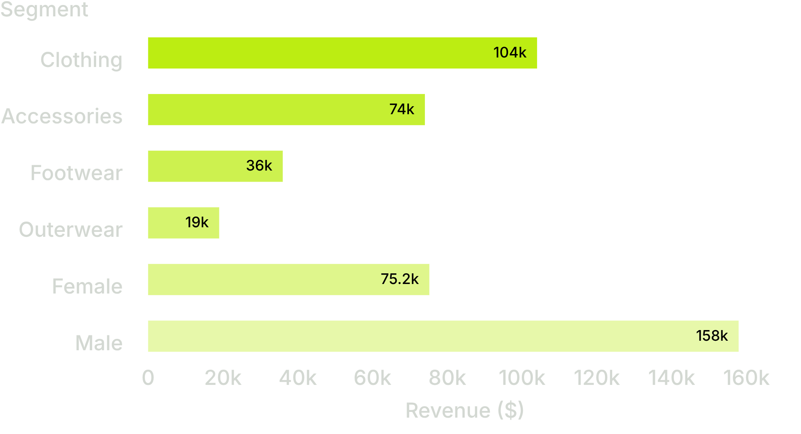
REVENUE MIX
Revenue is concentrated in clothing and male customers
READ-OUT
Clothing is the largest revenue pool.
Male customers generated $157,890 versus $75,191 from female customers.
Category and gender segments are shown together for directional comparison.
03
Notes:
Clothing leads the category pool, and male customers contribute more total revenue in this dataset. These are the clearest concentration signals for prioritizing campaigns.

Slide 4
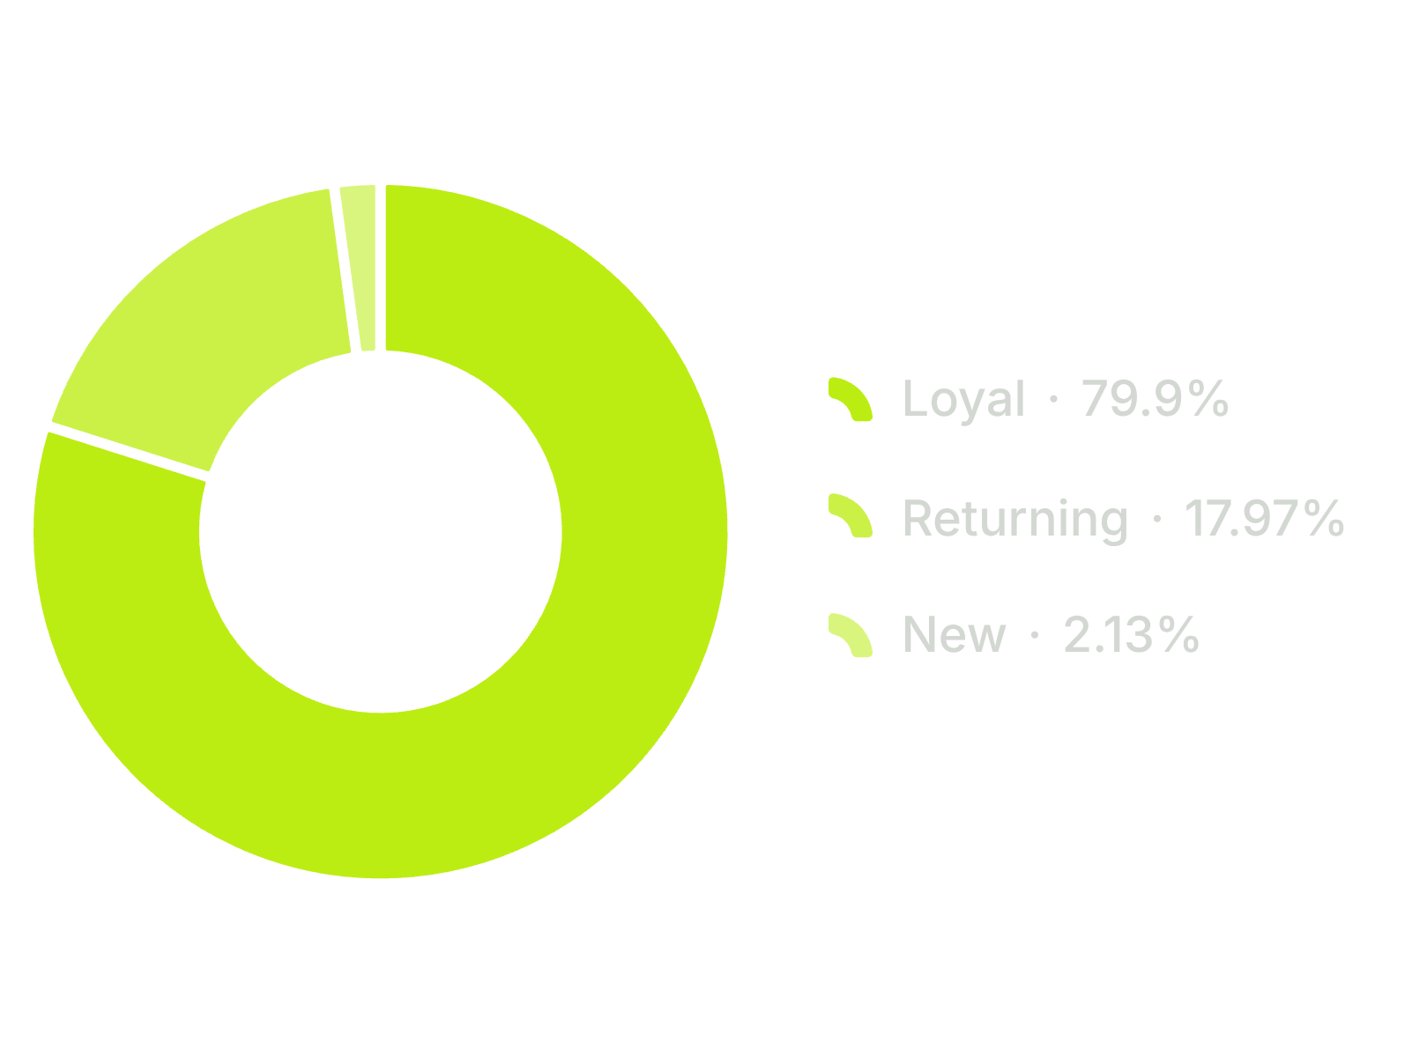
CUSTOMER SEGMENTS
The customer base is already mostly loyal
3,116
Loyal customers
701 returning
83 new customers
The priority is not only acquisition; it is moving repeat buyers into deeper engagement.
04
Notes:
The loyal segment dominates the base. The leadership question is therefore deeper engagement, especially moving returning buyers toward a more durable relationship.

Slide 5
SUBSCRIPTION GAP
Subscriptions have not changed spend yet
Subscribers · 1,053 customers
Non-subscribers · 2,847 customers
$59.49
$59.87
$62,645 total revenue
$170,436 total revenue
Measure | Subscriber | Non-subscriber
Average spend | $59.49 | $59.87
Customer share | 27.0% | 73.0%
The report also shows 7.3% versus 92.7% in one subscription visualization. Validate the dashboard definition before external use.
05
Notes:
Subscription adoption is the gap, but current subscribers have not yet changed average spend. Treat the 27.0% versus 7.3% discrepancy as a dashboard-definition issue to resolve before external use.

Slide 6
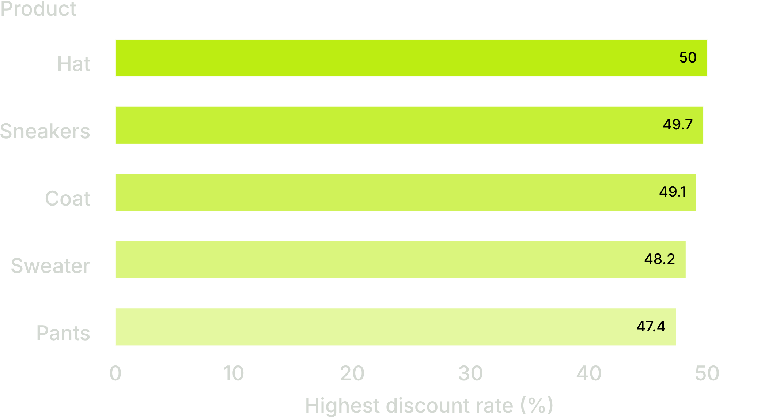
PROMOTION ECONOMICS
Discounts can drive volume without lowering basket size
839
Customers used discounts and still spent above the average purchase amount.
$60.48
Express-shipping average versus $58.46 for Standard.
06
Notes:
Discounting is not automatically a margin problem in this dataset. The signal is to review economics by product before scaling, while recognizing that discounted customers still exceeded the average purchase amount.

Slide 7
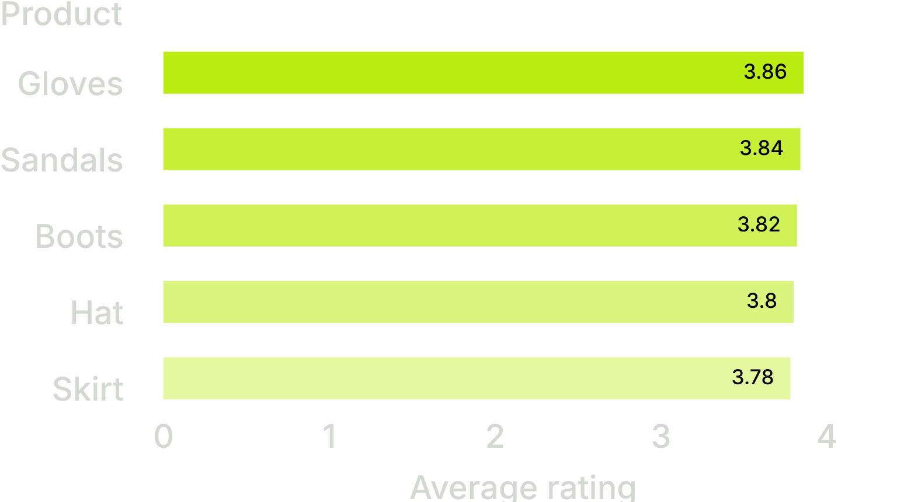
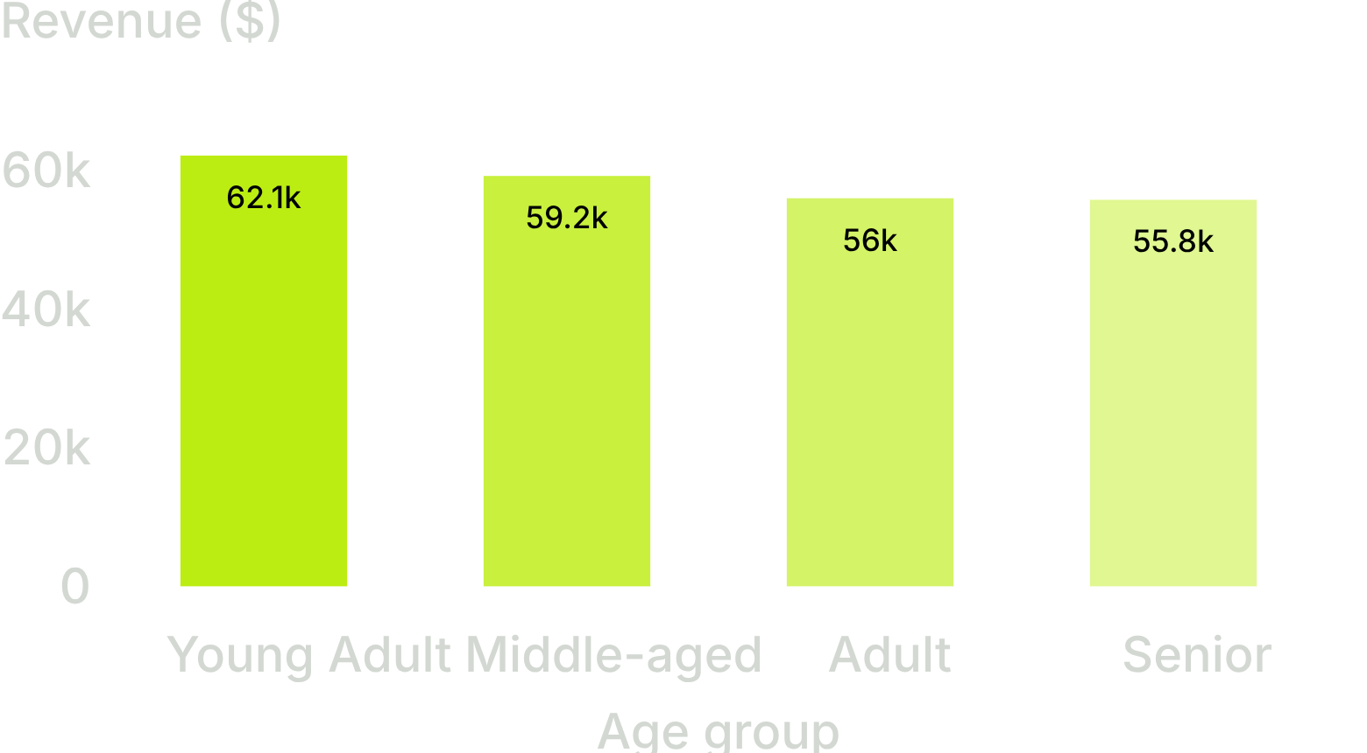
CAMPAIGN TARGETING
Product and age signals point to focused campaigns
Top-rated products
Revenue by age group
Lead campaigns with top-rated products and tailor offers by age group.
07
Notes:
Use the products with the strongest ratings as campaign anchors, then tailor the offer by age group. The revenue signal is distributed, with Young Adult highest in this dataset.

Slide 8

NEXT MOVE
Turn loyalty into recurring value
Bundle subscription benefits around repeat purchase moments
Reward returning buyers and move them toward the Loyal segment
Use top-rated products as subscription or campaign anchors
Review discount economics by product before scaling promotions
Test targeted messaging for high-revenue age groups and express-shipping users
08
Notes:
Close with the operating plan. Start from repeat purchase moments, move returning buyers toward deeper loyalty, anchor campaigns in top-rated products, protect discount economics, and test targeted messaging where the revenue signals are strongest.

