Slide 1
sneakertail.online
Azure Cloud Infrastructure & Deployment

Slide 2
Objective
Sneakertail demonstrates how to deploy a small e-commerce application on Azure using segmented networking, private backend services, a public Application Gateway, path-based routing, host-name based routing, private database access, autoscaling frontend compute, and a controlled management entry point.

Slide 3
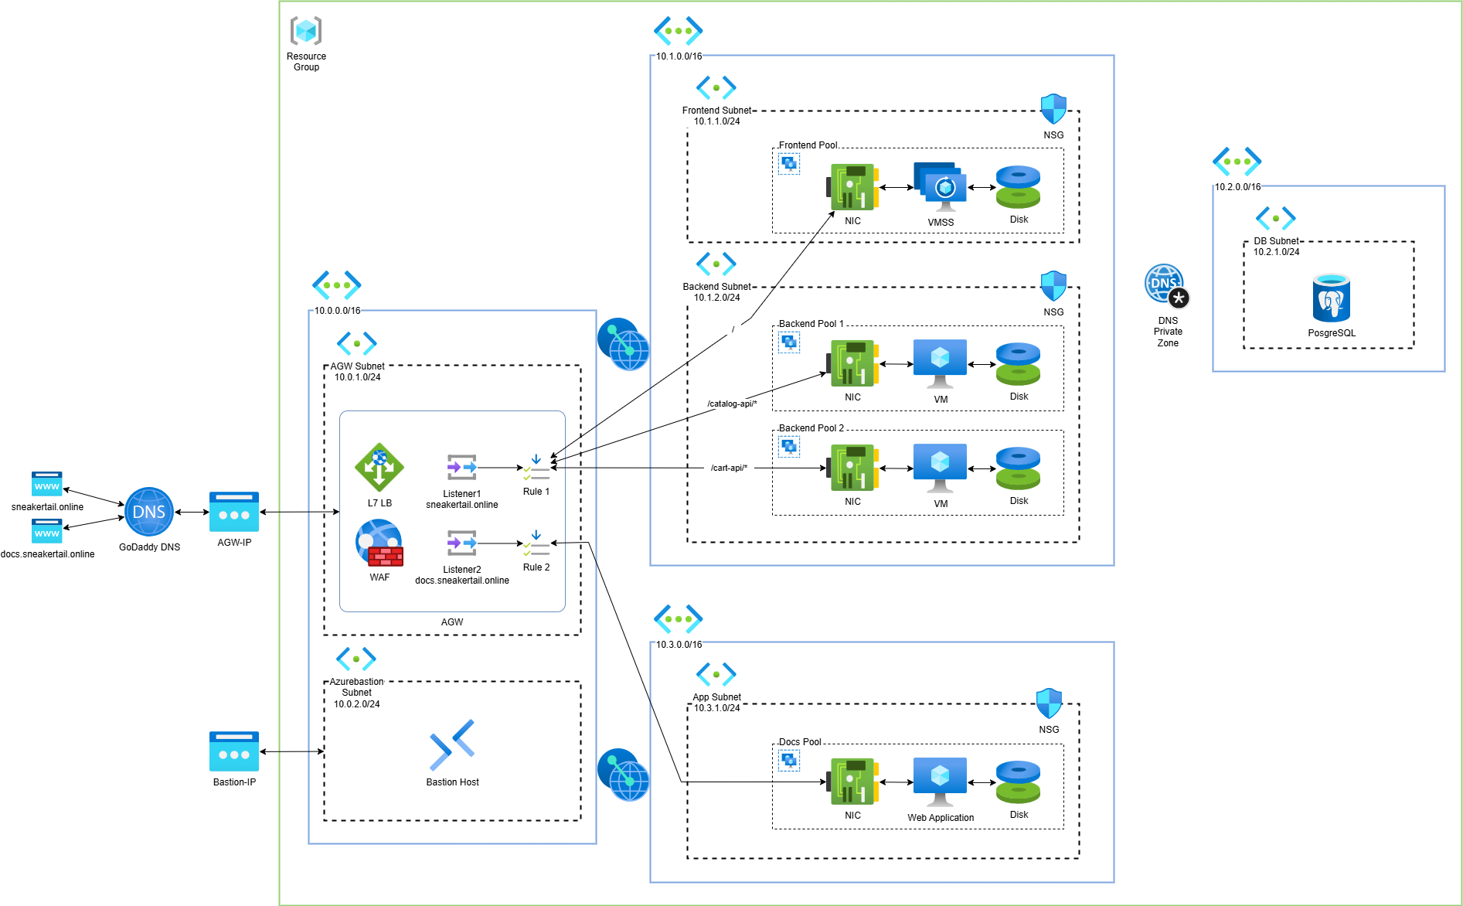
Architecture

Slide 4
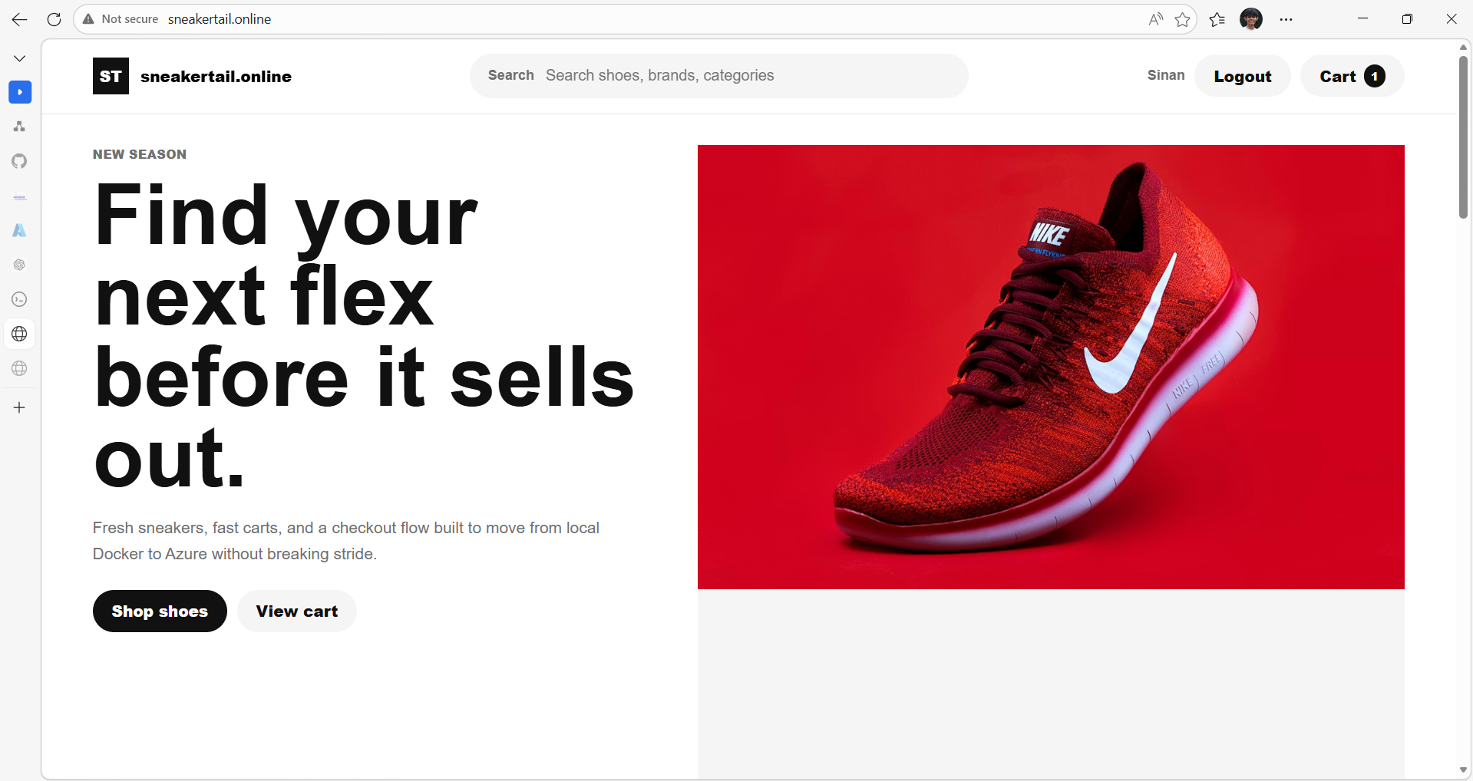

Slide 5
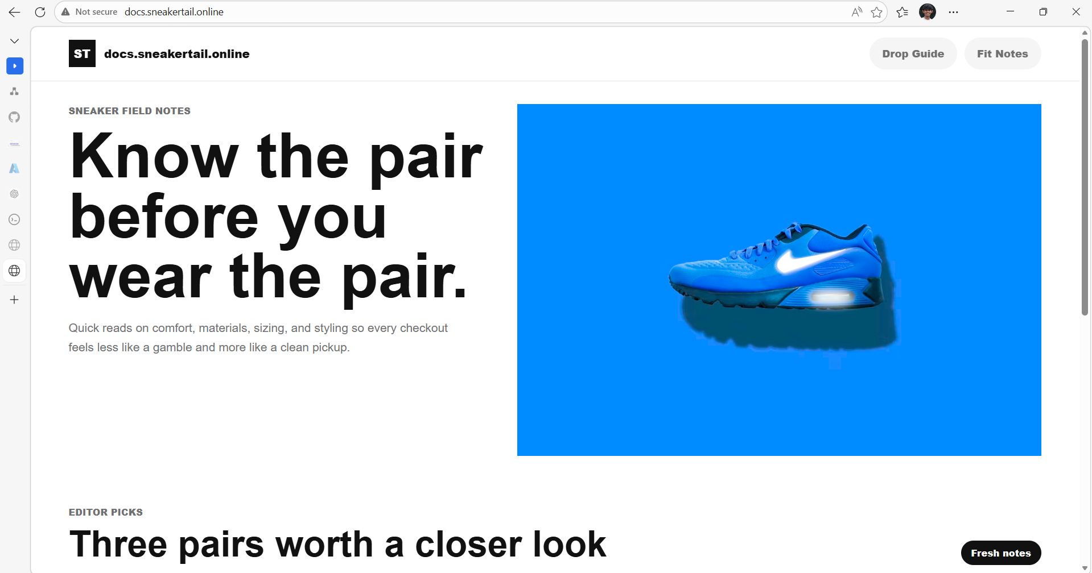

Slide 6
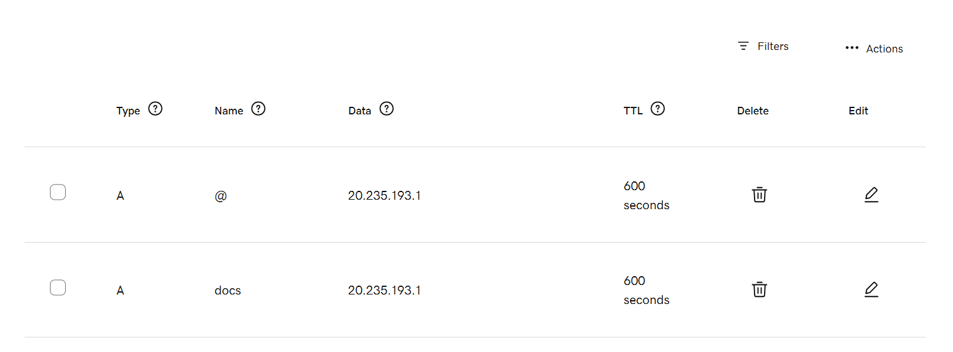
GoDaddy Records

Slide 7
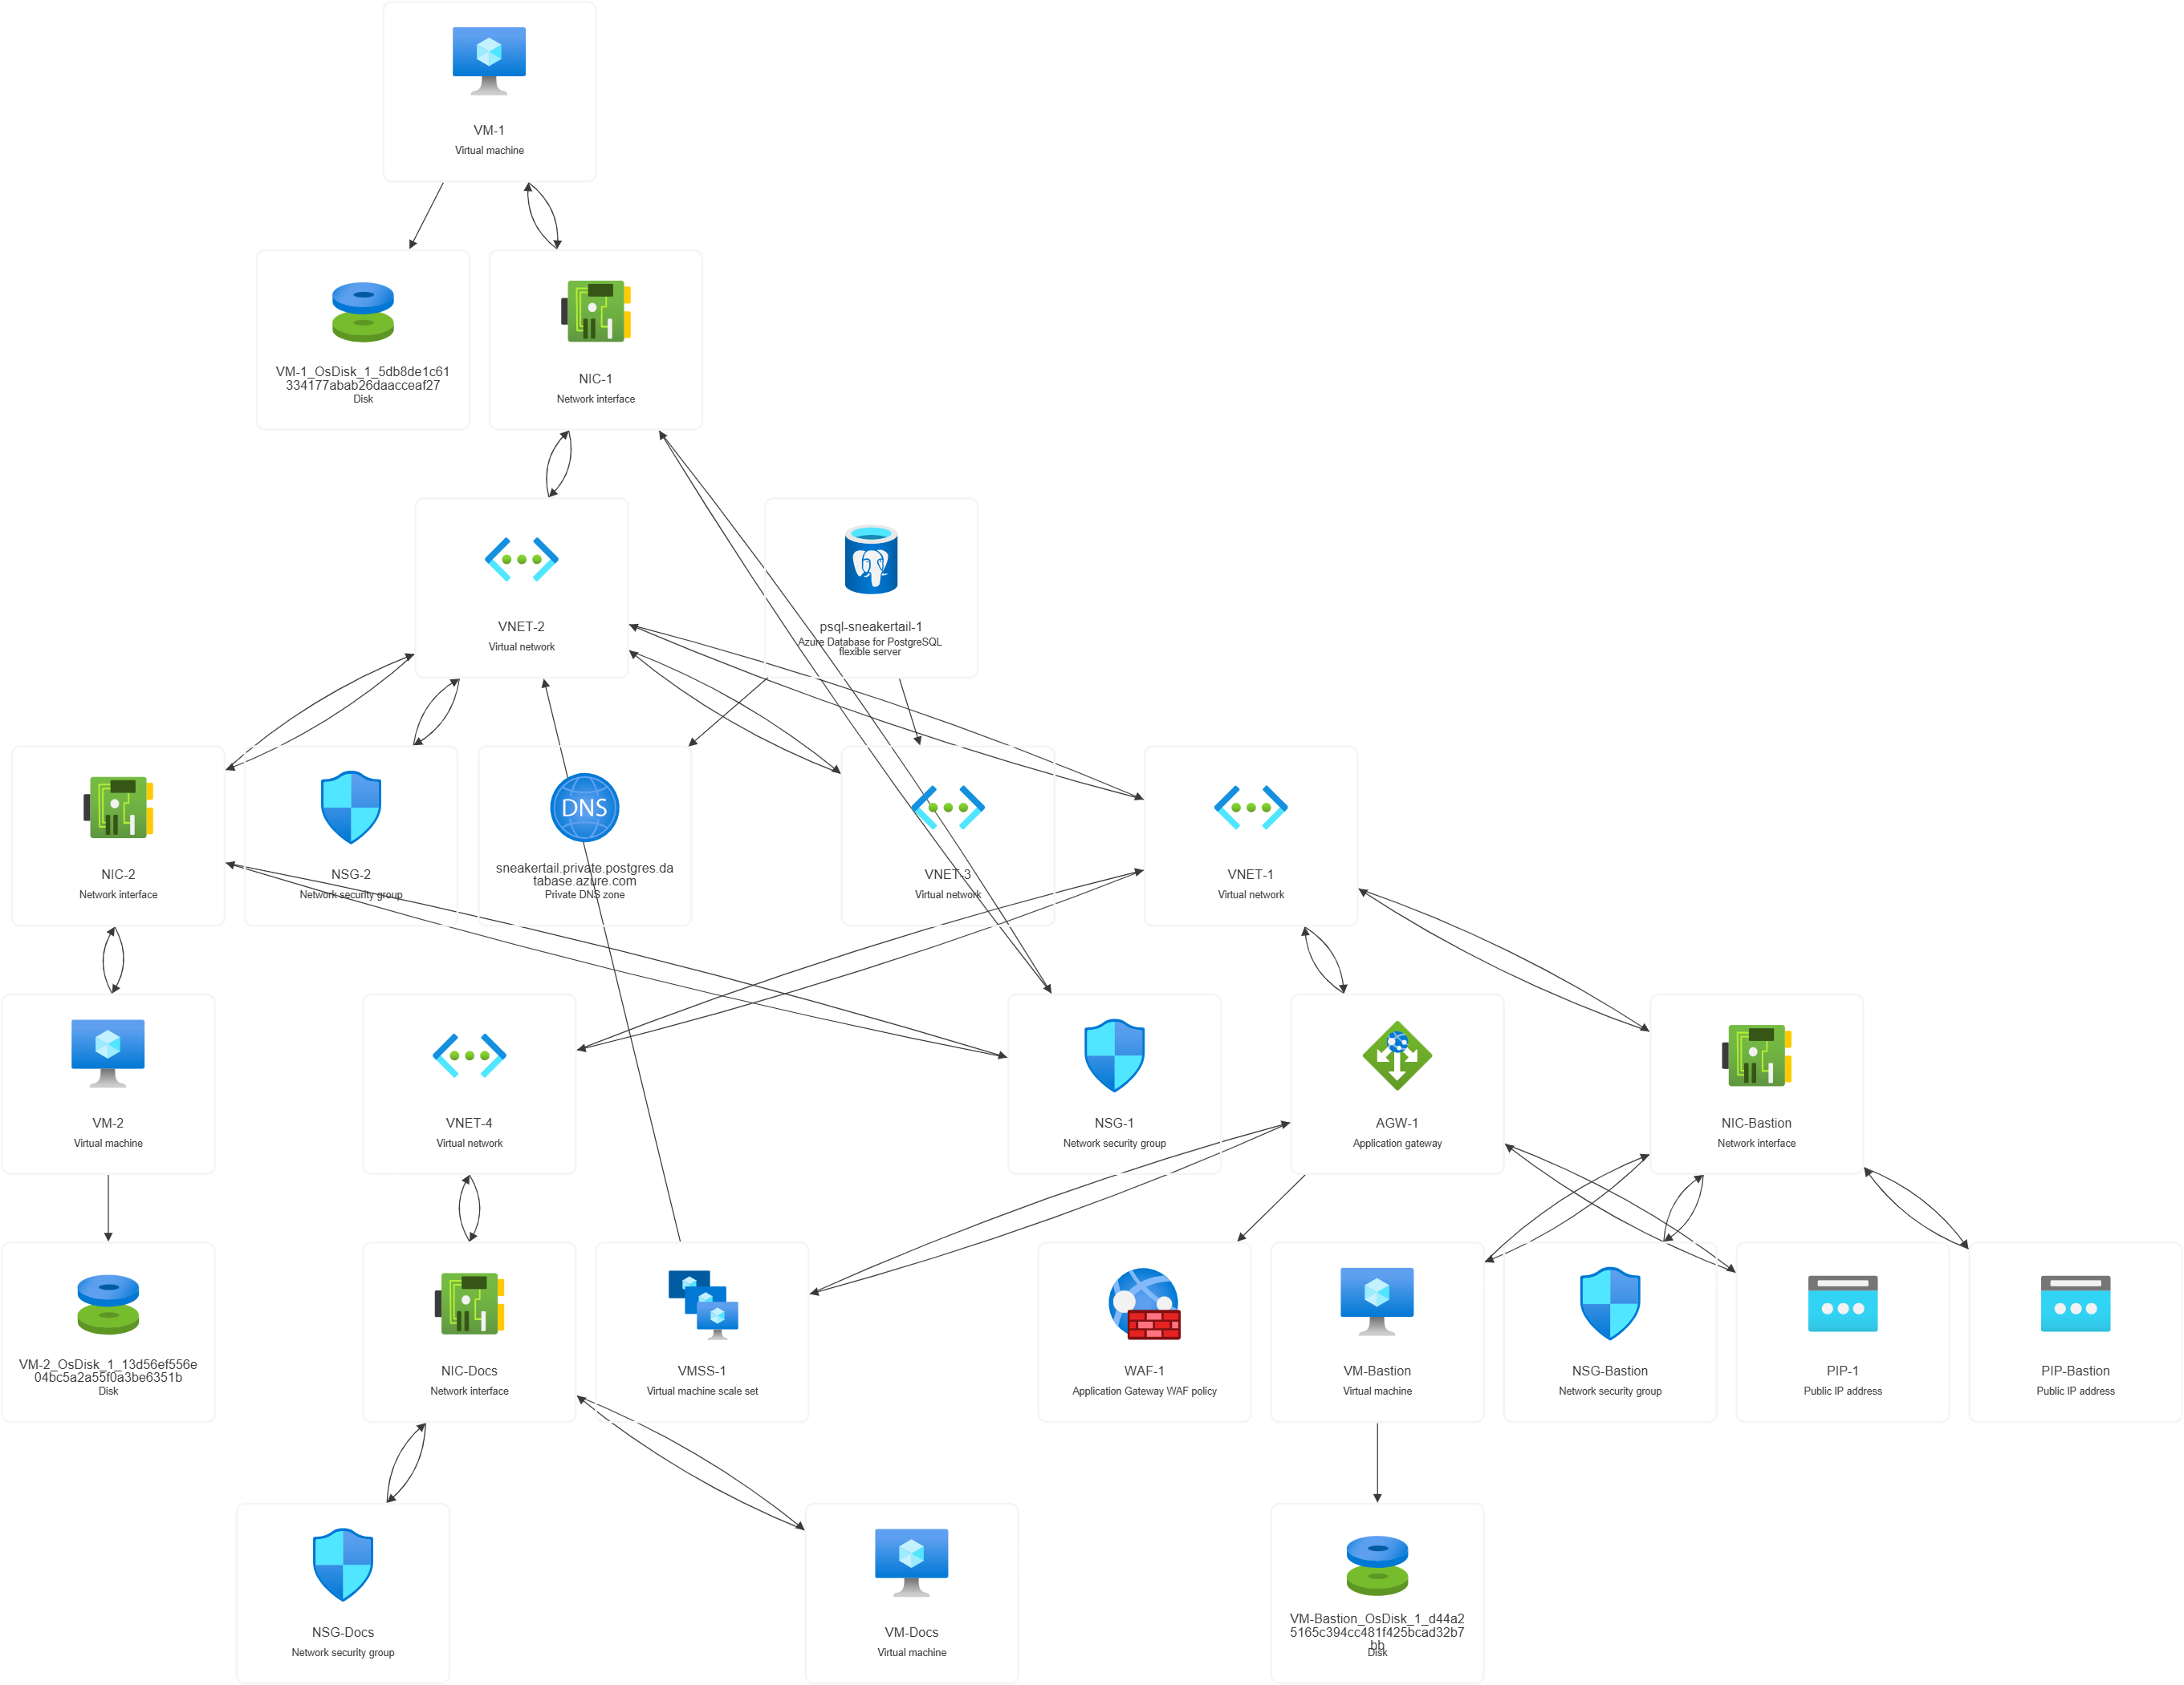

Slide 8
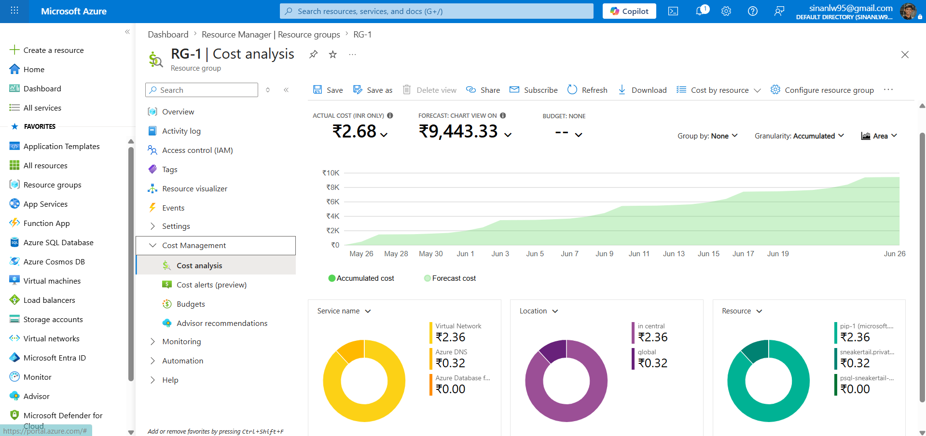

Slide 9
Thank You

