Slide 1
EC4206 Software Testing & Quality Assurance
Practical Assignment: Software Testing and Quality for MERN, Spring Boot, or .NET Applications

Slide 2
1. Test-Driven Development (TDD) & Behavior-Driven Development (BDD)
Part A) TDD – Test Driven Development
Made a simple backend using Sprinboot with only Login/Signup APIs.
Wrote following unit tests using Junit.

Slide 3
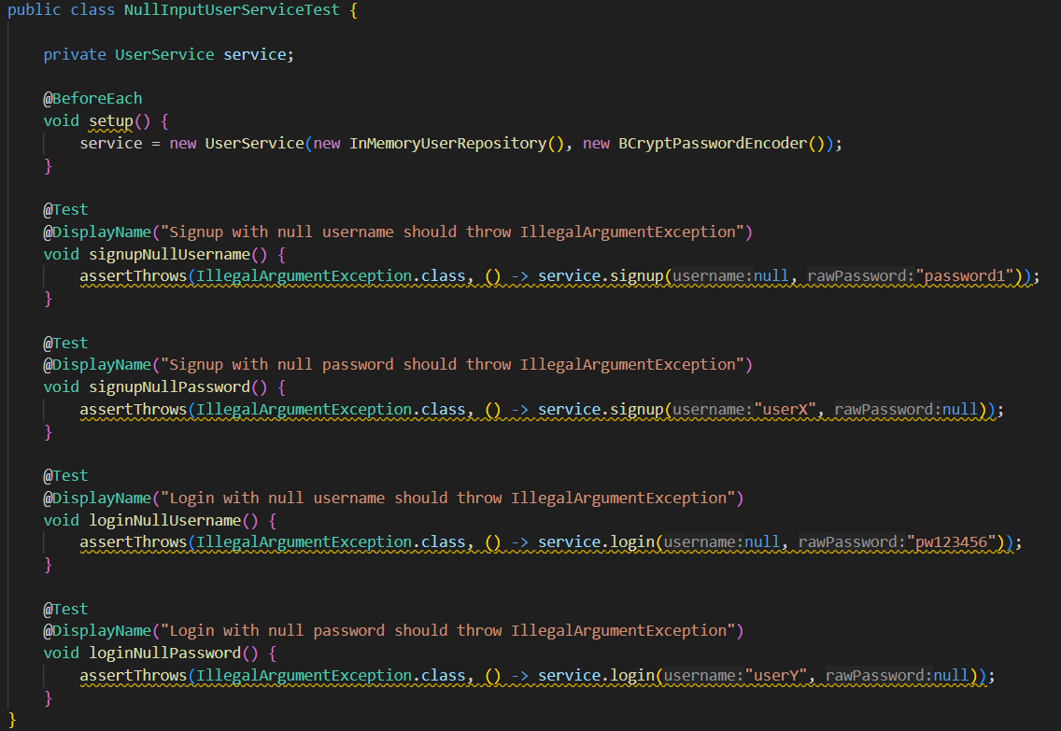

Slide 4
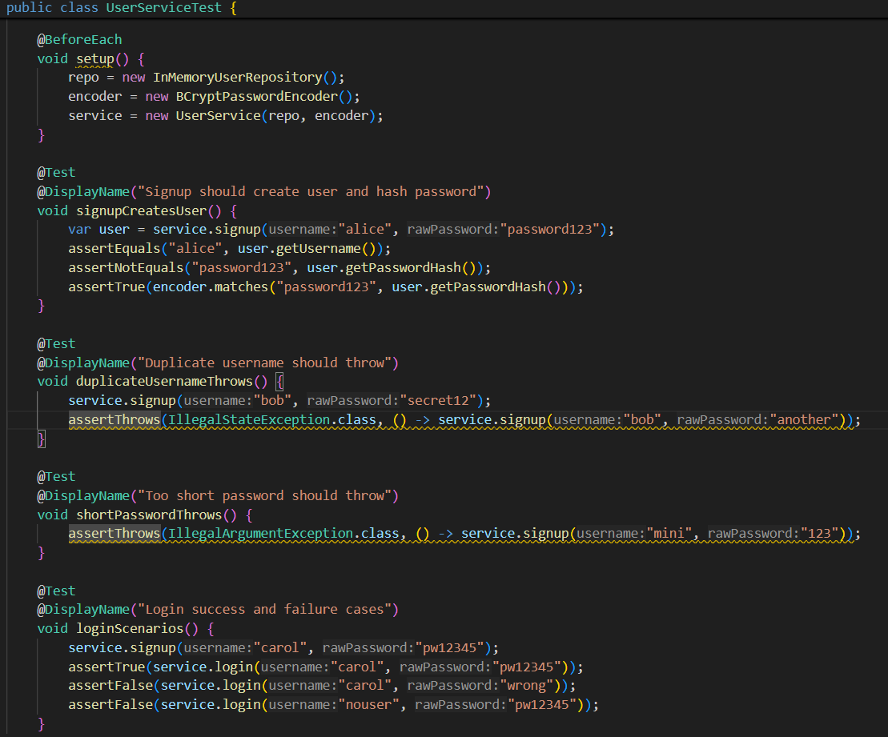

Slide 5
1. Test-Driven Development (TDD) & Behavior-Driven Development (BDD)
A) TDD
Made a simple backend using Sprinboot with only Login/Signup APIs.
Wrote above unit tests using Junit.
Made an intentional bug to get RED/ Failing test as below

Slide 6
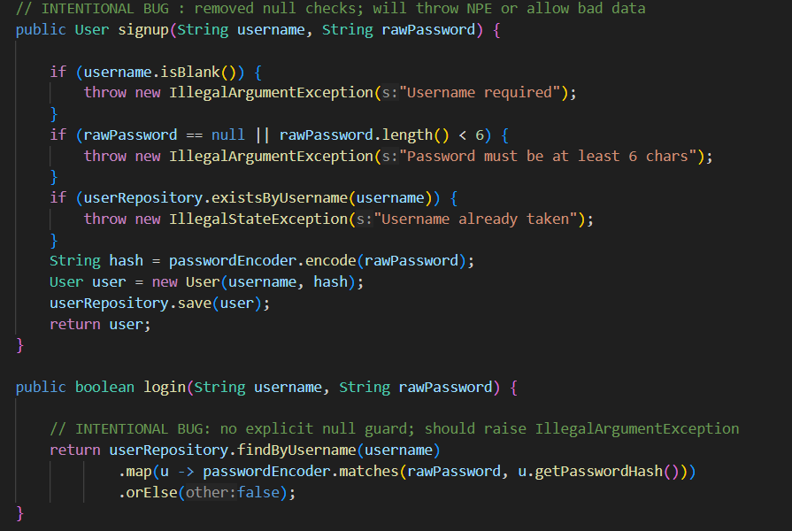

Slide 7
1. Test-Driven Development (TDD) & Behavior-Driven Development (BDD)
A) TDD
Made a simple backend using Sprinboot with only Login/Signup APIs.
Wrote above unit tests using Junit.
Made an intentional bug to get RED/ Failing test as above.
Ran test and test cases failed as below.

Slide 8
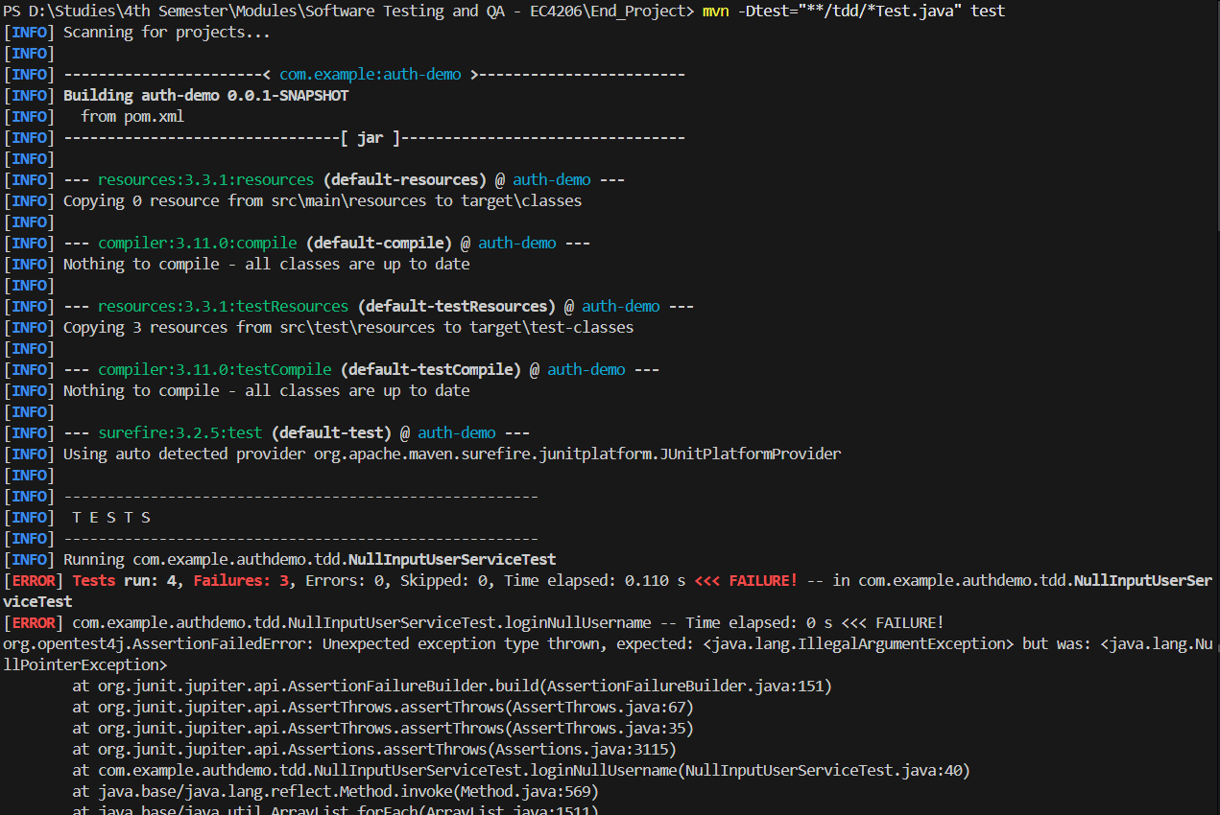

Slide 9
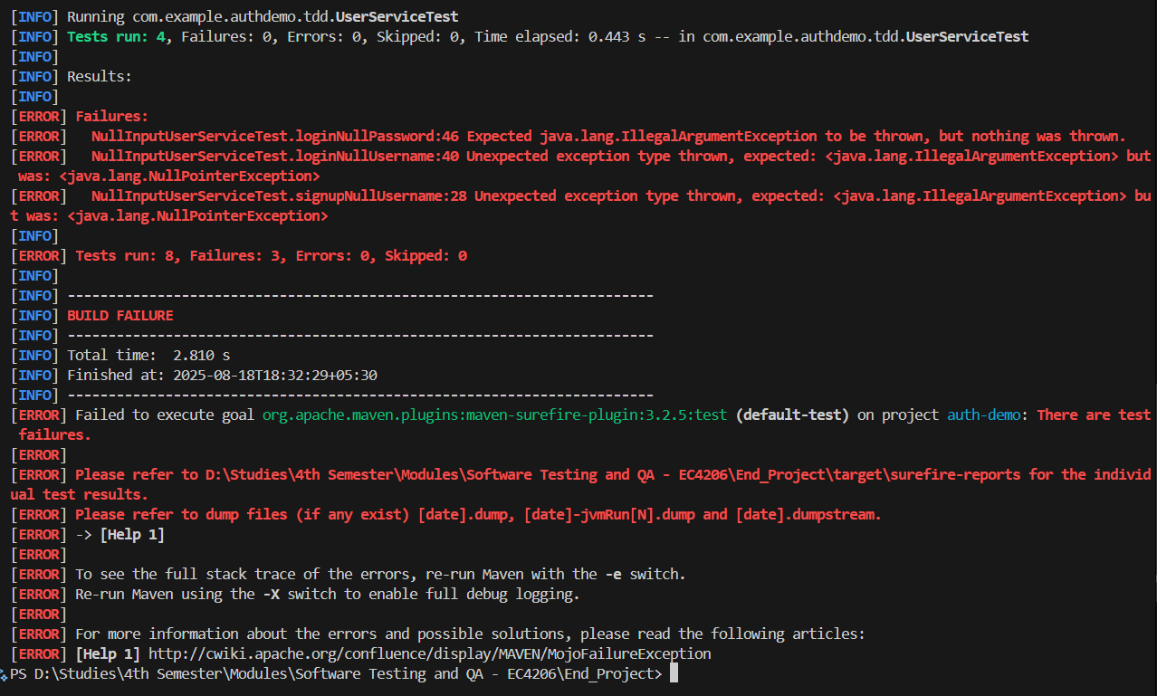

Slide 10
1. Test-Driven Development (TDD) & Behavior-Driven Development (BDD)
A) TDD
Made a simple backend using Sprinboot with only Login/Signup APIs.
Wrote above unit tests using Junit.
Made an intentional bug to get RED/ Failing test as above.
Ran test and test cases failed as above.
Commented erro-some code and added correct code (REFACTORED) as below.

Slide 11
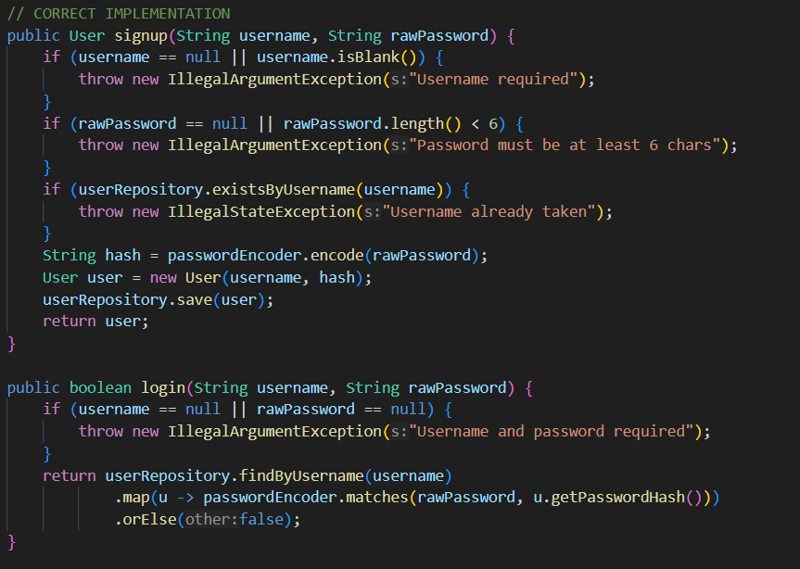

Slide 12
1. Test-Driven Development (TDD) & Behavior-Driven Development (BDD)
A) TDD
Made a simple backend using Sprinboot with only Login/Signup APIs.
Wrote above unit tests using Junit.
Made an intentional bug to get RED/ Failing test as above.
Ran test and test cases failed as above.
Commented erro-some code and added correct code (REFACTORED) as above.
Re-ran test and all test cases have passed like below (GREEN)

Slide 13
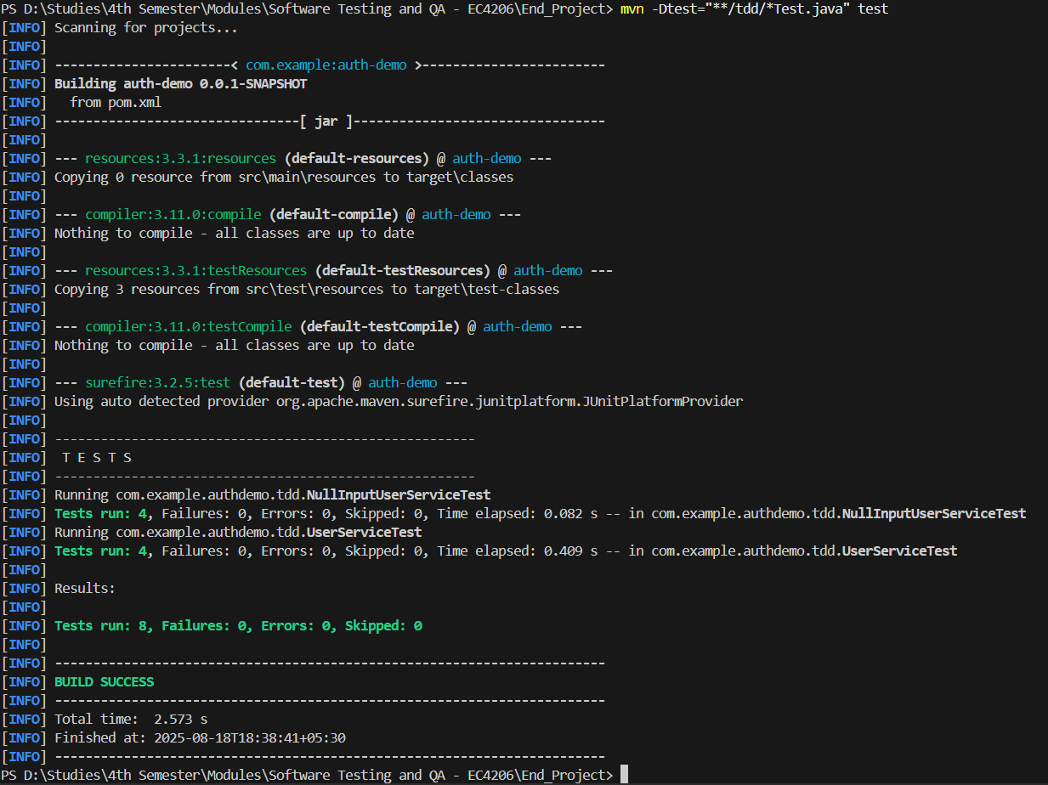

Slide 14
1. Test-Driven Development (TDD) & Behavior-Driven Development (BDD)
Part B) BDD – Behavior Driven Development
Made a simple backend using Sprinboot with only Login/Signup APIs.
User scenarios were written in Gherkin as below.

Slide 15
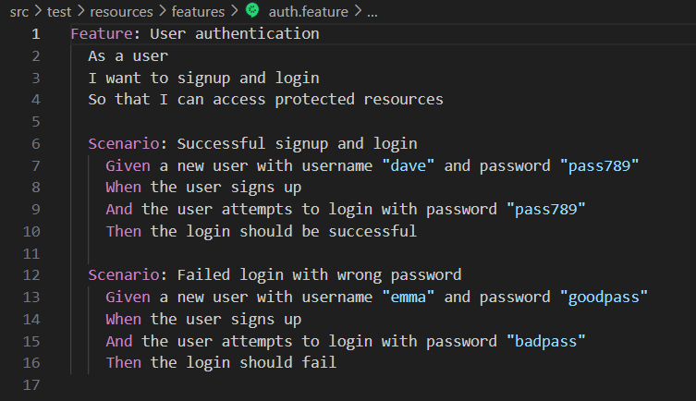

Slide 16
1. Test-Driven Development (TDD) & Behavior-Driven Development (BDD)
Part B) BDD – Behavior Driven Development
Made a simple backend using Sprinboot with only Login/Signup APIs.
User scenarios were written in Gherkin as above.
Following Cucumber tests were written.

Slide 17
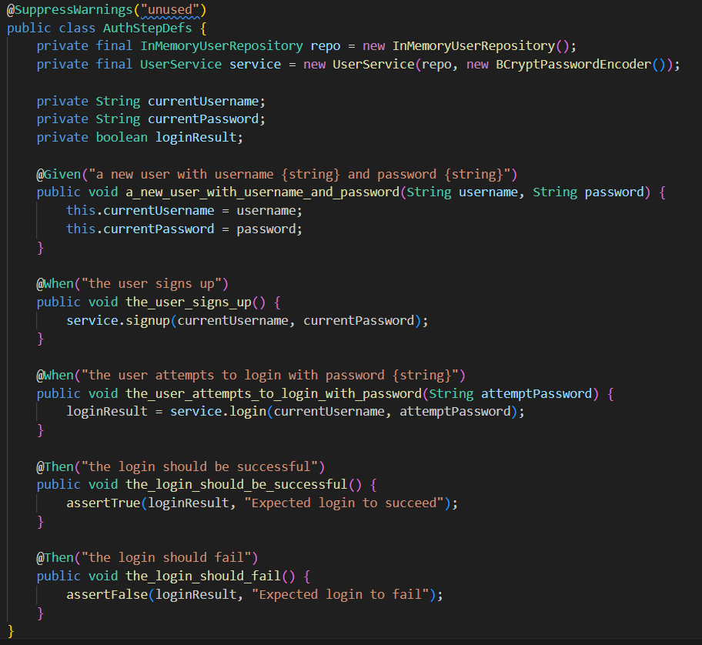

Slide 18
1. Test-Driven Development (TDD) & Behavior-Driven Development (BDD)
Part B) BDD – Behavior Driven Development
Made a simple backend using Sprinboot with only Login/Signup APIs.
User scenarios were written in Gherkin as above.
Above Cucumber tests were written.
Tests were passed giving following result.

Slide 19
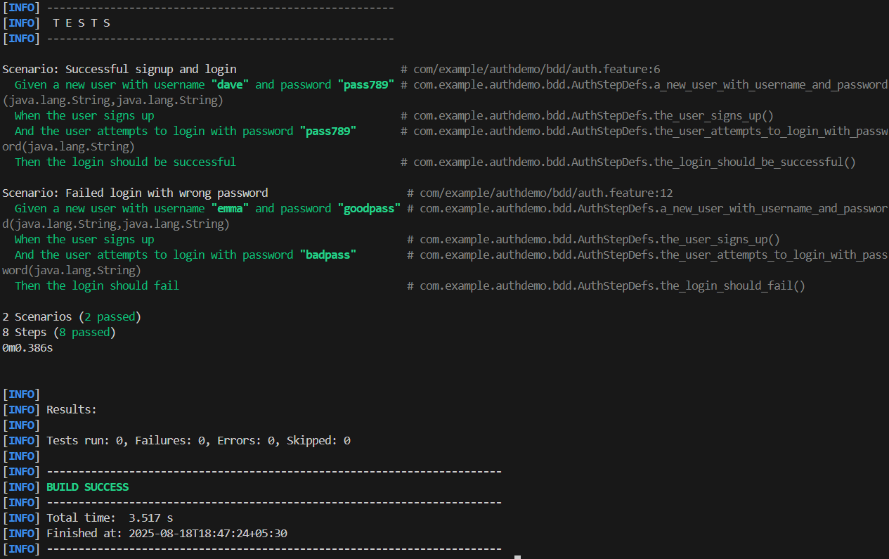

Slide 20
2. Test Automation & Continuous Integration
Part A) Selenium Automated Tests
Used MERN Web project made for EC4307 – Web Application Development module.
Wrote following selenium unit tests.

Slide 21
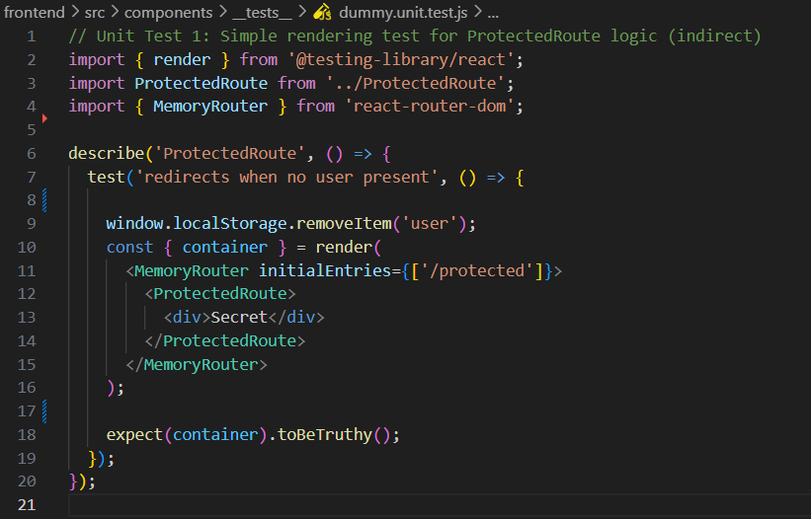

Slide 22
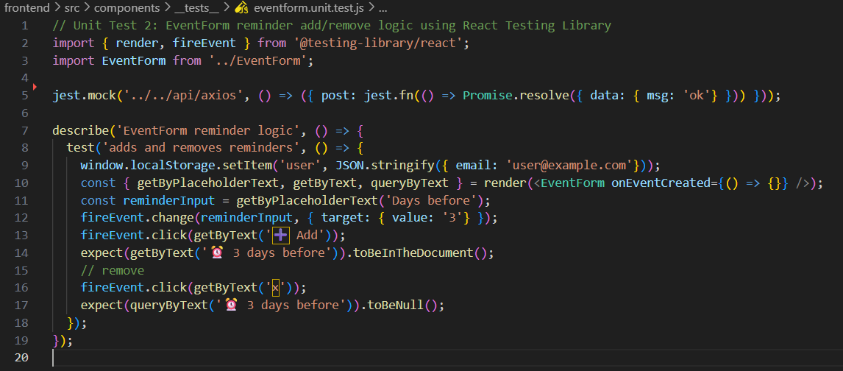

Slide 23
2. Test Automation & Continuous Integration
Part A) Selenium Automated Tests
Used MERN Web project made for EC4307 – Web Application Development module.
Wrote above selenium unit tests.
Started backend & frontend and Ran the test and got following result with fails.

Slide 24
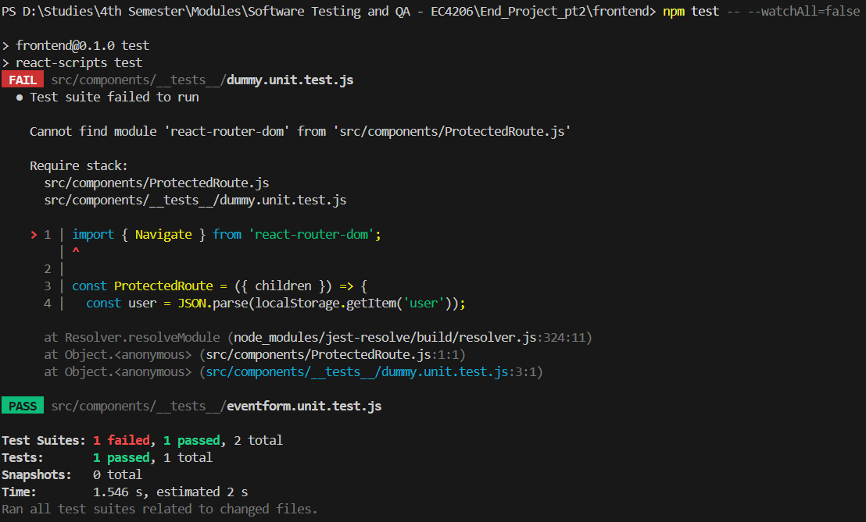

Slide 25
2. Test Automation & Continuous Integration
Part A) Selenium Automated Tests
Used MERN Web project made for EC4307 – Web Application Development module.
Wrote above selenium unit tests.
Started backend & frontend and Ran the test and got above result with fails.
Then did some refactoring and got following passing test results.

Slide 26
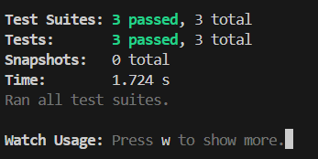

Slide 27
2. Test Automation & Continuous Integration
Part B) API Tests (using Postman)
Used MERN Web project made for EC4307 – Web Application Development module.
Wrote following API tests (and more) in Postman.

Slide 28

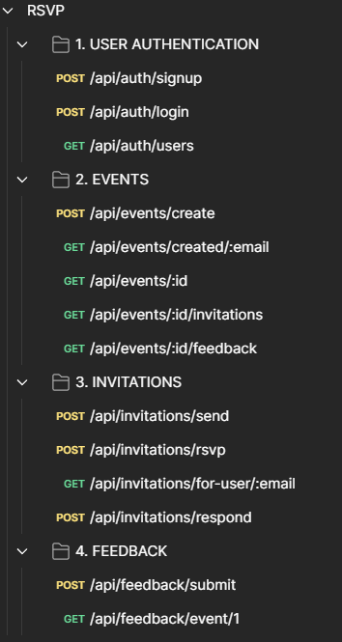
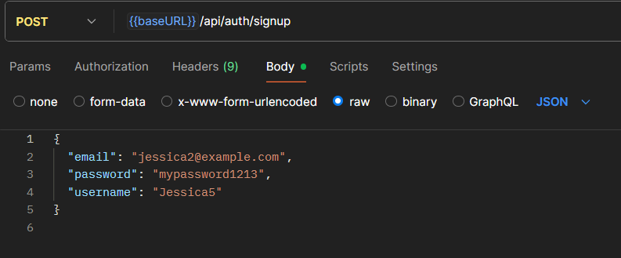

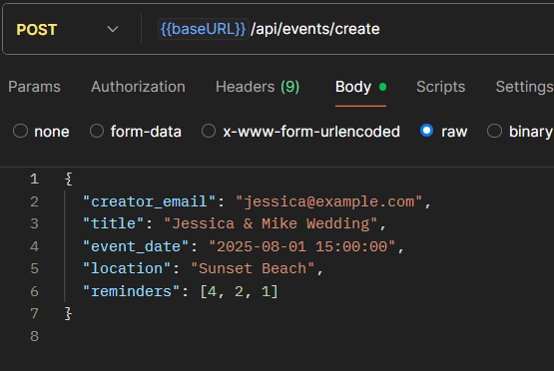
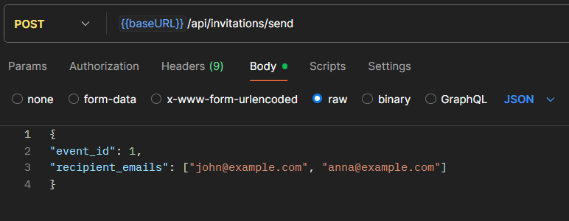

Slide 29
2. Test Automation & Continuous Integration
Part B) API Tests (using Postman)
Used MERN Web project made for EC4307 – Web Application Development module.
Wrote above API tests (and more) in Postman.
Ran the tests in 1 iteration and got following result

Slide 30
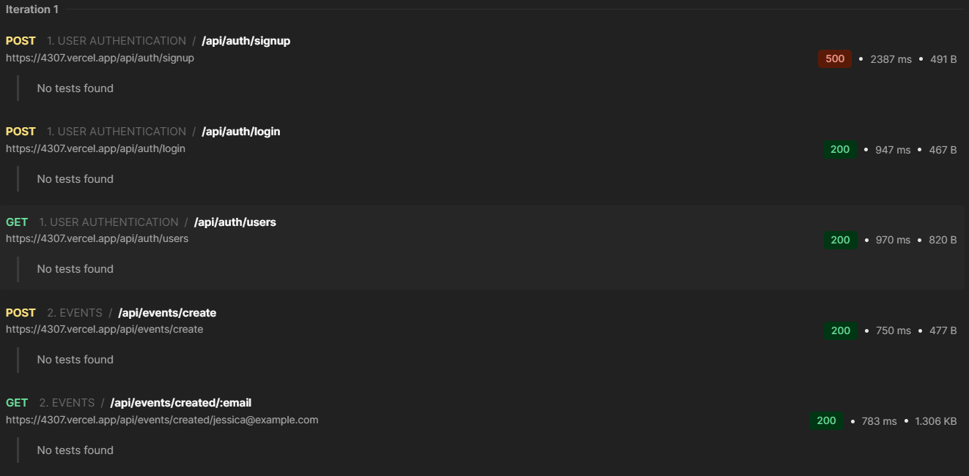

Slide 31
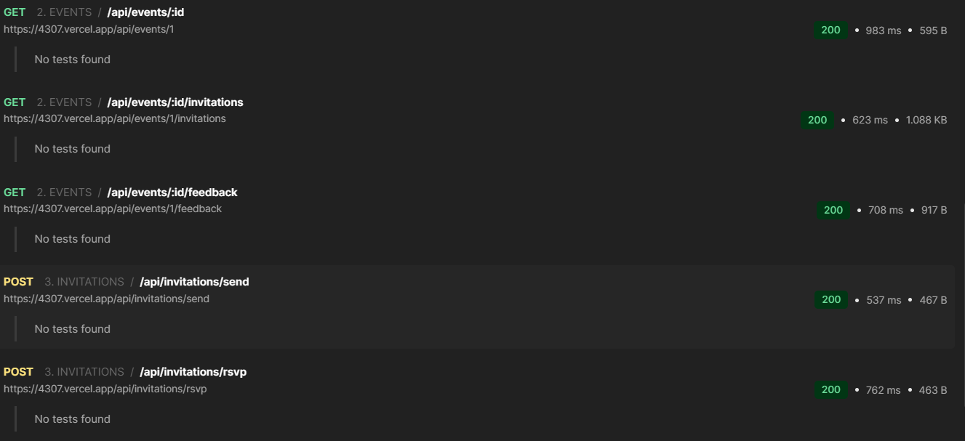

Slide 32
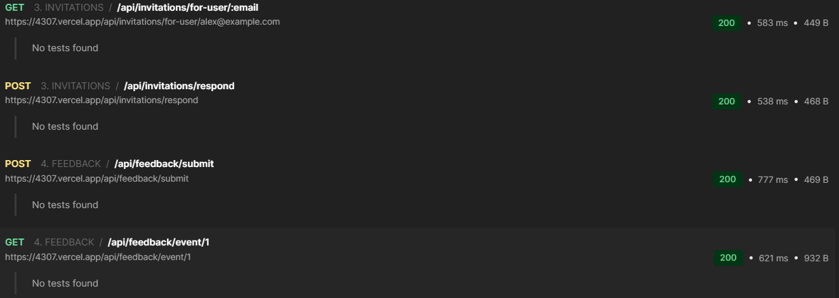

Slide 33
2. Test Automation & Continuous Integration
Part C) CI/CD Pipeline using Github Actions
Used MERN Web project made for EC4307 – Web Application Development module.
Wrote following Workflow for Github Actions as ci.yml

Slide 34
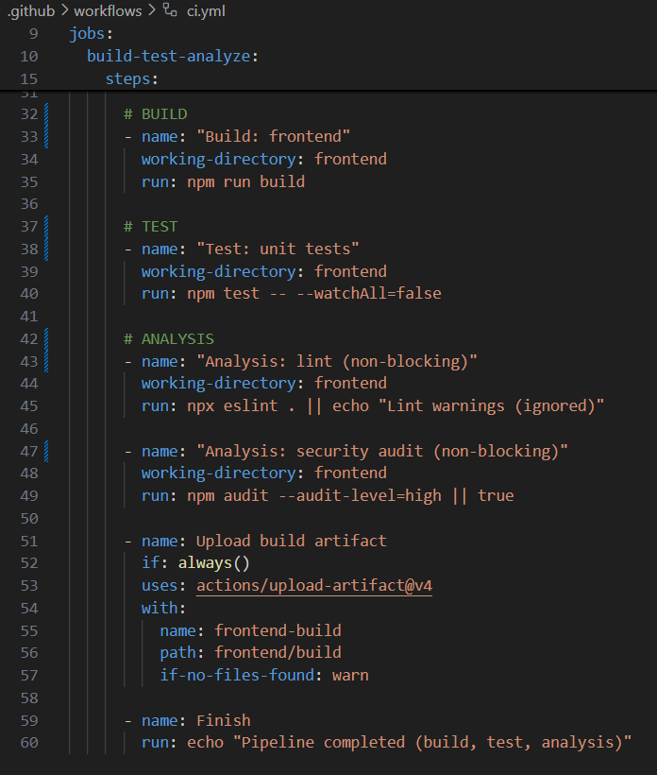
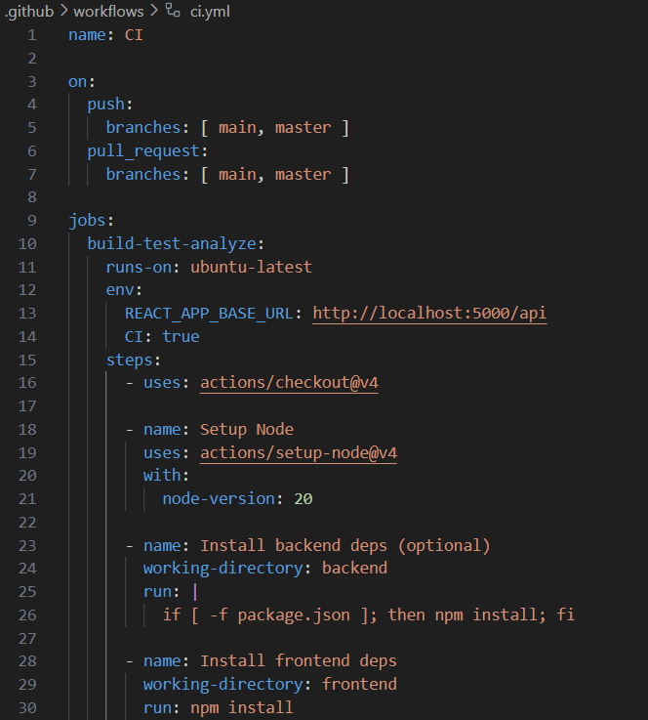

Slide 35
2. Test Automation & Continuous Integration
Part C) CI/CD Pipeline using Github Actions
Used MERN Web project made for EC4307 – Web Application Development module.
Wrote above Workflow for Github Actions as ci.yml
Got test result in Actions page as follows.

Slide 36
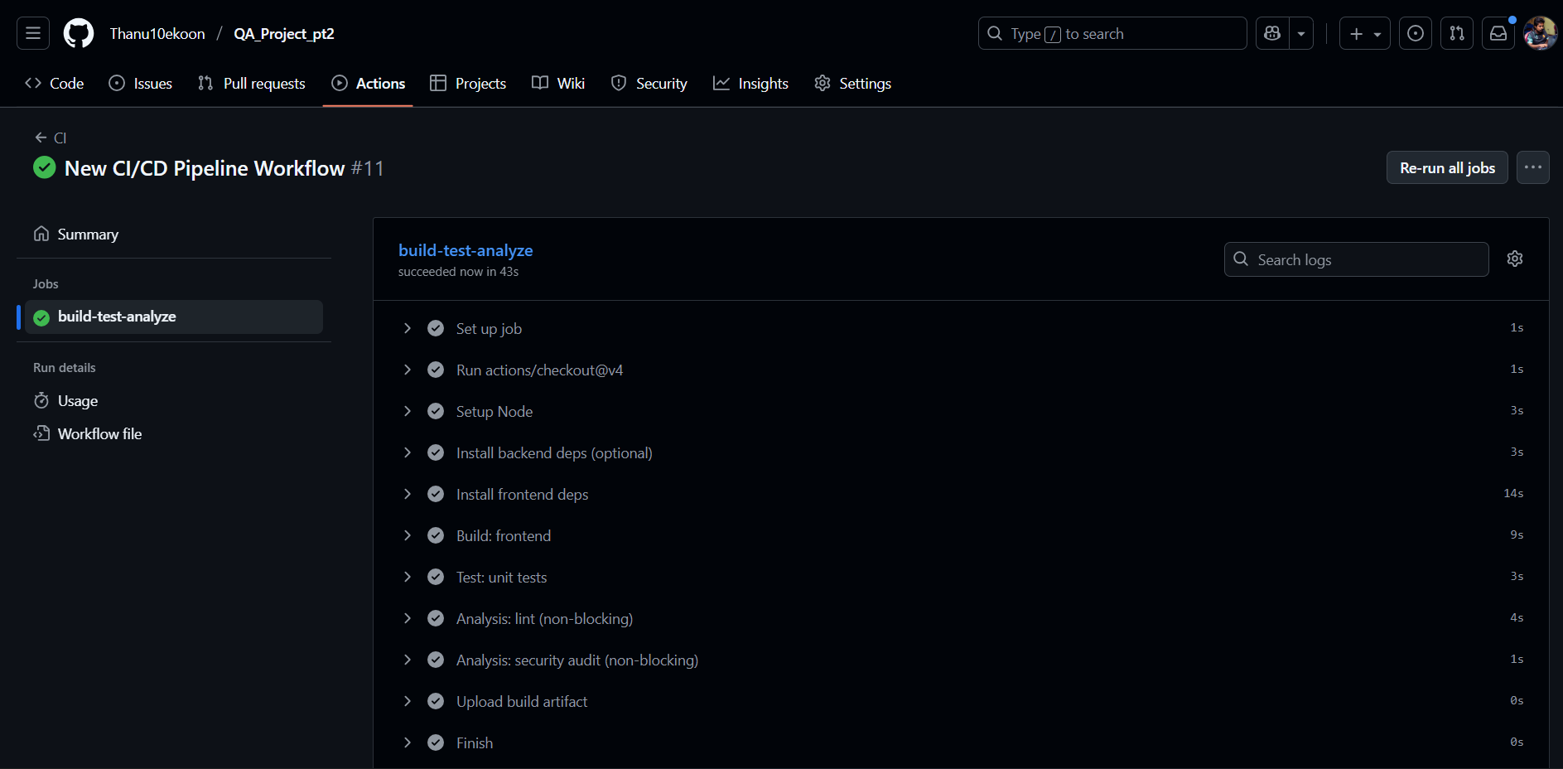

Slide 37
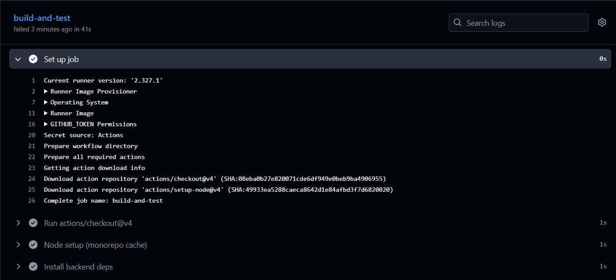

Slide 38
3. Performance, Security, and Usability Testing
Part A) Load Testing with JMeter
Used MERN Web project made for EC4307 – Web Application Development module.
Made test plan as below.

Slide 39
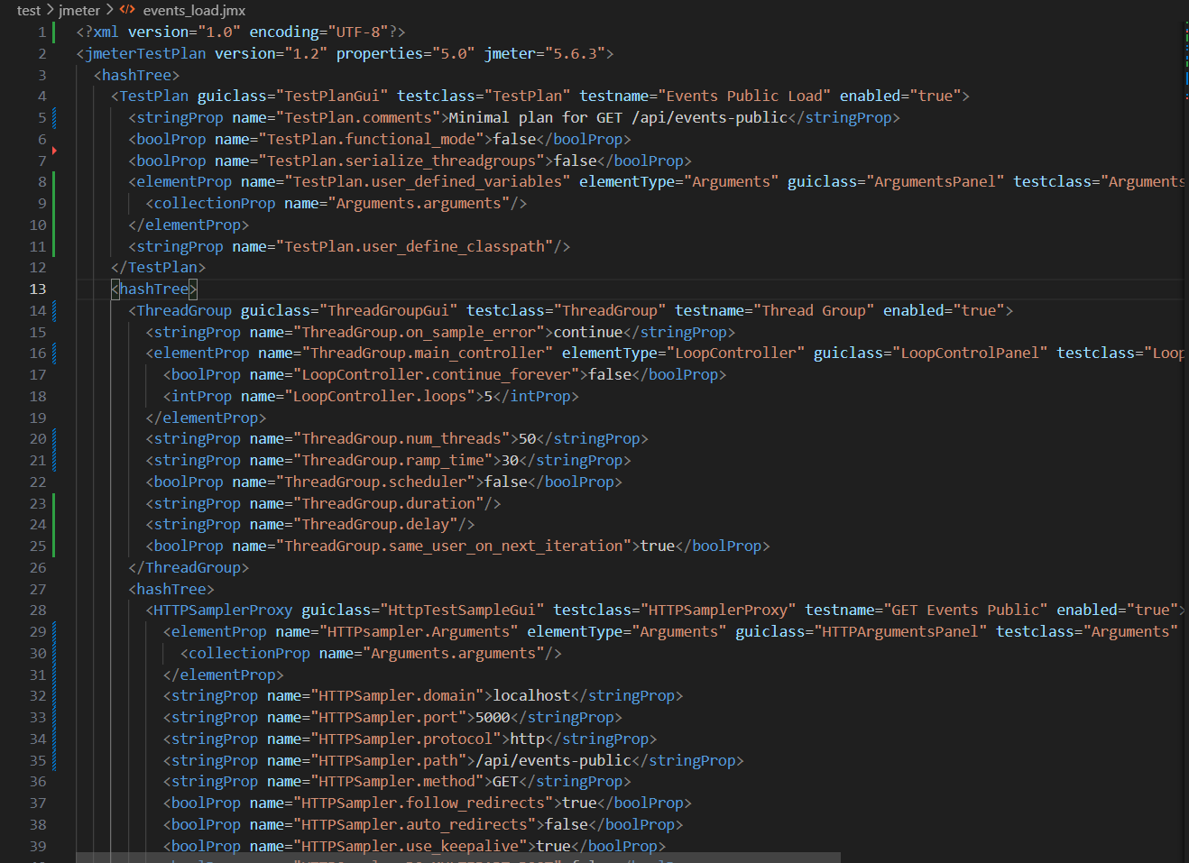

Slide 40
3. Performance, Security, and Usability Testing
Part A) Load Testing with JMeter
Used MERN Web project made for EC4307 – Web Application Development module.
Made test plan as above.
Wrote powershell script to run the jmeter test as below.

Slide 41
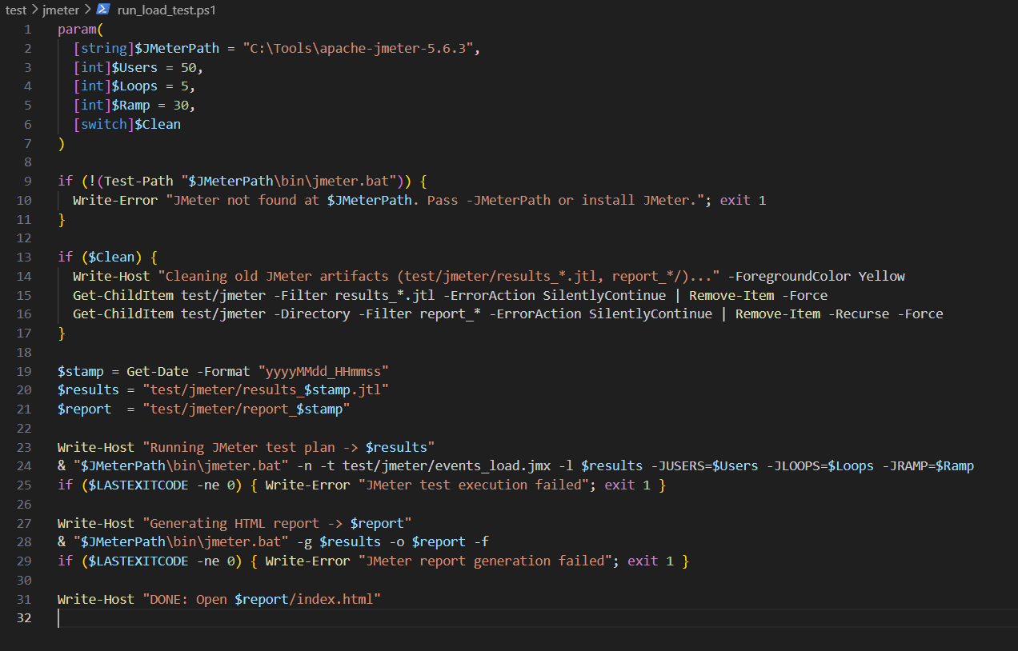

Slide 42
3. Performance, Security, and Usability Testing
Part A) Load Testing with JMeter
Used MERN Web project made for EC4307 – Web Application Development module.
Made test plan as above.
Wrote powershell script to run the jmeter test as below.
Ran the test and acquired following test report .html file

Slide 43
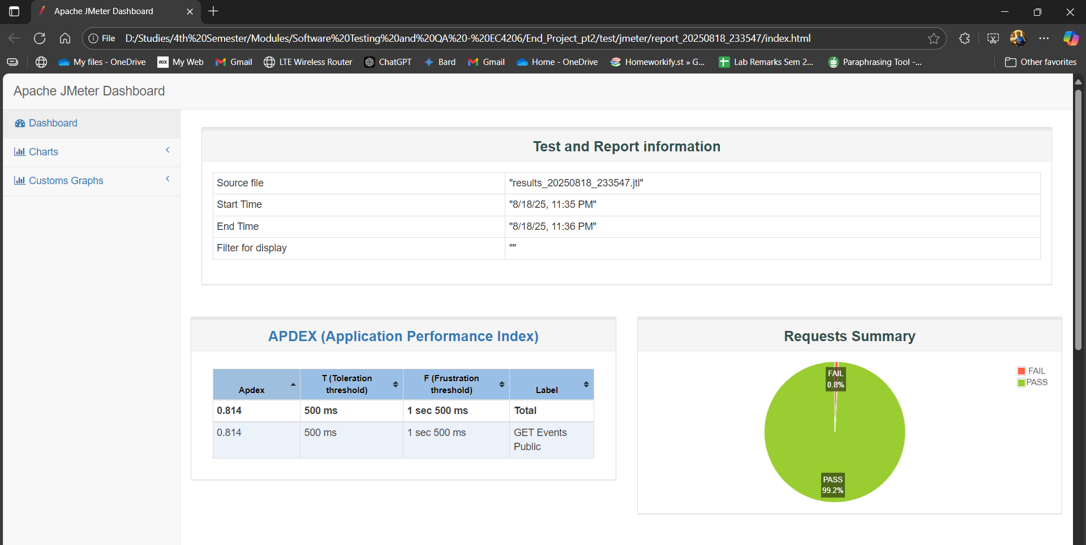
Dashboard

Slide 44
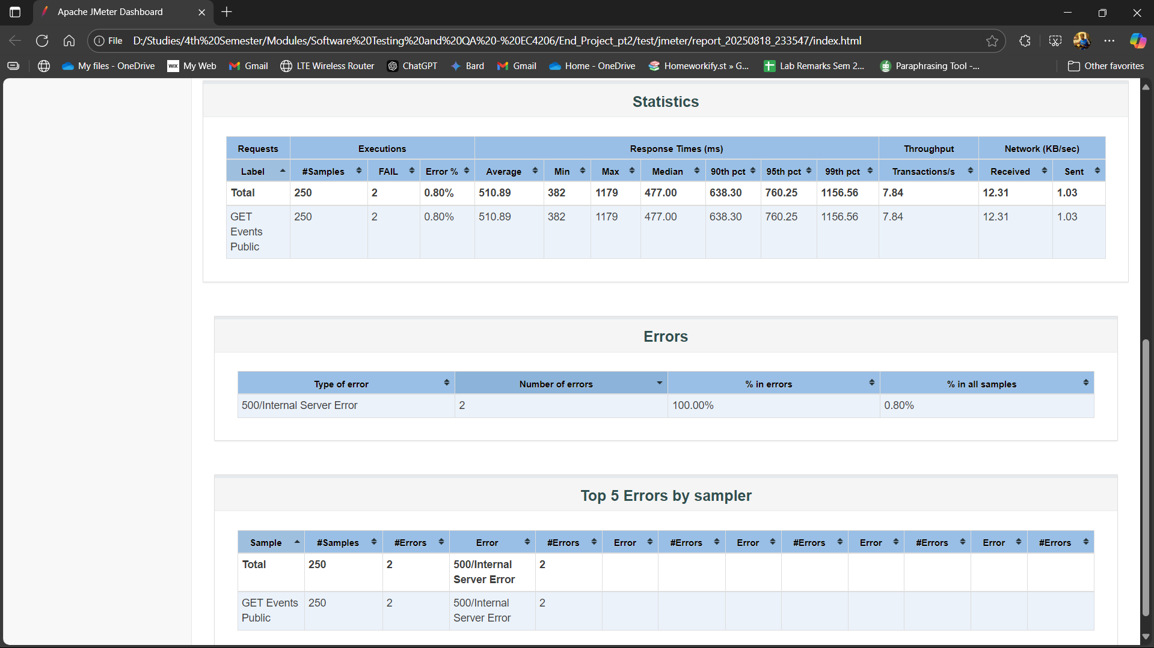
dashboard

Slide 45
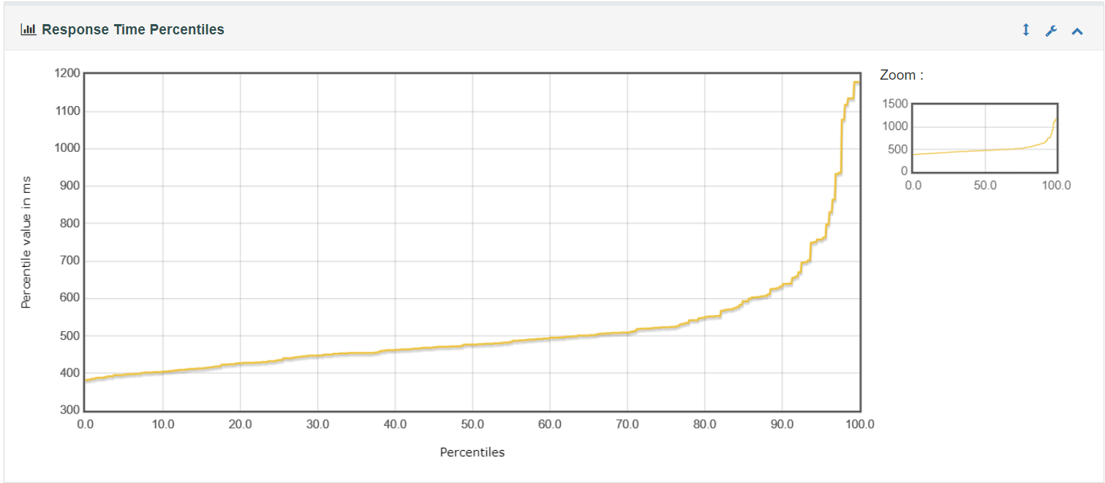
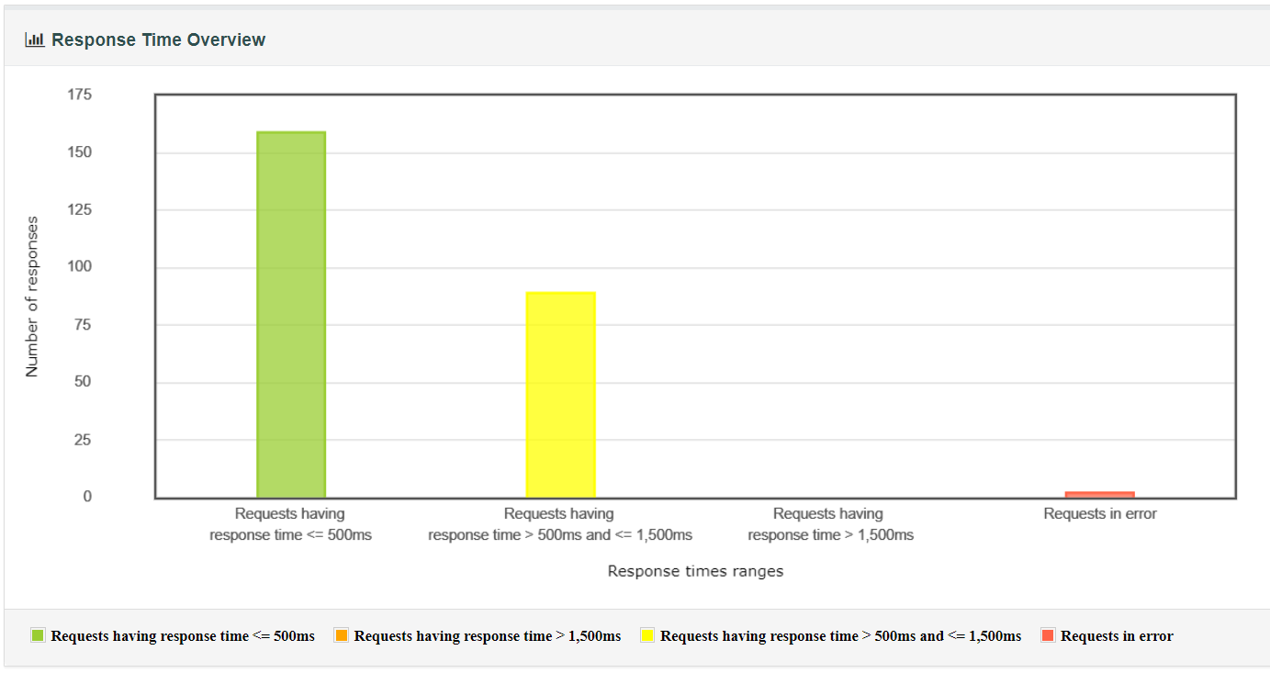
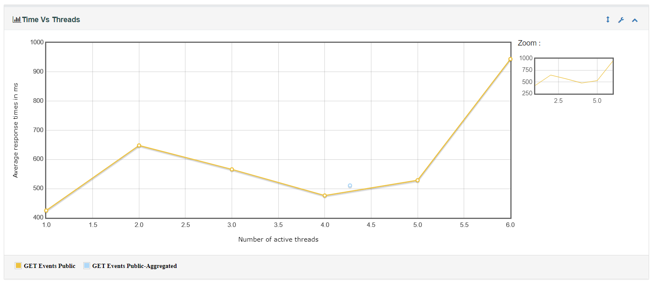
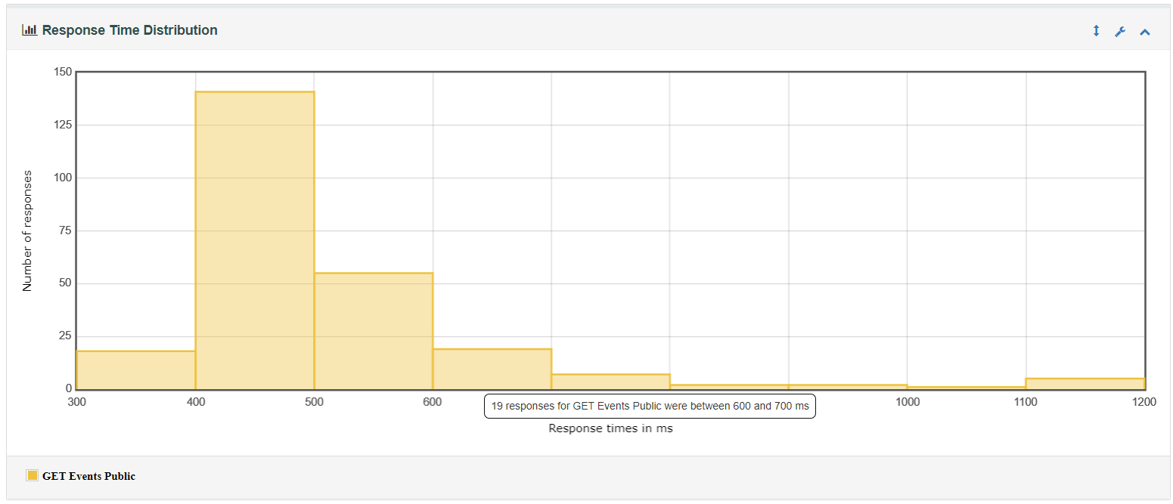
Response time

Slide 46
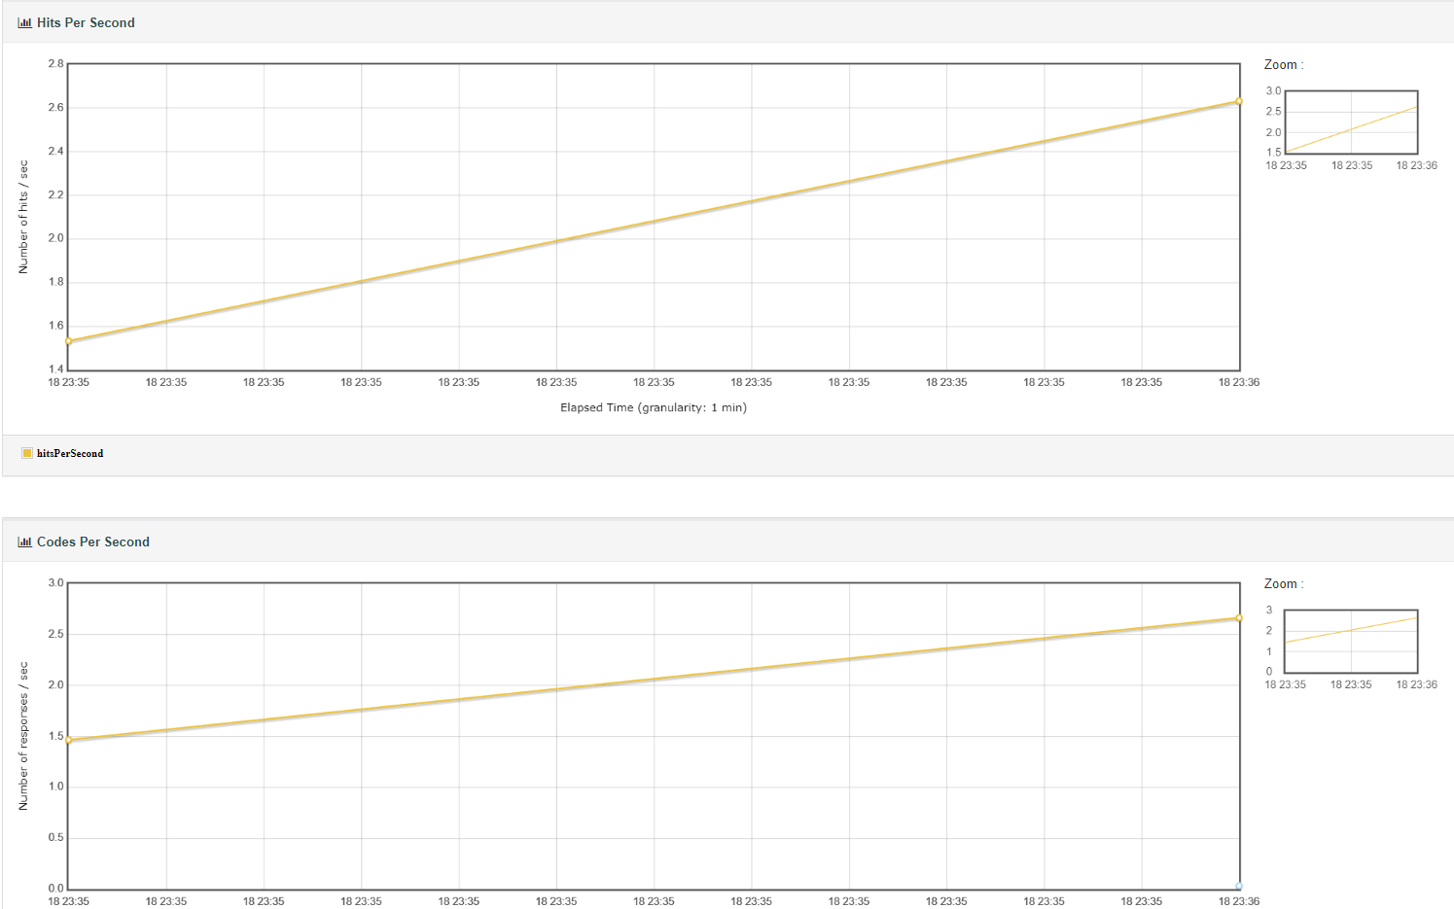
Throughput

Slide 47
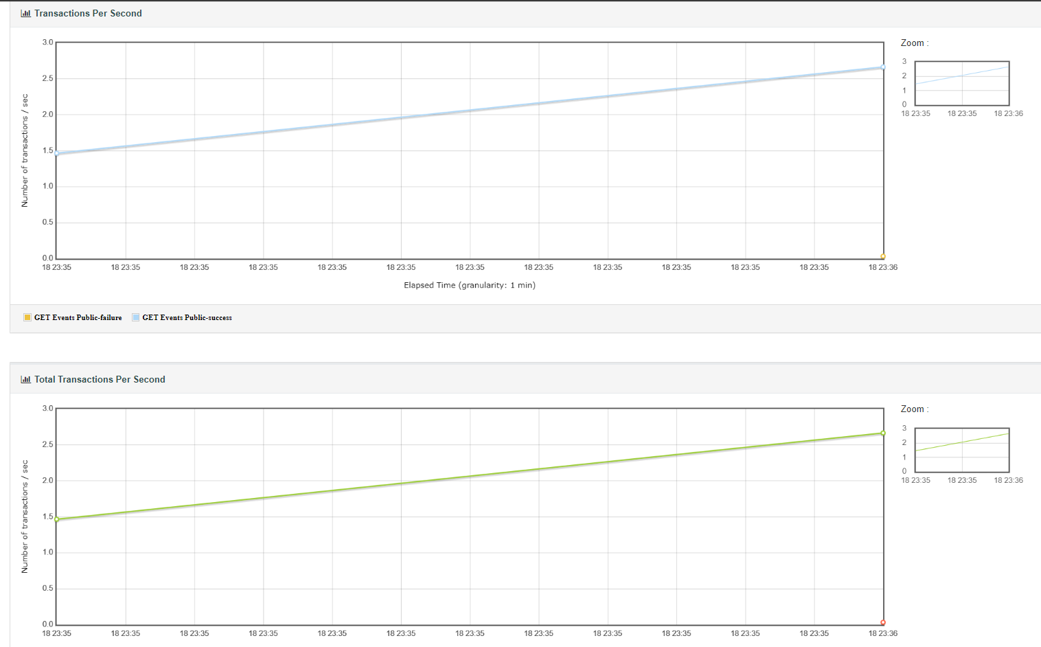
Throughput

Slide 48
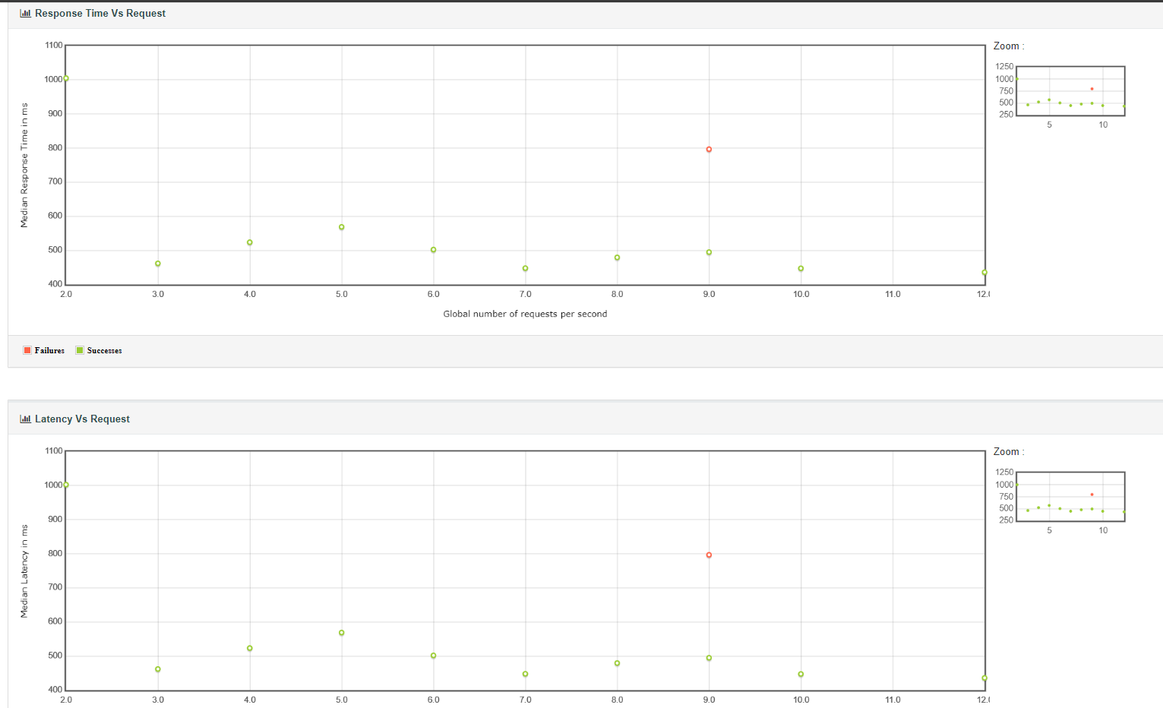
Throughput

Slide 49
3. Performance, Security, and Usability Testing
Part B) Security Testing (OWASP Top 10 basics)
Used MERN Web project made for EC4307 – Web Application Development module.
Kept an intentional query vulnerable to SQL Injection to test A03:2021 vulnerability.

Slide 50
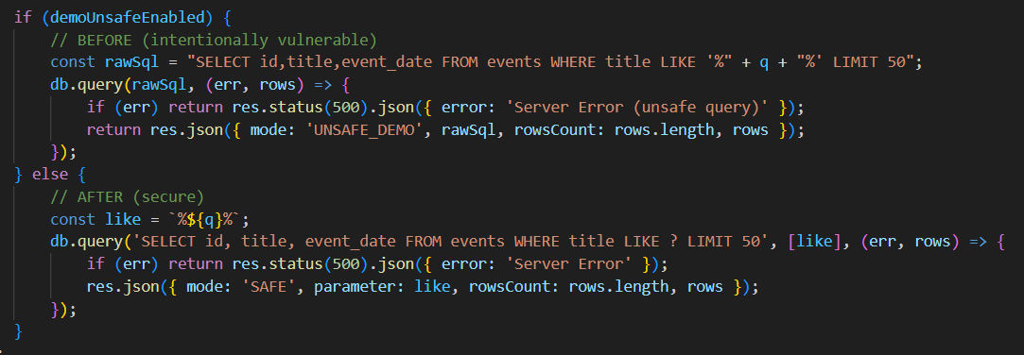
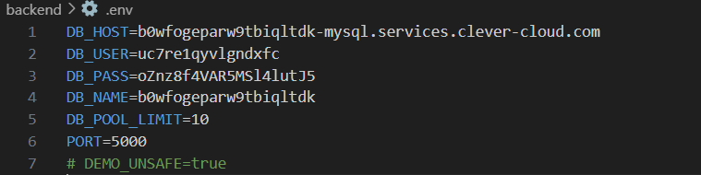




Slide 51
3. Performance, Security, and Usability Testing
Part B) Security Testing (OWASP Top 10 basics)
Used MERN Web project made for EC4307 – Web Application Development module.
Kept an intentional query vulnerable to SQL Injection to test A03:2021 vulnerability.
Unsafe (with intentional vulnerability) code got following result with all rows for SQL injection.
SQL Injection: http://localhost:5000/api/events/search?q=' OR 1=1 - -

Slide 52
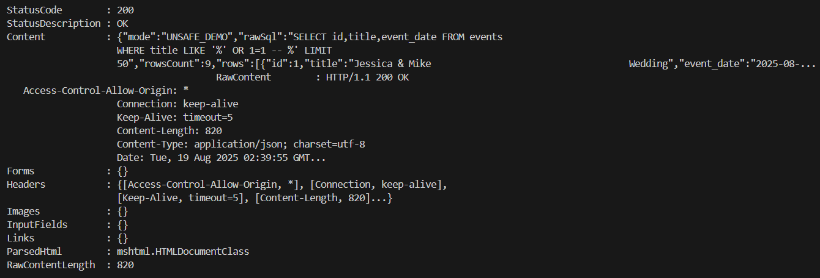

Slide 53
3. Performance, Security, and Usability Testing
Part B) Security Testing (OWASP Top 10 basics)
a) SQL Injection in OWASP
Used MERN Web project made for EC4307 – Web Application Development module.
Kept an intentional query vulnerable to SQL Injection to test A03:2021 vulnerability.
Unsafe (with intentional vulnerability) code got above result with all headers for SQL injection.
SQL Injection: http://localhost:5000/api/events/search?q=' OR 1=1 - -
Safe code got below result with minimum rows (harmless data headers) for same SQL Injection.

Slide 54
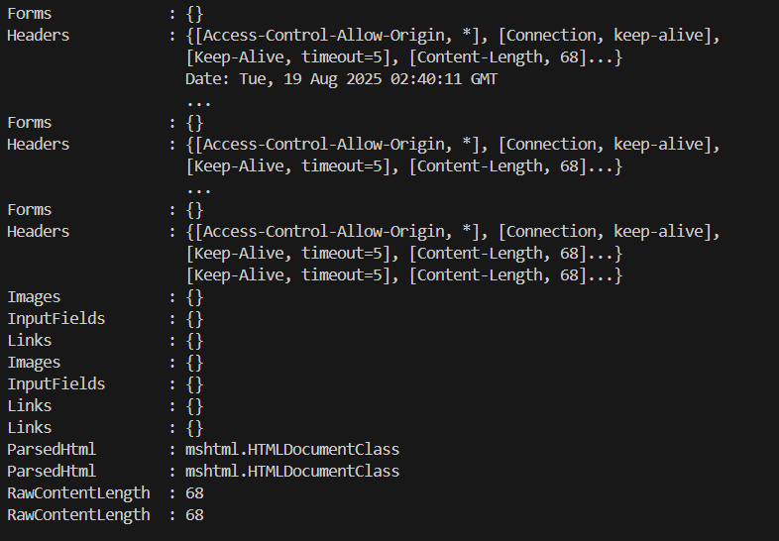

Slide 55
3. Performance, Security, and Usability Testing
Part B) Security Testing (OWASP Top 10 basics)
b) Broken Access Control (IDOR) in OWASP
Used MERN Web project made for EC4307 – Web Application Development module.
Made the following code with and without intentional IDOR vulnarability

Slide 56
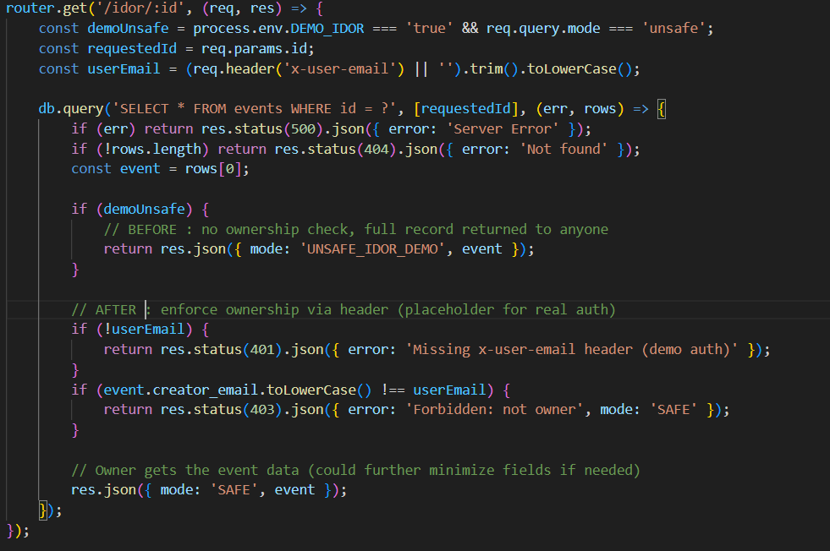

Slide 57
3. Performance, Security, and Usability Testing
Part B) Security Testing (OWASP Top 10 basics)
b) Broken Access Control (IDOR) in OWASP
Used MERN Web project made for EC4307 – Web Application Development module.
Made the above code with and without intentional IDOR vulnerability.
Got the following results contrast.

Slide 58
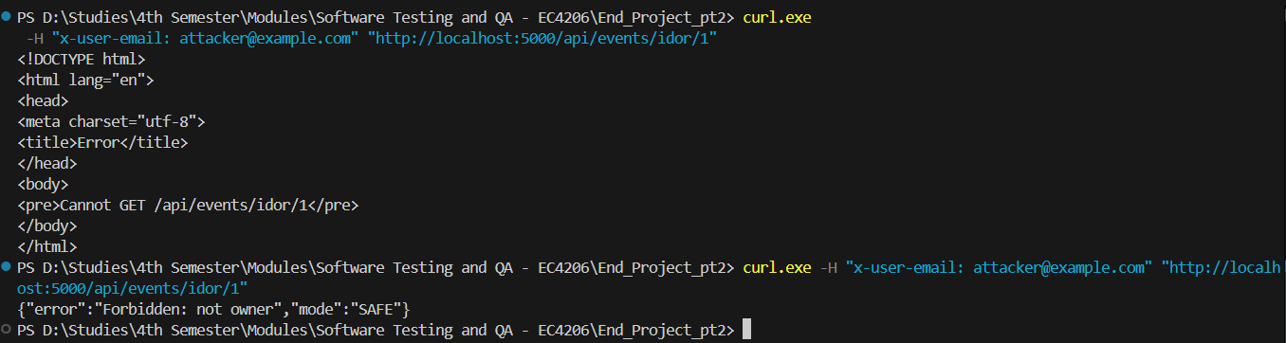
Before Refactor (Vulnerable)
After Refactor (Invulnerable)

Slide 59
4. Defect Tracking and Bug Management
Used Jira
Tracked the same SQL Injection Bug and IDOR for this

Slide 60
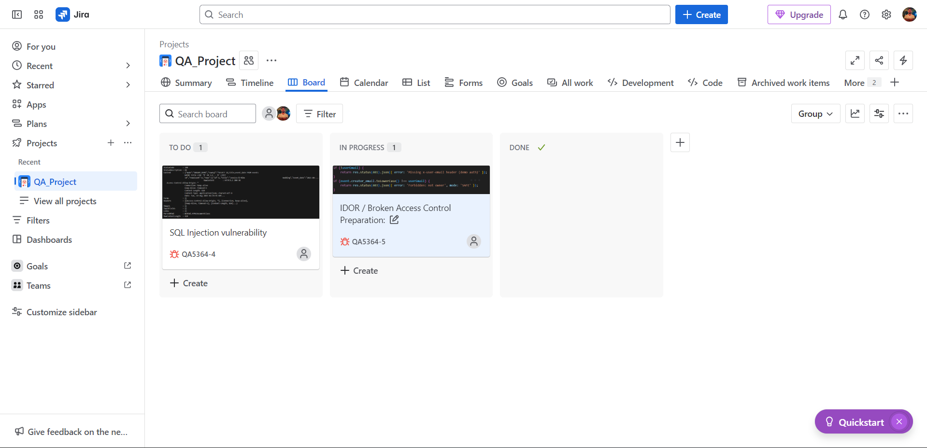
JIRA Project Dashboard

Slide 61
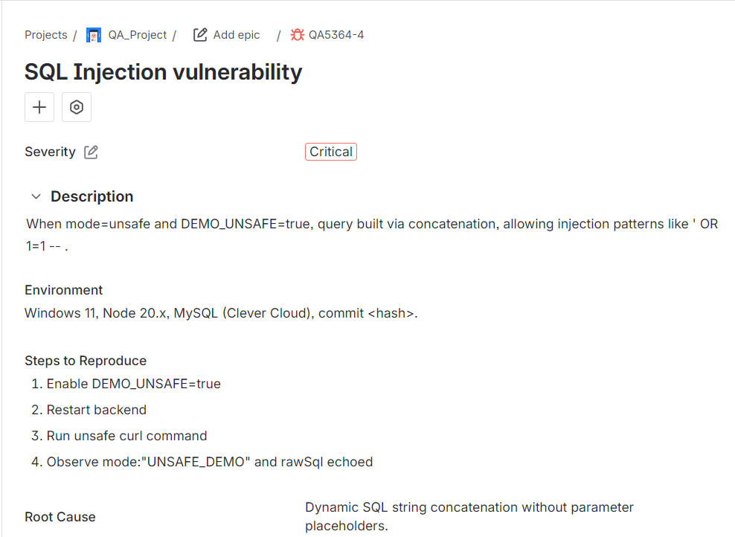
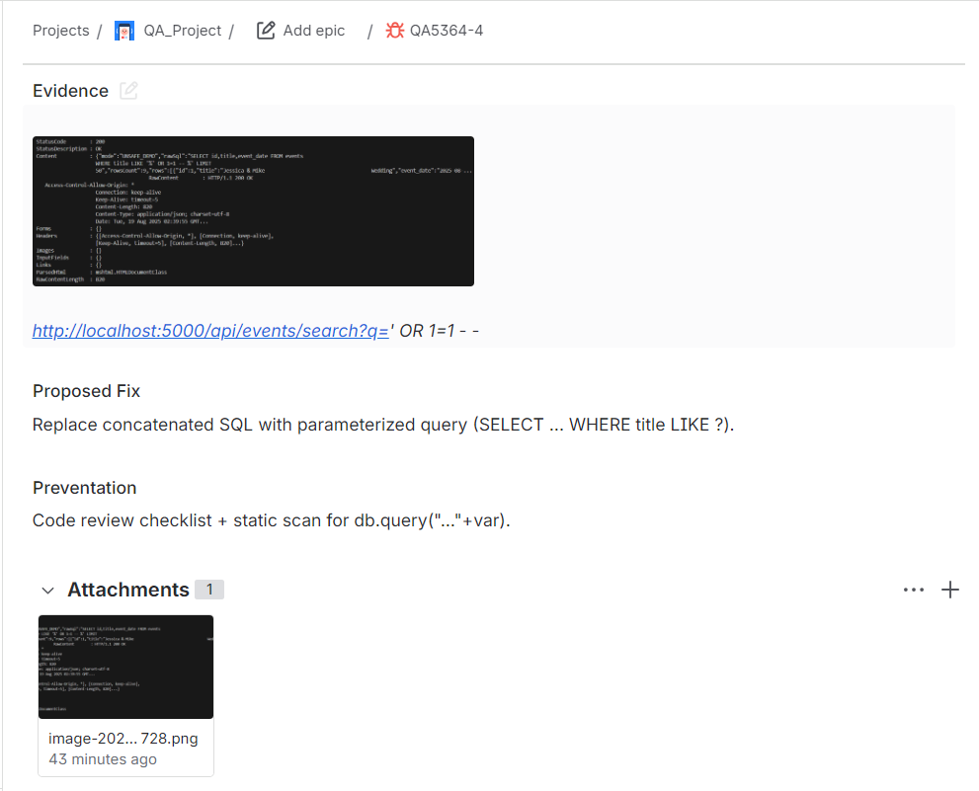
a) SQL Injection bug

Slide 62
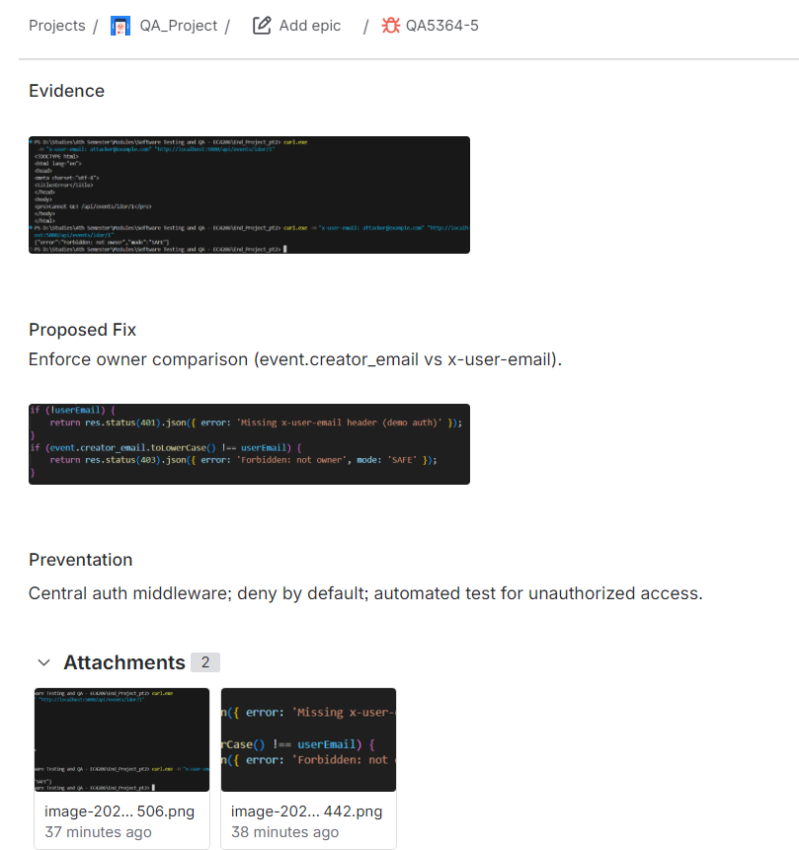
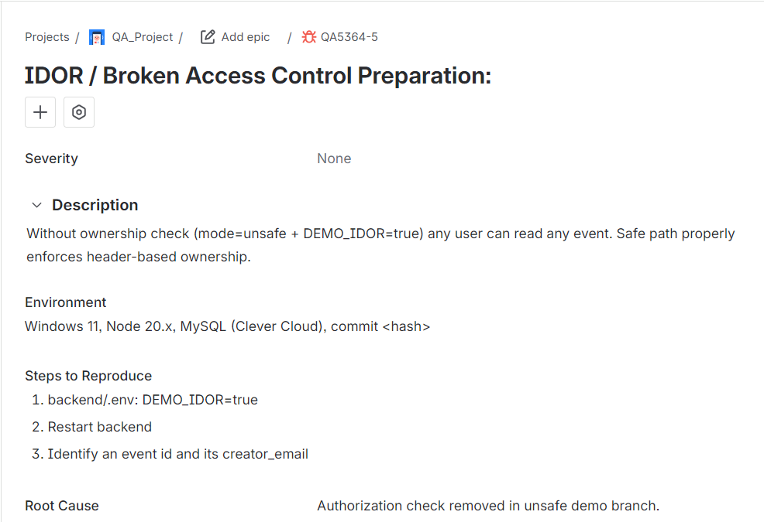
B) IDOR bug

Slide 63
5. Software Quality Metrics and Standards
A) Defects Density
Chosen event.js module (same module with SQL Injection and IDOR)
Effective LOC: 120 Defects: 2 Defect Density: 16.67 defects/KLOC

Slide 64
5. Software Quality Metrics and Standards
B) Mean Time To Failure (MTTF)
Timeline
10:10–10:30 (20 min) Running initial tests → Failure F1 occurs at 20 min
10:30–10:45 Fix period (NOT counted)
10:45–11:00 (15 min more) JMeter first run attempt → Failure F2 at cumulative 35 min operational time After F2 fix:
11:00–11:40 (40 min) Stable operation (no further failures) – optional evidence of reliability trend

Slide 65
5. Software Quality Metrics and Standards
B) Mean Time To Failure (MTTF)
Primary MTTF Calculation
Up to second failure: Total operational time to last failure = 35 minutes
Failures observed = 2
MTTF = 35 / 2 = 17.5 minutes

