Slide 1
EC4206 Software Testing & Quality Assurance
Practical Assignment: Software Testing and Quality for MERN, Spring Boot, or .NET Applications

Slide 2
1. Test-Driven Development (TDD) & Behavior-Driven Development (BDD)
Part A) TDD – Test Driven Development
Made a simple backend using Sprinboot with only Login/Signup APIs.
Wrote following unit tests using Junit.

Slide 3
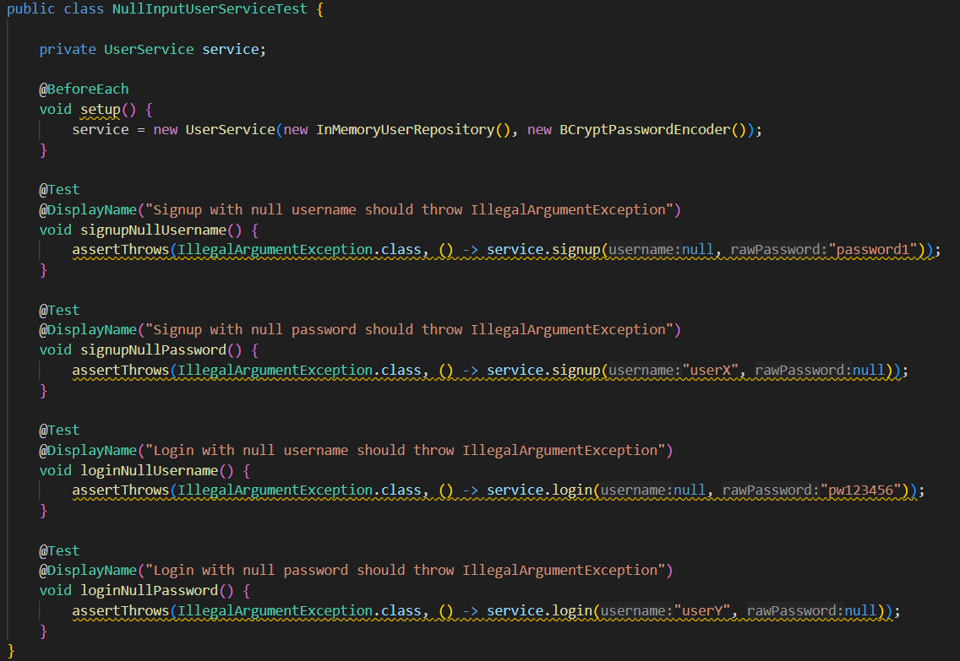

Slide 4
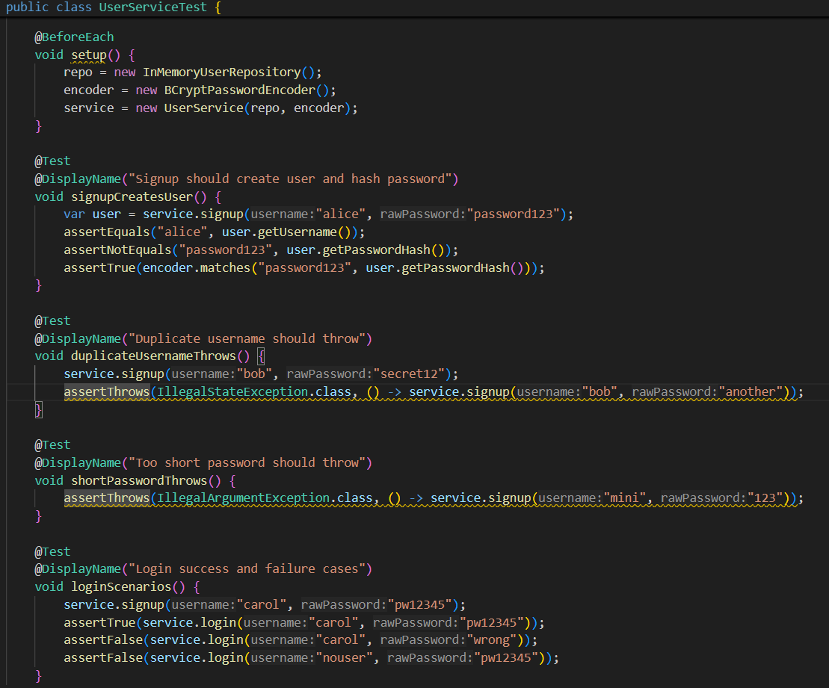

Slide 5
1. Test-Driven Development (TDD) & Behavior-Driven Development (BDD)
A) TDD
Made a simple backend using Sprinboot with only Login/Signup APIs.
Wrote above unit tests using Junit.
Made an intentional bug to get RED/ Failing test as below

Slide 6
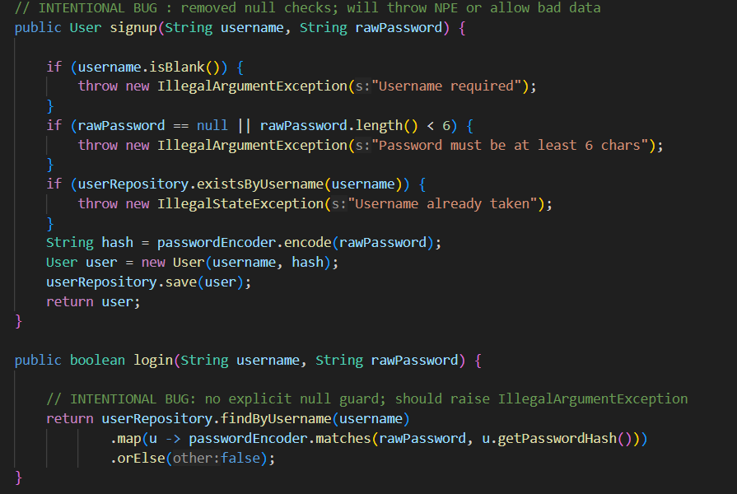

Slide 7
1. Test-Driven Development (TDD) & Behavior-Driven Development (BDD)
A) TDD
Made a simple backend using Sprinboot with only Login/Signup APIs.
Wrote above unit tests using Junit.
Made an intentional bug to get RED/ Failing test as above.
Ran test and test cases failed as below.

Slide 8
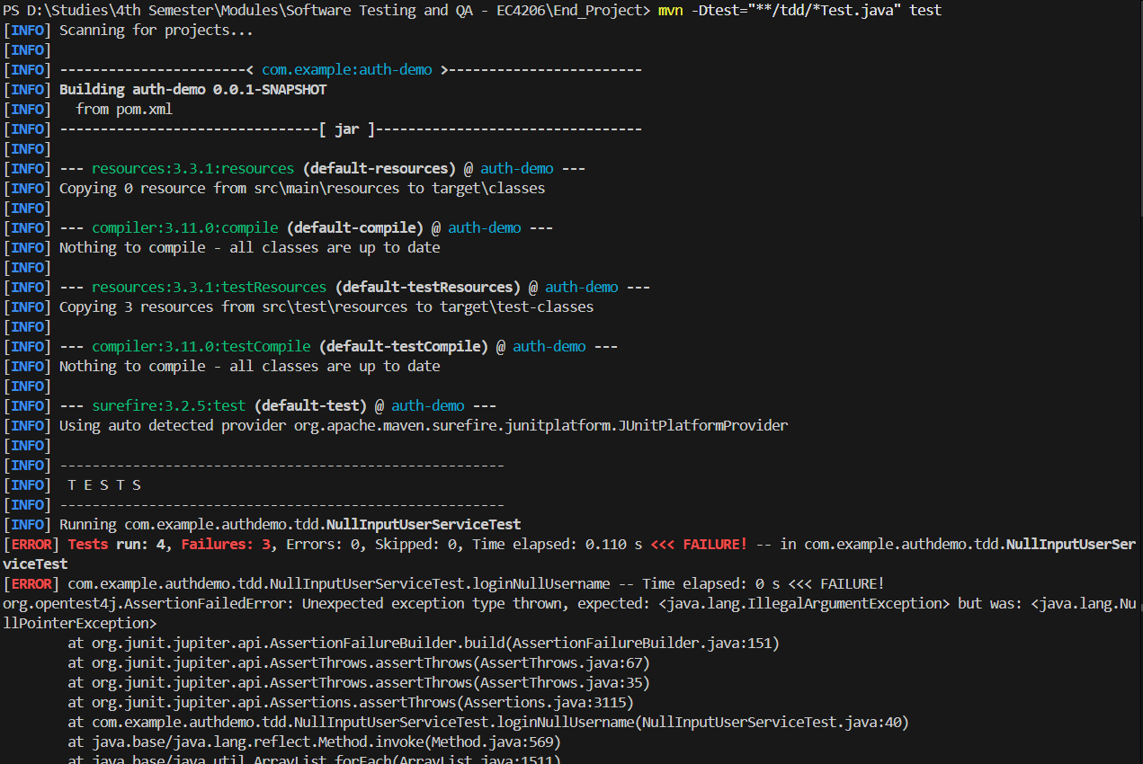

Slide 9
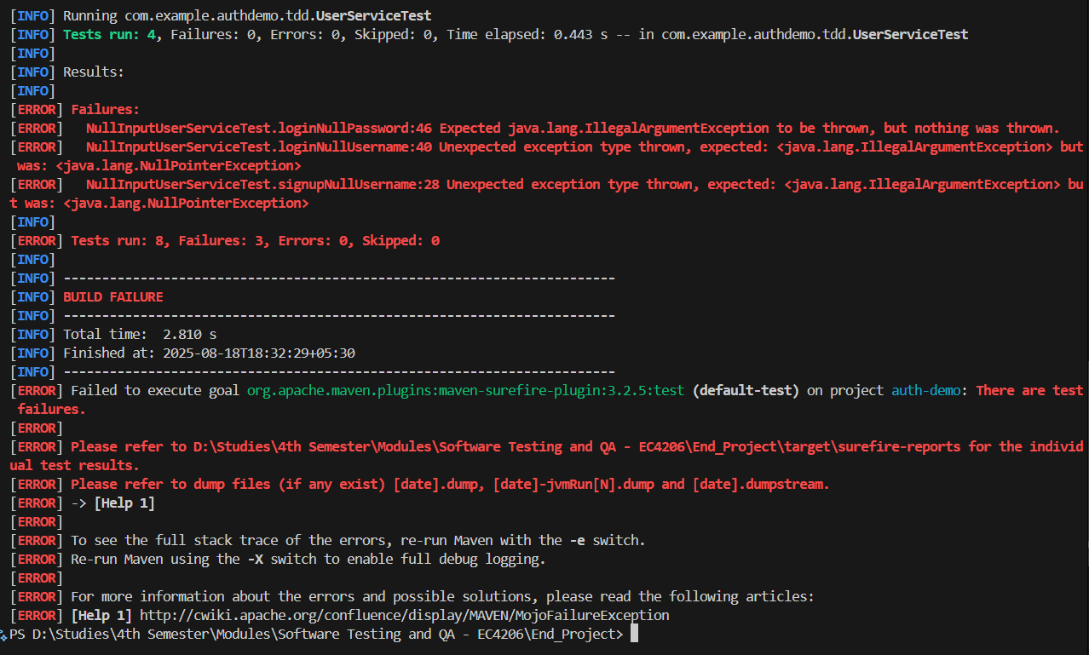

Slide 10
1. Test-Driven Development (TDD) & Behavior-Driven Development (BDD)
A) TDD
Made a simple backend using Sprinboot with only Login/Signup APIs.
Wrote above unit tests using Junit.
Made an intentional bug to get RED/ Failing test as above.
Ran test and test cases failed as above.
Commented erro-some code and added correct code (REFACTORED) as below.

Slide 11
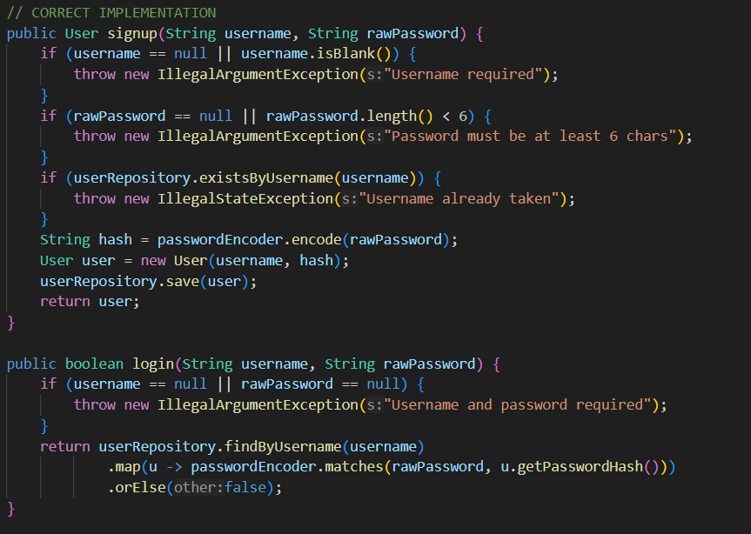

Slide 12
1. Test-Driven Development (TDD) & Behavior-Driven Development (BDD)
A) TDD
Made a simple backend using Sprinboot with only Login/Signup APIs.
Wrote above unit tests using Junit.
Made an intentional bug to get RED/ Failing test as above.
Ran test and test cases failed as above.
Commented erro-some code and added correct code (REFACTORED) as above.
Re-ran test and all test cases have passed like below (GREEN)

Slide 13
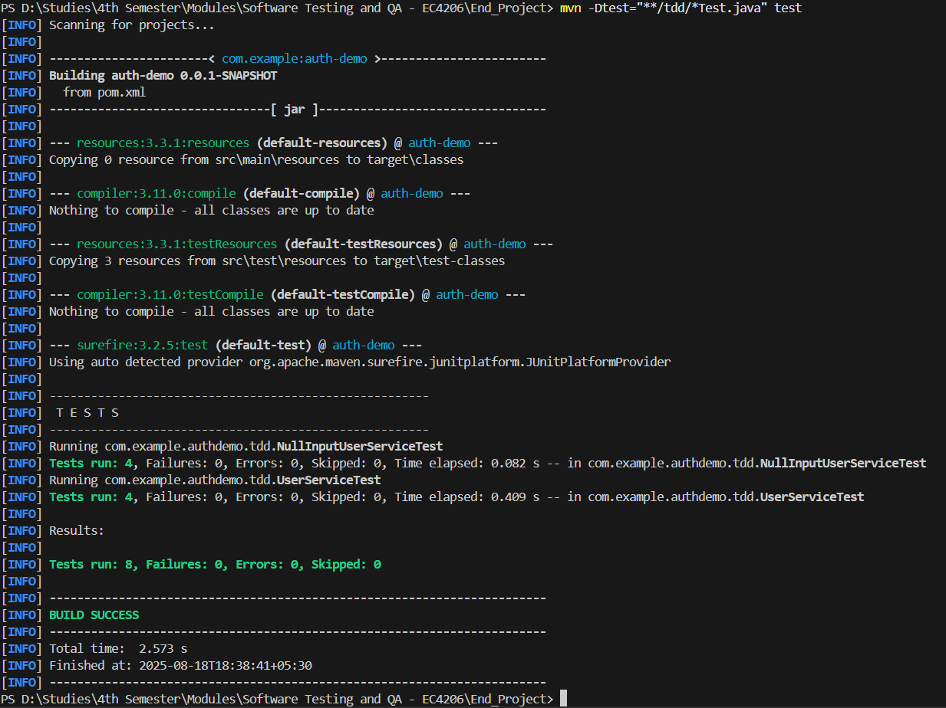

Slide 14
1. Test-Driven Development (TDD) & Behavior-Driven Development (BDD)
Part B) BDD – Behavior Driven Development
Made a simple backend using Sprinboot with only Login/Signup APIs.
User scenarios were written in Gherkin as below.

Slide 15
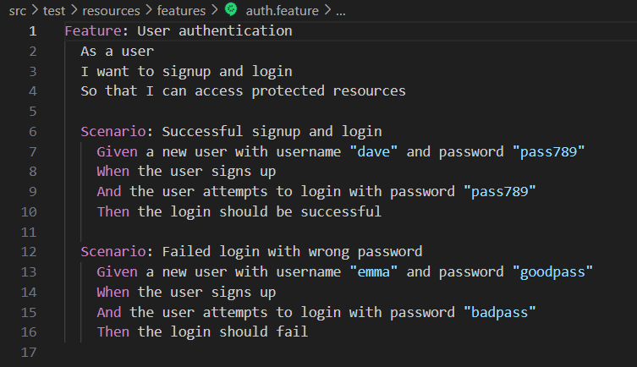

Slide 16
1. Test-Driven Development (TDD) & Behavior-Driven Development (BDD)
Part B) BDD – Behavior Driven Development
Made a simple backend using Sprinboot with only Login/Signup APIs.
User scenarios were written in Gherkin as above.
Following Cucumber tests were written.

Slide 17
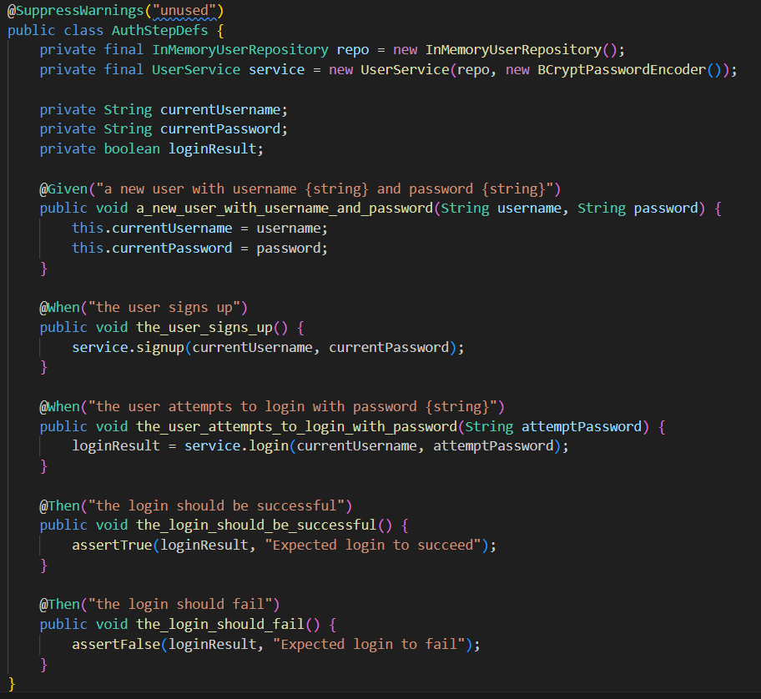

Slide 18
1. Test-Driven Development (TDD) & Behavior-Driven Development (BDD)
Part B) BDD – Behavior Driven Development
Made a simple backend using Sprinboot with only Login/Signup APIs.
User scenarios were written in Gherkin as above.
Above Cucumber tests were written.
Tests were passed giving following result.

Slide 19
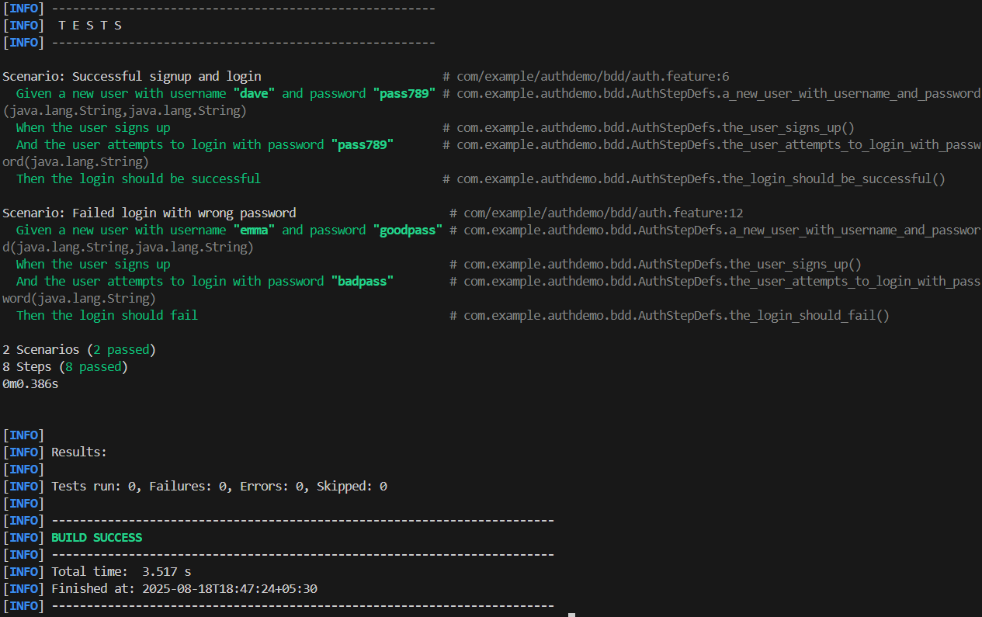

Slide 20
2. Test Automation & Continuous Integration
Part A) Selenium Automated Tests
Used MERN Web project made for EC4307 – Web Application Development module.
Wrote following selenium unit tests.

Slide 21
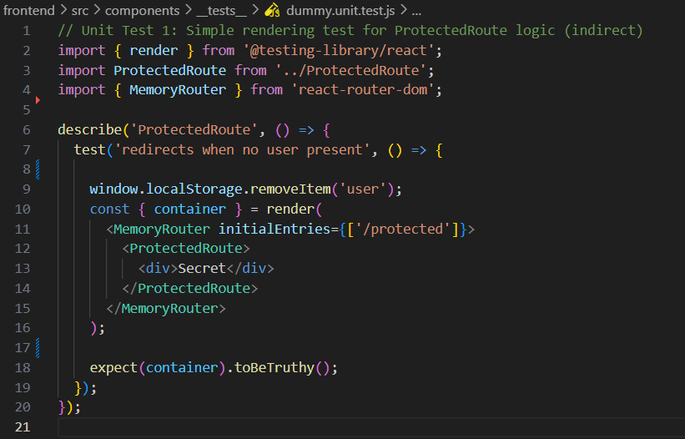

Slide 22
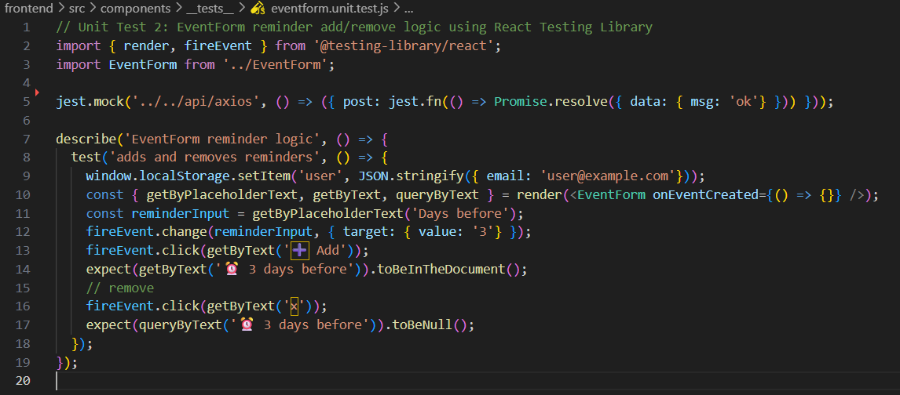

Slide 23
2. Test Automation & Continuous Integration
Part A) Selenium Automated Tests
Used MERN Web project made for EC4307 – Web Application Development module.
Wrote above selenium unit tests.
Started backend & frontend and Ran the test and got following result with fails.

Slide 24
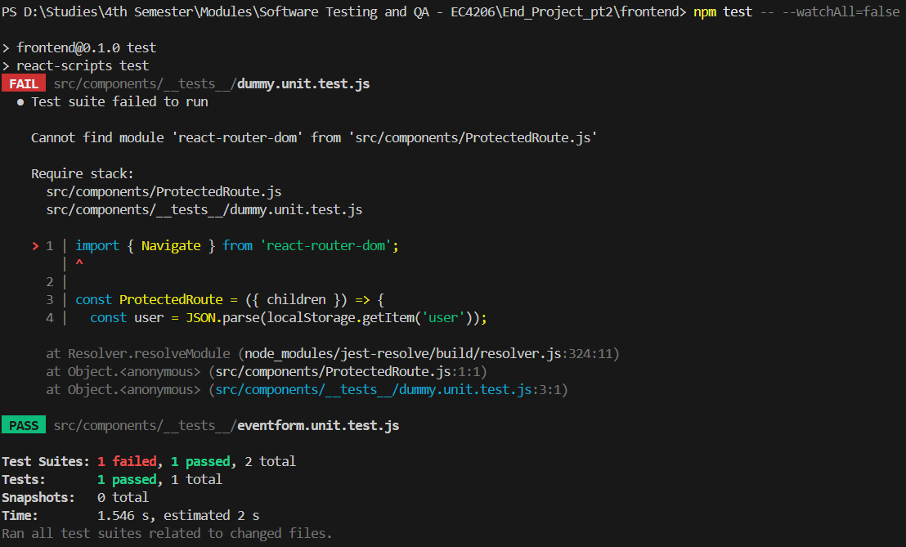

Slide 25
2. Test Automation & Continuous Integration
Part A) Selenium Automated Tests
Used MERN Web project made for EC4307 – Web Application Development module.
Wrote above selenium unit tests.
Started backend & frontend and Ran the test and got above result with fails.
Then did some refactoring and got following passing test results.

Slide 26
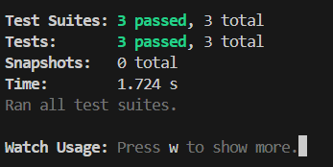

Slide 27
2. Test Automation & Continuous Integration
Part B) API Tests (using Postman)
Used MERN Web project made for EC4307 – Web Application Development module.
Wrote following API tests (and more) in Postman.

Slide 28

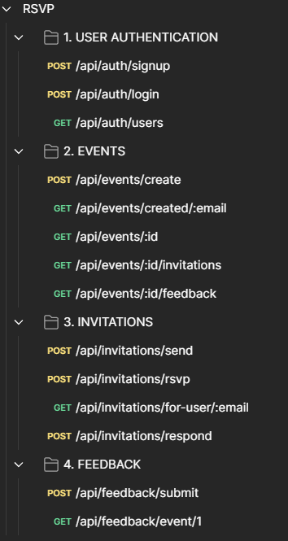
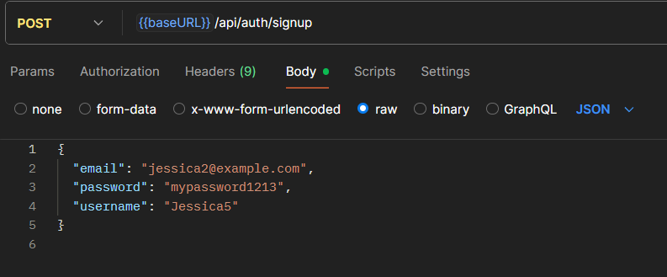

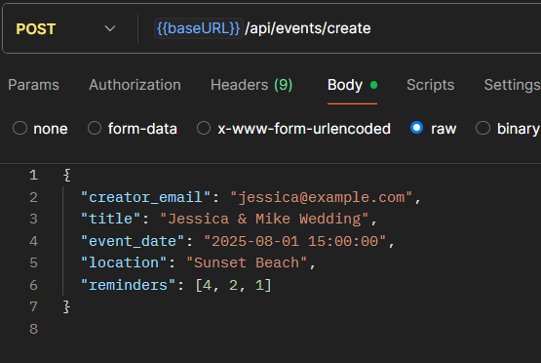
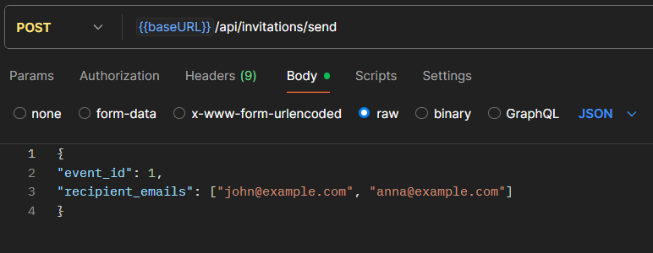

Slide 29
2. Test Automation & Continuous Integration
Part B) API Tests (using Postman)
Used MERN Web project made for EC4307 – Web Application Development module.
Wrote above API tests (and more) in Postman.
Ran the tests in 1 iteration and got following result

Slide 30
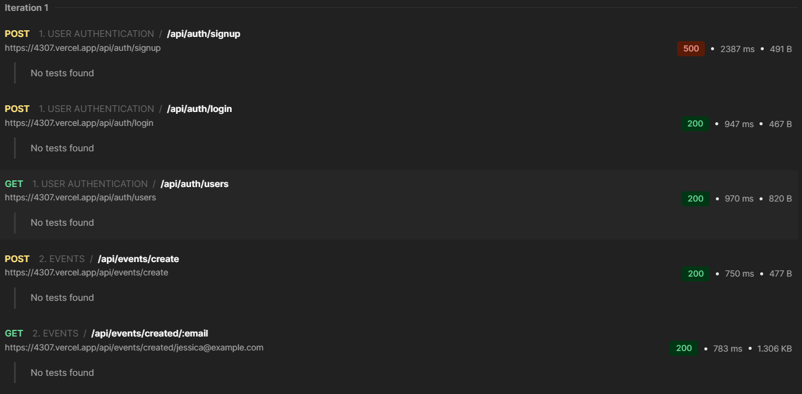

Slide 31
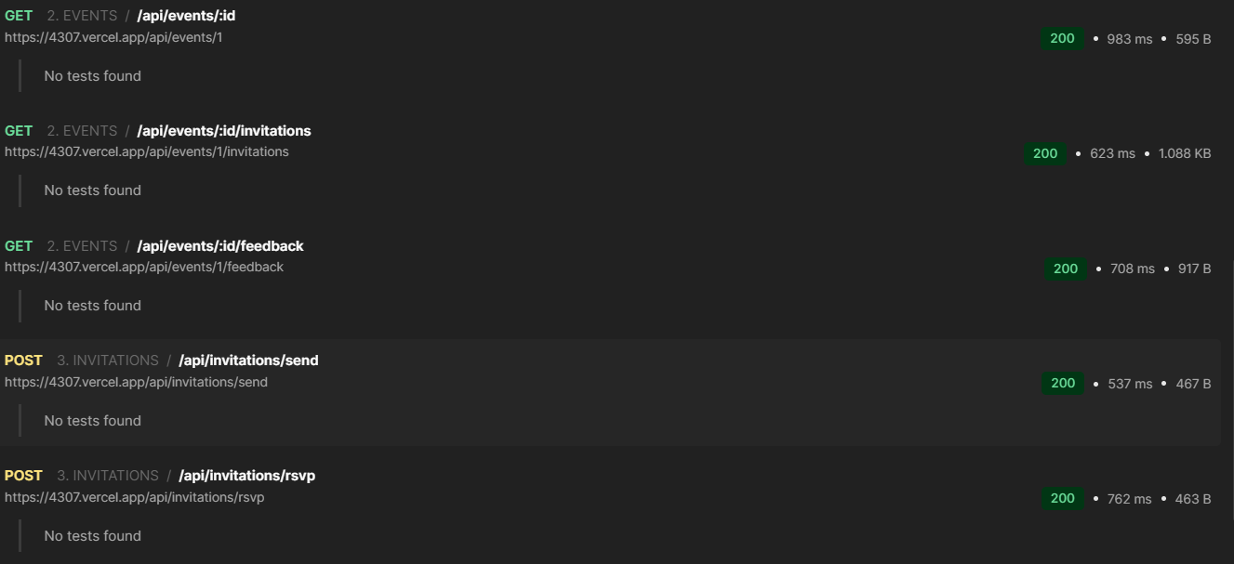

Slide 32
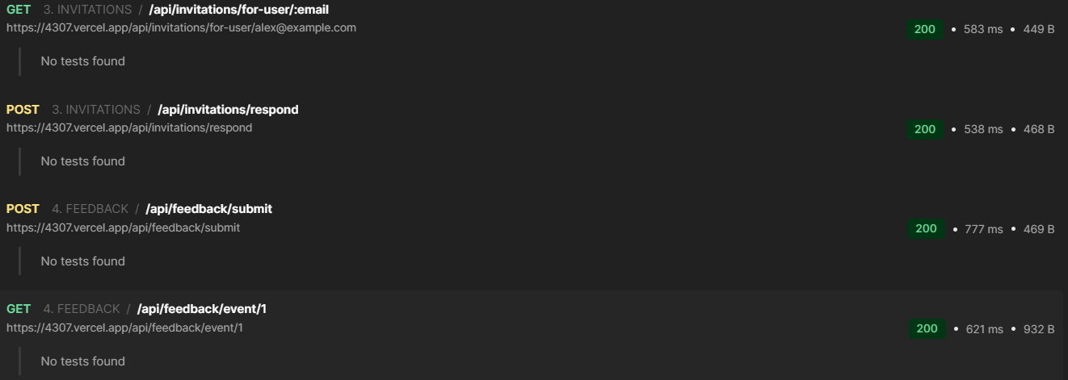

Slide 33
2. Test Automation & Continuous Integration
Part C) CI/CD Pipeline using Github Actions
Used MERN Web project made for EC4307 – Web Application Development module.
Wrote following Workflow for Github Actions as ci.yml

Slide 34
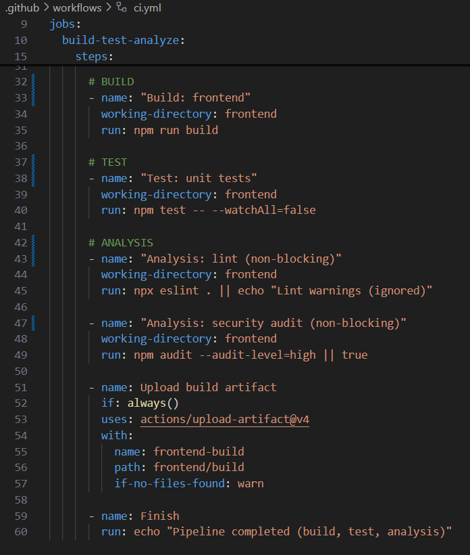
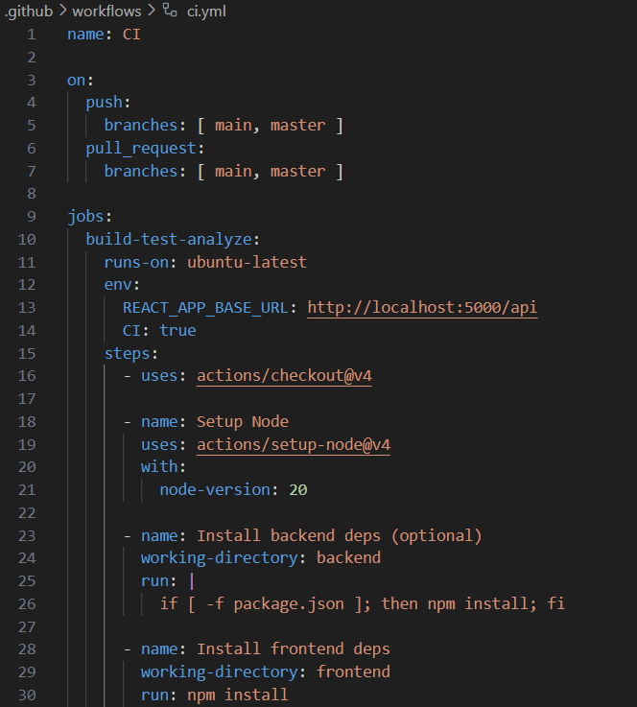

Slide 35
2. Test Automation & Continuous Integration
Part C) CI/CD Pipeline using Github Actions
Used MERN Web project made for EC4307 – Web Application Development module.
Wrote above Workflow for Github Actions as ci.yml
Got test result in Actions page as follows.

Slide 36
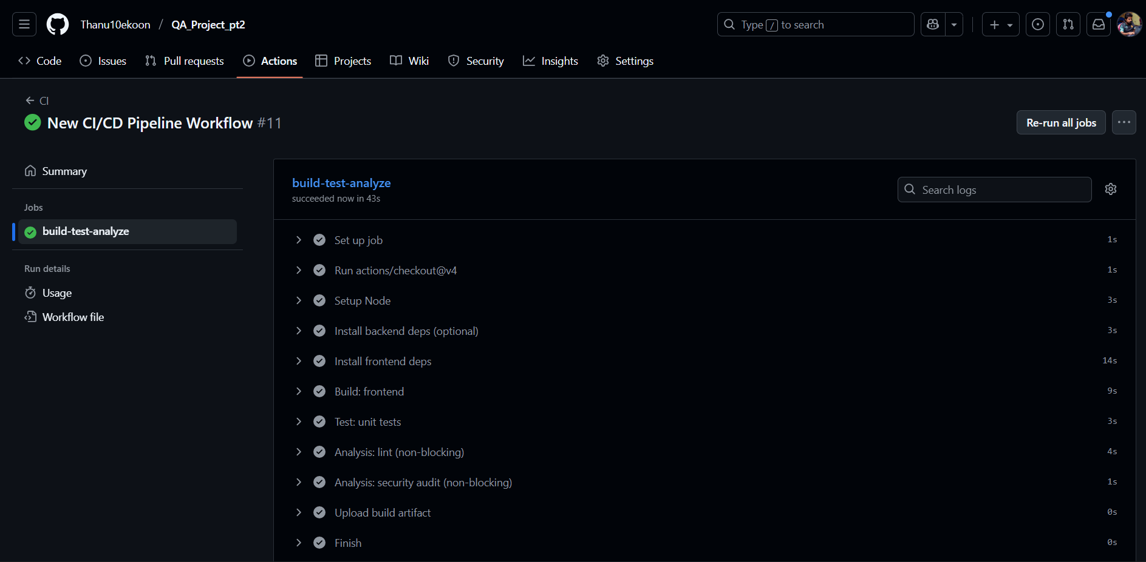

Slide 37
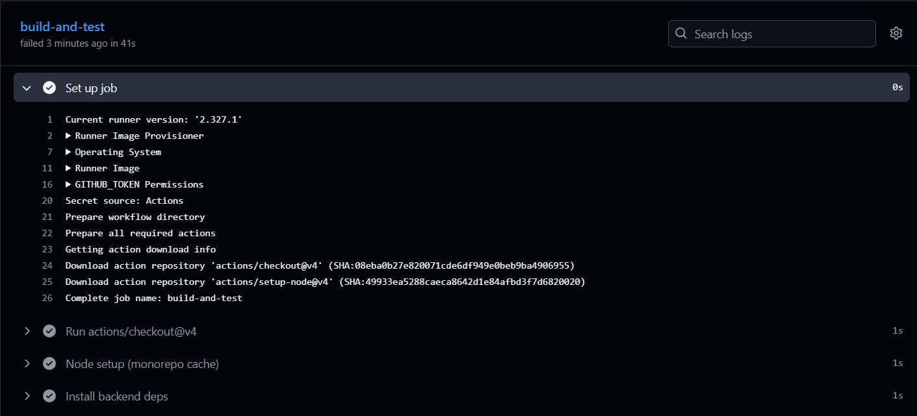

Slide 38
3. Performance, Security, and Usability Testing
Part A) Load Testing with JMeter
Used MERN Web project made for EC4307 – Web Application Development module.
Made test plan as below.

Slide 39
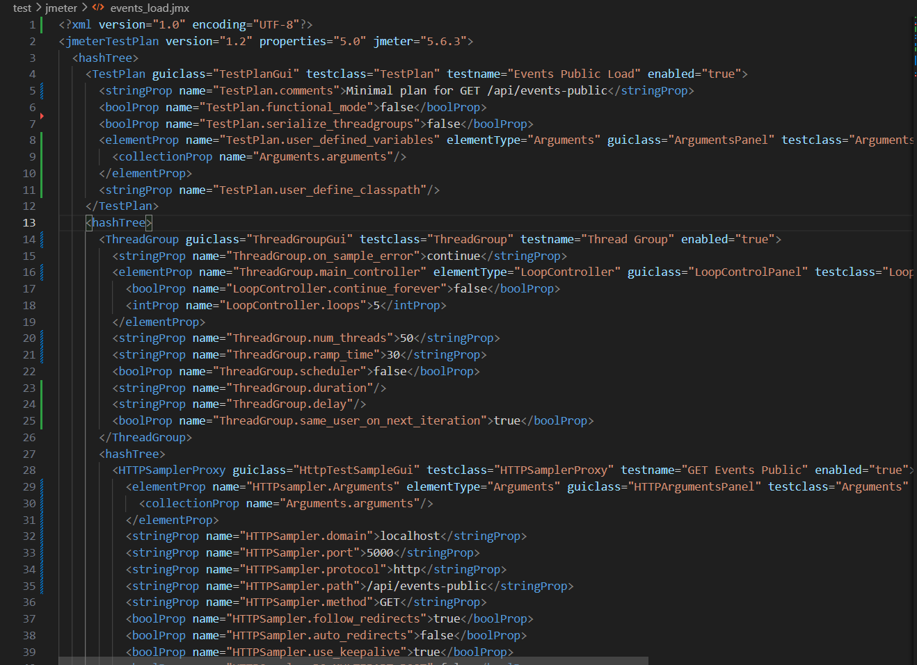

Slide 40
3. Performance, Security, and Usability Testing
Part A) Load Testing with JMeter
Used MERN Web project made for EC4307 – Web Application Development module.
Made test plan as above.
Wrote powershell script to run the jmeter test as below.

Slide 41
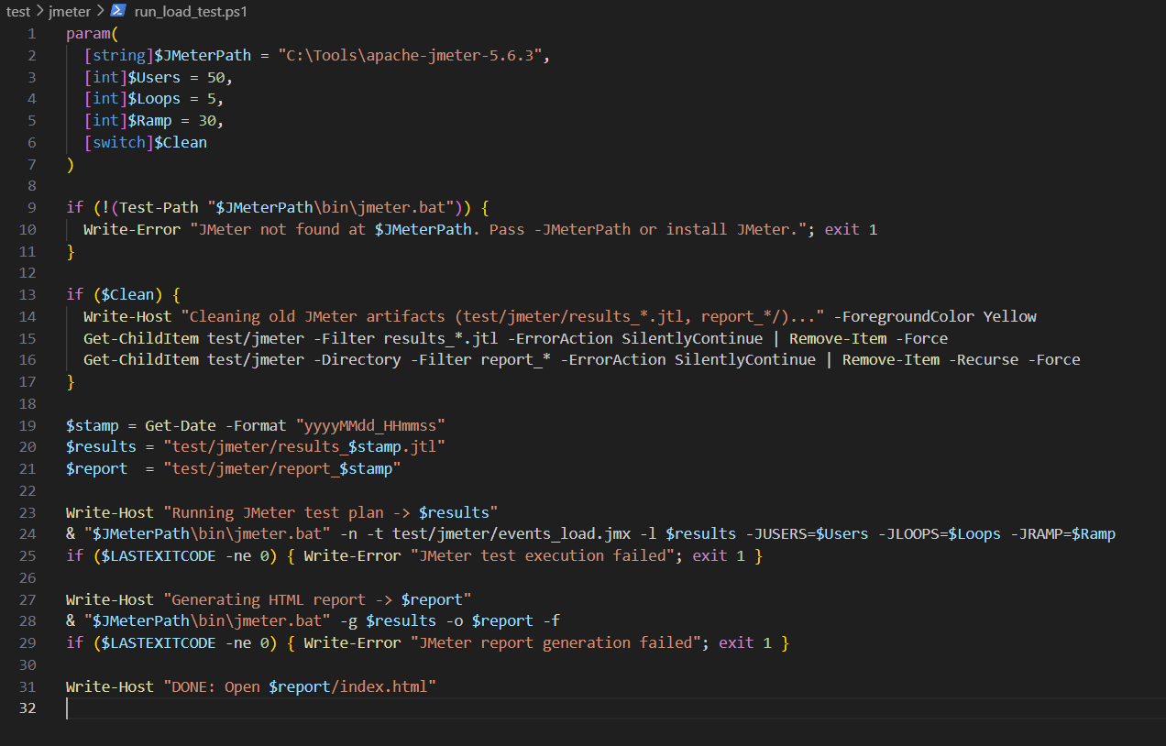

Slide 42
3. Performance, Security, and Usability Testing
Part A) Load Testing with JMeter
Used MERN Web project made for EC4307 – Web Application Development module.
Made test plan as above.
Wrote powershell script to run the jmeter test as below.
Ran the test and acquired following test report .html file

Slide 43
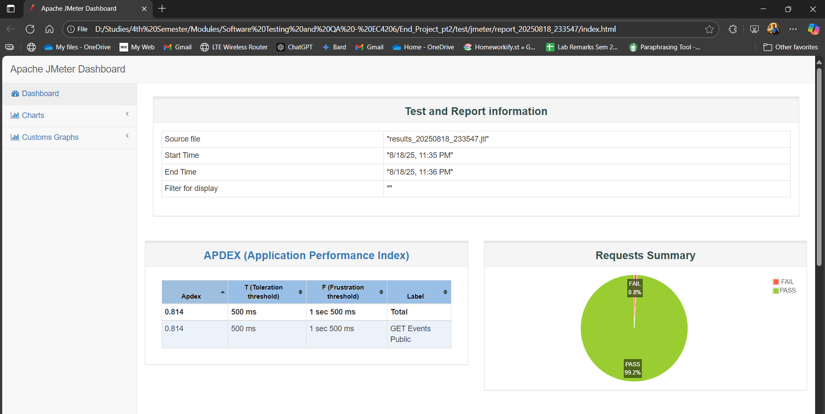

Slide 44
