Slide 1
LOOP, BREAK, CONTINUE GROUP – E Syed Waqeer Thanu priya. l Santhosh kumar Prateek Srivastava

Slide 2
.
There are total four types of loops in shell script.
For loop
While loop
Until loop
Select loop

Slide 3
.
For loop
The for loop operate on lists of items. It repeats a set of commands for every item in a list.
Syntax
for var in word1 word2 ...wordn
do
Statement to be executed
done

Slide 4
.
Example
i=1
for day in Mon Tue Wed Thu Fri
do
echo “ Weekday $((i++)) : $day”
done

Slide 5
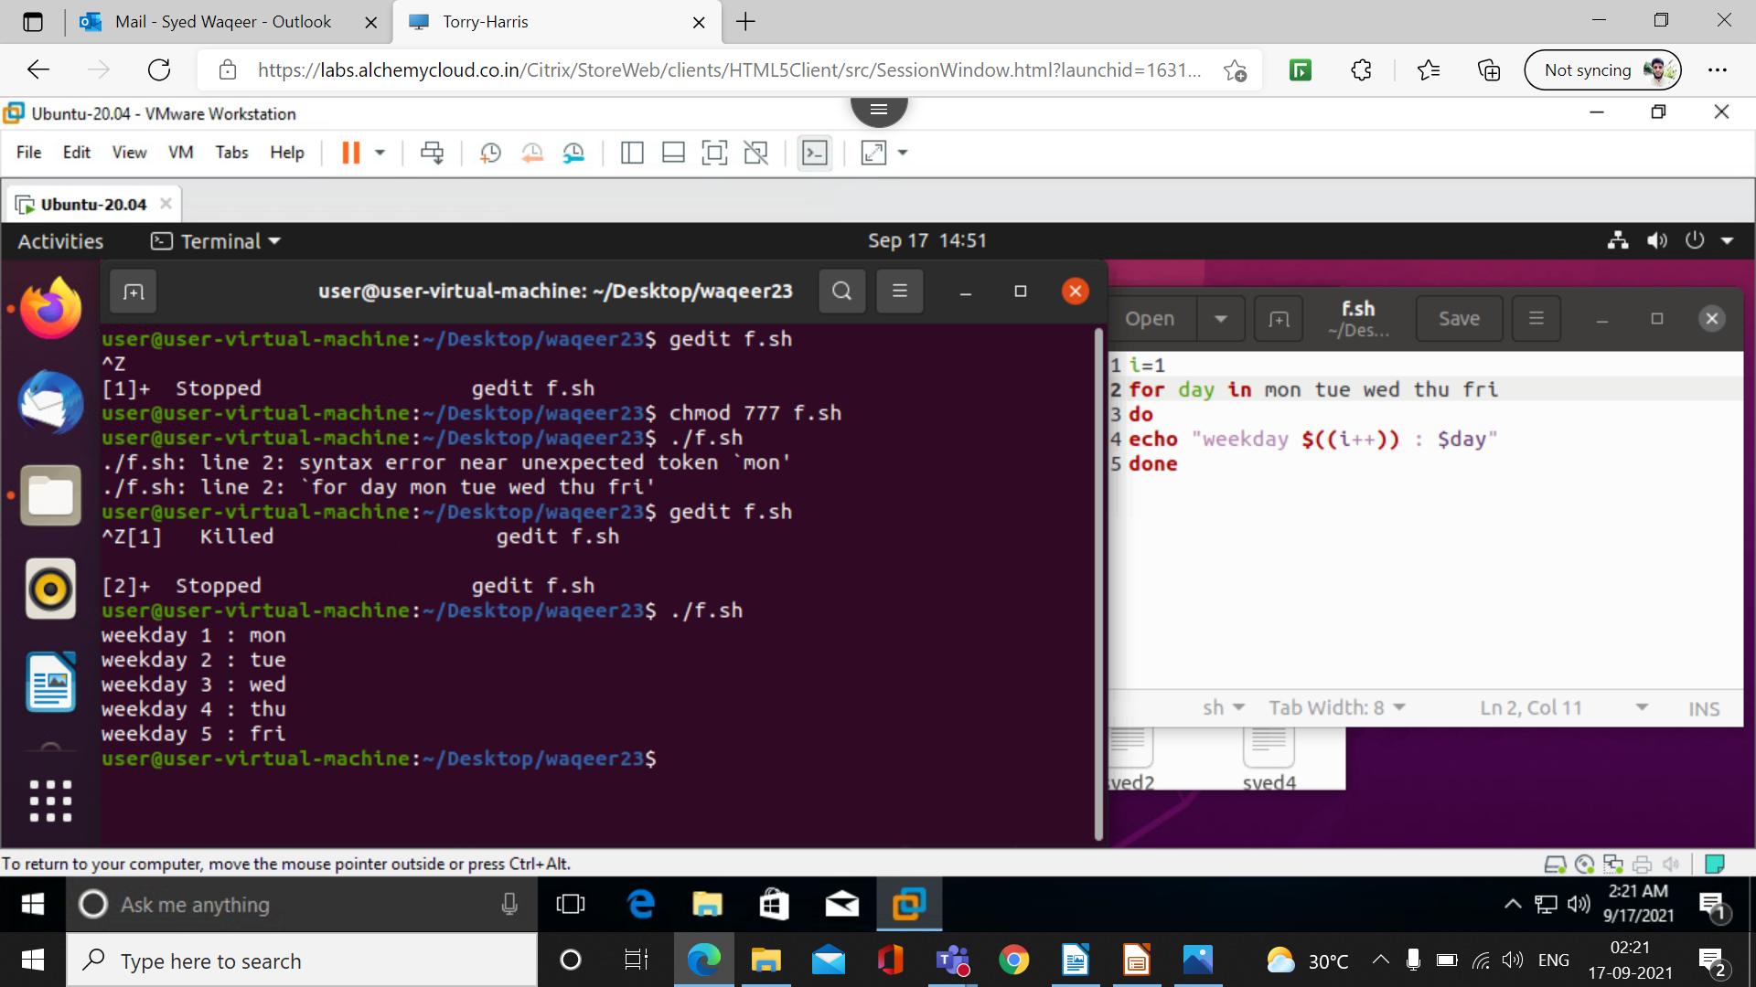
.

Slide 6
.
until statement
The until loop is executed as many as times the condition/command evaluates to false. The loop terminates when the condition/command becomes true.
Syntax
until command
do
Statement to be executed until command is true
done

Slide 7
.
Example
a=0
# -gt is greater than operator
#Iterate the loop until a is greater than 10
until [ $a -gt 10 ]
do
# Print the values
echo $a
# increment the value
a=`expr $a + 1`
done

Slide 8
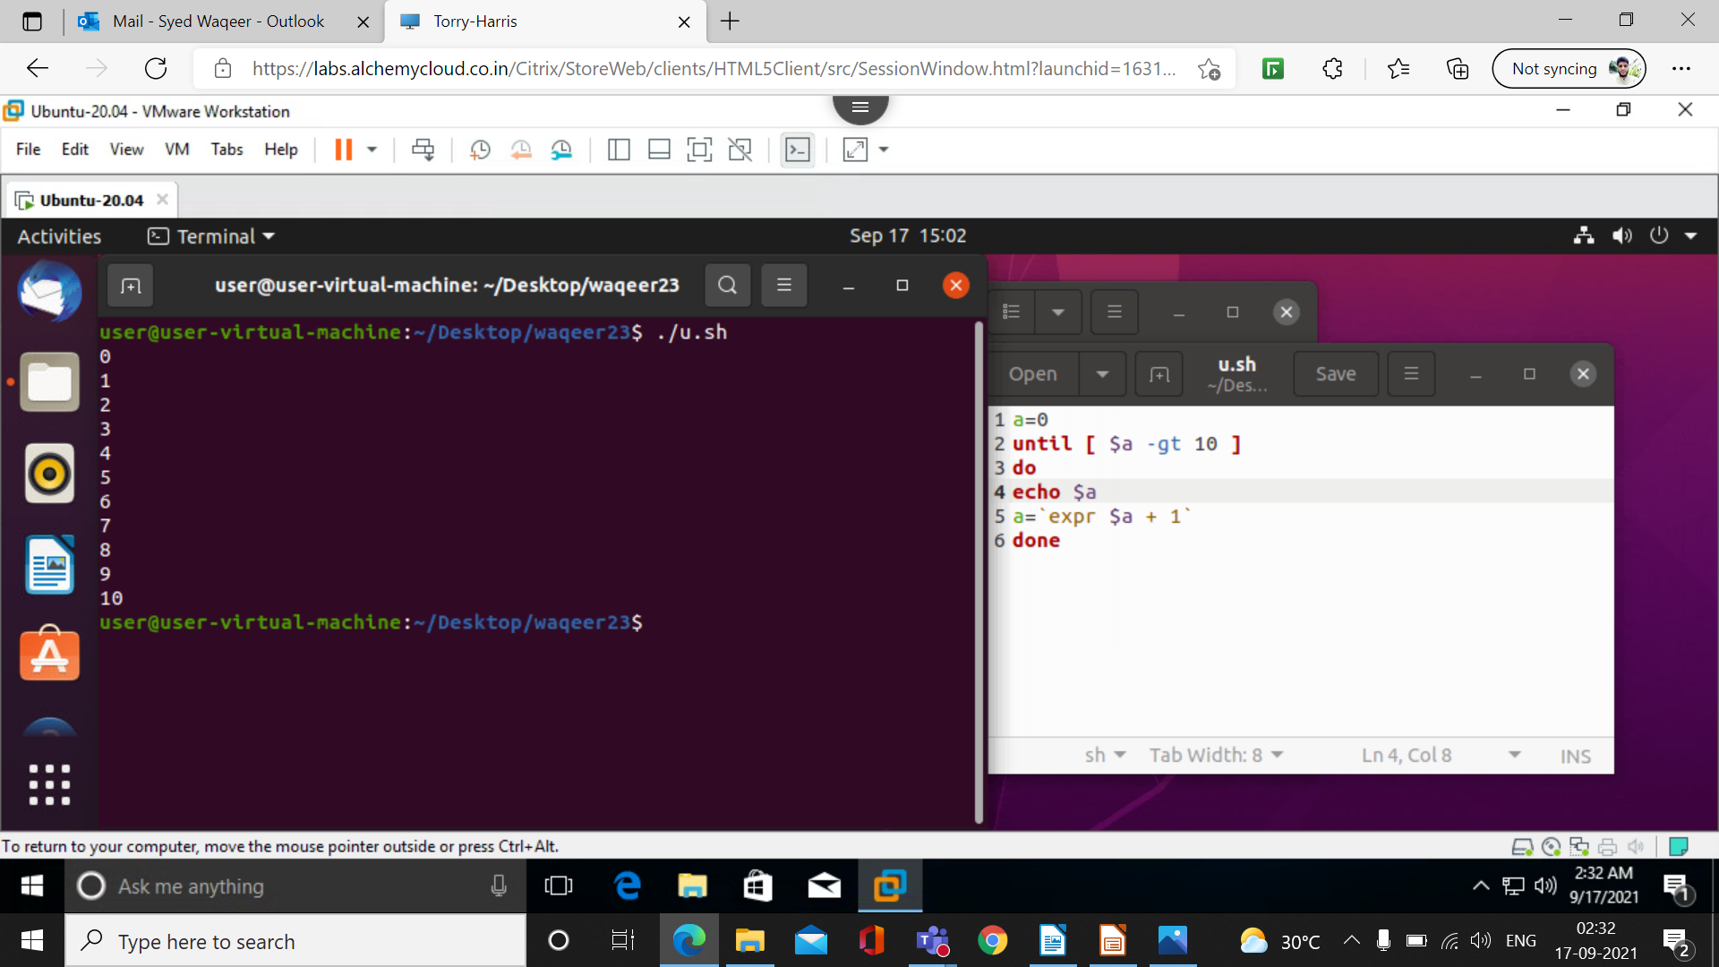
.

Slide 9
Select loop
The select loop provides an easy way to create a numbered menu from which users can select options. It is useful when you need to ask the user to choose one or more items from a list of choices.

Slide 10
Select loop
Syntax:-
Select varname in list
Do
Command1
Command2
…
Command n
done

Slide 11
While loop
The while loop loops through a block of code as long as a specified condition is true.

Slide 12
While loop
Syntax:
while command
do
Statement(s) to be executed if command is true
done

Slide 13


Continue Command In Linux
Continue is a command which is used to skip the current iteration in for, while and until loop. It takes one more parameter [N], if N is mentioned then it continues from the nth enclosing loop.
Notes:
13

Slide 14

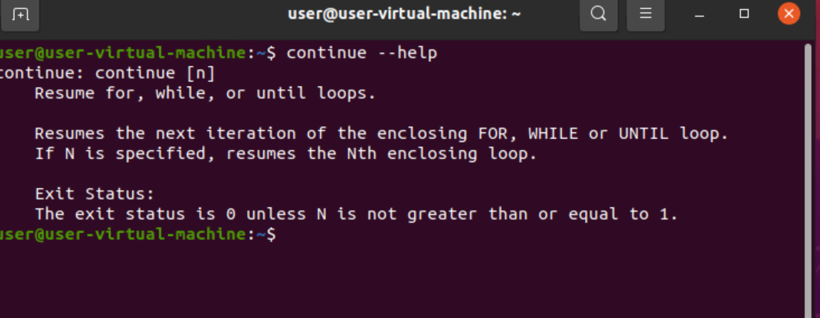
z
Continue --help

Slide 15
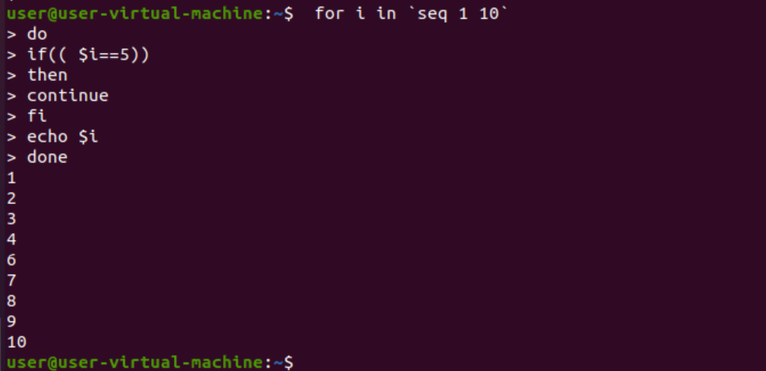
z
Continue Command in For Loop

Slide 16
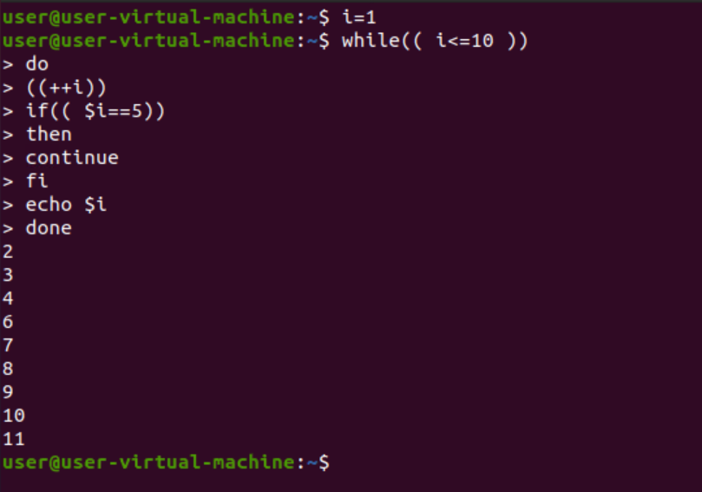
z
Continue Command in While Loop

Slide 17
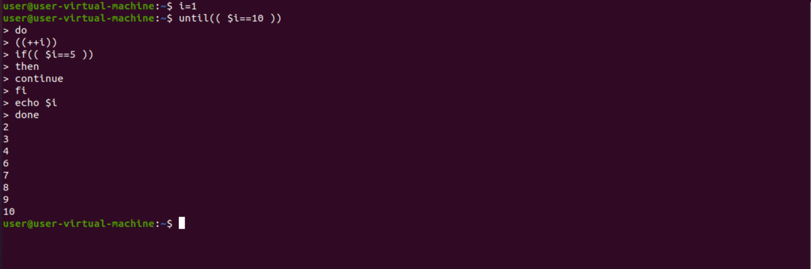
z
Continue Command in Until Loop

Slide 18
The Break Statement
The break statement is used to terminate the execution of the entire loop, after completing the execution of all of the line of the code up to the break statement .
Syntax = break
Break command can also be used to exit from a nested loop using the format break n

Slide 19
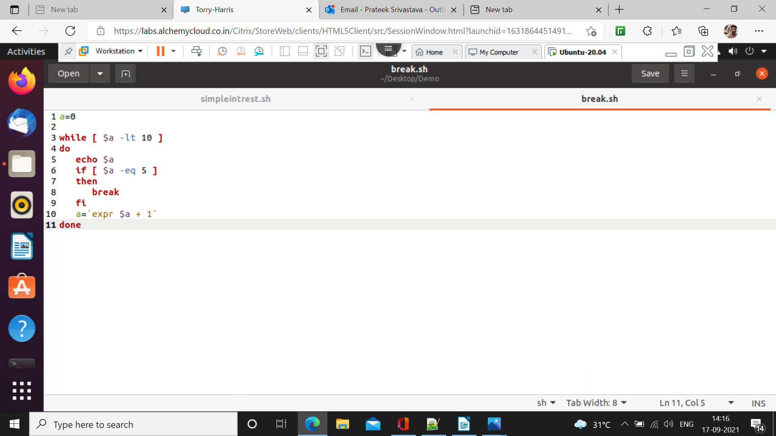
Execution-
a=0
while [ $a -lt 10 ]
do
echo $a
if [ $a -eq 5 ]
then
break
fi
a=`expr $a + 1`
done

Slide 20
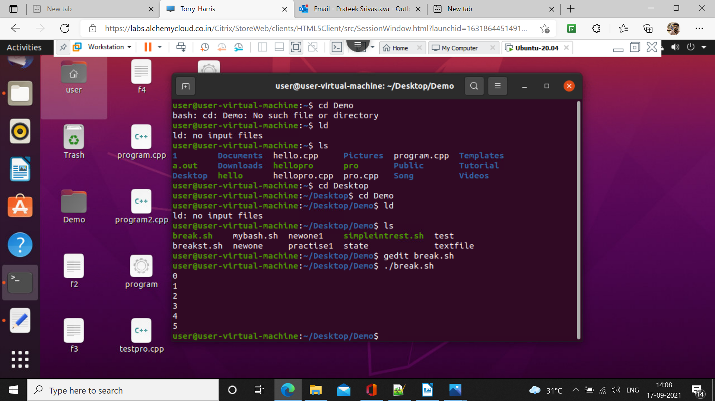
Output

