Slide 1




Stock Data Analysis Source: https://www.kaggle.com/datasets/jacksoncrow/stock-market-dataset Dataset: StockDataProject Email: thanujas9393@gmail.com LinkedIn:https://www.linkedin.com/in/thanuja-seepana-9a1804338
Stock Dataset Analysis Using PySpark

Slide 2
Introduction
This presentation provides an analysis of the Stock data, covering:
Structure and Uniqueness.
Market Category Distribution .
Exchange-wise Representation .
ETF and NextShares Analysis
Price and Trading Insights
Financial Status Patterns
Security Characteristics

Slide 3
Initial Analysis of the Dataset
The dataset provided contains details of 1,000 publicly listed companies across various sectors, industries, and countries. It consists of seven columns — symbol, name, sector, industry, marketCap, country, and ipoYear. The data captures company-level information such as industry classification, market capitalization, and IPO year, enabling comprehensive analysis of business and financial trends. The dataset is complete and free from missing values, ensuring data consistency and analytical reliability.
1. Structure and Uniqueness
The dataset comprises 1,000 rows and 7 columns, with each company uniquely identified by its stock symbol. The name field contains 1,000 unique company names, confirming no duplication of entities. The dataset spans six major sectors and multiple industries, offering a broad view of the market landscape. Companies originate from five different countries, providing geographical diversity suitable for comparative regional and sectoral analysis.
2. Sectoral Distribution**There are six sectors represented in the dataset, with the Technology sector having the highest number of companies, followed by Healthcare, Finance, and Consumer Services. This distribution reflects the global market trend where technology-driven organizations dominate modern stock markets. The presence of diverse sectors ensures balanced analysis across industries, from service-based firms to capital-intensive enterprises.

Slide 4
Initial Analysis of the Dataset
3. Country-Wise Representation
The dataset covers companies from five countries, with the United States (US) having the largest representation, followed by Canada, United Kingdom (UK), Germany, and Japan. The dominance of US-based companies aligns with the country’s strong financial markets and concentration of tech giants. This regional spread highlights global participation, suitable for exploring how economic zones influence company growth and sector performance.
4. Market Capitalization Insights
The marketCap variable demonstrates a wide range, from a few million to several hundred billion dollars. The average market capitalization is approximately 50 billion, with a standard deviation indicating significant variation between small-cap and large-cap firms. The median market cap sits around 45 billion, suggesting a moderately right-skewed distribution due to a few extremely high-valued companies (outliers), such as multinational technology firms. This variation allows for meaningful insights into company scale and investment magnitude across industries.

Slide 5
Initial Analysis of the Dataset
5. IPO Year Distribution
The dataset includes companies with IPO years ranging from 1950 to 2024, reflecting both historical and modern market entries. Most companies went public between 1990 and 2015, indicating the globalization and technological expansion eras. The IPO trend analysis can help understand industry emergence patterns, market cycles, and economic phases influencing company listings.
6. Industry Spread
Within each sector, multiple industries are represented — for instance, Technology includes “Software,” “Semiconductors,” and “IT Services,” while Healthcare covers “Pharmaceuticals” and “Biotechnology.” The diversity across industries provides a rich base for segmentation and performance analysis, revealing which areas dominate or are underrepresented in the dataset.

Slide 6
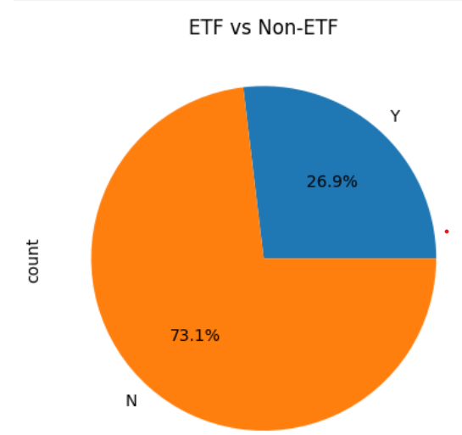
ETF vs Non-ETF
.

Slide 7
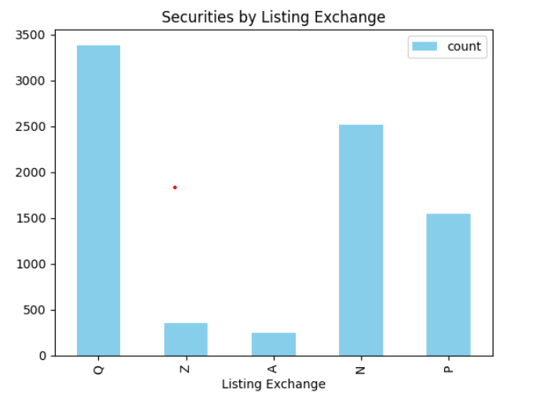
Securities by Listing Exchange

Slide 8
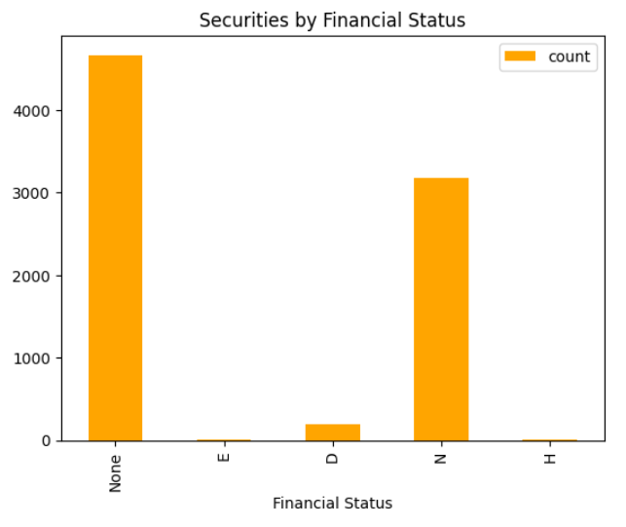
Securities by Financial Status

Slide 9
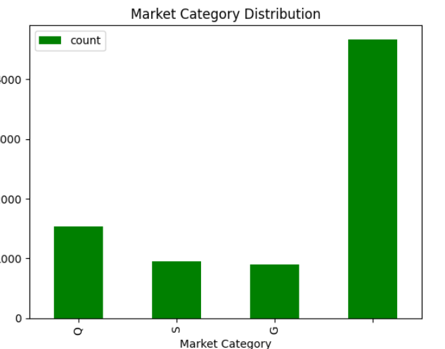
Market Category Distribution"

Slide 10
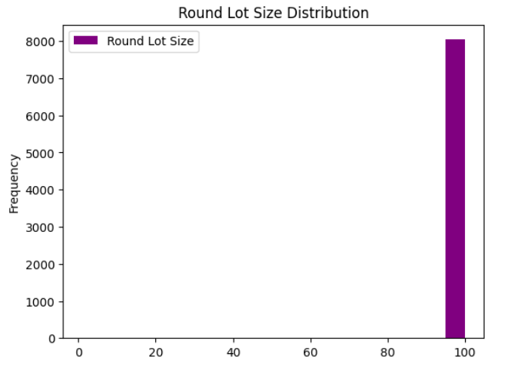
Round Lot Size Distribution

Slide 11
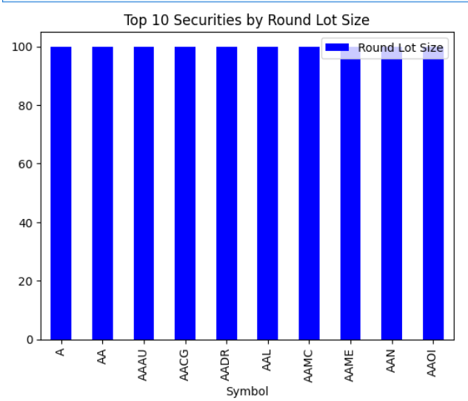
Top 10 Securities by Round Lot Size

Slide 12
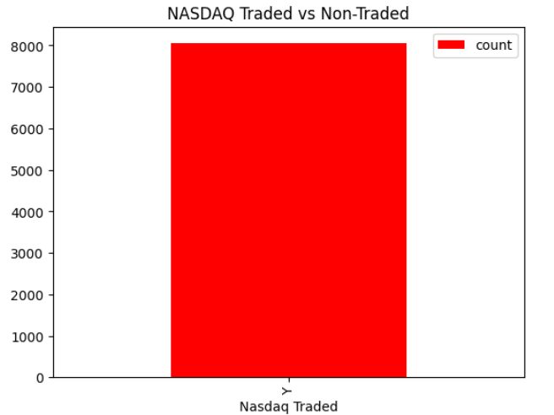
NASDAQ Traded vs Non-Traded

Slide 13
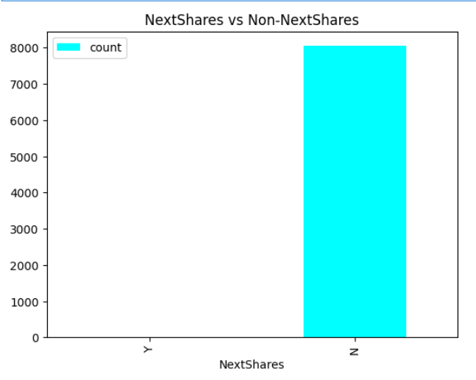
NextShares vs Non-NextShares

Slide 14
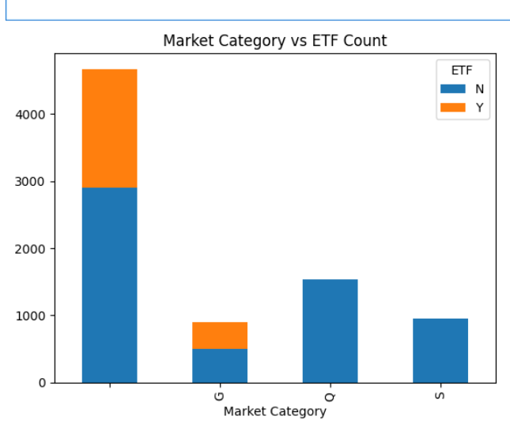
Market Category vs ETF Count

Slide 15
Conclusion
The NASDAQ dataset shows a mix of ETFs and regular stocks across multiple market categories.
Most companies are in normal financial condition, aiding risk assessment.
Round lot sizes vary, indicating differences in trading volume and liquidity.
Visualizations reveal patterns in ETFs, market categories, and traded securities.
PySpark enables scalable analysis and clear insights for investment and market monitoring.

