Slide 1
ELECTRICITY DEMAND
FORECASTING
INTELLIGENCE SYSTEM
IT22069740 | Janahan .r​
IT22545176 | Thanujan T
IT22273062 | MADUSHANI R P
IT22630216 | DEWMINI D.M.D.P.

Slide 2
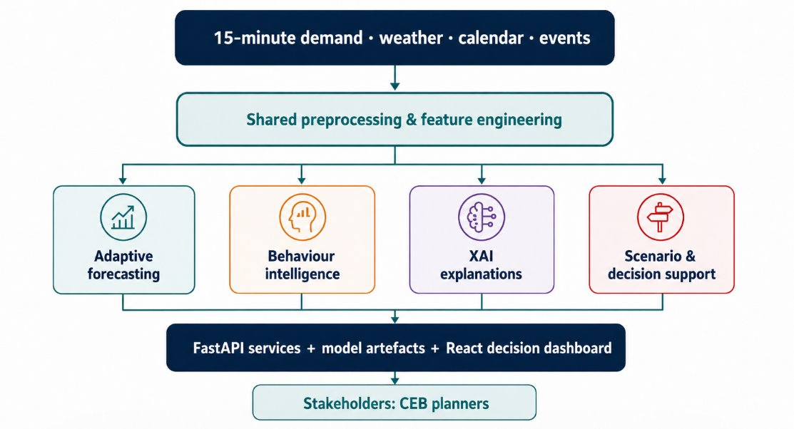
Problem in Brief & Our Overall Solution
Problem in brief
​​Point forecasts hide operating risk​
Demand shifts with weather, weekdays, holidays and Poya days
Numbers alone lack behavioural context​
Separate tools weaken decision flow​
Design excellence of the overall solution
One login and one dashboard: behaviour, forecast, what-if, why
Every model validated: ground truth, cross-validation, significance, coverage
Uncertainty shown as ranges and likelihoods, never false certainty
Abnormal day → one click to its LIME explanation
Notes:
[Elevator pitch, about 30 seconds]
Sri Lanka's electricity grid has to match supply to demand every fifteen minutes. Demand changes with the weather, weekdays, holidays and Poya days. Planners at the electricity board need more than one forecast number: they need to know what normal looks like, what will happen next, what happens if conditions change, and why.
[Product pitch, about 3 minutes]
Our solution, EDIS, brings four research components into one system with one login.
1. Behaviour Intelligence learns what normal demand looks like, flags abnormal days and predicts the behaviour of future dates.
2. Neural Forecasting predicts the next fifteen-minute load with deep-learning models and calibrated uncertainty.
3. Demand Forecasting and Scenarios lets a planner ask "what if": a heat wave, a price change, a Poya holiday, and shows which provinces could run short.
4. Explainable AI explains why a model predicted a value, using SHAP and LIME.
What makes the design strong:
- Everything is in one dashboard. The home page and login lead to the Behaviour Intelligence shell, and the other three apps open inside it.
- The parts are connected. When an abnormal day is found, one click opens its LIME explanation inside the same app.
- Every model is validated, not just trained: against known ground truth, with cross-validation, with statistical tests, and with coverage checks for the uncertainty ranges.
- We show uncertainty honestly. Forecasts come with ranges, and future behaviour comes with a likelihood that never claims 100% from limited data.
The diagram shows the ports: Behaviour Intelligence on 3000 and 8001, Neural Forecasting on 5176 and 8003, Demand Forecasting on 5175 and 8002, and Explainable AI on 5173 and 8000. One launcher, start-all.py, starts all of them.

Slide 3
PP2 Comments and Actions Taken
Member / component | PP2 comment | What we did | Evidence / impact
IT22545176 Thanujan Behaviour Intelligence | Moderate idea of clustering; why these models; which parameters and why; needs fine-tuning | Tuned every parameter with unsupervised criteria, then validated against known ground truth (notebook 07) | k = 2 chosen by 3 indices (ARI 0.965 vs weekday/weekend); Isolation Forest P = R = F1 = 1.00
IT22069740 Janahan Neural Forecasting | Moderate idea of models; needs clear parameter considerations; elaborate on optimisation | 7 architectures on one protocol; documented lookback, features, loss, optimiser; early stopping + learning-rate schedule | Best MAE 20.46 kW (R² 0.974); significance tests; calibrated 95% band covers 96.3%
IT22630216 Dewmini Demand Forecasting | Lacks idea of models used; needs parameter optimisation and a model comparison | Linear Regression vs Random Forest vs Gradient Boosting on the same split; Optuna tuning (20 trials, 6 parameters) | Gradient Boosting R² 0.824 vs 0.777 (RF) and 0.438 (LR); MAE 91.8 kW
IT22273062 Madushani Explainable AI | Lacks idea of models used; needs model architecture; model comparison needed | Model table + XGBoost architecture diagram; 4-model comparison and SHAP vs LIME comparison | XGBoost RMSE 2.02 kW; SHAP matches the true effect (r = 0.99994)
Notes:
[about 1 minute 15 seconds]
At PP2 the panel gave each of us comments. This table shows the comment, what we did, and the evidence.
Thanujan: the panel wanted a clearer idea of clustering, model choice and parameters. Every parameter is now tuned in notebook 07 with unsupervised methods first, and then checked against the known ground truth of the dataset. All three clustering indices pick k = 2, and Isolation Forest finds exactly the 60 injected anomaly days.
Janahan: the panel asked for clearer parameter considerations and more on optimisation. Seven neural architectures are compared on one protocol, with early stopping and a learning-rate schedule, plus significance tests.
Dewmini: the panel asked for a model comparison and parameter optimisation. Three model families are compared on the same split, and Gradient Boosting is tuned with Optuna.
Madushani: the panel asked for the models, the architecture and a comparison. She now shows the XGBoost architecture, a four-model comparison, and a SHAP versus LIME comparison validated against the true formula.
Each member has backup slides with the full details.

Slide 4
Results, Testimonials, Limitations & Future Improvements
Benchmark tests & accuracy (held-out data)
Limitations
Component | Benchmark | Result
Behaviour Intelligence | Anomalies vs 60 known injected days | P = R = F1 = 1.00
Behaviour Intelligence | Future label back-test (364 days) | 83.5% vs 62.4% baseline
Neural Forecasting | 6 models, 18,817 test windows | MAE 20.46 kW, R² 0.974
Demand Forecasting | Unseen test set (37,978 rows) | R² 0.824, MAE 91.8 kW
Explainable AI | SHAP vs known true effect | r = 0.99994
Integrated system | Automated UI test: login, LIME link, all pages | 44 / 44 checks passed
Historical data only: no live SCADA feed yet
Future improvements
Live data feed with scheduled retraining
Explain every model's forecast, not only XGBoost
Notes:
[about 1 minute 30 seconds]
Here are our results on held-out data.
Behaviour Intelligence finds all 60 known anomaly days with no false alarms, and its future-behaviour prediction reaches 83.5% accuracy against a 62.4% majority baseline.
Neural Forecasting: the best model's average error is 20.46 kW, with R-squared 0.974.
Demand Forecasting reaches R-squared 0.824 on unseen data.
Explainable AI: SHAP matches the true effect with correlation 0.99994.
The integrated system passed an automated test of 44 checks, covering login, the LIME link and every page.
[If you collected user feedback, mention it here; otherwise say: "We have not yet run a formal user acceptance test with CEB engineers; that is our next step."]
Limitations: our data is synthetic or semi-synthetic, each component still uses its own dataset, and we work on historical data, not a live feed.
Future work: real electricity board data, one shared dataset, a live feed with retraining, and explanations for every model. Thank you.

Slide 5
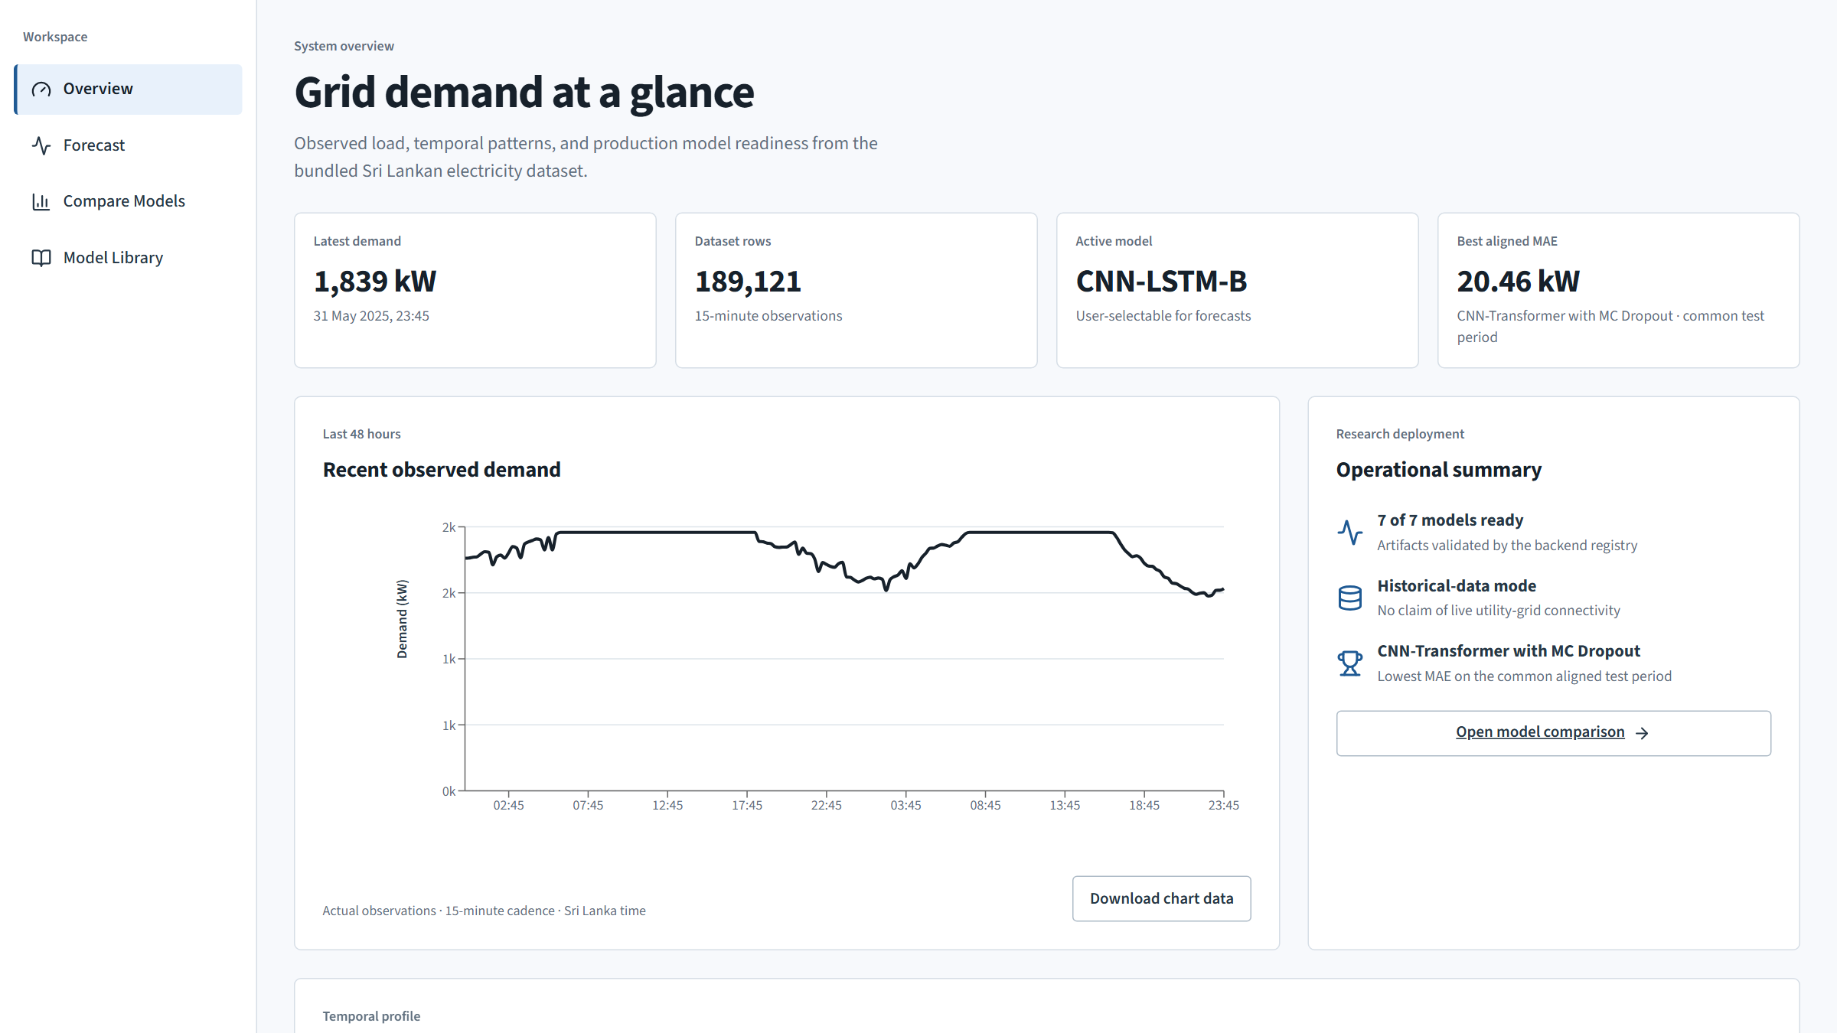
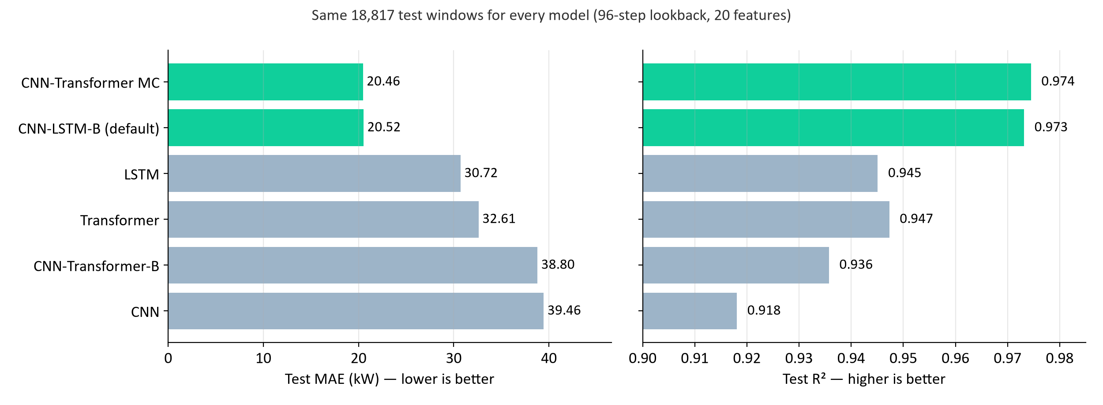
IT22069740 | Janahan R
Neural Forecasting: deep-learning load forecasts with calibrated uncertainty
Seven CNN, LSTM and Transformer models forecast the next 15-minute load from the last 24 hours (96 steps × 20 features); MC Dropout adds uncertainty.
Key results: Best MAE 20.46 kW (R² 0.974) · default CNN-LSTM-B MAE 20.52 kW · calibrated 95% band covers 96.3%
IT22069740 | Janahan R | R26-IT-010
Notes:
[about 1 minute — Janahan]
I am Janahan, IT22069740. My component is Neural Forecasting.
It answers: what will the load be in the next fifteen minutes?
Each model looks at the last 24 hours, 96 time steps, with 20 features: weather, calendar, Poya and public events, and past load. I compared seven deep-learning models on exactly the same test windows.
The two hybrid models are the best: CNN-Transformer with MC Dropout has a mean error of 20.46 kW and CNN-LSTM 20.52 kW. The difference between them is not statistically significant, so the simpler CNN-LSTM is the default.
MC Dropout also gives an uncertainty band; after calibration the 95% band contains 96.3% of real values.

Slide 6
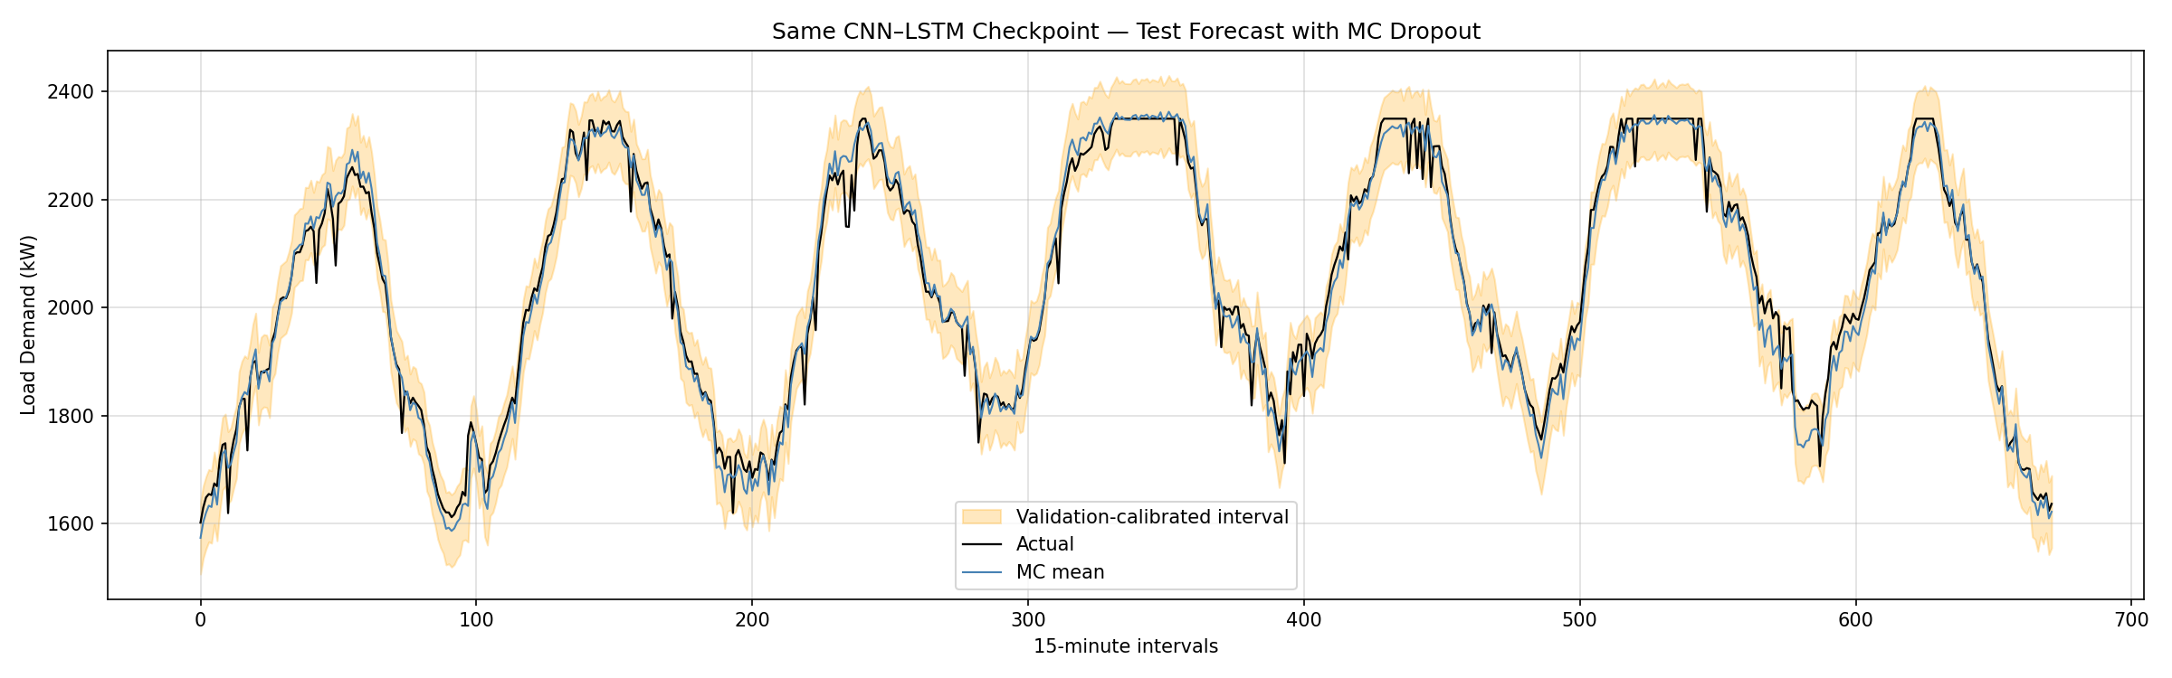
Neural Forecasting — Uncertainty, Dashboard & Limitations
CNN-LSTM with MC Dropout: test forecast with calibrated interval
MC Dropout: 30 forward passes give a mean and a spread
Raw 95% band covered only 85.2% of test values → calibrated ±67 kW covers 96.3%
Limitation: validation data was also used for early stopping, so coverage is supplementary
Dataset-backed forecasts, not a live feed; no inference-time benchmark saved
IT22069740 | Janahan R | R26-IT-010
Notes:
[backup — Janahan, about 40 seconds]
MC Dropout runs the model 30 times with dropout on and gives a mean and a spread. The raw 95% band covered only 85% of real values, so I calibrated it on validation residuals; the calibrated band of about ±67 kW covers 96.3%.
Limitations: validation was also used for early stopping, the forecasts are dataset-backed rather than live, and no inference-time benchmark was saved.

Slide 7
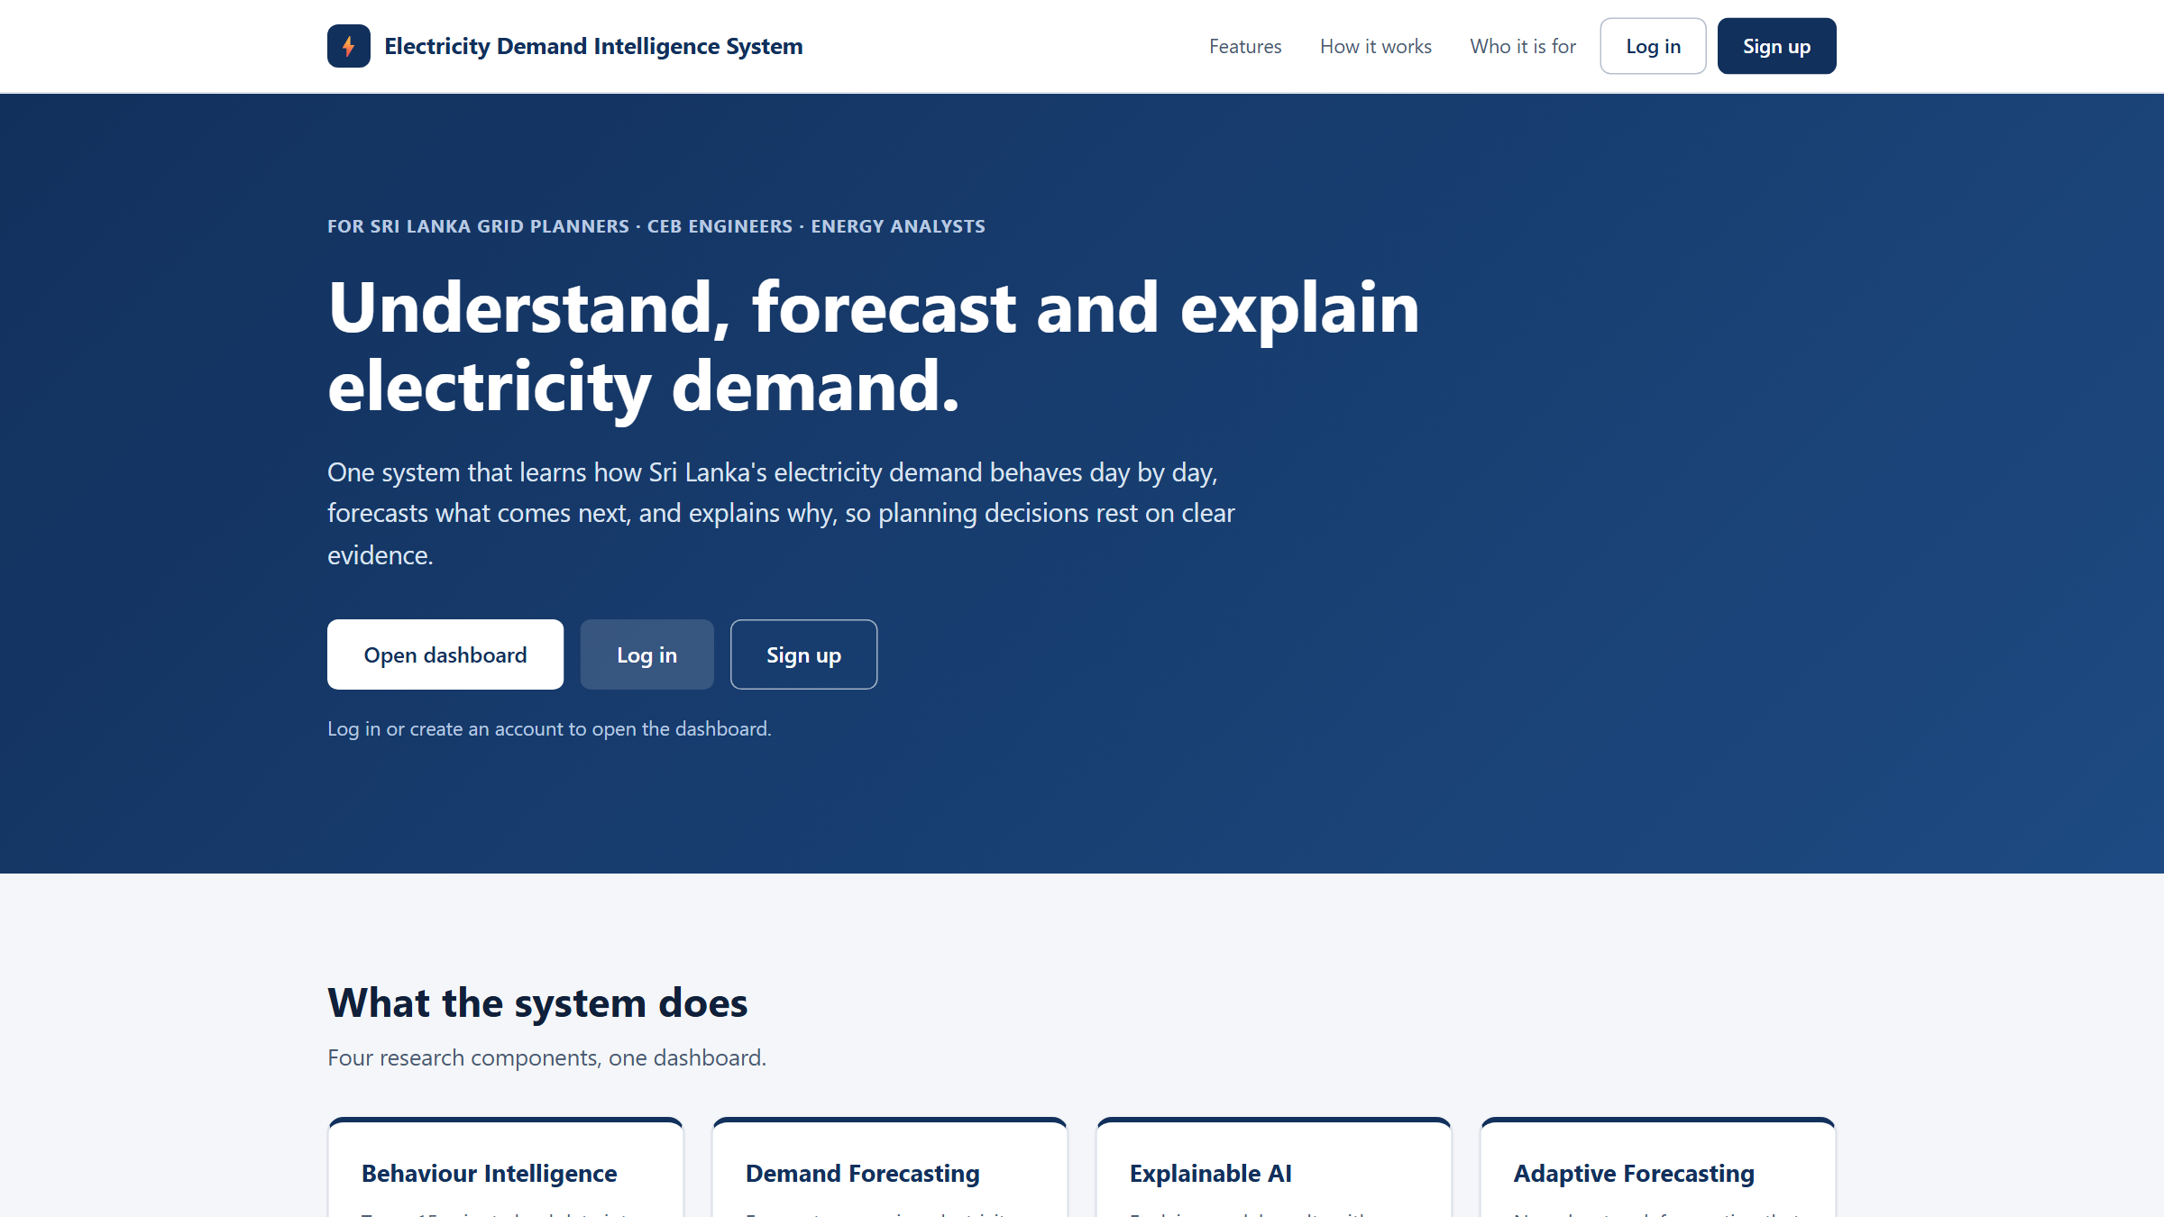
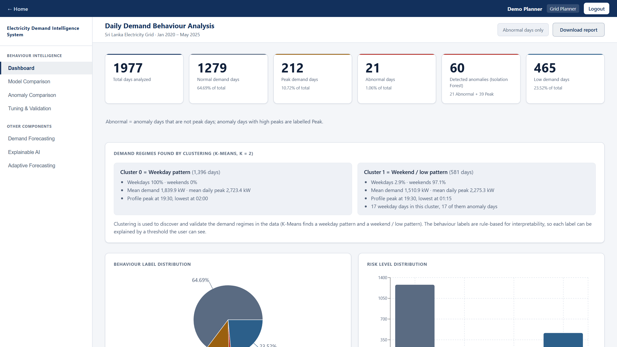
IT22545176 | Thanujan T
Behaviour Intelligence: daily demand patterns, abnormal days and future behaviour
Turns 15-minute load into 1,977 daily profiles, finds weekday and weekend regimes, flags abnormal days and labels each day Normal, Low, Peak or Abnormal.
Key results: K-Means k = 2 (ARI 0.965) · Isolation Forest P = R = F1 = 1.00 · back-test 83.5% vs 62.4%
IT22545176 | Thanujan T | R26-IT-010
Notes:
[about 1 minute — Thanujan]
I am Thanujan, IT22545176. My component is Behaviour Intelligence.
It answers the question: how does demand behave, and which days are unusual?
The 15-minute load is cleaned and turned into one profile of 96 points per day, 1,977 days in total. K-Means finds two regimes, weekdays and weekends. Isolation Forest finds abnormal days. Simple rules then label every day Normal, Low, Peak or Abnormal, with a risk level, and the system predicts the likely behaviour of a future date.
Because the dataset has 60 known injected anomaly days, I could check the results: the clusters match weekday and weekend with ARI 0.965, and Isolation Forest finds all 60 anomaly days with no false alarms.
It is also the shell of the whole system: home page, login, and the other three components inside it.

Slide 8
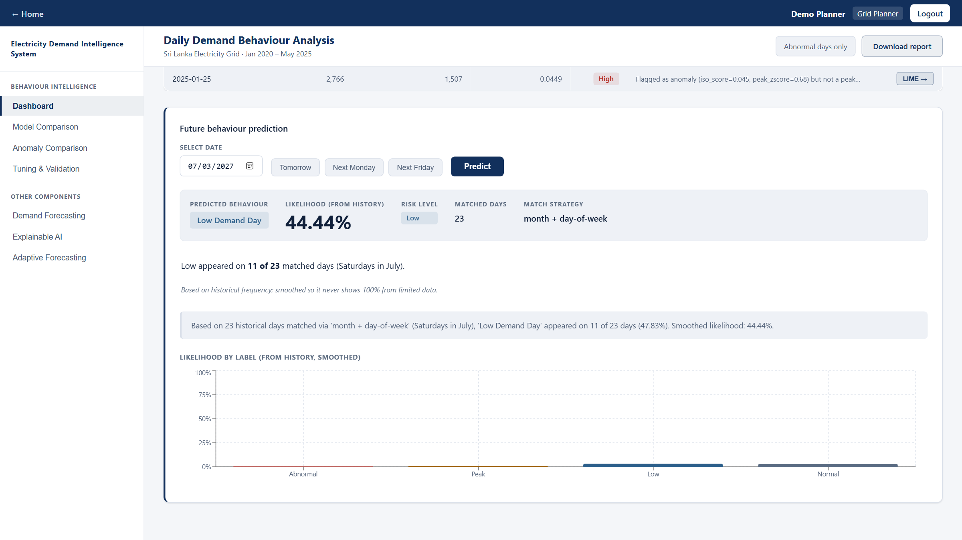
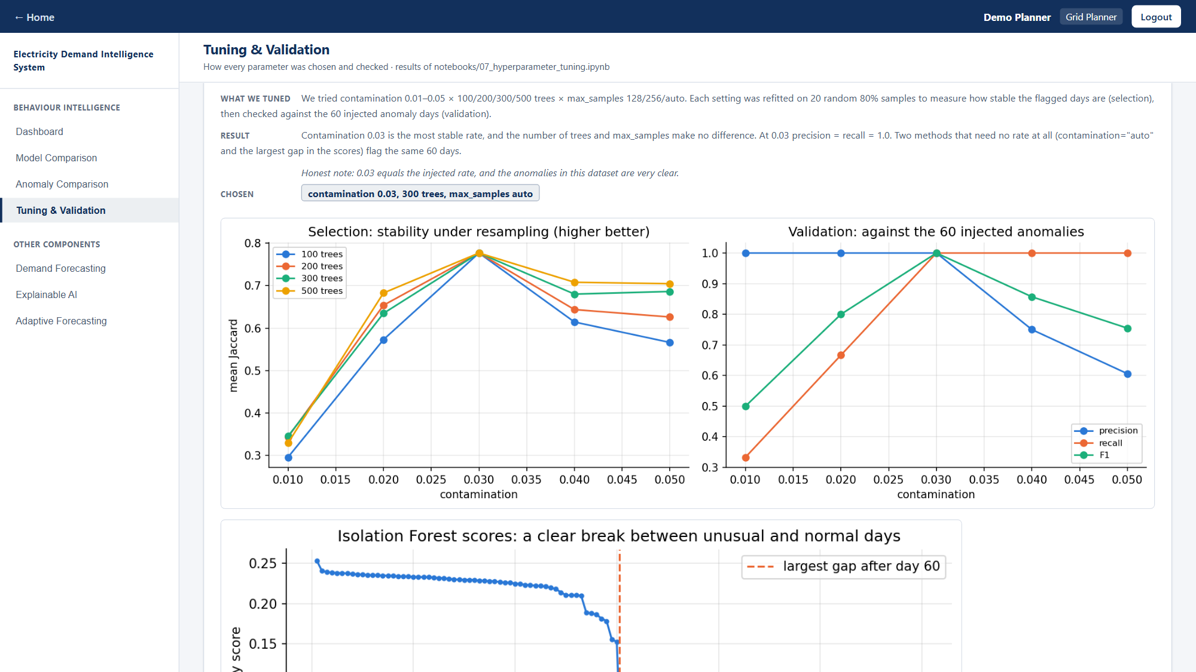
Behaviour Intelligence — Dashboard & Limitations
Future prediction: smoothed likelihood (44.4%, 11 of 23 Saturdays in July)
Tuning & Validation page (Isolation Forest section)
Limitations: synthetic dataset with clear anomalies; contamination equals the injected rate
Future prediction is only +0.5 points over a simple weekend rule (83.5% vs 83.0%)
Login protects the dashboard pages; the data API stays open for the embedded apps
IT22545176 | Thanujan T | R26-IT-010
Notes:
[backup — Thanujan, about 40 seconds]
Left: the future prediction now shows a smoothed likelihood, for example 11 of 23 Saturdays in July, 44.4%, instead of a misleading 100%. Right: the Tuning and Validation page, with every tuning table and figure.
Limitations, honestly: the dataset is synthetic with clear anomalies; contamination equals the injected rate; the future prediction is only a little better than a weekend rule; and login protects the pages, not the API.

Slide 9
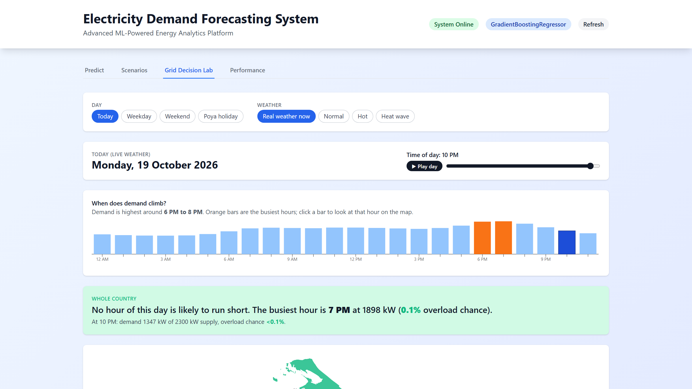
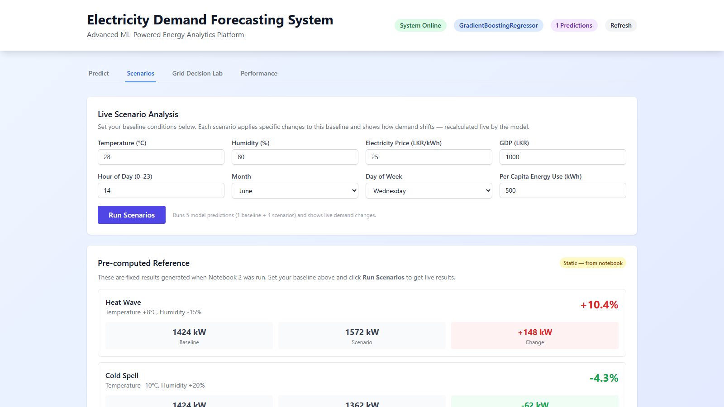
IT22630216 | Dewmini D.M.D.P
Demand Forecasting & Scenario Analysis: what-if planning with risk ranges
Gradient Boosting predicts demand from 13 weather, economic and calendar inputs; planners test scenarios and see which provinces could run short of supply.
Key results: Test R² 0.824 · MAE 91.8 kW · 90% range covers 89.8% · Grid Decision Lab risk map
IT22630216 | Dewmini D.M.D.P | R26-IT-010
Notes:
[about 1 minute — Dewmini]
I am Dewmini, IT22630216. My component is Demand Forecasting with Scenario Analysis.
It answers: what will demand be, and what if conditions change?
The model uses 13 inputs: weather, economy and calendar, including Poya days. I compared Linear Regression, Random Forest and Gradient Boosting on the same split. Gradient Boosting was best and was tuned with Optuna. On unseen data it reaches R-squared 0.824 with a mean error of about 92 kW.
Every prediction has a calibrated range: the 90% range really contained 89.8% of unseen values.
The dashboard has four tabs: Predict, Scenarios, the Grid Decision Lab risk map of the provinces, and Performance.

Slide 10
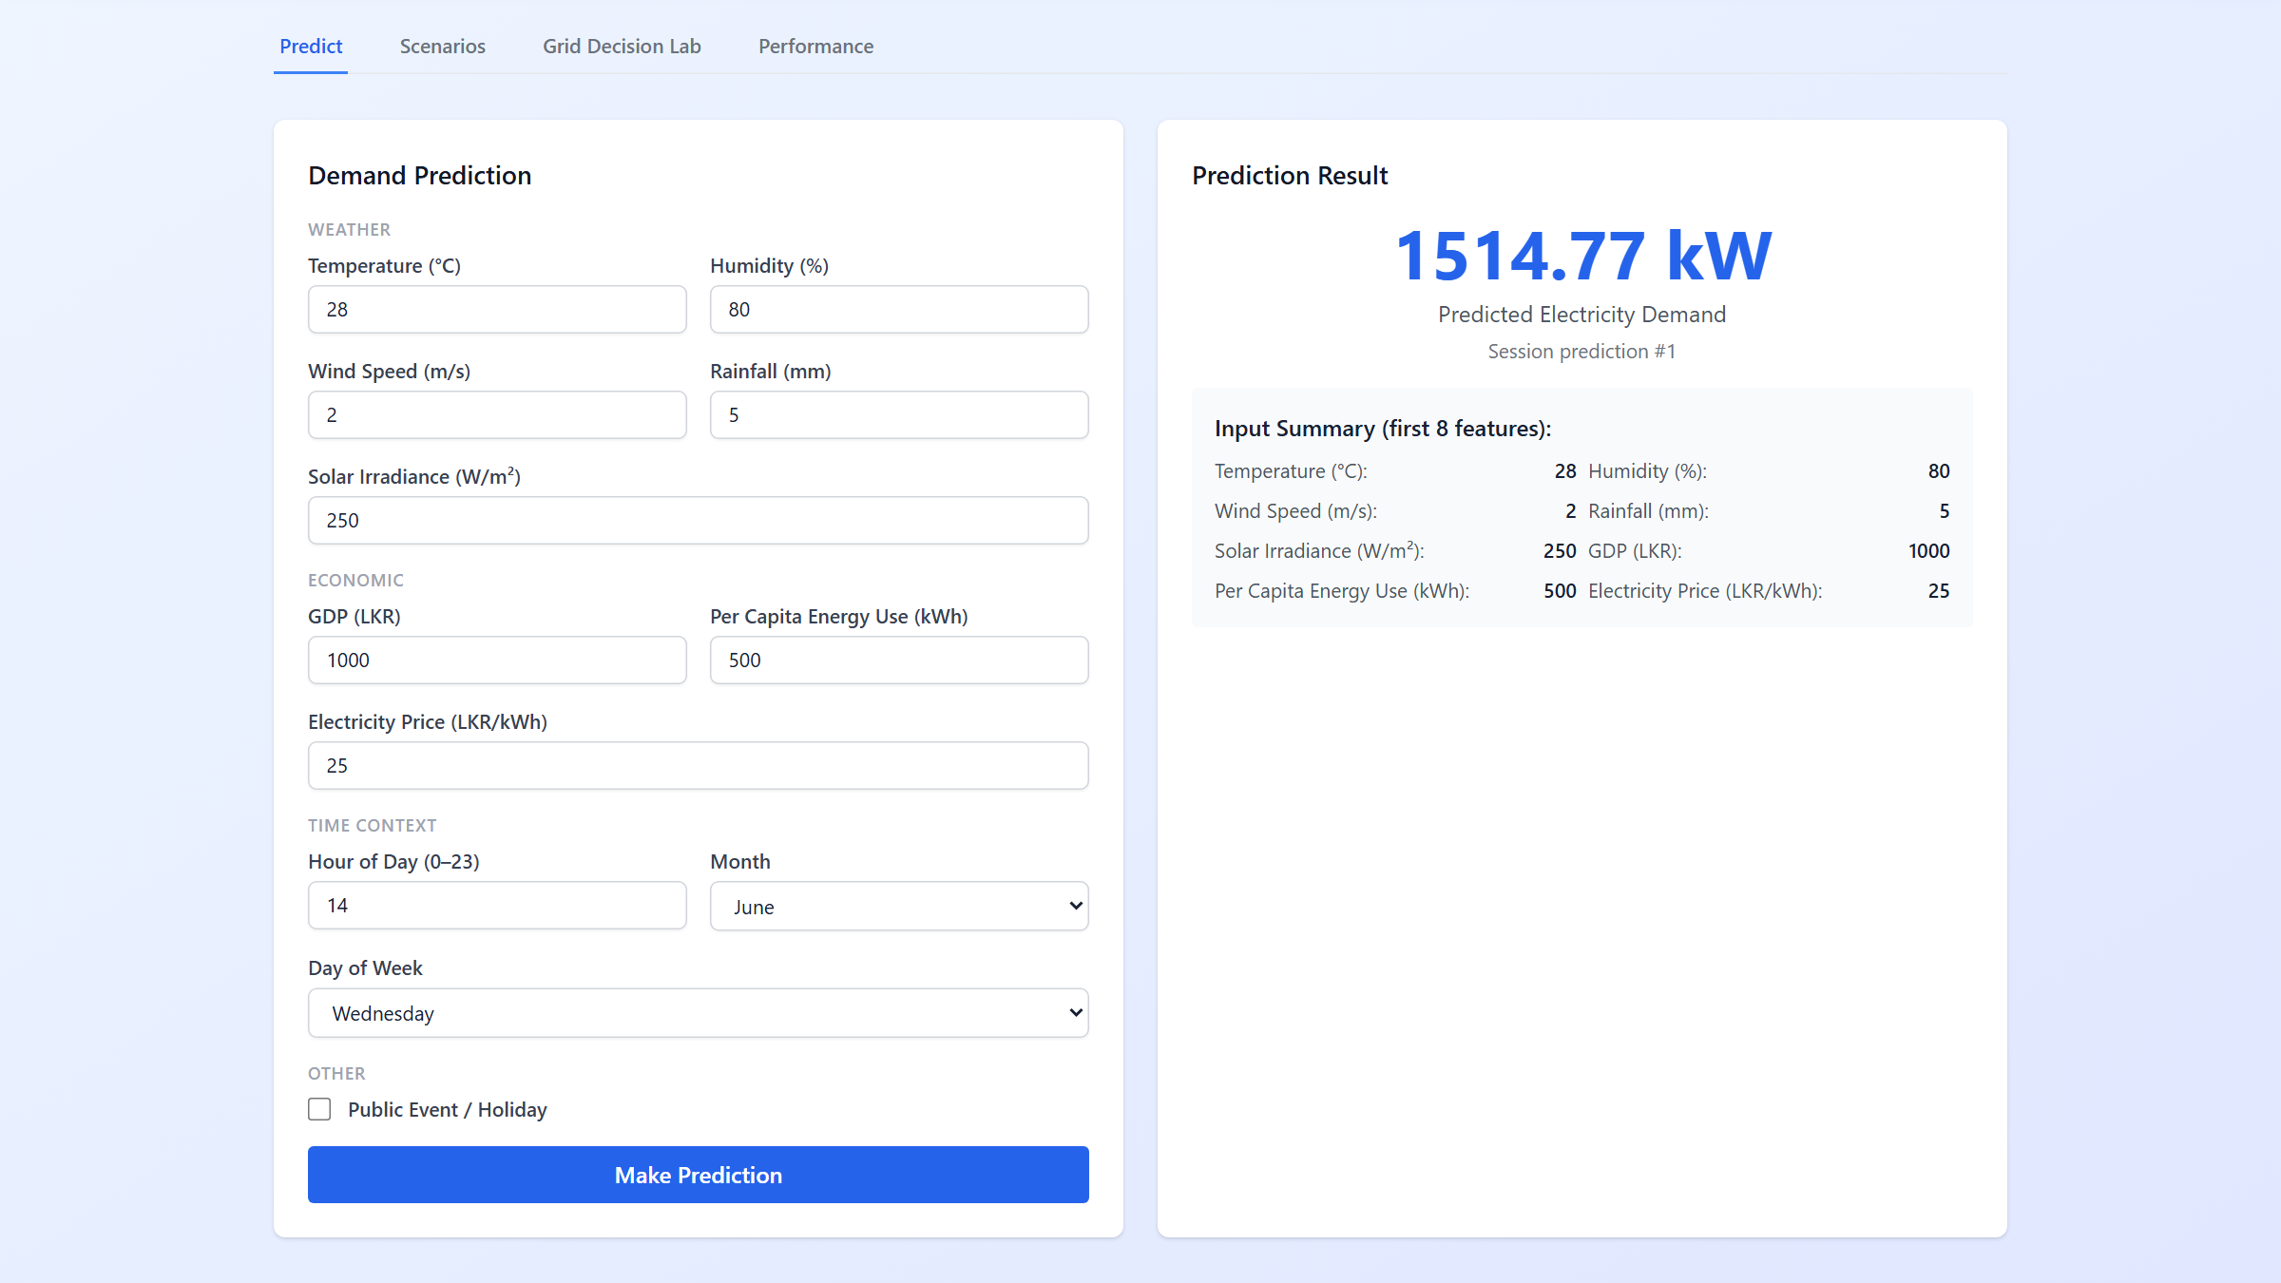
Demand Forecasting — Dashboard & Limitations
Predict tab: one demand prediction from 13 inputs
Grid Decision Lab: provincial overload risk
Limitations: synthetic practice data, so scores show the method, not real CEB accuracy
Regional demand shares and supply limits are illustrative assumptions
No lag features (previous-hour demand); future work: real CEB data and lag features
IT22630216 | Dewmini D.M.D.P | R26-IT-010
Notes:
[backup — Dewmini, about 40 seconds]
The Predict tab gives one prediction from the inputs. The Grid Decision Lab shows, hour by hour, which provinces could run short of supply, using the calibrated error distribution as an overload probability.
Limitations: the data is synthetic practice data, the regional shares are assumptions, and there are no lag features yet.

Slide 11
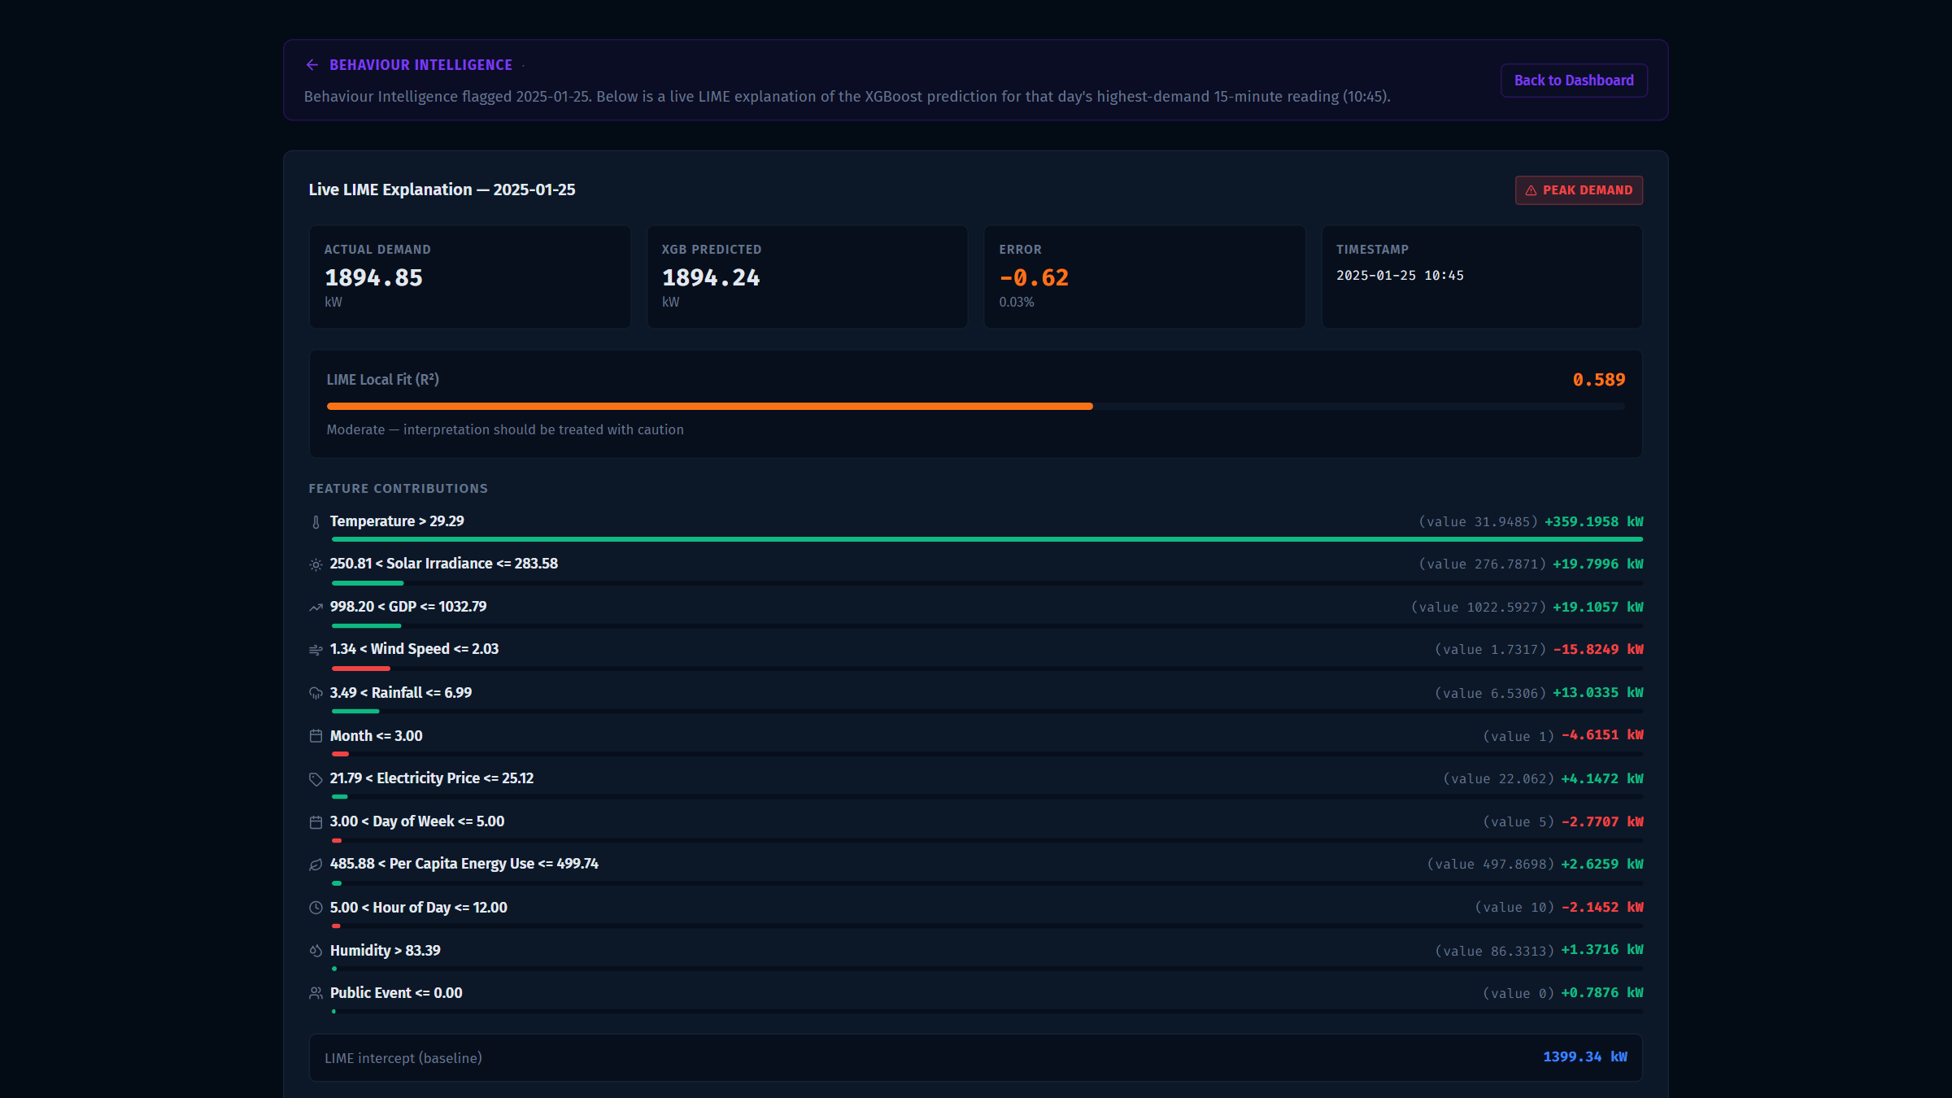
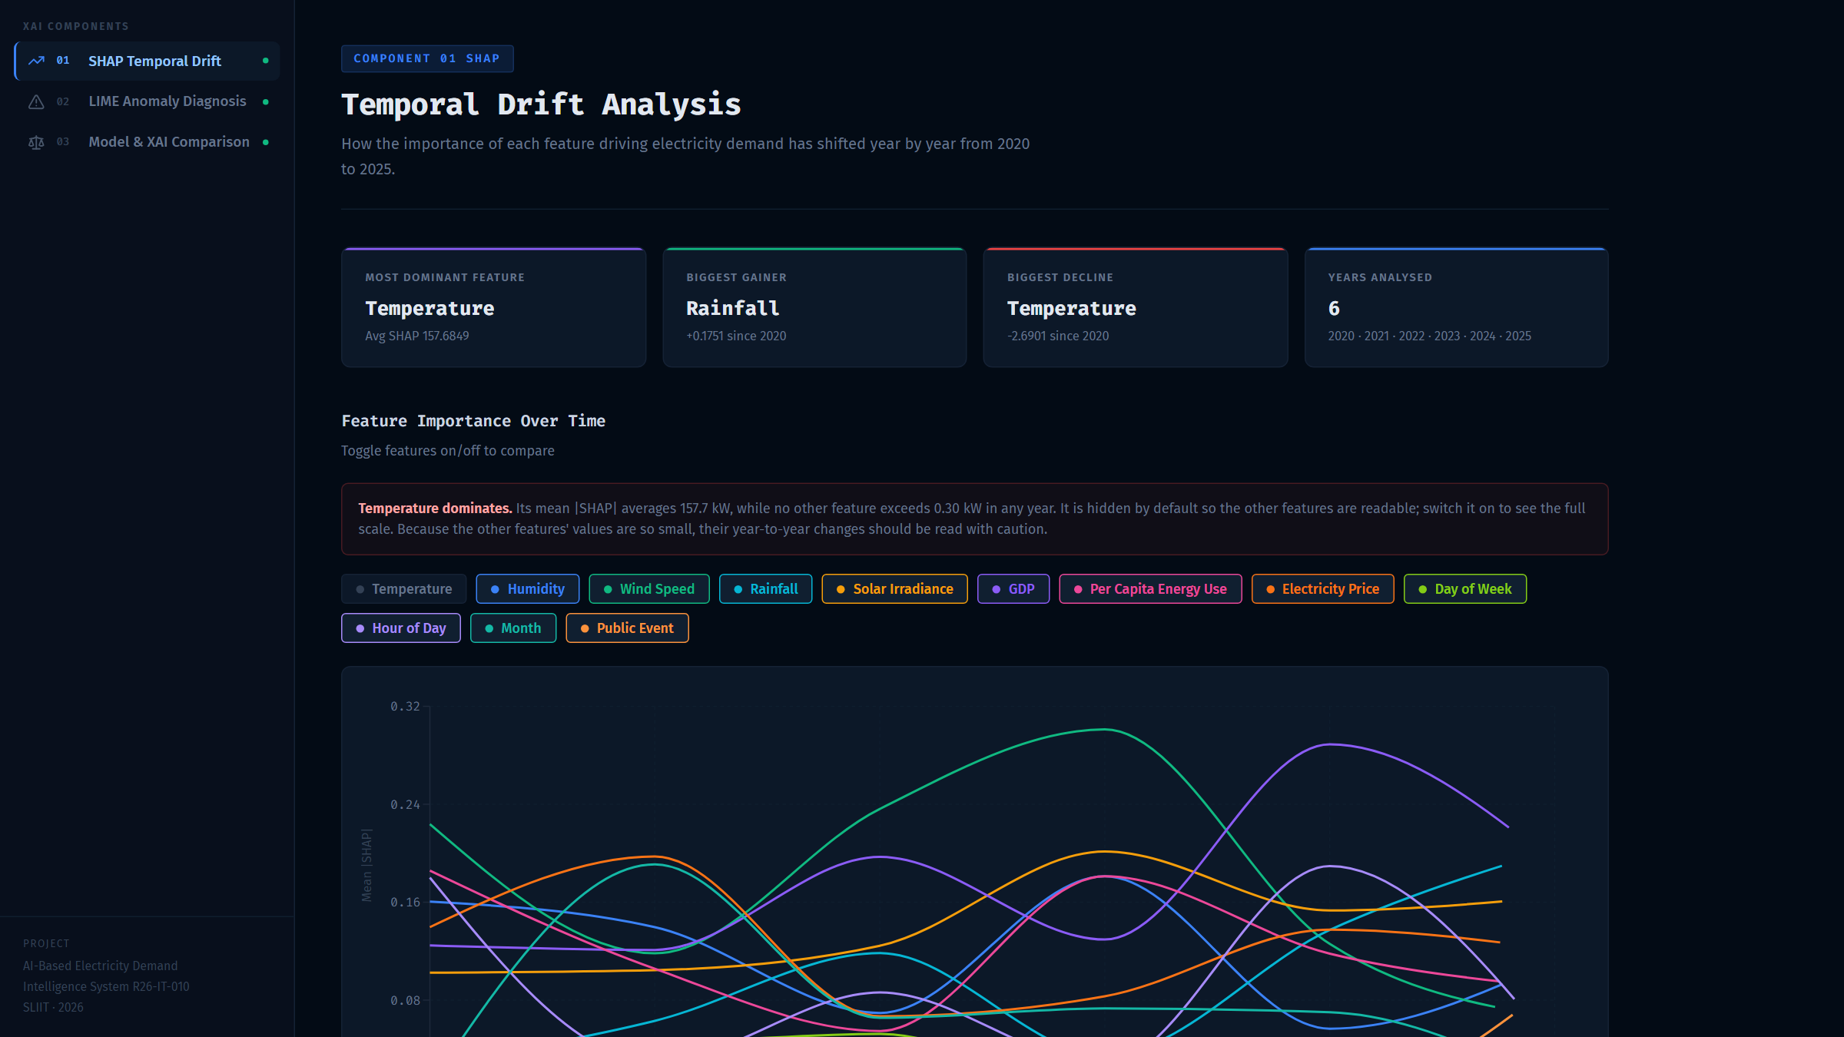
IT22273062 | Madushani R.P
Explainable AI: why the model predicts what it predicts
SHAP shows which features matter overall and whether that drifts over the years; LIME explains one reading and opens straight from Behaviour Intelligence.
Key results: XGBoost RMSE 2.02 kW · SHAP vs true effect r = 0.99994 · LIME picks the right top factor 100%
IT22273062 | Madushani R.P | R26-IT-010
Notes:
[about 1 minute — Madushani]
I am Madushani, IT22273062. My part is Explainable AI.
A forecast model gives a number. My part says WHY it gave that number.
I use an XGBoost model. Then I use two methods to explain it.
SHAP tells us which factors are important overall, and if that changes year by year.
LIME explains one single reading, for example one abnormal day.
In our data we know the true answer: demand is 100 times temperature minus 1300. So I could check the explanations. SHAP matches the true effect almost perfectly: r = 0.99994.
In the dashboard, the LIME button on an abnormal day opens my explanation directly.

Slide 12
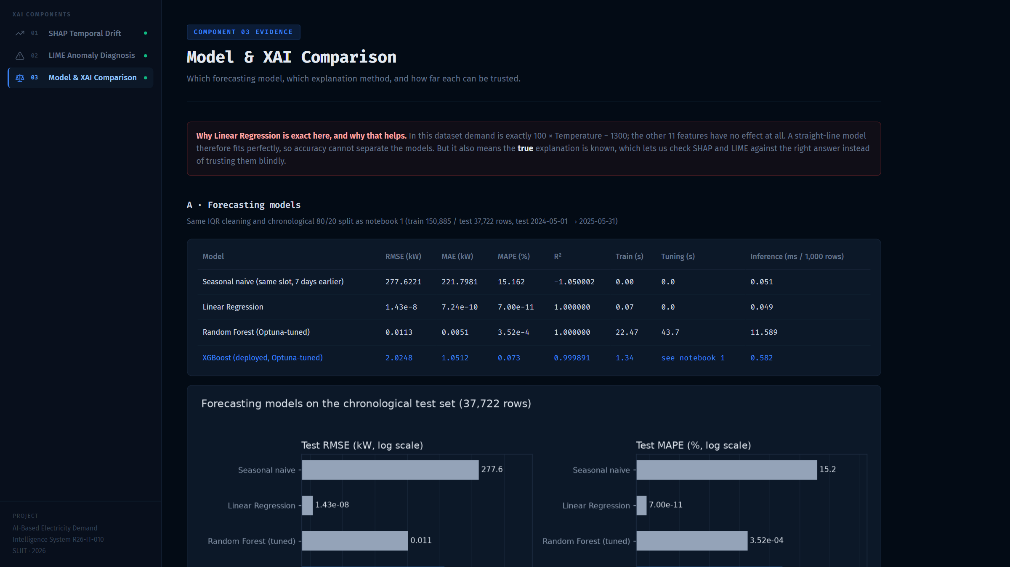
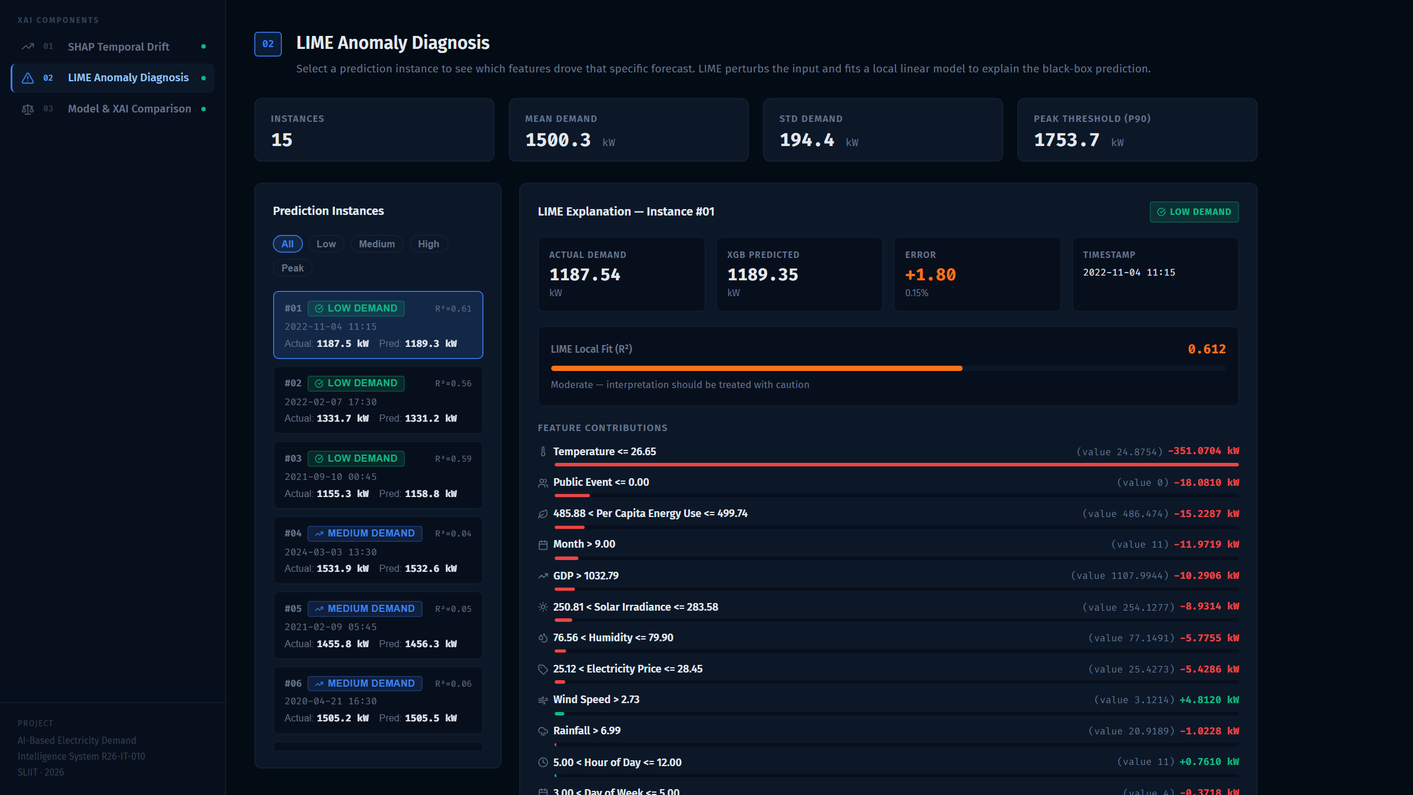
Explainable AI — Dashboard & Limitations
Page 03: model and XAI comparison
Page 02: LIME anomaly diagnosis
Limitations: synthetic data where demand is exactly linear in temperature
LIME fits poorly for medium demand (R² 0.06), so its confidence is shown
XAI uses a different dataset from BI, so kW values for a date can differ
IT22273062 | Madushani R.P | R26-IT-010
Notes:
[backup — Madushani, about 40 seconds. Say it slowly.]
My dashboard has three pages: SHAP drift over the years, LIME diagnosis, and the model comparison.
Limitations: our data is synthetic and very simple. LIME is weaker for medium demand, so the page shows its confidence. My dataset is different from Behaviour Intelligence, so kW values for the same date can differ.

Slide 13
Thank you
Notes:
These slides are for questions. Jump to the member's section when the panel asks for details.

Slide 14
Backup Slides
Detailed evidence for each component, for the panel's questions
Notes:
These slides are for questions. Jump to the member's section when the panel asks for details.

Slide 15
Commercialization Plan — Value Proposition & Customers
Problem
Target customer | What they get
Ceylon Electricity Board (CEB): system control & planning | Peak planning, abnormal-day alerts, forecasts
Lanka Electricity Company (LECO) | Distribution-area demand planning
Public Utilities Commission of Sri Lanka (PUCSL), regulator | Transparent, explainable evidence for review
Large industrial & commercial consumers | Plan own load around peak hours
Solar & battery operators | Match generation and storage to demand
Planners need: day behaviour, unusual days, future demand
…and WHY the models predict what they predict
Value proposition
Better peak planning, fewer surprises
Explainable, trustworthy decisions
One integrated web platform with secure login
Four modules: behaviour, forecasting, neural forecasting, XAI
Users (the platform's login roles):
Grid Planner · Analyst · Engineer · Researcher
Notes:
Presenter: [CHECK — group decides]
[about 50 seconds]
Now our commercialization plan.
The problem: planners need to know how each day behaves, which days are unusual, what demand will be, and why the models say so.
Our value: better peak planning, fewer surprises, and decisions that can be explained and trusted, all in one web platform with a secure login and four modules.
Our main customer is the Ceylon Electricity Board, for system control and planning, then LECO for distribution areas. PUCSL, the regulator, benefits from transparent, explainable evidence. Large industrial and commercial consumers, and solar and battery operators, can plan their own load.
The users match the four login roles we already built: grid planner, analyst, engineer and researcher.

Slide 16
Commercialization Plan — Go-to-Market & Competitive Advantage
Go-to-market roadmap (phases; timing to be agreed with partners — assumption)
1 Pilot
One CEB region / area with real metered data
2 Validate
Accuracy on real data + user feedback
3 Roll out
Full CEB and LECO deployment
4 Expand
Industrial consumers + other South Asian utilities
Competitive advantage
Integrated: behaviour + forecasting + explainability in one place
Explainable AI (SHAP, LIME) builds operator trust
Tuned and validated models, with honest uncertainty
Local context: Poya days, Sri Lankan public events, weather
Modular and web-based: add modules, cloud or on-premise
Built on open-source tools: no licence lock-in
Notes:
Presenter: [CHECK — group decides]
[about 55 seconds]
Our go-to-market plan has four steps.
First, a pilot with one CEB region or area, using real metered data.
Second, we validate: we measure accuracy on the real data and collect feedback from the planners.
Third, a full rollout to CEB and LECO.
Fourth, we expand to large industrial consumers and to other utilities in South Asia.
The timing will be agreed with partners; it is an assumption for now.
Why us? Behaviour, forecasting and explanations are in one place. The explanations build trust. Our models are tuned and validated and show their uncertainty. We include local context such as Poya days and Sri Lankan public events. And the platform is modular and web-based, so it can run in the cloud or on the utility's own servers.

Slide 17
Commercialization Plan — Business Model & Pricing
Software-as-a-Service (SaaS) subscription in three tiers
 | Basic | Professional | Enterprise
Includes | Dashboard + behaviour labels, anomaly alerts | Basic + demand forecasting + what-if scenarios | Professional + Explainable AI, custom models, API access
Deployment | Cloud (web) | Cloud (web) | Cloud or on-premise for utilities
Best for | Analysts, consumers | Planning teams, operators | CEB, LECO, regulator
Price | Indicative: lowest tier | Indicative: mid tier | Indicative: quoted per utility
Additional revenue (services)
Pricing note
All prices are indicative and must be validated with customers during the pilot (assumption). No market figures are claimed.
One-time setup and data integration
User training workshops
Annual support and maintenance contract
Notes:
Presenter: [CHECK — group decides]
[about 50 seconds]
Our business model is Software-as-a-Service: a subscription in three tiers.
Basic gives the dashboard, behaviour labels and anomaly alerts.
Professional adds demand forecasting and what-if scenarios.
Enterprise adds Explainable AI, custom models, API access, and an on-premise option, which utilities like CEB usually need for their data.
On top of subscriptions we earn from services: setup and data integration, training, and a yearly support contract.
We are careful here: the prices are only indicative. We will set real prices after the pilot, with customer feedback. We do not claim any market figures.

Slide 18
Commercialization Plan — Costs, Risks & Mitigation
Main costs (to be estimated in the pilot — assumption):
hosting (cloud or on-premise) · development & maintenance · data integration · user support
SWOT (summary)
Strengths
Integrated, explainable, local context
Weaknesses
Validated on synthetic data so far
Risk | Mitigation
Access to real utility data | Start with one pilot area under a data-sharing agreement
Data privacy & security | On-premise option; hashed passwords, signed sessions
Regulatory approval | Engage PUCSL early; explainable outputs for audit
Model accuracy on real data | Retrain and re-validate on pilot data before rollout
User adoption | Training, simple dashboard, ongoing support
Opportunities
Grid planning needs; solar & battery growth
Threats
Data access, established vendors, budgets
Notes:
Presenter: [CHECK — group decides]
[about 55 seconds]
Our main costs are hosting, either cloud or on the utility's servers, development and maintenance, data integration, and user support. We will estimate them properly during the pilot.
The biggest risk is access to real utility data; we start with one pilot area under a data-sharing agreement.
For privacy and security we offer on-premise deployment, and the login already stores only hashed passwords and uses signed sessions.
For regulatory approval we involve PUCSL early, and our explainable outputs support audits.
For accuracy, we retrain and re-validate on the pilot data before any rollout.
For adoption, we train users and keep the dashboard simple.
In short, our strengths are integration, explainability and local context. Our main weakness, to be honest, is that the models are validated on synthetic data so far, which is exactly what the pilot fixes.

Slide 19
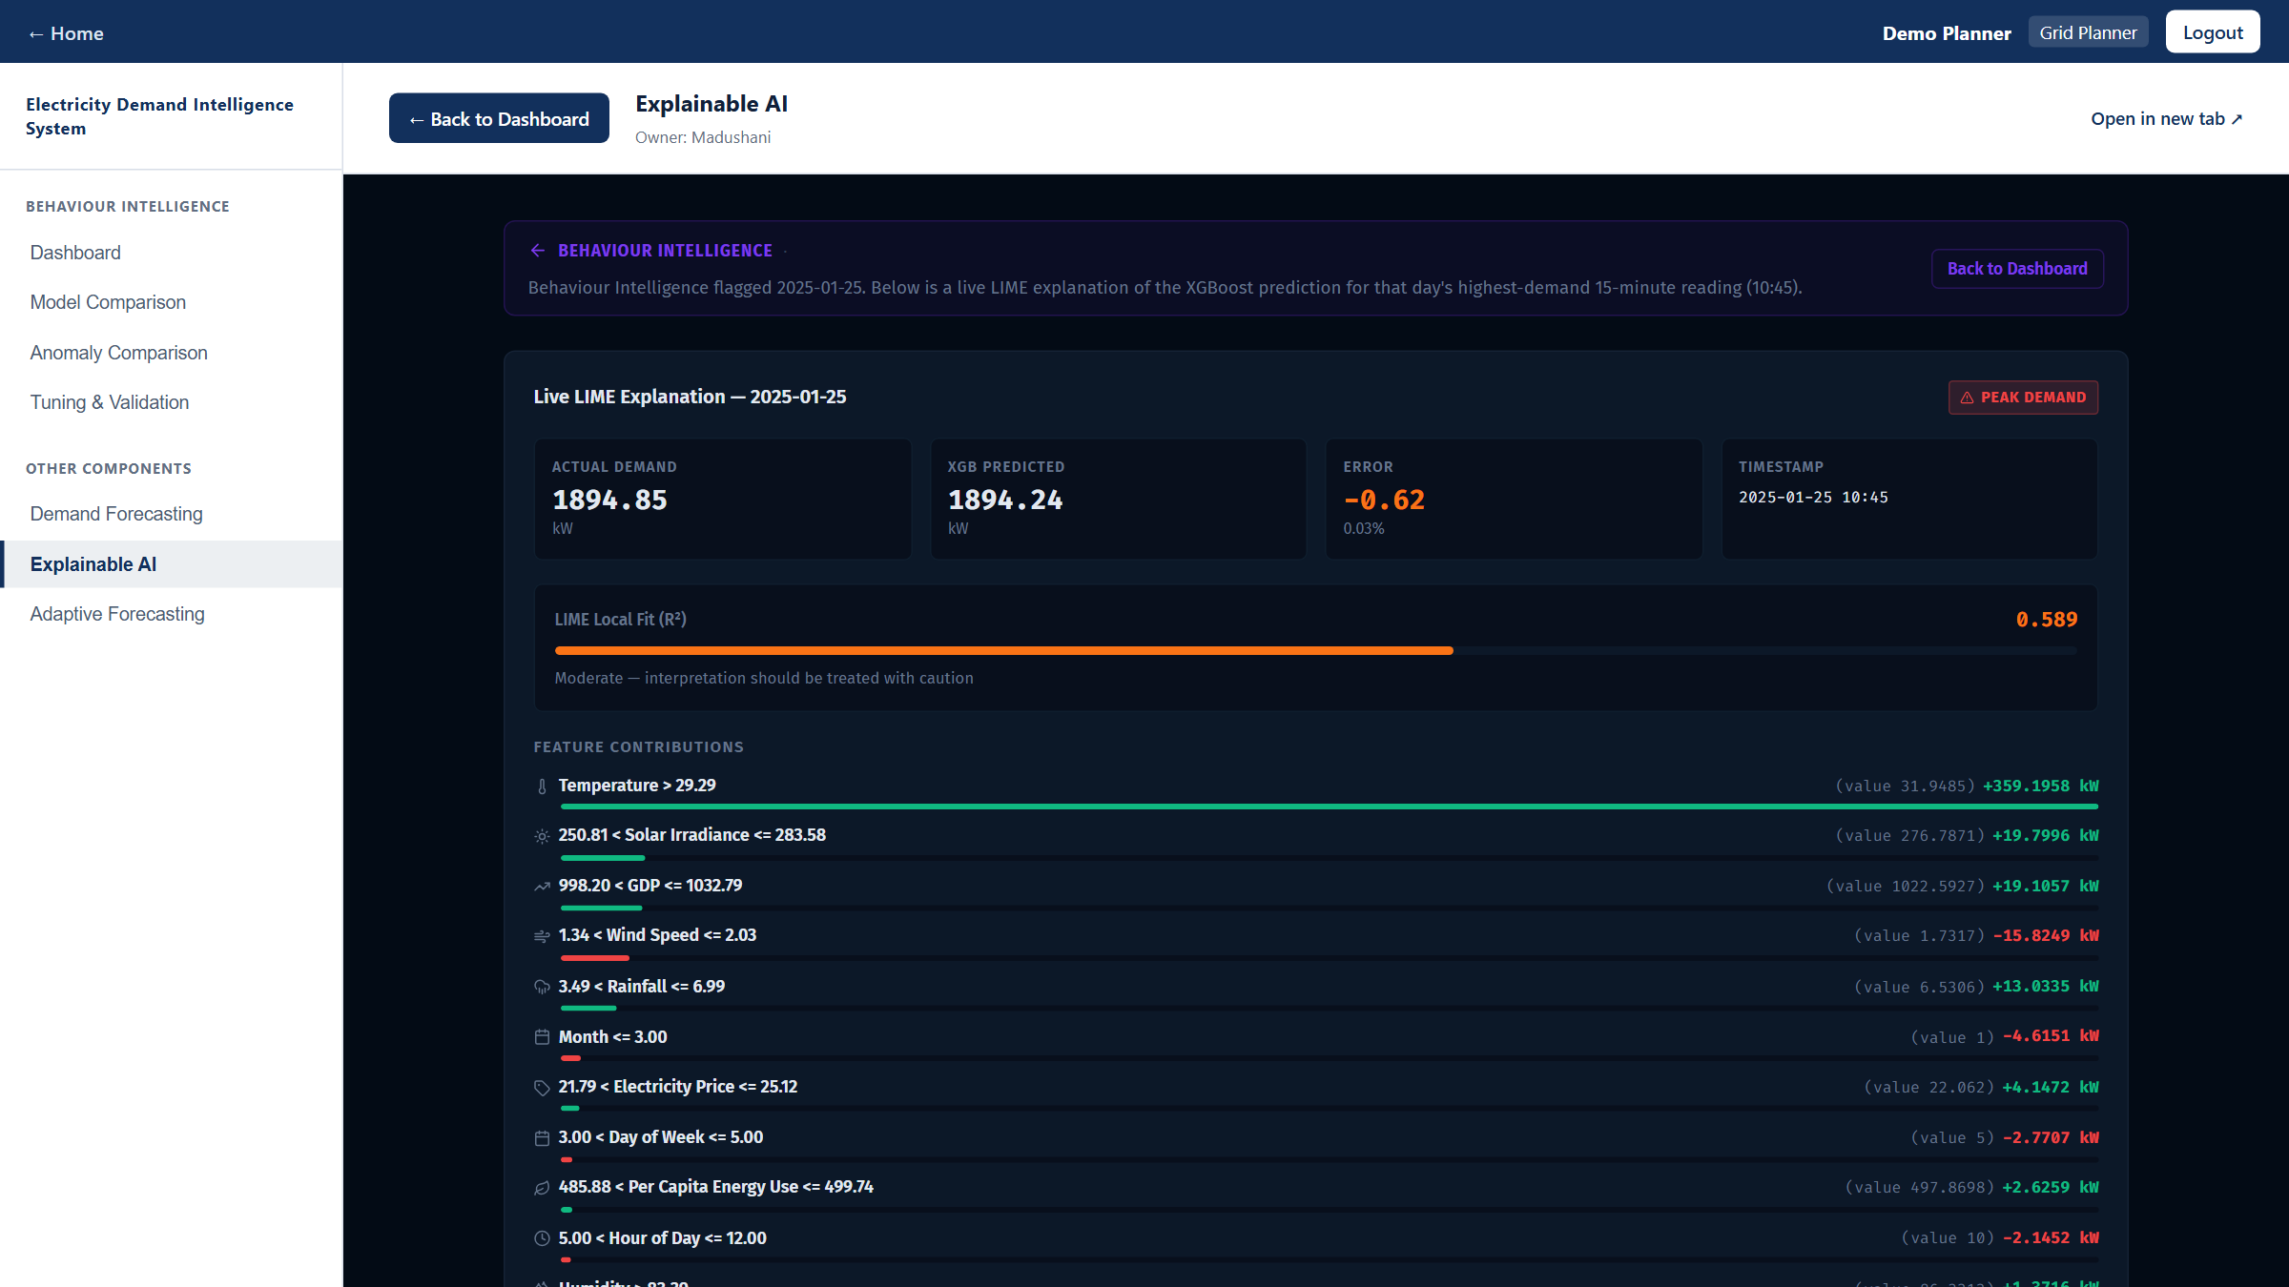

Technologies & Integrated System
Layer | Technologies
Frontend (all 4 apps) | React + Vite; Recharts charts; Tailwind CSS (scenarios); React Router (XAI)
Backend (all 4 apps) | Python FastAPI + Uvicorn REST APIs, one virtual environment per component
Machine learning | scikit-learn, XGBoost, TensorFlow / Keras, Optuna, SHAP, LIME
Data & evidence | pandas, NumPy, Jupyter notebooks, saved JSON / CSV results
Integration | start-all.py launcher; iframes; LIME deep link; login (PBKDF2 hashes, signed token)
LIME explanation for 2025-01-25 opened inside the BI dashboard
Notes:
[about 40 seconds]
All four apps use the same stack: React with Vite on the front, FastAPI in Python on the back. The machine learning uses scikit-learn, XGBoost, TensorFlow with Keras, Optuna for tuning, and SHAP and LIME for explanations.
Integration: one launcher starts everything, the shell embeds the other apps, and the login uses salted password hashes and a signed session token. The screenshot shows a LIME explanation opened inside the Behaviour Intelligence dashboard.

Slide 20
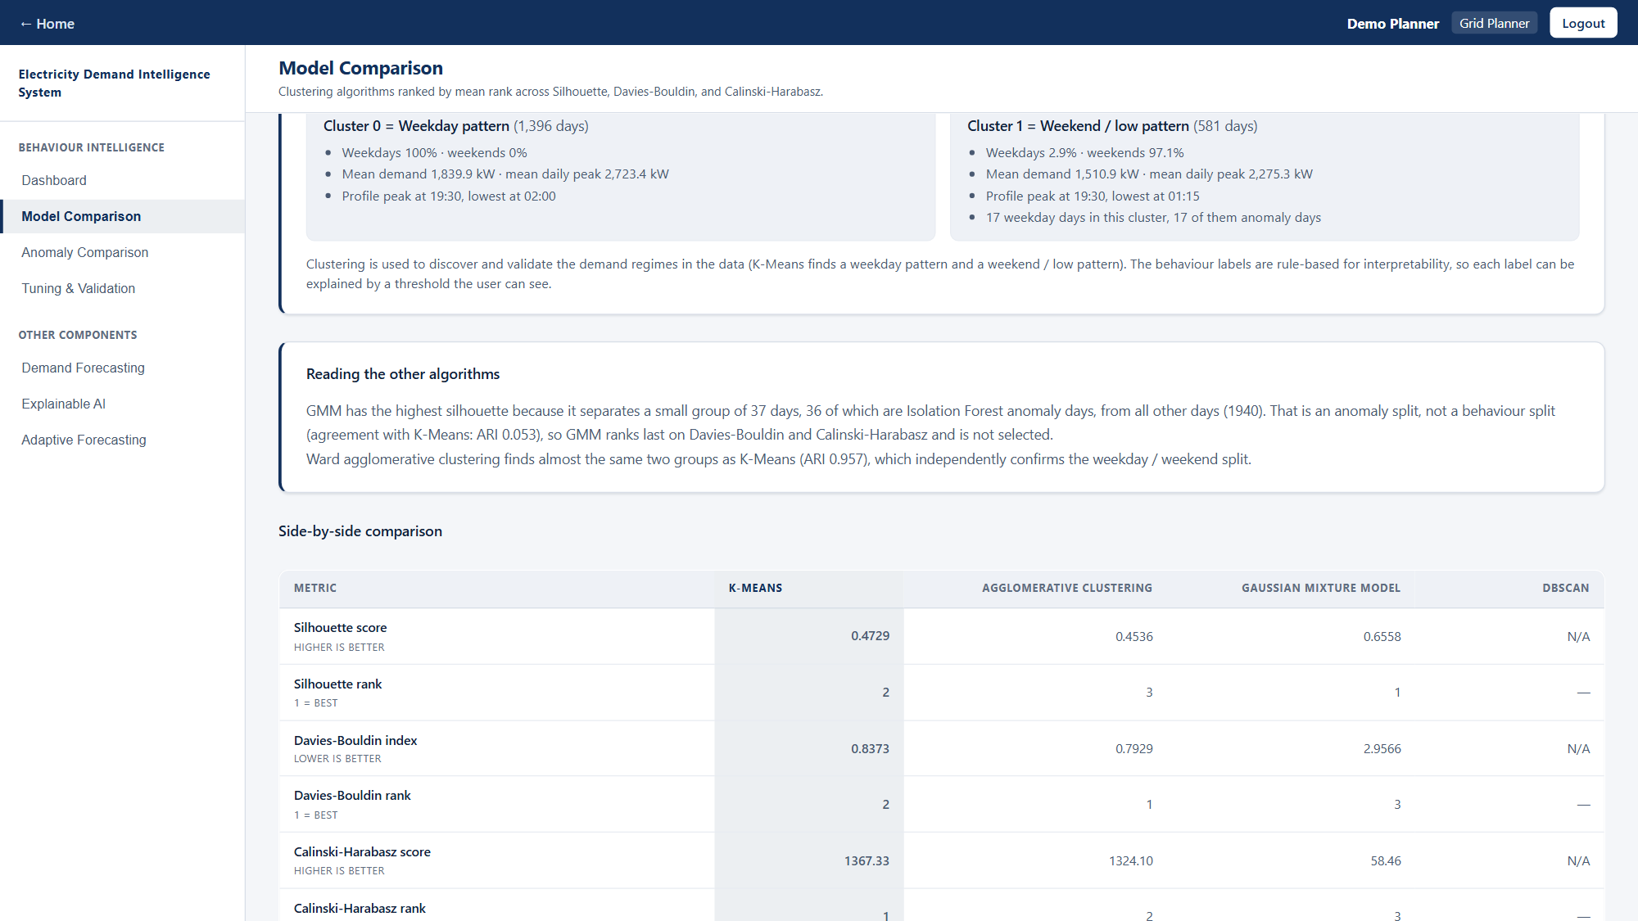
Behaviour Intelligence — Methodology & Models
Pipeline
15-min load → 3×IQR cleaning → 1,977 daily profiles (96 slots)
StandardScaler → K-Means groups days into regimes
DBSCAN density check; Isolation Forest flags anomalies
Rules label Normal / Low / Peak / Abnormal + risk
Future date: month + weekday history, Laplace-smoothed
Why these models
No labels exist, so unsupervised models are needed
K-Means: best on all 3 cluster indices, simple to explain
Isolation Forest: no labels, gives a score per day
Rules on top keep every label explainable
Cluster 0 = weekday pattern (1,396 days); Cluster 1 = weekend / low pattern (581 days)
IT22545176 | Thanujan T | R26-IT-010
Notes:
[backup — Thanujan, about 45 seconds]
The pipeline: clean the 15-minute data, build one 96-point profile per day, scale it, and cluster. K-Means finds the regimes; DBSCAN is a density check; Isolation Forest flags anomaly days. Rules on top give each day its label and risk.
Why these models: we have no labels, so unsupervised methods are needed. K-Means is best on all three indices and easy to explain. Isolation Forest needs no labels and gives a score for every day. The screenshot shows what the two clusters mean.

Slide 21
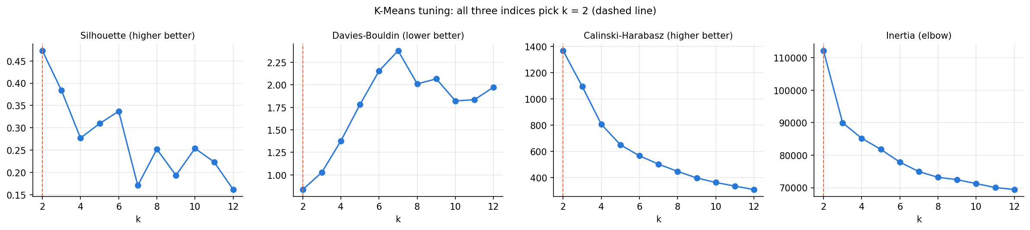
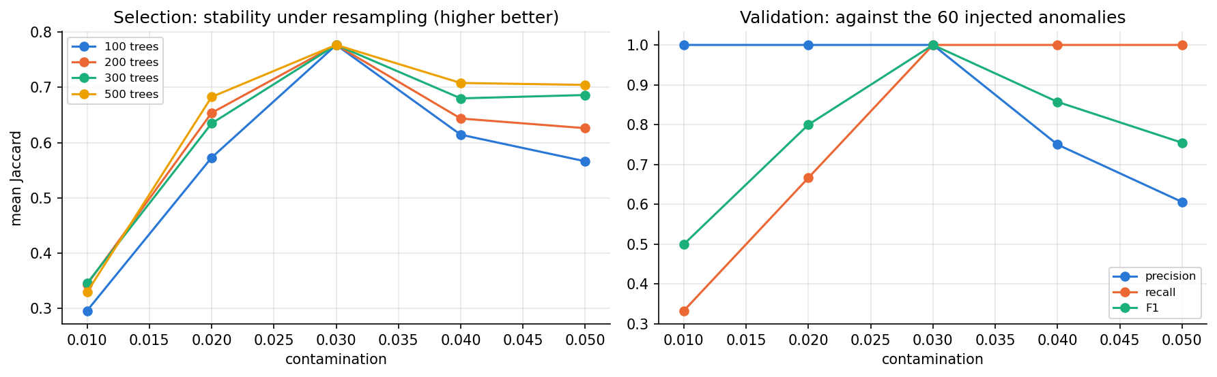
Behaviour Intelligence — Parameters & Fine-Tuning
Principle: choose without labels, then validate on ground truth
k = 2: silhouette 0.473, Davies–Bouldin 0.837, Calinski–Harabasz 1,367 all agree
DBSCAN eps from k-distance knee (4.42), min_samples 8
Isolation Forest: 60-setting grid × 20 bootstrap refits
contamination 0.03 most stable; trees and max_samples make no difference
Honest note: 0.03 equals the injected anomaly rate; two threshold-free methods (contamination='auto', largest score gap) find the same 60 days.
Notebook 07 and the dashboard's Tuning & Validation page
IT22545176 | Thanujan T | R26-IT-010
Notes:
[backup — Thanujan, about 50 seconds]
Notebook 07 tunes every parameter. First I choose without labels, as on real data: for k, three quality indices; for DBSCAN, the knee of the k-distance curve; for Isolation Forest, stability when refitting on random 80% samples.
Then I validate on the known ground truth. All three indices pick k = 2. Contamination 0.03 is the most stable, and the number of trees and samples makes no difference.
Honestly, 0.03 is the injected rate, but two threshold-free methods find the same 60 days without choosing any rate.

Slide 22
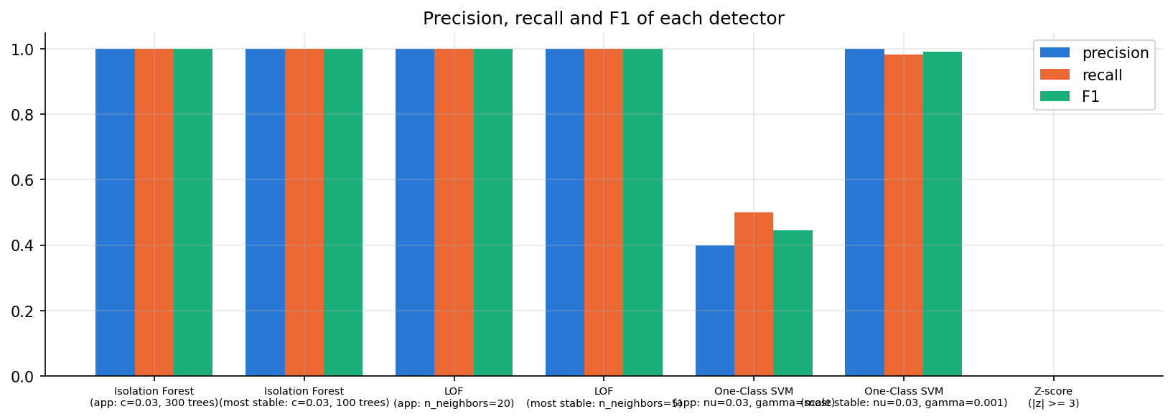
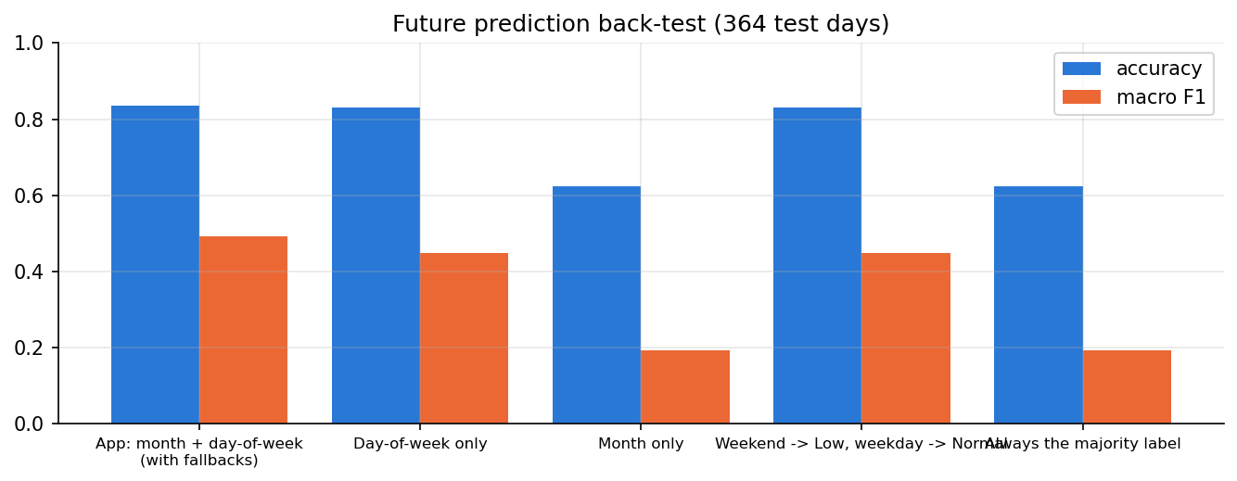
Behaviour Intelligence — Model Comparison & Results
Model | Role | Result
K-Means (k = 2) | chosen | ARI 0.965 vs weekday / weekend (1.0 without anomaly days)
Ward clustering | comparison | also best at k = 2; ARI 0.957 with K-Means
Gaussian Mixture | rejected | small group of 37 days, 36 of them anomalies
DBSCAN | density check | 1 cluster + 60 noise days = the 60 anomalies
Isolation Forest | chosen | 60 days flagged; precision = recall = F1 = 1.00
LOF / One-Class SVM | comparison | LOF same 60 days; OCSVM P 0.40, R 0.50 (default gamma)
Labels: Normal 1,279 · Low 465 · Peak 212 · Abnormal 21
60 anomaly days = 21 Abnormal + 39 Peak (high-peak anomalies)
Future label back-test: 83.5% vs 62.4% majority baseline
IT22545176 | Thanujan T | R26-IT-010
Notes:
[backup — Thanujan, about 50 seconds]
Clustering: K-Means k = 2 matches weekday and weekend with ARI 0.965, and 1.0 if the anomaly days are removed. Ward agrees. The Gaussian Mixture only isolates anomaly days, so it was rejected. DBSCAN's noise points are exactly the 60 anomalies.
Anomalies: Isolation Forest finds all 60 with no false alarms; LOF agrees; One-Class SVM is weak with its default setting.
Final labels: 1,279 Normal, 465 Low, 212 Peak, 21 Abnormal. The future-label back-test reaches 83.5% against a 62.4% baseline.

Slide 23
Addressing PP2 Feedback — Thanujan
PP2 comment | What was done | Evidence
Moderate idea about clustering | Compared K-Means, Ward, GMM and DBSCAN; explained what each cluster means | Weekday 1,396 / weekend 581 days; ARI 0.965; Ward ARI 0.957
Why the models were selected | Unsupervised selection by indices and stability, then ground-truth validation | All 3 indices pick k = 2; Isolation Forest P = R = F1 = 1.00
Parameters used, and why | Final parameter table: value, how chosen, evidence, reason | 18 parameters documented (notebook 07, table T13)
Need fine-tuning | Grid searches for k, eps, contamination, trees, max_samples, thresholds | 60-setting Isolation Forest grid × 20 refits; threshold ±5 sensitivity
IT22545176 | Thanujan T | R26-IT-010
Notes:
[backup — Thanujan, about 40 seconds]
For clustering, I compared four methods and explained what each cluster means. For model selection, every choice comes from unsupervised indices and stability, and is then checked against ground truth. Every parameter is documented with how and why it was chosen. Fine-tuning is done with grid searches in notebook 07, and the results are shown on the dashboard.

Slide 24
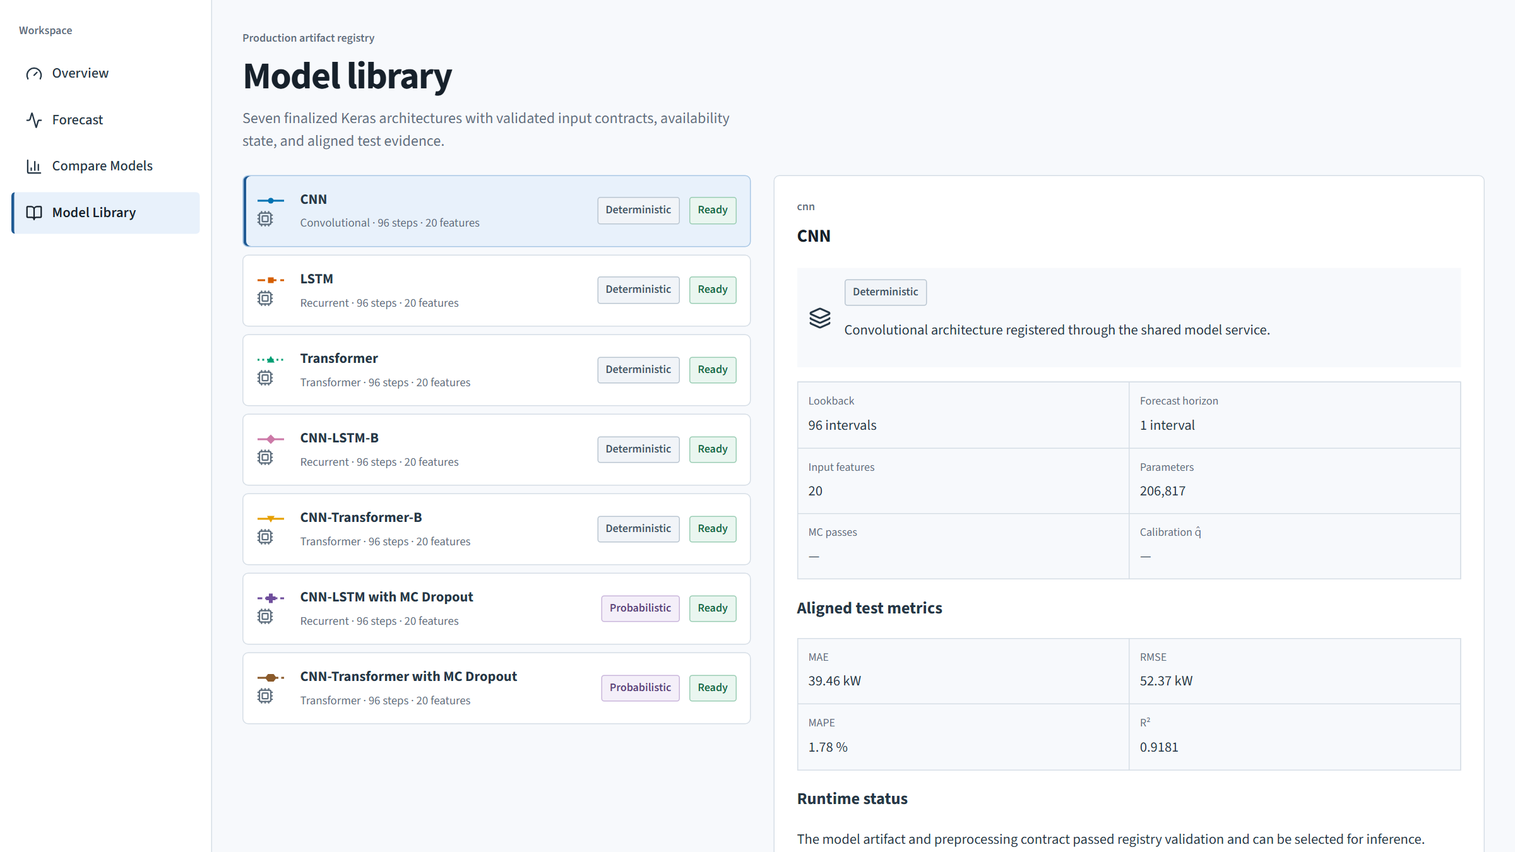
Neural Forecasting — Models & Architecture
Input: last 24 hours = 96 steps × 20 features
Features: weather, cyclic calendar, Poya / public events, load lags
7 models: CNN, LSTM, Transformer, CNN-LSTM, CNN-Transformer (+ MC Dropout)
CNN finds short patterns; LSTM / attention learn longer patterns
Output: the next 15-minute load (kW), one step ahead
Default model CNN-LSTM-B
Model library: all 7 models with the same 96 × 20 input contract
Conv1D 64 → Conv1D 32 (causal) → LSTM 128 → LSTM 64 → Dense 64 → Dropout 0.2 → 1 output
146,145 parameters
IT22069740 | Janahan R | R26-IT-010
Notes:
[backup — Janahan, about 45 seconds]
Every model gets the same input: the last 24 hours, 96 steps, with 20 features, and predicts the next 15-minute value.
I built seven models: CNN, LSTM, Transformer, and two hybrids, CNN-LSTM and CNN-Transformer, plus Monte Carlo Dropout versions for uncertainty.
The CNN layers find short local patterns, and the LSTM or attention layers learn the longer daily pattern. The default CNN-LSTM-B has two convolution layers, two LSTM layers and a dense output, about 146 thousand parameters.

Slide 25
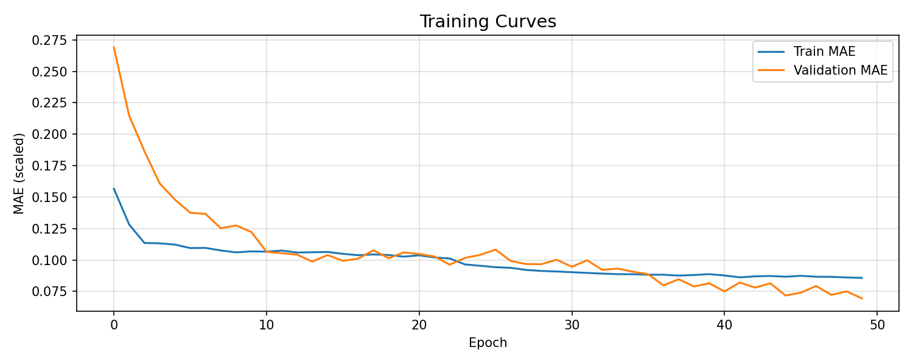
Neural Forecasting — Training Parameters & Optimisation
Parameter | Value | Why
Lookback | 96 steps | one full day of 15-min readings
Split | 80 / 10 / 10, chronological | no future data leaks into training
Optimiser | Adam, learning rate 0.001 | stable default for deep nets
Loss | MAE | robust to demand spikes
Batch size / epochs | 128 / up to 50 | early stopping decides
Early stopping | patience 15, restore best | stops before over-fitting
Learning-rate schedule | ×0.5 after 8 flat epochs, min 1e-5 | finer steps near the optimum
Dropout | 0.2 | regularisation; MC sampling
CNN-LSTM-B training curves (train vs validation MAE)
[CHECK] Was any automated hyperparameter search (grid / Optuna) run? None is recorded in the model folders; confirm with Janahan.
IT22069740 | Janahan R | R26-IT-010
Notes:
[backup — Janahan, about 50 seconds]
These are my training parameters and the reason for each. A lookback of 96 steps is one full day. The split is chronological so the model never sees the future. Adam with learning rate 0.001, MAE loss because it is robust to spikes, batch size 128.
Optimisation: early stopping with patience 15 keeps the best weights, and the learning rate is halved when validation stops improving. The training curves show train and validation error converging.
[CHECK] If you ran any extra hyperparameter search, mention it here.

Slide 26
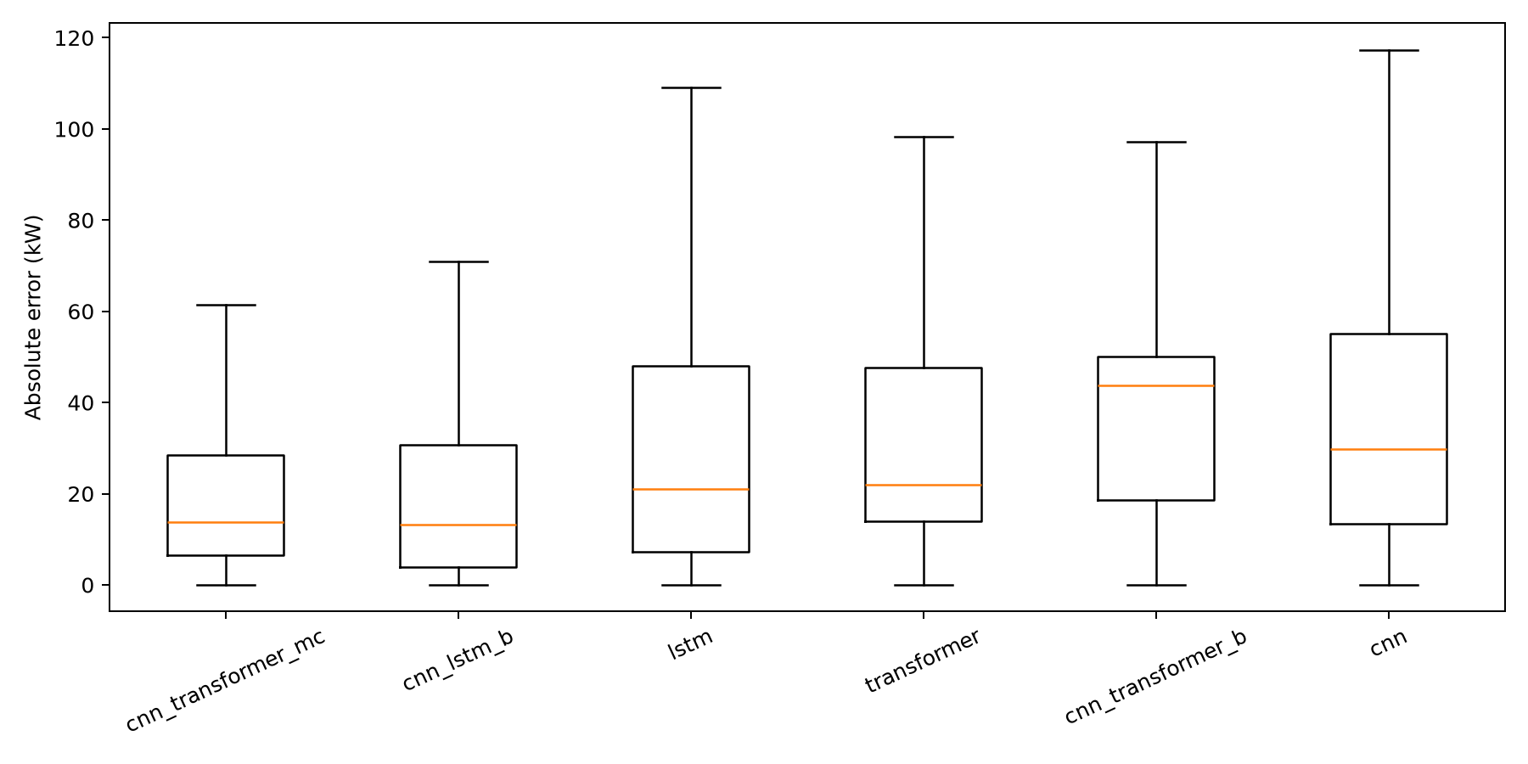
Neural Forecasting — Model Comparison
Hybrid models win: CNN-Transformer MC MAE 20.46 kW, CNN-LSTM-B 20.52 kW
Their difference is not significant (p = 0.90), so the simpler CNN-LSTM-B is the default
Both are clearly better than LSTM, Transformer and CNN alone (p ≈ 0.001)
CNN-LSTM MC is not ranked: its prediction file was not saved
IT22069740 | Janahan R | R26-IT-010
Notes:
[backup — Janahan, about 45 seconds]
All six saved models are compared on exactly the same 18,817 test windows. The two hybrids are clearly best. CNN-Transformer with MC Dropout has the lowest error, 20.46 kW, but its lead over CNN-LSTM-B is only 0.06 kW and not statistically significant, p = 0.90. So I use the simpler CNN-LSTM-B as the default. Both hybrids beat the single models with p around 0.001.

Slide 27
Addressing PP2 Feedback — Janahan
PP2 comment | What was done | Evidence
Moderate idea on models used | 7 architectures explained with the same 96 × 20 input and one-step output | Model library + architecture of the default CNN-LSTM-B
Clear, specific idea on parameter considerations | Each training setting documented with its reason | Lookback 96, Adam 0.001, MAE loss, batch 128, dropout 0.2
Elaborate on optimisation | Early stopping, learning-rate schedule, best checkpoint; MC Dropout calibration | 6-model ranking with significance tests; 95% band covers 96.3%
IT22069740 | Janahan R | R26-IT-010
Notes:
[backup — Janahan, about 40 seconds]
For models: all seven architectures are explained on the same input contract. For parameters: every training setting is documented with its reason. For optimisation: early stopping, a learning-rate schedule, best-checkpoint saving, a significance-tested comparison, and calibrated uncertainty.

Slide 28
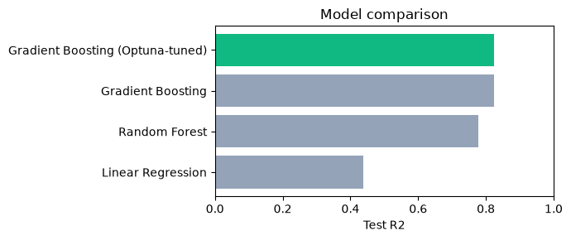
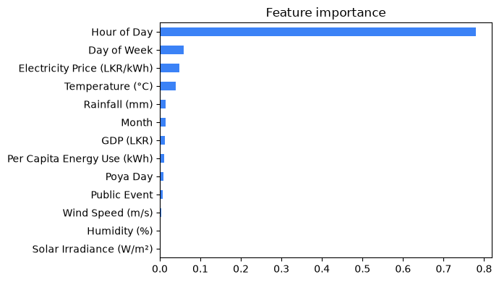
Demand Forecasting — Models & Why
13 inputs: weather, economy, calendar (incl. Poya days)
Same 80/20 split for all: 151,910 train / 37,978 test rows
Linear Regression, Random Forest, Gradient Boosting compared
Gradient Boosting captures curved effects (air-conditioning above ~26 °C)
Best R² and MAE, so it was tuned and deployed
Hour of day is the strongest input, then day of week, price and temperature.
IT22630216 | Dewmini D.M.D.P | R26-IT-010
Notes:
[backup — Dewmini, about 45 seconds]
My model uses 13 inputs: five weather, three economic and five calendar features, including Poya days. All three models are trained on the same split. Linear Regression can only draw straight lines; Random Forest and Gradient Boosting can follow curves, for example air-conditioning load that only starts above about 26 degrees. Gradient Boosting gives the best R-squared and error, so it is tuned and deployed. Hour of day is the strongest input.

Slide 29
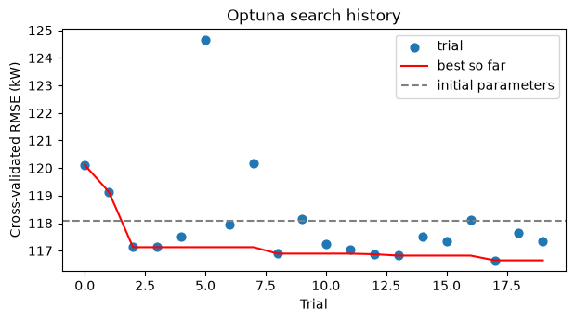
Demand Forecasting — Parameters & Optuna Optimisation
Hyperparameter | Search range | Chosen
n_estimators | 100 – 300 (step 50) | 250
max_depth | 3 – 7 | 3
learning_rate | 0.03 – 0.2 (log) | 0.0984
subsample | 0.6 – 1.0 | 0.860
min_samples_leaf | 5 – 80 (log) | 39
max_features | 0.5 – 1.0 | 0.869
Optuna TPE, 20 trials, 3-fold CV on training data only
Cross-validated RMSE 118.09 → 116.65 kW
Honest: test score unchanged (R² 0.825 → 0.824); tuned model is shallower
Optuna search history (each dot = one trial)
IT22630216 | Dewmini D.M.D.P | R26-IT-010
Notes:
[backup — Dewmini, about 50 seconds]
I tuned six hyperparameters with Optuna. Each trial is scored by 3-fold cross-validation on the training data only, so the test set is never used for tuning. Twenty trials improved the cross-validated error from 118.09 to 116.65 kW.
To be honest, the test score did not change, 0.825 before and 0.824 after, because the first model was already close to the noise floor. The tuned model is shallower, depth 3, so it is smoother and cheaper.

Slide 30
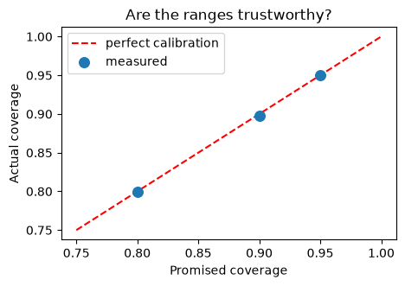
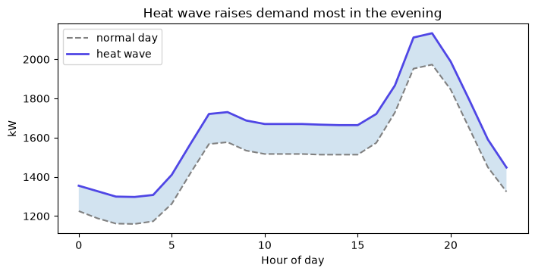
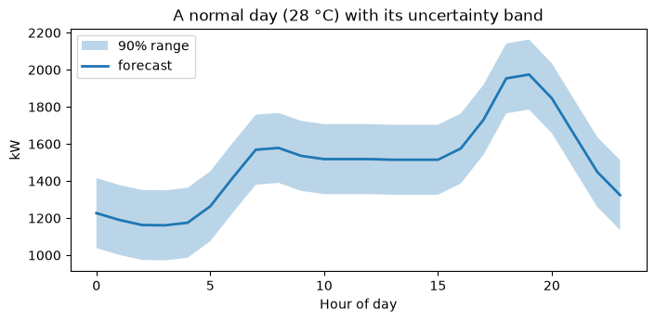
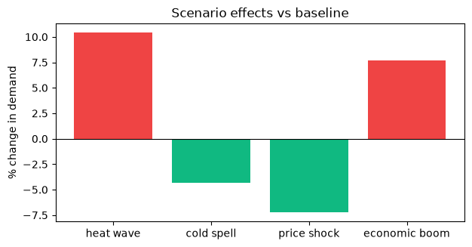
Demand Forecasting — Results, Uncertainty & Scenarios
Check | R² | MAE (kW)
Train | 0.828 | 91.1
Test (unseen) | 0.824 | 91.8
Chronological test | 0.826 | 91.7
Range | Width | Contained
80% | ± 147 kW | 79.9%
90% | ± 189 kW | 89.8%
95% | ± 225 kW | 95.0%
Train ≈ test: no over-fitting
Split-conformal ranges hit their promised coverage
IT22630216 | Dewmini D.M.D.P | R26-IT-010
Notes:
[backup — Dewmini, about 45 seconds]
Train and test scores are almost the same, so the model does not over-fit, and a chronological test gives the same result. The prediction ranges are calibrated with split-conformal prediction: the 90% range really contained 89.8% of unseen values. The scenario charts show, for example, how a heat wave raises evening demand.

Slide 31
Addressing PP2 Feedback — Dewmini
PP2 comment | What was done | Evidence
Lacks idea about the models used | Explained each model family and why Gradient Boosting fits curved effects | 13 inputs; feature importance; train vs test check
Needs consideration for parameter optimisation | Optuna TPE over 6 hyperparameters, CV on training data only | 20 trials; CV RMSE 118.09 → 116.65 kW
Needs a model comparison | LR, RF and GB trained on the identical 80/20 split | R² 0.438 / 0.777 / 0.824; MAE 160.1 / 102.9 / 91.8 kW
IT22630216 | Dewmini D.M.D.P | R26-IT-010
Notes:
[backup — Dewmini, about 40 seconds]
For the models: I explain each family and why Gradient Boosting fits this data. For optimisation: Optuna over six hyperparameters with cross-validation on training data only. For the comparison: all three models on the identical split, with R-squared and error for each.

Slide 32
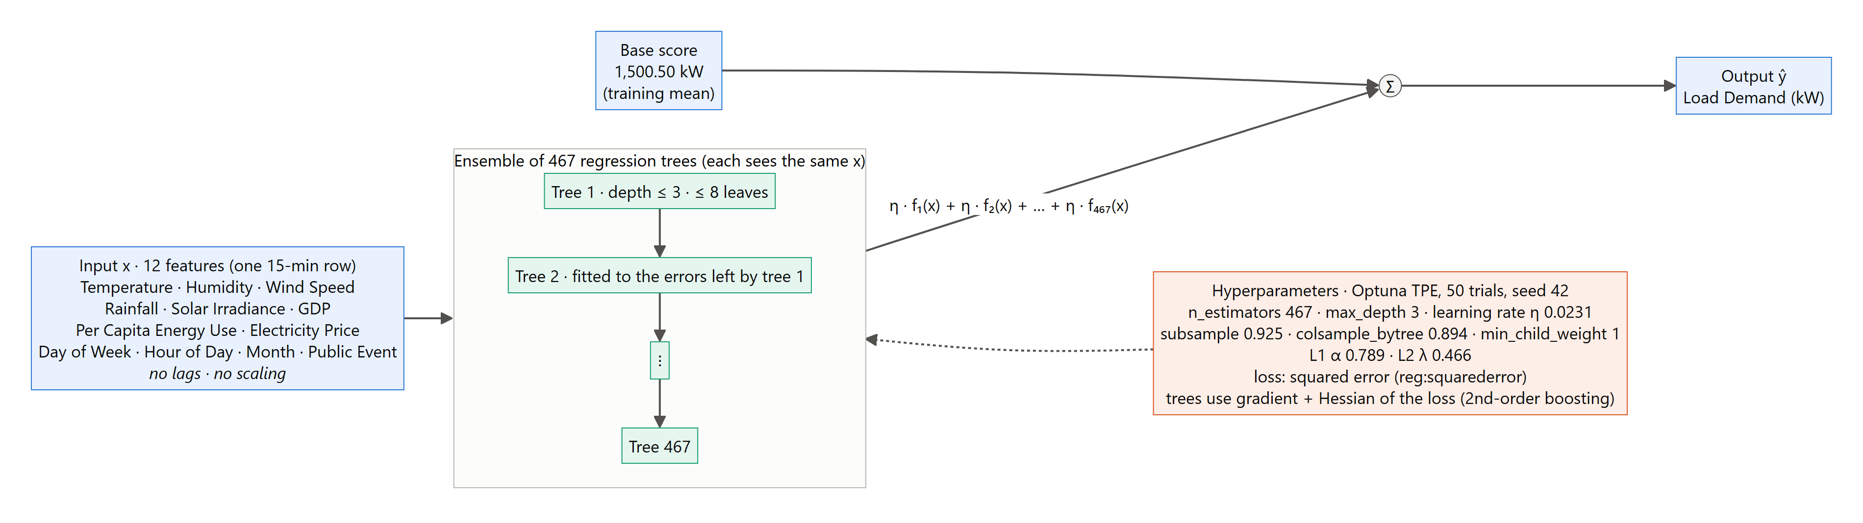
Explainable AI — Models & XGBoost Architecture
XGBoost: 12 inputs → 467 small trees → demand (kW)
Each new tree fixes the errors of the trees before it
Depth ≤ 3, learning rate 0.0231, Optuna (50 trials)
SHAP: exact share of each input in a prediction (TreeSHAP)
LIME: simple local rule from 1,000 nearby samples
IT22273062 | Madushani R.P | R26-IT-010
Notes:
[backup — Madushani, about 45 seconds. Say it slowly.]
My model is XGBoost. It takes 12 inputs and gives one demand value in kW.
It is made of 467 small trees. Each new tree fixes the mistakes of the trees before it.
The trees are small, only 3 levels deep. Optuna chose these settings in 50 trials.
To explain the model I use two methods.
SHAP gives the exact share of each input in a prediction.
LIME makes a simple rule for one prediction, using 1,000 nearby samples.

Slide 33
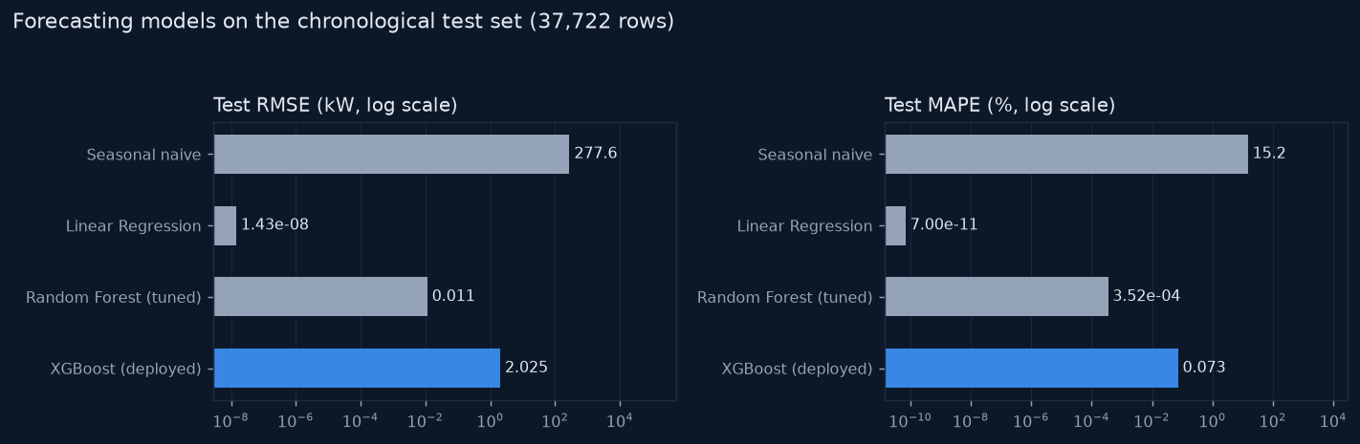
Explainable AI — Model Comparison
Model | RMSE (kW) | R²
Seasonal naive | 277.6 | −1.05
Linear Regression | ≈ 0 | 1.000
Random Forest (tuned) | 0.011 | 1.000
XGBoost (explained) | 2.02 | 0.99989
Same cleaning, split and metrics for all models
Linear Regression is exact: the data is Load = 100·T − 1300
XGBoost error is 0.07% of demand; rolling CV 2.10 ± 0.07 kW
XGBoost kept because TreeSHAP explains it exactly
IT22273062 | Madushani R.P | R26-IT-010
Notes:
[backup — Madushani, about 45 seconds. Say it slowly.]
I compared four models in the same way: same cleaning, same split, same metrics.
Linear Regression is perfect. That is because our data is a simple formula: demand = 100 × temperature − 1300.
XGBoost has a very small error: 2 kW, which is 0.07% of demand. It is also stable over time.
I keep XGBoost because SHAP can explain it exactly.

Slide 34
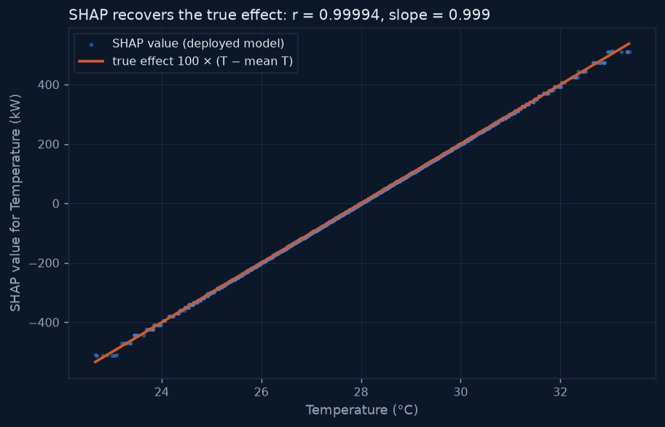
Explainable AI — SHAP vs LIME (validated against the true formula)
 | SHAP | LIME
Share on the true feature | 99.90% | 69.9%
Fidelity | error ≤ 0.007 kW | R² 0.46 mean (0.06 medium)
Stability | deterministic | varies with seed
Top factor correct | 100% | 100%
Runtime | 2.3 ms | 15 ms
SHAP vs true effect: r = 0.99994, slope 0.999
No real drift: Temperature 155.7 – 156.8 kW every year (95% CIs)
LIME for 2025-01-25: Temperature > 29.29 → +359 kW
IT22273062 | Madushani R.P | R26-IT-010
Notes:
[backup — Madushani, about 45 seconds. Say it slowly.]
We know the true formula, so we can check the explanations.
SHAP gives 99.9% of the importance to temperature. That is correct.
The chart shows SHAP and the true line on top of each other: r = 0.99994.
LIME also finds temperature first every time, but it is less exact and changes a little with the random seed.
Example: for 25 January 2025, LIME says "temperature above 29.29 added 359 kW".

Slide 35
Addressing PP2 Feedback — Madushani
PP2 comment | What was done | Evidence
Lacks idea on the models used | Table of every model and method with its role and key settings | XGBoost, LR, RF, seasonal naive; SHAP and LIME settings
Needs a clear idea of the model architecture | XGBoost architecture diagram, read back from the saved model | 467 trees, depth 3, learning rate 0.0231, Optuna 50 trials
Model comparison needed | 4 forecasting models + SHAP vs LIME on measurable criteria | XGBoost RMSE 2.02 kW; SHAP r = 0.99994 vs truth
IT22273062 | Madushani R.P | R26-IT-010
Notes:
[backup — Madushani, about 40 seconds. Say it slowly.]
The panel said I needed more about my models. Now I show a table of all models and methods.
The panel asked for the architecture. Now I show the XGBoost diagram with the real numbers from the saved model.
The panel asked for a comparison. I compare four forecasting models, and I compare SHAP with LIME.

