Slide 1

Your context.
In action.
“Change that to five.”
One chosen task.
Ready to continue.
ContextFlow / FEG Challenge 02
STORYBOARD REVIEW · Human-spoken opening to capture
Notes:
### 1 · Your context. In action. · 0:00–0:12
**Audience takeaway:** an instruction changes a persistent task. **Visual:** large actual app result beside the short title; use S01 only as an opening/closing surround. **Live action:** with the prepared one-selection task and warm microphone, say “Change that to five.” Hold until the exact 5.00 state is visible. **Narration after the result:** “That is the same task, continued in my own words.” **Validation:** the current captured follow-up is typed in a native voice session; the opening’s human-spoken evidence is still required. Do not label that capture a completed spoken test.
Background is generated staging with a blank phone screen. Do not mistake it for evidence. Live demo result will replace the blank screen at showtime.
Review edition: human recording, motion selection and target PowerPoint playback are pending.

Slide 2
The gap between sessions
A chosen task loses value when the next surface forgets it.
01
02
03
Research
The app
The home screen
Evidence gathered
Action prepared
A reason to return
ContextFlow carries the task between them.
STORYBOARD REVIEW · 02
Notes:
### 2 · The gap between sessions · 0:12–0:35
**Audience takeaway:** relevant research loses usefulness when the next surface forgets the task. **Visual:** three clear positions — research, app, home screen — with the same fictional event appearing only where it actually exists. Animate loss of continuity with a gap, not a fabricated error screen. **Narration:** “Research starts in one place. The action happens in another. Later, the home screen has no useful continuation. Challenge 02 asks for a reason to return. Our answer is to carry the task the user already chose, with enough context to continue it.” **Source:** FEG Challenge 02. No market-size or behavioral-causation claim.
Source: https://feg-hackathon-challenges.edgeone.dev/
Review edition: human recording, motion selection and target PowerPoint playback are pending.

Slide 3
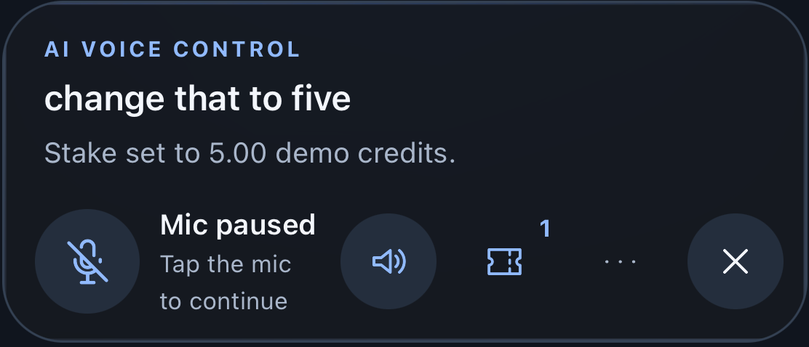
A task beyond the app
One fictional match. One instruction. One exact confirmation.
10.00 → 5.00
Home winner · odds 1.85
Estimated return 9.25
Demo credits only
Research → voice → review
→ confirm → native surface
Typed native QA reference
STORYBOARD REVIEW · 03
Notes:
### 3 · A task beyond the app · 0:35–1:55
**Audience takeaway:** one task survives research import, voice, review and a native surface. **Visual:** the intact 80-second native recording, with restrained S02/S03/S04 surrounds at its boundaries. The main app view occupies at least 65% of slide height; enlarge exact review and receipt details in separate deterministic overlays drawn from the same frame. **Narration:** “This is a fictional match. The research is background; the instruction is mine. I choose the outcome, change the stake, inspect the review, and confirm the exact action. The saved task then remains useful outside the app.” Pause for the actual interaction. **Evidence:** native sample-data capture; final human-spoken run pending. Never imply independent AI recommendations or a real-money placement.
Current image is a physical iPhone capture of a typed instruction in a native Azure voice session. The microphone is visibly muted. The updated source/instruction card and exact touch review/receipt are captured. This typed QA take is not evidence of human speech. Capture three consecutive human-spoken takes. Slide 3 media target is 80 seconds.
Review edition: human recording, motion selection and target PowerPoint playback are pending.

Slide 4
Designed to fit an operator
One shared action handler. Operator systems stay authoritative.
Research
Versioned task
Shared actions
Operator adapters
→
→
→
Explicit instruction
Context + sources
Eligibility + consent
Production dependency
Touch · voice · handoff · shortcuts
Review → explicit confirmation → receipt
STORYBOARD REVIEW · 04
Notes:
### 4 · Designed to fit an operator · 1:55–2:25
**Audience takeaway:** the operator retains control over actions and eligibility. **Visual:** editable horizontal diagram: external research → versioned task → shared action handler → operator adapters / native surfaces. Show consent and eligibility checks alongside the handler, and a separate explicit-confirmation step before receipt. **Narration:** “The reusable part is the context layer. Touch, voice and handoffs use the same action handler and the same review. An operator can connect its own event catalogue, identity, exclusion and receipt systems through adapters. This build demonstrates the pattern with sample records. Production connections are a separate integration project.” **Evidence:** shared contracts, SQLite/Edge action engine and atomic receipt tests. Do not show the operator integrations as implemented.
Implemented: server/src/actions.ts, shared/contracts.ts, shared/safeguards.ts and the generated Edge bundle. Production identity, exclusion and operator adapters remain outside the hackathon build.
Review edition: human recording, motion selection and target PowerPoint playback are pending.

Slide 5
What success looks like
1,000 people · 500 per arm · 30 days · later retention follow-up
Useful app opens
Widget adoption
Per assigned user, per week
Eligible treatment users
Surface engagement
Opt-in retention
Glances and deliberate continuations
Consent retained after exposure
Also track task success, off-app completion, opt-outs and harmful-play indicators.
STORYBOARD REVIEW · 05
Notes:
### 5 · What success looks like · 2:25–3:00
**Audience takeaway:** useful engagement is measurable without rewarding pressure to bet. **Visual:** four large measures: useful app opens; widget adoption; surface engagement; notification opt-in retention. Small but readable companion line: task completion, off-app completion, opt-outs and harmful-play indicators. **Narration:** “We propose 1,000 participants, split equally between control and treatment, with 30 days of exposure and later retention follow-up. We measure useful opens, widget adoption, surface engagement and retained consent. A successful glance outside the app counts separately. We also watch task failures, opt-outs and harmful-play indicators. A rise in opens alone is not the success criterion.” **Evidence:** pilot proposal, not results. Existing FEG betting-session tables do not establish these baselines.
Source: https://feg-hackathon-challenges.edgeone.dev/
Pre-register useful-open definition: a deliberate foreground open followed by a selected meaningful activity within two minutes, excluding auto-launches. Analyze randomized arms; adoption is a secondary treatment metric. Instrumentation and baseline rates are not yet available. Do not infer these metrics from the supplied betting-session workbook.
Review edition: human recording, motion selection and target PowerPoint playback are pending.

Slide 6
The value and the cost
Illustrative monthly operating case — usage calibration remains open.
Treatment adoption | 10% | 20% | 30%
Adopters | 50 | 100 | 150
Voice tasks | 200 | 400 | 600
Operating cost | €201 | €258 | €314
Contribution to break even¹ | €3.03 | €1.58 | €1.09
€9,120
illustrative upfront effort
¹ Per adopter, after assumed support savings. Excludes recovery of upfront effort and unquoted identity costs.
STORYBOARD REVIEW · 06
Notes:
### 6 · The value and the cost · 3:00–3:55
**Audience takeaway:** the pilot must prove enough contribution to cover integration and ongoing cost. **Visual:** editable three-column adoption comparison, with the 20% case emphasized. Show 50/100/150 adopters, approximately €201/€258/€314 monthly operating cost and required contribution of €3.03/€1.58/€1.09 per adopter after assumed support savings. Separate €9,120 illustrative upfront effort. **Narration:** “At twenty percent treatment adoption, we model one hundred adopters and four hundred voice tasks a month. The illustrative operating cost is about two hundred and fifty-eight euros, including voice, transcription, infrastructure, notifications and support. After assumed support savings, the monthly break-even contribution is one euro fifty-eight per adopter. Integration and assurance add nine thousand one hundred and twenty euros in this scenario. Low adoption does not pay back. Usage, negotiated prices and identity-service quotes still need validation; this pilot is designed to resolve them.” **Evidence:** impact workbook. No precision beyond supported assumptions; no short-payback promise.
Sources: https://azure.microsoft.com/en-us/pricing/details/azure-openai/
https://www.ecb.europa.eu/stats/policy_and_exchange_rates/euro_reference_exchange_rates/html/index.en.html
Linked model: ContextFlow_Impact_Model.xlsx. Actual monthly costs 201.287248 / 257.574496 / 313.861744 EUR. Assumptions: 3 EUR incremental contribution and 1 EUR avoided support cost per adopter. Operating net -1.287248 / 142.425504 / 286.138256 EUR. Upfront engineering 80h x75, legal/privacy24h x90, accessibility16h x60 =9120 EUR. No voice usage record establishes the token assumptions; SKU and contract need confirmation.
Review edition: human recording, motion selection and target PowerPoint playback are pending.

Slide 7
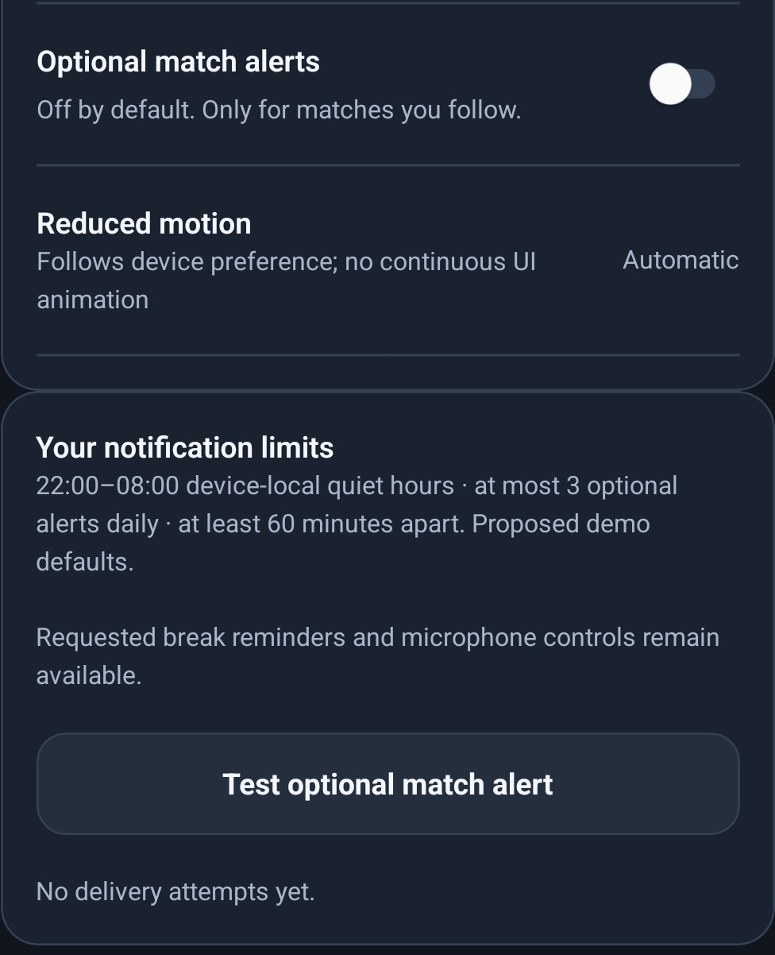
Control stays with the user
Permission, eligibility and exact review travel with the task.
Off by default
Optional notifications require consent.
22:00–08:00
Device-local quiet hours.
3 per day · 60-minute gap
Proposed demo defaults.
Explicit confirmation
Voice cannot override eligibility.
STORYBOARD REVIEW · 07
Notes:
### 7 · Control stays with the user · 3:55–4:35
**Audience takeaway:** relevance requires permission and protected decisions. **Visual:** actual optional-consent screen, a visible suppression reason and exact-review detail, revealed in sequence. **Narration:** “Optional alerts start off. The demo uses device-local quiet hours from ten at night to eight in the morning, a daily cap of three, and at least an hour between alerts. These are proposed defaults. Synthetic adult, unverified, underage, at-risk and excluded records demonstrate the eligibility check. Voice cannot override them. Requested safety reminders and microphone controls remain available. A change to the slip invalidates its review.” **Evidence:** guardrail tests, real settings screenshots and native delivery code. Real register integration, accessibility audit and legal review remain production dependencies.
Source: https://drive.google.com/file/d/1RUkxHqNRv1y3sAYB_nKPDbI7ahfKZheH/view
Screenshot: Android emulator, not physical Android. Backend tests cover withdrawal, quiet hours, caps, duplicate and stale suppression, restricted profiles and attempted overrides. Requested safety reminders and essential microphone controls remain available. No legal compliance certification or real identity verification is claimed.
Review edition: human recording, motion selection and target PowerPoint playback are pending.

Slide 8


The next screens
A smaller glance. A larger workspace. The same chosen task.
WATCH CONCEPT · not built
MAC CONCEPT · not built
A 30-day FEG pilot. An integration owner. Agreed success measures.
STORYBOARD REVIEW · 08
Notes:
### 8 · The next screens · 4:35–5:00
**Audience takeaway:** a bounded pilot can test a reusable native-context layer. **Visual:** S05 Watch concept for 6 seconds; S06 Mac concept for 6 seconds; finish on the pilot ask for 13 seconds. Persistent readable “CONCEPT — not built” labels on both sequences. **Narration:** “Watch and Mac are the next concepts: the same chosen task, adapted to a smaller glance or a larger workspace. Our ask is a thirty-day FEG pilot, an integration owner and agreed measures of usefulness, cost and control. Let the user’s context become their reason to return.”
Both visuals are generated future-concept plates, with no working Watch or Mac app. Final animation needs persistent concept labels and exact separately composited UI.
Review edition: human recording, motion selection and target PowerPoint playback are pending.

Slide 9
Technical evidence
What is demonstrated — and what still needs inspection.
Evidence | Checkpoint
Shared action + guardrail tests | 34 passing backend tests
Sample-only local and Edge feed | Deployed Edge version 14
Native recording | iPhone: sample flow + typed follow-up
Android | Release built; emulator captures
Acceptance gates | Human speech, final native QA, PowerPoint
Screenshots prove only the state and input method they actually show.
STORYBOARD REVIEW · 09
Notes:
Source evidence: submission/working/server-tests-current.txt, submission/working/mobile-tests-current.txt and current FEG capture bundle. 34 backend and 29 mobile tests passed at this checkpoint. Current Android Release and iPhone QA Release builds passed. Edge version14 contains the current sample-only action engine. A physical-iPhone typed QA journey passed through source import, five-credit change, touch review/confirmation and consent suppression. Receipt CF-87867C8E: stake5.00, return9.25. Human speech, lock-screen lifecycle and accessibility remain open.

Slide 10
Published competitor capabilities
The distinction is the demonstrated combination of handoff and surfaces.
Capability | AceAI | BetHarmony | ContextFlow
Conversational research | Published | Published | Sample demo
Action / slip support | Published | Published | Sample demo
Context memory | Published | Published | Persisted task
External research handoff | Unknown | Unknown | Demonstrated
Native OS surfaces | Unknown | Unknown | iPhone capture
Unknown means unverified in these sources. Watch and Mac remain concepts.
STORYBOARD REVIEW · 10
Notes:
Published sources checked 9 September 2026: https://www.fanduel.com/about/news/meet-aceai-fanduel-s-ai-powered-sports-betting-assistant
https://symphony-solutions.com/voice-to-voice-ai
FanDuel describes conversational research, context and slip building. BetHarmony describes voice-to-voice, context and operator API actions. Do not claim voice alone is unique or infer absent capabilities from missing public evidence. ContextFlow has no claimed world-first status.

Slide 11
Detailed economics
Assumed €3 contribution + €1 support saving per adopter / month.
Monthly scenario | 10% | 20% | 30%
Operating cost | €201.29 | €257.57 | €313.86
Benefit | €200.00 | €400.00 | €600.00
Net benefit | −€1.29 | €142.43 | €286.14
Payback on €9,120 | None | 64.0 mo | 31.9 mo
Public list prices ≠ the final invoice. Assumed workloads ≠ measured usage.
Missing: usage calibration, Azure SKU / contract and production identity-service quotes.
STORYBOARD REVIEW · 11
Notes:
Source: editable impact workbook; Azure rates https://azure.microsoft.com/en-us/pricing/details/azure-openai/ and ECB https://www.ecb.europa.eu/stats/policy_and_exchange_rates/euro_reference_exchange_rates/html/index.en.html. Formula: adopters x contribution + avoided support cost - operating cost. Payback only exists with positive monthly net and assumes a sustained flat run rate. Historical FEG betting sessions are separate from front-end sessions. Source https://docs.google.com/spreadsheets/d/1OQZ9dEyS6wmXjZeumU-6lsewlswNXg-p/edit. hr March555211 versus August447046 betting sessions: -19.5%, descriptive only. No attribution to ContextFlow or baseline for app opens.

Slide 12
Live-demo runbook
Five-minute core + seven-minute walkthrough leaves a three-minute buffer.
Before the stage
Sample profile · one match · warm microphone · offline backup
Opening
Human: “Change that to five.” Hold for the actual result.
Fallback
After 8 seconds without a result, announce the recording.
Walkthrough
Research → voice → review → confirm → native surfaces
Acceptance
3 human runs · matching receipts · native QA · PowerPoint
STORYBOARD REVIEW · 12
Notes:
Use ContextFlow_Prompt_Pack.md for the complete screen recording script. Keep the original native video intact. Failure resets the consecutive human-run count. Verify microphone permission, device-local time, exact sample profile, event, stake, odds and receipt. Disable unrelated notifications for the recording. PowerPoint is not installed in this environment: actual offline playback, embedded media, audio, poster frames and presenter view remain explicit gates.

