Slide 1
COURIER MANAGEMENT SYSTEM

Slide 2
Front-End And Back-End Development
Front-End Development:
Html
CSS
Bootstrap
AJAX
JSON
Back-End Development:
Mysql
PostgreSQl

Slide 3
CONTENTS OF THE WEBPAGE
Home page –describes about the contents
Admin – logs into the admin page
Employee – logs into the employee page
Customer – logs into the customer page
Hubs – displays the branch details
Contact – displays the address and contact details of branches
Review - Customer who wish to review
Track - Tracks the location and delivery of couriers

Slide 4
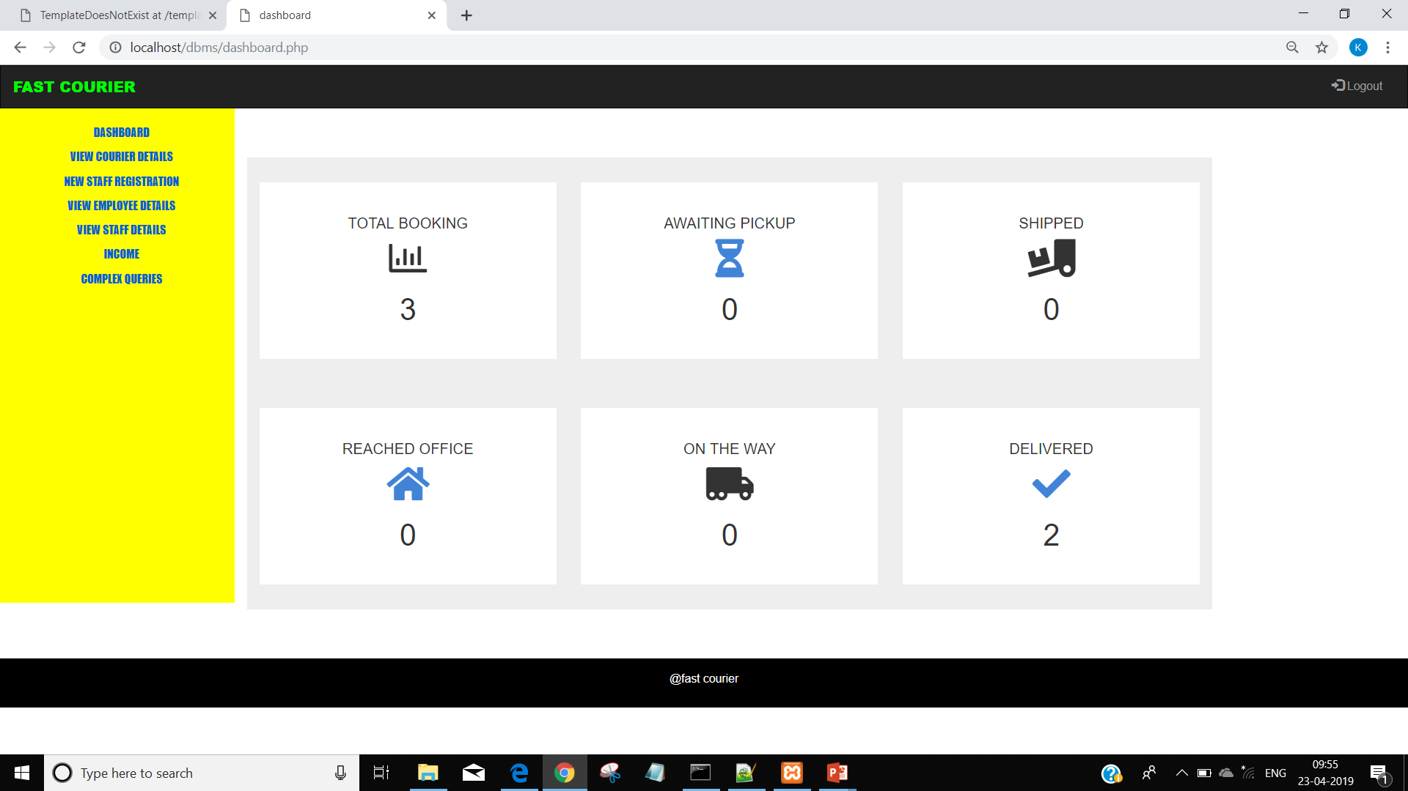
Admin Page :

Slide 5
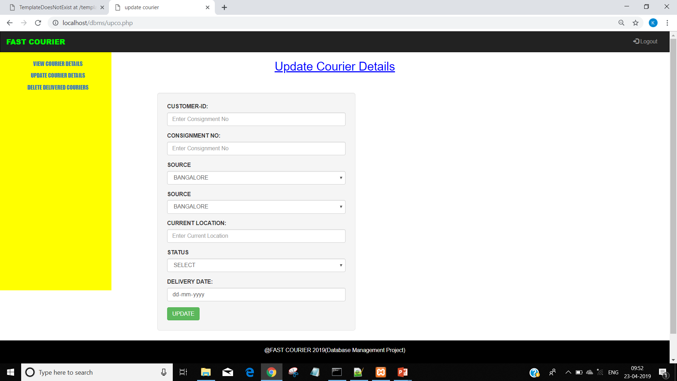
Employee Page :

Slide 6
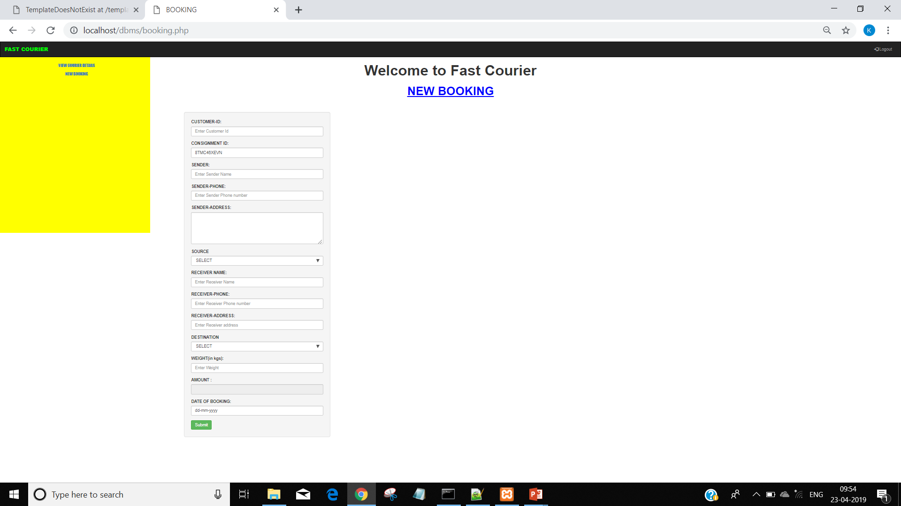
Customer Page :

Slide 7
By TEAM NO : 15 (G section) Keerthi Priya P (PES1201701643) Thanusha Sai Melavoy(PES1201701457) Britney D Mungra(PES1201701801)

