Slide 1
USABILITY TESTING AND VERIFICATION
WRAPPED WONDERS
Presented By:
Shivani Deepak Moray
Thanusha Ramesh
SRH Hochschule Heidelberg
March 13th 2020

Slide 2
CONTENTS
Introduction
Problem Statement
Analysis on Competitors
Proposed Design
Demo
Usability Testing
Analysis of the results
Challenges

Slide 3
INTRODUCTION
Design and Usability testing of an application to provide a platform for users to buy gift for special occasions.

Slide 4
In this busy world,most of them find difficulty in choosing gifts for special occasions.

Slide 5
TASK DISTRIBUTION
Brainstorming
Complete Design process
Implementation
Usability Testing
All the above tasks were equally distributed amongst us.

Slide 6
COMPETITIVE ANALYSIS
https://www.bavariashop.de/
Content filled all over the landing page.
Poor categorization of the gifts based on the occasions.
Confusion caused with the navigation bar.
https://www.igp.com/
Repeated information for the user all over the landing page.
User is engaged in the process of finding right gift, but is time consuming due to more number of clicks than required.

Slide 7
PROPOSED DESIGN
Paper Prototype
Mockup
Visual guide that represents the skeletal framework of a website
Process that helps designers to create sketch that meets user’s expectations and needs
Full-sized model of a design, used for demonstration, design and evaluation, promotion
Wireframe

Slide 8
https://xd.adobe.com/view/5939086d-7566-4388-4aa3-3a9915cef4ef-2f08/
DEMO

Slide 9
USABILITY TESTING
To Validate a prototype
To find issues with complex flows
To gather Unbiased opinion
To get insights that help create a better overall user experience
Notes:
Usability testing refers to evaluating a product or service by testing it with representative users.
Typically, during a test, participants will try to complete typical tasks while observers watch, listen and takes notes.
The goal is to identify any usability problems, collect qualitative and quantitative data and determine the participant's satisfaction with the product.

Slide 10
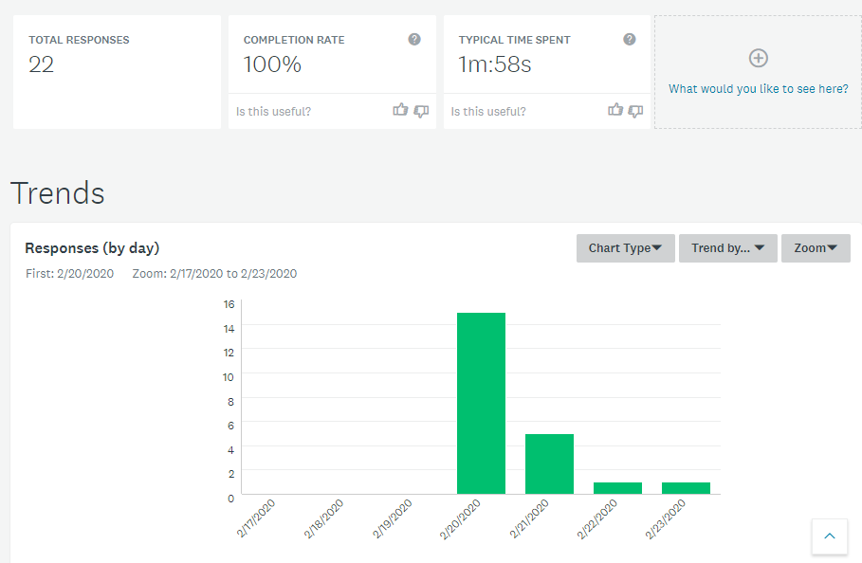
User Research
To find the approach of the target users in shopping gifts for special occasions, an online survey was made.
https://www.surveymonkey.de/r/55BMJT6

Slide 11
RED ROUTES
 | Gifts of range 10€-24€ | Search gifts by Occasion | Buy gifts in minimal amount of time
 | Prefer gifts for wedding -occasion | Customized gifts, Fashion accessories and games/toys as gift - Category | Gender Specific Search
Prefer gifts for House warming Ceremony -occasion | Home accessories, health and beauty products as gift - Category | Gifts more than 40€ | Prefer buying online gifts to deliver it to the recipient
Gifts less than 10€ | Gifts of range 24€-40€
All
the time
Most of the time
Some of the time
Very little of the time
Few of the people
Some of the people
Most of the people
All of the people

Slide 12
TEST SCENARIOS
Your female friend just got a promotion in her work. You would like to congratulate her by gifting her something which would surprise her.
It is May 10th, a celebration of motherhood.
You want to gift your mom the best selling gift of Wrapped Wonders which would make her happy.
As a user/customer of Wrapped Wonders, you are curious to know on how Wrapped Wonders function.

Slide 13
TEST SCENARIOS
You are invited to your friend’s house warming ceremony. You want to present a gift ranging from 10 euros-15 euros
As a user/customer, you want to contact the company regarding a query you have by writing them a mail.

Slide 14
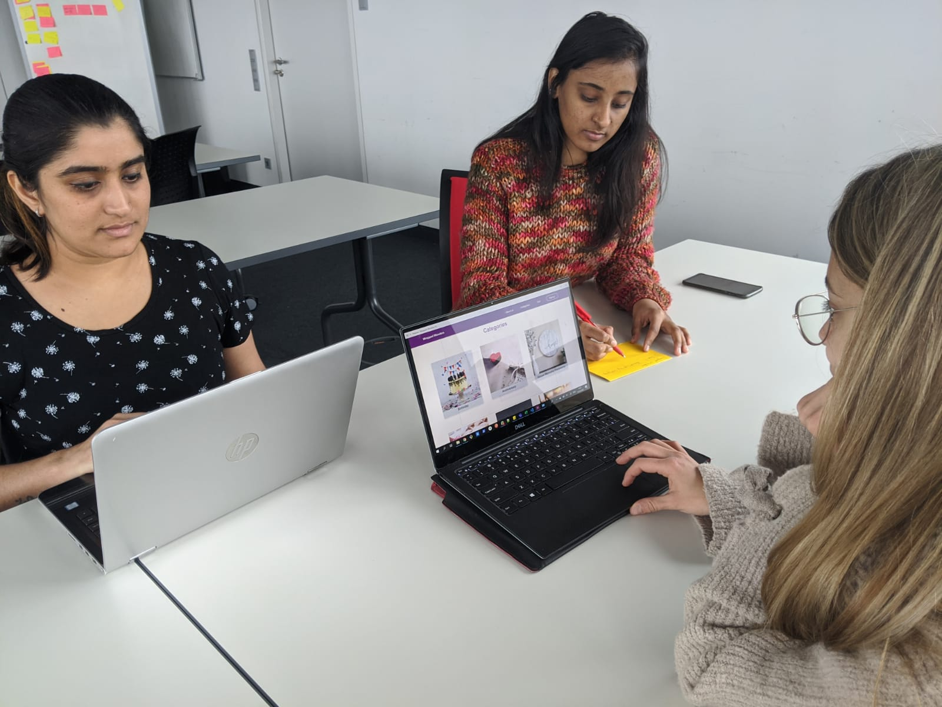
THINK ALOUD PROTOCOL
Simple usability tests where users think out loud.
Participants are asked to use the application, thinking out loud - speaking their thoughts loud through the flow of the user interface.
“Shut up and let the users do the talking.”

Slide 15
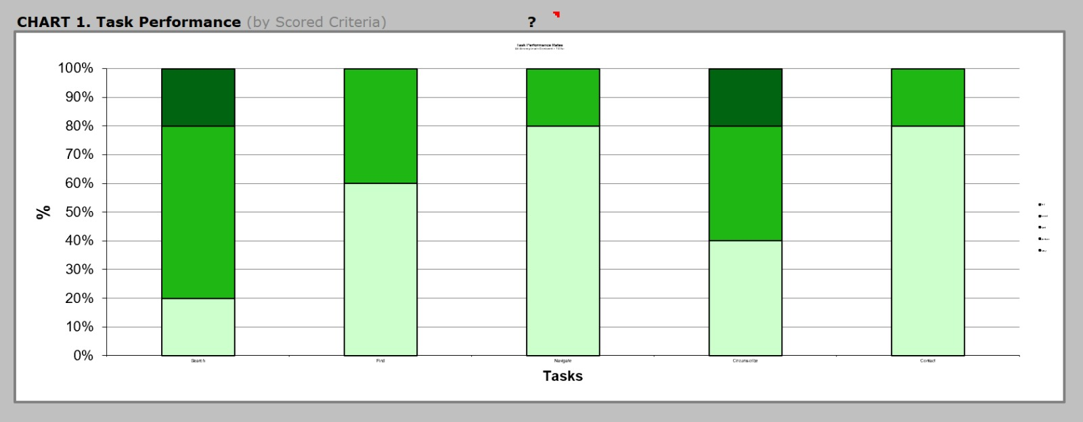
ANALYSIS OF THE RESULTS

Slide 16
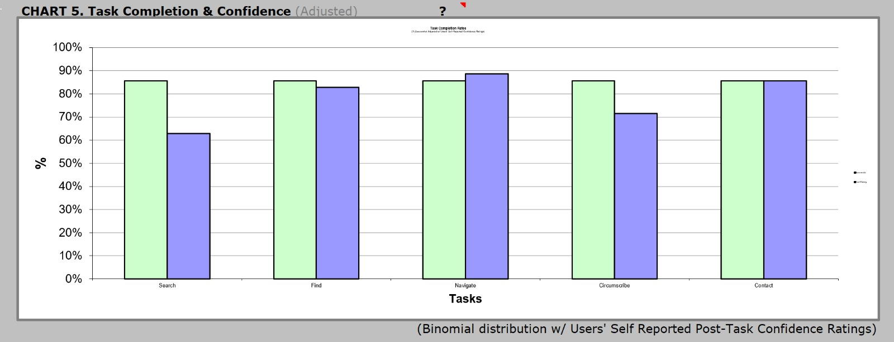
ANALYSIS OF THE RESULTS

Slide 17
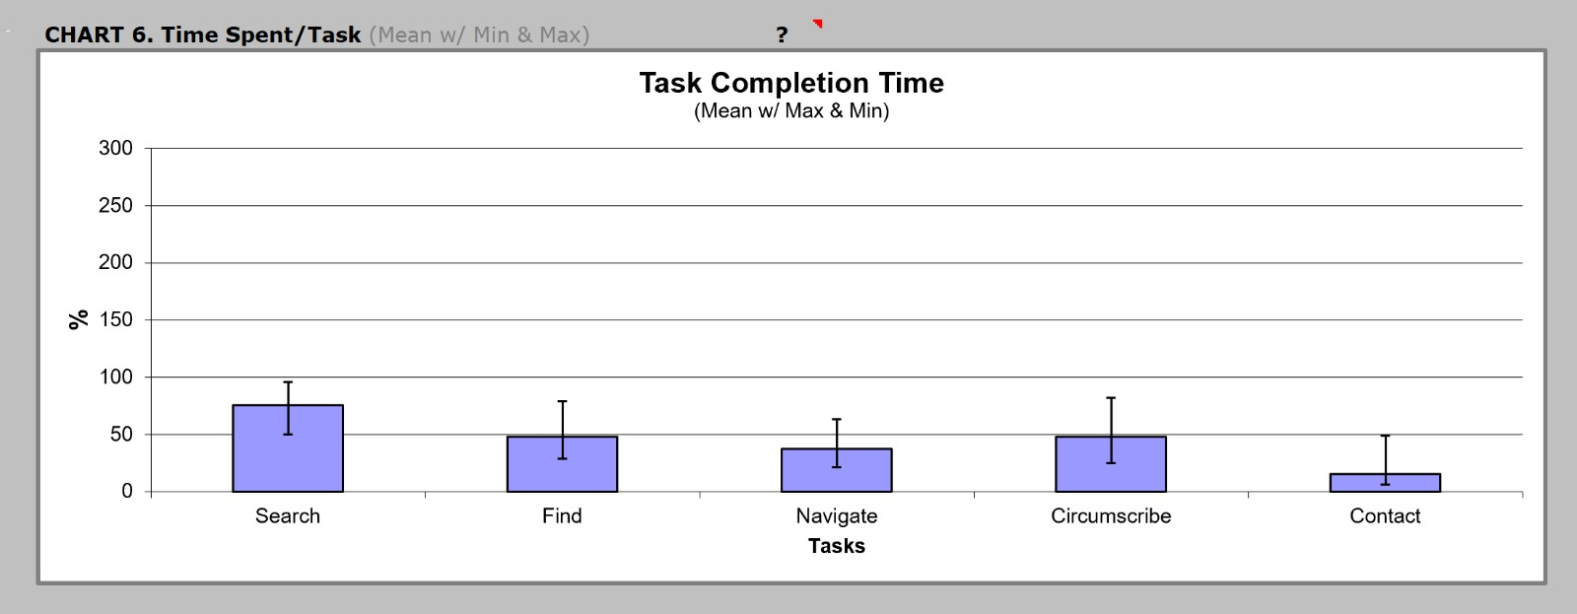
ANALYSIS OF THE RESULTS

Slide 18
SUS SURVEY
Strongly
Disagree
Strongly
Agree
1. I think that I would like to use this web site frequently
3
1
2
3
4
5
2.I found the website unnecessarily complex
4
1
2
3
4
5
3. I thought the web site was
easy to use
4
1
2
3
4
5

Slide 19
SUS SURVEY
Strongly
Disagree
Strongly
Agree
4. I think that I would need the support of a technical person to be able to use this web site
4
1
2
3
4
5
5. I found the various functions in this web site were well integrated
3
1
2
3
4
5
6. I thought there was too much inconsistency in this web site
3
1
2
3
4
5

Slide 20
SUS SURVEY
Strongly
Disagree
Strongly
Agree
7. I would imagine that most people would learn to use this web site very quickly
3
1
2
3
4
5
8. I found this web site very awkward to use
4
1
2
3
4
5
9. I felt very confident using this web site
3
1
2
3
4
5

Slide 21
SUS SURVEY
Strongly
Disagree
Strongly
Agree
10. I needed to learn a lot of things before I could get going with this web site
4
1
2
3
4
5
Calculations:
Sum of score contributions from each item = 35
Overall value of the SUS survey = 35 * 2.5
= 87.5
Grade for the score obtained = B

Slide 22
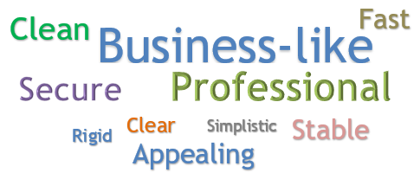
WORD CLOUD

Slide 23
CHALLENGES
LESSONS LEARNT
Adapting to new framework and architecture.
Adapting to the ever changing design requirements.
Implementation of UI components e.g. Gift details page.
Detailed process of Usability Testing.
React framework and the testing libraries.

Slide 24
THANK YOU!!
ANY QUESTIONS

