Slide 1

  Scalable Multi-Node ASCON-Secured IoT Communication: A Gateway-Based Architecture with Dynamic Key Exchange
TEAM - 09
Akchara - cb.ai.u4qts25004
Archand - cb.ai.u4qts25007
Karthik - cb.ai.u4qta25026
Thanushree - cb.ai.u4qts25044
Slide 1

Slide 2
Why IoT Security Matters
  IoT market projected to reach USD 1.1 trillion by 2025 (McKinsey Global Institute, 2024)
  47% of Latin American companies adopted IoT by end 2023 (996M devices in operation)
  Critical vulnerability: Resource constraints make traditional encryption infeasible
  Real threat: Mirai botnet (2016) weaponized 100K IoT devices → 1.2 Tbps DDoS attack
  Solution paradigm shift: Lightweight cryptography (ASCON) designed for constrained devices
Slide 2

Slide 3
ASCON as the Solution
  ASCON: Winner of NIST Lightweight Cryptography Competition (2019)
  Authenticated Encryption with Associated Data (AEAD) - confidentiality + integrity
  Low computational overhead: Hardware implementations on FPGA/ASIC prove efficiency
  Used in: Automotive CAN systems, IoV (Internet of Vehicles), industrial IoT
  Gap in literature: Current implementations (including published paper) have critical oversights
Slide 3

Slide 4

Literature Review - Key Papers
Paper Title
Publisher
Year
Technology
Key Contribution
Implementation and Performance of Lightweight Authentication Encryption ASCON on IoT Devices
IEEE Access
2025
ASCON, CupCarbon, Raspberry Pi
First integrated CupCarbon simulation; Raspberry Pi validation; 2-node testing
ASCON v1.2: Lightweight Authenticated Encryption and Hashing
J. Cryptology
2021
ASCON algorithm
Formal algorithm specification; security proofs
A Robust ASCON Cryptographic Coprocessor for Secure IoT Applications
IEEE (PACET)
2024
FPGA/ASIC
Hardware acceleration; energy efficiency analysis
Lightweight Post-Quantum Security in Automotive CAN Systems
Electronics
2024
ASCON + CAN
Real-world automotive deployment; quantum resistance
Slide 4

Slide 5
Research Objectives
Fix Key Exchange Vulnerability
Scale ASCON in CupCarbon
Production-Ready Security Model
  Eliminate plaintext key transmission by integrating ECDH (Curve25519) before ASCON encryption
  Validate cryptographic correctness of ECDH + ASCON composition
  Measure latency overhead on Raspberry Pi Zero W
  Extend 2-node simulation to multi-node topologies (10, 25, 50 nodes)
  Identify resource bottlenecks (gateway decryption throughput)
  Characterize performance degradation as network size grows
  Combine key agreement + lightweight encryption
  Validate on real hardware (Raspberry Pi) + simulator (CupCarbon)
Slide 5

Slide 6
The Critical Flaw
WHY THIS MATTERS
CURRENT IMPLEMENTATION
CLIENT:
key = random_bytes(16)
socket.send(key) ← PLAINTEXT over WiFi
nonce = random_bytes(16)
ciphertext = ASCON(plaintext, key)
↓ [Network - WiFi sniffing]
ATTACKER (passive sniffing):
Intercepts: key, nonce, ciphertext
Decrypts: plaintext = ASCON_decrypt(...)
✗ ENTIRE COMMUNICATION COMPROMISED
  Violates core encryption principle: key must be secret
  ASCON's 128-bit authenticated encryption is pointless if key is known
  Real-world IoT deployments (smart factories, medical devices) use shared WiFi
  Passive attacker (no active attack needed) defeats entire security model
Slide 6

Slide 7
#1: ECDH Pre-Authentication Key Exchange
Phase 1: Ephemeral ECDH Exchange (Curve25519)
  Client → Server: EC_public_key (32 bytes, unencrypted but authenticated)
  Server → Client: EC_public_key (32 bytes)
  Both compute: shared_secret = ECDH(private, peer_public)
Phase 2: Key Derivation (KDF)
  ASCON_key = HKDF-SHA256(shared_secret, info="ascon-key", length=16)
Phase 3: Authenticated Encryption
  Client → Server: ASCON_encrypt(plaintext, ASCON_key, nonce)
  Key is NEVER transmitted; derived from DH exchange
  Each session has unique key (ephemeral DH)
Slide 7

Slide 8
#2: CupCarbon Multi-Node Scaling Study
Star Topology (Gateway Decryption)
    N nodes (5, 10, 25, 50, 100) send encrypted data to central gateway
    Gateway decrypts all inbound traffic
    Measure: Decryption queue depth, CPU %, latency tail (p99)
Mesh Topology (Per-node Decryption)
    Nodes route encrypted packets; each node decrypts and re-encrypts
    Measure: Per-node resource utilization, end-to-end latency distribution
Scalability Threshold
    Identify: At what N does gateway throughput saturate?
Slide 8

Slide 9
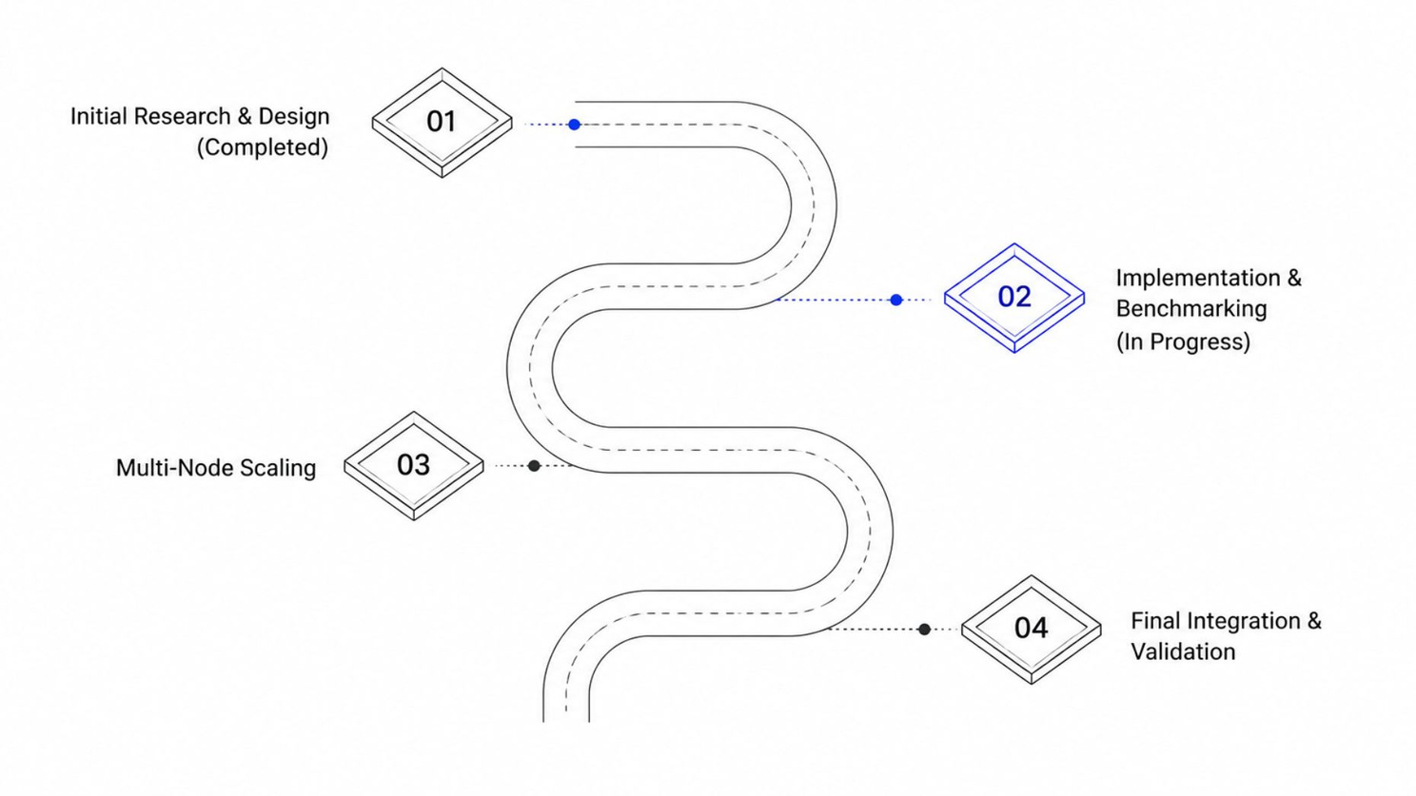
Progress So Far
  Literature review: 5+ papers on ASCON, IoT cryptography, key agreement
  Identified research gaps (Gap #1: key exchange, Gap #2: multi-node scaling)
  Analyzed original paper's code (Listings 1-14); documented vulnerability
  Designed ECDH + ASCON integration architecture
  Set up development environment: Python 3.11, cryptography library, Raspberry Pi toolchain
Slide 9

Slide 10
Challenges & Risks
  Network timing variability in CupCarbon simulator
    Solution: Run 100+ samples per configuration; use statistical analysis (mean ± σ)
  Raspberry Pi resource constraints
    Limited RAM (512 MB); key exchange libraries may add overhead
    Mitigation: Use lightweight crypto library; profile memory usage
  Multi-node CupCarbon stability at 100 nodes
    Simulator may become unresponsive
    Mitigation: Incremental scaling (10 → 25 → 50 → 100)
Slide 10

Slide 11
Work flow
  Complete ECDH X25519 implementation in Python
  Set up Raspberry Pi for benchmarking
  Obtain baseline latency measurements (plaintext key method)
  Validate correctness (decrypted plaintext matches original)
  Measure memory footprint on Pi Zero W
  Deploy 10-node CupCarbon simulation
  Integrate ECDH with existing ASCON code (Listings 13-14
  Run 50+ iterations; collect statistical data
  Begin CupCarbon test harness development
  Scale to 50, 100 nodes in CupCarbon
  Identify bottleneck (expected: gateway decryption at N > 50)
  Propose hierarchical gateway solution
Slide 11

Slide 12
Conclusion & Key Takeaways
NEXT RESEARCH DIRECTIONS:
KEY FINDINGS :
Security gap is real: Original ASCON-IoT paper transmits key in plaintext
Scalability ceiling exists: CupCarbon reveals gateway bottleneck →
Lightweight design scales: ASCON remains efficient even at 100-node scale →
  Post-quantum ASCON (Kyber key exchange + ASCON)
  Broadcast ASCON schemes (1 sender → N recipients)
  Heterogeneous network topology (gateways at multiple levels)
Slide 12

Slide 13

Thank You
Slide 13

