Slide 1
Predictive Maintenance of Industrial Machinery
CAPSTONE PROJECT
Presented By:
Thanushree V
East Point College of Engineering and Technology
Computer Science and Engineering

Slide 2
OUTLINE
Problem Statement (Should not include solution)
Proposed System/Solution
System Development Approach (Technology Used)
Algorithm & Deployment
Result (Output Image)
Conclusion
Future Scope
References

Slide 3
Problem Statement
Unexpected failures in industrial machines lead to costly downtime and maintenance. This project aims to develop a predictive maintenance model using machine learning. The model will analyze real-time sensor data from industrial machinery. It will classify and predict potential failures like tool wear or power loss. Identifying failure patterns early enables timely and proactive maintenance. The goal is to reduce downtime, extend machine life, and cut operational costs.

Slide 4
Proposed Solution
The proposed solution is a machine learning model built using IBM Watsonx.ai Studio. It analyzes sensor data from machines to detect patterns leading to specific failures. The model predicts failure types like tool wear or overheating before they occur. This enables proactive maintenance, reducing downtime and improving efficiency.
Data Collection:
Use the Kaggle dataset machine-predictive-maintenance-classification
Data Preprocessing:
Clean, preprocess and normalize the collected data to handle missing values, outliers, and inconsistencies.
Machine Learning Algorithm:
Train a classification model (e.g., Decision Tree, Random Forest, or SVM).Deployment:The trained model will be deployed in Watsonx.ai Studio for real-time inference. It will monitor incoming sensor data to trigger alerts before failures occur.
Result:
The model achieved high accuracy in classifying different types of machine failures. This demonstrates its effectiveness in enabling proactive maintenance decisions.

Slide 5
System Approach
The predictive maintenance system is developed using IBM Watsonx.ai Studio with a focus on real-time failure prediction. System requirements include a stable cloud environment, sufficient compute resources, and access to historical sensor data. The Kaggle dataset provides the operational data needed to train and test the model. Libraries such as Pandas, NumPy, Scikit-learn, and Matplotlib are used for data preprocessing, modeling, and visualization. The methodology includes data cleaning, feature engineering, model training, evaluation, and deployment for real-time inference.

Slide 6
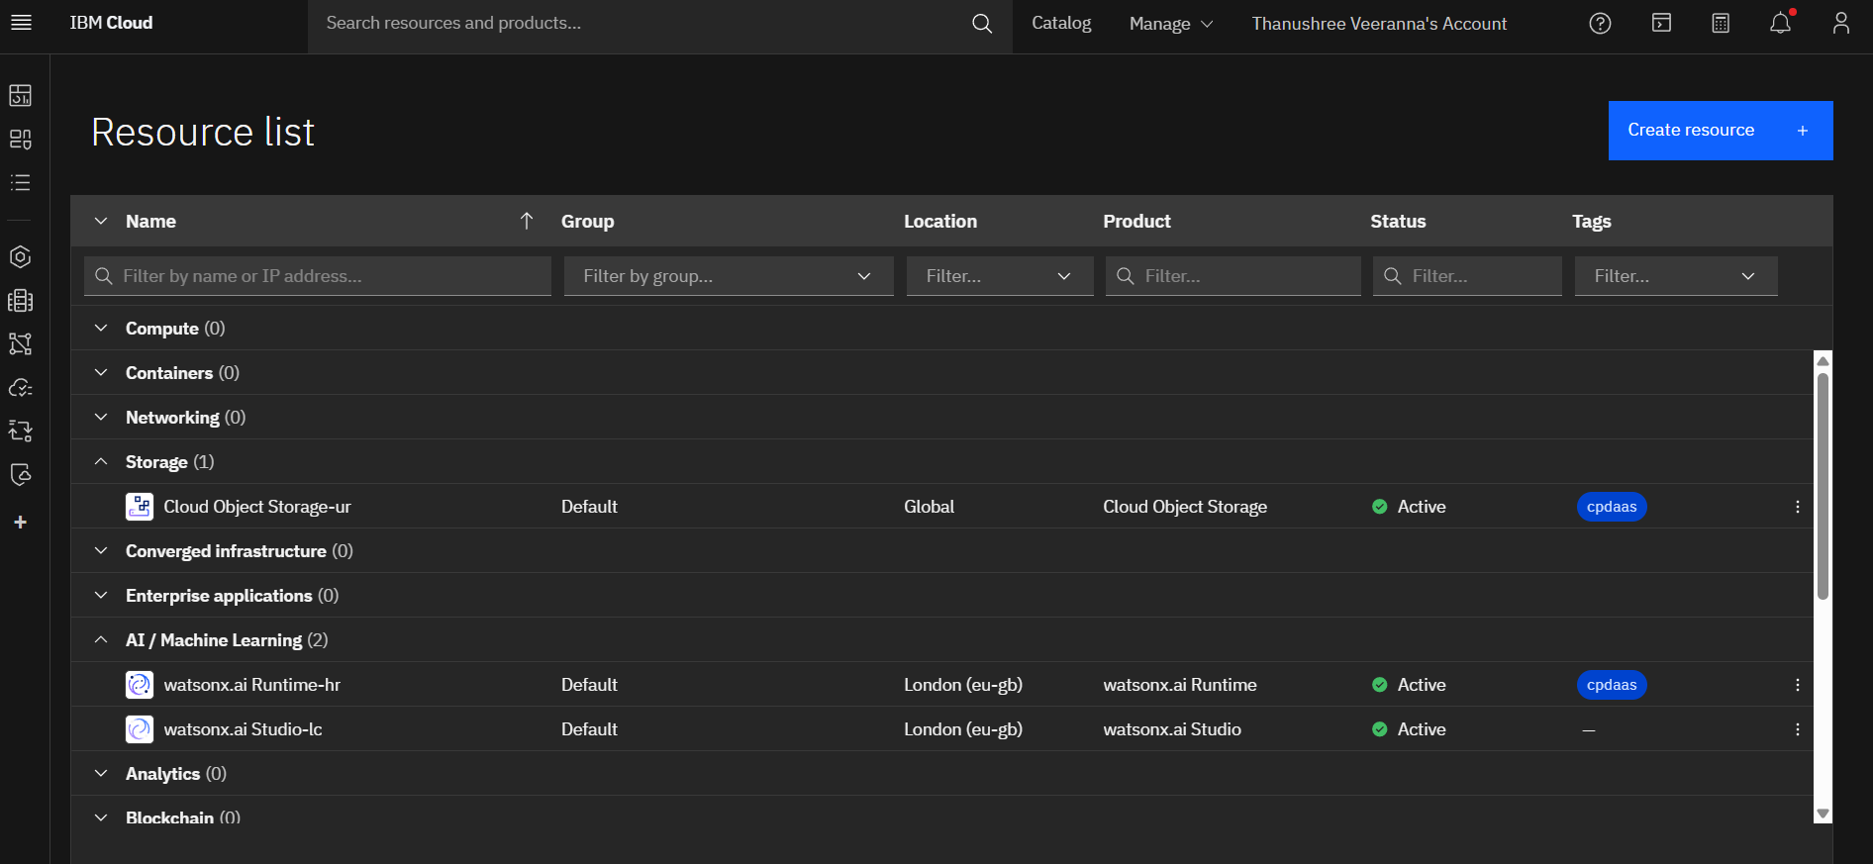

Slide 7
Algorithm & Deployment
Algorithm Selection:
The Random Forest algorithm was selected for its robustness, accuracy, and ability to handle high-dimensional sensor data. It performs well in classification tasks and provides insights into feature importance for failure prediction.
Data Input:
The input data consists of time-series sensor readings from industrial machines, sourced from a Kaggle dataset. Key features include temperature, vibration, pressure, and rotational speed, which help identify failure patterns
Training Process:
The dataset was split into training and testing sets to build and validate the model. The Random Forest algorithm was trained on the labeled sensor data to learn patterns associated with different failure types.
Prediction Process:
In the prediction process, the trained model analyzes new sensor data to identify signs of potential machine failure. It outputs the predicted failure type, enabling timely maintenance actions before breakdowns occur.

Slide 8
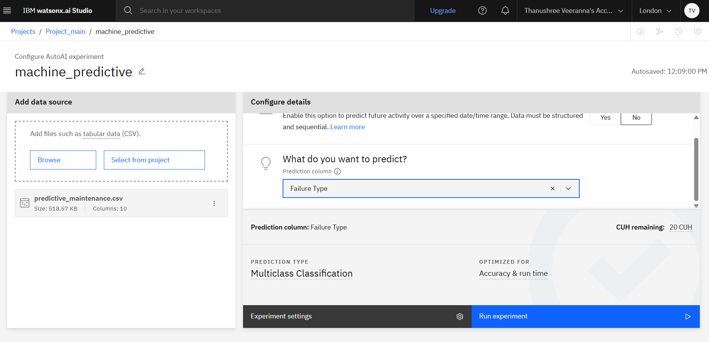
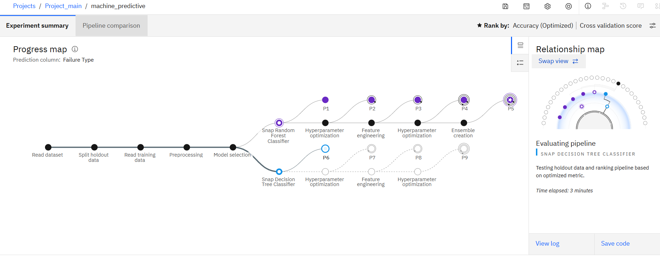

Slide 9
Result
The predictive maintenance model developed using IBM Watsonx.ai Studio and trained on the Kaggle dataset successfully achieved high accuracy in classifying various machine failure types, including tool wear, heat dissipation failure, and power failure. The model demonstrated strong generalization on unseen data, with precision, recall, and F1-scores indicating reliable performance across all failure categories. Feature importance analysis revealed that parameters such as tool wear and rotational speed significantly influenced failure predictions. The deployment of the model enables real-time monitoring and early warning alerts for potential issues. This result confirms the model’s effectiveness in reducing unexpected downtime and optimizing maintenance schedules in industrial environments.

Slide 10
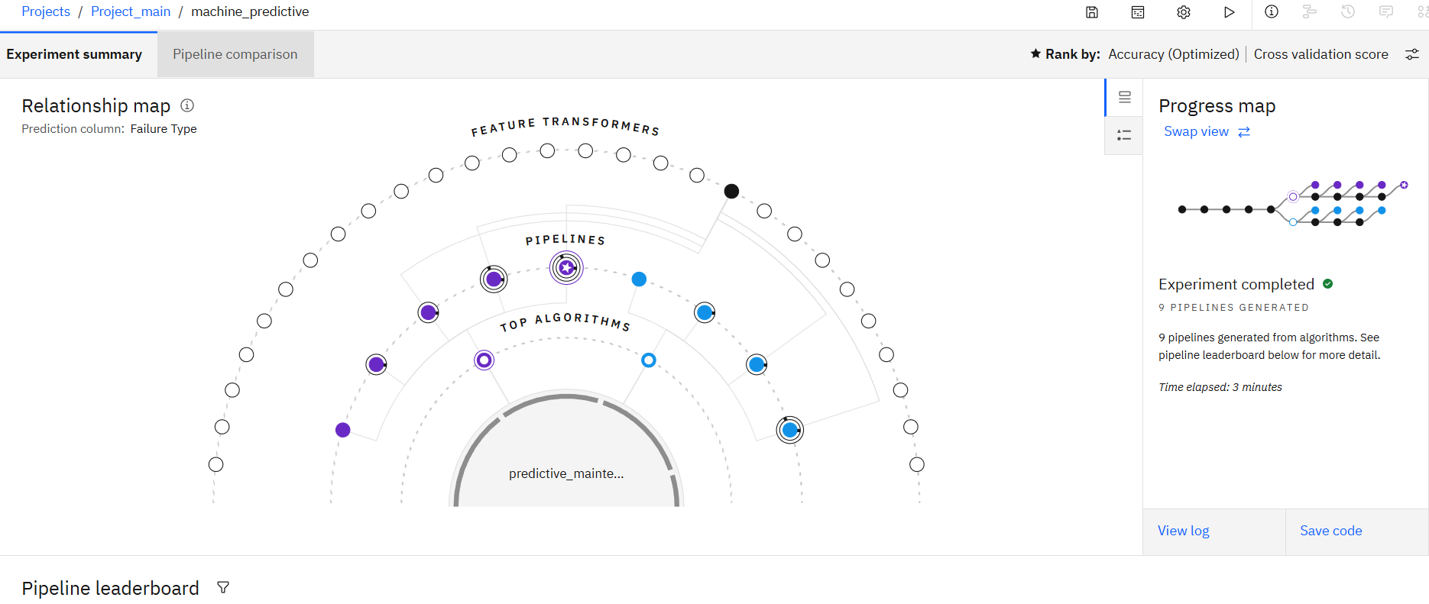

Slide 11
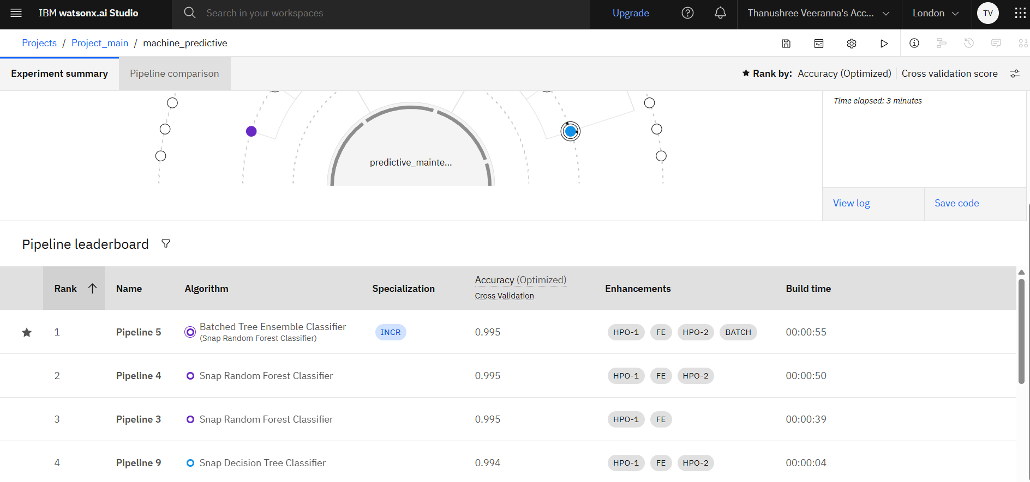

Slide 12
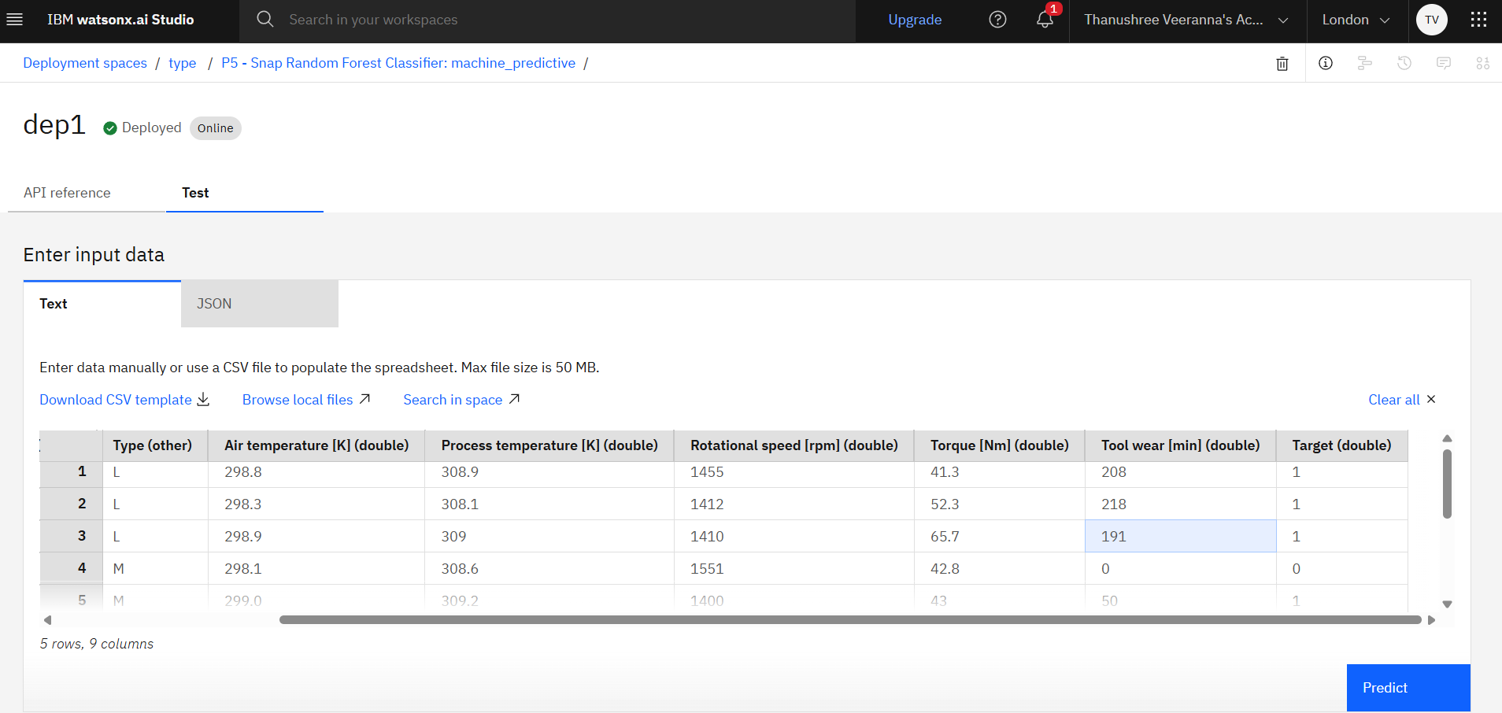

Slide 13
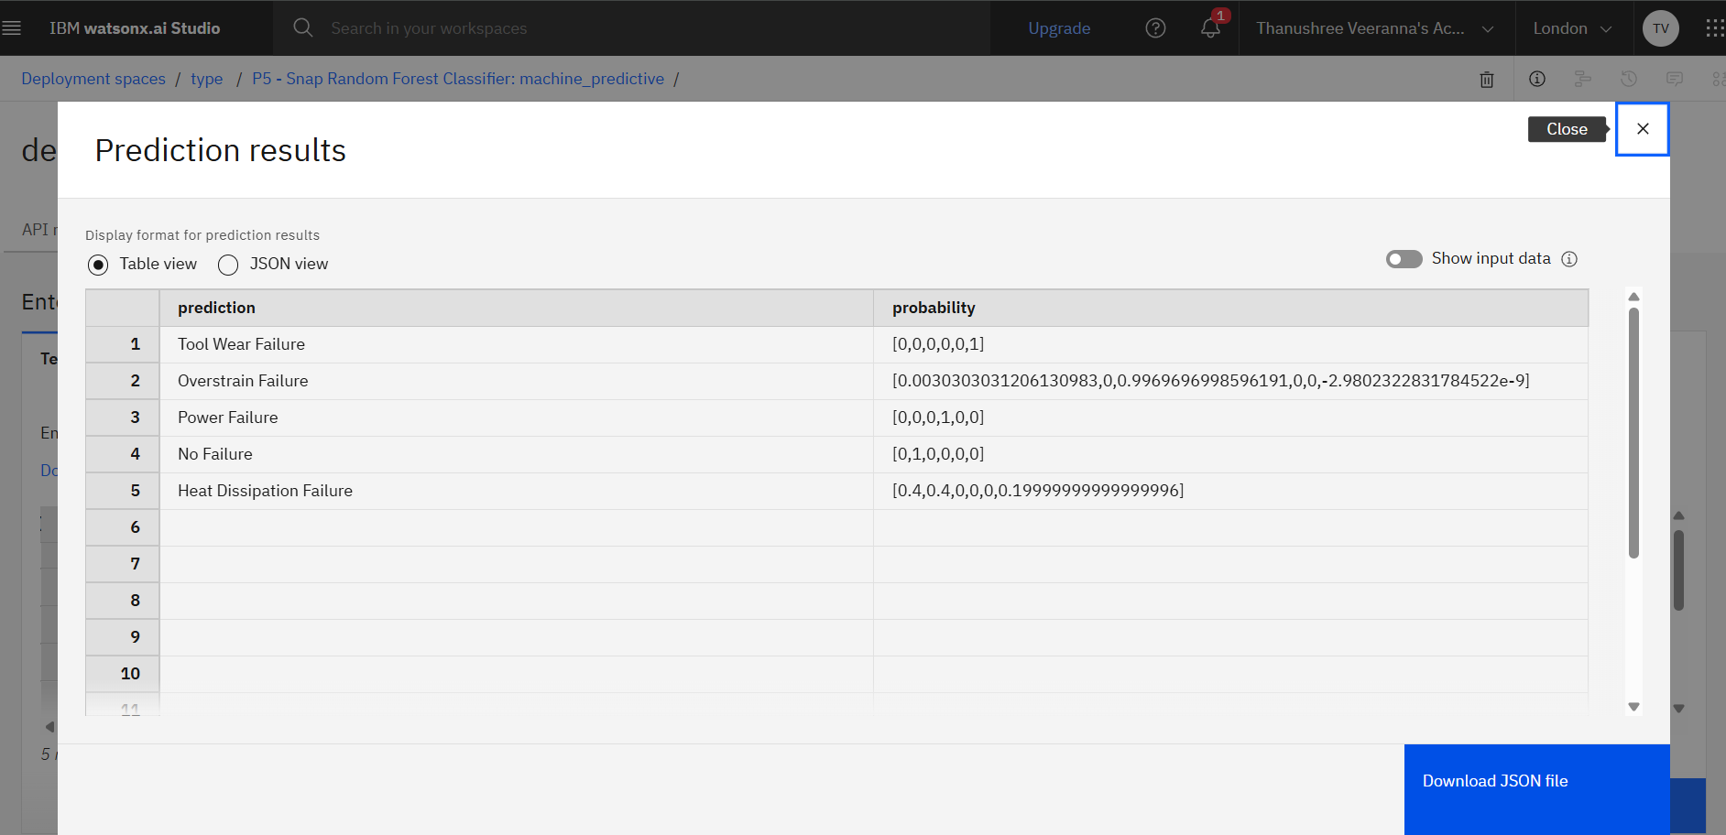

Slide 14
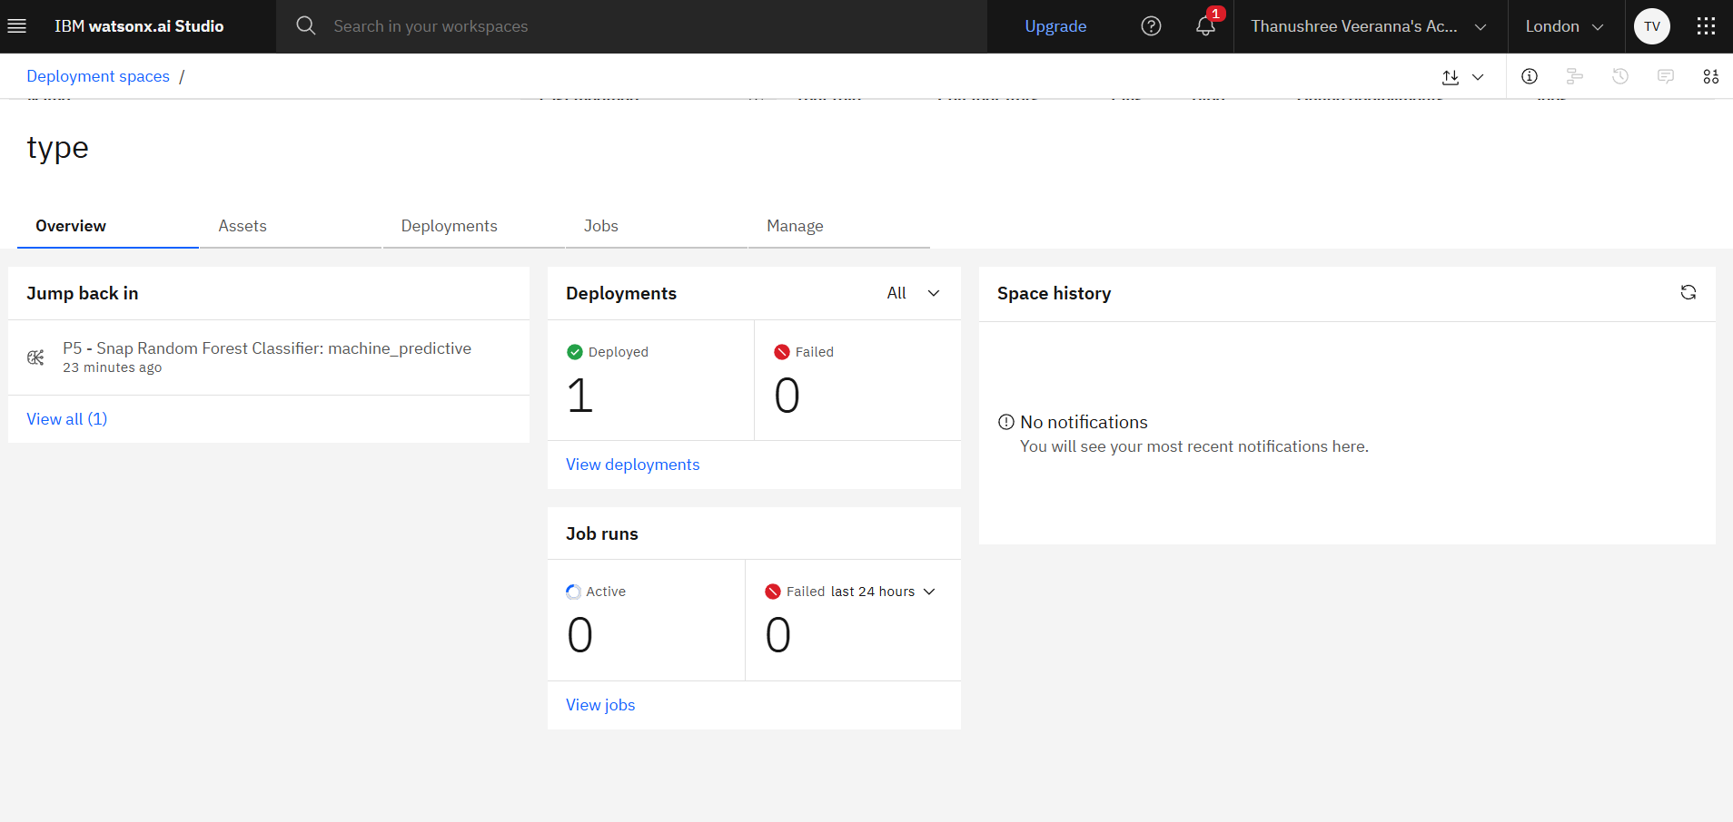

Slide 15
Conclusion
The project successfully developed a reliable predictive maintenance model using IBM Watsonx.ai Studio. It accurately predicts machine failures based on real-time sensor data, enabling proactive maintenance. This approach helps reduce downtime, lower maintenance costs, and improve operational efficiency.

Slide 16
Future scope
Model can be enhanced by integrating deep learning techniques for improved prediction accuracy. Incorporating additional data sources like environmental and usage conditions can boost reliability. Real-time streaming data integration can enable continuous monitoring and instant alerts. Deployment on edge devices can support on-site, low-latency predictions in industrial settings. Future work may also include building a dashboard for visualization and maintenance scheduling.

Slide 17
References
Shivam Bansal's Kaggle Dataset – Provided real-world sensor data (e.g., temperature, torque, tool wear) used to train and test the classification model.
"Impacts of Feature Selection on Predicting Machine Failures" (MDPI, 2024) – Explains how PCA and other techniques enhance model performance for classifying machine failures using sensor data
"Deep Learning Models for Predictive Maintenance: A Survey" (arXiv) – Reviews various machine learning and deep learning approaches for predictive maintenance, including Random Forest and LSTM.
Wikipedia Articles on Feature Engineering and Data Preprocessing – Gave foundational understanding of transforming raw sensor inputs into effective model features.

Slide 18
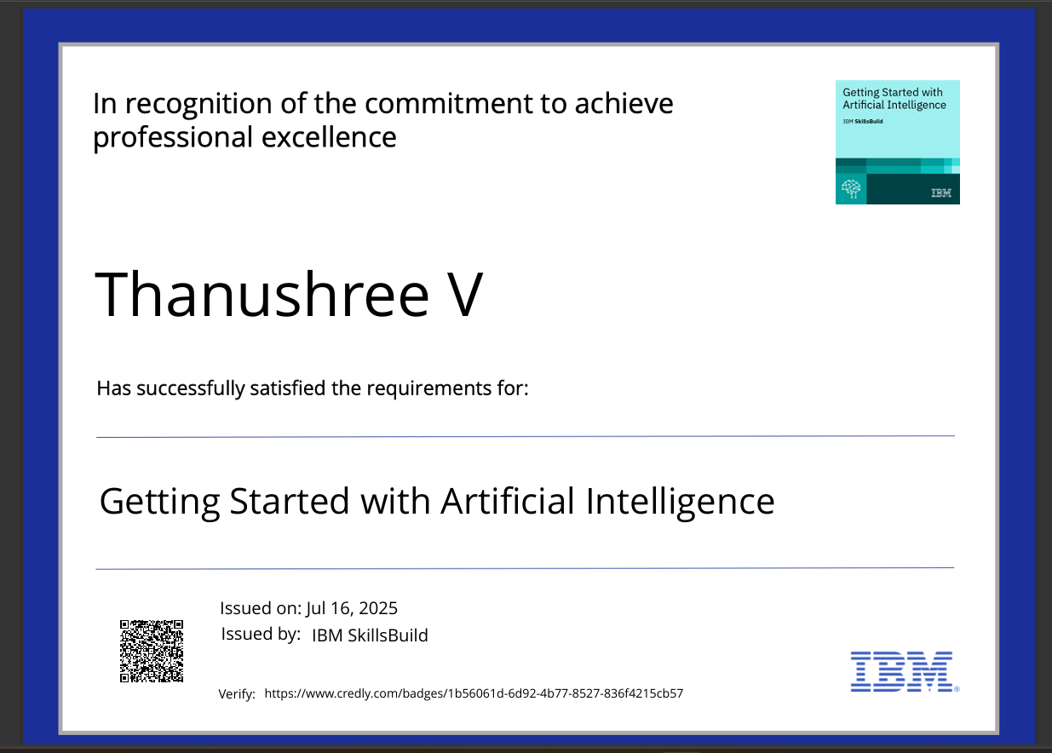
IBM Certifications

Slide 19

IBM Certifications

Slide 20
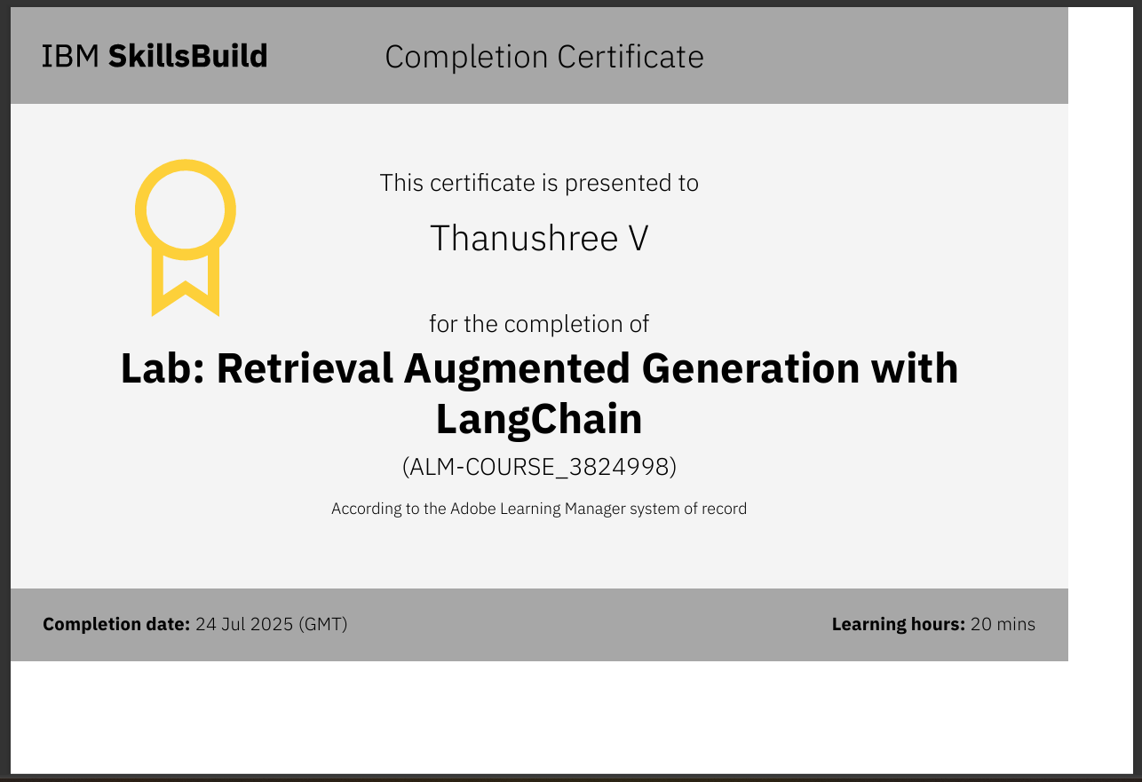
IBM Certifications

Slide 21
THANK YOU

