Slide 1
Module -2
Dr.Hussain syed

Slide 2
OBSTACLES AND PITFALLS IN DEVELOPMENT PATH
•No body ever gets it right for the first time
•Development is chock full of surprises.
•Good design requires living in a sea of changes.
•Designers need good tools.
•Performance design goals
•People may make mistakes while using a good system also

Slide 3
COMMON PITFALLS
•No early analysis and understanding the users needs and expectations.
•A focus on using design features or components .
•No usability testing.
•No common design team vision.
•Poor communication

Slide 4
COMMON USABILITY PROBLEMS
•Ambiguous menus and icons.
•Languages that permit only single direction movement through a system.
•Input and direct manipulation limits.
•Complex linkage.
•Inadequate feedback.
•Lack of system anticipation.
•Inadequate error messages.

Slide 5
•
IRRITATING CHARACTERS
•Visual clutter
•Impaired information readability
•Incomprehensible components
•Annoying distractions.
•Confusing navigation.
•Inefficient operations
•Inefficient page scrolling.
•Information overload

Slide 6
DESIGN TEAM
•Development
•Human factors
•Visual Design
•Usability assesment
•Documentation
•Training
HUMAN INTERACTION WITH COMPUTERS
Understanding How People Interact with Computers Characteristics of computer systems, past and present, that have caused, and are causing, people problems. We will then look at the effect these problems have –
•Why people have trouble with computers
•Responses to poor design
•People and their tasks

Slide 7
Why People Have Trouble with Computers
•Extensive technical knowledge but little behavioral training.
•With its extensive graphical capabilities.
•Poorly designed interfaces.
•What makes a system difficult to use in the eyes of its user?
•Use of jargon
•Non-obvious design
•Fine distinctions
•Disparity in problem-solving strategies
•an "error-preventing" strategy
•Design inconsistency

Slide 8
PSYCHOLOGICAL
Typical psychological responses to poor design are:
•Confusion:.
•Annoyance:
•Frustration:
•Panic or stress
•Boredom
Abandonment of the system

Slide 9
With the Web, almost all users can exercise this option.
•Partial use of the system: Only a portion of the system's capabilities are used, usually those operations that are easiest to perform or that provide the most benefits. Historically, this has been the most common user reaction to most computer systems. Many aspects of many systems often go unused.
•
Indirect use of the system: An intermediary is placed between the would-be user and the computer. Again, since this requires high status and discretion, it is another typical response of managers or others with authority

Slide 10
•Modification of the task: The task is changed to match the capabilities of the system. This is a prevalent reaction when the tools are rigid and the problem is unstructured, as in scientific problem solving.
•
•Compensatory activity: Additional actions are performed to compensate for system inadequacies. A common example is the manual reformatting of information to match the structure required by the computer. This is a reaction common to workers whose discretion is limited, such as clerical personnel.
•
•Misuse of the system: The rules are bent to shortcut operational difficulties. This requires significant knowledge of the system and may affect system integrity.
•
•Direct programming: The system is reprogrammed by its user to meet specific needs. This is a typical response of the sophisticated worker.
•
•These physical responses also greatly diminish user efficiency and effectiveness. They force the user to rely upon other information sources, to fail to use a system's complete capabilities, or to perform time-consuming "work-around" actions

Slide 11
IMPORTANT HUMAN CHARACTERISTICS IN DESIGN
•Importance in design are perception, memory, visual acuity, foveal and peripheral vision, sensory storage, information processing, learning, skill, and individual differences.
•
•Perception
•Proximity
•Similarity
•Matching patterns
•Succinctness
•Closure
•Unity
•Continuity
•Balance
•Expectancies
•Context
•Signals versus noise

Slide 12
•Memory: Memory is not the most stable of human attributes, as anyone who has forgotten why they walked into a room, or forgotten a very important birthday, can attest.
•-Short-term, or working, memory.
-Long-term memory
-Mighty memory
Sensory Storage
•Mental Models: As a result of our experiences and culture, we develop mental models of things and people we interact with.
•
•A mental model is simply an internal representation of a person's current understanding of something. Usually a person cannot describe this mental mode and most often is unaware it even exists.
•
•Mental models are gradually developed in order to understand something, explain things, make decisions, do something, or interact with another person.
•Mental models also enable a person to predict the actions necessary to do things if the action has been forgotten or has not yet been encountered.
•
•Movement Control : Once data has been perceived and an appropriate action decided upon, a response must be made.

Slide 13
•THE IMPLICATIONS IN SCREEN DESIGN
•Learning: Learning, as has been said, is the process of encoding inlong-term memory information that is contained in short-term memory.
It is a complex process requiring some effort on our part. Our ability to learn is important-it clearly differentiates people from machines.
Given enough time people can improve the performance in almost any task. Too often, however, designers use our learning ability as an excuse to justify complex design.
A design developed to minimize human learning time can greatly accelerate human performance.
People prefer to stick with what they know, and they prefer to jump in and get started. Unproductive time spent learning is something frequently avoided.
Skill: The goal of human performance is to perform skillfully. To do so requires linking inputs and responses into a sequence of action.

Slide 14
•The essence of skill is performance of actions or movements in the correct time sequence with adequate precision. It is characterized by consistency and economy of effort.
Economy of effort is achieved by establishing a work pace that represents optimum efficiency.
It is accomplished by increasing mastery of the system through such things as progressive learning of shortcuts, increased speed, and easier access to information or data.
Skills are hierarchical in nature, and many basic skills may be integrated to form increasingly complex ones. Lower-order skills tend to become routine and may drop out of consciousness.
System and screen design must permit development of increasingly skillful performance.
Individual Differences: In reality, there is no average user. A complicating but very advantageous human characteristic is that we all differ-in looks, feelings, motor abilities, intellectual abilities, learning abilities and speed, and so on.
In a keyboard data entry task, for example, the best typists will probably be twice as fast as the poorest and make 10 times fewer errors.

Slide 15
HUMAN CONSIDERATIONS IN DESIGN
•The User's Knowledge and Experience
The knowledge possessed by a person, and the experiences undergone, shape the design of the interface in many ways. The following kinds of knowledge and experiences should be identified.
•Computer Literacy - Highly technical or experienced, moderate computer experience, or none
•
•System Experience - High, moderate, or low knowledge of a particular system and its methods of interaction
•
•Application Experience - High, moderate, or low knowledge of similar systems

Slide 16
HUMAN CONSIDERATIONS IN DESIGN
Task Experience - Other Level of knowledge of job and job tasks
•Systems Use - Frequent or infrequent use of other systems in doing job
•Education - High school, college, or advanced degree
•Reading Level - Less than 5th grade, 5th-12th, more than 12th grade
•Typing Skill - Expert (135 WPM), skilled (90 WPM), good (55 WPM), average (40 WPM), or "hunt and peck" (10 WPM).
Native Language or Culture- English, another, or several.
JOB/TASK NEEDED
•Type of System Use - Mandatory or discretionary use of the system.
•Frequency of Use - Continual, frequent, occasional, or once-in-a-lifetime use of system
Task or Need importance - High, moderate, or low importance of the task being performed
Task Structure - Repetitiveness or predictability of tasks being automated, high, moderate, or low
Social Interactions - Verbal communication with another person required or not required
Primary Training - Extensive or formal training, self training through manuals, or no training
Turnover Rate - High, moderate, or low turnover rate for jobholders
Job Category - Executive, manager, professional, secretary, clerk
Lifestyle - For Web e-commerce systems, includes hobbies, recreational pursuits, and economic status

Slide 17
PSYCHOLOCICAL CHARCTERISTICS
•Attitude - Positive, neutral, or negative feeling toward job or system
•Motivation - Low, moderate, or high due to interest or fear
•Patience - Patience or impatience expected in accomplishing goal
•Expectations - Kinds and reasonableness
•Stress Level - High, some, or no stress generally resulting from task performance
Cognitive Style - Verbal or spatial, analytic or intuitive, concrete or abstract
PHYSICAL CHARACTRISTICS
•Age Young middle aged or elderly
•Gender Male or Female
•Handness Left, right or ambidextrous
•Disabilities Blind, defective vision, deafness, motor handicap

Slide 18
HUMAN INTERACTION SPEEDS
•The speed at which people can perform using various communication methods has been studied by a number of researchers.
•
•Reading: The average adult, reading English prose in the United States, has a reading speed in the order of 250-300 words per minute. Proof reading text on paper has been found to occur at about 200 words per minute, on a computer monitor, about 180 words per minute.
•
•One technique that has dramatically increased reading speeds is called Rapid Serial Visual Presentation, or RSVP. In this technique single words are presented one at a time in the center of a screen. New words continually replace old words at a rate set by the reader. For a sample of people whose paper document reading speed was 342 words per minute. (With a speed range of 143 to 540 words per minute.) Single words were presented on a screen in sets at a speed sequentially varying ranging from 600 to 1,600 words per minute. After each set a comprehension test was administered.

Slide 19
READING
•Prose text - 250-300 words per minute.
•Proof reading text on paper - 200 words per minute.
•Proofreading text on a monitor - 180 words per minute.
•
LISTENING
•Speaking to a computer: 150-160 words per minute.
After recognition corrections: 105 words per minute
KEYING
•Typewriter
Fast typist: 150 words per minute and higher Average typist: 60-70 words per minute
Computer
Transcription: 33 words per minute Composition: 19 words per minute
Two finger typists
Memorized text: 37 words per minute Copying text: 27 words per minute
Hand printing
Memorized text: 31 words per minute. Copying text: 22 words per minute

Slide 20
UNDERSTAND THE BUSINESS FUNCTION
\•Business definition and requirements analysis
--Direct methods -
-Indirect methods
--Requirements collection guidelines Determining basic business functions
--Developing conceptual modes
--Understanding mental models -
-Users new mental model
Design standards or style guides
--Value of standards and guidelines --Document design
--Design support and implementation System training and documentation
-- Training
--Documentation

Slide 21
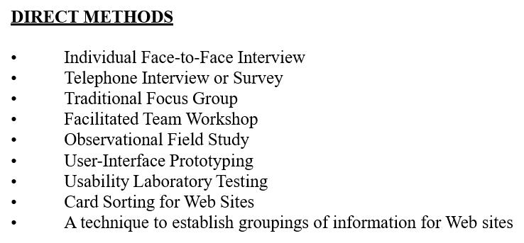

Slide 22
INDIRECT METHODS
•MIS Intermediary
•Paper Surveyor Questionnaire
•Electronic Surveyor Questionnaire
•Electronic Focus Group
•Marketing and Sales
•Support Line
•E-Mail or Bulletin Board
•User Group
•Competitor Analyses
•Trade Show
•Other Media Analysis
•System Testing

Slide 23
DETERMINING BASIC BUSINESS FUNCTIONS
•Major system functions are listed and described, including critical system inputs and outputs.
•
A flowchart of major functions is developed.
Gain a complete understanding of the user's mental model based upon:
•The user's needs and the user's profile.
•A user task analysis.
•Develop a conceptual model of the system based upon the user's mental model. This includes:
•Defining objects.
•Developing metaphors.
UNDERSTANDING THE USER'S MENTAL MODEL
A goal of task analysis, and a goal of understanding the user, is to gain a picture of the user's mental model.

Slide 24
A mental model is an internal representation of a person's current conceptualization and understanding of something.
Mental models are gradually developed in order to understand, explain, and do something.
Mental models enable a person to predict the actions necessary to do things if the actions have been forgotten or have not yet been encountered.
PERFORMING A TASK ANALYSIS
••Task analysis involves breaking down the user's activities to the individual task level.
Knowing why establishes the major work goals;
Complete description of all user tasks and interactions.
Work activities are studied using the techniques just reviewed;
Direct observation, interviews, questionnaires, or obtaining measurements of actual current system usage.
Listing of the user's current tasks.
Another result is a list of objects the users see as important to what they do

Slide 25
•A conceptual model is the general conceptual framework through which the system's functions are presented.
•Such a model describes how the interface will present objects, the relationships between objects, the properties of objects, and the actions that will be performed.
•A conceptual model is based on the user's mental model. Since the term mental model refers to a person's current level of knowledge about something, people will always have them
DEVELOPING CONCEPTUAL MODELS
•Since mental models are influenced by a person’s experiences, and people have different experiences, no two user mental models are likely to be exactly the same.
•
•Each person looks at the interface from a slightly different perspective. The goal of the designer is to facilitate for the user the development of useful mental model of the system.
•
•This is accomplished by presenting to the user a meaningful conceptual model of the system .

Slide 26
Guidelines for Designing Conceptual Models
Reflect the user's mental model, not the designer's.
•Draw physical analogies or present metaphors.
•Comply with expectancies, habits, routines, and stereotypes.
Provide action-response compatibility.
•Make invisible parts and process of a system visible.
•Provide proper and correct feedback.
•Avoid anything unnecessary or irrelevant.
•Provide design consistency.
•Provide documentation and a help system that will reinforce the conceptual model.
Promote the development of both novice and expert mental models

Slide 27
Defining Objects
•Determine all objects that have to be manipulated to get work done.
•
Describe:
-The objects used in tasks.
-Object behavior and characteristics that differentiate each kind of object.
-The relationship of objects to each other and the people using them.
-The actions performed.
-The objects to which actions apply.
-State information or attributes that each object in the task must preserve, display,or allow to be edited.
-
•Identify the objects and actions that appear most often in the workflow.
•
•Make the several most important objects very obvious and easy to manipulate

Slide 28
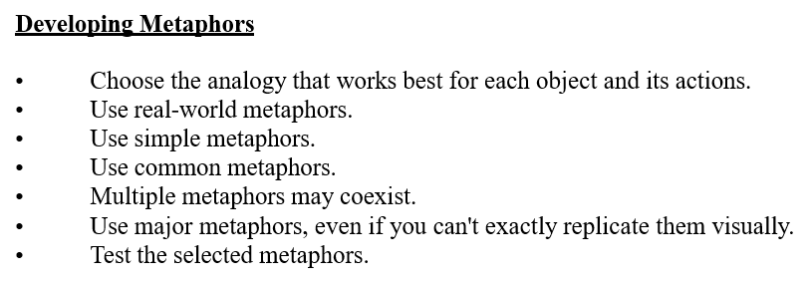

Slide 29
SCREEN DESIGNING
How to distract the screen user
•Unclear captions
•Improper type and graphic emphasis
•Misleading headings
•Irrelevant and unnecessary headings
•Inefficient results
•Clustered and cramped layout
•Poor quality of presentation
•Appearance
•arrangement
•Visual inconsistency
•Lack of design features
•Over use of 3D presentations
•Overuse of too many bright colors
•Bad typography

Slide 30
Variety of distractions
•Numerous audio and visual interruptions
•Extensive visual clutter
•Poor information readability
•In comprehensible screen components
•Confusing and inefficient navigation
•Inefficient operations
•Excessive or inefficient page scrolling
•Information overload
•Design in consistency
•Outdated information

Slide 31
What screen users want
•an orderly clean clutter free appearance
•An obvious indication of what is being shown and what should be done with it.
•Expected information located where it should be.
•A clear indication of what relates to what.
•Plain and simple english
•A clear indication of when an action can make a permanent change in data
•
What screen users do
•Identifies a task to be performed or need to be fulfilled.
•Decides how the task will be completed or need fulfilled.
•Manipulates the computers controls.
•Gathers necessary data.
Forms judgments resulting in decisions relevant to task

Slide 32
Design goals
•Reduce visual work
•Reduce intellectual work
•Reduce memory work
•Reduce mentor work
•Eliminate burdens or instructions.
•
SCREEN MEANING AND PURPOSE
Each screen element
•Every control
•All text
•Screen organization
•All emphasis

Slide 33
•Each color
•Every graphic
•All screen animation
•All forms of feedback
•
Must
•Have meaning to screen users
•Serve a purpose in performing task organizing screen elements
•
Consistency
•Provide real world consistency
•Provide internal consistency
•Operational and navigational procedures
•Visual identity or theme
•Component
•Organization
•Presentation
•Usage
•Locations
•Follow the same conventions
•Deviate only when there is clear benefit to user

Slide 34
•Sequence of use
•Frequency of use
•Function
•Importance
•General to specific.
•
•Form groups that cover all possibilities.
•Ensure that information is visible.
•Ensure that only information relative to task is presented on screen.
•Organizational scheme is to minimize number of information variables.
•Upper left starting point
•Provide an obvious starting point in the screen’s upper left Corner.
SCREEN NAVIGATION AND FLOW
•Provide an ordering of screen information and elements that:
is rhythmic guiding a person’s eye through display
encourages natural movement sequences. minimizes pointer and eye movement distances.

Slide 35
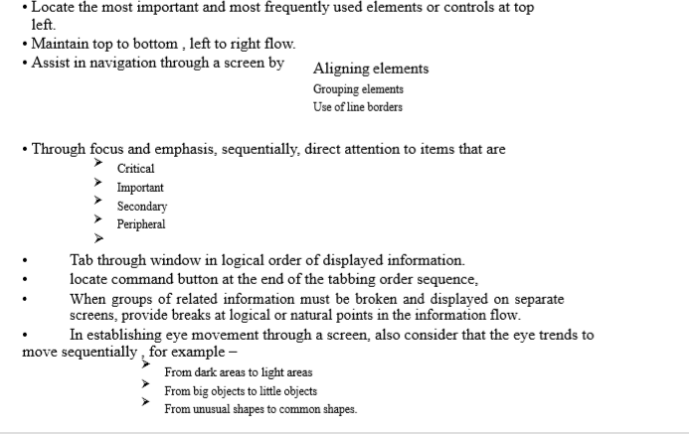

Slide 36
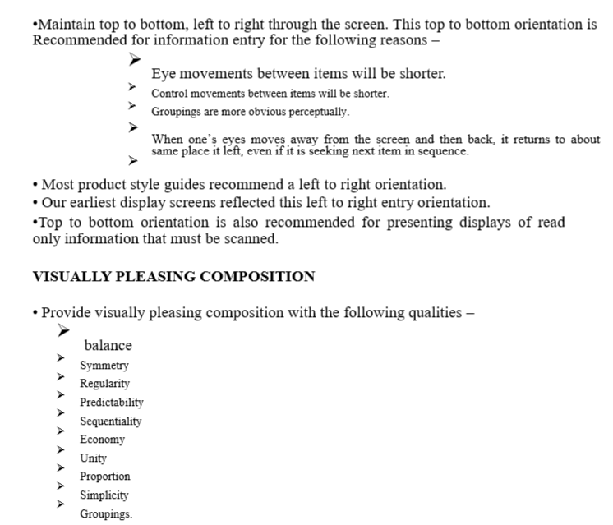
From highly saturated colors to unsaturated colors.

Slide 37
PROBLEMS WITH SEARCHING
•Not understanding the user.
•Difficulties in formulating the search.
•Difficulties in presenting meaningful results.
•Identify the level of expertise of user.
•
KNOW THE SEARCH USER
•Plan for user’s switchig purposes during search process.
•Plan for flexibility in the search process.
•Anticipate
•Nature of every possible query
•Kind of information desired
How much information will result the search

Slide 38
STATISTICAL GRAPHICS
•A statistical graphic is data presented in a graphical format.
•A well designed statistical graphic also refered to as chart or graph.
•Use of statistical graphics
- reserve for material that is rich, complex or difficult.
•Data Presentation
•emphasize the data
•Minimize non data elements
•Minimize redundant data
•Fill the graph’s available area with data.
•Show data variation
•Provide proper context for data interpretation.
•Scales and shading
-place ticks to marks scales on the outside edge of each axis.
-employ a linear scale.
-mark scales at standard or customary intervals

Slide 39
TECHNOLOGICAL CONSIDERATION -INTERFACE DESIGN
Graphical systems
•Screen design must be compatible with the capabilities of the system –
•system power
•Screen size
•Screen resolution
•Display colors
•Other display features
•Screen design must be compatible with the capabilities of the
•Platform compatibility
•development and implementation
•Platform style guide

