Slide 1

Exploratory Data Analysis on AMCAT

Slide 2

Dataset Description:
The dataset was released by Aspiring Minds from the Aspiring Mind Employment Outcome 2015 (AMEO). The study is primarily limited only to students with engineering disciplines. The dataset contains the employment outcomes of engineering graduates as dependent variables (Salary, Job Titles, and Job Locations) along with the standardized scores from three different areas – cognitive skills, technical skills and personality skills. The dataset also contains demographic features. The dataset contains around 40 independent variables and 4000 data points. The independent variables are both continuous and categorical in nature.
Objective:
Times of India article dated Jan 18, 2019 states that “After doing your Computer Science Engineering if you take up jobs as a Programming Analyst, Software Engineer, Hardware Engineer and Associate Engineer you can earn up to 2.5-3 lakhs as a fresh graduate.” Test this claim with the data given to you.
Is there a relationship between gender and specialization? (i.e. Does the preference of Specialisation depend on the Gender?)

Slide 3
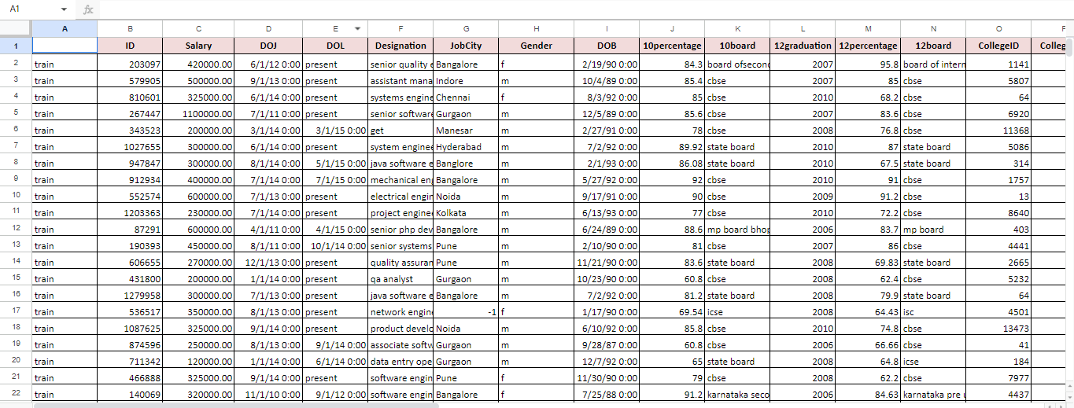
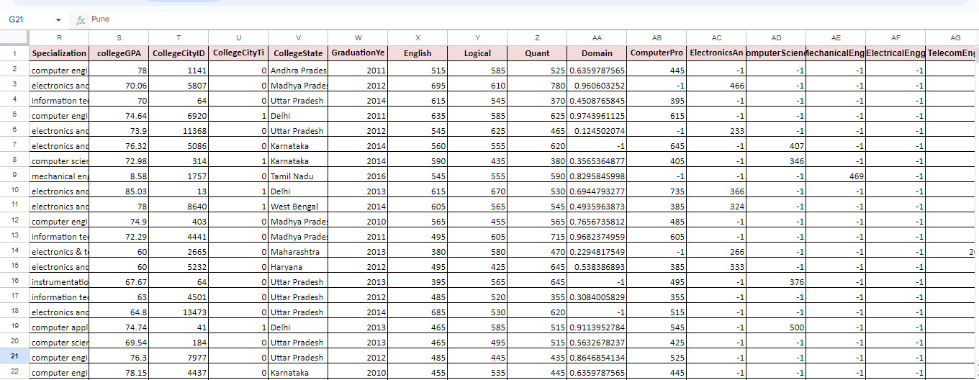
Raw data:

Slide 4
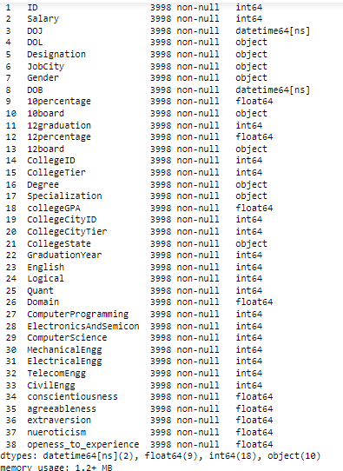
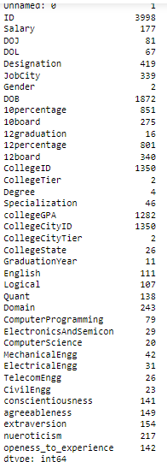
Info of the dataset:

Slide 5
Data Cleaning:
Duplicates: Identifying and removing identical rows or records that occur more than once in the dataset. There are no duplicate values found in the dataset.
Structural Errors: Correcting inconsistencies in the structure or format of the data, such as mislabeled columns, inconsistent date formats, etc. Here in the dataset i’ve replaced or corrected identified structural errors to maintain consistency within the dataset.
Missing Values: Handling missing data by either imputing values based on statistical methods or removing records with missing values. Missing values in numerical columns have been identified as '-1' for clarity and that these values will be handled appropriately during further analysis.
Outliers: Detecting and handling outliers that may significantly skew statistical analyses or machine learning models.
Type Casting: Converting data from one data type to another (e.g., converting object to datetime) to ensure consistency and accuracy in data analysis.
These methods are essential for ensuring the quality and integrity of the data before performing further analysis or modeling.

Slide 6
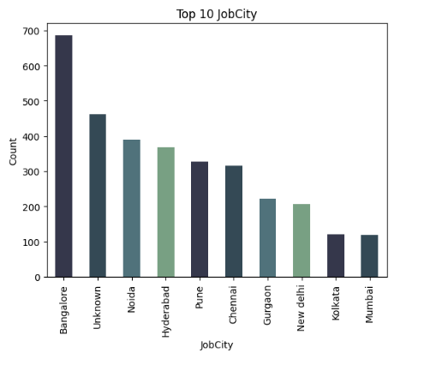
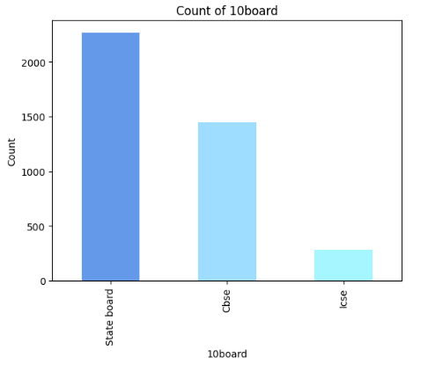
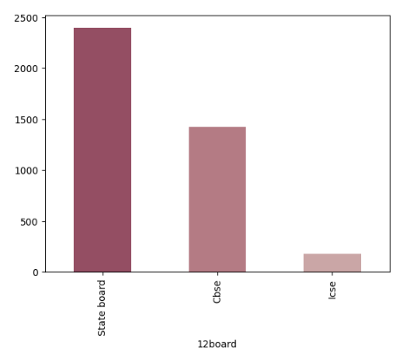
Univariate:
for categorical columns:
Based on 10board & 12board most of the people are from State Board and least are ICSE. The prevalence of state boards for both 10th and 12th grades suggests a strong influence of regional education policies and accessibility to state board schools.
Jobcity of the most of them are from bangalore. it suggests that Bangalore is a prominent employment hub, possibly indicating a concentration of industries, job opportunities, and a favorable economic environment in the city.

Slide 7
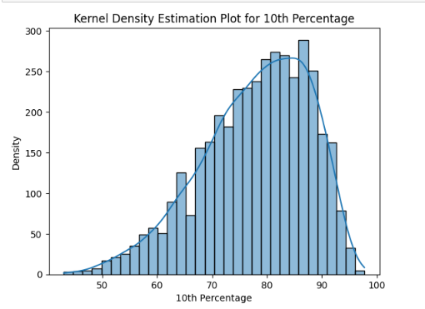
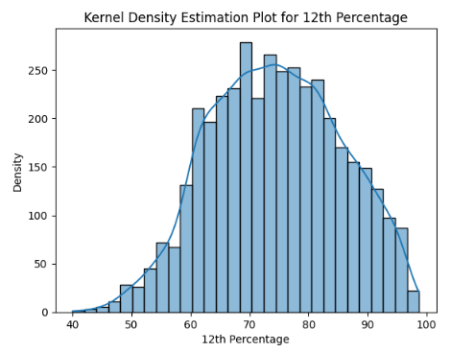
Univariate:
for numerical columns:
The first graph shows a left-skewed distribution, indicating that most of the data points are concentrated towards the lower end, while the following graph suggests that the dataset follows a slightly normal distribution.

Slide 8
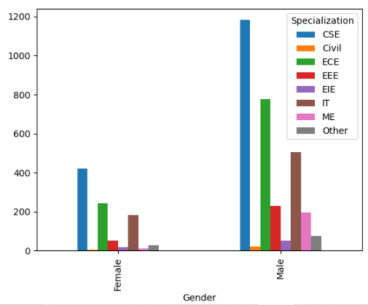
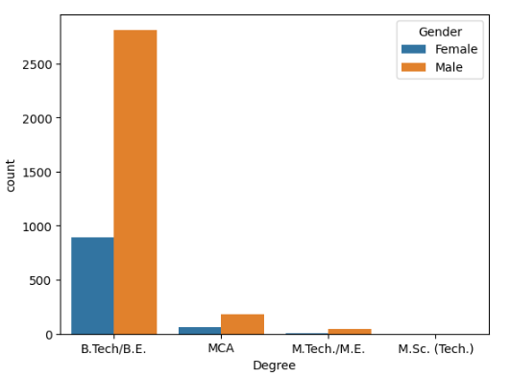
Bivariate:
In every field, males are dominating. Both males and females have opted for their degree course as B.Tech/B.E, and in specialization CSE, civil and ECE qw there are more males than females in this category, indicating a gender imbalance across various fields of study.

Slide 9
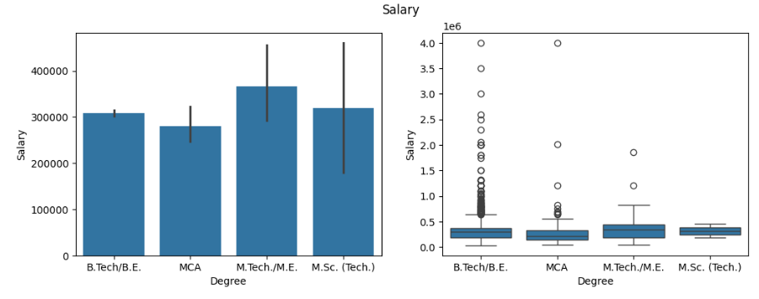
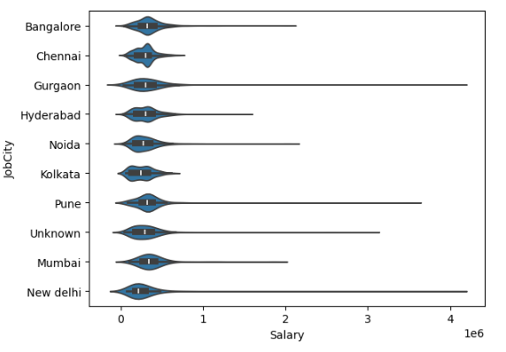
Bivariate:
In every field, males are dominating. Both males and females have opted for their degree course as B.Tech/B.E, and M.Tech/M.E students are earning More than others, but B.Tech/B.E Students having more chances to earn better than M.Tech Students.
Most of them Jobcity is bangalore.
CSE graduates often secure higher salaries, highlighting the high demand for their skill set in the job market.

Slide 10
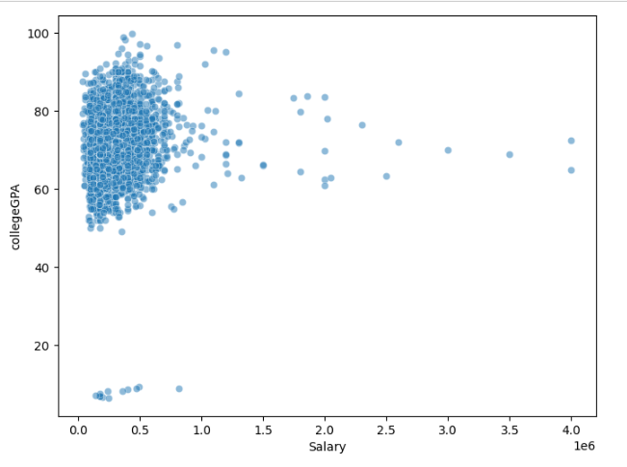
Bivariate:
The scatterplot between salary and college GPA reveals a scattered distribution, lacking any discernible trend or pattern, suggesting no correlation between the two variables. This implies that factors beyond GPA likely influence salary determinations, emphasizing the complexity of salary determination processes.

Slide 11
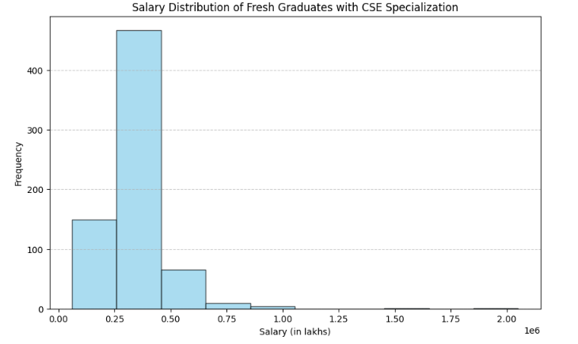
Research question:
Times of India article dated Jan 18, 2019 states that “After doing your Computer Science Engineering if you take up jobs as a Programming Analyst, Software Engineer, Hardware Engineer and Associate Engineer you can earn up to 2.5-3 lakhs as a fresh graduate.” Test this claim with the data given to you.
-Is there a relationship between gender and specialization? (i.e. Does the preference of Specialisation depend on the Gender?)
Gender and specialization exhibit no discernible correlation, as the distribution of specializations remains uniform across genders, indicating that specialization choices are independent of gender.

Slide 12
Conclusion:
The dataset unveils a gender imbalance, urging for diversity efforts in the workforce as most of them are male.
Technical skills, particularly in Computer Science and Engineering, are in high demand, reflected by the prevalence of related degrees.
Preferences for educational boards impact policies, with a notable preference for State Boards, CBSE, and ICSE.
Technical expertise remains vital, as demonstrated by the prevalence of Bachelor of Technology/Engineering graduates.
The data does not confirm the claim from the Times of India article regarding fresh graduates in Computer Science Engineering earning between 2.5 to 3 lakhs in roles like Programming Analyst, Software Engineer, Hardware Engineer, and Associate Engineer.
Gender significantly influences specialization preferences.

