Slide 1

Project On:
Enhancing Search Engine Relevance for
Video Subtitles
Team: Madhu Priya and Thanvi Reddy

Slide 2


Objective
In today's fast-paced digital landscape, finding relevant content within videos, especially for subtitle users, can be challenging. Our solution aims to change that.
We've developed a cutting-edge search algorithm specifically tailored for video subtitles, leveraging state-of-the-art natural language processing and machine learning techniques. By understanding the context and meaning behind user queries, we're enhancing the search experience like never before.
In this presentation, we'll outline our methodology, from data ingestion to document retrieval, highlighting the advantages of semantic search over traditional keyword-based approaches. Ultimately, the goal is to improve search accuracy and relevance for video subtitles using natural language processing and machine learning methods.

Slide 3
Step 1: Connecting to SQLite
Retrieve Table Information with SQLite: Used sqlite3 to connect to the SQLite database and execute PRAGMA to fetch column details from the 'zipfiles' table.
Read Data into DataFrame: Loaded data from the 'zipfiles' table into a pandas DataFrame (df) using pd.read_sql_query().
Extract Subtitle Content from ZIP Files: Defined a function (decode_method) to extract subtitle content from binary ZIP data, utilizing zipfile module for decompression and decoding.
Process Binary Data: Accessed binary data from a specific DataFrame row and passed it to decode_method to extract subtitle content.
Display Subtitle Content: Printed the extracted subtitle content (assumed Latin-1 encoding) to verify the extraction process.

Slide 4
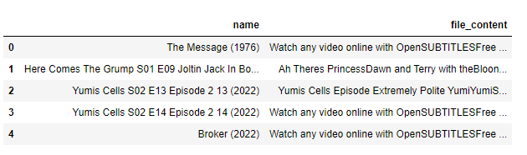
Step 2: Data Cleaning
Timestamp and Special Character Removal: Eliminated timestamps, \r, \n tags, and numerical values embedded within the video subtitle content.
Column Selection: Retained only the 'title' or movie name column and the 'file_content' column containing the cleaned video subtitles.
Proper Movie Name Formatting: Ensured that movie names were cleaned and formatted appropriately for consistency and readability.

Slide 5
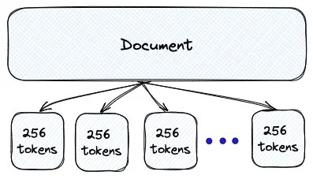
Step 3: Chunking
Chunking is breaking a big piece of data into smaller parts for easier handling. We use it to save memory, speed up processing, and work with large datasets more efficiently. It's like dividing a big task into smaller, more manageable pieces.
To convert each chunk into tokens, we used a technique called tokenization. Tokenization breaks a text into individual tokens.
We loaded the 'all-mpnet-base-v2' SentenceTransformers model. You can use any other BERT-based model depending on your requirements.
We iterate over each chunk, encode it using the BERT model, and store the resulting embeddings in the bert_embeddings list.

Slide 6
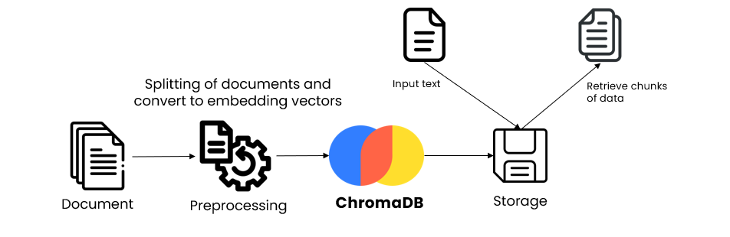
Step 4: ChromaDB & Embeddings setup
VectorDB (ChromaDB) database is created with PersistentClient for storage and retrieval of embeddings.
An embedding function is defined using the SentenceTransformer model.
Collection "eng_subtitles_collection" stores documents, embeddings, and metadata.
The search function retrieves the top 10 similar documents based on cosine similarity.

Slide 7
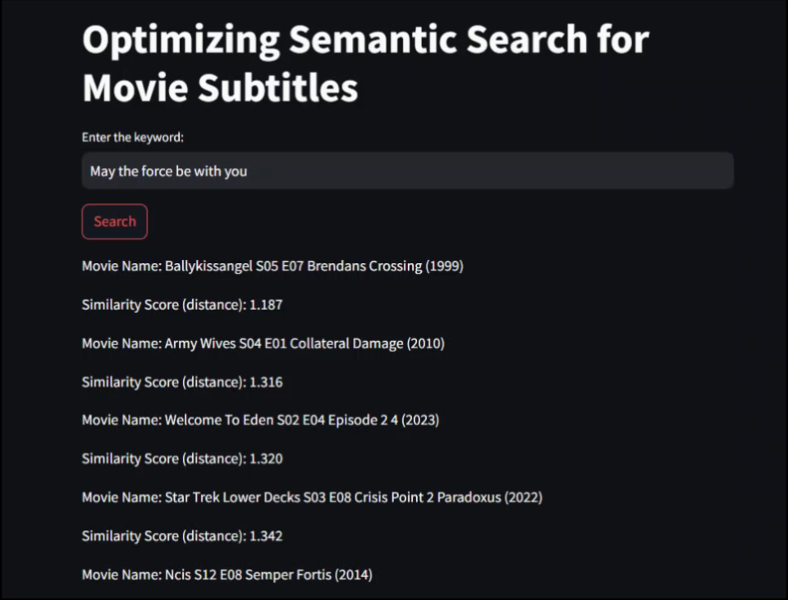
Step 5: Search functionality implementation
Developed a user-friendly application using Streamlit.
User inputs a movie query into the interface.
Query is encoded using the same model as the dataset.
Implemented cosine similarity for efficient distance calculation. Cosine similarity finds the closest embeddings to the query.
Displays corresponding movie names based on the top 10 closest embeddings to the user.

