Slide 1
UE19CS390B –Project Phase – 2
END SEMESTER ASSESSMENT
Project Title :Stock market prediction using LSTM
Project ID :113
Project Guide : Shilpa S
Project Team : Pratheek
Thanish Vishaal
Disha BS
S Kalyan

Slide 2
Outline
Abstract
Summary of Requirements and Design ( Phase - 1)
Summary of Methodology / Approach (Phase - 1)
Design Description
Modules and Implementation Details
Project Demonstration and Walkthrough
Results and Discussion
Lessons Learnt
Conclusion and Future Work
References

Slide 3
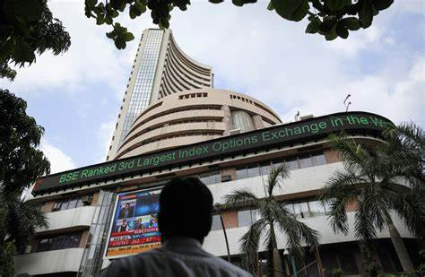
Abstract
The stock market is a component of a free-market
Economy. It allows companies to raise money by offering stock shares and corporate bonds and allows investors to participate in the financial achievements Of the companies, that make profits through capital gains, and earn income through dividends.

Slide 4
Summary of requirments and design
Hardware requirments:
A ram of 4 GB with 500 GB storage ,a CPU of 2 GHZ or faster and the architecture of either 32 or 64 bit
Software requirments:
Python jupyter notebook
Os:windows 7 and above , MAC, linux

Slide 5
Summary of metholodogy
Basic approach:
RNN recurrent neural network
LSTM long term short term memory
Benefits and drawbacks of approach: .
1.What makes lstm better is their tendency to store information for longer times .
2.Resource and time requirement is high for training data
3.Ability to predict is less as lstm predicts next day using value close to previous day closing price

Slide 6
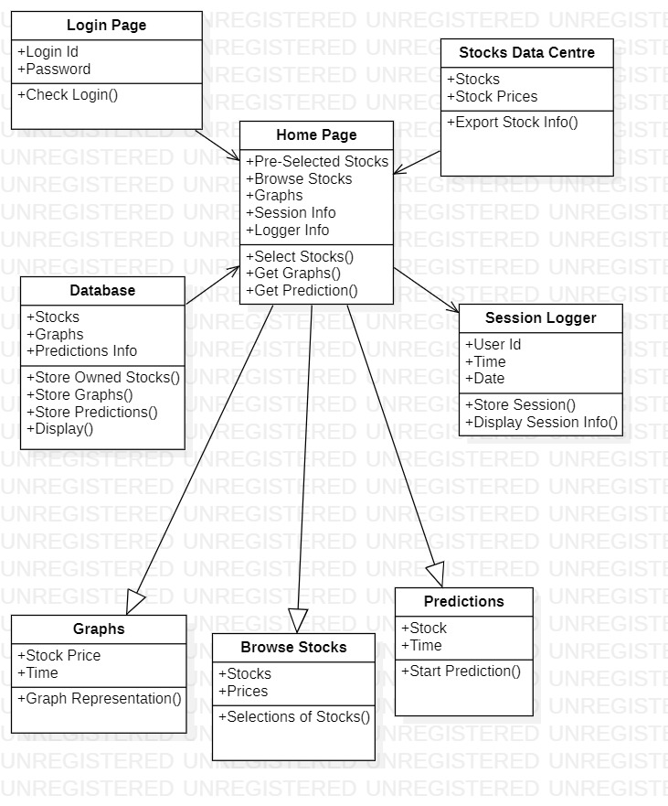
Design Description
CLASS DIAGRAM

Slide 7
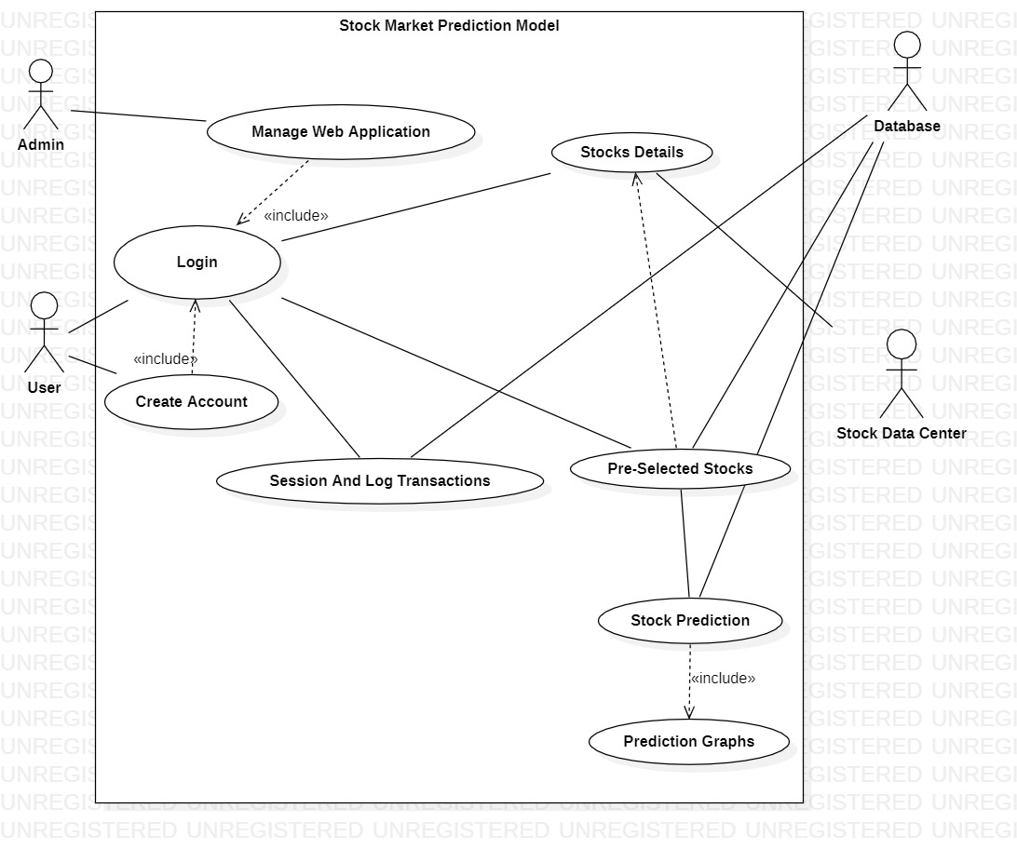
USE CASE DIAGRAM

Slide 8
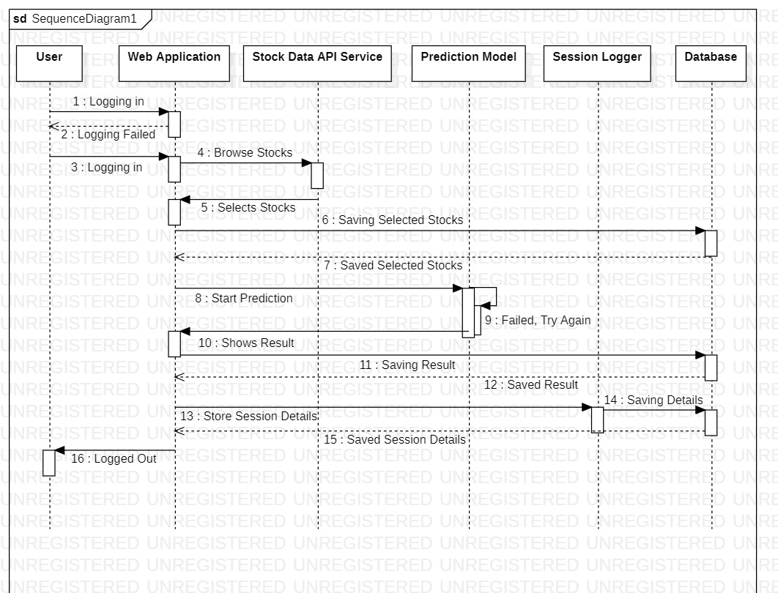
SEQUENCE DIAGRAM

Slide 9
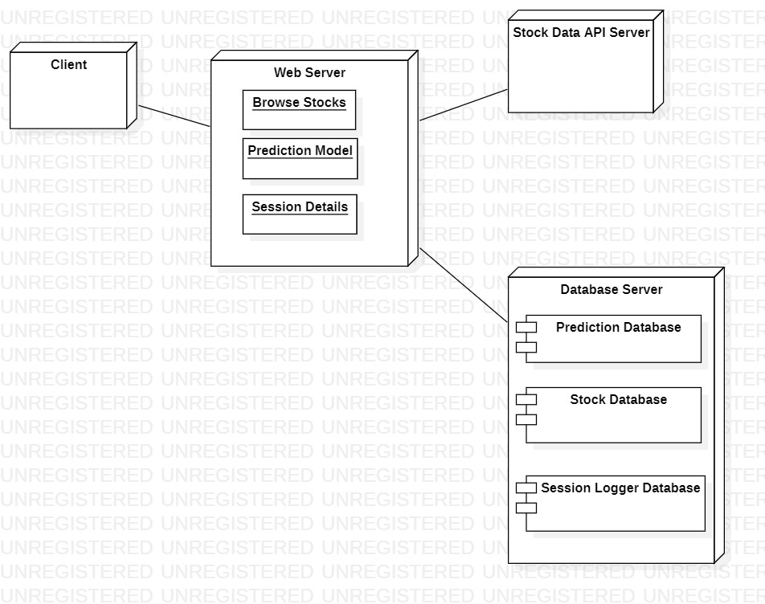
DEPLOYMENT DIAGRAM

Slide 10
Implementation Details
Modules Used
numpy-To perform a wide variety of mathematical operation on arrays.
pandas-Used to analyse data.
matplotLib.pyplot-Is a collections of functions that make matplotlib work like MATLAB,each pyplot function makes some changes to a figure.
pandas_datareader-is a python package that allows us to create a pandas DataFrame Object by using various data sources from the internet.

Slide 11
Implementation Details
Sklearn.preprocessing-provides several common utility functions and transformer classes to change raw feature vectors into a representation that is more suitable for the downstream estimators.
MinMaxScaler-Scales our data set between in the rage of 0 and 1.
Keras.layers-neural network Application Programming Interface (API) for python that is tightly integrated with the TensorFlow,which is used to build machine learning models .
Dense-for adding densely connected neural network
DropOut-To prevent overfitting.
LSTM-Long Short Term Memory which can remember the past information and forget the information that is not required.

Slide 12
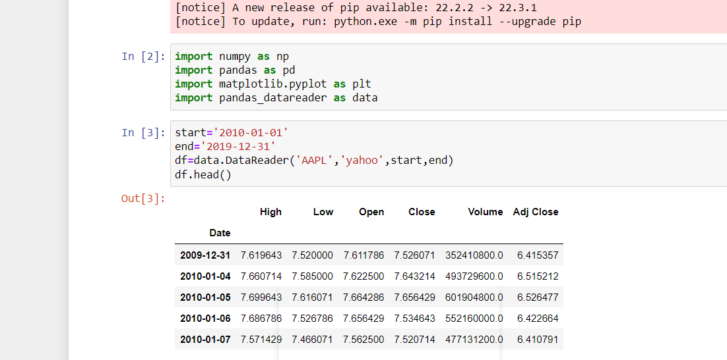
Project Demonstration
Importing the required libraries

Slide 13
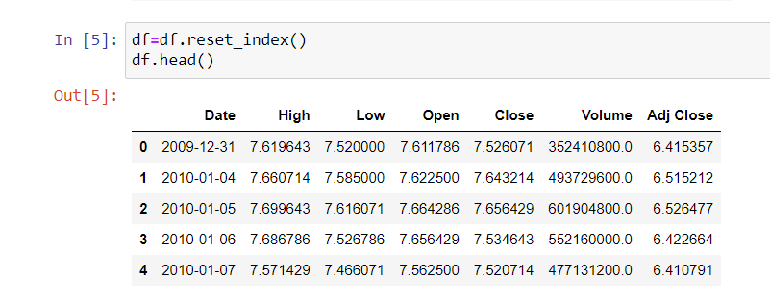
Resetting the index

Slide 14
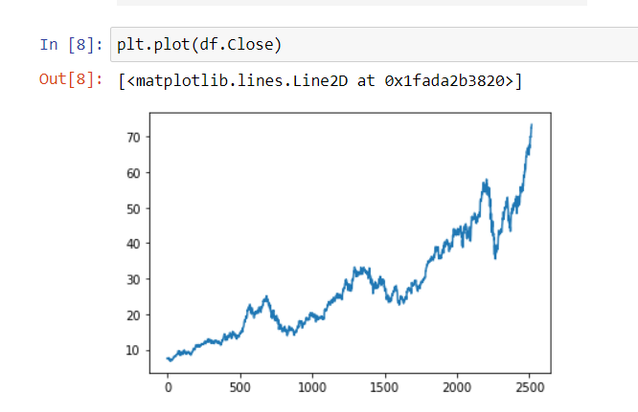
Plotting the graph for the closing price value of the stock.

Slide 15
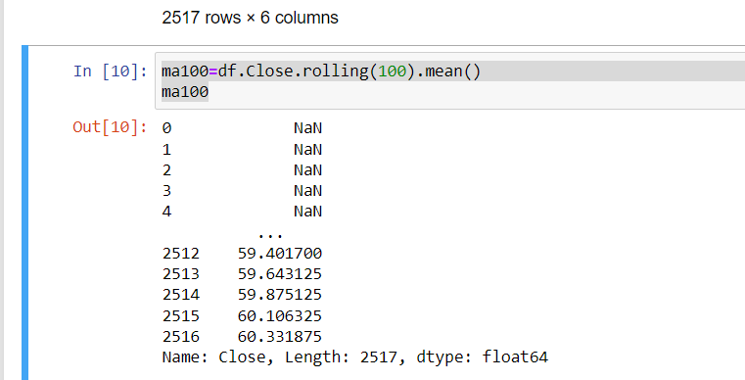
Getting the MA(Moving Average)value of the first 100 indexes.

Slide 16
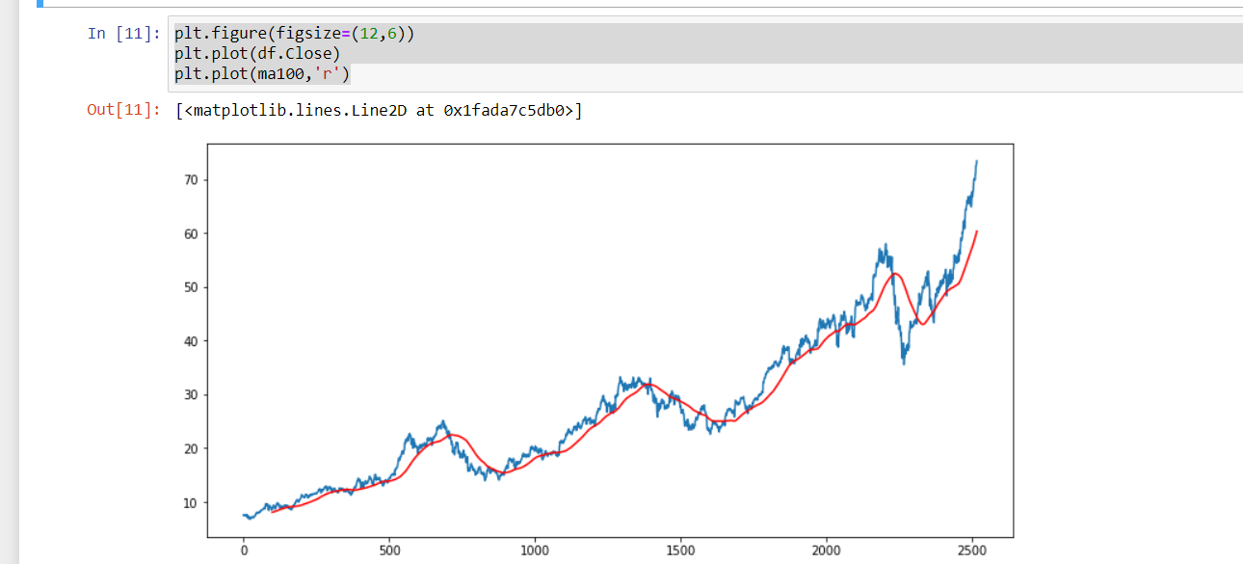
Plotting the graph with moving average and closing price of stock

Slide 17
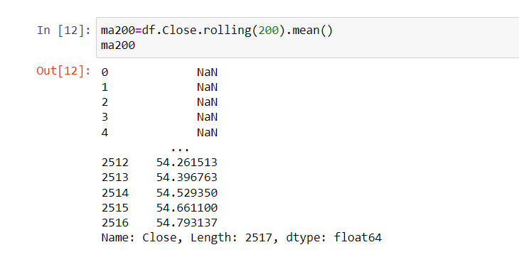
Getting the MA(Moving average) value for the first 200 indexes.

Slide 18
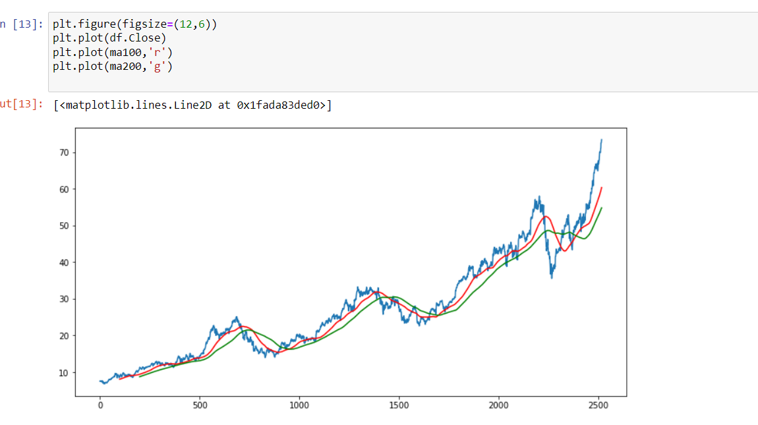
Plotting the graph with 100 moving average and 200 moving average and closing price value of the stock market.
If the moving average (red line ) is above the moving average(green line) then its called the uptrend
If the moving average (red line)is below the moving average(green line)then its called as a downtrend.

Slide 19
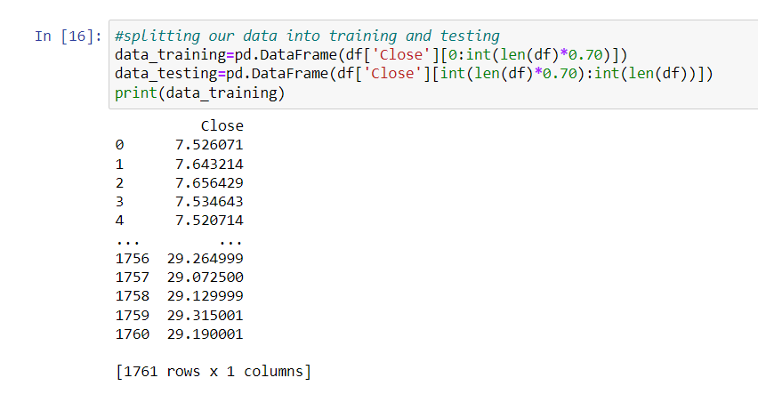
Splitting our datasets into training and testing data sets.

Slide 20
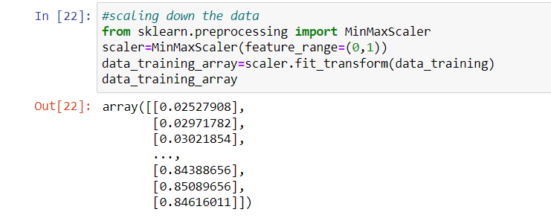
Scaling down our data using MinMaxScaler.

Slide 21
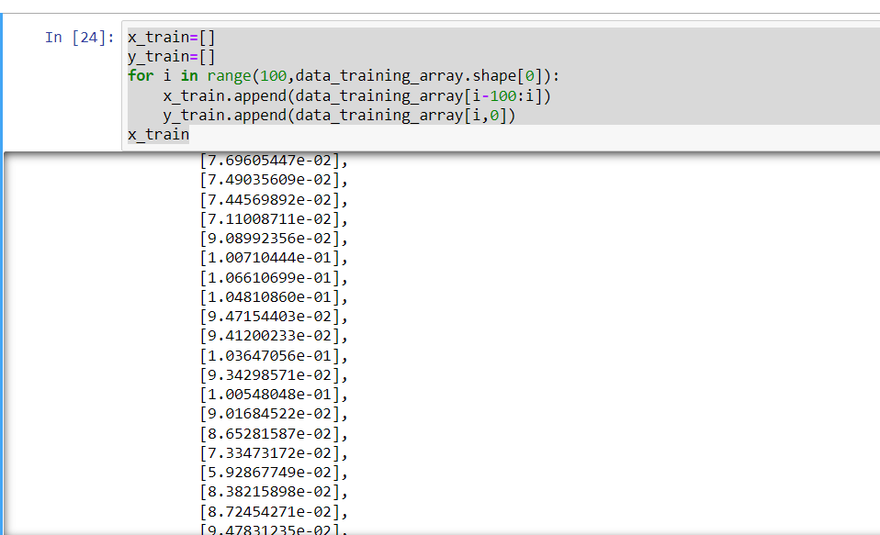
Appending the values to the y_train one by one

Slide 22
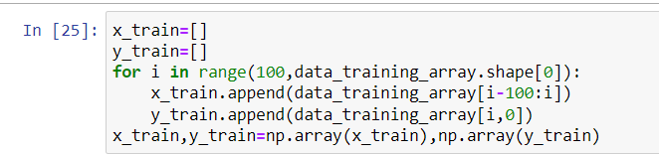
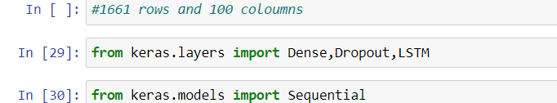
Converting it into a NumPy array
Importing the required layers

Slide 23
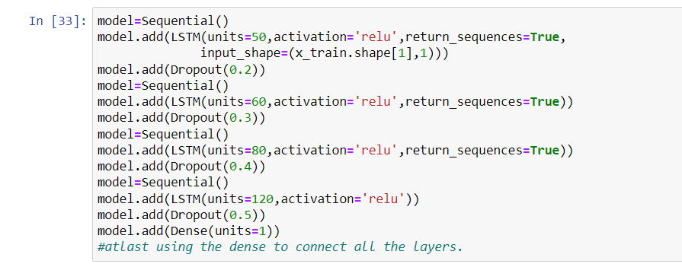
Building the LSTM Model

Slide 24
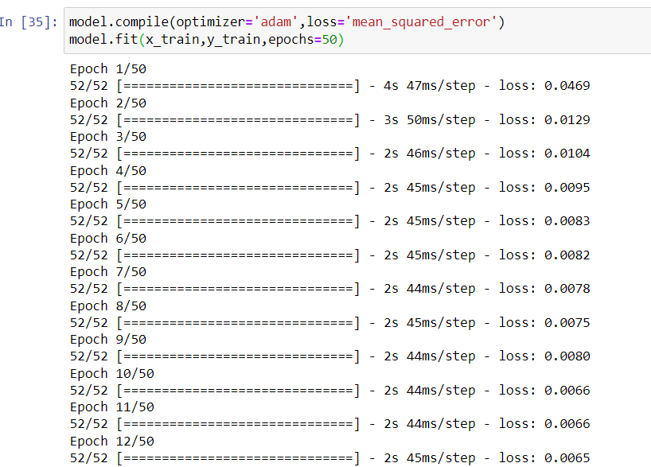
Compiling it using adam optimizer

Slide 25
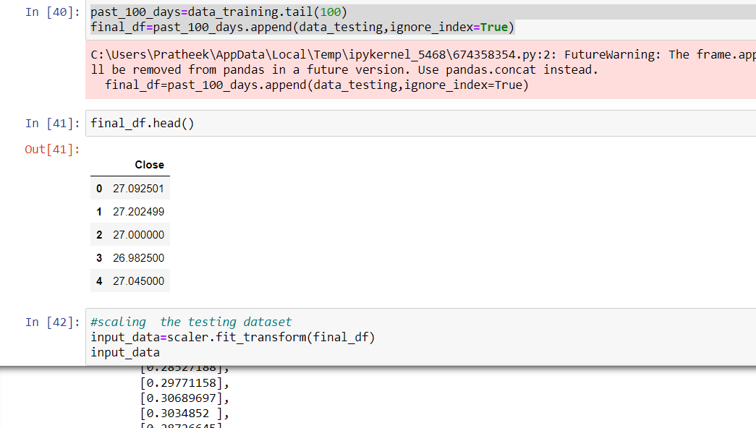
Appending the training dataset values to the testing the dataset to obtain the required results.

Slide 26
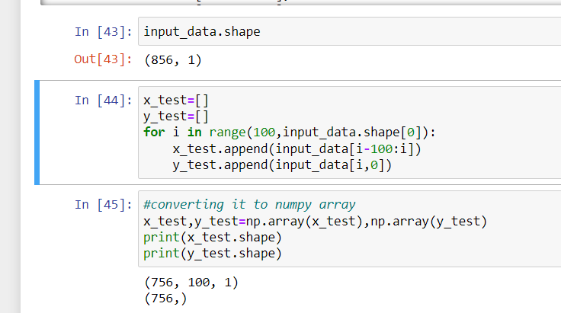
Appending the value to the y_test and converting it into a numPy array

Slide 27
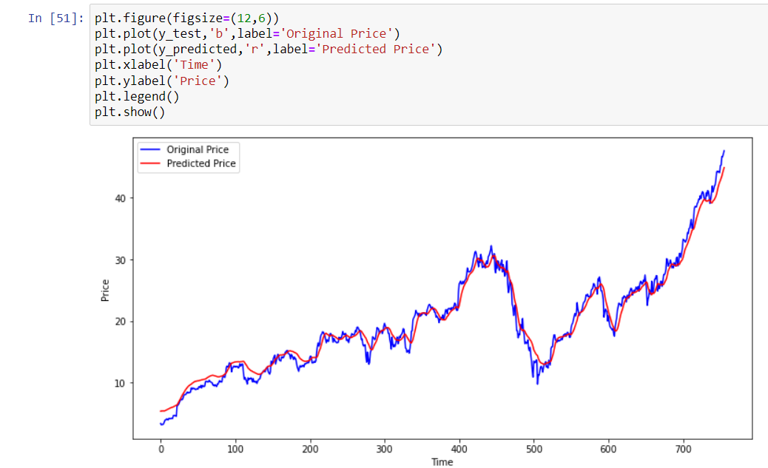
Finally plotting the graph with y_test and y_predicted to predict our stock prices.

Slide 28
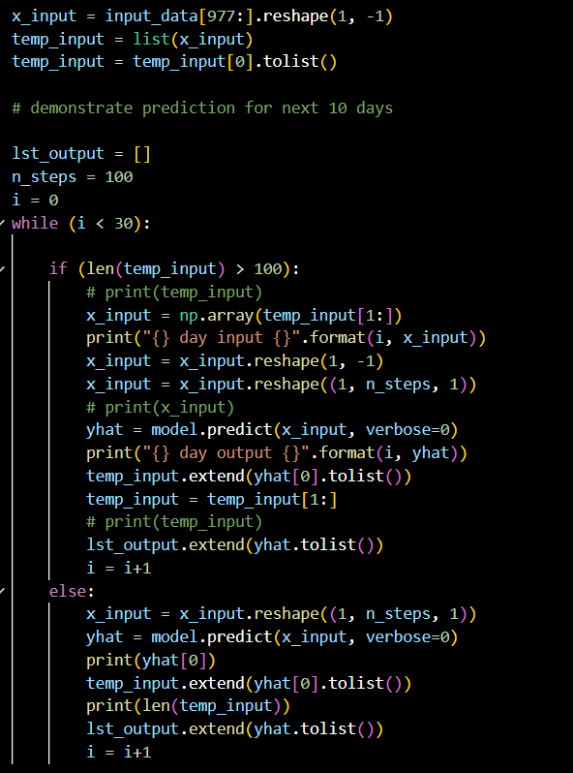
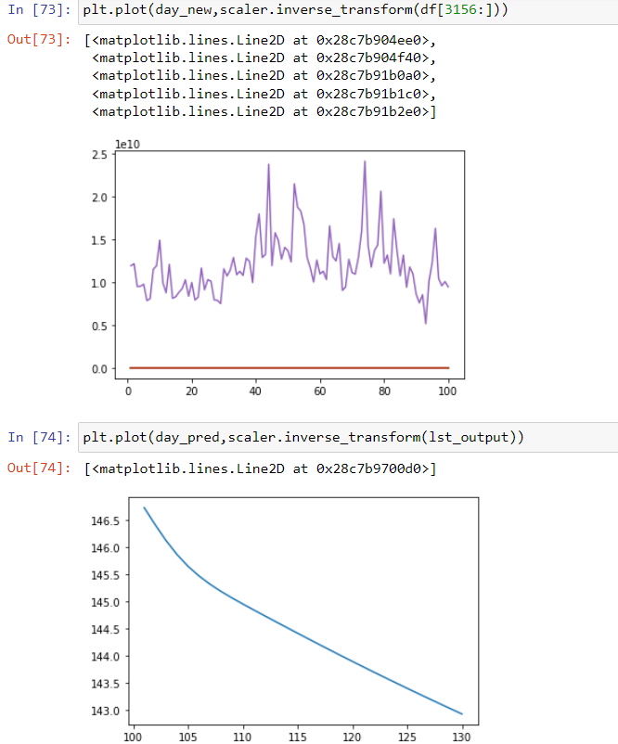
Prediction for next 30 days

Slide 29
Results and Discussion
Final predicted graph

Slide 30
Conclusion and Future work
We have splitted our data into training and testing and we modelled the data using LSTM model at last we plotted the graph of actual and predicted stock prices full stock.
We designed a web application to predict stock prices that can register and store user information within the database and allows us to select stock from company based on interest.

Slide 31
References
• Stock Price Prediction Using LSTM on Indian Share Market by Achyut Ghosh, Soumik Bose1, Giridhar Maji, Narayan C. Debnath, Soumya Sen-2012
• S. Selvin, R. Vinaya kumar, E. A. Gopalkrishnan, V. K. Menon and K. P. Soman - Stock price prediction using LSTM, RNN and CNN-sliding window model - 2017
• Murtaza Roondiwala, Harshal Patel, Shraddha Varma, “Predicting Stock Prices Using LSTM” in Undergraduate Engineering Students, Department of Information Technology, Mumbai University,2005
• Osman Hegazy, Omar S. Soliman and Mustafa Abdul Salam Faculty of Computers and • Informatics, Cairo University, Egypt - A Machine Learning Model for Stock Market Prediction 2015 • M. Mekayel Anik · M. Shamsul Arefin (B) Department of Computer Science and Engineering, Chittagong University of Engineering and Technology, Chittagong, Bangladesh - An Intelligent Technique for Stock Market Prediction.

Slide 32
Thank You

