Slide 1
CP5637 - Assignment 3 - Plugin
Student name: Thi Thao Ngo
Student id: 13378135

Slide 2
Category thumbnail list plugin
Purpose
Display a category list with thumbnail image, post title and link to content.
Set size for thumbnail image.
Set Category thumbnail list order (by title or date)

Slide 3
Category thumbnail list plugin
Function.php
Add the following rows to themes functions.php
add_theme_support( 'post-thumbnails' );
set_post_thumbnail_size( form_option('thumbnail_size_w&&echo=false'), form_option('thumbnail_size_h&&echo=false'), true );

Slide 4
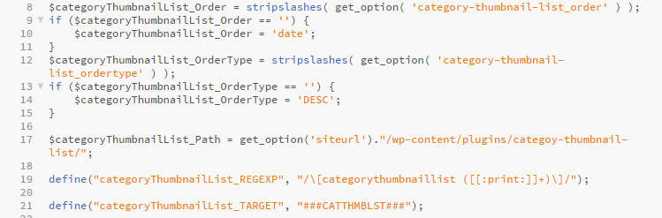
Category thumbnail list plugin
Define all variable in categoy-thumbnail-list.php

Slide 5
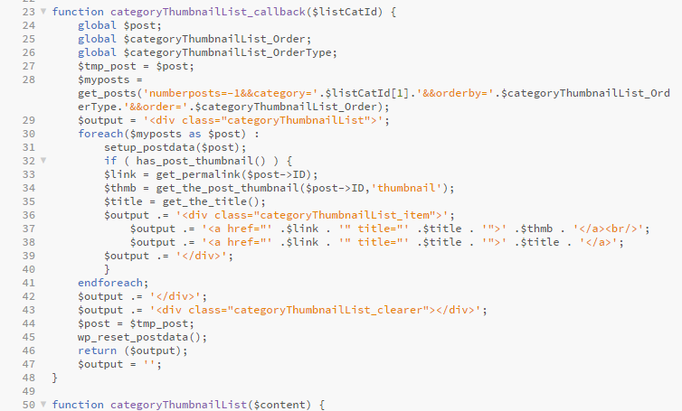
Category thumbnail list plugin
Get category by Id

Slide 6
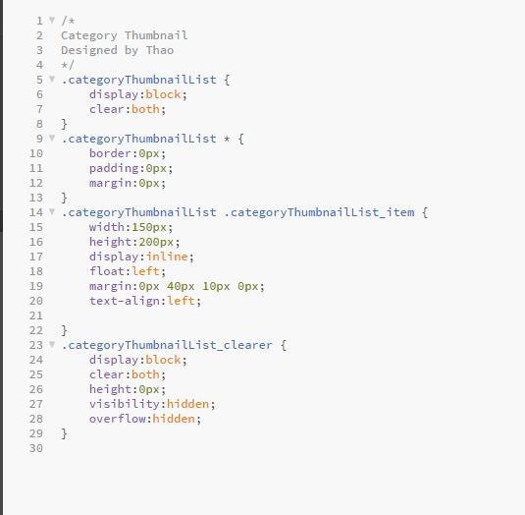
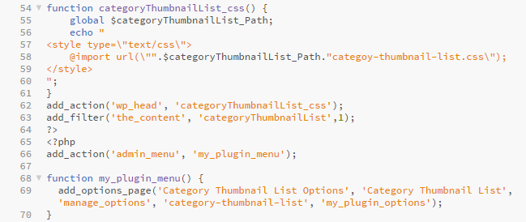
Category thumbnail list plugin
Create categoy-thumbnail-list.css
Create function: categoryThumbnailList_css() in categoy-thumbnail-list.php

Slide 7
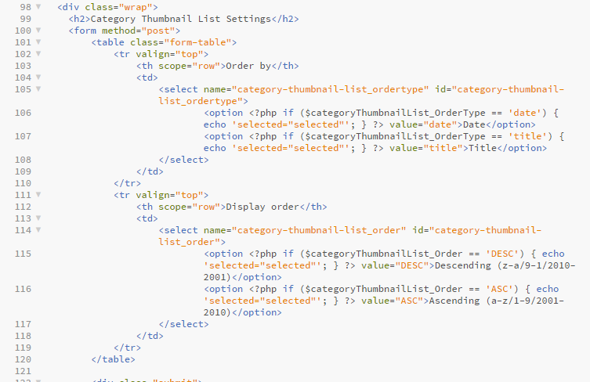
Category thumbnail list plugin
Build Category thumbnail list Setting

Slide 8
Contact form plugin
Purpose
Create a contact form with name, email, subject and message area.
Send a email to admin email when click submit.

Slide 9
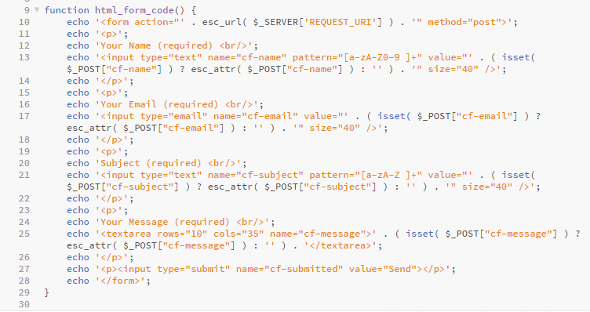
Contact form plugin
Create a contact form:

Slide 10
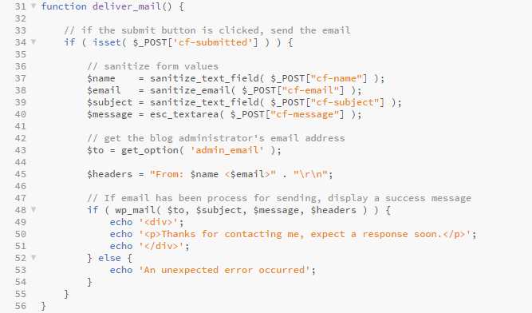
Contact form plugin
Create a email:

Slide 11
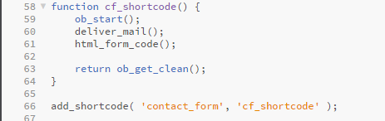
Contact form plugin
Add shortcode:

Slide 12
Thank you

