Slide 1
PetShop
Business Management System

Slide 2
Table of contents
01
02
03
PROJECT OVERVIEW
SYSTEM ARCHITECTURE
CORE FEATURES
04
05
LIVE DEMONSTRATION
PROJECT HIGHLIGHTS
Real-world problem analysis and technology solution approach
Business features:
inventory, billing, customer management
MVC architecture design
and database relationships overview
End-to-end system
demonstration with live features
Key achievements, lessons learned, and future plans

Slide 3
01.
PROJECT OVERVIEW

Slide 4
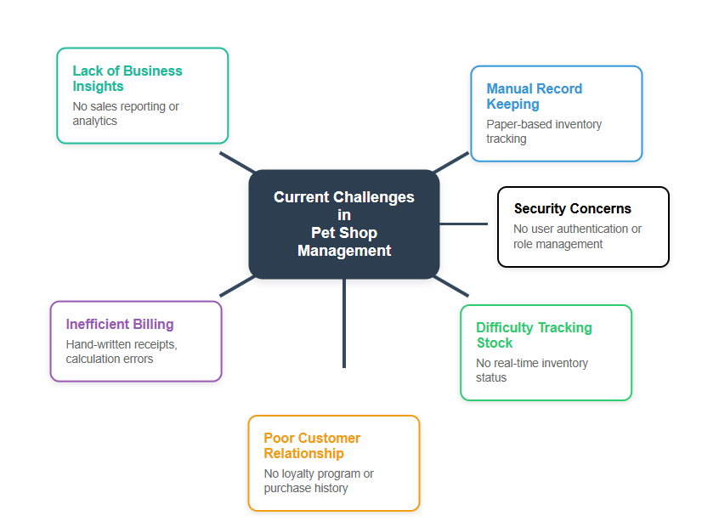
Current Challenges in Pet Shop Management:

Slide 5
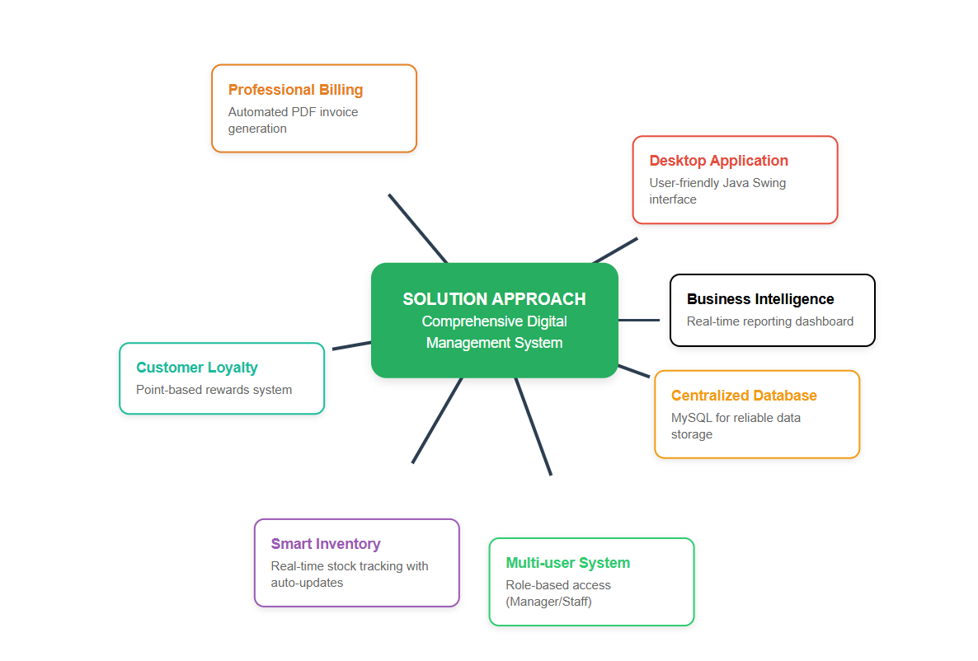
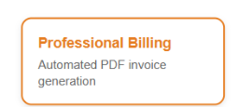
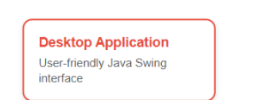
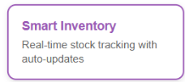

SOLUTION APPROACH

Slide 6
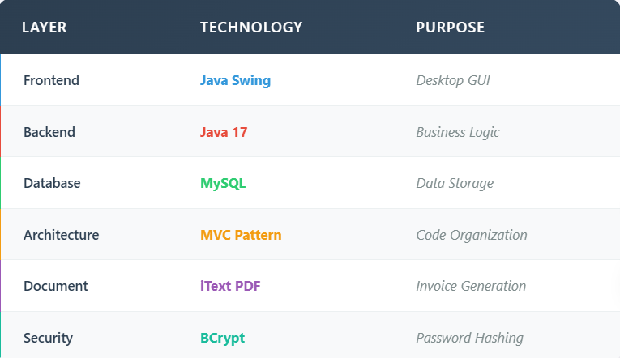
TECHNOLOGY STACK

Slide 7
PROJECT SCOPE
Manager
Staff
Customer
Target Users:

Slide 8
PROJECT SCOPE
Key Business Modules:
Authentication - Secure login/signup system
Product Management - Food, Medicine, Toys inventory
Pet Management - Dogs, Cats with breed information
Customer Management - Profile, loyalty points, purchase history
Billing System - Shopping cart, payment processing, PDF receipts
Analytics - Sales reports, revenue tracking, inventory status

Slide 9
02.
SYSTEM ARCHITECTURE

Slide 10
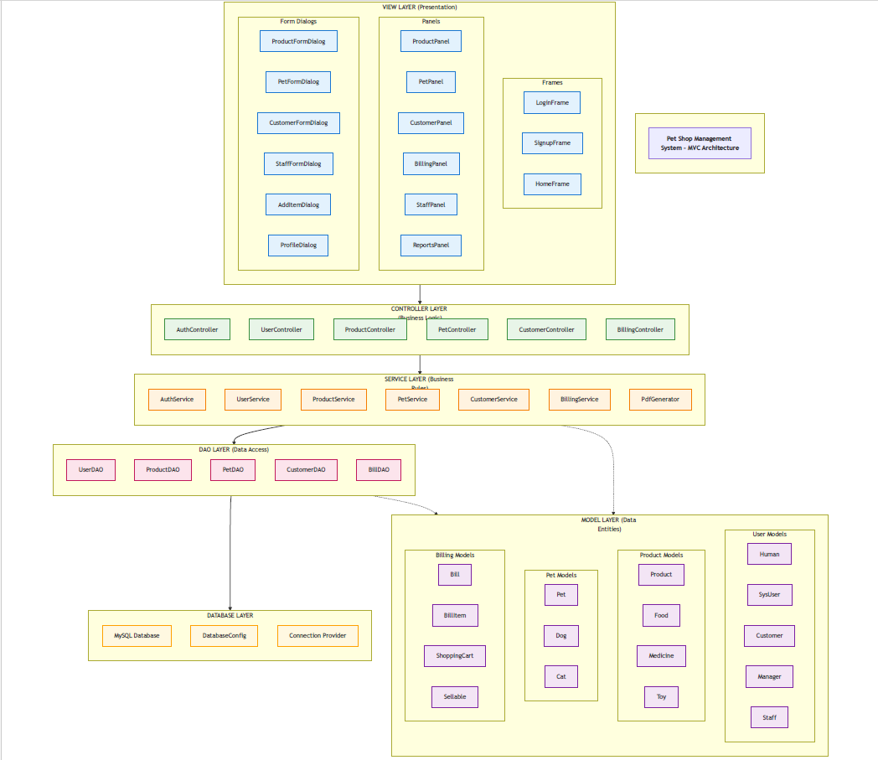
MVC ARCHITECTURE PATTERN

Slide 11
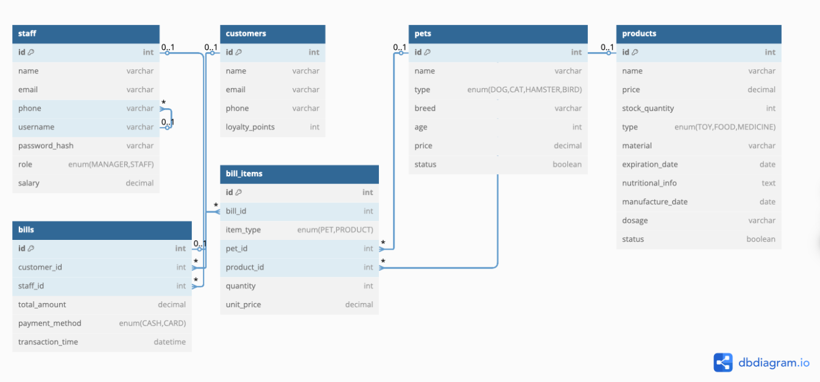
DATABASE DESIGN

Slide 12
03.
Core Features

Slide 13
AUTHENTICATION & AUTHORIZATION
Role | Permissions | Access Level
Manager | Full System Access | • Staff Management • Business Reports • System Configuration • All CRUD Operations
Staff | Operational Access | • Daily Transactions • Customer Service • Inventory Updates • Limited Access

Slide 14
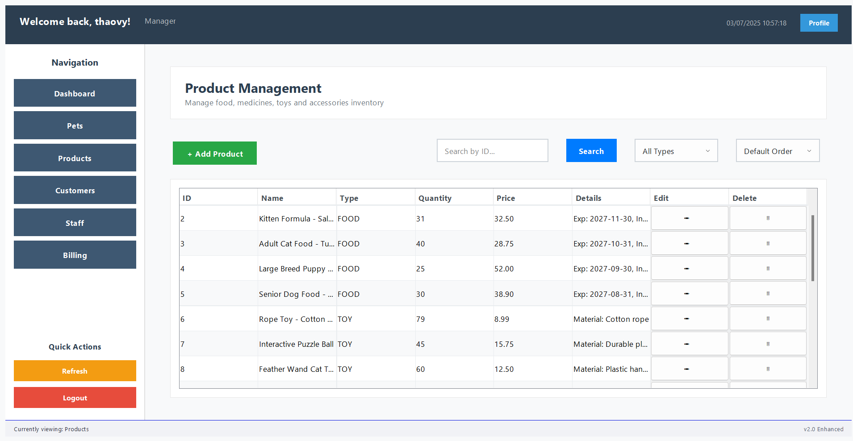
PRODUCT MANAGEMENT

Slide 15
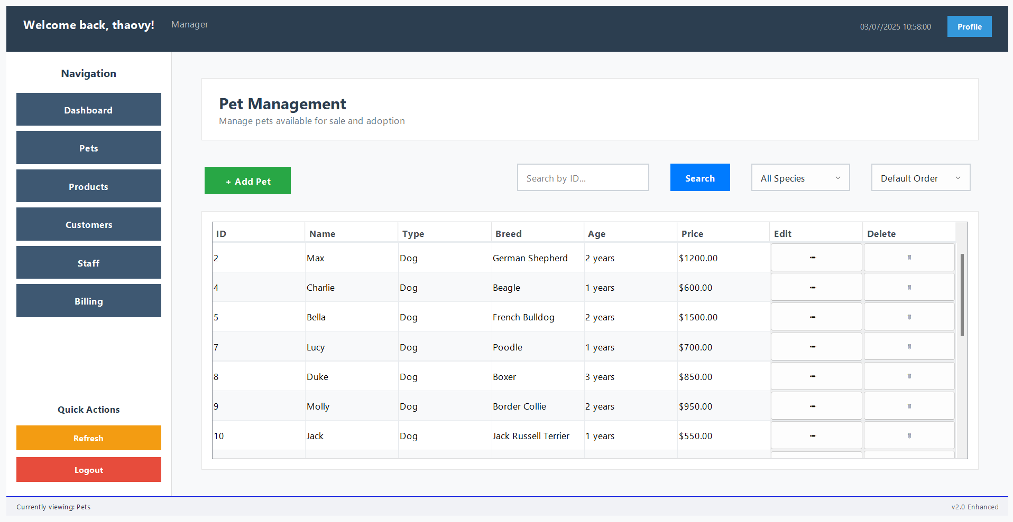
PET MANAGEMENT

Slide 16
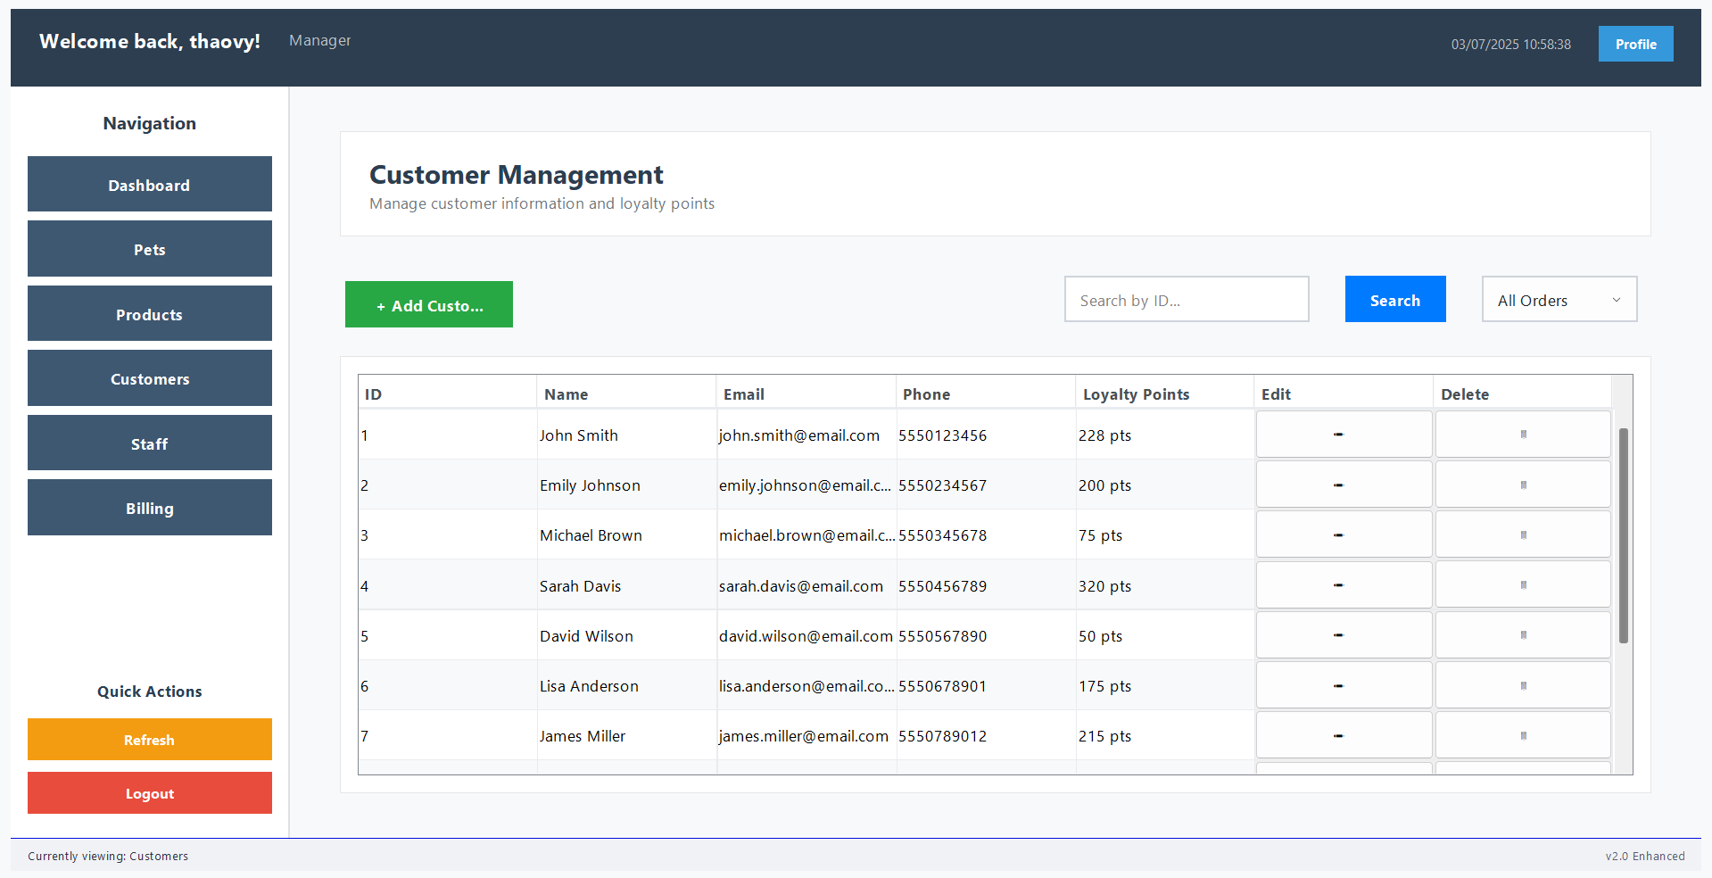
CUSTOMER MANAGEMENT

Slide 17
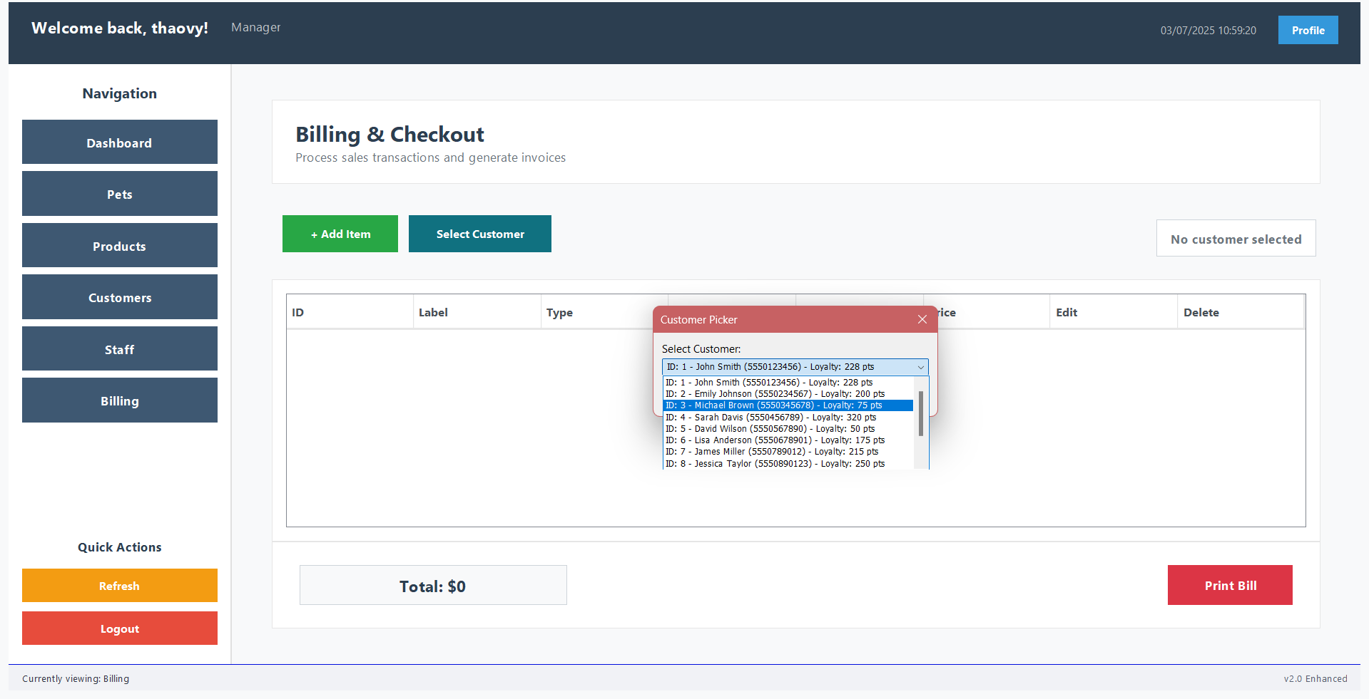
BILLING SYSTEM

Slide 18
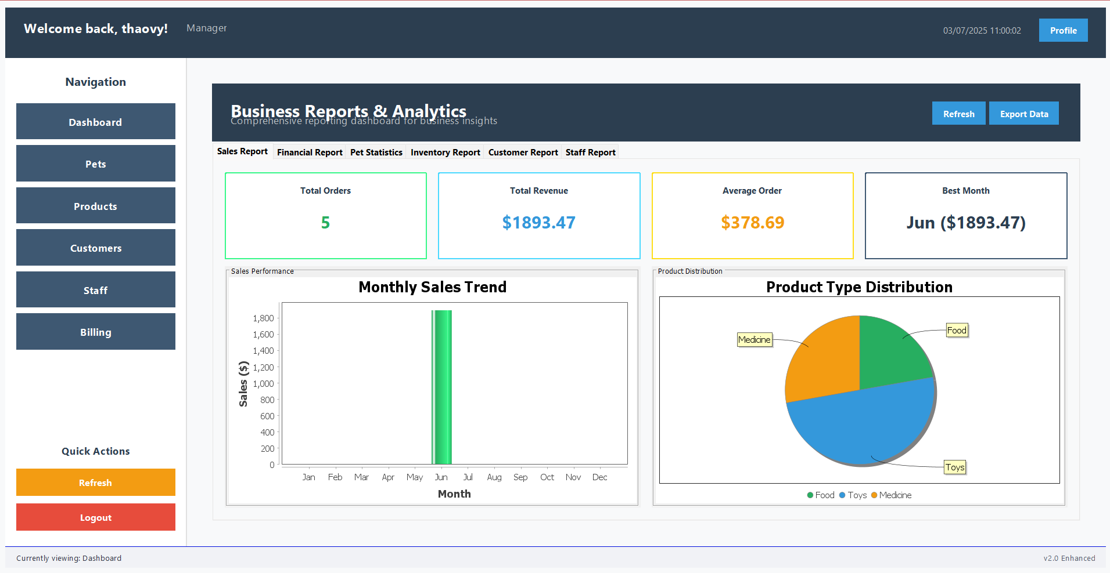
REPORTING DASHBOARD

Slide 19
04.
LIVE DEMONSTRATION

Slide 20
05.
Project Highlights
Notes:
FEATURE HIGHLIGHTS
Key Differentiators:
Complete Business Solution - Covers all pet shop operations
Professional Invoicing - PDF generation for customer receipts
Inventory Intelligence - Smart stock management with auto-updates
Customer Loyalty - Built-in rewards system
Role-Based Security - Proper access control for different users
Real-Time Operations - Live updates and instant data refresh
Business Benefits:
Increased Efficiency - Automated processes reduce manual work
Better Customer Experience - Professional receipts and loyalty rewards
Business Insights - Real-time reporting for informed decisions
Data Security - Secure user authentication and role management
Revenue Growth - Better inventory control and customer retention

Slide 21
Thanks for Watching

