Slide 1
Unit-III Cascading Style Sheet (8 Hrs)

Slide 2
Introduction to CSS
CSS stands for Cascading Style Sheets.
It is a style sheet language which is used to describe the look and formatting of a document written in markup language.
It provides additional feature to HTML.
CSS saves a lot of work. It can control the layout of multiple web pages all at once
Describe the appearance, layout and presentation of information on a web page.
Generally used with HTML to change the style of web pages and user interfaces.
It can be used with HTML, JavaScript, any kind of XML documents including plain XML, SVG and XUL.
It can be embedded in HTML document or placed separate .css file .

Slide 3
Why use CSS
Solves a big problem
Before CSS, tags like font, color, background style, element alignment, border and size had to be repeated on every web page.
If you are developing a large website where fonts and color information are added on every single it will be long and expensive process.
It is W3C recommendation.
Saves a lot of time
If external CSS files are used, it is possible to change the entire website by changing just one file.
Provide more attributes
It provides more detailed attribute to define the look and feel of the website.

Slide 4
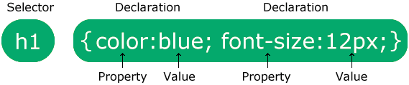
Basic CSS Syntax
selector {
property: value;
property: value;
...
property: value;
} CSS
4
p {
font-family: sans-serif;
color: red;
} CSS
A CSS file consists of one or more rules
Each rule starts with a selector
A selector specifies an HTML element(s) and then applies style properties to them
a selector of * selects all elements

Slide 5
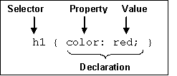
CSS Syntax
CSS statement contains three element:
Selector
What HTML sections does it affect?
Property
What attribute of that HTML section will be affected?
Value
What change will be made to that attribute?

Slide 6
How to add CSS/ Inserting CSS
When a browser reads a style sheet, it will format the HTML document according to the information in the style sheet.
Three ways to Insert CSS
External CSS
Internal CSS
Inline CSS

Slide 7
1. External CSS
With an external style sheet, you can change the look of an entire website by changing just one file!
Each HTML page must include a reference to the external style sheet file inside the <link> element, inside the head section.
External styles are defined within the <link> element, inside the <head> section of an HTML page:
An external style sheet can be written in any text editor, and must be saved with a .css extension.
The external .css file should not contain any HTML tags.

Slide 8
External CSS
Syntax:
<head>
...
<link href="filename" type="text/css“rel="stylesheet" />
...
</head>
Example
<link href="style.css" type="text/css" rel="stylesheet" />
<link href="http://www.google.com/uds/css/gsearch.css" rel="stylesheet" type="text/css" />
A page can link to multiple style sheet files.
In case of conflict (two sheets define a style for the same HTML element), the latter sheets properties will be used

Slide 9
2. Internal CSS
An internal style sheet may be used if one single HTML page has a unique style .
The internal style is defined inside the <style> element, inside the head section
<head>
<style type="text/css">
p { font-family: sans-serif; color: red; }
h2 { background-color: yellow; }
</style>
</head>
CSS code can be embedded within the head of an HTML page
Bad style should be avoided when possible

Slide 10
3. Inline CSS
An inline style may be used to apply a unique style for a single element.
To use inline styles, add the style attribute to the relevant element. The style attribute can contain any CSS property
<p style=“font-family: sans-serif; color: red;”> this is a paragraph</p>
Higher precedence than embedded or linked styles
Used for one-time overrides and styling a particular element .
Bad Style and should be avoided when possible

Slide 12
Example
Inline styles are defined within the "style" attribute of the relevant element:
<!DOCTYPE html> <html> <body> <h1 style="color:blue;text-align:center;">This is a heading</h1> <p style="color:red;">This is a paragraph.</p> </body> </html>

Slide 13
Three CSS Definition Locations
Inline: the “style” attribute
Note, the selector for inline CSS is the tag which contains the style attribute.
Internal: the <style> markup tag
External: the .css stylesheet file
<p style=“font-color:red;font-size:10px;”>Content</p>
<html><head><style>
p { background-color: Red;
font-family: serif;
font-color: White; }
</style></head><body>
<p>Content</p> </body></html>
<link rel="stylesheet" type="text/css" href=“mystylesheet.css" />

Slide 14
CSS comments /*…*/
/* This is a comment.
It can span many lines in the CSS file. */
p {
color: red; background-color: aqua;
} CSS
CSS (like HTML) is usually not commented as rigorously as programming languages such as Java
The // single-line comment style is NOT supported in CSS
The <!-- ... --> HTML comment style is also NOT supported in CSS

Slide 15
Selectors
A CSS selector selects the HTML element(s) you want to style. CSS selectors are used to "find" (or select) the HTML elements you want to style.
We can divide CSS selectors into five categories:
Simple selectors (select elements based on name, id, class)
Combinator selectors (select elements based on a specific relationship between them)
Pseudo-class selectors (select elements based on a certain state)
Pseudo-elements selectors (select and style a part of an element)
Attribute selectors (select elements based on an attribute or attribute value)

Slide 16
The CSS element Selector
The element selector selects HTML elements based on the element name.
Example
Here, all <p> elements on the page will be center-aligned, with a red text color:
p{ text-align: center; color: red; }

Slide 17
The CSS id Selector
The id selector uses the id attribute of an HTML element to select a specific element.
The id of an element is unique within a page, so the id selector is used to select one unique element!
To select an element with a specific id, write a hash (#) character, followed by the id of the element.
Example
The CSS rule below will be applied to the HTML element with id="para1":
#para1 { text-align: center; color: red; }
Note: An id name cannot start with a number!

Slide 18
The CSS class Selector
The class selector selects HTML elements with a specific class attribute.
To select elements with a specific class, write a period (.) character, followed by the class name.
Example
In this example all HTML elements with class="center" will be red and center-aligned:
.center { text-align: center; color: red; }

Slide 19
You can also specify that only specific HTML elements should be affected by a class.
Example
In this example only <p> elements with class="center" will be red and center-aligned:
p.center { text-align: center; color: red; }

Slide 20
The CSS Universal Selector
The universal selector (*) selects all HTML elements on the page.
Example
The CSS rule below will affect every HTML element on the page:
* { text-align: center; color: blue; }

Slide 21
The CSS Grouping Selector
The grouping selector selects all the HTML elements with the same style definitions.
Example
h1, h2, p { text-align: center; color: red; }

Slide 22
CSS Combinators
A combinator is something that explains the relationship between the selectors.
A CSS selector can contain more than one simple selector. Between the simple selectors, we can include a combinator.
There are four different combinators in CSS:
descendant selector (space)
child selector (>)
adjacent sibling selector (+)
general sibling selector (~)

Slide 23
Descendant Selector
The descendant selector matches all elements that are descendants of a specified element.
The following example selects all <p> elements inside <div> elements:
Example
div p { background-color: yellow; }

Slide 24
Child Selector (>)
The child selector selects all elements that are the children of a specified element.
The following example selects all <p> elements that are children of a <div> element:
Example
div > p { background-color: yellow; }

Slide 25
Adjacent Sibling Selector (+)
The adjacent sibling selector is used to select an element that is directly after another specific element.
Sibling elements must have the same parent element, and "adjacent" means "immediately following".
The following example selects the first <p> element that are placed immediately after <div> elements:
Example
div + p { background-color: yellow; }

Slide 26
General Sibling Selector (~)
The general sibling selector selects all elements that are next siblings of a specified element.
The following example selects all <p> elements that are next siblings of <div> elements:
Example
div ~ p { background-color: yellow; }

Slide 27
Pseudo-class selector
A pseudo-class is used to define a special state of an element.
For example, it can be used to:
Style an element when a user mouses over it
Style visited and unvisited links differently
Style an element when it gets focus

Slide 28
Syntax of pseudo class
The syntax of pseudo-classes:
selector:pseudo-class { property: value; }

Slide 29
Anchor Pseudo Classes
Links can be displayed in different ways:
Example
/* unvisited link */ a:link { color: #FF0000; } /* visited link */ a:visited { color: #00FF00; } /* mouse over link */ a:hover { color: #FF00FF; } /* selected link */ a:active { color: #0000FF; }
Try it Yourself
Note: a:hover MUST come after a:link and a:visited in the CSS definition in order to be effective! a:active MUST come after a:hover in the CSS definition in order to be effective! Pseudo-class names are not case-sensitive.

Slide 30
Pseudo-classes and HTML Classes
Pseudo-classes can be combined with HTML classes:
When you hover over the link in the example, it will change color:
Example
a.highlight:hover { color: #ff0000; }

Slide 31
Hover on <div>
An example of using the :hover pseudo-class on a <div> element:
Example
div:hover { background-color: blue; }

Slide 32
CSS Pseudo Elements
What are Pseudo-Elements?
A CSS pseudo-element is used to style specified parts of an element.
For example, it can be used to:
Style the first letter, or line, of an element
Insert content before, or after, the content of an element

Slide 33
Syntax
The syntax of pseudo-elements:
selector::pseudo-element { property: value; }

Slide 34
The ::first-line Pseudo-element
The ::first-line pseudo-element is used to add a special style to the first line of a text.
The following example formats the first line of the text in all <p> elements:
Example
p::first-line { color: #ff0000; font-variant: small-caps; }
Try it Yourself »

Slide 35
The ::first-letter Pseudo-element
The ::first-letter pseudo-element is used to add a special style to the first letter of a text.
The following example formats the first letter of the text in all <p> elements:
Example
p::first-letter { color: #ff0000; font-size: xx-large; }
Try it Yourself

Slide 36
Pseudo-elements and HTML Classes
Pseudo-elements can be combined with HTML classes:
Example
p.intro::first-letter { color: #ff0000; font-size: 200%; }

Slide 37
CSS - The ::before Pseudo-element
The ::before pseudo-element can be used to insert some content before the content of an element.
The following example inserts an image before the content of each <h1> element:
Example
h1::before { content: "123"; }

Slide 38
CSS - The ::after Pseudo-element
The ::after pseudo-element can be used to insert some content after the content of an element.
The following example inserts an image after the content of each <h1> element:
Example
h1::after { content: url(smiley.gif); }
Try it Yourself »

Slide 39
CSS - The ::marker Pseudo-element
The ::marker pseudo-element selects the markers of list items.
The following example styles the markers of list items:
Example
::marker { color: red; font-size: 23px; }
Try it Yourself »

Slide 40
CSS - The ::selection Pseudo-element The ::selection pseudo-element matches the portion of an element that is selected by a user. The following CSS properties can be applied to ::selection: color, background, cursor, and outline. The following example makes the selected text red on a yellow background: Example ::selection { color: red; background: yellow; }

Slide 41
CSS [attribute] Selector
The [attribute] selector is used to select elements with a specified attribute.
The following example selects all <a> elements with a target attribute:
Example
a[target] { background-color: yellow; }

Slide 42
CSS [attribute="value"] Selector
The [attribute="value"] selector is used to select elements with a specified attribute and value.
The following example selects all <a> elements with a target="_blank" attribute:
Example
a[target="_blank"] { background-color: yellow; }

Slide 43
CSS [attribute~="value"] Selector
The [attribute~="value"] selector is used to select elements with an attribute value containing a specified word.
The following example selects all elements with a title attribute that contains a space-separated list of words, one of which is "flower":
Example
[title~="flower"] { border: 5px solid yellow; }

Slide 44
CSS [attribute^="value"] Selector
The [attribute^="value"] selector is used to select elements with the specified attribute, whose value starts with the specified value.
The following example selects all elements with a class attribute value that starts with "top":
Note: The value does not have to be a whole word!
Example
[class^="top"] { background: yellow; }

Slide 45
CSS [attribute$="value"] Selector
The [attribute$="value"] selector is used to select elements whose attribute value ends with a specified value.
The following example selects all elements with a class attribute value that ends with "test":
Note: The value does not have to be a whole word!
Example
[class$="test"] { background: yellow; }
Try it Yourself »0

Slide 46
CSS [attribute*="value"] Selector
The [attribute*="value"] selector is used to select elements whose attribute value contains a specified value.
The following example selects all elements with a class attribute value that contains "te":
Note: The value does not have to be a whole word!
Example
[class*="te"] { background: yellow; }

Slide 47
CSS [attribute|="value"] Selector
The [attribute|="value"] selector is used to select elements with the specified attribute, whose value can be exactly the specified value, or the specified value followed by a hyphen (-).
Note: The value has to be a whole word, either alone, like class="top", or followed by a hyphen( - ), like class="top-text".
Example
[class|="top"] { background: yellow; }

Slide 48
All CSS Attribute Selectors
Selector | Example | Example description
[attribute] | [target] | Selects all elements with a target attribute
[attribute=value] | [target="_blank"] | Selects all elements with target="_blank"
[attribute~=value] | [title~="flower"] | Selects all elements with a title attribute containing the word "flower"
[attribute|=value] | [lang|="en"] | Selects all elements with a lang attribute value starting with "en"
[attribute^=value] | a[href^="https"] | Selects every <a> element whose href attribute value begins with "https"
[attribute$=value] | a[href$=".pdf"] | Selects every <a> element whose href attribute value ends with ".pdf"
[attribute*=value] | a[href*="w3schools"] | Selects every <a> element whose href attribute value contains the substring "w3schools"

Slide 49
CSS colors
p {
color: red;
background-color: yellow;
}
CSS
This paragraph uses the style above output
property | description
color | color of the element's text
background-color | color that will appear behind the element
Colors are specified using predefined color names, or RGB, HEX, HSL, RGBA, HSLA value
Notes:
Hue, Saturation and Lightness and Alpha channel(opacity)

Slide 50
Specifying colors
p { color: red; }
h2 { color: rgb(128, 0, 196); }
h4 { color: #FF8800; } CSS
This paragraph uses the first style above
This h2 uses the second style above.
This h4 uses the third style above.
output
color names: aqua, black, blue, fuchsia, gray, green, lime, maroon, navy, olive, purple, red, silver, teal, white (white), yellow
RGB codes: red, green, and blue values from 0 (none) to 255 (full)
hex codes: RGB values in base-16 from 00 (0, none) to FF (255, full)

Slide 51
CSS properties for backgrounds
The CSS background properties are used to add background effects for elements.
property | description
background-color | color to fill background
background-image | image to place in background
background-position | placement of bg image within element
background-repeat | whether/how bg image should be repeated
background-attachment | whether bg image scrolls with page
background | shorthand to set all background properties

Slide 52
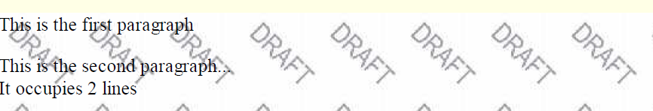
background-image
body {
background-image: url("images/draft.jpg");
}
CSS
background image/color fills the element's content area

Slide 53
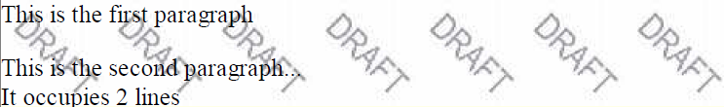
background-repeat
body {
background-image: url("images/draft.jpg");
background-repeat: repeat-x;
}
CSS
can be repeat (default), repeat-x, repeat-y, or no-repeat

Slide 54
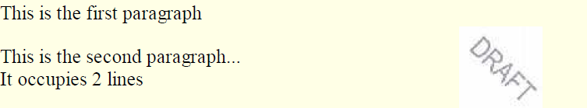
background-position
body {
background-image: url("images/draft.jpg");
background-repeat: no-repeat;
background-position: 370px 20px;
} CSS
value consists of two tokens, each of which can be top, left, right, bottom, center, a percentage, or a length value in px, pt, etc.
value can be negative to shift left/up by a given amount

Slide 55
Background-attachment
The background-attachment property specifies whether the background image should scroll or be fixed (will not scroll with the rest of the page):
body { background-image: url("img_tree.png"); background-repeat: no-repeat; background-position: right top; background-attachment: fixed; }

Slide 56
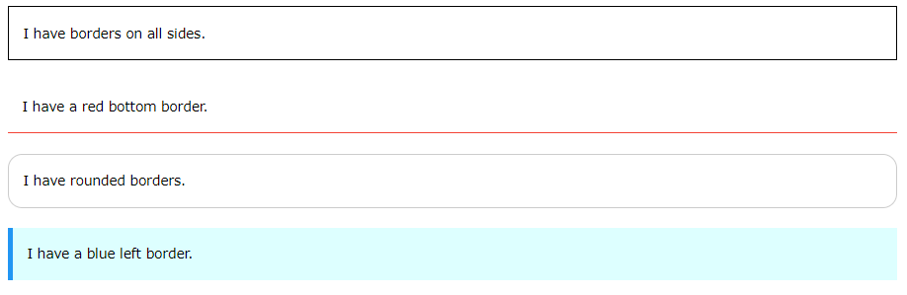
CSS Border
The CSS border properties allow you to specify the style, width, and color of an element's border.

Slide 57
CSS Border Style
The border-style property specifies what kind of border to display.
The following values are allowed:
dotted - Defines a dotted border
dashed - Defines a dashed border
solid - Defines a solid border
double - Defines a double border
groove - Defines a 3D grooved border. The effect depends on the border-color value
ridge - Defines a 3D ridged border. The effect depends on the border-color value
inset - Defines a 3D inset border. The effect depends on the border-color value
outset - Defines a 3D outset border. The effect depends on the border-color value
none - Defines no border
hidden - Defines a hidden border
The border-style property can have from one to four values (for the top border, right border, bottom border, and the left border).

Slide 58
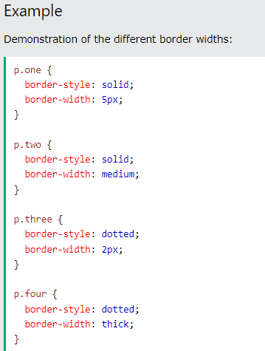
CSS Border Width
The border-width property specifies the width of the four borders.
The width can be set as a specific size (in px, pt, cm, em, etc) or by using one of the three pre-defined values: thin, medium, or thick:
Notes:
What is 2 em in CSS?
EM is relative to the current font size of the element (2em means 2 times the size of the current font)

Slide 59
CSS Border Color
The border-color property is used to set the color of the four borders.
The color can be set by:
name - specify a color name, like "red"
HEX - specify a HEX value, like "#ff0000"
RGB - specify a RGB value, like "rgb(255,0,0)"
HSL - specify a HSL value, like "hsl(0, 100%, 50%)"
Transparent
Note: If border-color is not set, it inherits the color of the element.
Example
Demonstration of the different border colors:
p.one { border-style: solid; border-color: red; }

Slide 60
Specific Side Colors
The border-color property can have from one to four values (for the top border, right border, bottom border, and the left border).
Example
p.one { border-style: solid; border-color: red green blue yellow; /* red top, green right, blue bottom and yellow left */ }

Slide 61

CSS Border - Individual Sides
In CSS, there are also properties for specifying each of the borders (top, right, bottom, and left):
Example
p { border-top-style: dotted; border-right-style: solid; border-bottom-style: dotted; border-left-style: solid; }

Slide 62
If the border-style property has four values:
border-style: dotted solid double dashed;
top border is dotted
right border is solid
bottom border is double
left border is dashed
If the border-style property has three values:
border-style: dotted solid double;
top border is dotted
right and left borders are solid
bottom border is double
If the border-style property has two values:
border-style: dotted solid;
top and bottom borders are dotted
right and left borders are solid
If the border-style property has one value:
border-style: dotted;
all four borders are dotted

Slide 63
CSS Border - Shorthand Property
To shorten the code, it is also possible to specify all the individual border properties in one property.
The border property is a shorthand property for the following individual border properties:
border-width
border-style (required)
border-color
Example
p { border: 5px solid red; }

Slide 64
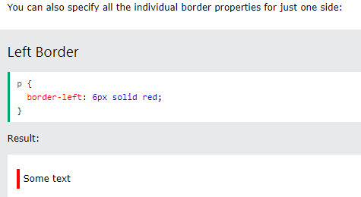
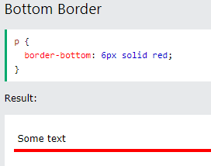

Slide 65
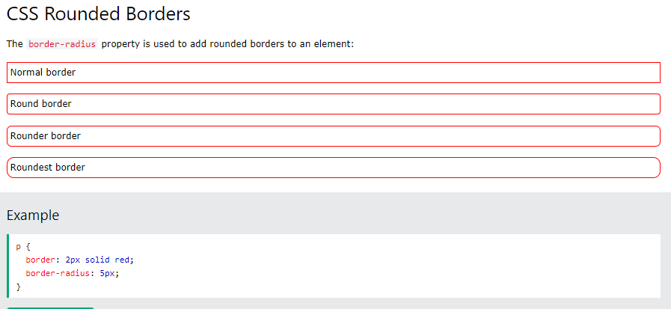
CSS Rounded Borders

Slide 66
CSS Text
Text Color
The color property is used to set the color of the text.
Text Color and Background Color
In this example, we define both the background-color property and the color property:
Example
body { background-color: lightgrey; color: blue; }

Slide 67
The CSS Text Alignment/Direction Properties
Property | Description
direction | Specifies the text direction/writing direction
text-align | Specifies the horizontal alignment of text
text-align-last | Specifies how to align the last line of a text
unicode-bidi | Used together with the direction property to set or return whether the text should be overridden to support multiple languages in the same document
vertical-align | Sets the vertical alignment of an element

Slide 68
CSS properties for text
property | description
text-align | alignment of text within its element
text-decoration | decorations such as underlining
line-height, word-spacing, letter-spacing | gaps between the various portions of the text
text-indent | indents the first letter of each paragraph
Complete list of text properties (http://www.w3schools.com/css/css_reference.asp#text)

Slide 69

text-align
blockquote { text-align: justify; }
h2 { text-align: center; } CSS
The Gollum’s Quote
We wants it, we needs it. Must have the precious. They stole it from us. Sneaky little hobbitses. Wicked, tricksy, false! output
text-align can be left, right, center, or justify
Notes:
justify (which widens all full lines
of the element so that they occupy its entire width)

Slide 70
text-decoration
p {
text-decoration: underline;
} CSS
This paragraph uses the style above. output
can also be overline, line-through, blink, or none
effects can be combined:
text-decoration: overline underline;

Slide 71
CSS properties for fonts
property | description
font-family | which font will be used
font-size | how large the letters will be drawn
font-style | used to enable/disable italic style
font-weight | used to enable/disable bold style
Complete list of font properties (http://www.w3schools.com/css/css_reference.asp#font)

Slide 72
font-family
p {
font-family: Georgia;
}
h2 {
font-family: "Courier New";
} CSS
This paragraph uses the first style above.
This h2 uses the second style above.
output
Enclose multi-word font names in quotes

Slide 73
More about font-family
p {
font-family: Garamond, "Times New Roman", serif;
} CSS
This paragraph uses the above style. output
We can specify multiple fonts from highest to lowest priority
Generic font names:
serif, sans-serif, cursive, fantasy, monospace
If the first font is not found on the user's computer, the next is tried
Placing a generic font name at the end of your font-family value, ensures that every computer will use a valid font

Slide 74
font-size
p {
font-size: 24pt;
} CSS
This paragraph uses the style above. output
units: pixels (px) vs. point (pt) vs. m-size (em)
16px, 16pt, 1.16em
vague font sizes: xx-small, x-small, small, medium, large, x-large, xx-large, smaller, larger
percentage font sizes, e.g.: 90%, 120%

Slide 75
font-size
p {
font-size: 24pt;
} CSS
This paragraph uses the style above. output
pt specifies number of point, where a point is 1/72 of an inch onscreen
px specifies a number of pixels on the screen
em specifies number of m-widths, where 1 em is equal to the font's current size

Slide 76
font-weight, font-style
p {
font-weight: bold;
font-style: italic;
} CSS
This paragraph uses the style above. output
Either of the above can be set to normal to turn them off (e.g. headings)

Slide 77
CSS Links
With CSS, links can be styled in many different ways.
Styling Links
Links can be styled with any CSS property (e.g. color, font-family, background, etc.).
Example
a { color: hotpink; }

Slide 78
In addition, links can be styled differently depending on what state they are in.
The four links states are:
a:link - a normal, unvisited link
a:visited - a link the user has visited
a:hover - a link when the user mouses over it
a:active - a link the moment it is clicked
Example
/* unvisited link */ a:link { color: red; } /* visited link */ a:visited { color: green; } /* mouse over link */ a:hover { color: hotpink; } /* selected link */ a:active { color: blue; }
When setting the style for several link states, there are some order rules:
a:hover MUST come after a:link and a:visited
a:active MUST come after a:hover

Slide 79
Text Decoration
The text-decoration property is mostly used to remove underlines from links:
Example
a:link { text-decoration: none; } a:visited { text-decoration: none; } a:hover { text-decoration: underline; } a:active { text-decoration: underline; }
Background Color
The background-color property can be used to specify a background color for links:
Example
a:link { background-color: yellow; } a:visited { background-color: cyan; } a:hover { background-color: lightgreen; } a:active { background-color: hotpink; }

Slide 80
CSS List The list-style-type property
ol { list-style-type: lower-roman; } CSS
Possible values:
i. none : No marker
ii. disc (default), circle, square
iii. Decimal: 1, 2, 3, etc.
iv. decimal-leading-zero: 01, 02, 03, etc.
v. lower-roman: i, ii, iii, iv, v, etc.
vi. upper-roman: I, II, III, IV, V, etc.
vii. lower-alpha: a, b, c, d, e, etc.
viii. upper-alpha: A, B, C, D, E, etc.
x. lower-greek: alpha, beta, gamma, etc.
others: hebrew, armenian, georgian, cjk-ideographic, hiragana…

Slide 81
An Image as The List Item Marker
The list-style-image property specifies an image as the list item marker:
Example
ul { list-style-image: url('sqpurple.gif'); }

Slide 82
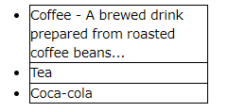
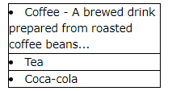
Position The List Item Markers
The list-style-position property specifies the position of the list-item markers (bullet points).
"list-style-position: outside;" means that the bullet points will be outside the list item. The start of each line of a list item will be aligned vertically. This is default:
Example
ul.a { list-style-position: outside; } ul.b { list-style-position: inside; }
"list-style-position: inside;" means that the bullet points will be inside the list item. As it is part of the list item, it will be part of the text and push the text at the start:

Slide 83

CSS Tables
Table Borders
To specify table borders in CSS, use the border property.
The example below specifies a solid border for <table>, <th>, and <td> elements:
Example
table, th, td { border: 1px solid; }

Slide 84

Full-Width Table
The table above might seem small in some cases. If you need a table that should span the entire screen (full-width), add width: 100% to the <table> element:
Example
table { width: 100%; }

Slide 85
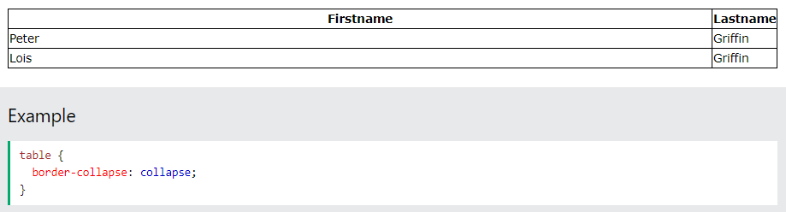
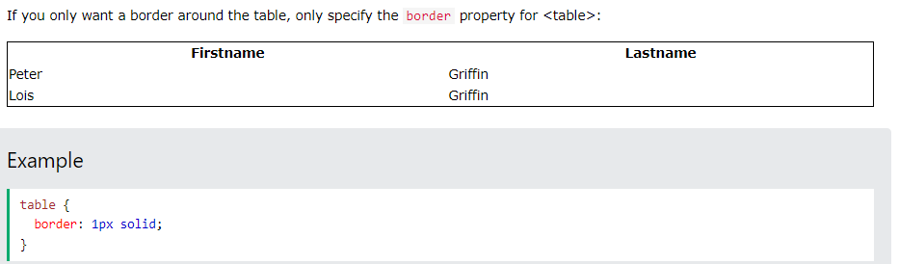
Collapse Table Borders
The border-collapse property sets whether the table borders should be collapsed into a single border:

Slide 86
Table Size
Table Width and Height
The width and height of a table are defined by the width and height properties.
Example
table { width: 100%; } th { height: 70px; }

Slide 87
CSS Table Alignment
Horizontal Alignment
The text-align property sets the horizontal alignment (like left, right, or center) of the content in <th> or <td>.
By default, the content of <th> elements are center-aligned and the content of <td> elements are left-aligned.
To center-align the content of <td> elements as well, use text-align: center:
Example
td { text-align: center; }
Example
th { text-align: left; }

Slide 88
Vertical Alignment
The vertical-align property sets the vertical alignment (like top, bottom, or middle) of the content in <th> or <td>.
By default, the vertical alignment of the content in a table is middle (for both <th> and <td> elements).
The following example sets the vertical text alignment to bottom for <td> elements:
Example
td { height: 50px; vertical-align: bottom; }

Slide 89
Table Padding
To control the space between the border and the content in a table, use the padding property on <td> and <th> elements:
Horizontal Dividers
Add the border-bottom property to <th> and <td> for horizontal dividers:
Hoverable Table
Use the :hover selector on <tr> to highlight table rows on mouse over:
Example
tr:hover {background-color: coral;}

Slide 90
Responsive Table
A responsive table will display a horizontal scroll bar if the screen is too small to display the full content:
Add a container element (like <div>) with overflow-x:auto around the <table> element to make it responsive:
Example
<div style="overflow-x:auto;"> <table> ... table content ... </table> </div>

Slide 91
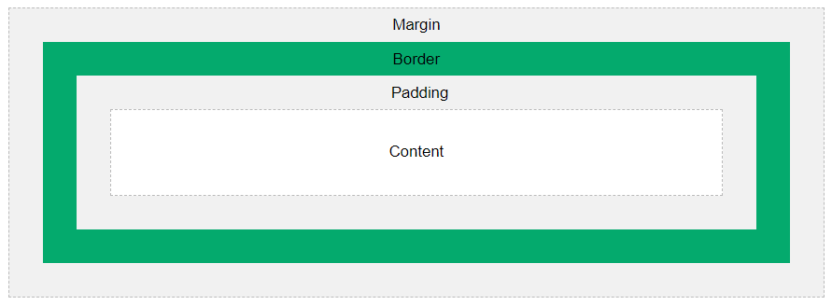
The CSS Box Model
In CSS, the term "box model" is used when talking about design and layout.
The CSS box model is essentially a box that wraps around every HTML element.
It consists of: margins, borders, padding, and the actual content. The image below illustrates the box model:

Slide 92
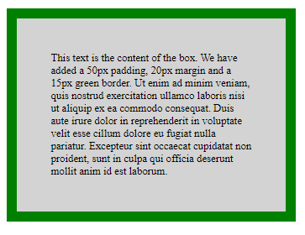
Explanation of the different parts:
Content - The content of the box, where text and images appear
Padding - Clears an area around the content. The padding is transparent
Border - A border that goes around the padding and content
Margin - Clears an area outside the border. The margin is transparent
The box model allows us to add a border around elements, and to define space between elements.
Example
Demonstration of the box model:
div { width: 300px; border: 15px solid green; padding: 50px; margin: 20px; }

Slide 93
Width and Height of an Element
In order to set the width and height of an element correctly in all browsers, you need to know how the box model works.
Important: When you set the width and height properties of an element with CSS, you just set the width and height of the content area. To calculate the full size of an element, you must also add padding, borders and margins.
Example
This <div> element will have a total width of 350px:
div { width: 320px; padding: 10px; border: 5px solid gray; margin: 0; }
Here is the calculation:
320px (width) + 20px (left + right padding) + 10px (left + right border) + 0px (left + right margin) = 350px

Slide 94
The total width of an element should be calculated like this:
Total element width = width + left padding + right padding + left border + right border + left margin + right margin
The total height of an element should be calculated like this:
Total element height = height + top padding + bottom padding + top border + bottom border + top margin + bottom margin

Slide 95
CSS Margins
Margins are used to create space around elements, outside of any defined borders.
CSS has properties for specifying the margin for each side of an element:
margin-top
margin-right
margin-bottom
margin-left
All the margin properties can have the following values:
auto - the browser calculates the margin
length - specifies a margin in px, pt, cm, etc.
% - specifies a margin in % of the width of the containing element
inherit - specifies that the margin should be inherited from the parent element
Tip: Negative values are allowed.

Slide 96
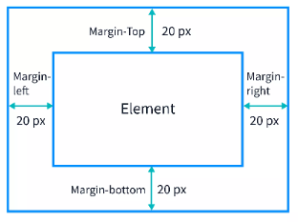
Example
Set different margins for all four sides of a <p> element:
p { margin-top: 20px; margin-bottom: 20px; margin-right: 20px; margin-left: 20px; }

Slide 97
Margin - Shorthand Property
To shorten the code, it is possible to specify all the margin properties in one property.
The margin property is a shorthand property for the following individual margin properties:
margin-top
margin-right
margin-bottom
margin-left
If the margin property has four values:
margin: 25px 50px 75px 100px;
top margin is 25px
right margin is 50px
bottom margin is 75px
left margin is 100px

Slide 98
If the margin property has three values:
margin: 25px 50px 75px;
top margin is 25px
right and left margins are 50px
bottom margin is 75px
If the margin property has two values:
margin: 25px 50px;
top and bottom margins are 25px
right and left margins are 50px
If the margin property has one value:
margin: 25px;
all four margins are 25p

Slide 99
All CSS Margin Properties
Property | Description
margin | A shorthand property for setting all the margin properties in one declaration
margin-bottom | Sets the bottom margin of an element
margin-left | Sets the left margin of an element
margin-right | Sets the right margin of an element
margin-top | Sets the top margin of an element

Slide 100
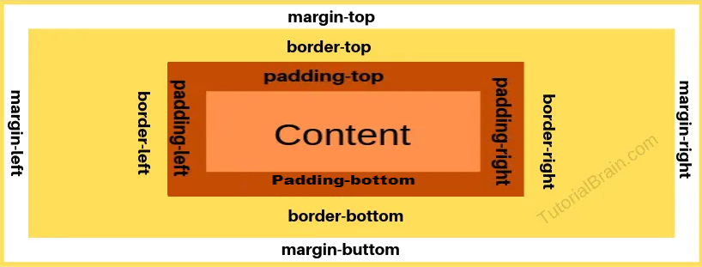
CSS Padding
Padding is used to create space around an element's content, inside of any defined borders.

Slide 101
Padding - Individual Sides
CSS has properties for specifying the padding for each side of an element:
padding-top
padding-right
padding-bottom
padding-left
All the padding properties can have the following values:
length - specifies a padding in px, pt, cm, etc.
% - specifies a padding in % of the width of the containing element
inherit - specifies that the padding should be inherited from the parent element
Note: Negative values are not allowed.

Slide 102
Padding - Shorthand Property
To shorten the code, it is possible to specify all the padding properties in one property.
The padding property is a shorthand property.
Similar as Margin Shorthand property

Slide 103
CSS Height, Width, Max Width
The CSS height and width properties are used to set the height and width of an element.
The CSS max-width property is used to set the maximum width of an element.
CSS height and width Values
The height and width properties may have the following values:
auto - This is default. The browser calculates the height and width
length - Defines the height/width in px, cm, etc.
% - Defines the height/width in percent of the containing block
initial - Sets the height/width to its default value
inherit - The height/width will be inherited from its parent value

Slide 104
Example
Set the height and width of a <div> element:
div { height: 200px; width: 50%; background-color: powderblue; }

Slide 105
Setting max-width
The max-width property is used to set the maximum width of an element.
The max-width can be specified in length values, like px, cm, etc., or in percent (%) of the containing block, or set to none (this is default. Means that there is no maximum width).
The problem with the <div> above occurs when the browser window is smaller than the width of the element (500px). The browser then adds a horizontal scrollbar to the page.
Using max-width instead, in this situation, will improve the browser's handling of small windows.
Example
This <div> element has a height of 100 pixels and a max-width of 500 pixels:
div { max-width: 500px; height: 100px; background-color: powderblue; }

Slide 106
CSS Layout - The display Property
The display property is the most important CSS property for controlling layout.
The display Property
The display property specifies if/how an element is displayed.
Every HTML element has a default display value depending on what type of element it is.
The default display value for most elements is block or inline.

Slide 107
Block-level Elements
A block-level element always starts on a new line and takes up the full width available (stretches out to the left and right as far as it can).
The <div> element is a block-level element.
Examples of block-level elements:
<div>
<h1> - <h6>
<p>
<form>
<header>
<footer>
<section>
a { display: block; }
Try it Yourself

Slide 108
Inline Elements
An inline element does not start on a new line and only takes up as much width as necessary.
This is an inline <span> element inside a paragraph.
Examples of inline elements:
<span>
<a>
<img>
Example
li { display: inline; }

Slide 109
Hide an Element - display:none or visibility:hidden?
Hiding an element can be done by setting the display property to none.
The element will be hidden, and the page will be displayed as if the element is not there:
Example
h1.hidden { display: none; }
visibility:hidden; also hides an element.
However, the element will still take up the same space as before. The element will be hidden, but still affect the layout:
Example
h1.hidden { visibility: hidden; }

Slide 110
CSS Layout - The position Property
The position property specifies the type of positioning method used for an element (static, relative, fixed, absolute or sticky).
The position Property
The position property specifies the type of positioning method used for an element.
There are five different position values:
static
relative
fixed
absolute
sticky
Elements are then positioned using the top, bottom, left, and right properties.
However, these properties will not work unless the position property is set first. They also work differently depending on the position value.

Slide 111
position: static;
HTML elements are positioned static by default.
Static positioned elements are not affected by the top, bottom, left, and right properties.
An element with position: static; is not positioned in any special way; it is always positioned according to the normal flow of the page:
This <div> element has position: static;
Here is the CSS that is used:
Example
div.static { position: static; border: 3px solid #73AD21; }

Slide 112
position: relative;
An element with position: relative; is positioned relative to its normal position.
Setting the top, right, bottom, and left properties of a relatively-positioned element will cause it to be adjusted away from its normal position. Other content will not be adjusted to fit into any gap left by the element.
Example
div.relative { position: relative; left: 30px; border: 3px solid #73AD21; }

Slide 113
position: fixed;
An element with position: fixed; is positioned relative to the viewport, which means it always stays in the same place even if the page is scrolled. The top, right, bottom, and left properties are used to position the element.
A fixed element does not leave a gap in the page where it would normally have been located.
position: absolute;
An element with position: absolute; is positioned relative to the nearest positioned ancestor (instead of positioned relative to the viewport, like fixed).
However; if an absolute positioned element has no positioned ancestors, it uses the document body, and moves along with page scrolling.
position: sticky;
An element with position: sticky; is positioned based on the user's scroll position.
A sticky element toggles between relative and fixed, depending on the scroll position. It is positioned relative until a given offset position is met in the viewport - then it "sticks" in place (like position:fixed).

Slide 114
CSS Overflow
The CSS overflow property controls what happens to content that is too big to fit into an area.
The overflow property specifies whether to clip the content or to add scrollbars when the content of an element is too big to fit in the specified area.
The overflow property has the following values:
visible - Default. The overflow is not clipped. The content renders outside the element's box
hidden - The overflow is clipped, and the rest of the content will be invisible
scroll - The overflow is clipped, and a scrollbar is added to see the rest of the content
auto - Similar to scroll, but it adds scrollbars only when necessary
Note: The overflow property only works for block elements with a specified height.

Slide 115
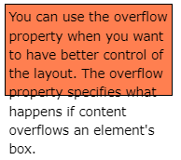
overflow: visible
By default, the overflow is visible, meaning that it is not clipped and it renders outside the element's box:
Example
div { width: 200px; height: 65px; background-color: coral;
border: 1px solid; overflow: visible; }

Slide 116
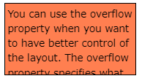
overflow: hidden
With the hidden value, the overflow is clipped, and the rest of the content is hidden:
Example
div { overflow: hidden; }

Slide 117
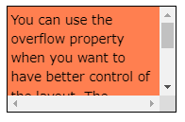
overflow: scroll
Setting the value to scroll, the overflow is clipped and a scrollbar is added to scroll inside the box. Note that this will add a scrollbar both horizontally and vertically (even if you do not need it):
Example
div { overflow: scroll; }

Slide 118
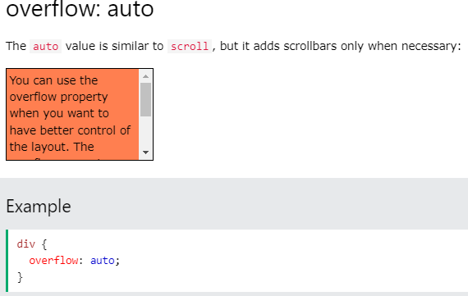

Slide 119
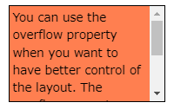
overflow-x and overflow-y
The overflow-x and overflow-y properties specifies whether to change the overflow of content just horizontally or vertically (or both):
overflow-x specifies what to do with the left/right edges of the content.
overflow-y specifies what to do with the top/bottom edges of the content
Example
div { overflow-x: hidden; /* Hide horizontal scrollbar */ overflow-y: scroll; /* Add vertical scrollbar */ }
Try it Yourse

Slide 120
CSS Layout - float and clear ❮ Pr
The CSS float property specifies how an element should float.
The CSS clear property specifies what elements can float beside the cleared element and on which side.

Slide 121
The float Property
The float property is used for positioning and formatting content e.g. let an image float left to the text in a container.
The float property can have one of the following values:
left - The element floats to the left of its container
right - The element floats to the right of its container
none - The element does not float (will be displayed just where it occurs in the text). This is default
inherit - The element inherits the float value of its parent.
In its simplest use, the float property can be used to wrap text around images.

Slide 122
Example - float: right;
The following example specifies that an image should float to the right in a text:
img { float: right; }

Slide 123
The clear Property
When we use the float property, and we want the next element below (not on right or left), we will have to use the clear property.
The clear property specifies what should happen with the element that is next to a floating element.
The clear property can have one of the following values:
none - The element is not pushed below left or right floated elements. This is default
left - The element is pushed below left floated elements
right - The element is pushed below right floated elements
both - The element is pushed below both left and right floated elements
inherit - The element inherits the clear value from its parent
When clearing floats, you should match the clear to the float: If an element is floated to the left, then you should clear to the left. Your floated element will continue to float, but the cleared element will appear below it on the web page.

Slide 124
Example
This example clears the float to the left. Here, it means that the <div2> element is pushed below the left floated <div1> element:
div1 { float: left; } div2 { clear: left; }

Slide 125
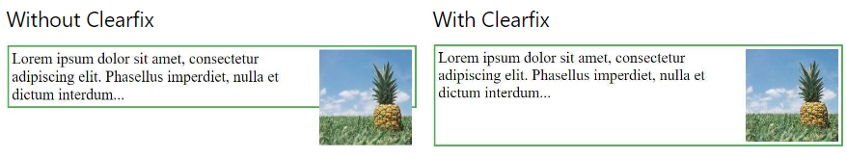
The clearfix
If a floated element is taller than the containing element, it will "overflow" outside of its container.
We can then add a clearfix hack to solve this problem:
.clearfix { overflow: auto; }

Slide 126
The overflow: auto clearfix works well as long as you are able to keep control of your margins and padding (else you might see scrollbars). The new, modern clearfix hack however, is safer to use, and the following code is used for most webpages:
Example
.clearfix::after { content: ""; clear: both; display: table; }

Slide 127
CSS Align
Center Align Elements
To horizontally center a block element (like <div>), use margin: auto;
Setting the width of the element will prevent it from stretching out to the edges of its container.
The element will then take up the specified width, and the remaining space will be split equally between the two margin
Example
.center { margin: auto; width: 50%; border: 3px solid green; padding: 10px; }

Slide 128
Center Align Text
To just center the text inside an element, use text-align: center;
Example
.center { text-align: center; border: 3px solid green; }

Slide 129
CSS Shadow Effects
CSS Shadow is used to add shadow effect on elements
There two types of shadow effect:
Box shadow
Text shadow

Slide 130
Box Shadow
It is used to add shadow-like effect around the frame of an element.
Syntax:
box-shadow: h-offset v-offset blur spread color |inset|inherit|initial|none;
h-offset
it horizontally sets shadow position
Its positive value will set the shadow to the right side of the box where as negative value set the shadow to the left side of the box
V-offset
Unlike the h-offset, it is used to set the shadow position vertically.
The positive value in it sets the shadow below the box, and the negative value sets the shadow above of the box.
Blur
it is used to blur the box-shadow. This attribute is optional.
Spread
It sets the shadow size. The spread size depends upon the spread value.

Slide 131
Box Shadow
Color
this attribute is used to set the color of the shadow. It is an optional attribute.
Inset
Normally, the shadow generates outside of the box, but by using inset, the shadow can be created within the box.
Initial
It is used to set the property of the box-shadow to its default value.
Inherit
it is inherited from its parent.
None
It is the default value that does not include any shadow property.

Slide 132
Text Shadow
As its name implies, this CSS property adds shadows to the text.
It accepts the comma-separated list of shadows that applied to the text. It's default property is none.
It applies one or more than one text-shadow effect on the element's text content.
Syntax:
text-shadow: h-shadow v-shadow blur-radius color| none | initial | inherit;
h-shadow: It is the required value. It specifies the position of the horizontal shadow and allows negative values.
v-shadow: It is also the required value that specifies the position of the vertical shadow. It does not allow negative values.

Slide 133
Text Shadow...
blur-radius: It is the blur-radius, which is an optional value. Its default value is 0.
color: It is the color of the shadow and also an optional value.
none: It is the default value, which means no shadow.
initial: It is used to set the property to its default value.
inherit: It simply inherits the property from its parent element.

Slide 134
Text Effects
We can apply different effects on the text used within an HTML document.
Some properties can be used for adding the effects on text.
Using CSS, we can style the web documents and affects the text.
The properties of the text effect help us to make the text attractive and clear.
There are some text effect properties in CSS that are listed below:
Word break
Text overflow
Word wrap
Writing mode

Slide 135
Text Effects
Word break
It specifies how words should break at the end of the line. It defines the line break rules.
Syntax:
word-break: normal |keep-all | break-all | inherit ;
Keep-all: It breaks the word in the default style.
Break-all: It inserts the word break between the characters in order to prevent the word overflow.
Default value of this property is normal

Slide 136
Text Effects
Word Wrap
CSS word-wrap property is used to break the long words and wrap onto the next line. This property is used to prevent overflow when an unbreakable string is too long to fit in the containing box.
Syntax
word-wrap: normal| break-word| inherit ;
normal: This property is used to break words only at allowed break points.
break-word: It is used to break unbreakable words.
initial: It is used to set this property to its default value.
inherit: It inherits this property from its parent element.

Slide 137
Text Effects
Writing-mode
It specifies whether the text will be written in the horizontal or vertical direction. If the writing direction is vertical, then it can be from left to right (vertical-lr) or from right to left (vertical-rl).
Syntax
writing-mode: horizontal-tb | vertical-lr | vertical-rl | inherit ;
horizontal-tb: It is the default value of this property in which the text is in the horizontal direction and read from left to right and top to bottom.
vertical-rl: It displays the text in the vertical direction, and the text is read from right to left and top to bottom.
vertical-lr: It is similar to vertical-rl, but the text is read from left to right.

Slide 138
Text Effects
Text-overflow
It specifies the representation of overflowed text, which is not visible to the user. It signals the user about the content that is not visible. This property helps us to decide whether the text should be clipped or show some dots (ellipsis).
This property does not work on its own. We have to use white-space: nowrap; and overflow: hidden; with this property.
Syntax
text-overflow: clip | ellipsis;
clip: It is the default value that clips the overflowed text.
ellipsis: This value displays an ellipsis (…) or three dots to show the clipped text. It is displayed within the area, decreasing the amount of text.

Slide 139
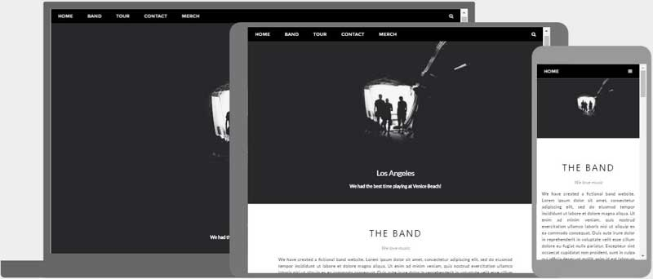
Basics of Responsive Web Designs
Responsive web design is about creating web pages that look good on all devices.
A responsive web design will automatically adjust for different screen sizes and viewports.
Responsive web design is about using HTML and CSS to automatically resize, hide, shrink or enlarge a website to make it look good on all devices(desktops, tablets and phones)

Slide 140
Basics of Responsive Web Designs
For responsive web design, we can use
Viewport
<meta name="viewport" content="width=device-width, initial-scale=1.0">
View area of page are adjusted based on devices
Grid view
Pages are generally divided into grid or columns usually 12 columns
.col-1 {width: 8.33%;}
.col-2 {width: 16.66%;}
.col-3 {width: 25%;}
Media queries
Images
Setting height and width in % and max-width
Videos
Same as image property
Framework
Using popular framework like W3.css , bootstrap etc.

Slide 141
CSS Media Queries
CSS2 introduced Media Types which made it possible to define different style rules or different media types.
Unfortunately these media types never got a lot of support by devices other than print media types.
Later on CSS3 introduced Media Queries which is the extensions on CSS2 media types.
Media queries, instead of looking for type of device, they look at the capability of the device.
Media query can be used to check :
Width and height of viewport
Width and height of device
Orientation
resolution

Slide 142
CSS Media Queries
It uses @media rule to include a block of CSS property only if certain condition is true.
Syntax:
@media not|only mediatype and (expressions) {
CSS-Code;
}
Value | Description
all | Used for all media type devices
print | Used for printers
screen | Used for computer screens, tablets, smart-phones etc.
speech | Used for screenreaders that "reads" the page out loud

Slide 143
CSS Media Queries
Example:
@media only screen and (min-width: 600px) {
body {
background-color: lightgreen;
}
}
Example 2:
@media only screen and (orientation: landscape) {
body {
background-color: lightblue;
}
}

Slide 144
Introduction to Bootstrap
Bootstrap is the most popular HTML, CSS and JavaScript framework for developing a responsive and mobile friendly website.
It is absolutely free to download and use.
It is a front-end framework used for easier and faster web development.
It includes HTML and CSS based design templates for typography, forms, buttons, tables, navigation, modals, image carousels and many others.
It can also use JavaScript plug-ins.
It facilitates you to create responsive designs.

Slide 145
Introduction to Bootstrap
History:
Bootstrap was developed by Mark Otto and Jacob Thornton at Twitter.
First released as open source product in August 2011 on github and it becomes no. 1 project on github.
Why Bootstrap???
Very easy to use
Facilitates users to develop a responsive website
Compatible on most of the browser like chrome, firefox, internet explorer, safari, opera etc.

Slide 146
Introduction to Bootstrap
How to use??
<!DOCTYPE html>
<html lang="en">
<head>
<title> Bootstrap </title>
<meta name="viewport" content="width=device-width, initial-scale=1">
<link rel="stylesheet“href="https://maxcdn.bootstrapcdn.com/bootstrap/3.3.6/css/bootstrap.min.css">
</head>
<body>
<div class="container">
<h1> First Bootstrap web page</h1>
<p> Paragraph..</p>
</div>
<script src="https://ajax.googleapis.com/ajax/libs/jquery/1.12.0/jquery.min.js"></script>
<script src="https://maxcdn.bootstrapcdn.com/bootstrap/3.3.6/js/bootstrap.min.js"></script>
</body>
</html>

Slide 147
Lab Assignment-2
Using CSS and HTML design following layout
Design your class routine using appropriate.
Write a code for the position relative, absolute, fixed and make html page using css position.
Using CSS design attractive 3D effect buttons.
1
2 | 3 |  | 4
5 |  | 6

Slide 148
Thank You !!!☺

