Slide 1
F
Thousands of learners fail the same exam every year —
and still don't know why.
Notes:
Every year, thousands of South African learners open their exam results... and see a mark. Not an explanation. Not a reason. Just a number that tells them they failed — without ever telling them what they don't understand.

Slide 2
Two people. Two blind spots.
🎓
🧑‍🏫
“I study everything.
I still don't know
what I'm missing.”
“I can see who's
struggling. I can't see
exactly why.”
THE LEARNER
THE TEACHER
Notes:
For learners, this means studying blindly — cramming entire syllabi instead of the two or three topics actually holding them back. For teachers, it means knowing which learners are struggling, but not having the time or tools to diagnose why, learner by learner, topic by topic.

Slide 3
The cost of the gap
📚
⏱️
🏫
⌛
Learners study
the wrong topics
Teachers lose hours
diagnosing gaps
Schools lack
personalised tools
Learning time
is lost — for good
Notes:
The result is a system-wide loss: wasted study hours, wasted teaching time, and — because time in a school year doesn't come back — learning that's lost for good. This is the gap GapWise exists to close.

Slide 4

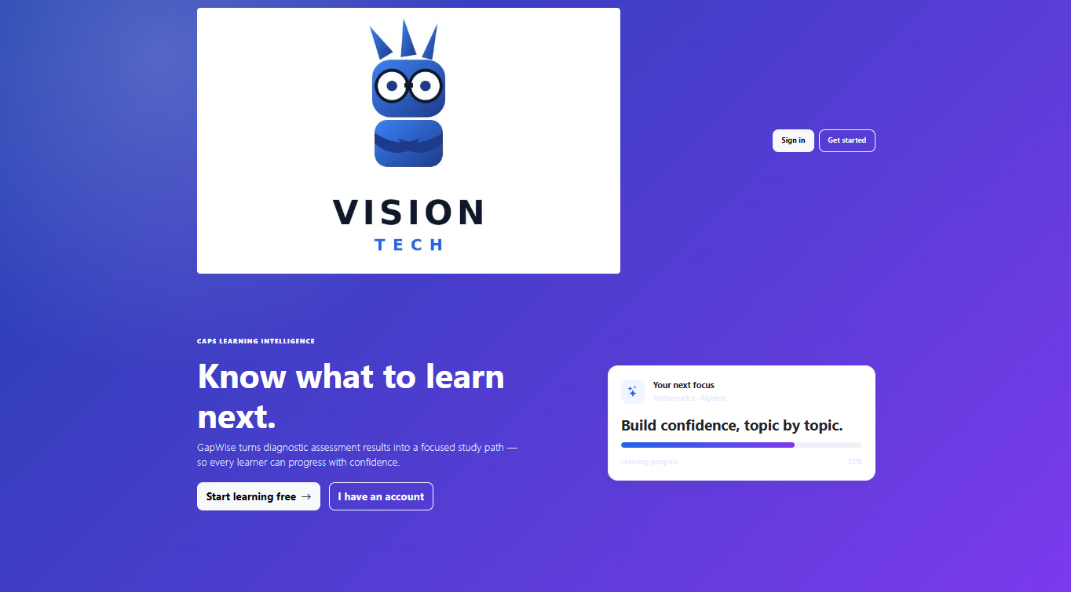
GapWise
Closing Learning Gaps Through Intelligent Diagnostics
Vision Tech branding
Live progress preview
Notes:
That's why we built GapWise — a diagnostic learning platform aligned to the CAPS curriculum, that doesn't just mark a learner's work. It tells them, and their teacher, exactly where the gap is — and exactly what to do next.

Slide 5
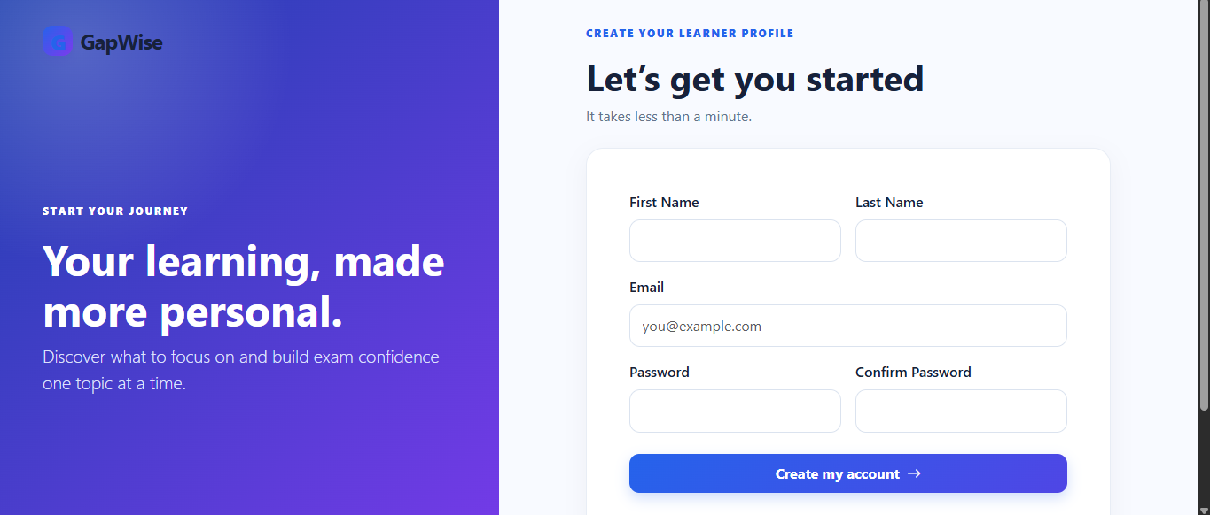
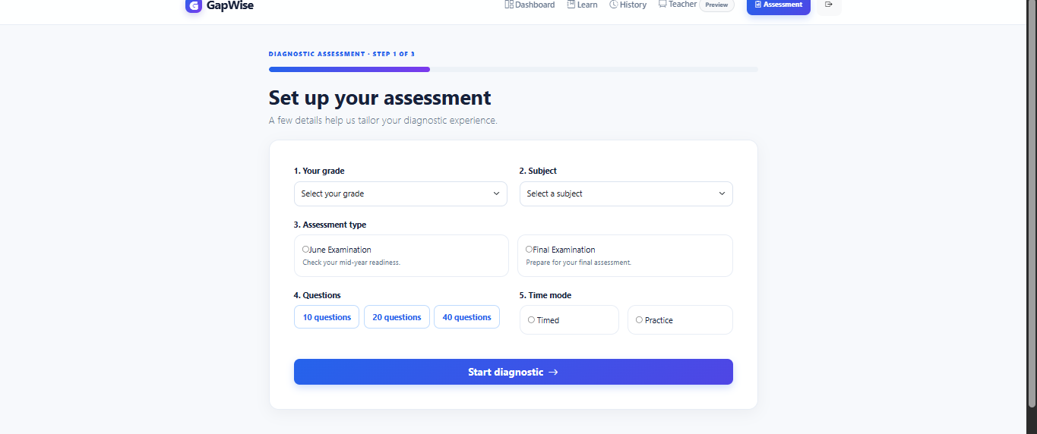
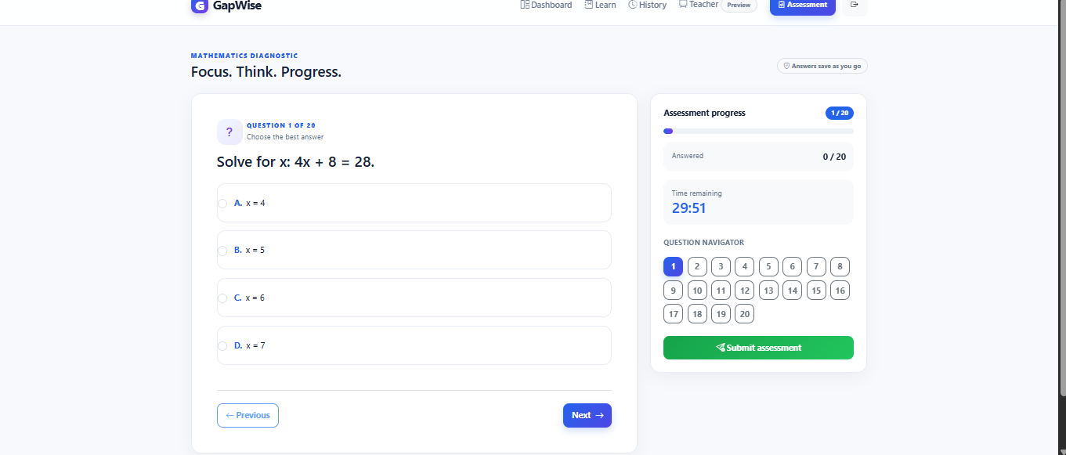
The learner journey begins
From sign-up to first diagnostic in under 5 minutes.
→
→
1 · SIGN UP
2 · SET UP
3 · TAKE THE TEST
Frictionless learner onboarding
Grade, subject & timed/practice modes
Live timer & question navigator
Notes:
It starts simply. A learner creates an account, selects their grade and subject, and takes a short, timed diagnostic — built to feel like a real exam, not a quiz. Every answer is captured and analysed by our rule-based diagnostic engine as they go.

Slide 6
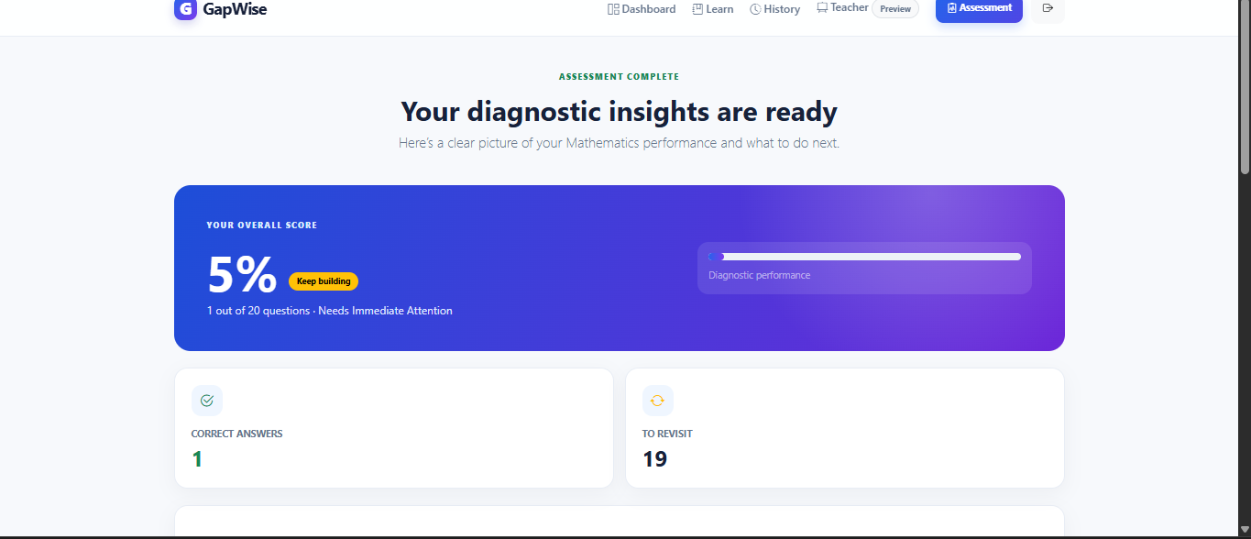
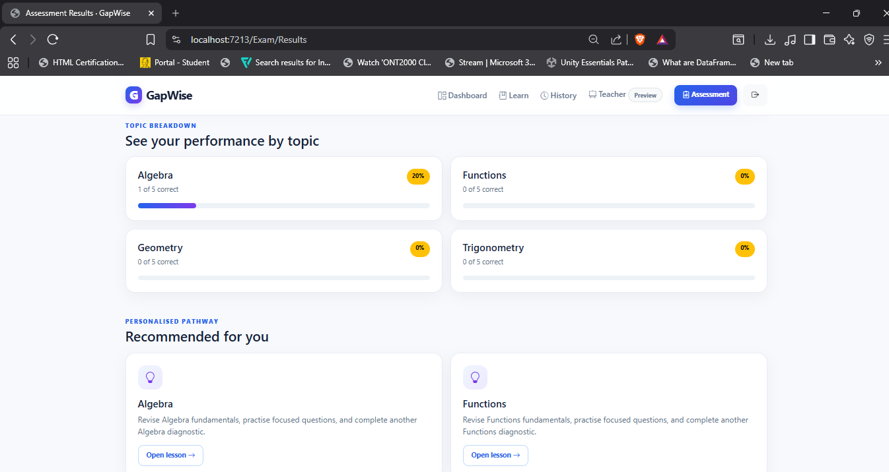
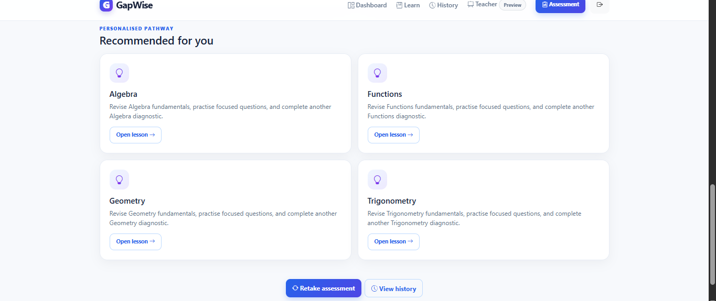
Not just a score. A map of what to learn next.
Instant score breakdown
Topic-level breakdown
Sample diagnostic data
Personalised learning paths
Notes:
Instead of a single mark, GapWise breaks performance down topic by topic — Algebra, Functions, Geometry, Trigonometry — and instantly recommends a personalised pathway. This learner doesn't need to study everything. They need Algebra first, then Functions. That's the shift from marking to diagnosing.

Slide 7
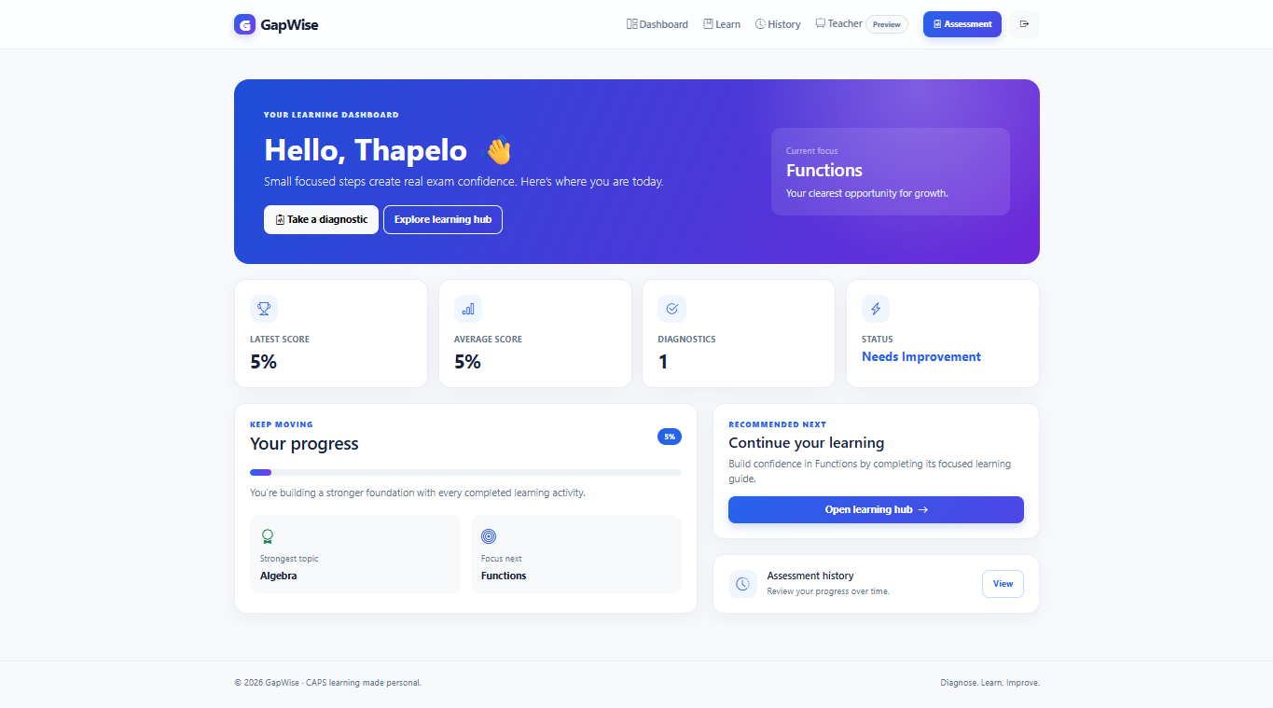
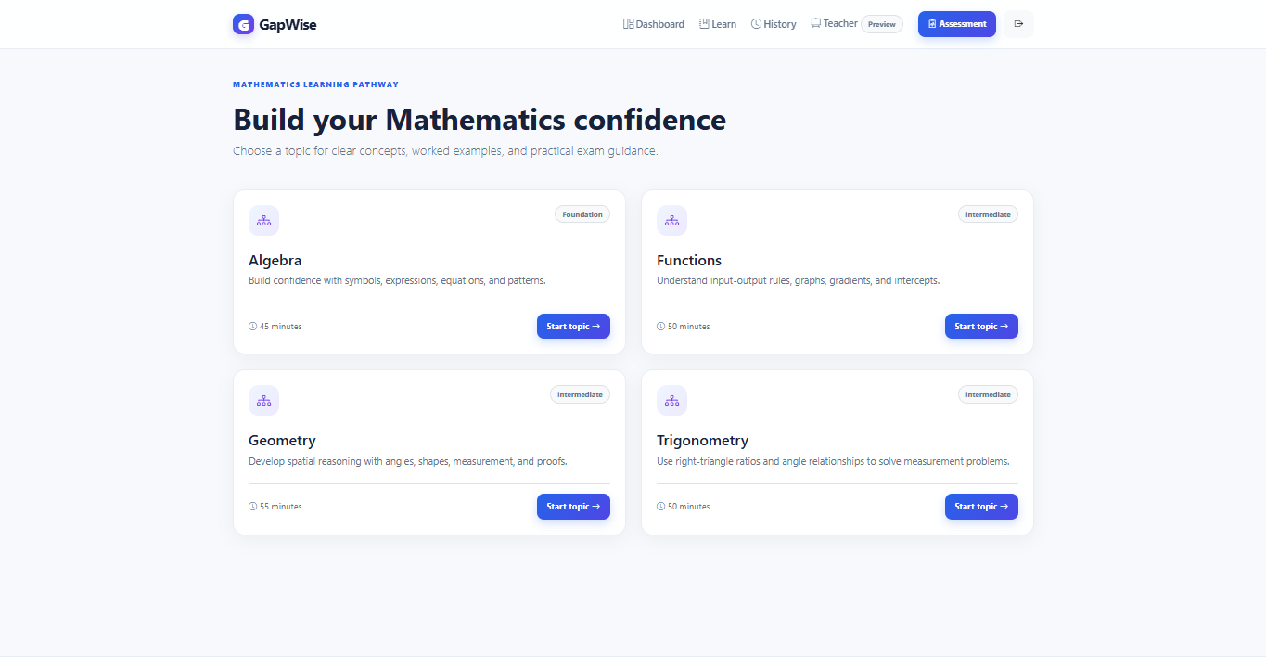
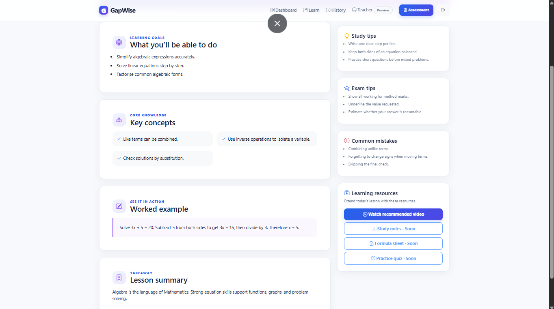
One dashboard. A clear next step, every time.
→
Personalised focus area
Progress tracking
Structured topic pathways with worked examples & exam tips
Notes:
Every time a learner logs in, they land on a dashboard that already knows their strongest topic and their next focus area. One click takes them into a structured lesson — learning goals, key concepts, a worked example, even exam and study tips — built specifically around their diagnosed gap.

Slide 8
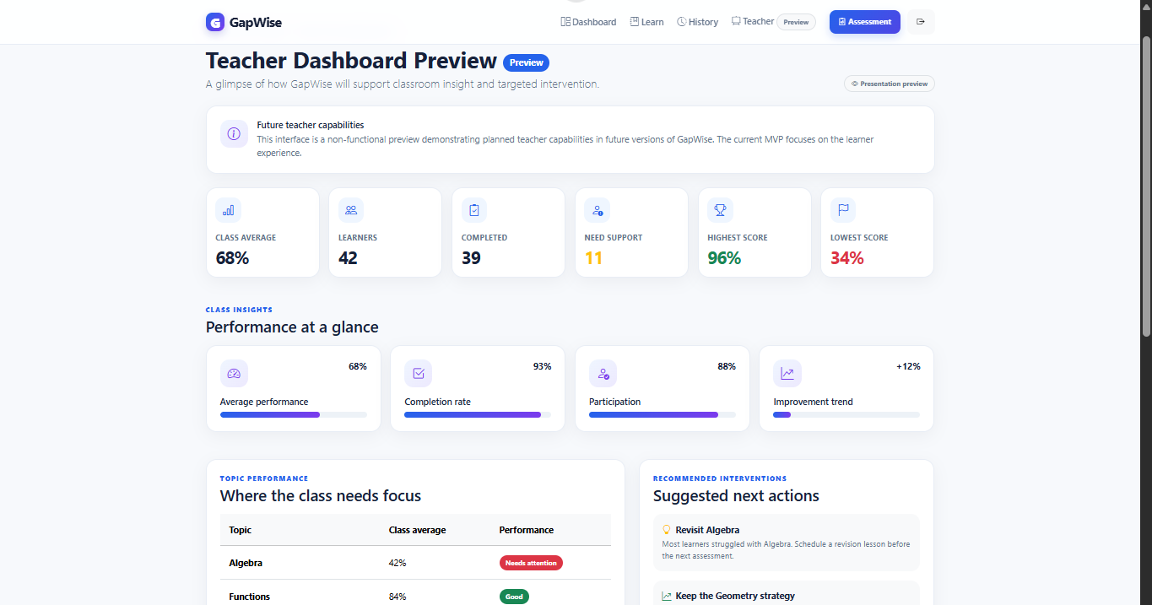
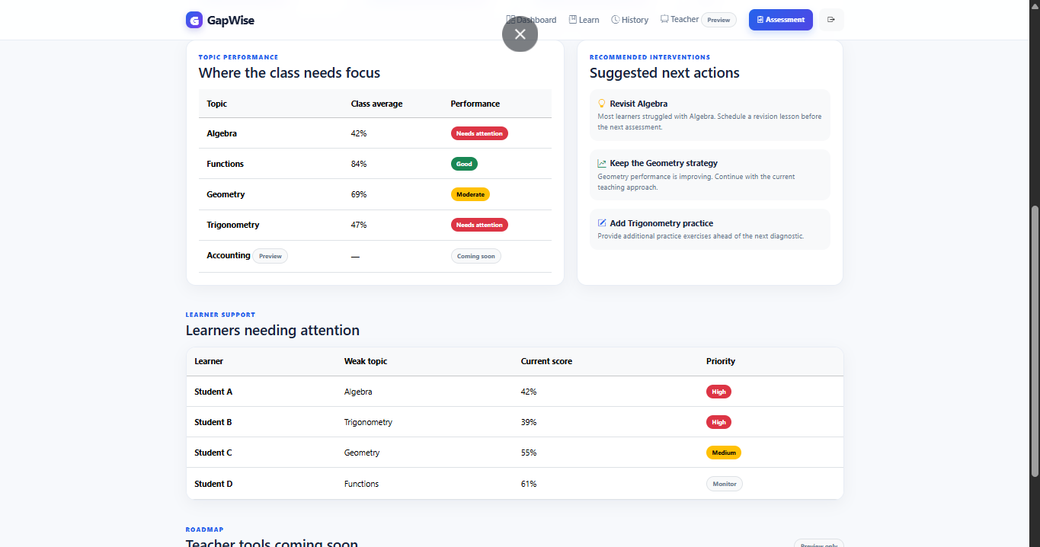
Empowering the teacher
MVP PREVIEW
Class-wide performance metrics
Topic-level class insights
Priority-ranked learner list
Notes:
For teachers, GapWise aggregates every learner's diagnostic into one view — which topics the whole class is struggling with, and which individual learners need attention first, ranked by priority. What used to take hours of manual marking analysis now takes seconds.

Slide 9
The business opportunity
🏫
📈
🤝
→
→
Schools Subscribe
GapWise Powers Learning
Commercial Schools Sponsor
Primary customer
Learners & teachers benefit
Under-resourced schools
Schools subscribe. GapWise scales. Sponsorship makes it fair.
Notes:
Our model is simple: schools subscribe to GapWise. Commercial, well-resourced schools can sponsor access for disadvantaged schools through the same platform — so the schools that can pay, help fund the schools that can't. It's a subscription model with a built-in social impact multiplier.

Slide 10
Every learner deserves to know exactly what to learn next.
GapWise: Closing Learning Gaps Through Intelligent Diagnostics.
Mathematics
More CAPS Subjects
More Grades
AI-Assisted Recs
School Analytics
Notes:
Today, GapWise closes the gap in Mathematics for South African learners. Tomorrow, it's every CAPS subject, every grade, powered by AI — until no learner in South Africa opens an exam result without knowing exactly what to do next. That's GapWise. Thank you.

Slide 12
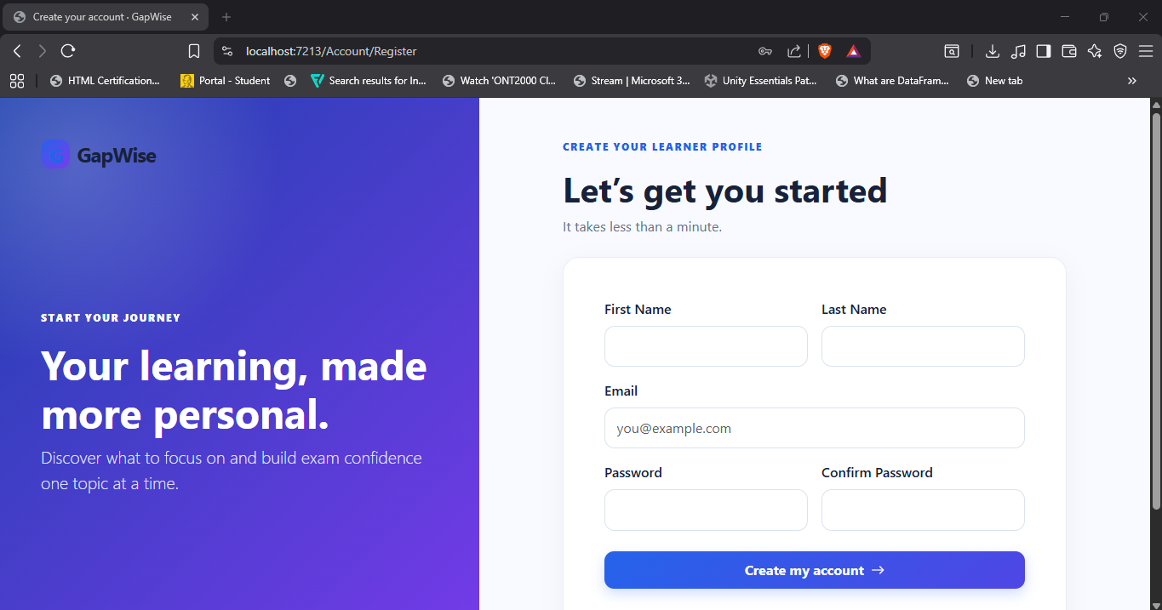

Slide 13
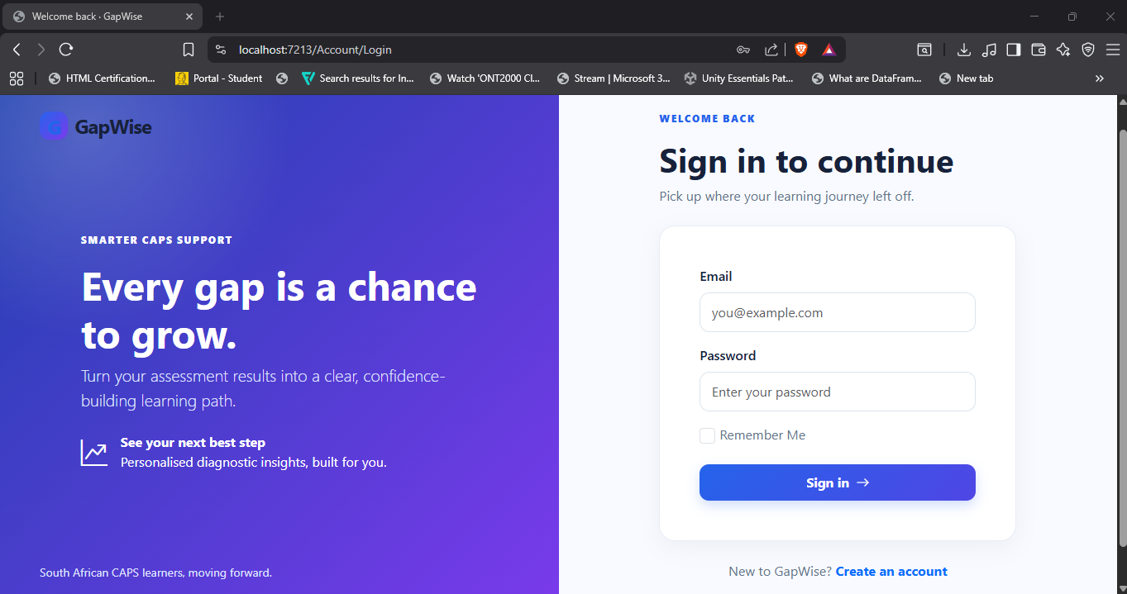

Slide 15
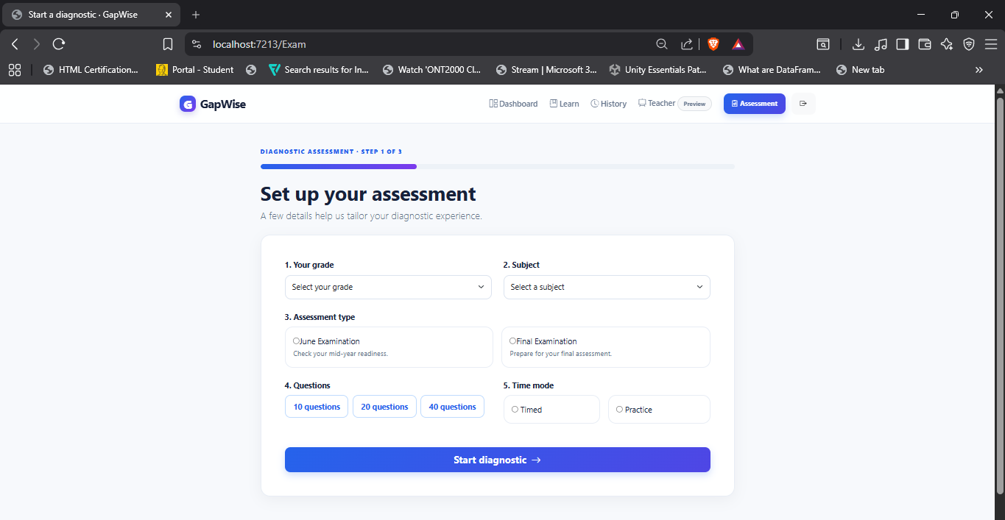

Slide 16
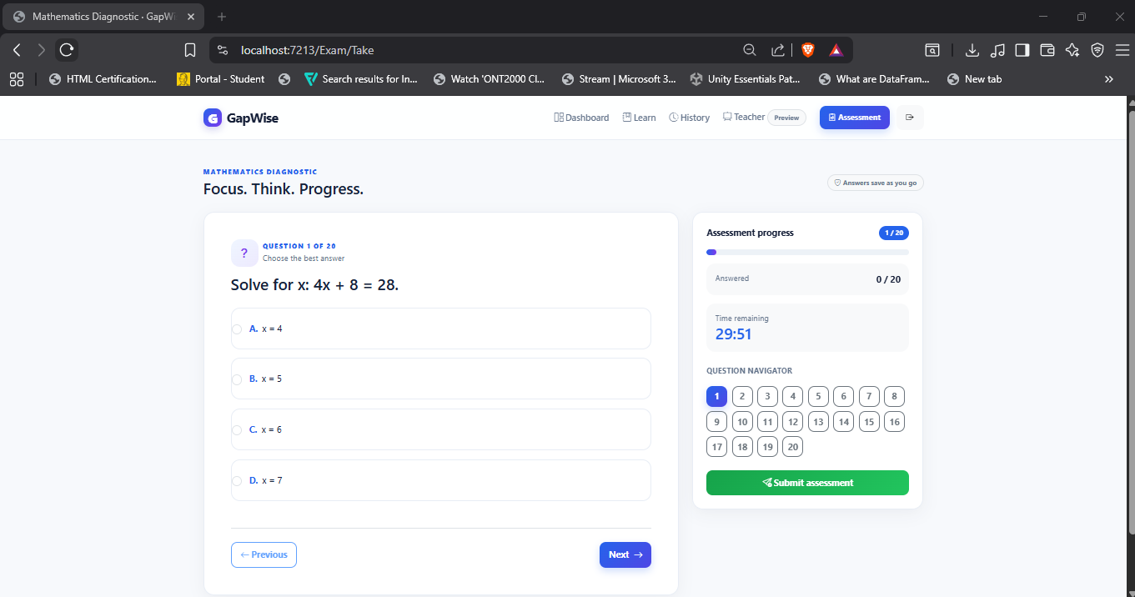

Slide 17
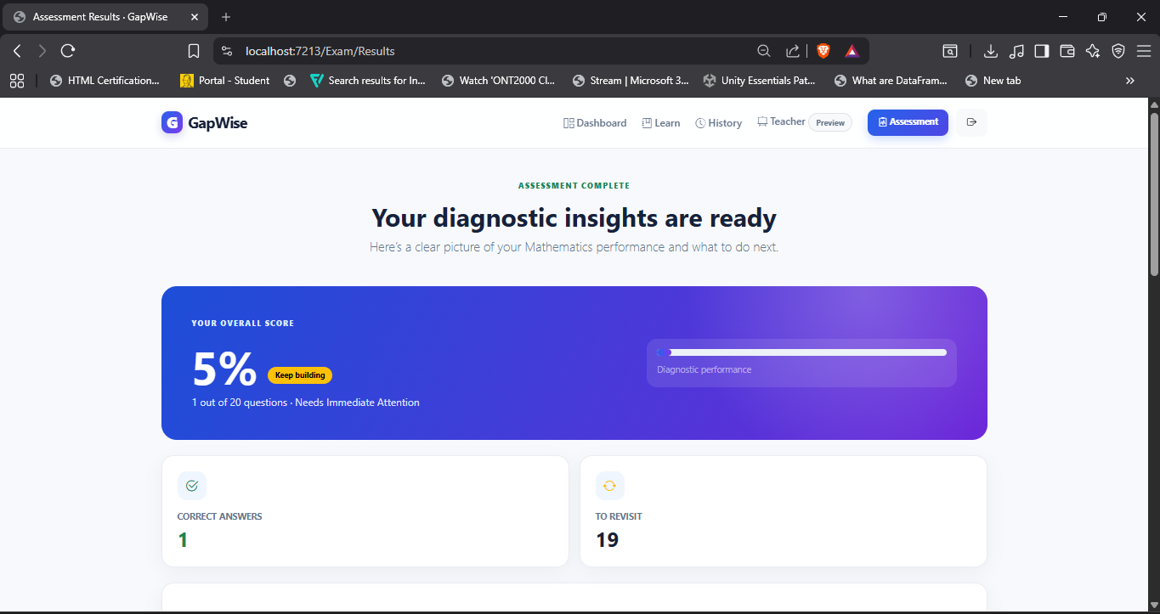

Slide 18
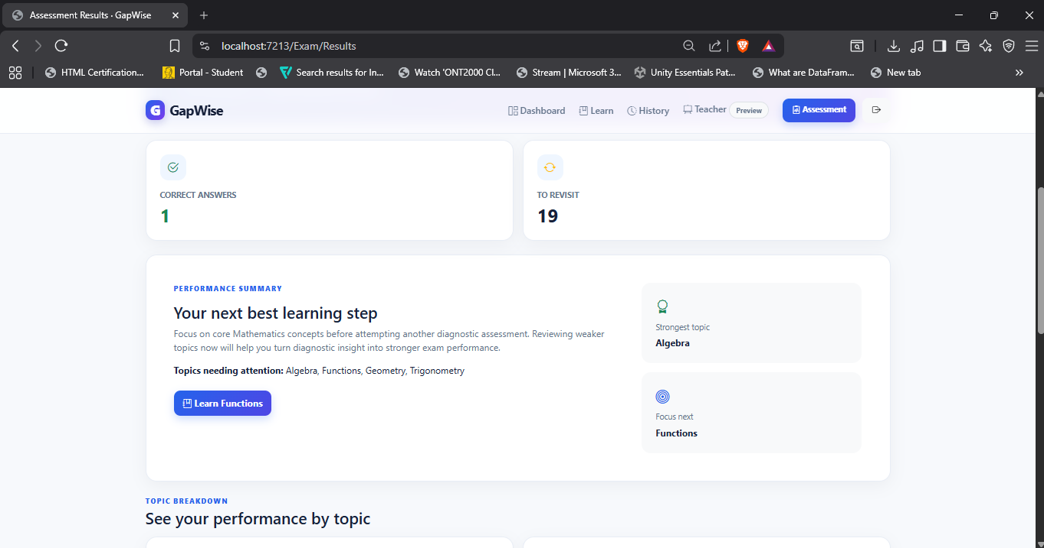

Slide 20
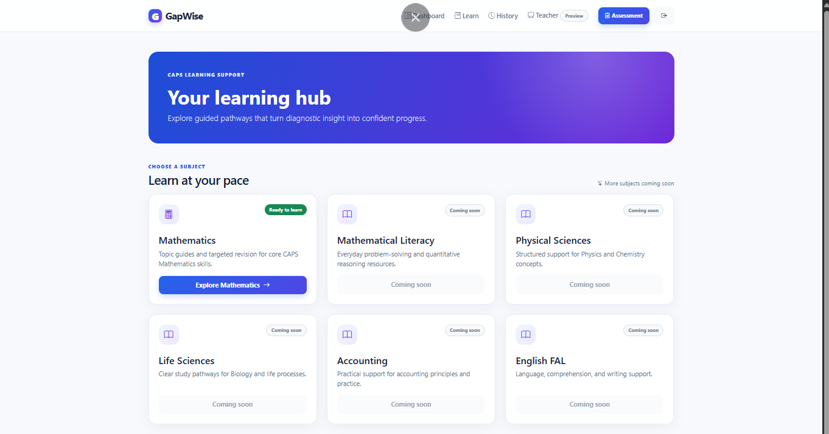

Slide 22
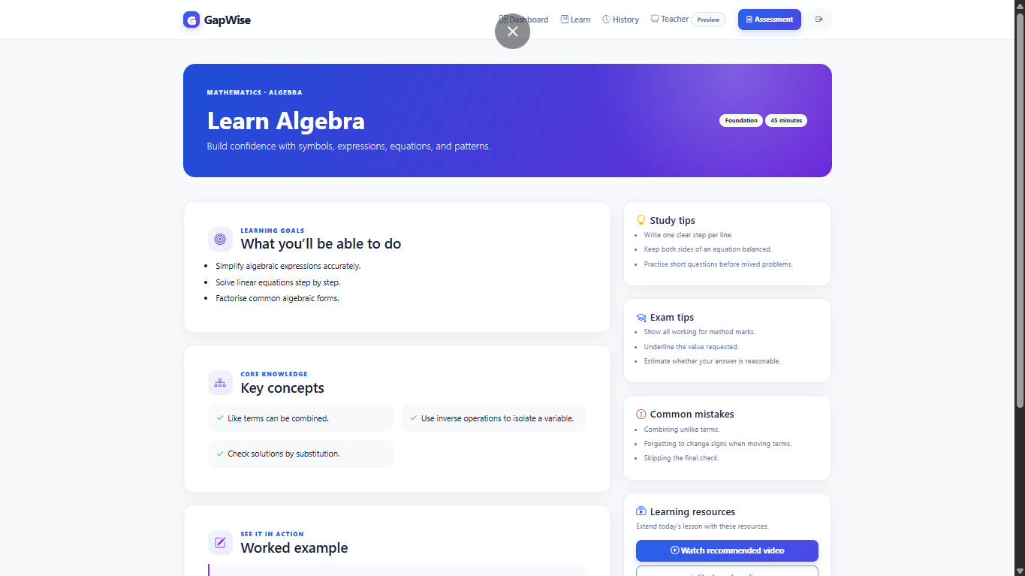

Slide 26
